Slide 1
Unit 3: Operator Selection

Slide 2
How to discover what to do in a new task?
Construct new operators
Reuse old operators
Reuse skills
Trial-and-error
Using examples
Using instruction
Using explicit reasoning

Slide 3
Trial-and-error (possibly guided)
If we are successful in using an operator for a particular skill, we increase the association with that skill
We also increase the base-level activation of the operator

Slide 4
PRIMs associations
Start-Count
Goal
Count
Daydream
Iterate
Final

Slide 5
define task count-learn {
initial-goals: (count-learn)
default-activation: 1.0
ol: t
rt: -2.0
lf: 0.2
default-operator-self-assoc: 0.0
skill-operator-learning: t
reward: 10.0
beta: 0.1
}

Slide 6
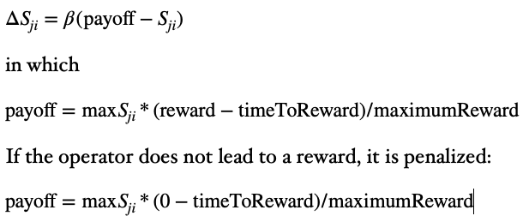
Equations

Slide 7
Similarities and differences from ACT-R
The mechanism is the same (reinforcement learning)
ACT-R learns utilities, which are context independent
PRIMs learns associations, which fully depend on the context

Slide 8
Far transfer
Transfer between tasks that do not resemble each other
Overlap is in a few key operators that determine the strategy

Slide 9
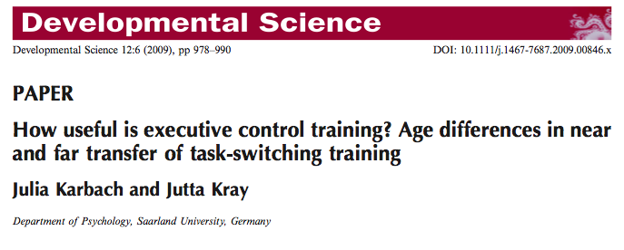
Karbach and Kray
Trained people on task-switching, and found improved proactive control

Slide 10




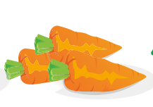
Task Switching (food/size)
Respond to fruit/veg
Respond to size
Respond to fruit/veg
. . .
left
left
right
right
left

Slide 11
Stroop
Stroop task:
BLUE or PIANO or RED
Name the color of the ink as fast as possible
Typical result: people are slower when there is a mismatch between the word and the ink.

Slide 12
Two strategies
Proactive: anticipate next trial
Reactive: wait for stimulus, the decide
This version of task switching requires a proactive strategy
Key: preparation is a separate goal

Slide 13
First step in task switching
operator prepare-for-stimulus {
V1 = fixation
G2 = nil
==>
*prepare -> G2
}
Here, prepare is bound to a skill that determines the next task (prepare-next)

Slide 14
define skill prepare-next {
operator set-first-task {
V1 = fixation
WM1 = nil
==>
one -> WM2
nil -> G2
wait -> AC1
}
...
}

Slide 15
operator determine-next-task-retrieve-count {
RT1 = nil
WM1 <> nil
==>
count-fact -> RT1
WM2 -> RT2
}

Slide 16
operator determine-next-task-decide-to-stay {
RT1 = count-fact
RT3 = two
==>
RT3 -> WM2
nil -> G2
wait -> AC1
}

Slide 17
operator determine-next-task-decide-to-switch {
RT1 = count-fact
RT3 = three
==>
one -> WM2
othertask -> RT1
G1 -> RT2
}
operator set-other-task {
RT1 = othertask
==>
RT3 -> G1
nil -> G2
wait -> AC1
}

Slide 18
Two choices for preparation in Stroop
Each choice is in a separate goal that is not initially associated with Stroop:
default attend
attend color

Slide 19
In Stroop we need to do a similar thing
operator prepare-for-stimulus {
V1 = fixation
G2 = nil
==>
*prepare -> G2
}
Now prepare is bound to focus-color
define skill focus-color {
operator attend-just-color {
V1 = stim
V2 = nil
==>
attend-color -> AC1
}
}

Slide 20
Competition
operator attend-just-color {
V1 = stim
V2 = nil
==>
attend-color -> AC1
}
operator attend (activation=1.5) {
V1 = stim
V2 = nil
==>
attend -> AC1
}

Slide 21
Running the model multiple times: taskswitchstrooptransfer.bprims
repeat 10
reset
run stroop stroopcontrol 50
reset
run taskswitching taskswitching 300
run stroop strooptransfer 50

Slide 22
Transfer
If we do task-switching before Stroop, the prepare operator will be reinforced, and is therefore more likely to be chosen
If we do Stroop without preparation, the just-wait operator is the more likely candidate, because it has a higher base-level activation

Slide 23
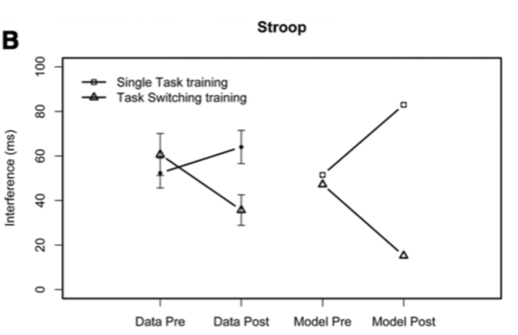
Results of the model

Slide 24
Learning operators from primitive operations
Count-learn was an example of learning a skill based on individual operators
Stroop/Task Switching was an example of learning a task based on existing skills
But can we also learn Operators out of PRIMs?

Slide 25
Approach
Start with operators that only perform a single PRIM
Use reinforcement learning to discover which PRIMs go well with a certain task/skill
Use operator compilation to combine PRIMs into operators

Slide 26
Lower level of abstraction
How can we learn operators from primitive operations?
Construct basic operators with a single primitive operation
Use “operator compilation” and reinforcement learning to discover the knowledge needed for a task

Slide 27
Example: Choice-reaction task
define facts {
(f1 associate vanilla thumb)
(f2 associate ice ring)
(f3 associate paper pinkie)
(fa1 taste vanilla sweet)
(fa2 temperature ice cold)
(fa3 weight paper small)
(fb1 color vanilla yellow)
(fb2 texture ice slippery)
(fb3 color paper white)
}

Slide 28
Example basic operators
operator V1toRT2 {
V1 <> nil
==>
V1 -> RT2
nil -> V1
}
operator RT2toRT1 {
RT2 <> nil
==>
RT2 -> RT1
}
operator RT1equalC1 {
RT1 = *fact-type
==>
}

Slide 29
Initial model

Slide 30
After learning

Slide 31
One possible solution
Operator 1
V1 <> nil
==>
V1 -> RT2
*fact-type -> RT1
Operator 2
RT1 = *fact-type
RT3 <> nil
==>
action -> AC1
RT3 -> AC2

Slide 32
More complex task
define facts {
(fac1 category goat animal)
(fac2 category pinguin animal)
(fac3 category cabbage plant)
(fac4 category tulip plant)
(altfac1 property goat hair)
(altfac2 property pinguin notfly)
(altfac3 property cabbage food)
(altfac4 property tulip mania)
(fca1 response animal left)
(fca2 response plant right)
(fca3 response somethingelse middle)
(fca4 response differentyet upper)
(fca5 response noguessing lower)
(altfca1 property animal livingthing)
(altfca2 property plant livingthing)
}

Slide 34
Learning is more successful with prior learning
Two CRT tasks
One CRT task
No prior learning

Slide 35
Assignment
Try out the simple tasks in the “bottom-up learning” folder in Unit 3
primitives.prims contains the primitive operations
The other files just contain task definitions, scripts and facts (so no skills)
You can also define your own tasks and test the limitations of the system

