Slide 1
PRIMs tutorial
Unit 4: Composable Goals

Slide 2
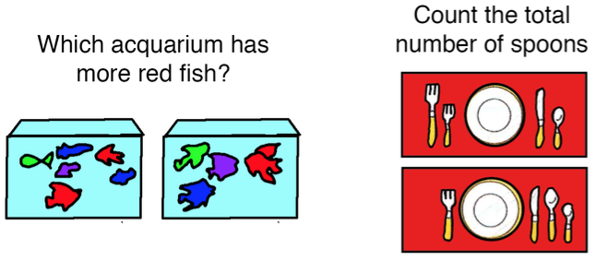
How to do tasks we have all the skills for?

Slide 3
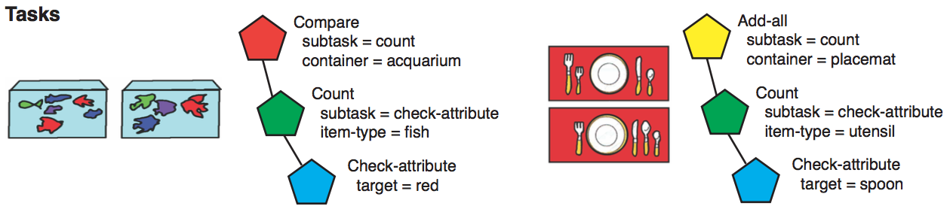

Slide 4
One problem left: how do goals communicate their results?
WM
>>WM3
WM<<
Working memory is limited to a single chunk

Slide 5
New aspect
If we perform >>WM1, and WM1 is empty, we create a new chunk in that slot and shift attention to it

Slide 6
Spoons example
operator init-add-all {
WM1=nil
V1=screen
==>
>>V3 // shift to the first container (placemat)
overall-total -> WM1
zero -> WM3 // that is the current total
>>WM4 // this creates a new chunk that is placed in // WM4, and shifts focus to that chunk
total-count -> WM1
push-goal -> AC1
subtask -> AC2
}

Slide 7
operator init-countgoal {
WM1 = total-count
WM3 = nil
V1 = container
==>
zero -> WM3
>>V3 // shift to first item
>>WM4 // Determine whether this is something
// that we need to count
member -> WM1
push-goal -> AC1
subsubtask -> AC2
}

Slide 8
operator answer-yes {
WM1 = member
V1 = item-type
V4 = target
==>
yes -> WM2
WM<<
remove-goal -> AC1
}

Slide 9
operator retrieve-count-fact-for-countable-item {
WM1 = total-count
>>WM4
WM2 = yes
WM<<
==>
count-fact -> RT1
WM3 -> RT2
nil -> WM4
}

Slide 10
Transfer to More-Fish
Demo

Slide 11
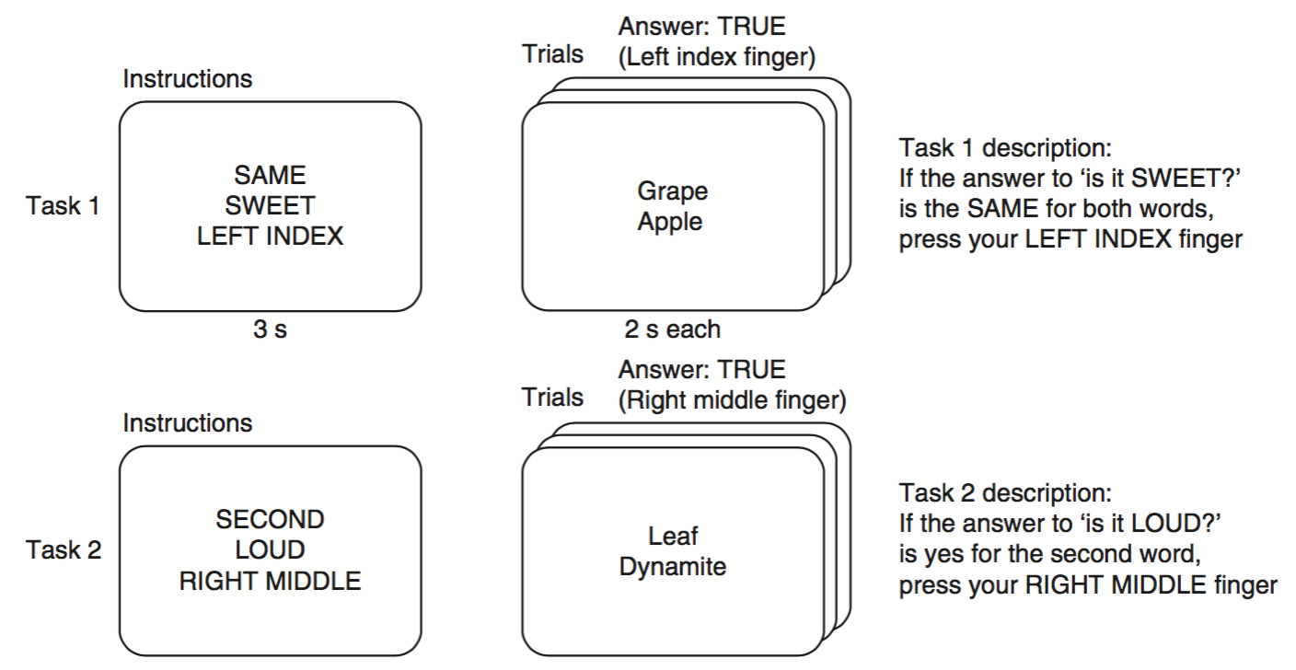
Example: RITL experiment

Slide 12
Same
Conditional-action
press
L.index
has-attribute
R.index
sweet

Slide 13
One last component
A goal that generates the goal structure based on the instruction
In our case they are just three words from restricted sets, so that is simple

Slide 14
Discussion
It may be necessary to define and study multiple levels of abstraction to understand the human mind
We need to link these levels together
Lower levels are mechanical
Higher levels deal with meaning and semantics
Work in progress!
Lower levels? Spiking neurons, learning...
Even higher levels? Language, metacognition....

