Slide 1
AIT-204 Deep Learning
RNN Temperature Forecasting
Jena Climate Dataset · NumPy Implementation
Truong Anh Dao Nguyen
Gavin Higgins

Slide 2
Agenda
Dataset
Preprocessing
1
2
Jena Climate 2009-2016 · 14 features · 420K rows
Min-Max normalization · Sliding window (720 steps)
Model
Training
3
4
Vanilla RNN · Xavier init · Truncated BPTT · Adam
30 epochs · batch 64 · BPTT 50 · lr 0.001
Results
Discussion
5
6
RMSE = 0.254 °C · MAE = 0.184 °C
Observations · Improvements · Conclusions

Slide 3
1 · Dataset: Jena Climate
Dataset Overview
All 14 Features
Source
Max Planck Inst. for Biogeochemistry, Jena DE
• p (mbar) — Pressure
Period
Jan 2009 — Dec 2016 (7+ years)
★ T (degC) — Temperature
• Tpot (K) — Potential temp
Frequency
Every 10 minutes
• Tdew (degC) — Dew point
Total rows
420,551
• rh (%) — Humidity
Features
14 meteorological variables
• VPmax / VPact / VPdef — Vapour
Target
T (degC) — air temperature
• sh (g/kg) — Specific humidity
Temp range
−23.01 °C to +37.28 °C
• H2OC — Water vapour conc.
• rho (g/m³) — Air density
Temp mean
≈ 9.5 °C
• wv / max.wv — Wind speed
• wd (deg) — Wind direction

Slide 4
2 · Data Preprocessing
Data Loading
Min-Max Normalization
Sequence Creation
pandas read_csv() Extract T (degC) column Convert to float64 NumPy array
Scale T to [0, 1] T_min = −23.01 °C T_max = +37.28 °C norm = (T − T_min) / (T_max − T_min)
Sliding window: 720 steps = 5 days × 144 readings X[i] = temp[i : i+720] y[i] = temp[i+720]
Data Split & Shapes
Training samples
Test samples
X shape
y shape
Total possible seqs
33,587
8,397
(N, 720, 1)
(N, 1)
419,830
Chronological 80% Sample step = 10
Most recent 20% Chronological split
Samples × Time steps × Features
Next temperature scalar
Before sampling

Slide 5
3 · Model Architecture — Vanilla RNN
Recurrence Equations
Training Configuration
h_t = tanh( x_t · W_xh
+ h_{t-1} · W_hh + b_h )
y = h_T · W_hy + b_y
x_t ∈ ℝ¹ (input at step t)
h_t ∈ ℝ³² (hidden state)
y ∈ ℝ¹ (output from h_T)
Optimiser
Adam (β₁=0.9, β₂=0.999)
Learning rate
0.001
Batch size
64
Epochs
30
Parameters
Activation
tanh (hidden)
W_xh
1×32 = 32
Init method
Xavier / Glorot
W_hh
32×32 = 1,024
BPTT window
50 steps (≈ 8.3 h)
b_h
32
Grad clipping
Max global norm = 5.0
W_hy
32×1 = 32
b_y
1
Loss function
MSE
TOTAL
1,121
Architecture
Single-layer

Slide 6
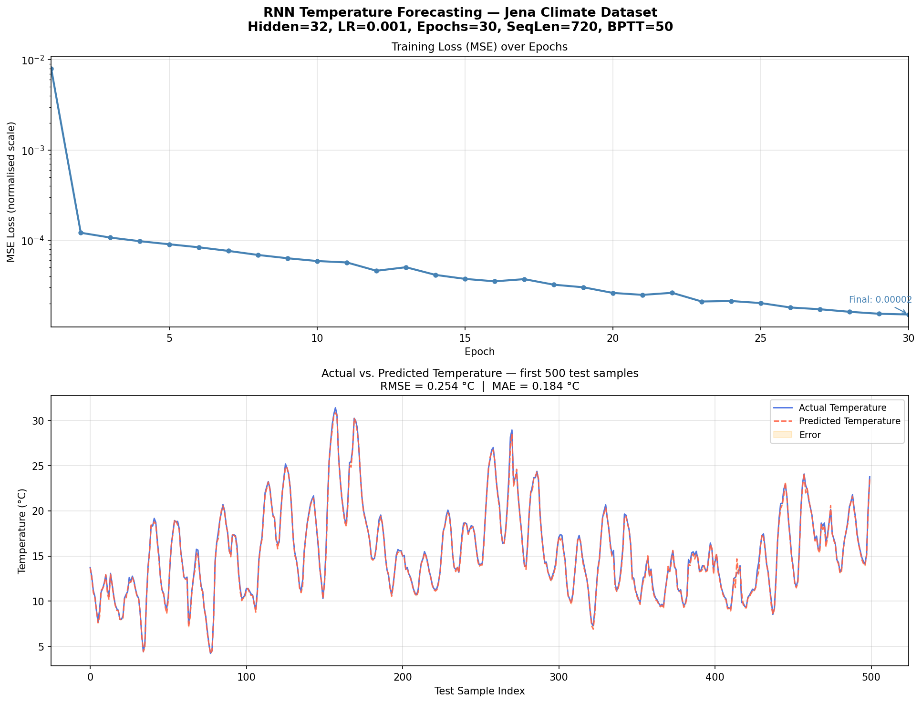
4 · Training Results
30
0.000015
187 s
1,121
Epochs
Final MSE
Train time
Parameters
Figure: Training loss (MSE, log scale) and actual vs. predicted temperature on test set.

Slide 7
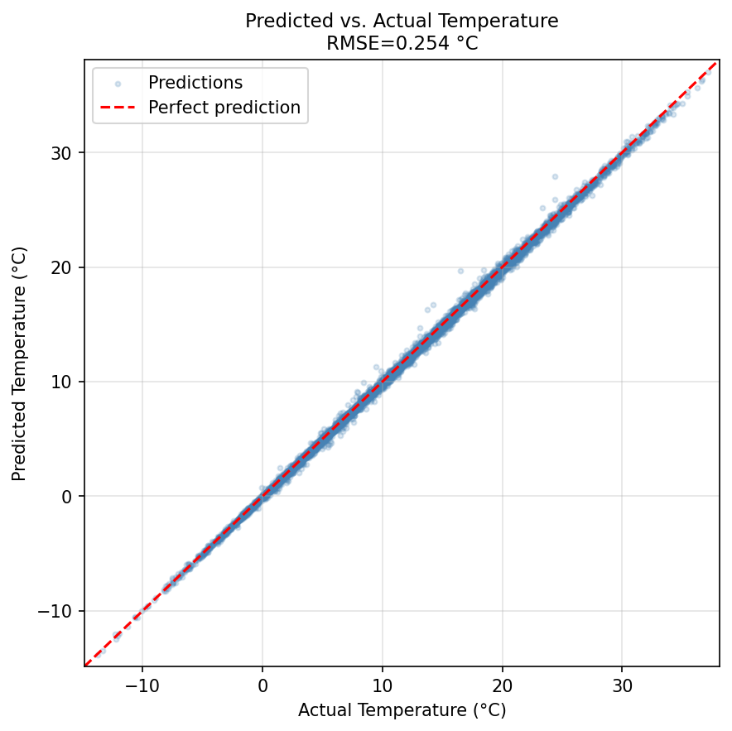
5 · Model Evaluation
RMSE
MAE
MSE
0.254 °C
0.184 °C
0.0646
Root Mean Square Error (Test Set)
Mean Absolute Error (Test Set)
Mean Squared Error (normalised scale)
Interpretation
• RMSE of 0.254 °C is very strong for 1-step-ahead prediction
• Temperature is a highly autocorrelated signal — the model exploits
short-term momentum in the time series effectively
• Scatter plot shows tight clustering around the ideal diagonal,
confirming predictions track actual temperatures closely
• Slight spread at extreme temperatures (very cold / very hot)
is expected, as these are rarer training samples

Slide 8
6 · Discussion & Potential Improvements
Key Observations
Potential Improvements
▸ Truncated BPTT
→ LSTM / GRU
Gradients propagate only 50 steps (≈8 h). Very long-range dependencies not fully captured.
Gated units handle long-range dependencies far better than vanilla RNN
▸ Vanishing gradients
→ Multi-feature input
Vanilla RNN struggles with long horizons. Gradients decay exponentially over time.
Use all 14 features (pressure, humidity…) for richer context
▸ Autocorrelation
→ Multi-step output
Temperature is highly predictable in the short term — this favours simple models.
Predict next 6 or 12 readings for practical utility
→ Stacked RNN layers
▸ Hyperparameters
Deeper architecture captures hierarchical temporal patterns
Hidden size 32 outperformed 64 per unit of compute; lr=0.001 converged cleanly.
→ Batch normalisation
Stabilise training; allow higher lr

Slide 9
7 · Conclusion
Summary
1
Implemented a Vanilla RNN from scratch in NumPy — no external deep learning framework
2
Preprocessed 420K rows: Min-Max normalization + 720-step sliding window sequences
3
Achieved Test RMSE = 0.254 °C and MAE = 0.184 °C in 30 epochs (~3 minutes)
4
Training loss fell from 0.00798 → 0.000015 — strong, stable convergence
5
Model captures short-term temperature dynamics effectively via Truncated BPTT + Adam
Lessons Learned
✓ Truncated BPTT is essential for long-sequence training efficiency
✓ Gradient clipping prevents training instability in deep recurrent nets
✓ Next step: replace with LSTM for better long-range dependency modelling

