Slide 1


Contextualized Diachronic Word Representations
Ganesh Jawahar Djamé Seddah
Inria, France
{firstname.lastname}@inria.fr
French-Israeli PHC Maimonide

Slide 2
We are interested in
tracking semantic/usage shifts
in a
large Twitter corpus
over
five years.

Slide 3
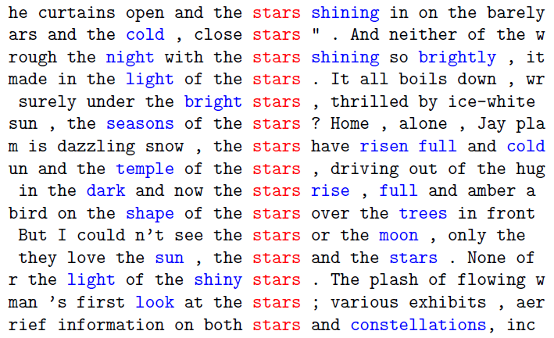
Distributional Hypothesis
“You shall know a word by the company it keeps” (Firth)
Are surrounding words enough for modeling the context?

Slide 4
Going beyond lexical context
Tweets are short. => surrounding words as a context are probably not enough.
Meaning of a word can also depend on factors:
Temporal (ex: ‘Bataclan’ => theatre vs Paris attacks spot)
Spatial (ex: Chocolate bread => chocolatine (south-west) vs pain au chocolat)
Network (ex: FDP == Francais de papier (alt-right) vs Fils de P..E (suburb))
Topic
Socio-economic
Interests
Knowledge

Slide 5
Our hypothesis
Utilizing signals such as:
User’s spatial info (department, region)
User’s network info (co-mention network)
User’s economic info (income)
User as a latent variable (his/her knowledge)
User’s textual info (his/her interest)
Tweet’s topic information (tweet category)
Can we improve the Diachronic Word Embedding Model (DWEM) (???)

Slide 6
General Challenges
How do we fuse the contextual information with the existing information exploited by DWEM (i.e., neighboring words and time) ?
Can DWEM adapt well to the language evolution seen in Twitter?
Can DWEM work well for non-english text?
How to build methods to evaluate how well DWEM works for French tweets?

Slide 7

Dataset Info. (Abitbol et al., WWW’18)
Tweets (140 -280 ch. max )
French language
22 selected months from 2014-18
~18M tweets in French territory
Pre-processing:
Removing hashtags, URLs, numbers, mentions
Lowercasing the words
Keeping the stop words
“une cure de tiny tea pour avoir le ventre plat la nouvelle folie du moment”
a cure of tiny tea to have a flat stomach the new madness of the moment

Slide 8
Social Feature Extraction (1)
User’s French Department and Region
User’s home location is ascertained using several heuristics as discussed in (Abitbol et al., WWW’18)
User’s Income Group
Status homophily where people from similar socioeconomic classses tends to be connected (Abitbol et al., WWW’18)
User’s Co-Mention Network Info
Two users are connected if they’ve mentioned each other at least once.
This network seems to have more interaction (less sparse) and accurate than a friendship network.
Use LINE model (Tang et al., WWW’15) to compute the node embeddings.

Slide 9
Social Feature Extraction (2)
User interest vector
Summarizing the topics a user care about.
Computed from identifying his/her important words (by tf-idf) and adding their Word2vec vectors.
User as a latent (knowledge) vector
Learn a latent vector that summarizes the way he/she writes.
Learned automatically as a part of DWEM objective.
Tweet’s category
Tweet that has an accompanying YouTube link can be associated to the category of the video (queried from YouTube API)
Introduced in “Distant Supervision for Tweet Classification Using YouTube Labels” (Magdy et al., ICWSM’15)

Slide 10

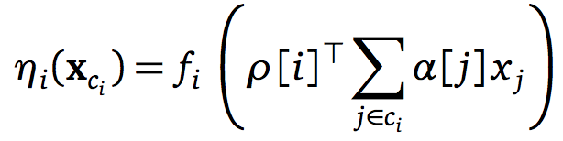
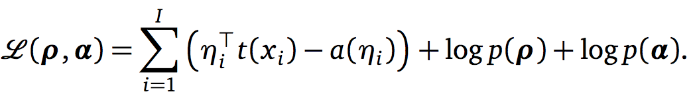
Exponential Family Embeddings (Rudolph et al., NeurIPS’16)
Extend the idea of Word2vec to other types of data:
Count data from market based analysis (Context: other items in shopping cart)
Target = i
Context of i = c_{i}
Conditional Exponential Family (for Word2vec, its categorical. For count data, it could be Poisson.)
Objective Function: Log probability functions as regularizers (Gaussian would make it L2 reg.)

Slide 11


Dynamic Embeddings for Language Evolution (Rudolph et al., WWW’18)
Adapt EFE for capturing how the meanings of word change over time.
Sequence of words: (x₁,…,x_{N}) (one-hot)
Conditional distribution: x_{iv}
Inner product between target vector and context vectors (non-dynamic)

Slide 12

Dynamic Embeddings for Language Evolution (Rudolph et al., WWW’18)
Problem 1: How to ensure the word embeddings across time slices are grounded in same space?
Inner product between target vector and context vectors (dynamic)
Solution: Sharing the context vectors across the time slices helps ground the target vectors in the same semantic space.

Slide 13
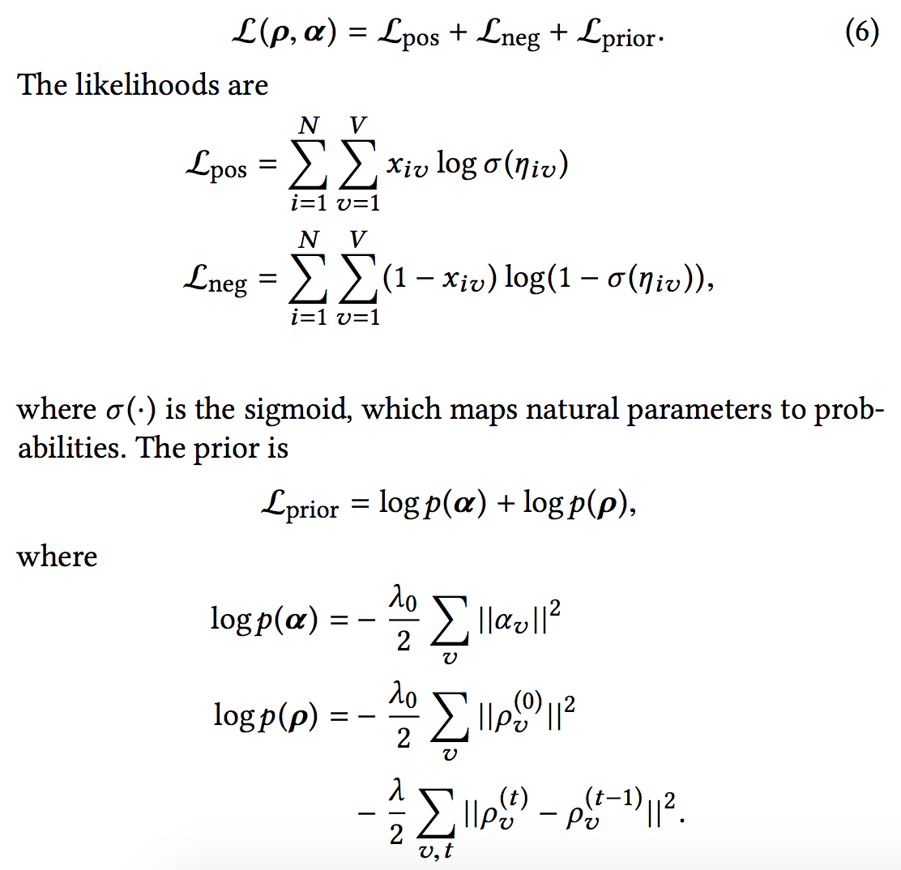
Dynamic Embeddings for Language Evolution (Rudolph et al., WWW’18)
Problem 2: How to prevent the word embedding across adjacent time slices from drifting too apart?
Solution: Prefer parameter settings for which the norm of their difference is small.

Slide 14
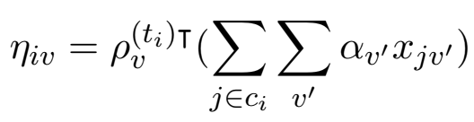
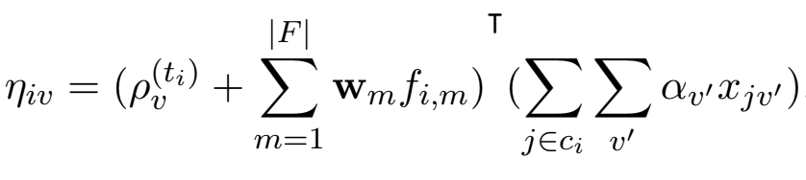
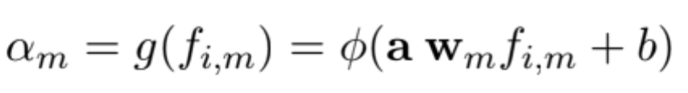
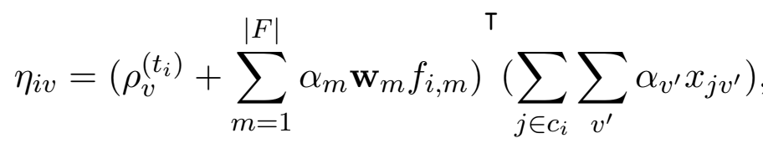
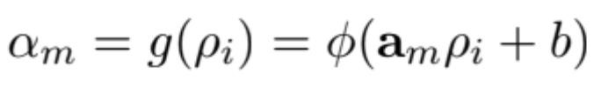
How do we fuse the contextual information with the existing information exploited by DWEM (i.e., neighboring words and time)?
Idea: Let the network decide which extra-linguistic signal is good for a given target word.
Techniques:
No attention
Self attention
Contextual attention
(borrowed from Kiela et al., EMNLP’18)
Pros: Get to understand when a particular extra-linguistic signal is useful.

Slide 15
Models
Baseline
Vanilla - Word2vec (non-dynamic)
HistWords - Word2vec Dynamic Rotation (rotating cur. year word vec. to match prev. year word vec.) (Hamilton et al., ACL’16)
DBE - Joint Learning by sharing context vectors (Rudolph et al., WWW’18)
Proposed (extension of DBE)
No attention (unweighted sum)
Self attention
Contextual attention

Slide 16
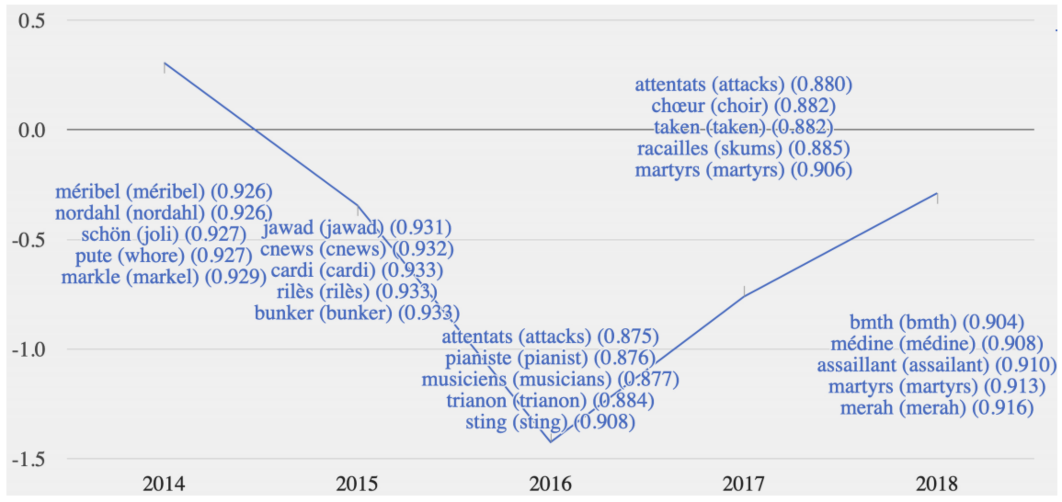
Evaluation – Embedding Neighborhood
bataclan

Slide 17
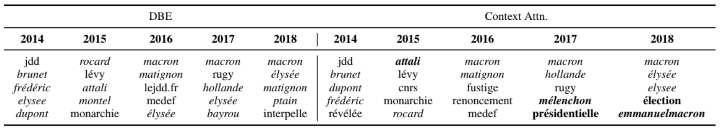
Evaluation – Embedding Neighborhood
EMMANUEL (First name of France President)

Slide 18
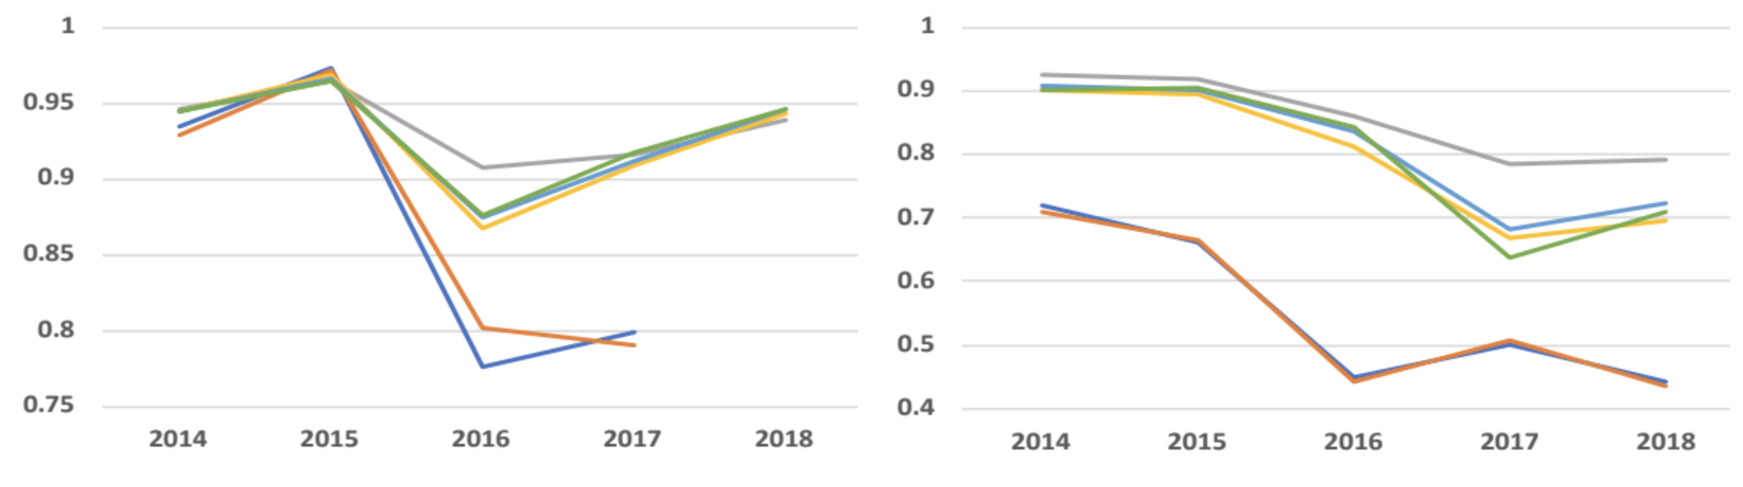
Smoothness of temporal trajectories
equipedefrance (french football team) and euro2016
marcon and president

Slide 19
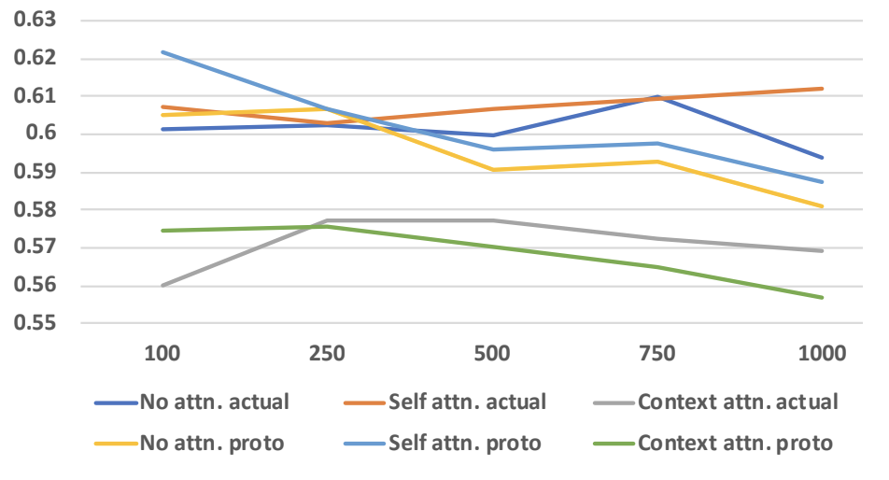
Law of Prototypicality
Law: Likelihood of changes in a word’s meaning correlates with its position within its cluster ” (Dubossarsky et al., NetWords’15)
Prototypicality measure: Word’s distance from its cluster centroid. (Sword is a more prototypical exemplar than spear or dagger)
Task: Correlate
Distance of word vector corresponding to 2014 and 2018.
Distance the word vector corresponding to 2014 (2018) moved from its cluster center

Slide 20
Log-likelihood
Calculating the log-likelihood for positive sample along with 20 negative samples each
Used in several works: EFE (Rudolph et al., NeurIPS’16), S-EFE (Rudolph et al., NeurIPS’17) and DBE (Rudolph et al., WWW’18)
Our model with contextual attention performs the best.
Method | Log-likelihood
DBE | -7.708
No Attn. | -8.059
Self Attn. | -7.840
Context Attn. | -7.425

Slide 21
Semantic Similarity
Introduced by Yao et al., WSDM’18
Tests if words can be categorized by meaning based on embeddings.
Idea: If a word is extremely frequent in a particular section, we associate that word with that section and use that as ground truth.
Automatically create triplets such as:
Perform clustering and report normalized mutual info on train set
Method | NMI
Vanilla | 0.034
HistWords | 0.042
DBE | 0.065
No Attn. | 0.058
Self Attn. | 0.061
Context Attn. | 0.068
Word | Period | Category
Amazon | 1995 | World
Amazon | 2012 | Technology

Slide 22
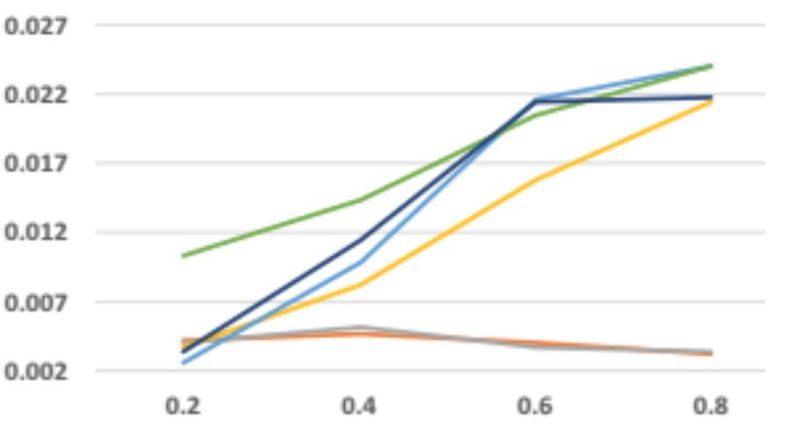
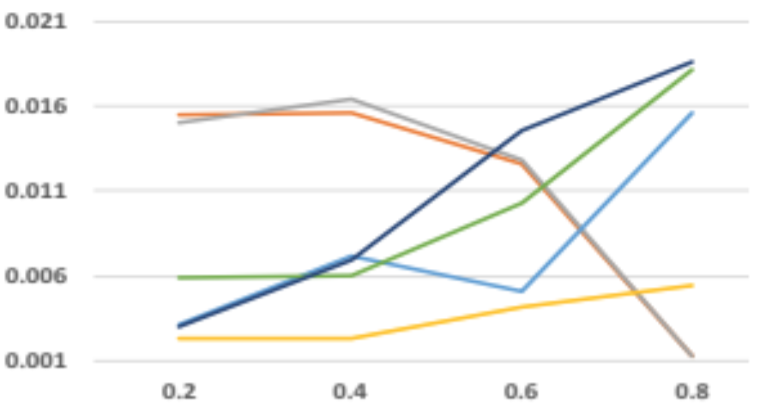
Synthetic Evaluation
(a) frequent
Idea: Synthetically introduce changes to a word’s usage to model linguistic shift. (Kulkarni et al., WWW’15)
Sample donor and receptor words, replace donor words with receptor words with certain probability in 2 ways:
Syntactic way – If both donor and receptor share the same most frequent PoS tag.
Frequent way – Without syntactic constraint.
Rank all the words according to their p-value and report the Mean Reciprocal Rank.
(b) syntactic

Slide 23
Interpretation via Erasure
Compute the importance of a contextualized feature by observing the change in confidence when the contextualized feature is erased.
Most of the contextualized features are ‘equally’ important to the performance of our model.

Slide 24
Revisiting Challenges
How do we fuse the contextual information with the existing information exploited by DWEM (i.e., neighboring words and time) ?
Can DWEM adapt well to the language evolution seen in Twitter?
Can DWEM work well for non-english text?
How to build methods to evaluate how well DWEM works for French tweets?
use word-based attention
yes, with extra-linguistic features
Need more work

Slide 25
Conclusion
Contextualized features act as good inductive biases to provide better fits to a social media corpus.
Future work:
Annotate for short-term changes
Characterize usage change and semantic change
Consider temporal nature of contextualized feature (ex. dynamic co-mention network)
Perform a fine-grained analysis of each feature

Slide 26
Thank you
Questions?
https://github.com/ganeshjawahar/social_word_emb

Slide 27
Text classification
Proposed Approach:
Weakly label a sample of tweets from SoSweet
Represent a tweet feature vector based on the sum of dynamic word embeddings
Train a simple ML model and report its F-score on test set.
Idea: Test the real world application potential of DWE.

Slide 28
Text classification
Tasks:
Sentiment Analysis – Tweets are labelled as positive (negative) if they contain positive (negative) emoticons. (Go et al., Stanford Report’09)
Hashtag Prediction – Hashtags within the tweet are predicted given the tweet. (Weston et al., EMNLP’14)
Topic Categorization – Tweet category is obtained from the category of the YouTube video accompanying the tweet. (Magdy et al., ICWSM’15)
Conversation Prediction – Predict if a tweet will receive a reply or not. (Elazar et al., EMNLP’18)
Method | Senti | Htag | Topic | Conv.
Vanilla | 71.54 | 37.32 | 34.98 | 70.04
HistWords | 73.69 | 36.75 | 36.85 | 70.17
DBE | 73.00 | 41.83 | 40.01 | 70.98
No Attn. | 73.22 | 42.11 | 39.61 | 71.21
Self Attn. | 73.18 | 42.19 | 39.67 | 71.10
Context Attn. | 73.19 | 41.88 | 39.65 | 71.15

