Slide 1
Temporary Results
Environments:
"HumanoidBulletEnv-v0"
"Walker2DBulletEnv-v0"
"Pendulum-v0"
"HalfCheetahBulletEnv-v0"
“Walker2d-v2”
“HalfCheetah-v2/3”
Algorithms:
gradient-based
derivative-free
Neural Network Architechtures:
RBF (with different hyperparameters)
MLP (1-2 Layers, 64 or 256 neurons each)
Linear

Slide 2
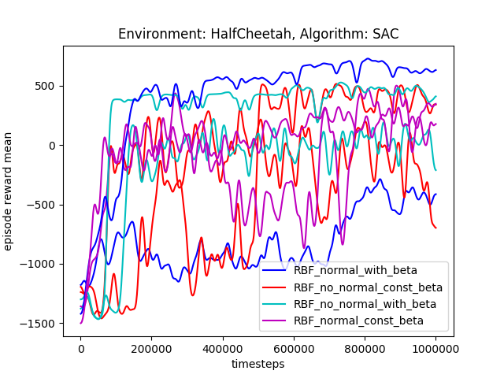
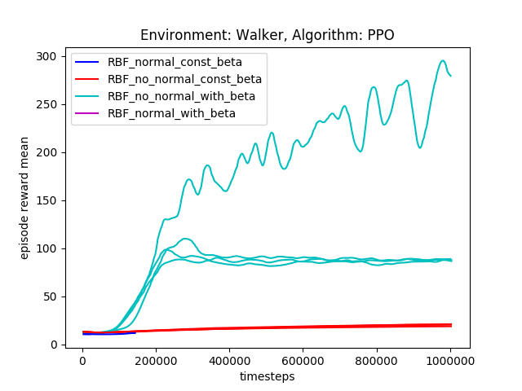
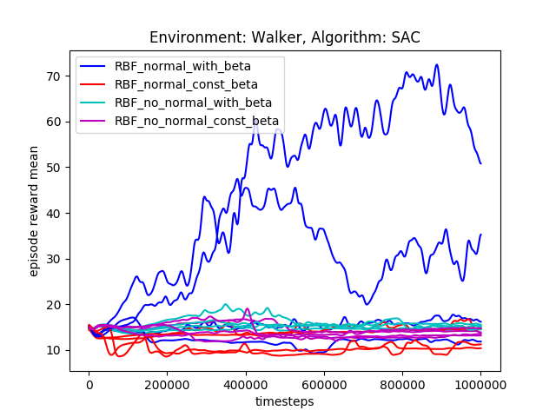
I RBF Hyperparameters
For halfcheetah no clear tendencies
For walker only the networks with no constant beta values achieve higher rewards, but should definitely be investigated further

Slide 3
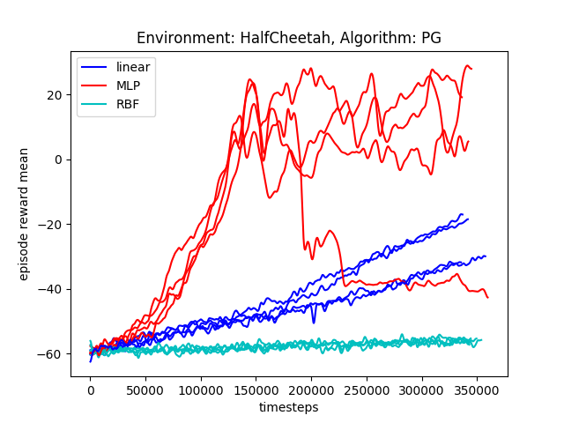
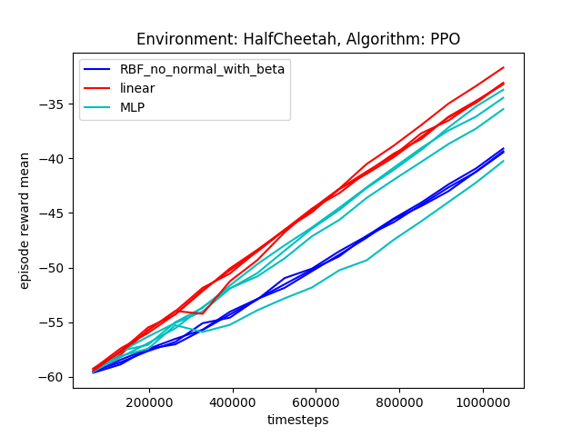
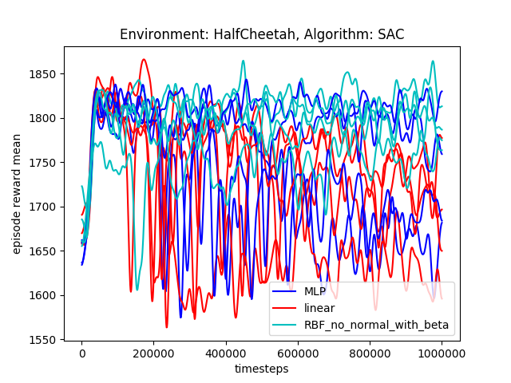
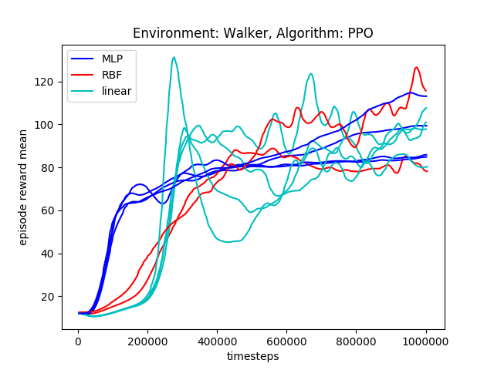
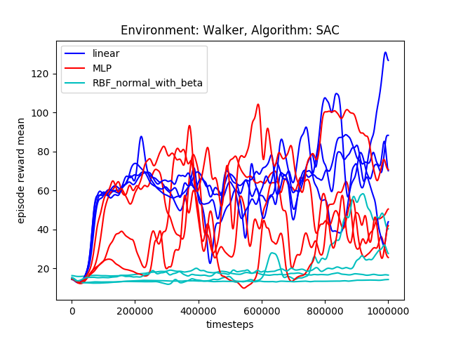
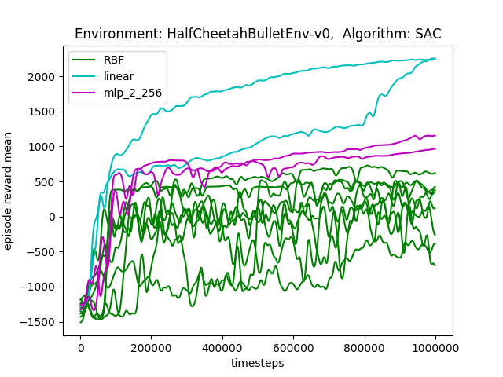
II Linear vs. RBF vs. MLP
Note: the colors are not
Consistent!

Slide 4
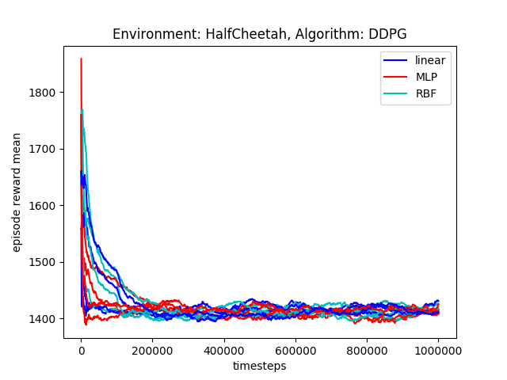
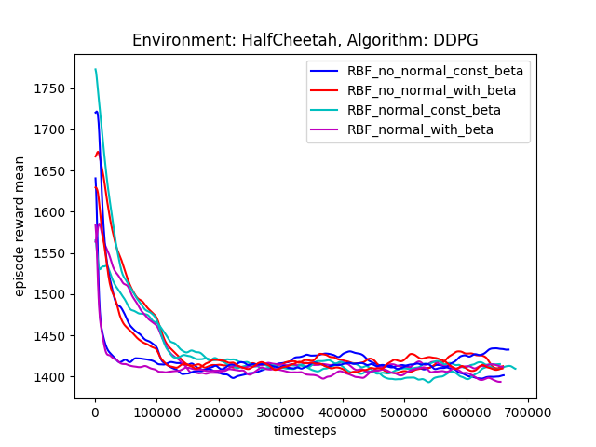
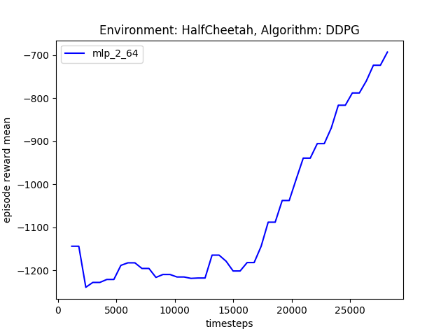
III.1 Trials with strange behavior
Why did it work for that trial? Check hyperparameters
Difference in hyperparameters:
- timesteps per iteration (1000 vs 600)
- mlp code for the second one is newer, but only customizable, the executed code should be the same

Slide 5
IV Errored Trials
A2C for RBF and A3C for MLP errored, A3C errored for RBF for some seeds!
The fix with the normalization/regularization didn’t fix the errors

Slide 6
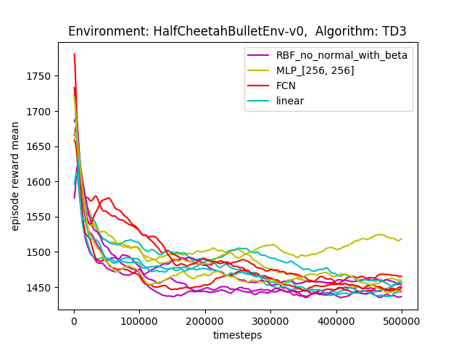
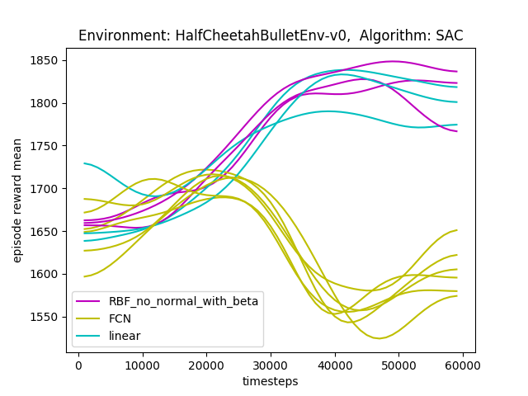
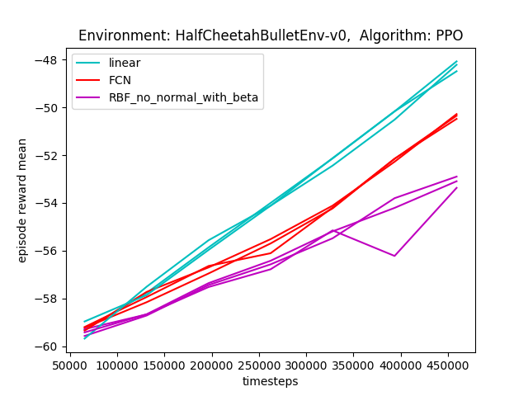
Linear vs RBF vs FCN (MLP failed due to a typo)

Slide 7
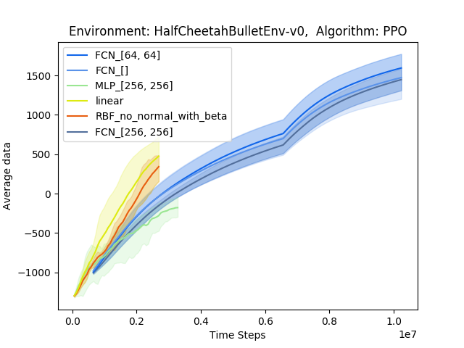
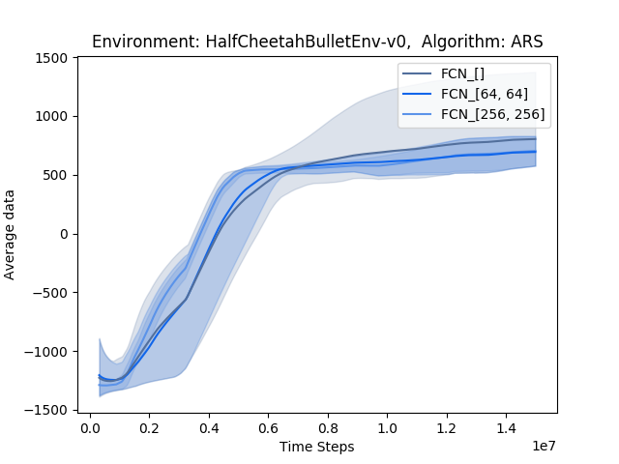
PPO and ARS - HalfCheetah

Slide 8
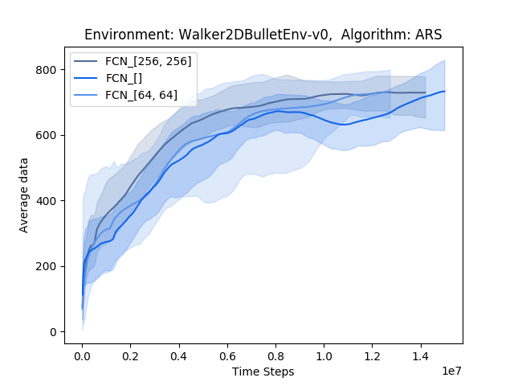
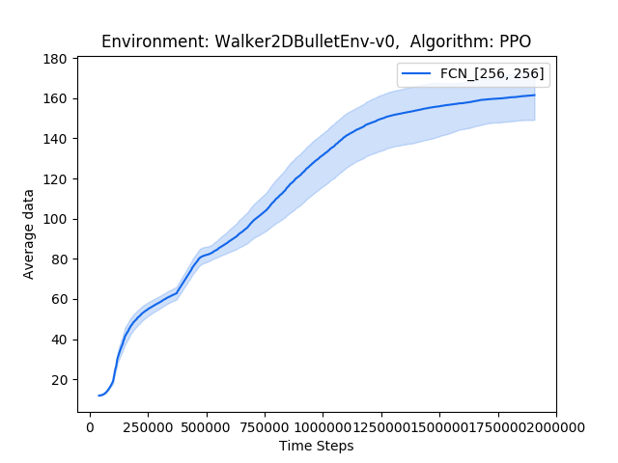
PPO and ARS - Walker

Slide 9
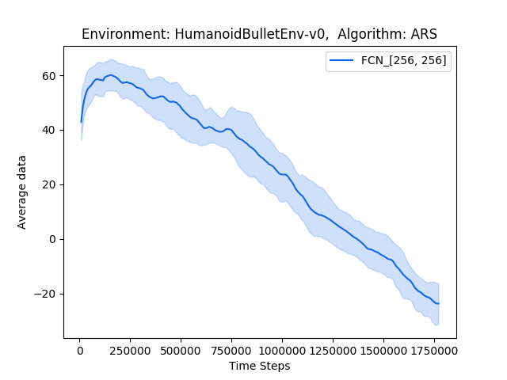
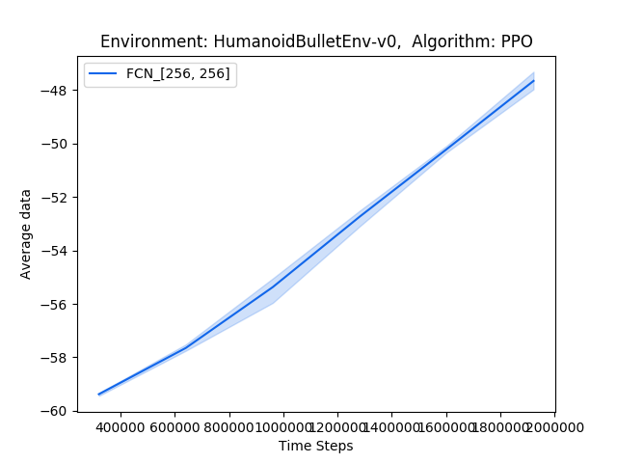
ARS and PPO - Humanoid

Slide 10
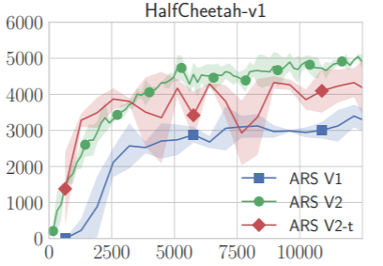
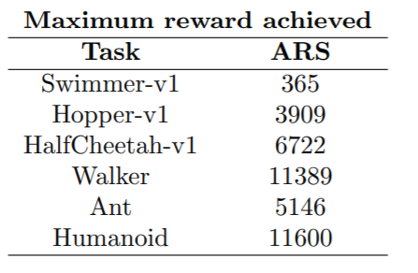
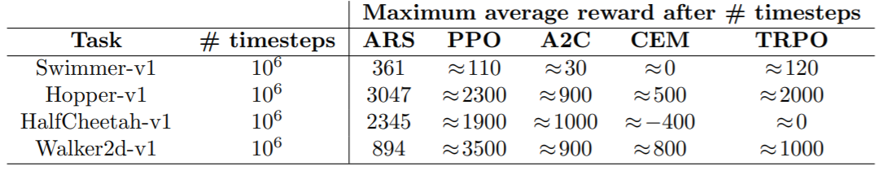
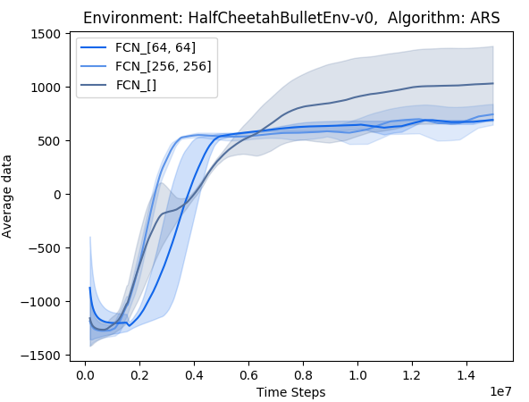
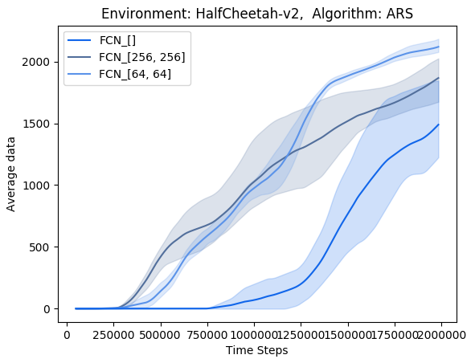
Comparison to results in papers - ARS
The results of the paper after 1mio ts are comparable with the mujoco results after 2mio ts
The total time stated in the outputs is very similar for all three policies for some reason?
After 1mio ts still 0?

Slide 11
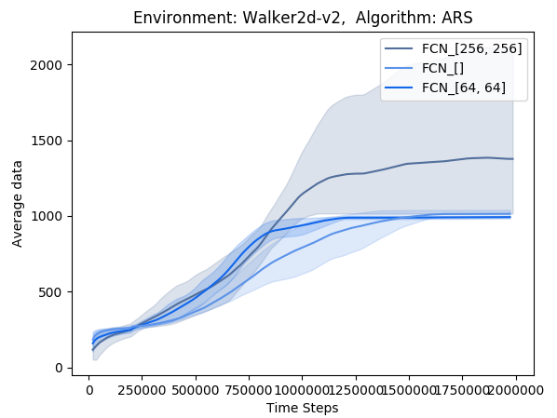
Comparison to results in papers – ARS (Walker)
comparable results
- episode reward mean, max is not stored in the progress.csv

Slide 12
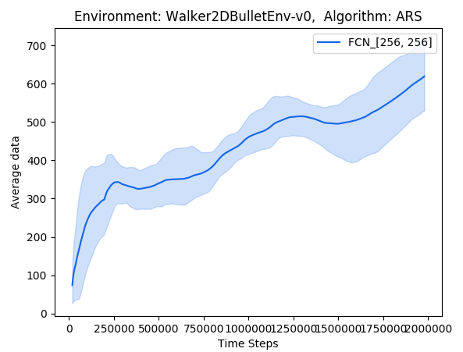
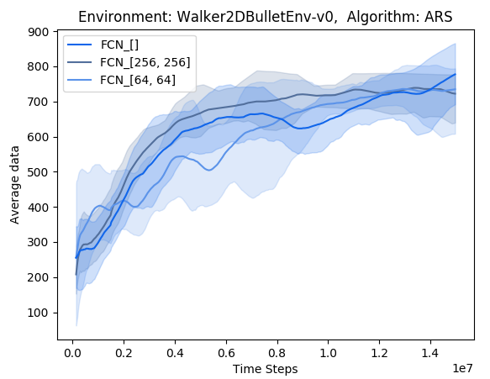
ARS (Walker) – Bullet vs Mujoco
Bullet after 2 mio: 300-700
Mujoco after 2 mio: 1000-2000

Slide 13
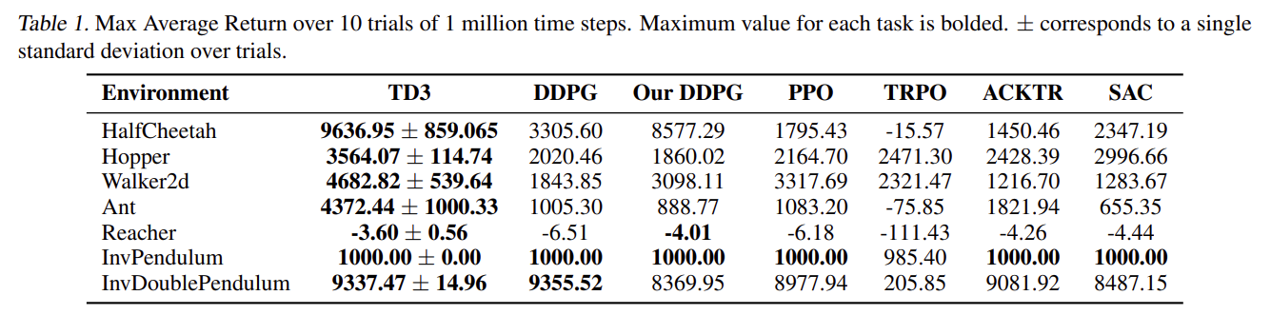
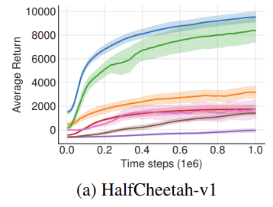
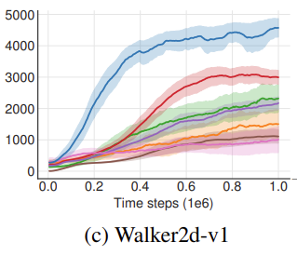
results in papers

Slide 14
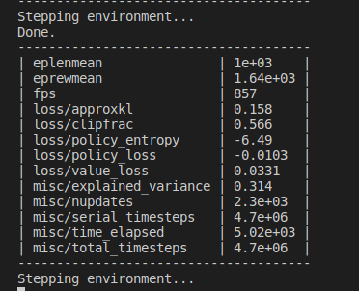
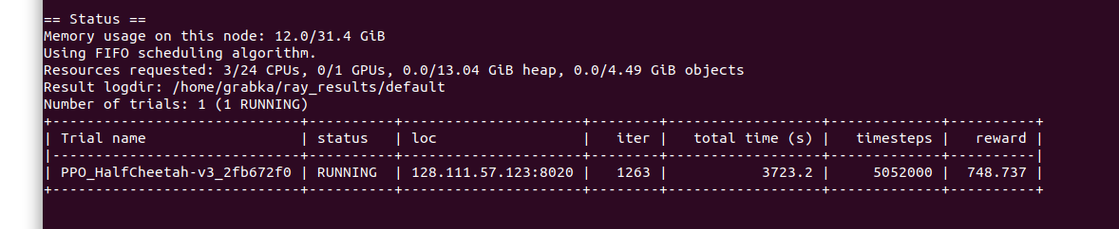
Baselines vs. Rllib with mujoco
Both default command line training
python -m baselines.run --alg=ppo2 --env=HalfCheetah-v2 --num_timesteps=2e7 --save_path=~/Documents/seagul/seagul/rllib/rllib_with_rbf/data/baselines/
&
rllib train --run=PPO --env=HalfCheetah-v3

Slide 15
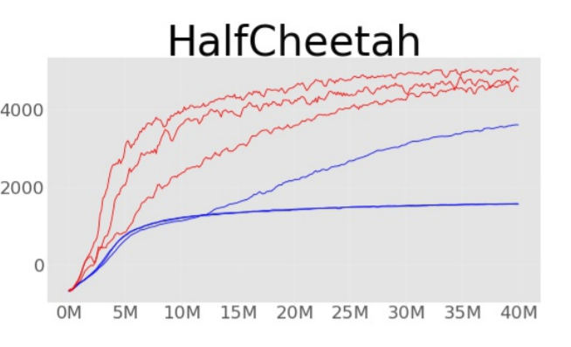
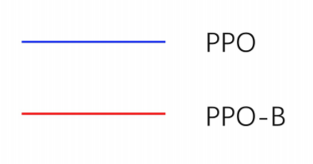
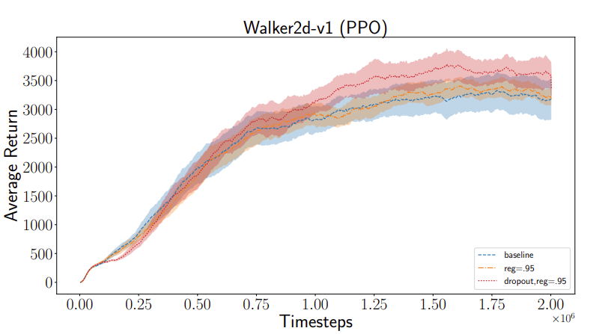
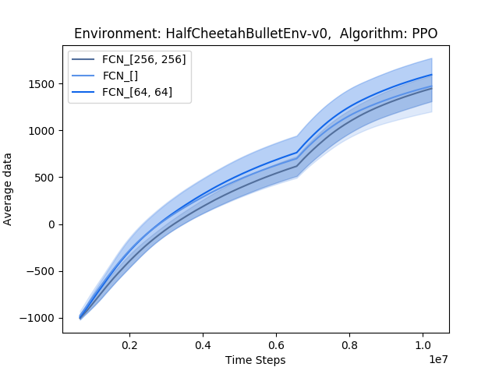
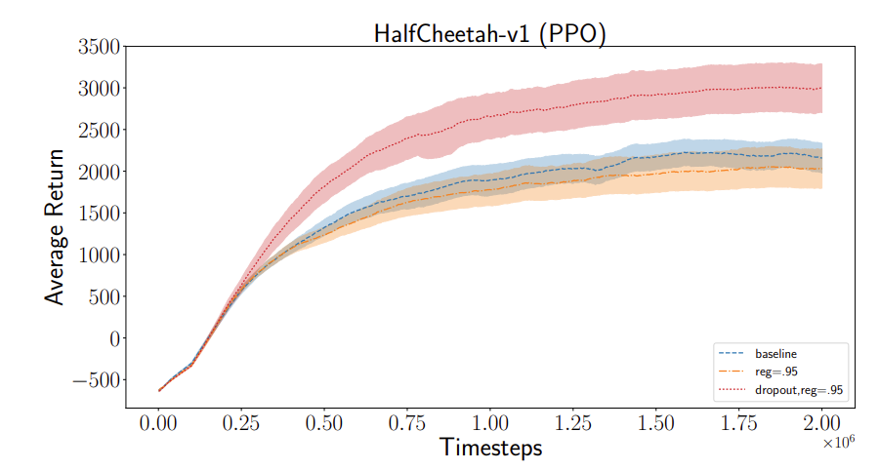
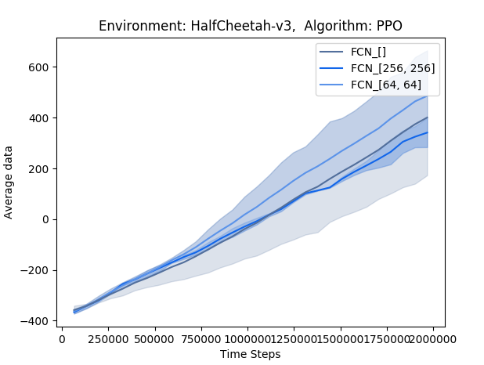
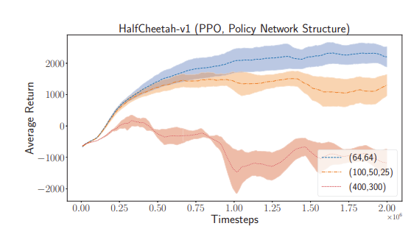
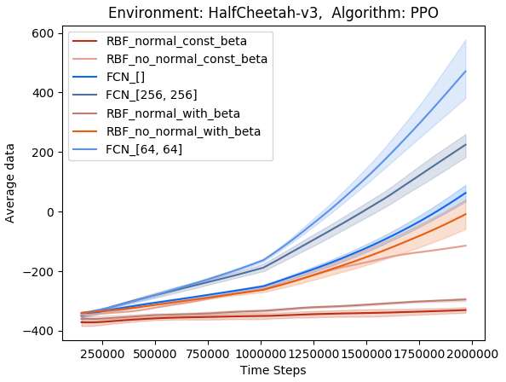
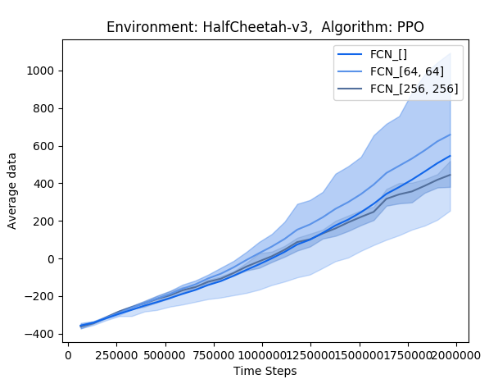
Comparison to results in papers - PPO
Reward after 10^6 timesteps: ~ from -1000 to -500

Slide 16
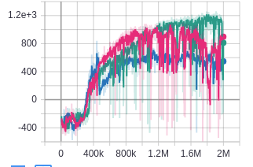
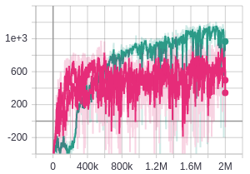
Stable baselines with HalfCheetah-v2
680, 609, 1168 (mlp)
1175, 720, 780 (linear)
mlp [64,64]
linear

Slide 17
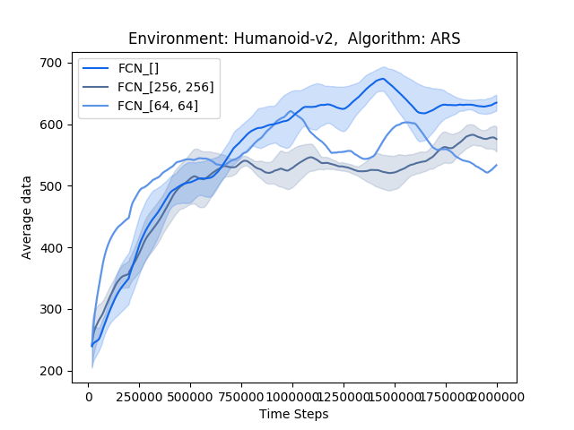
Mujoco Humanoid MLP vs Linear

Slide 18
Comparison of rbfs on Pendulum
Try ARS with mujoco and all three environments
Compare the time difference for MLP and linear –> no big differences for some reason

Slide 19
Problems with SAC
InvalidArgumentError: Dimension size must be evenly divisible by 2 but is 27
Number of ways to split should evenly divide the split dimension for 'default_policy/lambda/split' (op: 'Split') with input shapes: [], [?,27] and with computed input tensors: input[0] = <-1>.
https://github.com/ray-project/ray/issues/5777

