Slide 1
Overview over tested frameworks
Environments:
"HumanoidBulletEnv-v0"
"Walker2DBulletEnv-v0"
"Pendulum-v0"
"HalfCheetahBulletEnv-v0"
“Walker2d-v2”
“HalfCheetah-v2/3”
Algorithms:
gradient-based
derivative-free
Neural Network Architechtures:
RBF (with different hyperparameters)
MLP (1-2 Layers, 64 or 256 neurons each)
Linear
RL-libraries:
Rllib
Stable baselines / baselines

Slide 2
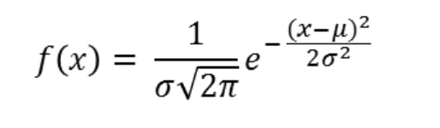
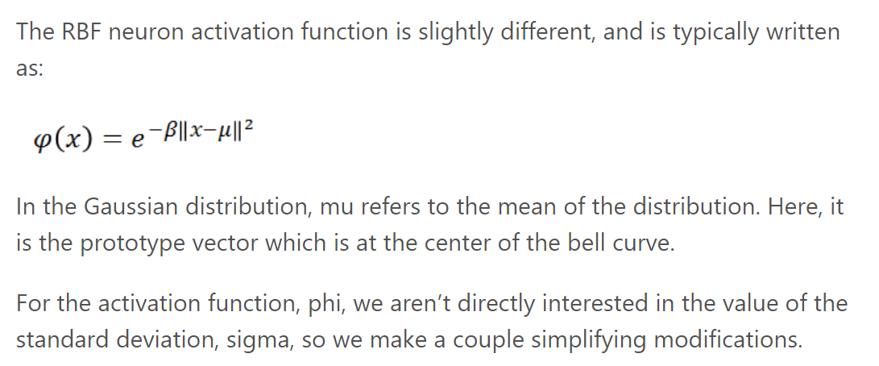
















I RBF Network Hyperparameters

Slide 3






I RBF Network Hyperparameters
Parameter initialization (default: random normal for mu and ones for beta)
Number of hidden neurons (64/256)
Constant smoothing factor beta (default: false)
Distance calculation (distance between inputs and mu values, default: Euclidean, mahalanobis not implemented yet)
Normalization (default: true)

Slide 4
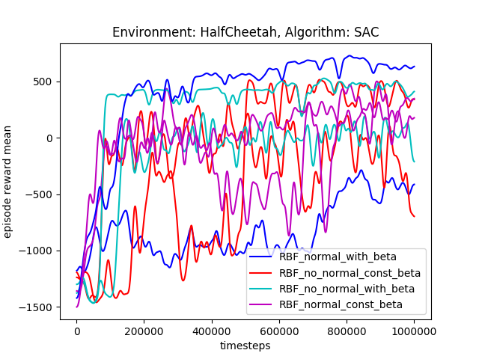
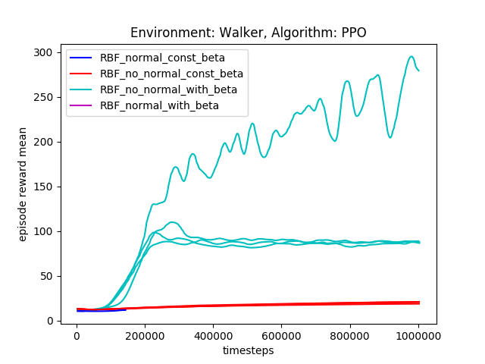
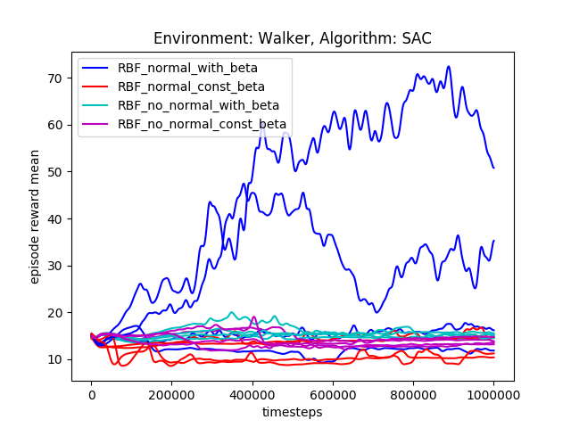
I RBF Network Hyperparameters
bullet ↓
bullet ↓
bullet ↓
Results:
For halfcheetah no clear tendencies
For walker only the networks with no constant beta values achieve higher rewards, but should definitely be investigated further

Slide 5
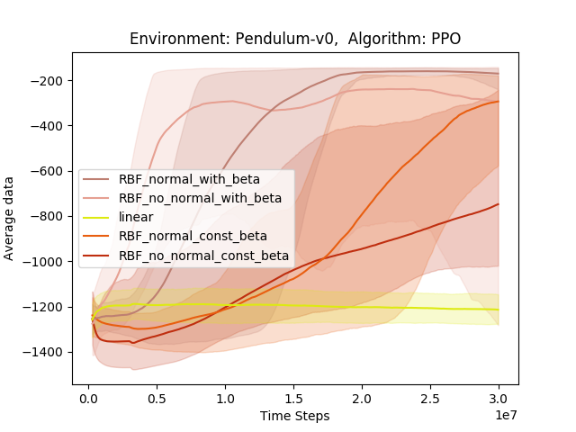
I RBF Network Hyperparameters
Run the same with ARS
Results:
PPO doesn’t work with the Pendulum, at least not with the set hyperparameters, it should have reached the desired threshold of -150 very quickly (it wasn’t supposed to run 30mio timesteps, that was a typo in the run script)

Slide 6
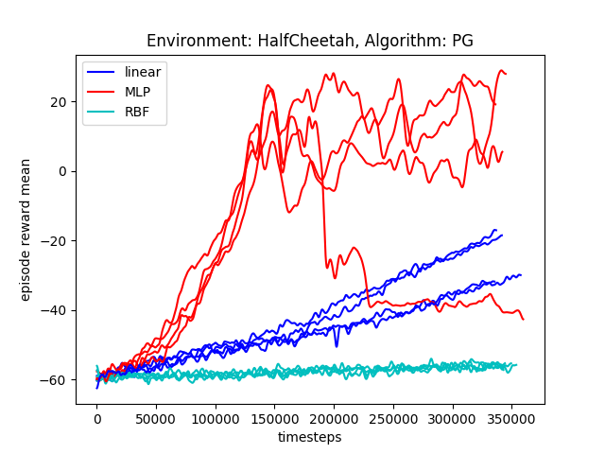
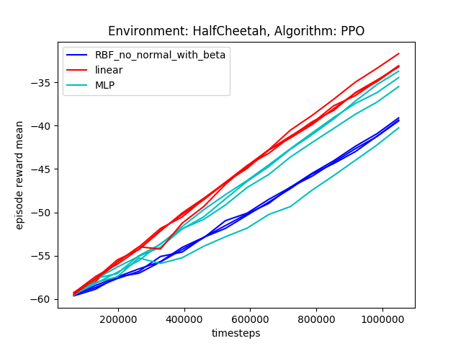
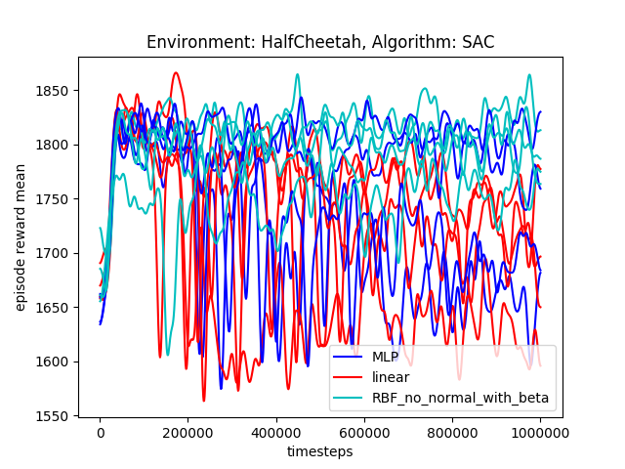
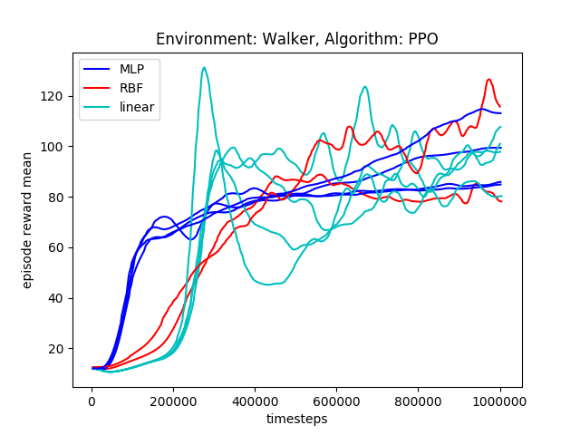
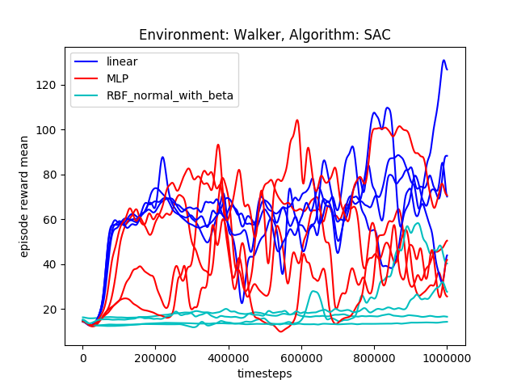
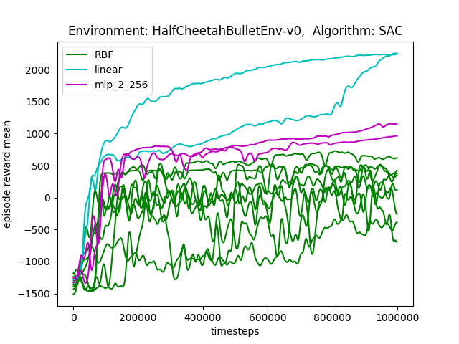
II Linear vs. RBF vs. MLP
Note: the colors are not
Consistent!

Slide 7
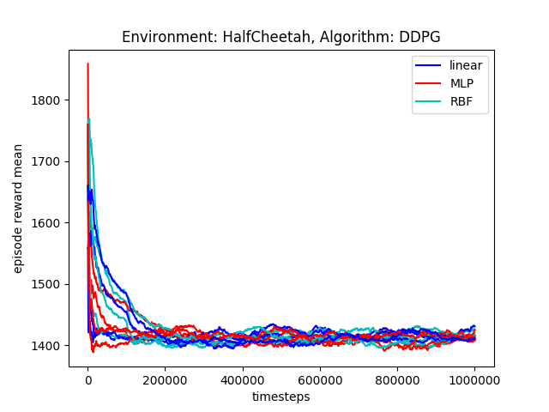
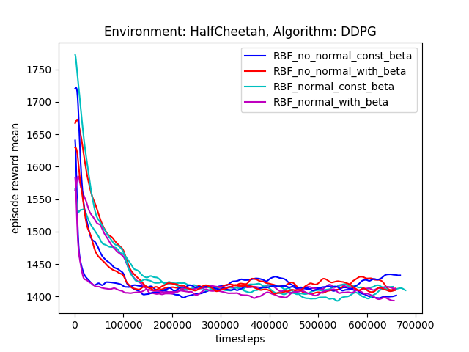
DDPG & HalfCheetahBulletEnv

Slide 8
IV Errored Trials
A2C for RBF and A3C for MLP errored, A3C errored for RBF for some seeds!
The fix with the normalization/regularization (adding an epilon=10e-6 to the normalization term) didn’t fix the errors

Slide 9
SAC & HalfCheetah-v2 (mujoco)
InvalidArgumentError: Dimension size must be evenly divisible by 2 but is 27
Number of ways to split should evenly divide the split dimension for 'default_policy/lambda/split' (op: 'Split') with input shapes: [], [?,27] and with computed input tensors: input[0] = <-1>.
Problem mentioned here:
https://github.com/ray-project/ray/issues/5777

Slide 10
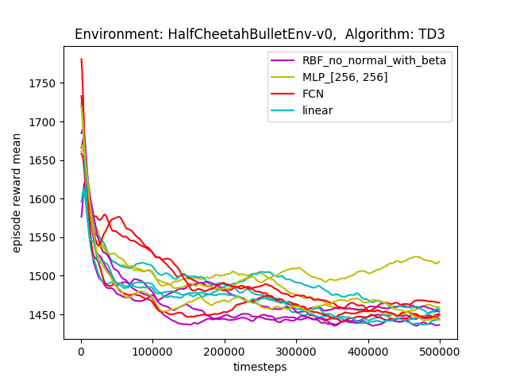
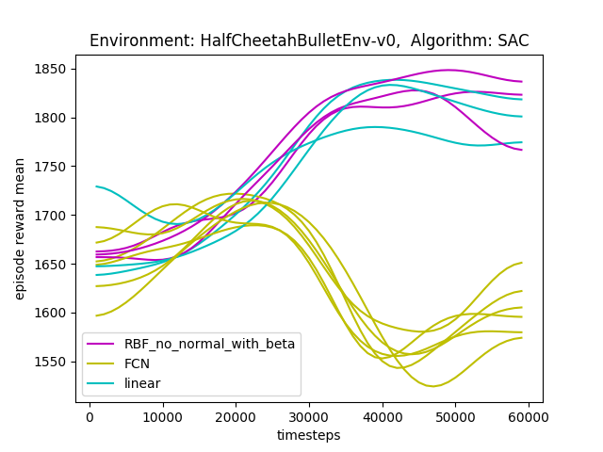
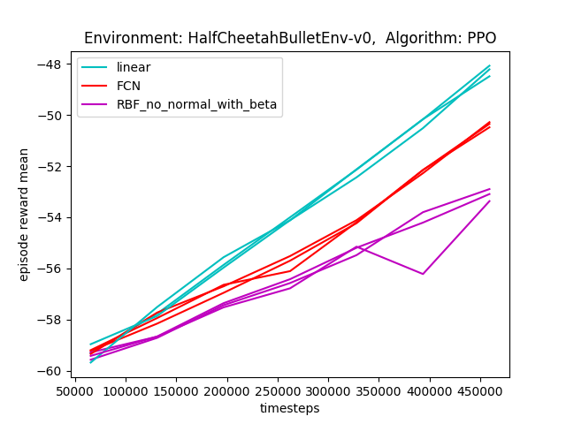
Linear vs RBF vs FCN

Slide 11
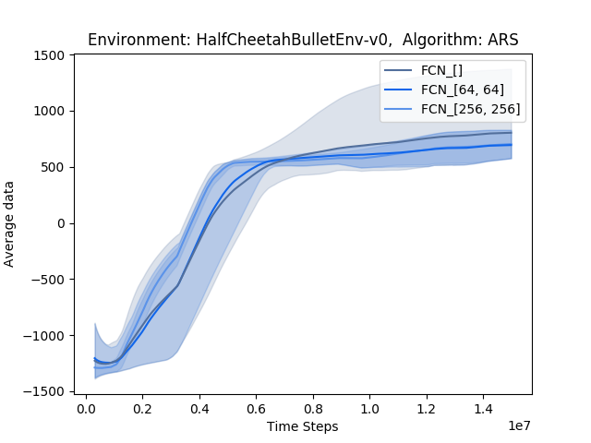
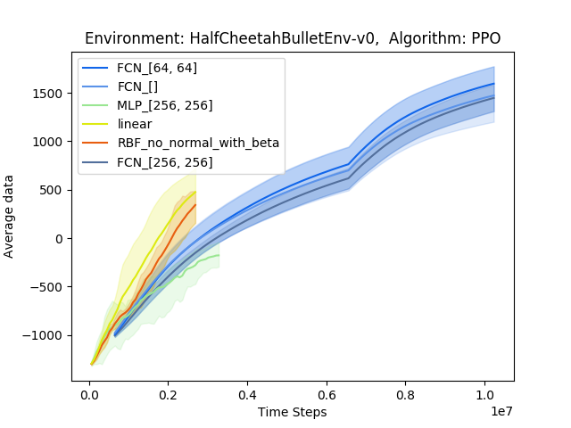
PPO and ARS - HalfCheetah

Slide 12
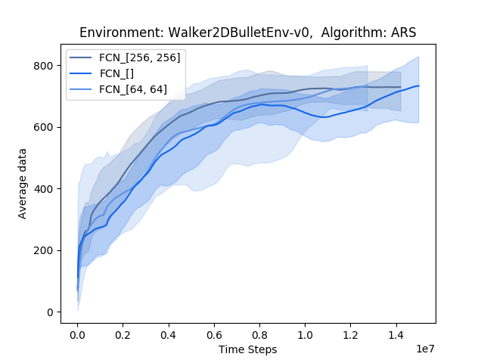
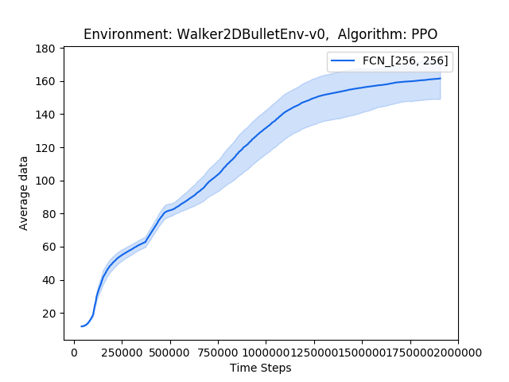
PPO and ARS - Walker

Slide 13
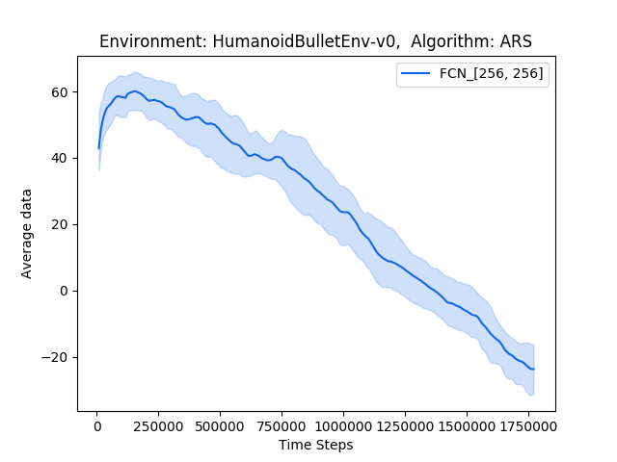
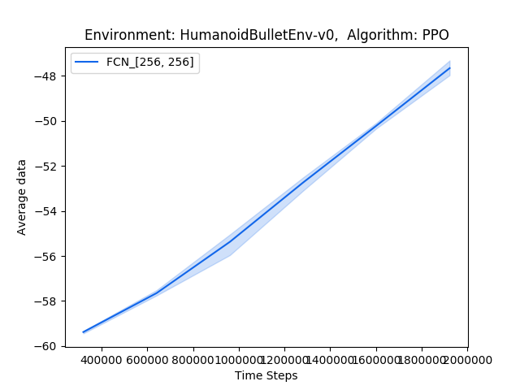
ARS and PPO - Humanoid

Slide 14
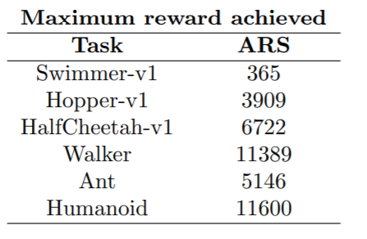
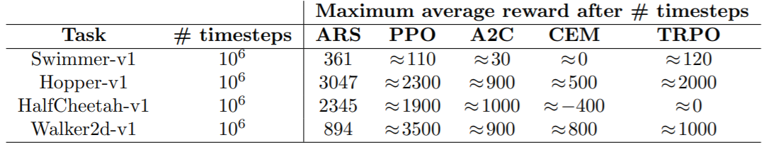
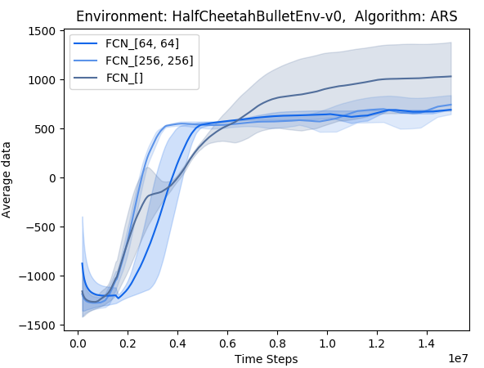
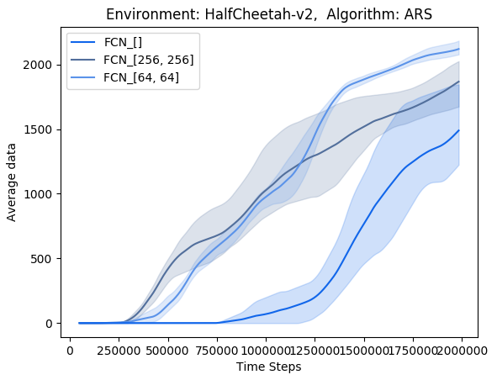
Comparison to results in papers - ARS
“max average return over 10 trials” – these results might be a bit better than the mean average rewards of 3 seeds
The total time stated in the outputs is very similar for all three policies for some reason?
The results of the paper after 1mio ts are comparable with the mujoco results after 2mio ts
After 1mio ts still 0?

Slide 15
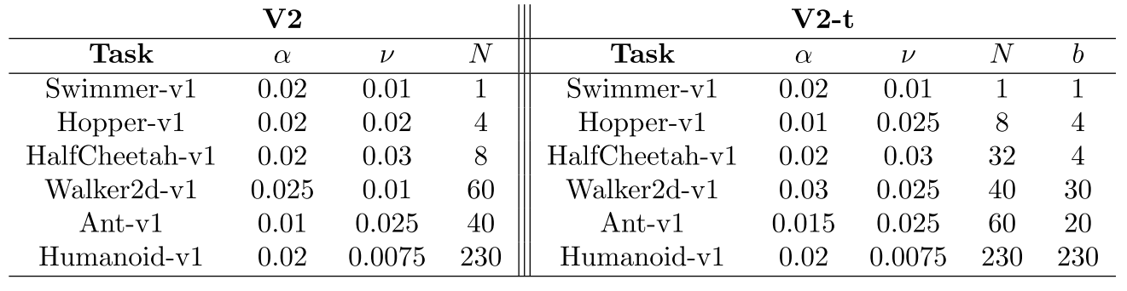
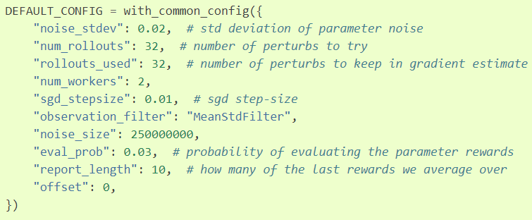
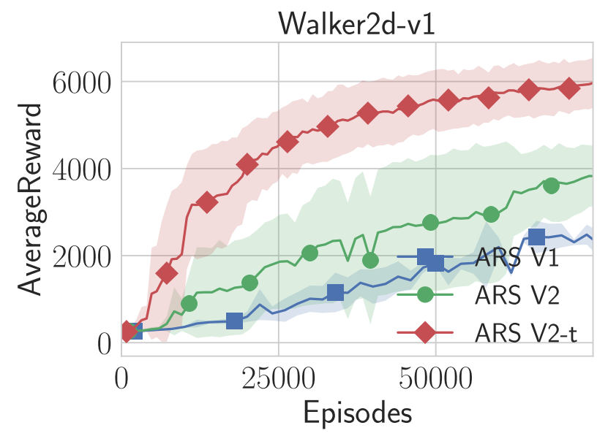
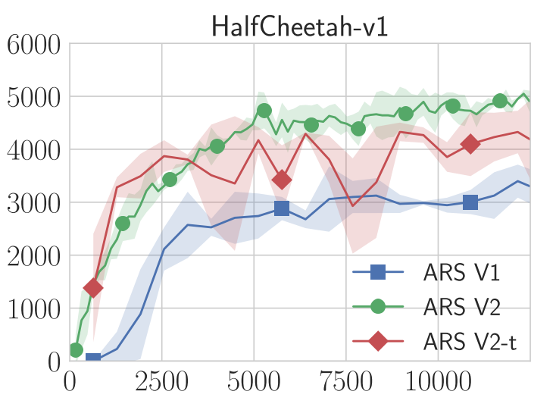
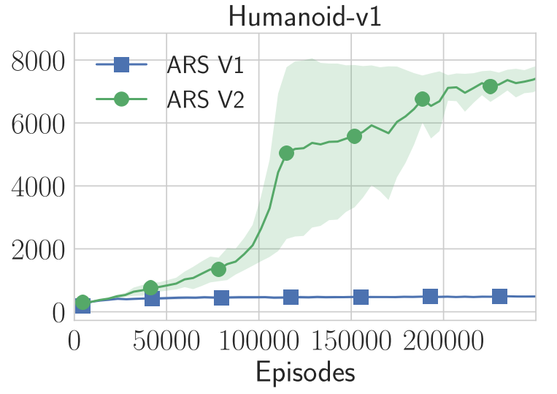
Hyperparameters for ARS
RLLIB ↓
↑ from ARS paper ↓

Slide 16
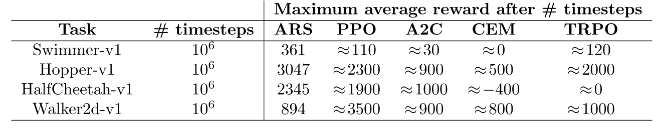
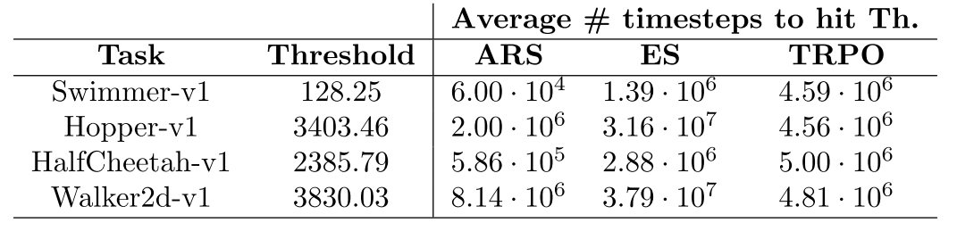

Slide 17
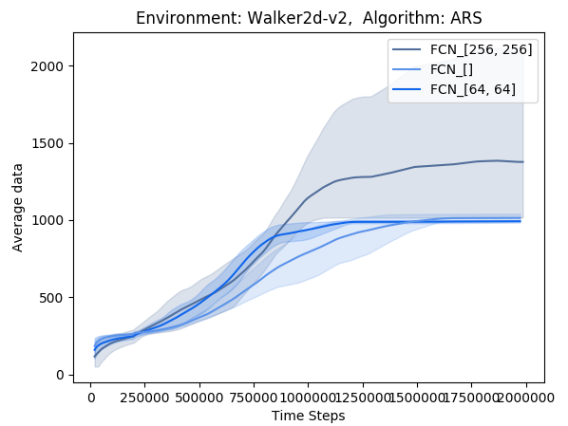
Comparison to results in papers – ARS (Walker)
comparable results
- episode reward mean, max is not stored in the progress.csv

Slide 18
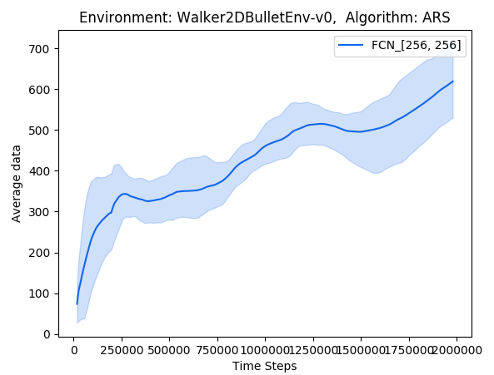
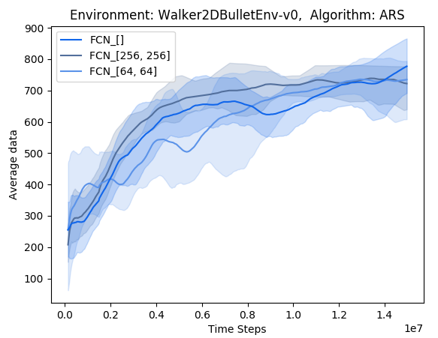
ARS (Walker) – Bullet vs Mujoco
Bullet after 2 mio: 300-700
Mujoco after 2 mio: 1000-2000

Slide 19
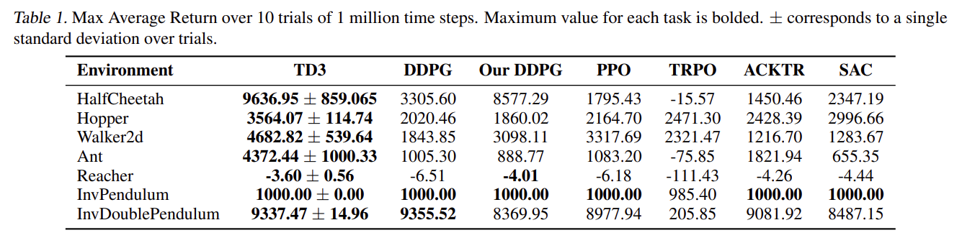
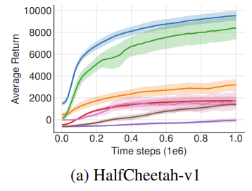
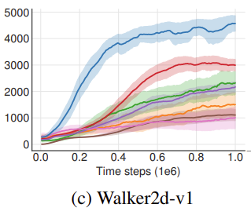
results in papers

Slide 20
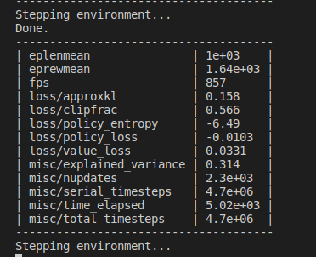
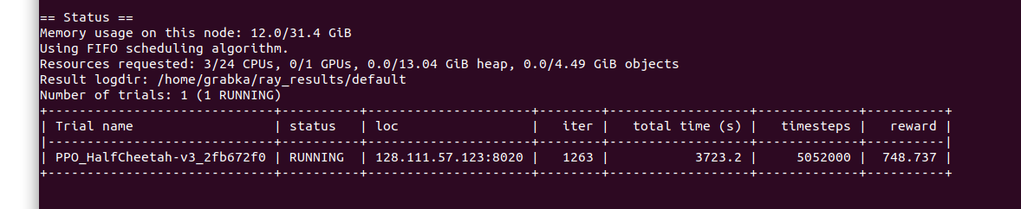


Baselines vs. Rllib with mujoco
comparison of default command line training:
python -m baselines.run --alg=ppo2 --env=HalfCheetah-v2 --num_timesteps=2e7 --save_path=~/Documents/seagul/seagul/rllib/rllib_with_rbf/data/baselines/
rllib train --run=PPO --env=HalfCheetah-v3
After ~5mio timesteps:
baselines – 1640
rllib - 750

Slide 21
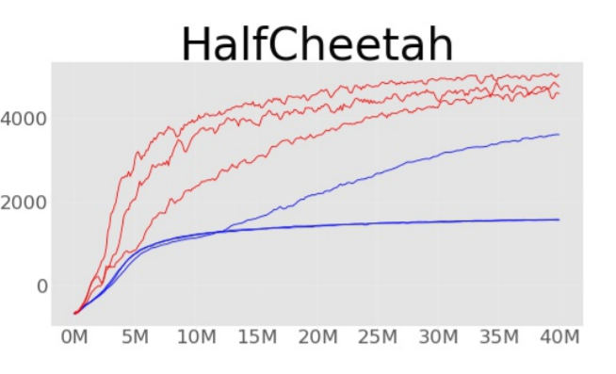
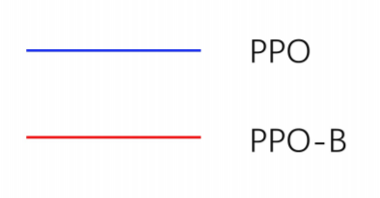
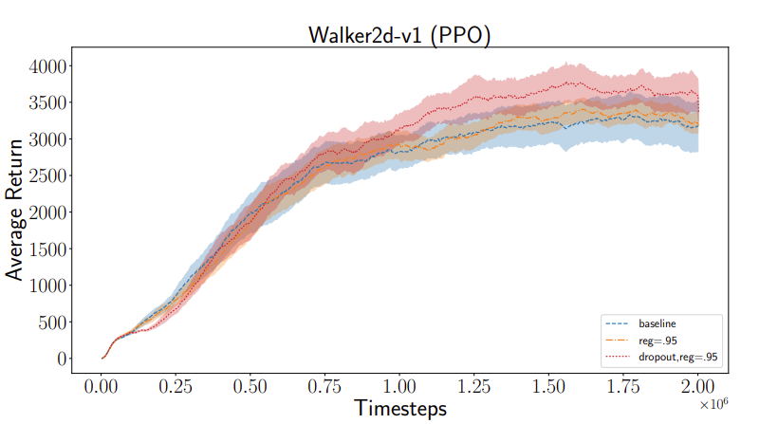
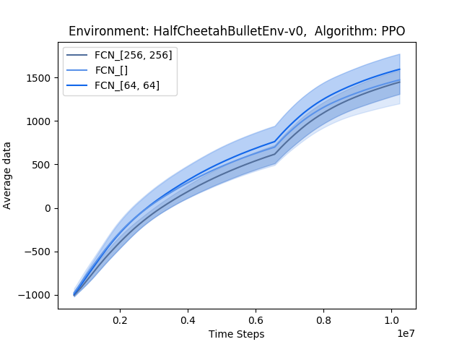
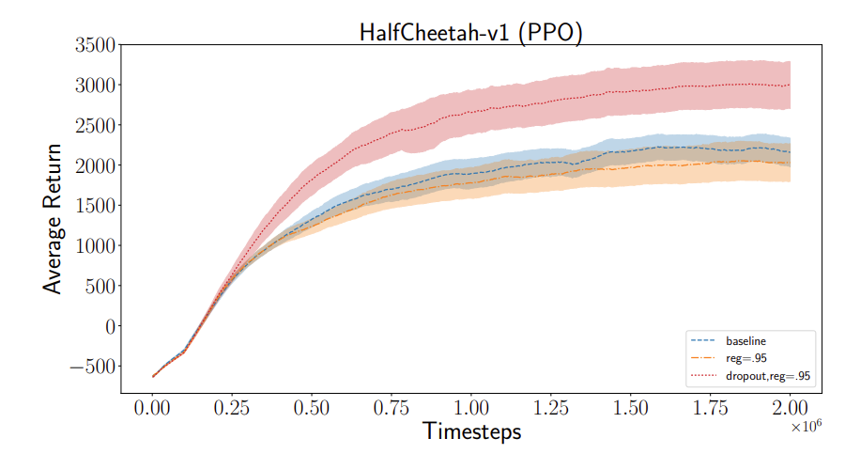
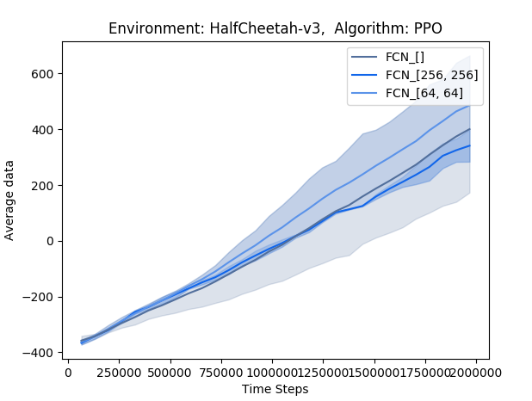
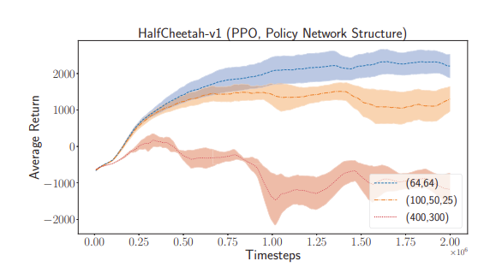
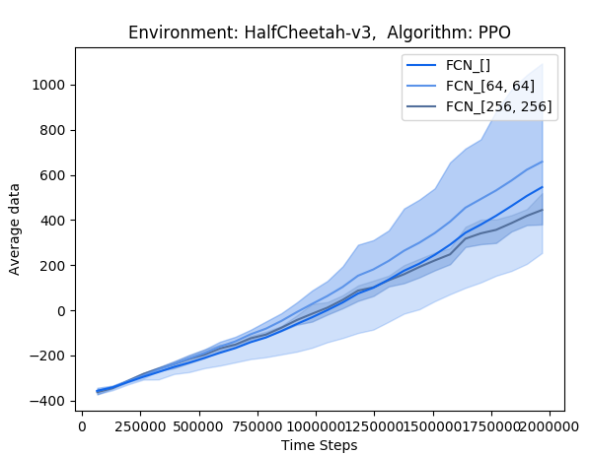

Comparison to results in papers - PPO
Reward after 10^6 timesteps: ~ from -1000 to -500

Slide 22


Stable baselines with HalfCheetah-v2 (PPO)
680, 609, 1168 (mlp)
1175, 720, 780 (linear)
mlp [64,64]
linear
→ mlp and linear have similar rewards, rewards achieved in the paper are twice as high

Slide 23

Mujoco vs. Bullet Humanoid, MLP vs Linear

Slide 24
TODO
Humanoid for PPO to complete the table
ARS Walker with more seeds
Mark in table: linear better/same/worse
Pendulum with ARS
Put humanoid and walker plot into slides
Try ARS with mujoco and all three environments
vf_clip_param
Compare the time difference for MLP and linear –> no big differences for some reason

Slide 25
Results after 1 mio timesteps
Linear policy behaves…
Worse
Slightly worse
Similar
Slightly better
Better
Environment | PPO | Result found in papers for PPO | ARS | Result found in papers for ARS
HalfCheetahBulletEnv-v0 | - 700 | -- | - 1000 | --
HalfCheetah-v2 | 800 | 1800 | 1200 | 2300
Walker2dBulletEnv-v0 | 120 | -- | 500 | --
Walker2d-v2 | 1200 | 3300 | 1300 | 890
HumanoidBulletEnv-v0 | - 50 | -- | 20 | --
Humanoid-v2 |  | -- | 600 | --

