Slide 1
IS590Labtime topic: Expectation-maximization (EM) algorithm and Latent Dirichlet Allocation (LDA) algorithm
Date: 10/18
Time: 4:40-5:30pm
Instructor: Yingjun Guan

Slide 2
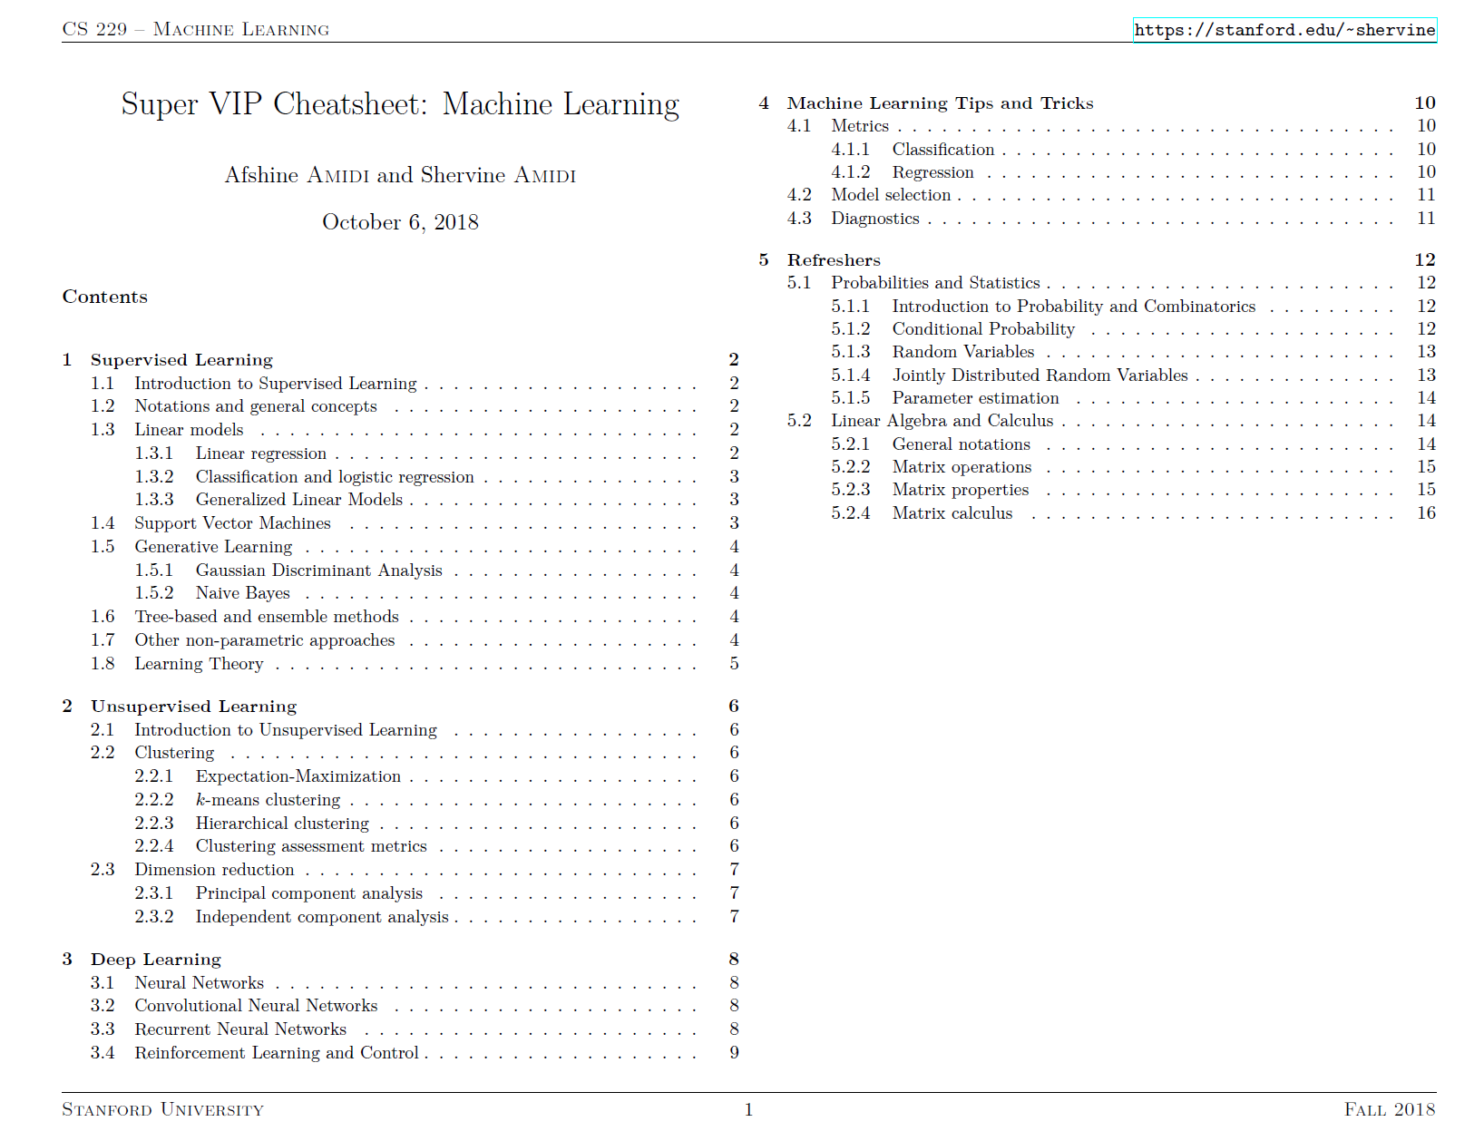
A big picture of Machine Learning.

Slide 3
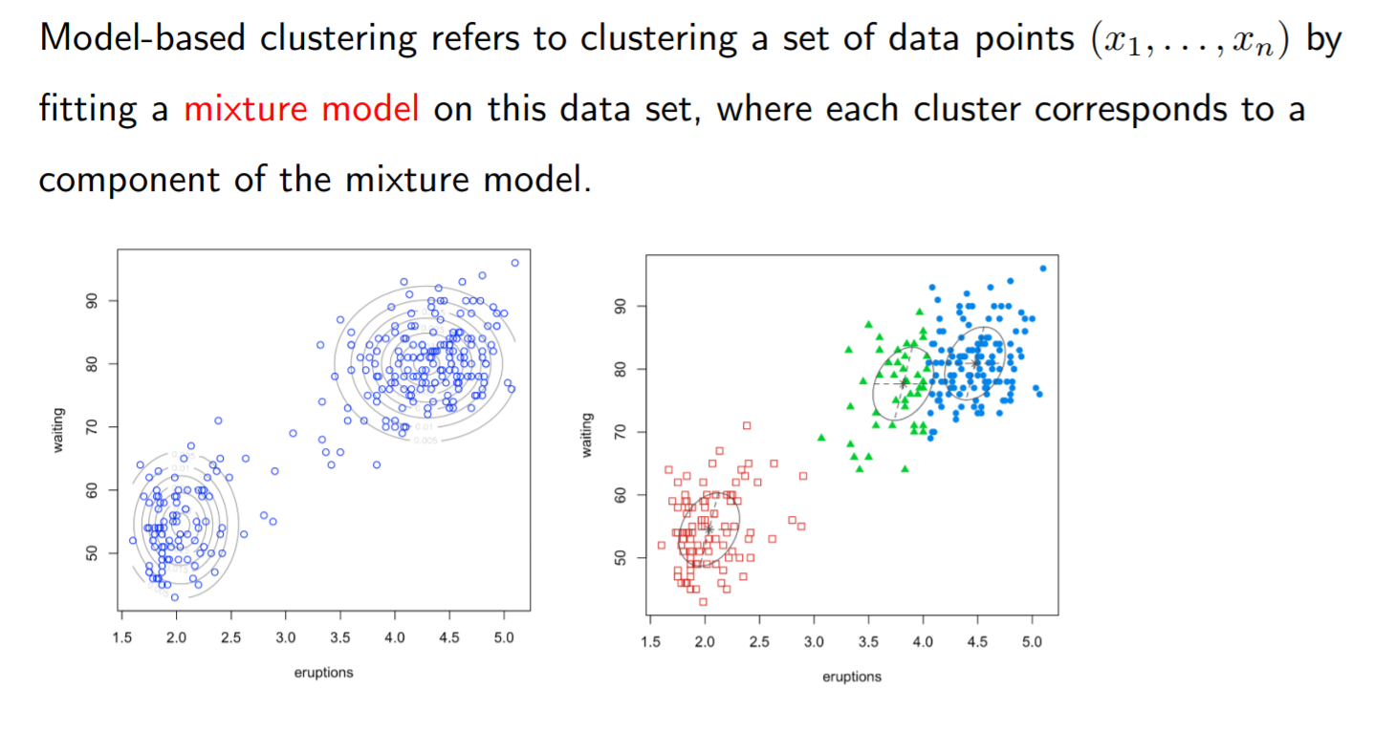
Today, we’re talking about model-based clustering.

Slide 4
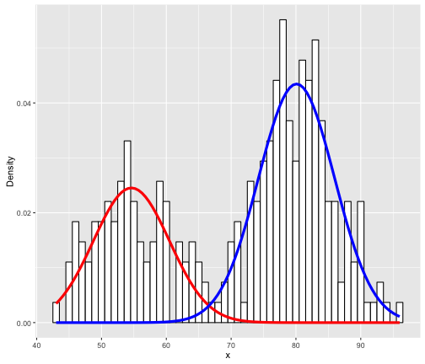
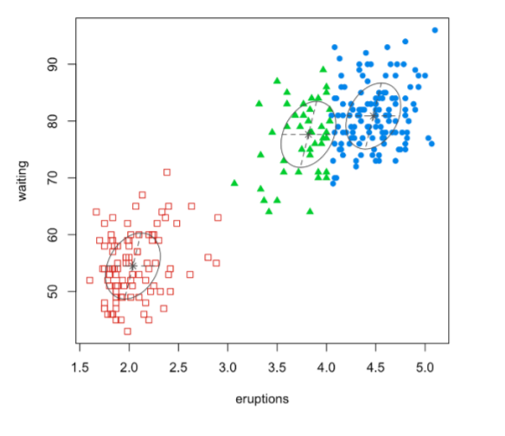
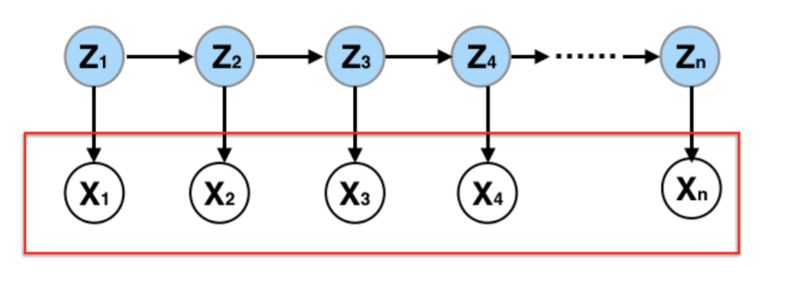
Latent variables are hidden/unobserved data help to estimate the clustering, thus could be described in different ways.

Slide 5
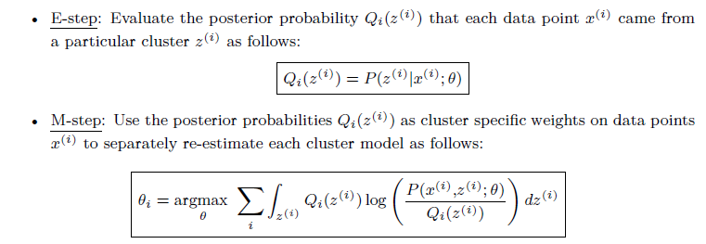
What is EM?
Parameter → Probability [Expectation]
The Expectation-Maximization (EM) algorithm is an iterative method that finds the MLE by enlarging the sample with unobserved latent data.
Probability → Parameter [Maximization]

Slide 6
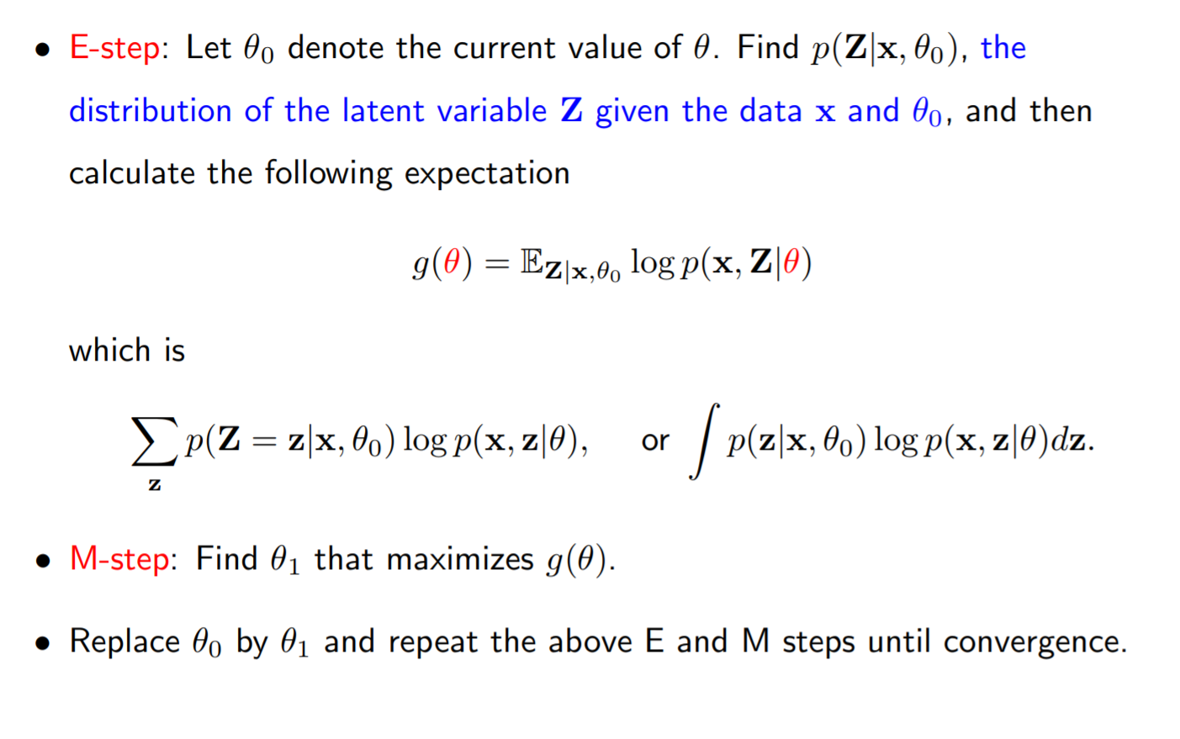
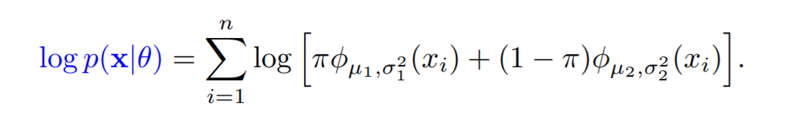
How to explain EM in equations (n-component gaussian mixture)

Slide 7
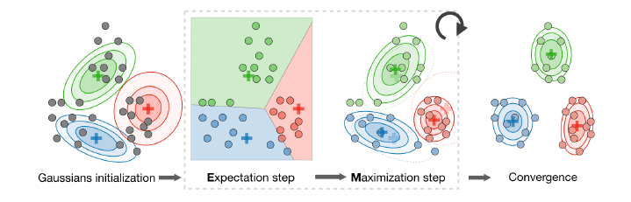
How to explain EM in figures. (n-component gaussian mixture)

Slide 8

Hypotheses and targets of LDA (Latent Dirichlet Allocation)
We want to find themes (or topics) in documents
useful for e.g. search or browsing
We don’t want to do supervised topic classification
rather not fix topics in advance nor do manual annotation
Need an approach which automatically teases out the topics
This is essentially a clustering problem
can think of both words and documents as being clustered
Documents
Terms
Topics

Slide 9
Key Assumptions behind the LDA topic model
Documents exhibit multiple topics (but typically not many)
LDA is a probabilistic model with a corresponding generative process
each document is assumed to be generated by this (simple) process
A topic is a distribution over a fixed vocabulary
these topics are assumed to be generated first, before the documents
Only the number of topics is specified in advance
Documents
Terms
Topics

Slide 10
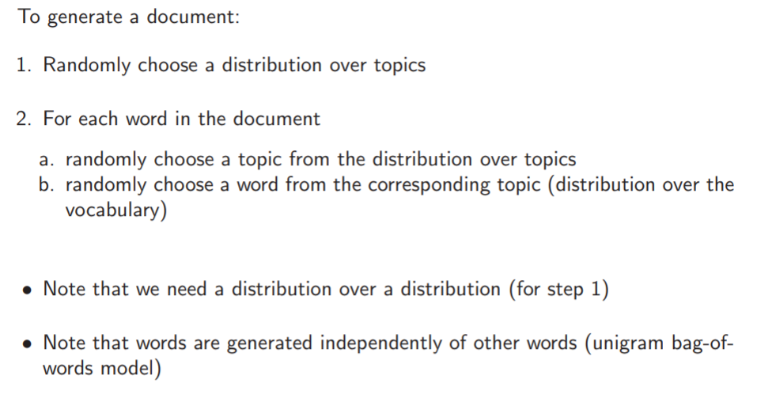
Now, let’s look at the generative process of LDA.
Documents
Terms
Topics

Slide 11
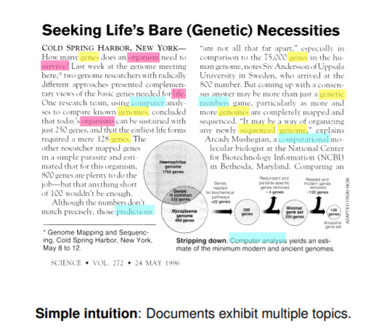
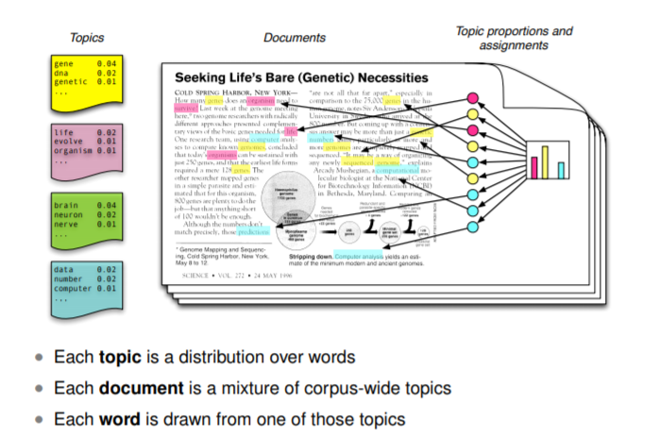
Documents → terms → topics

Slide 12
R-implementation
Are you with me so far?
Any questions are welcome.

Slide 13
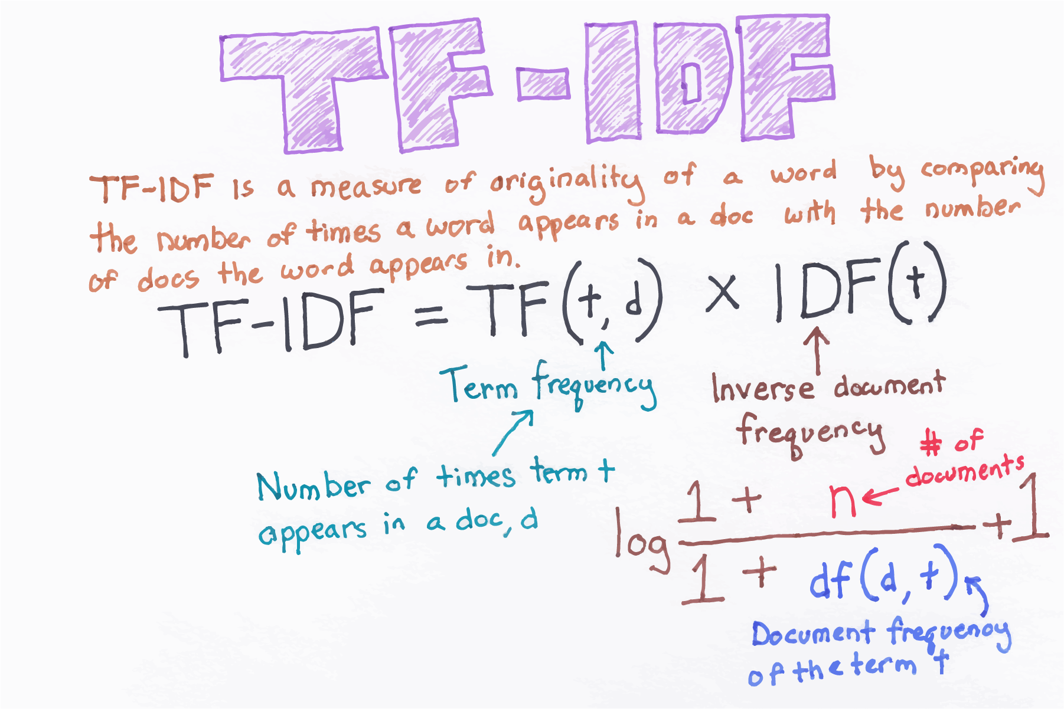
TF-IDF: one way of textual feature selection

Slide 14
Reference:
Online tutorial. https://www.cl.cam.ac.uk/teaching/1213/L101/clark_lectures/lect7.pdf
David Blei’s webpage is a good place to start
Intro to EM on Youtube https://www.youtube.com/watch?v=REypj2sy_5U
Blei, D. M., Ng, A. Y., & Jordan, M. I. (2003). Latent dirichlet allocation. Journal of machine Learning research, 3(Jan), 993-1022.
https://www.tidytextmining.com/topicmodeling.html

