Slide 1
Einstein and friends
Theory of relativity

Slide 2
Fundamental terms
Fundamental terms
Time
Spacetime
Time travel
Paradoxes

Slide 3
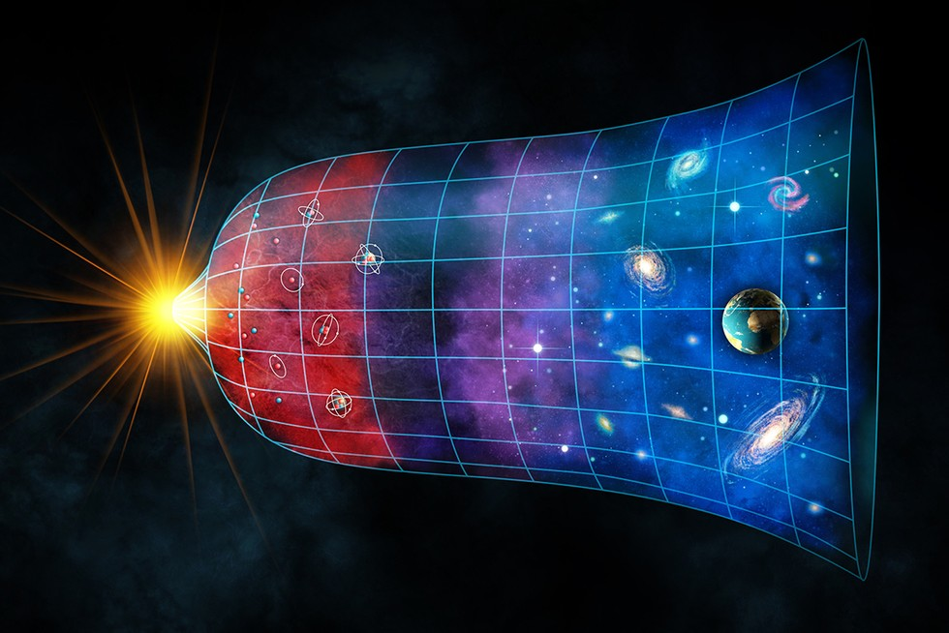
Fundamental terms
s = v.t
c = 299,792,458 m/s ~ 300,000 km/s
Universe expansion

Slide 4
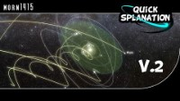
Fundamental terms

Slide 5
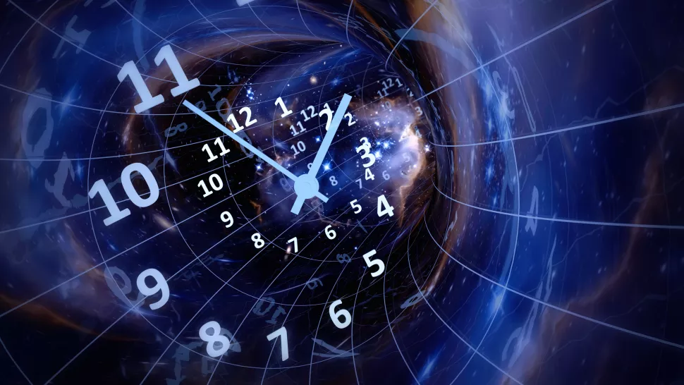
Time

Slide 6
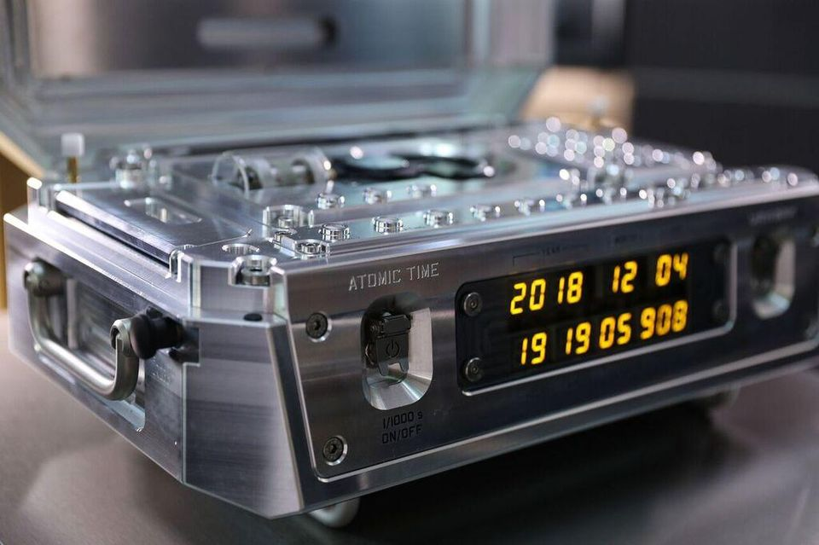
Time

Slide 7
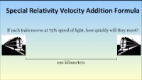
Time

Slide 8

Time

Slide 9

Spacetime

Slide 10
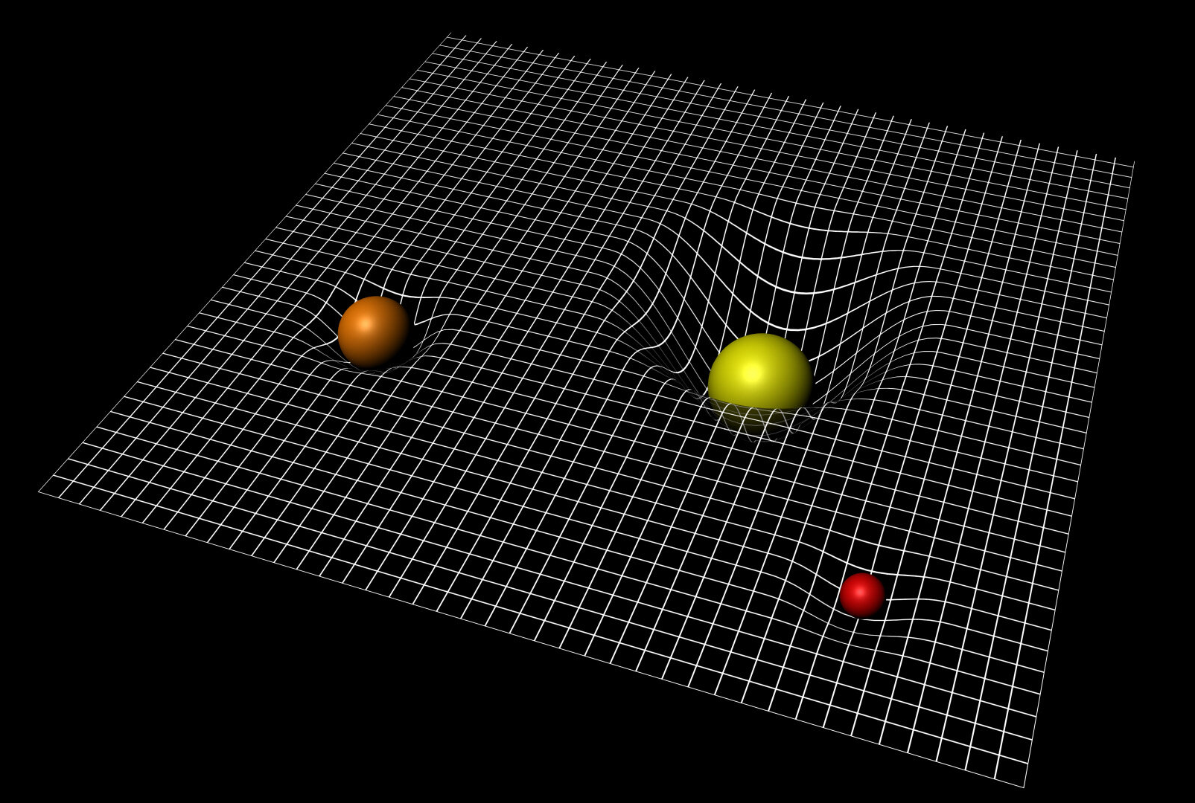
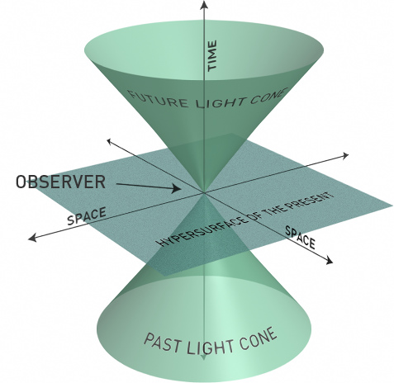
Spacetime

Slide 11
Time travel

Slide 12

Past, Present Future ???

Slide 13
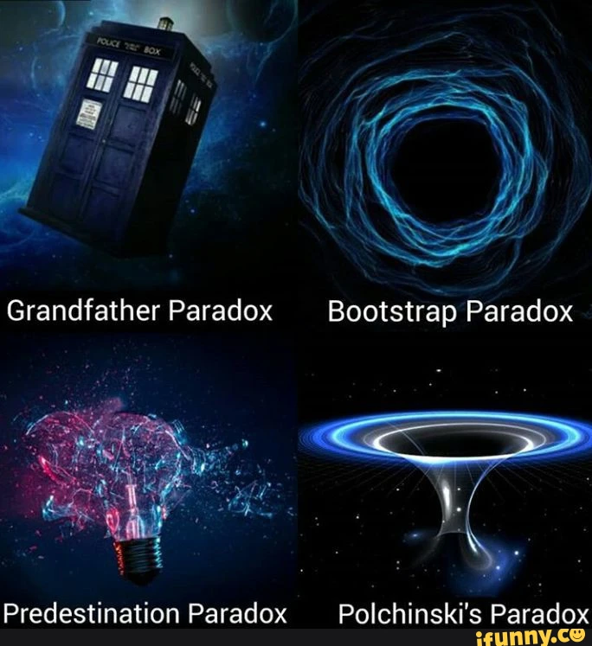
Paradoxes

