Slide 1
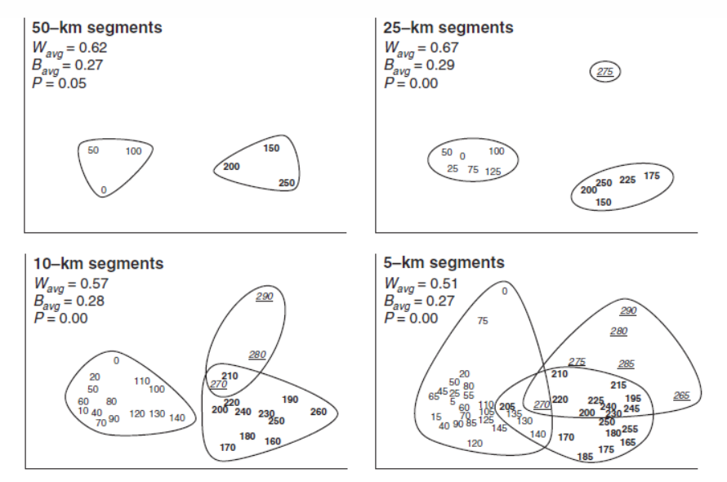

Slide 2
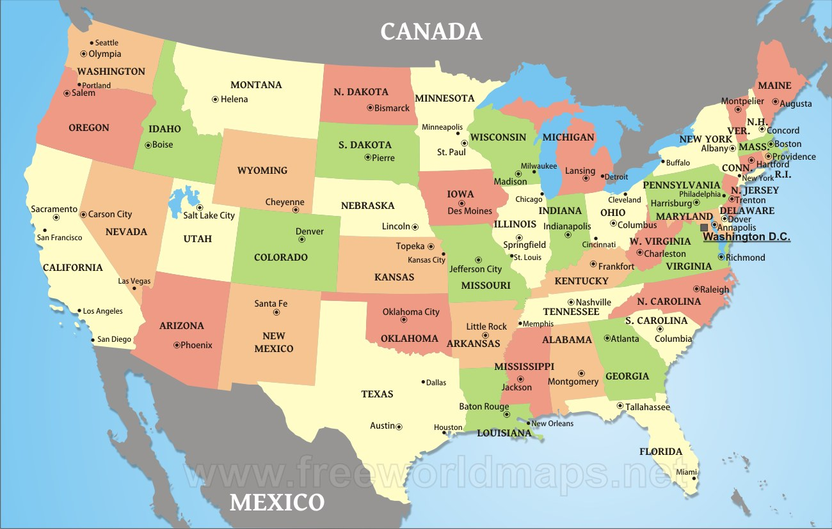

Slide 3
Multidimensional Scaling
Distance matrix (km)

Slide 4

Multidimensional Scaling
Distance matrix (km)
1000 km
Chicago
Atlanta
Richmond
Miami

Slide 5
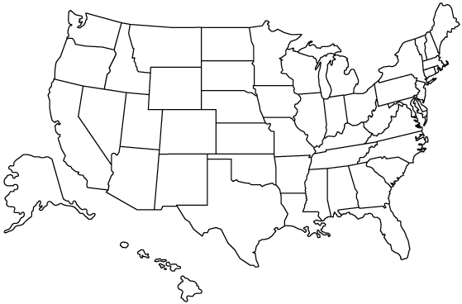
Multidimensional Scaling
Chicago
Atlanta
Richmond
Miami

Slide 6
Multidimensional Scaling
Chicago
Atlanta
Richmond
Miami

Slide 7
Let’s try this in R…

Slide 8
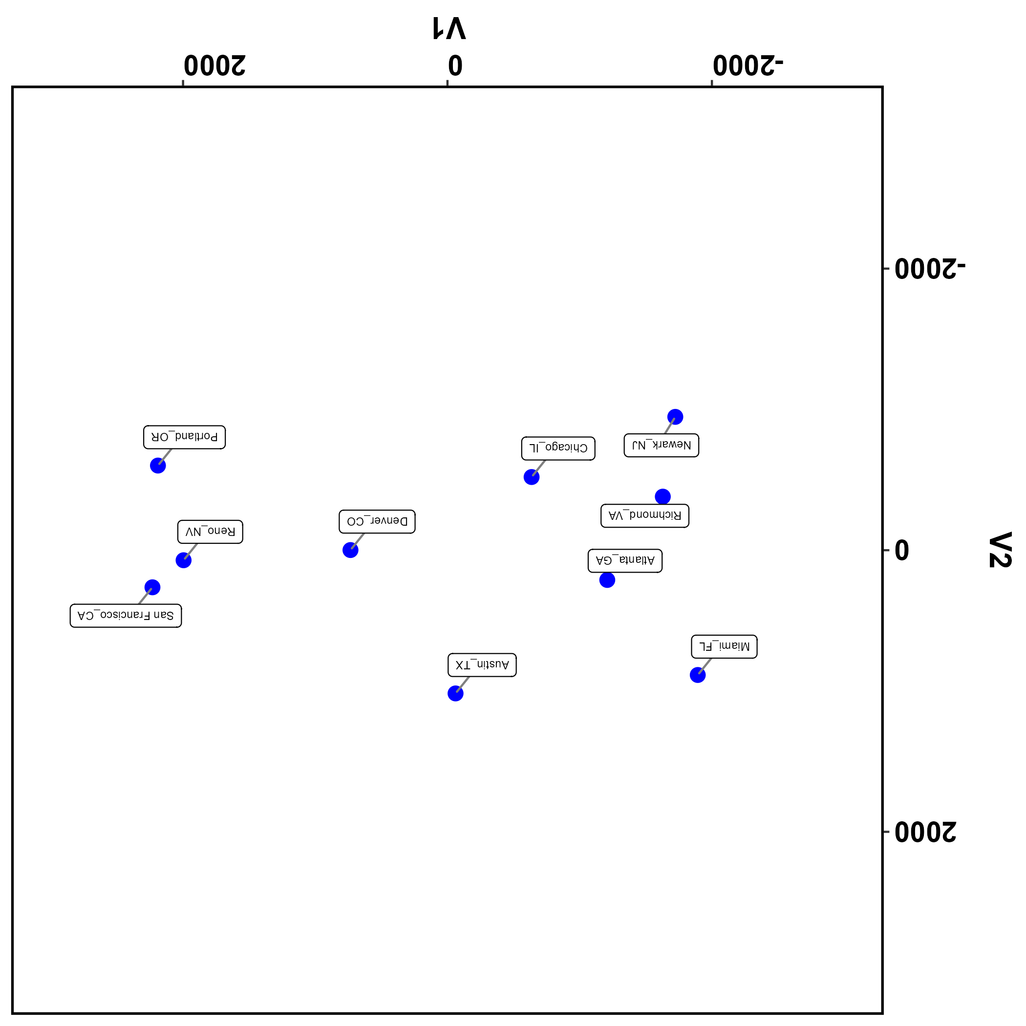
Notes:
You cannot interpret MDS axes.

Slide 9
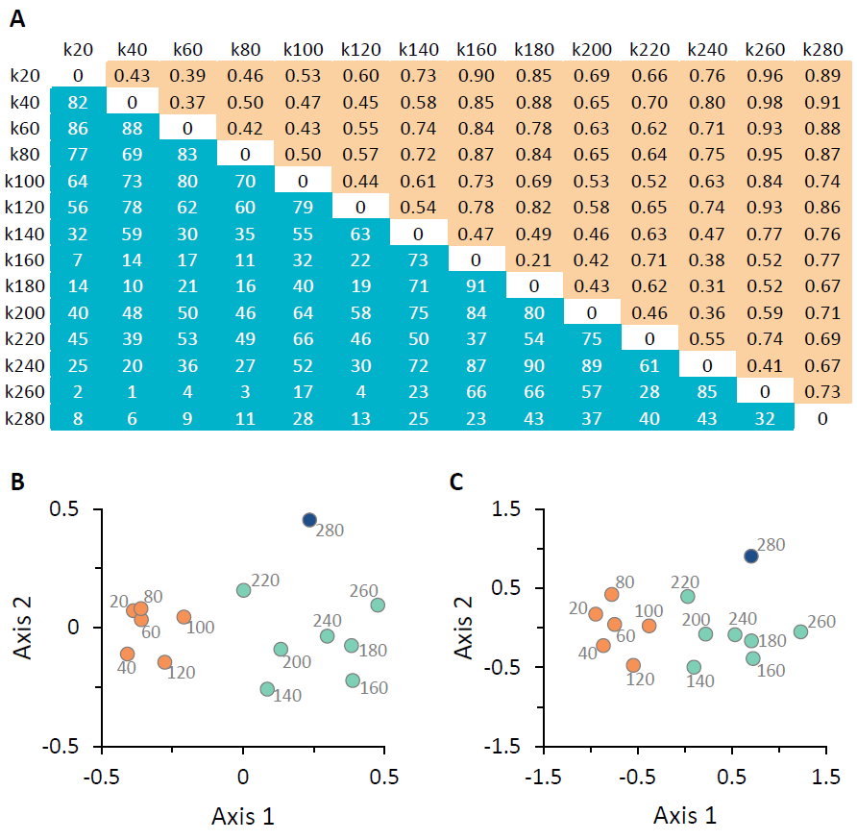
Metric vs. Nonmetric MDS
Multidimensional scaling (MDS) results for fish assemblage samples from the Cahaba River, Alabama. Panel A shows the Bray-Curtis dissimilarity matrix for 14 sample sites, organized along a longitudinal gradient and identified by river kilometer. Values in the upper-right diagonal (peach shading) are the pairwise Bray-Curtis dissimilarities. Values in the lower-left diagonal (blue shading) are ranked values, with rank 1 (k40 vs. k260) indicating the largest dissimilarity. Panel B shows the metric MDS ordination plot, built from the Bray-Curtis dissimilarity values. Panel C shows the nonmetric MDS ordination plot, built from the ranked dissimilarity values. In both ordination plots, numbers are used to identify samples (corresponding to river km values) and colors reflect longitudinal clustering: orange points are lower, mainstem samples, blue-green points are mid-reach samples, and dark blue points are headwater samples.

Slide 10
Distance matrix (km)

Slide 11
How do we build a distance matrix from traditional ecological community data (i.e., species’ counts at study sites)?
Site | SpeciesA | SpeciesB | SpeciesC | SpeciesD | SpeciesE | SpeciesF | SpeciesG | SpeciesH | SpeciesI | SpeciesJ
Site1 | 0 | 23 | 0 | 0 | 0 | 98 | 98 | 0 | 0 | 0
Site2 | 0 | 93 | 0 | 0 | 0 | 28 | 6 | 0 | 61 | 0
Site3 | 0 | 0 | 54 | 55 | 98 | 0 | 7 | 0 | 0 | 57
Site4 | 15 | 94 | 0 | 69 | 0 | 17 | 5 | 0 | 15 | 0
Site5 | 0 | 0 | 22 | 0 | 0 | 23 | 0 | 0 | 49 | 27
Site6 | 0 | 0 | 44 | 99 | 93 | 3 | 99 | 45 | 0 | 90
Site7 | 0 | 37 | 0 | 0 | 73 | 73 | 84 | 50 | 17 | 0
Site8 | 0 | 39 | 0 | 66 | 0 | 64 | 31 | 0 | 35 | 0
Site9 | 0 | 19 | 0 | 0 | 93 | 0 | 71 | 99 | 0 | 0
Site10 | 44 | 0 | 0 | 31 | 0 | 31 | 0 | 55 | 68 | 0

Slide 12

Distance / Dissimilarity Measures - binary data -
Jaccard dissimilarity
$$dissimilarity= \frac{b+c}{a+b+c}$$
where a is the number of species-pairs found at BOTH sites 1 & 2, b is the number of species unique to site 1,and c is the number of species unique to site 2.
Site | Sp. A | Sp. B | Sp. C | Sp. D | Sp. E
Site 1 | 1 | 0 | 1 | 0 | 1
Site 2 | 1 | 1 | 1 | 0 | 0
Jaccard dissimilarity = 2/4 = 0.5

Slide 13
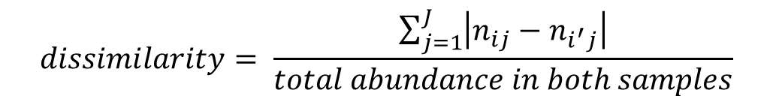
Distance / Dissimilarity Measures - abundance data -
Bray-Curtis dissimilarity
$$dissimilarity= \frac{\sum_{j=1}^{J}{\left|n_{ij}−n_{i^{′}j}\right|}}{total abundance in both samples}$$
where n_{ij} is the abundance of the j^{th} species in sample i, and n_{i’j} is the abundance of the j^{th} species in sample i’.
Site | Sp. A | Sp. B | Sp. C | Sp. D | Sp. E
Site 1 | 11 | 0 | 7 | 8 | 0
Site 2 | 24 | 37 | 5 | 18 | 1
B-C dissimilarity = 63/111 = 0.568

Slide 14
Back to R…

Slide 15
Monte Carlo tests

Slide 16
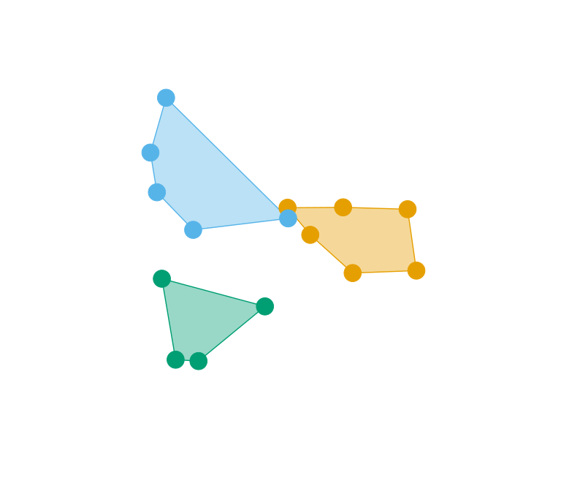
NMDS insects
Posey Creek, VA
Seasonal overlap ≈ 0
Is the observed overlap
(or lack thereof)
significant?

Slide 17
NMDS insects
Posey Creek, VA
Seasonal overlap ≈ 0
Is the observed overlap
less than what we would
observe if the samples
were distributed at random?

Slide 18
Monte Carlo test
Randomly shuffle the
individual samples
many times.

Slide 19
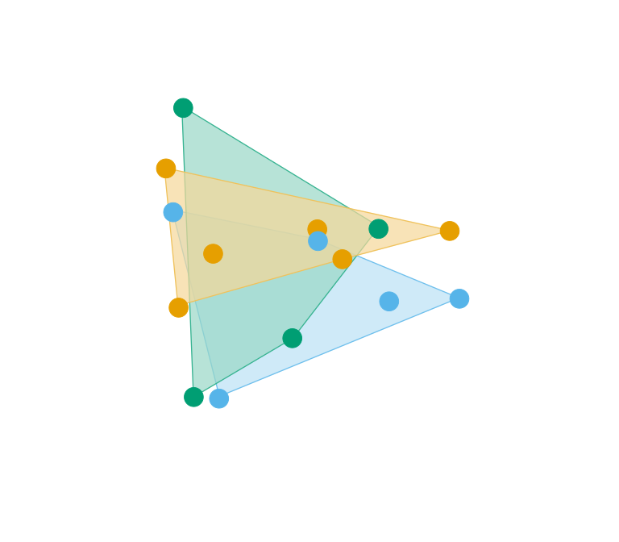
Monte Carlo test
Randomly shuffle the
individual samples
many times.
Each time, measure the
overlap and compare
with observed overlap.

Slide 20
Observed
Randomized
P-value = # times the randomized overlap ≤ true (observed) overlap.

Slide 21
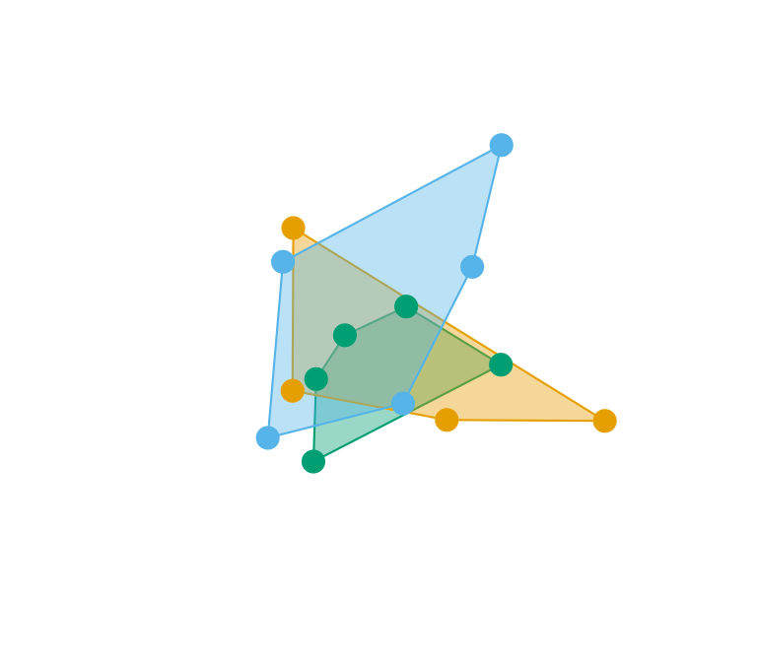
NMDS insects
Lewis Run, VA

