Slide 1
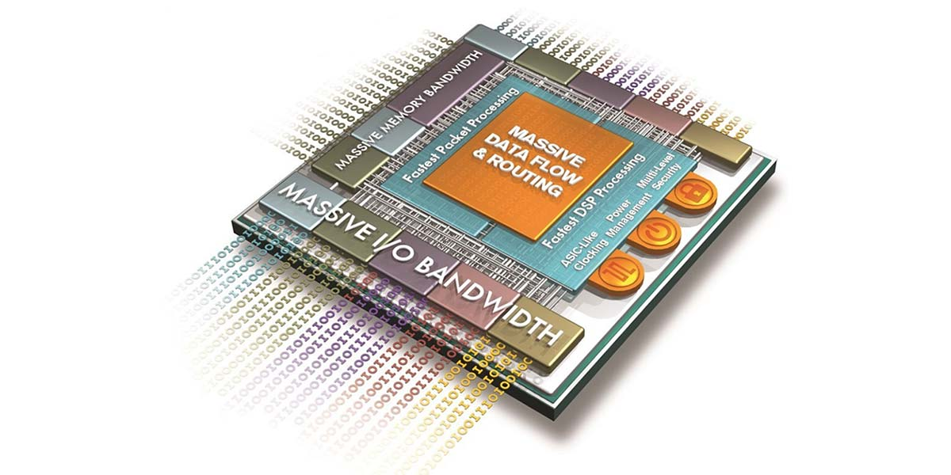

WHAT EVERY DEVELOPER NEEDS TO KNOW ABOUT FIRMWARE With Form Wizards And The Open Tools API
NIGEL TAVENDALE
www.allthingssyslog.com

Slide 2
Code Samples
https://github.com/ntavendale/Ekon29

Slide 3

Application Specific Integrated Circuits (ASIC)
Custom designed and built for specific purpose
High Performance.
Can be engineered to consume less power.
Small size.
Difficult to reverse engineer
Fast. Can be clocked at very high rates.
Usually have their own drivers.
Very high setup costs. Only cost effective for large production runs, but cost effective at scale.
Design is permanent and cannot be revised.
Any bug is going to be very expensive to fix - if it’s even feasible.

Slide 4
Field Programmable Gate Arrays (FPGAs)
Programmable. One FPGA can be reprogrammed for different purposes.
Bug fixes are easier to deploy. Don’t have to replace chip – only bit file it is loaded with.
Much more cost effective at low production numbers.
Setup costs are the design software and the time to do the design.
Per chip cost is more expensive ( large, high speed FPGA chips can run to $100K+)
Power consumption is generally higher.
Larger form factor – take up more space on PCB.
Lower performance – ASICs can generally be clocked faster
Finite resources – only so many gates, blocks, flip flops etc.

Slide 5




Field Programmable Gate Arrays (FPGAs)
(AMD)
52 %
(Intel)
35 %
5 %
5 %
Others (inc. Cologne Chip AG)
3 %

Slide 6

Things To Remember
Everything firmware needs you have to supply it with.
Everything all the time in parallel.
architecture Behavioral of Example is
signal r_Input : std_logic := '0';
signal r_Output : std_logic;
begin
if rising_edge(clock_signal) then
r_Input <= '1';
r_Output <= r_Input;
end if;
end Behavioral;
r_Input = '1';
r_Output = '0';
r_Input = '1'
r_Output = '1'

Slide 7
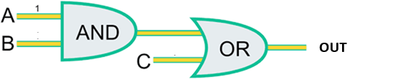
Defining Logic – Lookup Tables
Out = (A * B) + C
A B C Out
0 0 0 0
0 0 1 1
0 1 0 0
0 1 1 1
1 0 0 0
1 0 1 1
1 1 0 1
1 1 1 1
Address
Data
Lookup tables are like RAM, not circuits
Lookup table output always reflects inputs – regardless of clock.

Slide 8
Storing Data – Registers
0
1
0
0
0
1
D
Q
D
Q
D
Q
D
Q
_
Q
_
Q
_
Q
_
Q
Clk
Clk
Clk
Clk
Clk
0
1
1
0
std_logic_vector(3 downto 0);
FPGA registers can be any length!
std_logic_vector(9 downto 0);
std_logic_vector(24 downto 0);

Slide 9
Building Your FPGA – Hardware Description Languages
VHDL: VHSIC Hardware Description Language.
Verilog
architecture Behavioral of Example is
signal r_Input : std_logic := '0';
signal r_Output : std_logic;
begin
if rising_edge(clock_signal) then
r_Input <= '1’;
r_Output <= r_Input;
end if;
end Behavioral;
wire r_Input;
wire r_Output;
assign r_input = 0’b1;
always @(posedge clock_signal)
begin
r_Input <= 1’b1;
r_Output <= r_Input;
end

Slide 10
Building Your FPGA – Hardware Description Languages
VHDL: VHSIC Hardware Description Language.
Verilog
Deterministic
Strongly Typed
Weakly typed
Concise
Used By
Used By
Academia
Defense Industries
Popular in Europe
Non-defense industries
More popular in US

Slide 11
Finite State Machines Are Your Best Friends
Idle
Everywhere in firmware designs
Cleanup
Start Bit
Needed for sequential operations
Stop Bit
Communications
Control Logic
Data Bit

Slide 12
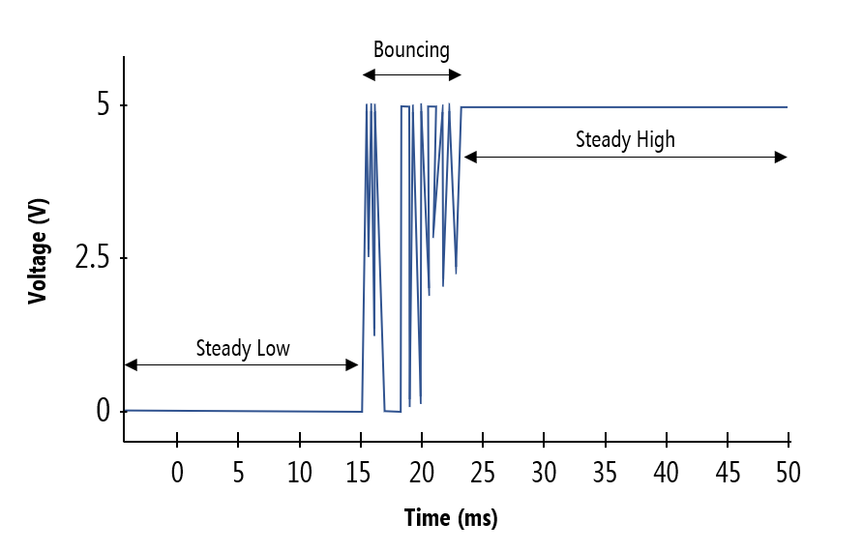
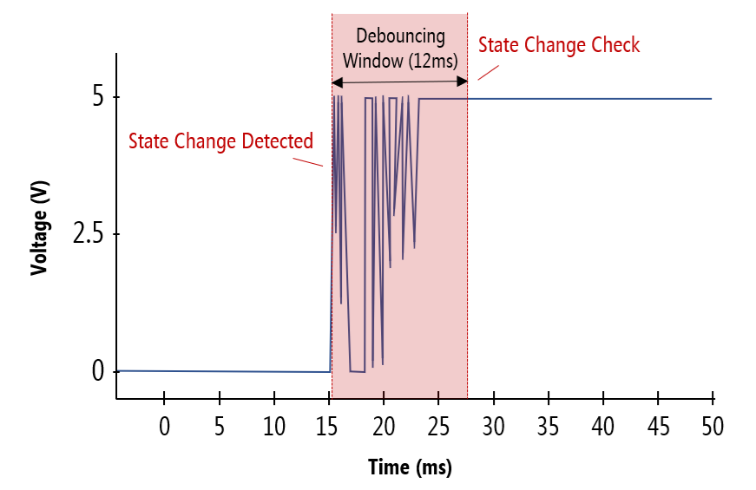
User Input - Debouncing
entity Debounce_Filter is
generic (DEBOUNCE_LIMIT : integer := 12000);
port ( i_Clk_Signal : in std_logic;
i_User_Input : in std_logic;
o_Debounced : out std_logic );
end entity Debounce_Filter;
architecture RTL of Debounce_Filter is
signal r_Count : integer range 0 to DEBOUNCE_LIMIT := 0;
signal r_State : std_logic := '0’;
begin
process (i_Clk_Signal) is begin
-- change our state on rising edge
if rising_edge(i_Clk_Signal) then
if (i_User_Input /= r_State and r_Count < DEBOUNCE_LIMIT - 1) then
r_Count <= r_Count + 1;
elsif r_count = DEBOUNCE_LIMIT -1 then
r_State <= i_User_Input;
r_Count <= 0;
else
r_Count <= 0;
end if;
end if;
end process;
-- tie state to output output signal
o_Debounced <= r_State;
end architecture RTL;

Slide 13
Software Input - UART
Universal Asynchronous Receiver/Transmitter
AKA: RS232, Serial COM
Most common way to communicate with firmware from your application.
Some custom firmware boards will use drivers and register writes.
TurboPower AsyncPro available through GetIt.

Slide 14
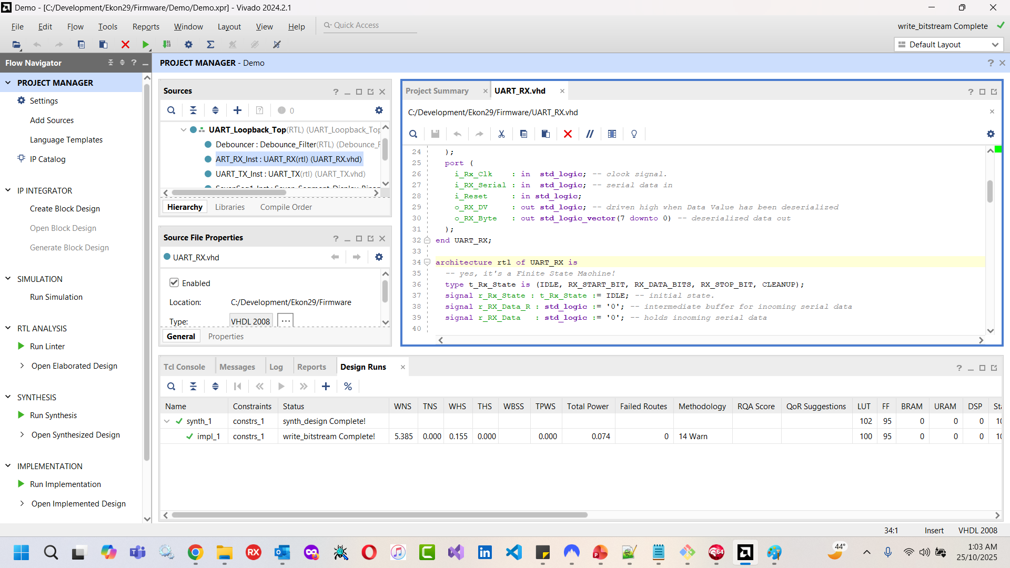
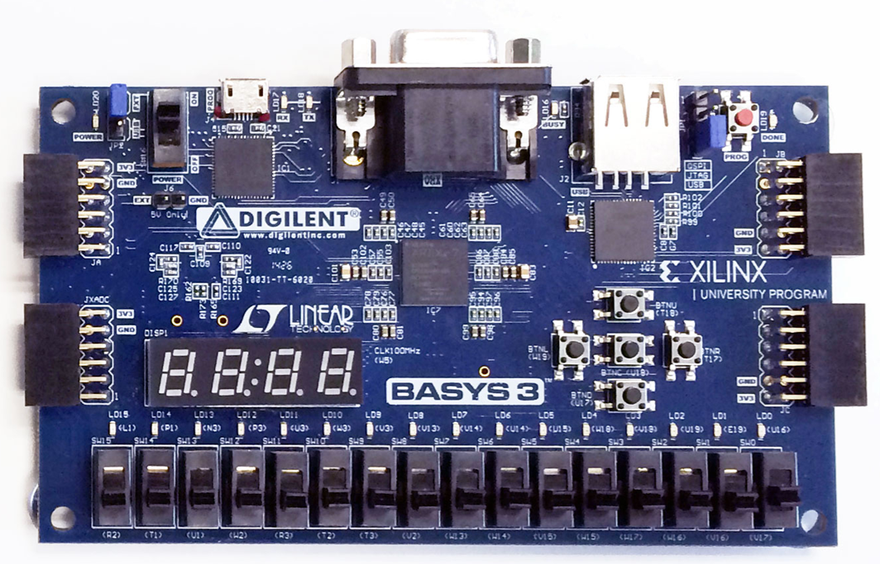
Getting Started
Vivado
Free for basic FPGAs (Artix & Virtex)
Full suite of simulation/debug tools
Development Board
~ €120,00

Slide 15

Further Reading
https://www.nandland.com (NOTE: Uese lattice, not Xilinx, but most samples work unless using 7 segment display)
https://www.fpga4student.com/ (Sample projects in VHDL and Verilog)
https://www.digelent.com/ (Almost all sample projects in Verilog only, but documentation for boards is excellent!)
NIGEL TAVENDALE
nigel.tavendale@allthingssyslog.com
www.allthingssyslog.com
https://www.linkedin.com/in/nigel-tavendale-2a6a723

