Slide 1

Unit Testing For Delphi With Form Wizards And The Open Tools API
NIGEL TAVENDALE
www.allthingssyslog.com

Slide 2
Code Samples
https://github.com/ntavendale/Ekon29

Slide 3

Agenda
CustomTestCaseSource attribute – implementing tests over a range of values.
Test case providers.
External data sources for tests.
Customized logging
Include/Exclude test cases.

Slide 4
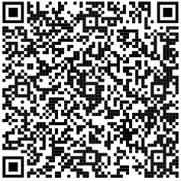
NIGEL TAVENDALE
nigel.tavendale @ allthingssyslog.com
www.allthingssyslog.com
https://www.linkedin.com/in/nigel-tavendale-2a6a723

