Slide 1

COMPANIONI-BRITO.CALIBJO.NTAMBAAZI
ProJect
JPEG ENCODER FOR .AVI VIDEO
&
CODING
COMPRESSION
OF MEDIA DATA

Slide 2
COMPANIONI-BRITO.CALIBJO.NTAMBAAZI
Requires the implementation of JPEG encoder for .avi video, and application of JPEG compression on extracted frames of the video
Encoder should work on the principles of JPEG and each step of the encoder process should be coded as separate function
DescriPtion
JPEG ENCODER FOR .AVI VIDEO
Notes:
The tasks involve creation of GUI, loading of .avi video on the GUI, playing (and/ or preview) the video, extraction of a frame from the video while showing the step by step process of JPEG encoder, and application of JPEG encoder on the full video. The step by step process of JPEG encoder should allow the user to input the frame number to extract, display the extracted frame, apply JPEG encoder on the extracted frame, show all the intermediate steps of the encoder process on the GUI such as colour conversion, DCT, quantization, and save the compressed frame on the disk. At the end of the compression process, the evaluation rate (bit/pixel) and distortion (RMS error) before and after the compression will be evaluated.

Slide 3
COMPANIONI-BRITO.CALIBJO.NTAMBAAZI
CCProjectUserManual_CIMET.pdf
jpeg_project\CCProjectGUI.m
JPEG Encoder
JPEG ENCODER FOR .AVI VIDEO
Notes:
Read page 3-4 of user’s manual and open matlab scripts for demonstration.

Slide 4
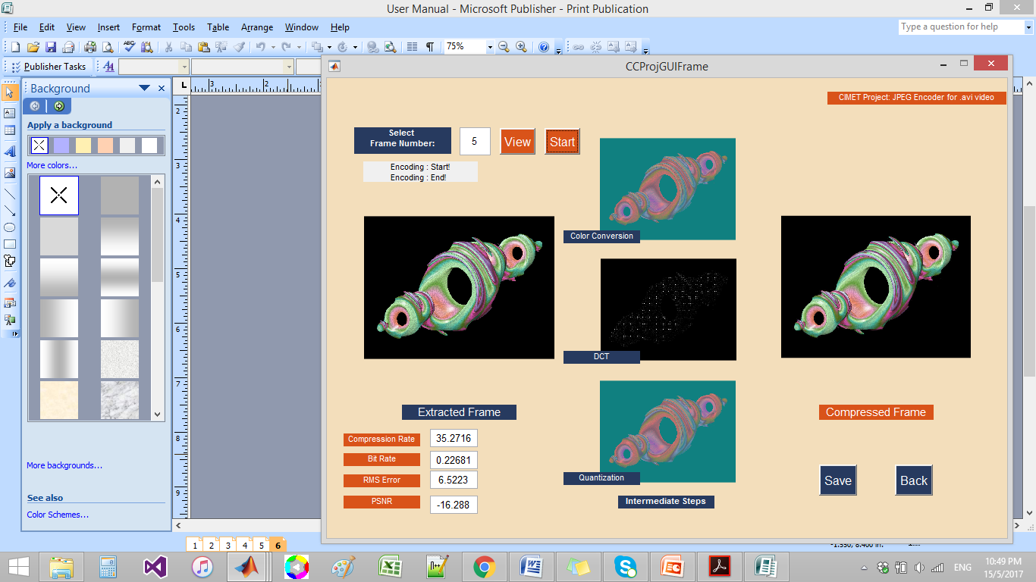
COMPANIONI-BRITO.CALIBJO.NTAMBAAZI
JPEG Encoder
JPEG ENCODER FOR .AVI VIDEO
Notes:
The following step-by-step process of JPEG encoder:
1. Color conversion and chroma subsampling – convert color images to a luminance-chrominance color space, YCbCr.
An image uses RGB color space and to allow different processing on the luminance and chroma channels, the RGB image will be converted to YCbCr color space. YCbCr has three components namely, Y for luminance, Cb for blue chrominance, and Cr for red chrominance. Due to different sensitivity of the rods and cones of the eye, some information is not as important as the others. Some information represented by Cb and Cr can be discarded or sub-sampled through compression.
2. DCT on image blocks – this process divides the image into 8x8 blocks and applies 2D DCT to each image block with DCT coefficients as output for each block. However, using blocks and isolating each block from its neighboring context can result to choppy or blocky JPEG images when a high compression ratio is utilized.
3. Quantization – introduces loss in JPEG compression and it also maximizes the compression ratio while minimizing the perceptual losses in JPEG compressed images using the Luminance and Chrominance Quantization tables.
4. Zig-zag ordering and Run-length Encoding – turns the 8x8 matrix into a 64-vector. The Run-length coding will be used for AC coefficients and Differential Pulse Code Modulation for DC Coefficients.
5. Entropy coding – in this step, the DC and AC coefficients will finally undergo an entropy coding step for further compression. Huffman coding will be used for the project.

Slide 5
COMPANIONI-BRITO.CALIBJO.NTAMBAAZI
Evaluation Criteria:
Evaluation
JPEG ENCODER FOR .AVI VIDEO
Notes:
To evaluate the efficiency of the JPEG encoder, the compression ratio, peak signal-to-noise ratio (PSNR), and root-mean-square error (RMS error) will be computed. Compression ratio will measure the reduction in size after running the JPEG encoder algorithm. It is equal to the number of bits of final file divided by number of bits of the original file. PSNR will measure the quality of the compression algorithm or the compressed image. A higher PSNR will usually indicate a higher quality of compression. RMS error will measure the efficiency of the compression algorithm based on the compressed and original images. Thank you.

