Slide 1
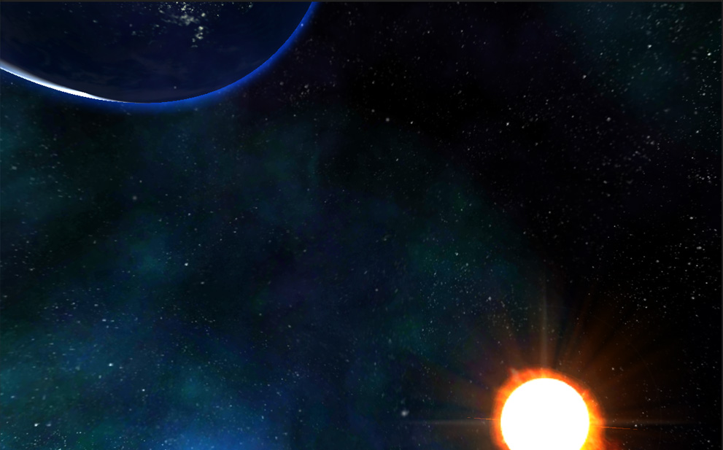
COSMO NOVA
Imperial greed

Slide 2
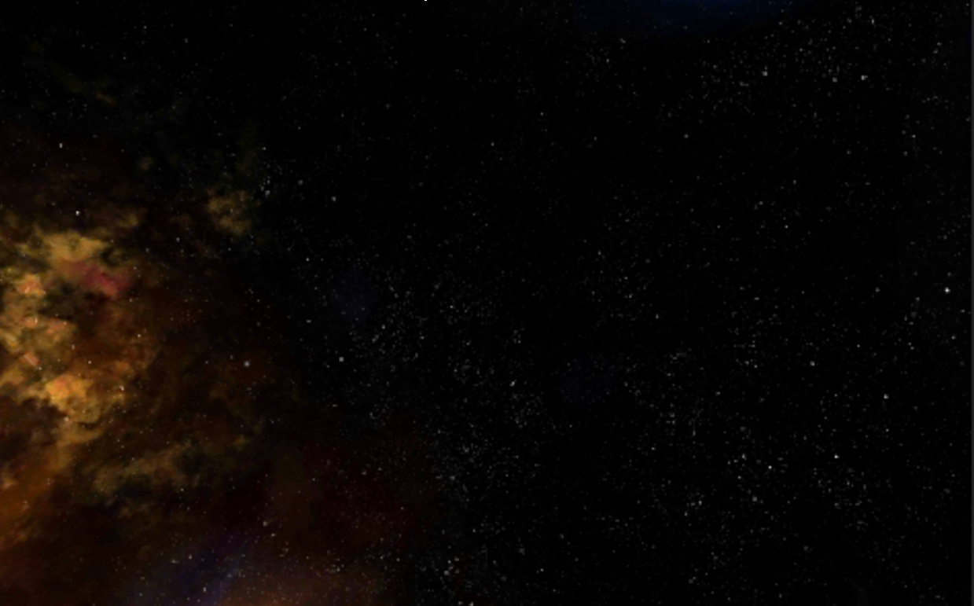
Introduction
Our product
Attractions
Cosmo Nova: Imperial Greed. With polished 3D graphics, the game lives up fierce space battles in a far future when greedy humankind fights each other for energy and resources.
The epic and heroic feeling when player directly controls the mothership fighting against thousands of enemy ships in vast 3D space.
In addition, players can use bluetooth or wifi to play together in a breathetaking arms race to quell the Imperial expansionism.

Slide 3
Introduction
The difference
The innovation
A multiplayer game that simulates thousands of 3D spacecrafts in a realtime consistent world is still rare on mobile-game stores.
The epic number of spacecrafts in a big scene.
Many fierce battles occur in realtime in one single big scene.
The realtime multiplayer with such epic number of units.
Players can play the game with just simple touches.
Realtime multiplayer. No need to wait others turn-by-turn.
The game demonstrates excellent graphics and computational capabilities of Windows Phone devices by simulating thousands of spacecraft objects in realtime total war.

Slide 4
Information Architecture
New round
Setup scenario
Start game
Player profile
Profile details
Settings
Fleet equipments
Statistics
Leaderboard
Achivements
Shop
In-app purchases

Slide 5
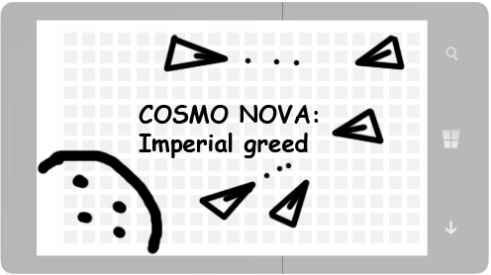
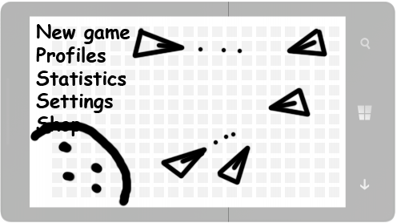
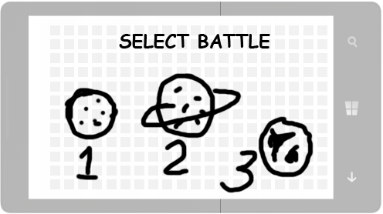

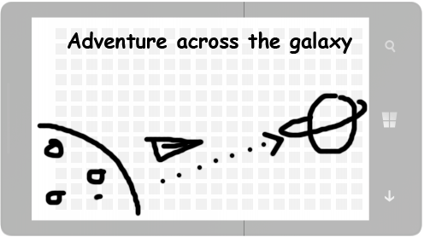
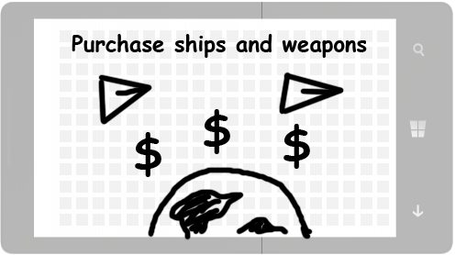
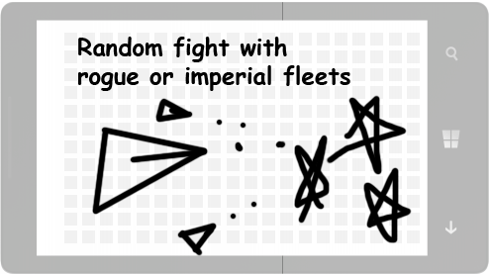
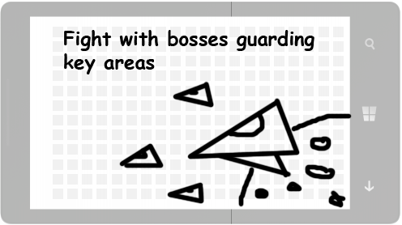
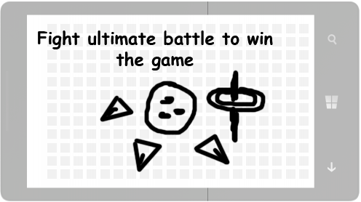
Storyboard

