Slide 1
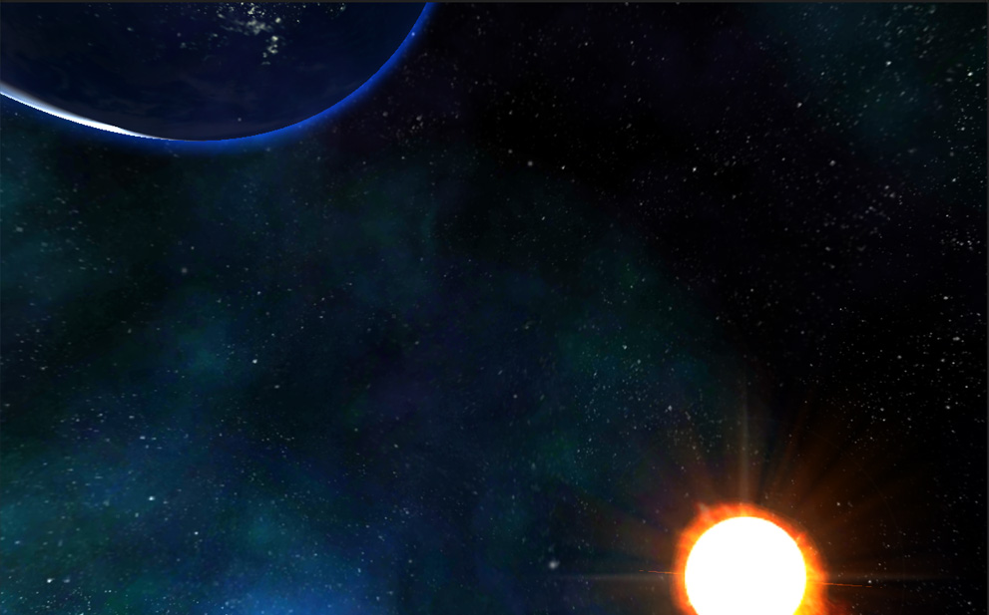
COSMO NOVA
Imperial greed

Slide 2
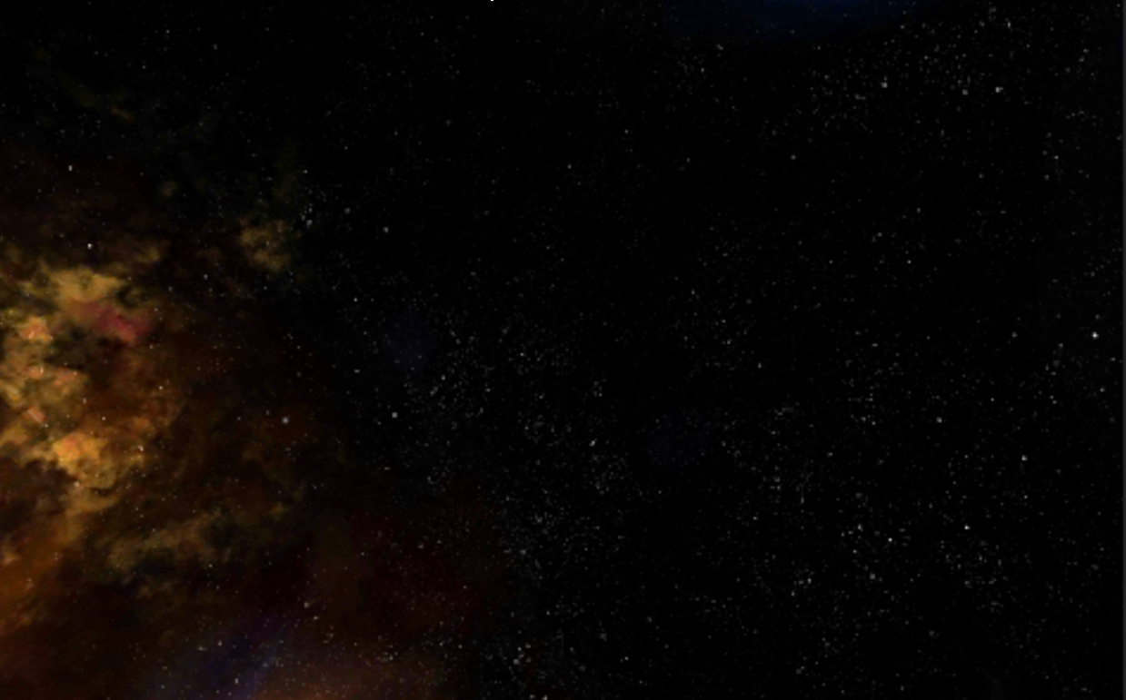
Introduction
Our product
Attractions
Cosmo Nova: Imperial Greed. With polished 3D graphics, the game lives up fierce space battles in a far future when greedy humankind fights each other for energy and resources.
Target platforms: Windows 8 and Windows Phone 8.
The epic and heroic feeling when player directly controls the mothership fighting against hundreds of enemy ships in vast 3D space.
In addition, players can use bluetooth or wifi to play together in a breathetaking arms-race to quell the Imperial expansionism.

Slide 3
Introduction
The difference
The innovation
A multiplayer game that simulates thousands of 3D spacecrafts in a realtime consistent world is still rare on mobile-game stores.
The epic number of spacecrafts in a big scene.
Many fierce battles occur in realtime in one single big scene.
The realtime multiplayer with such epic number of units.
Players can play the game with just simple touches.
Realtime multiplayer with online competition.
The game demonstrates excellent graphics and computational capabilities of Windows Phone devices by simulating thousands of spacecraft objects in realtime total war.

Slide 4
Information Architecture
New round
Setup scenario
Start game
Player profile
Profile details
Settings
Fleet equipments
Statistics
Leaderboard
Achivements
Shop
In-app purchases

Slide 5
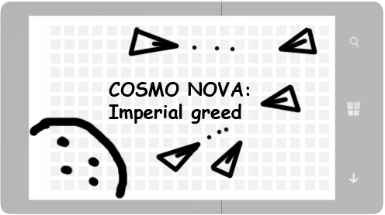
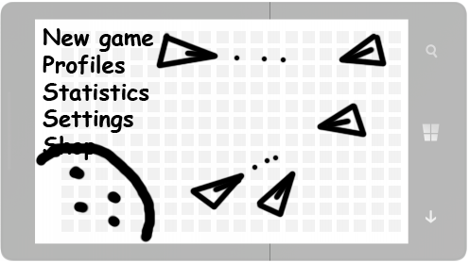
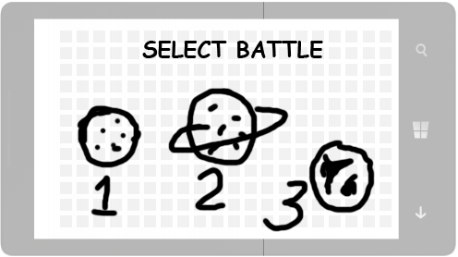
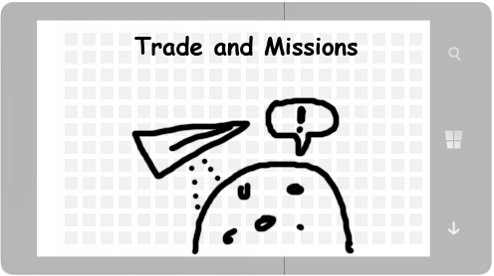
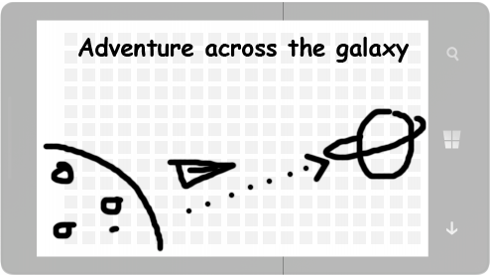
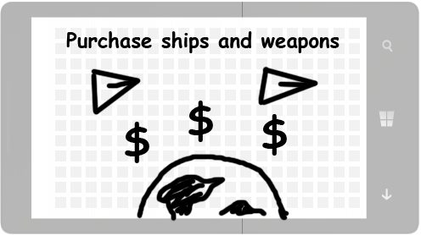
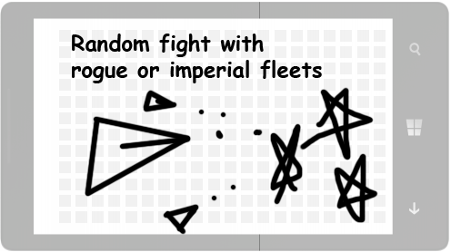
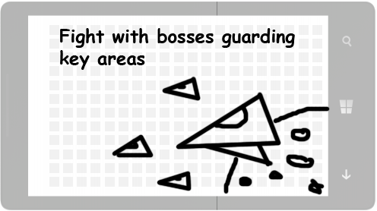
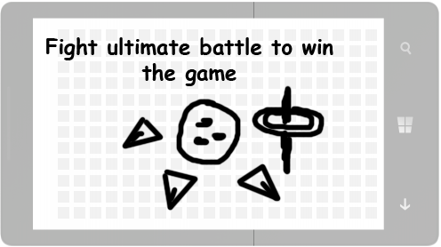
Storyboard

Slide 6
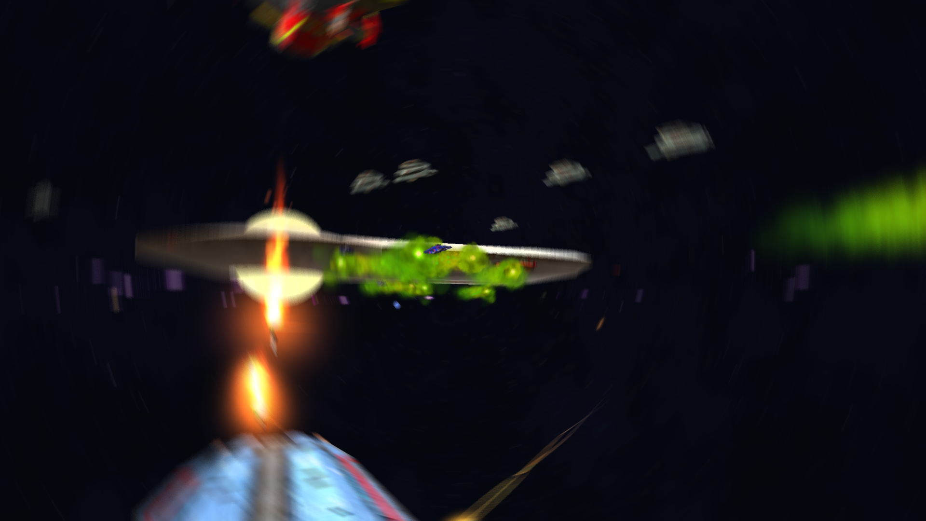
The demo
The demo runs on Windows.
Use mouse to aim, left click to shoot laser.
Press ESC to quit the game.
The demo is not yet a complete game, but it shows an epic battle, which is the core gameplay.

Slide 7
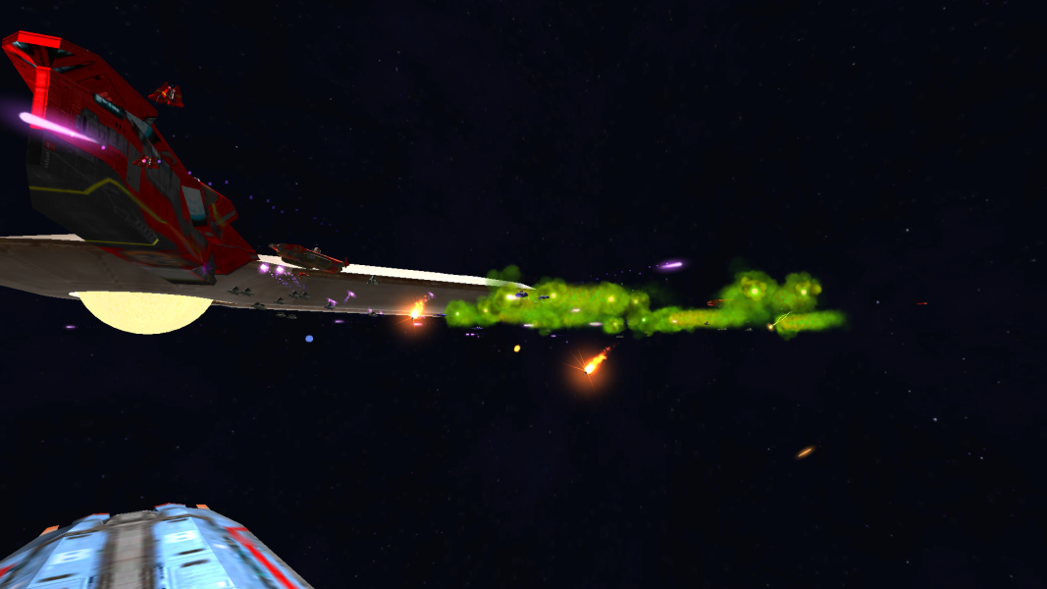
Epic battles, yet easy to play!
Hundreds of ships fighting one another in big space.
Player just aims the turret of mother ship and fire. The ship moves automatically to simplify the control.

Slide 8
Casual game but high quality !
Polished and shiny graphics.
3D sound effects.
High performance on Windows Phone devices.

Slide 9
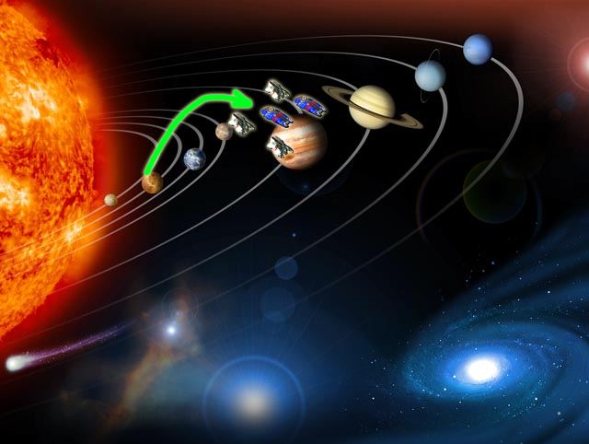
The game lives online
Players move their battle-fleet from planets to planets in a large cosmic adventure. Status of the planets is updated frequently online.

Slide 10
The economic fun
Players receive missions at planets. Accomplishing missions to earn credits.
Players use credits to purchase and upgrade ships.
With stronger fleets, players can explore deeper into space for fame and glory (to have their names in the leaderboard).
Players can buy credits with real money.

Slide 11
Danger and opportunities
Players can encounter random or designated battles everywhere in space.
The primary purpose of the game is to destroy bosses. Battles with bosses are not easy and require strong investment.
The game records player’s achievements and praise them on a polished leaderboard to encourage players to keep on playing.

Slide 12
Tricks and treats
Players can hinder others by releasing some of their ships as pirates. This provides the thrill of interacting with other players though indirectly.

Slide 13
Thank you for reading!
Please try the demo.

