Slide 1

PHPUnit
Testing PHP one unit at a time!
Hoang Son
Tuan Dung
12.7.2016

Slide 2
Agenda
Why Unit Test?
Why PHPUnit?
Installing PHPUnit
Writing Tests with PHPUnit
Best Practices for Writing Tests

Slide 3
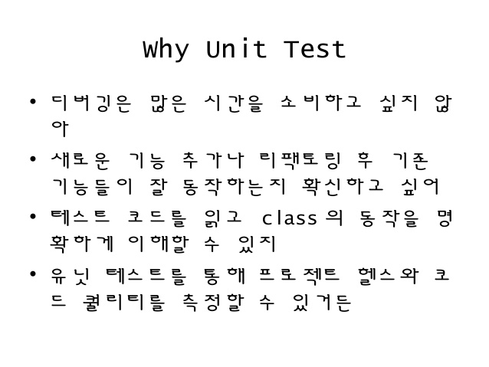

Slide 4
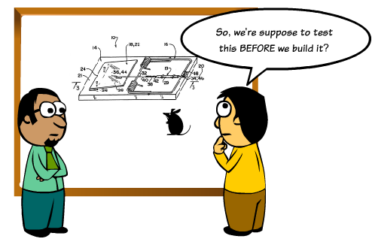
Why Unit Test?
Reduce Bugs
Good Documentation
Reduce the
Cost of Change
Help Refactoring Code
Improve Design
Save Development Time
Inspire Confidence

Slide 5
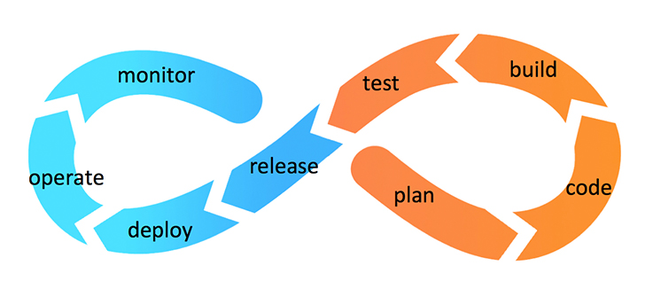
Why PHPUnit?
It’s the standard
Integrated in many IDE
Now coming with most frameworks
Works fine with every continuous integration
Actively maintained and adapted
Provides better code coverage reports

Slide 6

Installing PHPUnit
Traditional way - PEAR
pear channel-discover pear.phpunit.de
pear install phpunit/package_name
The new way - PHAR or composer
https://phpunit.de/manual/4.8/en/ installation.html

Slide 7
Writing Tests with PHPUnit
<?php
require_once 'PHPUnit/Framework.php';
class ArrayTest extends PHPUnit_Framework_TestCase
{
public function testNewArrayIsEmpty()
{
// Create the Array fixture.
$fixture = array();
// Assert that the size of the Array fixture is 0.
$this->assertEquals(0, sizeof($fixture));
}
public function testArrayContainsAnElement()
{
// Create the Array fixture.
$fixture = array();
// Add an element to the Array fixture.
$fixture[] = 'Element';
// Assert that the size of the Array fixture is 1.
$this->assertEquals(1, sizeof($fixture));
}
}
?>

Slide 8
Test classes are suffixed "Test", and should extend the class PHPUnit_Framework_TestCase.
Test methods are prefixed "test"
Inside the test methods, assertion methods such as assertEquals() are used to assert that an actual value matches an expected value.

Slide 9
Assertions
assertArrayHasKey
assertClassHas Attribute
assertContains
assertEquals
assertFalse
assertFileEquals
assertFileExists
assertGreaterThan
assertInstanceOf
assertLessThan
assertNan
assertNotNull
assertRegExp
assertSame
and many more!

Slide 10
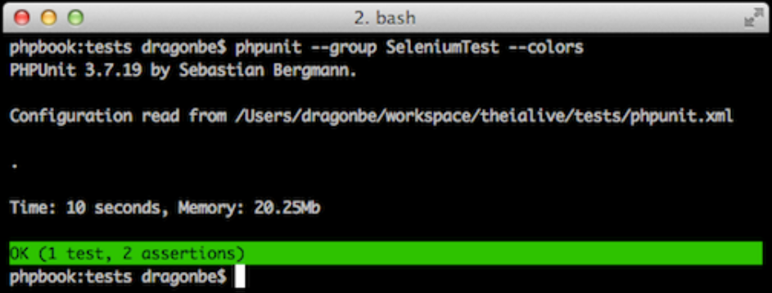
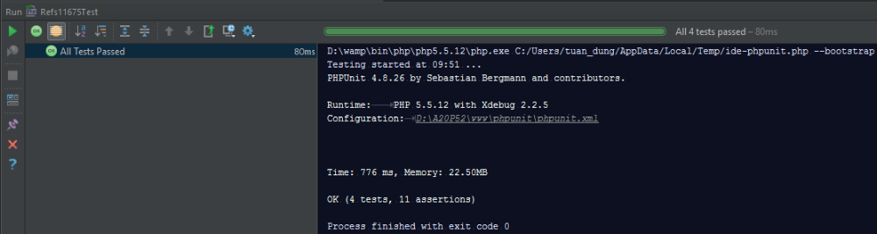
Running Tests
Tests can be run via:
Command Line
IDE
Continuous Integration

Slide 11
.
  Printed when the test succeeds
F
  Printed when an assertion fails
  while running the test method
E
  Printed when an error occurs
  while running the test method
S
  Printed when the test has been skipped
I
  Printed when the test is marked as being incomplete
  or not yet implemented

Slide 12
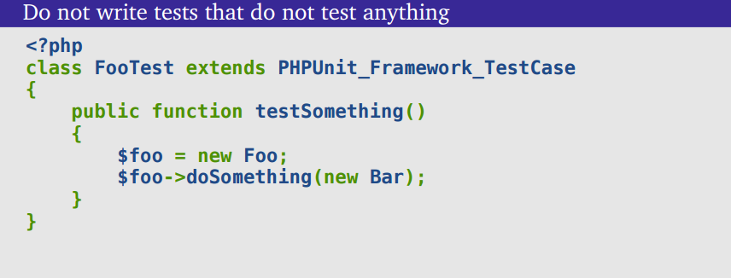
Best Practices for Writing Tests

Slide 13
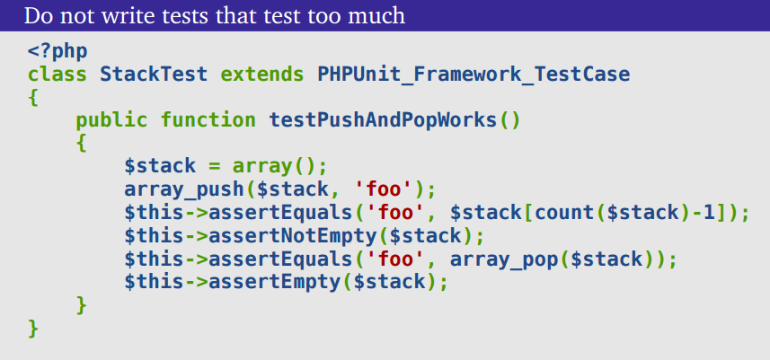
Best Practices for Writing Tests

Slide 14
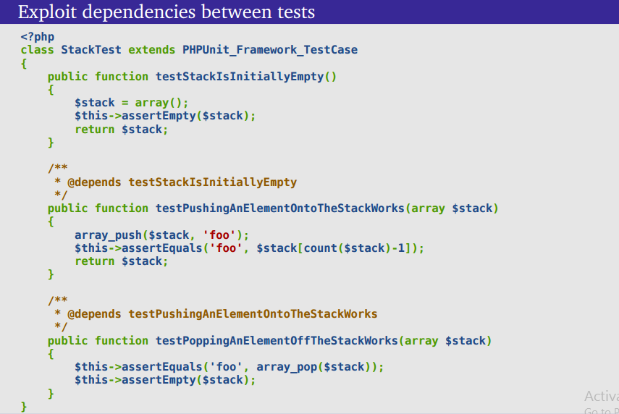

Slide 15
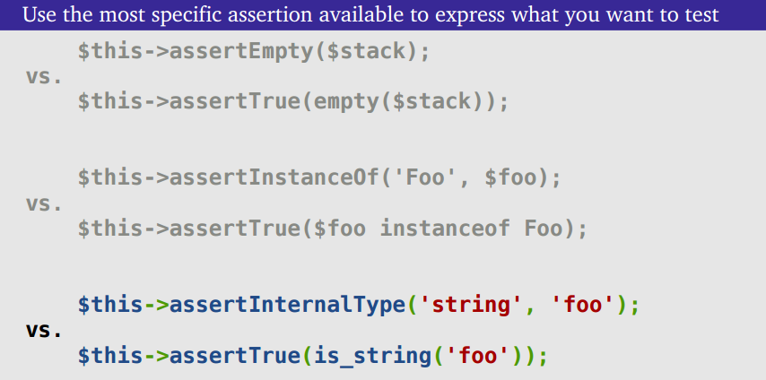
Best Practices for Writing Tests

Slide 16
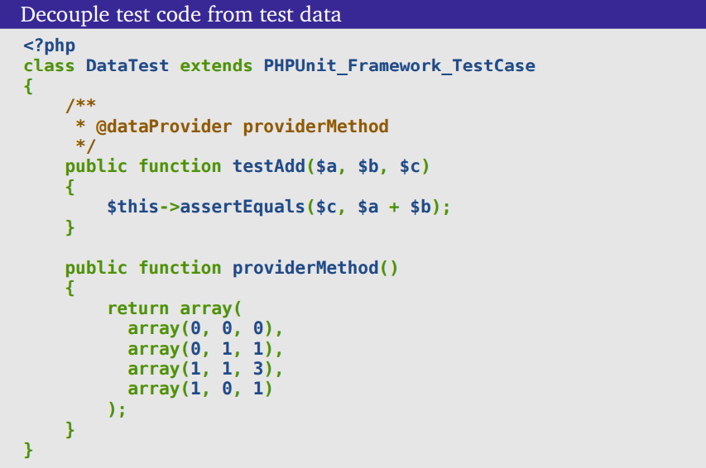

Slide 17
References
PHPUnit Manual
PHPUnit Best Practices
PHPUnit Best Practices (Video)
Testing Frameworks For PHP
Unit Test với PTPM
Giải thích về CI - Continuous Integration
Tổng quan về TDD - BDD

Slide 18


Questions?

