Slide 1


Brown Bag Sessions
Week 5
CQRS and Event Sourcing Design Pattern
Chris Ngo

Slide 2




Agenda
What is CQRS?
CQRS
CQRS Regular and Premium
CQRS and Event Sourcing

Slide 3
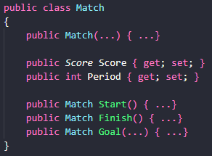
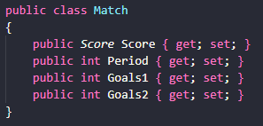
Common Patterns Why CQRS?
Great for commands
Great for queries
Requires fixes for persistence
Exposes behavior to presentation
No business rules in the class
Risk of getting into incongruent state
Notes:
Because of getter and setter

Slide 4
CQRS Definition
Command Query Responsibility Segregation
Command
Alter state
Doesn’t return data
Query
Returns data
Doesn’t alter state
Responsibility Separation
Notes:
This is nothing new. Back in the 1980s, Bertrand Meyer said, any action can be a command or a query, but never both

Slide 5
CQRS Definition
Layered Architecture
CQRS
Presentation Layer
Presentation Layer
Application Layer
Application Layer
Data access + DTO
Domain Layer
Domain Layer
Infrastructure Layer
Infrastructure Layer
Commands
Queries
Notes:
This is nothing new. Back in the 1980s, Bertrand Meyer said, any action can be a command or a query, but never both

Slide 6
CQRS Aspects
Benefits
Distinct optimization
Scalability potential
Side effects
Simplified design
Hassle-free stacks enhancement
Flavors
Regular
Premium
Deluxe

Slide 7
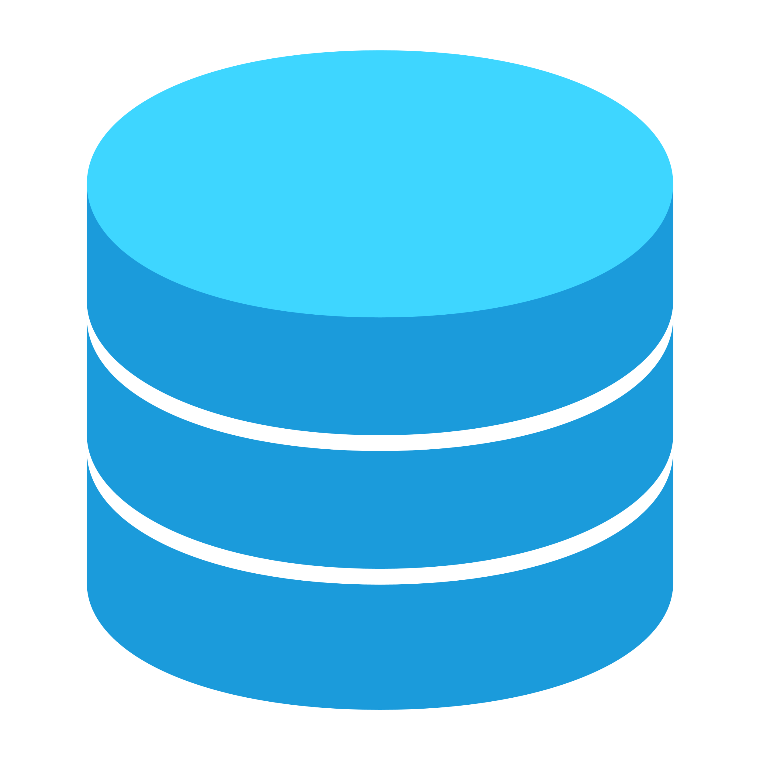
Applications Regular
Layered Architecture
App.CommandStack
App.ReadStack
Presentation & Application
Presentation & Application
Notes:
This is nothing new. Back in the 1980s, Bertrand Meyer said, any action can be a command or a query, but never both

Slide 8

Applications Regular
App.CommandStack
App.ReadStack
Presentation & Application
Use just the pattern that fits better
Existing code
Existing products
Existing skills
ORM of choice
LINQ
Database in use
Use a read-only wrapper for the DbContext instance used in the read stack
Notes:
This is nothing new. Back in the 1980s, Bertrand Meyer said, any action can be a command or a query, but never both

Slide 9
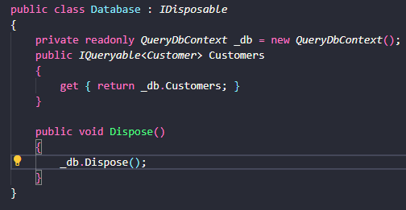
Applications Read-only Database Facade
Notes:
This is nothing new. Back in the 1980s, Bertrand Meyer said, any action can be a command or a query, but never both

Slide 10

CQRS Regular In action
ASP.NET app
App.Server.dll
Queries
Commands
App.ReadStack.dll
App.CommandStack.dll
Externals
Entity Framework
Notes:
This is nothing new. Back in the 1980s, Bertrand Meyer said, any action can be a command or a query, but never both

Slide 11
CQRS Regular In action
Queries
Commands
Presentation
Presentation
Application
Application
Read stack
Command stack
View Model
Redirect to Read Stack
Notes:
This is nothing new. Back in the 1980s, Bertrand Meyer said, any action can be a command or a query, but never both

Slide 12
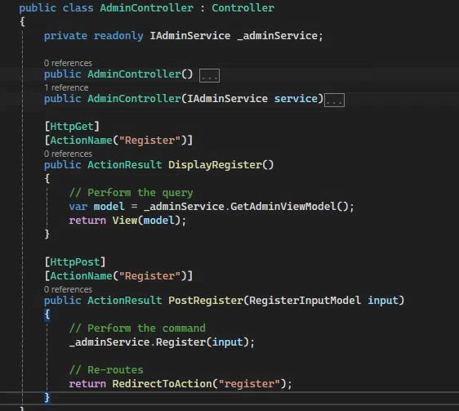
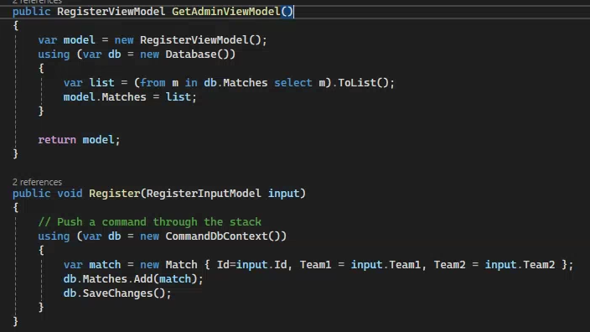
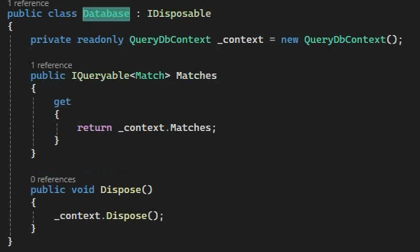
CQRS Regular In action
2 different DbContext objects
Notes:
This is nothing new. Back in the 1980s, Bertrand Meyer said, any action can be a command or a query, but never both

Slide 13

CQRS Premium In action
Presentation & Application
Presentation & Application
Notes:
This is nothing new. Back in the 1980s, Bertrand Meyer said, any action can be a command or a query, but never both

Slide 14
CQRS Premium In action
Use just the pattern that fits better
Task-oriented
Domain model
Ad-hoc storage
Transaction Script
Relational
NoSql
Events
Notes:
This is nothing new. Back in the 1980s, Bertrand Meyer said, any action can be a command or a query, but never both

Slide 15

CQRS Premium In action
Use just the code that does the job
ORM of choice
Issue
How would you define slate data? How critical is stale data for the app
LINQ
Ad-hoc storage
Relational
Notes:
This is nothing new. Back in the 1980s, Bertrand Meyer said, any action can be a command or a query, but never both

Slide 16



CQRS Premium In action
Synchronous
Every command triggers sync updates
Asynchronous
Every command triggers async updates
Scheduled
On-demand
Updates triggered by requests (if older enough)
A job runs periodically and updates the read storage
Automatically up-to-date
Eventually
up-to-date
Controlled staleness
Controlled
up-to-date
Notes:
This is nothing new. Back in the 1980s, Bertrand Meyer said, any action can be a command or a query, but never both

Slide 17
CQRS Premium In action
Presentation & Application
Presentation & Application
Application
Application
Request for action
Command Stack
Request for data
Formatted data
Aggregate ID | Data
Log of actions
Notes:
This is nothing new. Back in the 1980s, Bertrand Meyer said, any action can be a command or a query, but never both

Slide 18
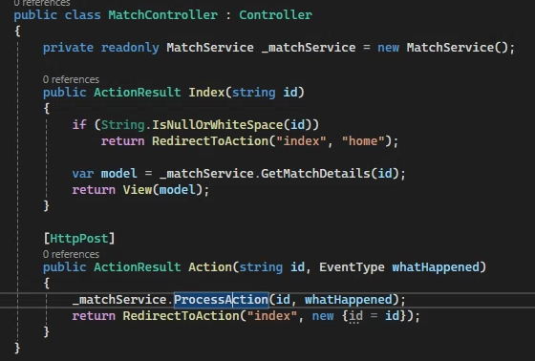
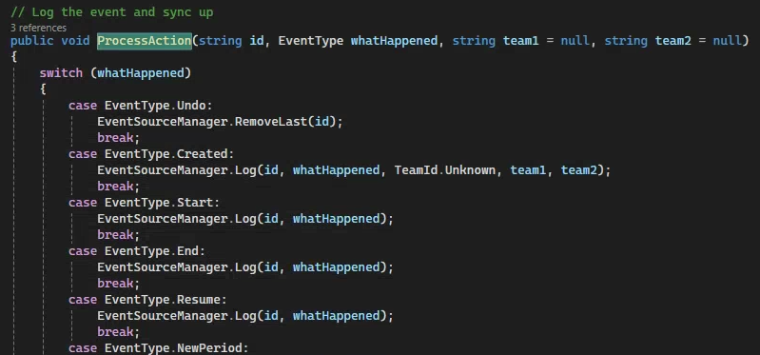
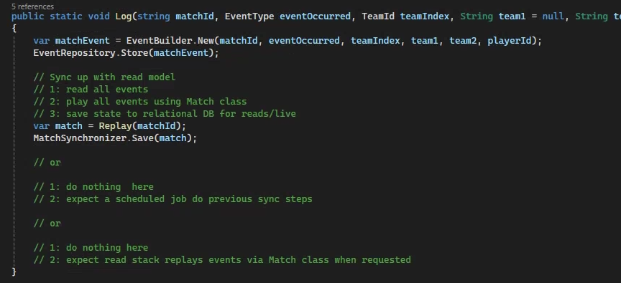
CQRS Premium In action

Slide 19

Event Sourcing Definition
Structural Representation
Structural Representation
List of ordered goods
Add item #1
Payment information
Add item #2
Shipping information
Remove item #1
Add shipping info
It’s about ensuring that all changes made to the application state during the entire lifetime of the application are stored as a sequence of events
Notes:
This is nothing new. Back in the 1980s, Bertrand Meyer said, any action can be a command or a query, but never both

Slide 20
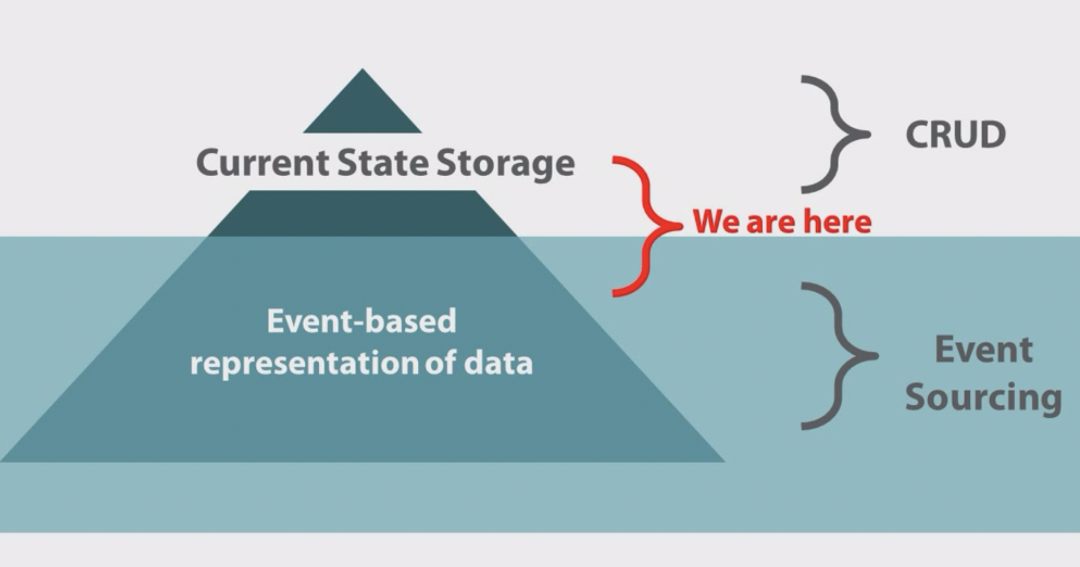
Event Sourcing Definition
Notes:
This is nothing new. Back in the 1980s, Bertrand Meyer said, any action can be a command or a query, but never both

Slide 21
Event Sourcing Definition
An event is something that has happened in the past
Events are expression of the ubiquitous language
Events are not imperative and are named using past tense verbs
Have a persistent store for events
Append-only, no delete
Replay the (related) events to get to the last known state of an entity
Notes:
This is nothing new. Back in the 1980s, Bertrand Meyer said, any action can be a command or a query, but never both

Slide 22
Event Sourcing and CQRS
Commands
Queries
Event
stream
Orders table
Notes:
This is nothing new. Back in the 1980s, Bertrand Meyer said, any action can be a command or a query, but never both

