Slide 1
Design App manage dog & cat - Pet App

Slide 2

Hello!
This is team 13 from K17HTN
1720063 Nguyễn Trung Dương
1720056 Mai Xuân Đức
1720100 Lê Phước Hưng
1720033 Lê Thị Bảy
1720111 Trần Hoàng Huy

Slide 3
Instructions for use
Pet App can:
Show you the temperature in pet room over the time
Control the electric device (like: air-conditioner, fan, lamp…) in your mobile.
Insert the data your pet
Pet App developed in kotlin
Connect via internet (http)
Using php MySQL
Connect to ESP8266 board. This board can control the relay or emit the infrared to control the AC

Slide 4
Our process is easy
first
second
last
Login and SignUp
Main
Question

Slide 5
Login and SignUp
1
Let’s start with the first set of slides

Slide 6
SignUp success when you have the id-device(“123”,”456”)
Login with your phone & password
Using the sharepreference to save the data after login

Slide 7
This is demo

Slide 8
After SignUp
Your account is saved in the cloud

Slide 9
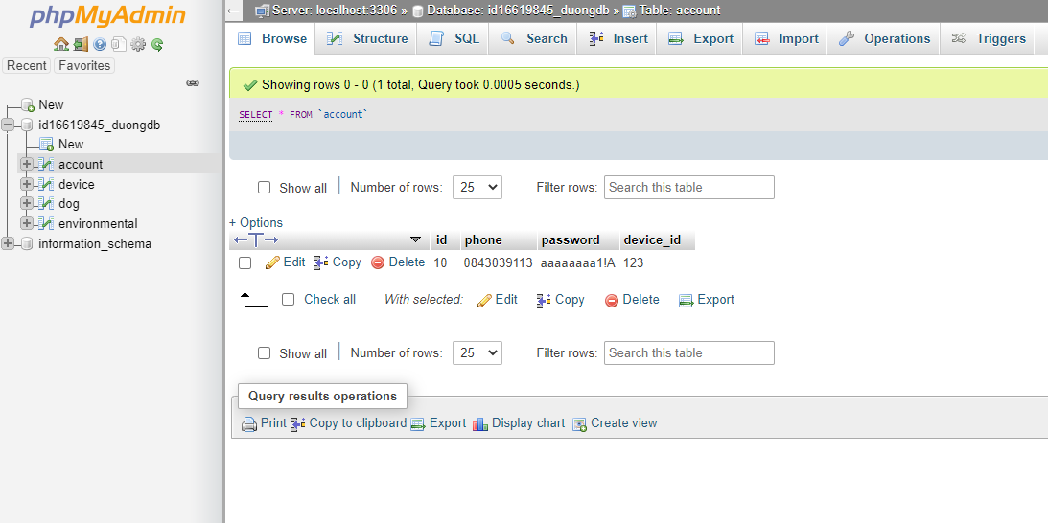
This is the tabe save the accounts

Slide 10
Main
2
Device, Temperature and Dog-database

Slide 11
1. Temperature
This is a sample
This is a sample
This is a sample
This is a sample
This is a sample
This is a sample
1
2
3
4
5
6
7
8
9
10
11
12
This is a sample
This is a sample
This is a sample
This is a sample
This is a sample
This is a sample

Slide 12
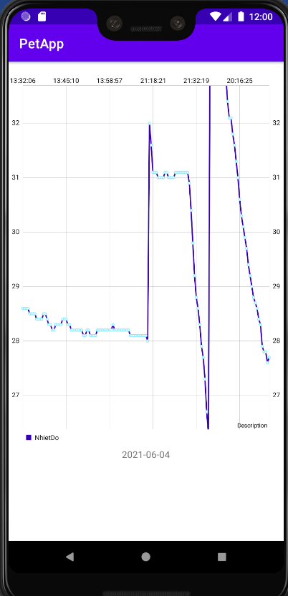
This is the chart of Temperature

Slide 13
2. Device-Controler
AC-control using led to emit infrared
Fan-control using relay for ON/OFF
1
2
Lamp-control using relay for ON/OFF
Other device can be control like that
3
4

Slide 14
How to work (Auto and Manual)
Repeat this process
Finish the command – repeat after 2 minutes (only last control in 2 minute is access)
Device ON/OFF in real-time
Device is ON/OFF
Control the device
Board select correct way to control according to data
Board esp get the data
Board esp8266 get the data from cloud
Connect to Cloud
Using http method POST to update the status of the device by .php file
Control on mobile
Using the button in AppPet to control the device

Slide 15
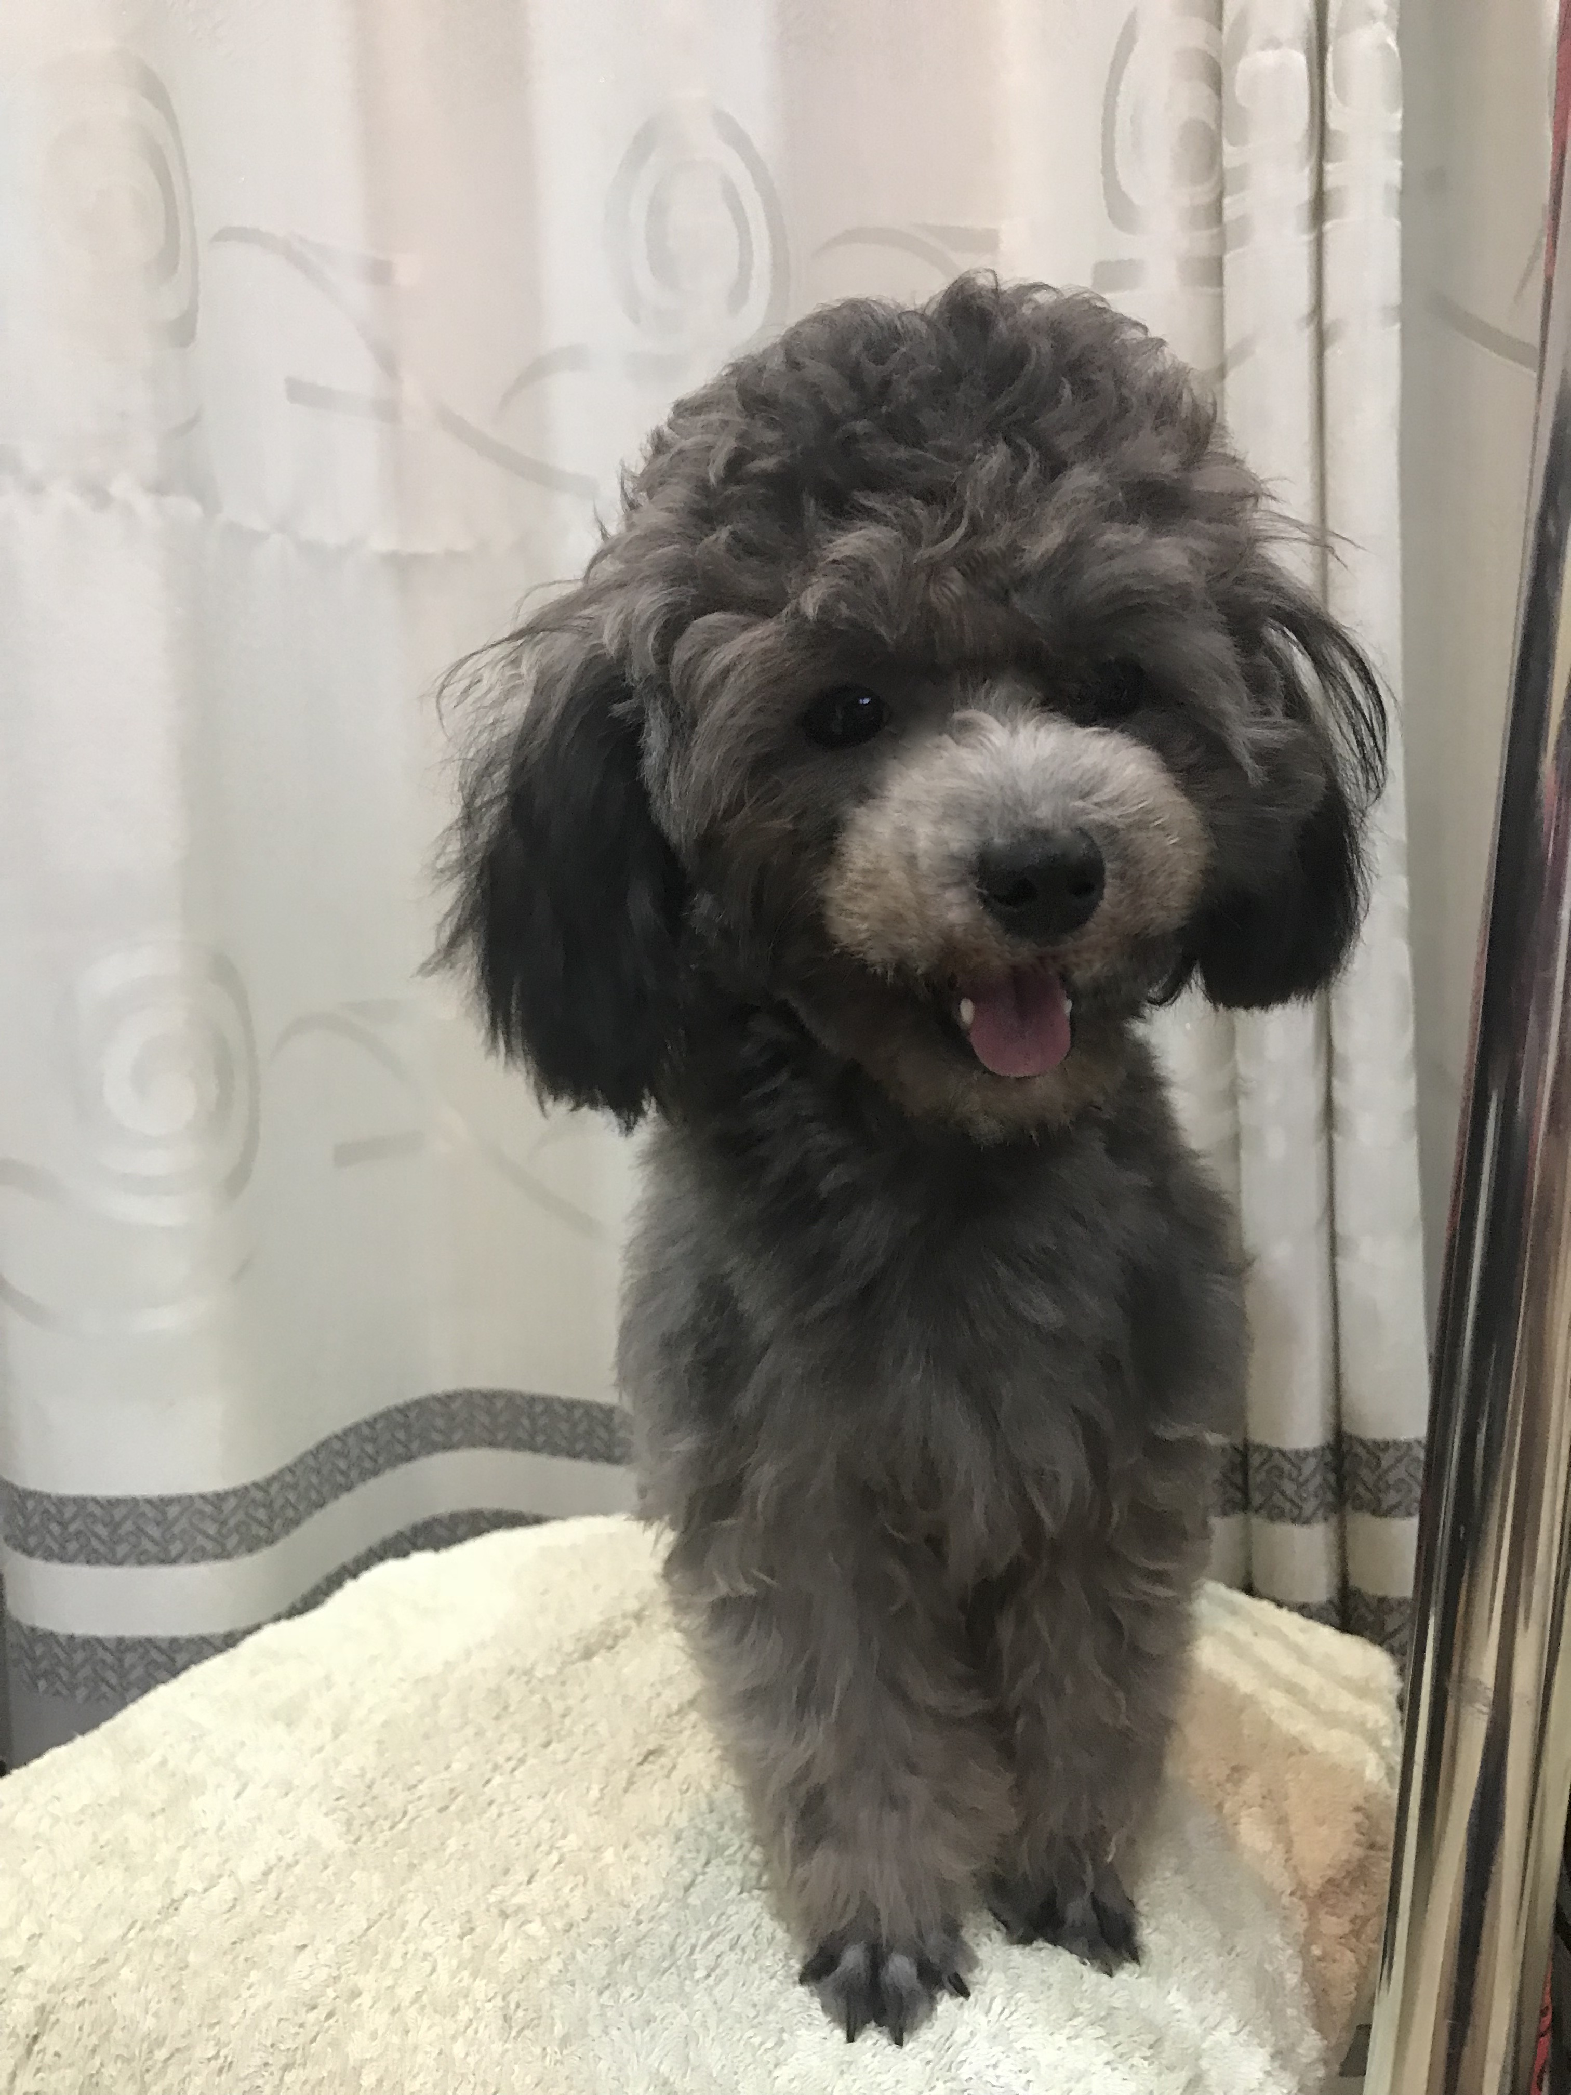
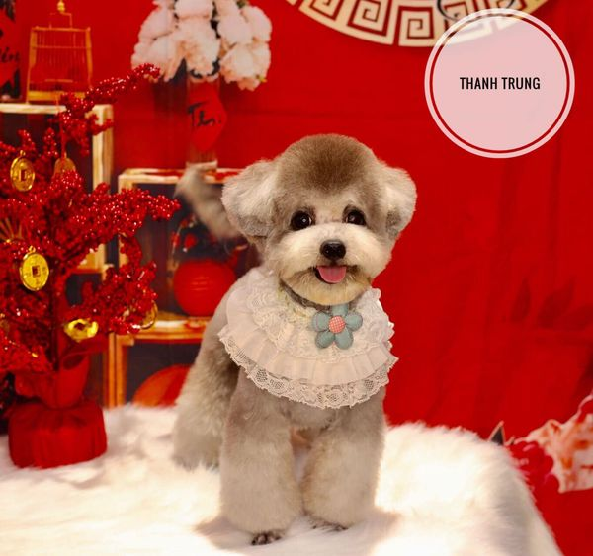
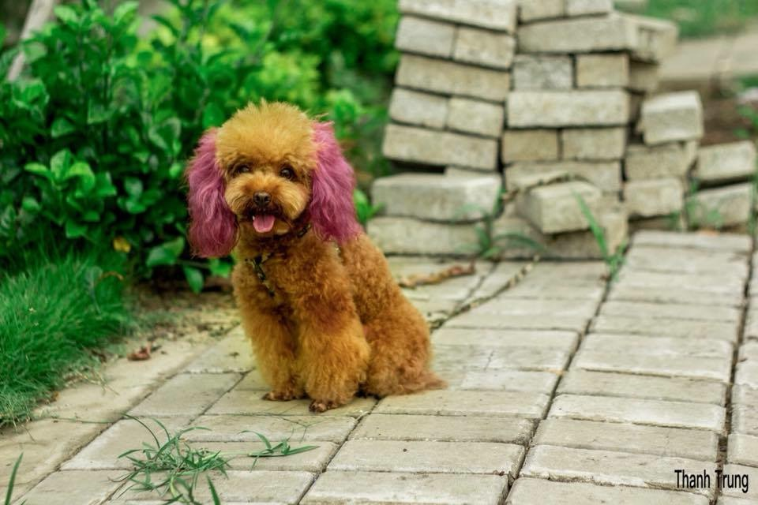
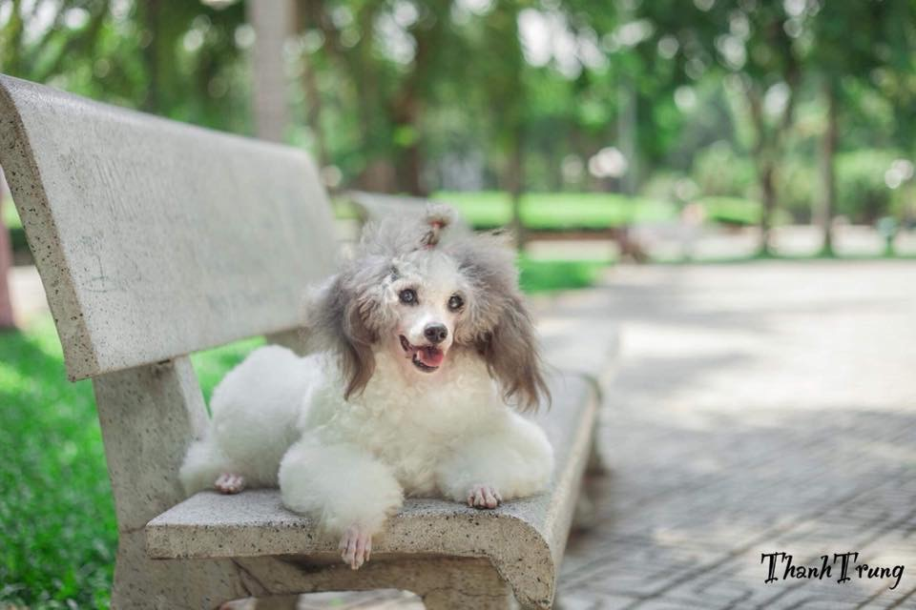
3. Dog-database
ID: 12
Name: Su
Dog's estrous day:22-05-2021
Color: red-brown
Describe: none
ID: 13 Name: Tom
Dog's estrous day:26-05-2021
Color: milker
Describe: none
ID: 14 Name: Tep
Dog's estrous day:02-06-2021
Color: milker (silver)
Describe: none
ID: 15
Name: Ken
Dog's estrous day:27-04-2021
Color: silver
Describe: none

Slide 16
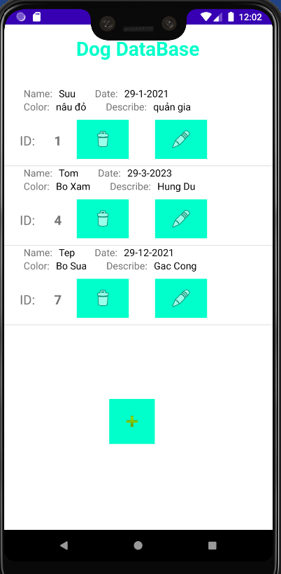
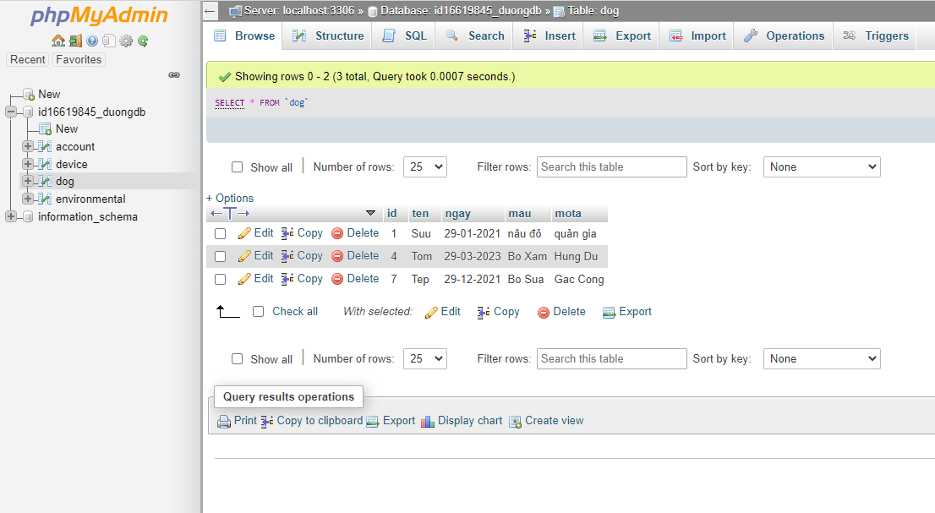
The database in cloud

Slide 17
Thank you for your attendtion!
Any questions?

