Slide 1










QML TRAINING
Embedded Fresher Training – July 28th, 2022

Slide 2
Contents
01 Overview
02 Structure
03 QML
04 C++
05 D - BUS

Slide 3

Overview
What is Qt?
Qt is a cross-platform application development framework for desktop, embedded and mobile.
Supported Platforms include Linux, OS X, Windows, VxWorks, QNX, Android, iOS, BlackBerry, Sailfish OS and others.

Slide 4
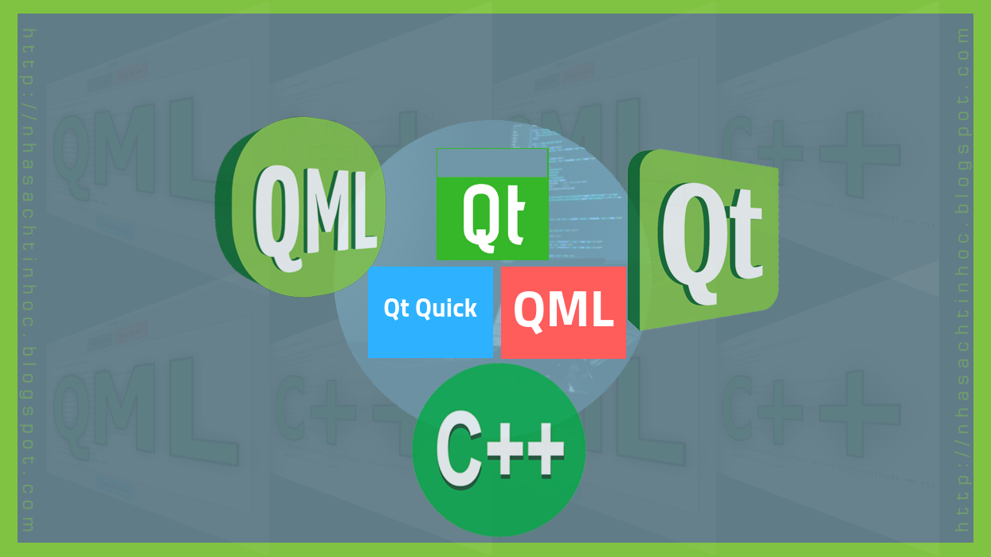
Overview
What is QML?
QML (Qt Modeling Language) is a user interface markup language.
It is based on JavaScript and is used to create the user interface of an application
It allows you to use both traditional components (buttons, lists, etc.) and graphic elements to which logic is added

Slide 5
Structure
Controller
View
Model

Slide 6
QML
Component
Properties
Signals – Slots
Loader
States
Transition - Animation
User defined component

Slide 7
QML
Component | Use
Rectangle | Create a rectangle, circle or a box
Text | Show the text
TextInput | Allow user to input a string
MouseArea | Catch the mouse events
Image | Display the image
ListView | Display data as a list
Grid | Display data as a grid
Loader | Load components
Flickable | place its children on a surface that can be dragged
Shape | Render a path, create a shape
Dialog | provides common QML API for native platform dialogs
Timer | used to trigger an action either once, or repeatedly at a given interval.
ComboBox | ComboBox is a combined button and popup list
MenuBar | consists of drop-down menus, and is normally located at the top edge of the window

Slide 8
C++
Class
Q_OBJECT
Q_PROPERTY
Signals
Property name
Read
Write
Notify
Slots

Slide 9
C++
There are 2 methods to expose a C++ class with Signals and Slots to QML:
 | Expose an Object to QML as a Context Property | Register C++ Class as a QML Type
Operation | create an object to the context that can be used from QML code. | Register a type known to the QML engine and then you can instantiate new objects from that type directly in your QML code.
Domain | myObject is a global object that can be used in every QML files in project | - Have to import <com.yourcompany.xyz> 1.0 - Can be used as other component types
Syntax | <ClassName> myObject; engine.rootContext()->setContextProperty ("myGlobalObject", &myObject); | qmlRegisterType<ClassName> ("com.yourcompany.xyz", 1, 0,“<ComponentName>");

Slide 10
C++
C++ Object
Properties name
Signals
Slots / Q_INVOKABLE
Properties
Signals
Slots
QML Component

Slide 11
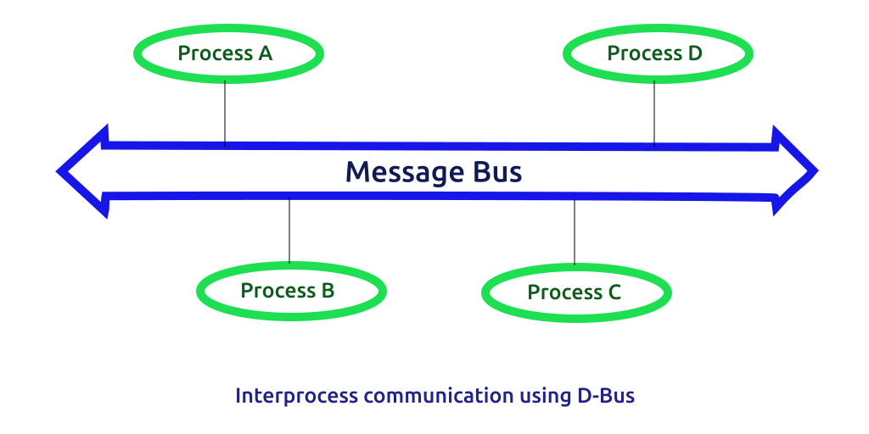
D-Bus
What is Dbus?
D-Bus is an Inter-Process Communication (IPC) and Remote Procedure Calling (RPC) mechanism originally developed for Linux to replace existing and competing IPC solutions with one unified protocol.

Slide 12
D-Bus
Concepts
Messages: method calls, method returns, signals, and errors.
Service Names: When communicating over a bus, applications obtain what is called a "service name": it is how that application chooses to be known by other applications on the same bus.
Object Paths: Like network hosts, applications provide specific services to other applications by exporting objects.
Interfaces: Interfaces are similar to C++ abstract classes and Java's interface keyword and declare the "contract" that is established between caller and callee.

Slide 13
Design
Create .h library
Generate a XML interface from .h file
Edit .pro file
QT += dbus quick
<interface name>
signals
slots
<property>
<signal>
<method>
properties
DBUS_ADAPTORS / DBUS_INTERFACES += .xml
Edit library functions
Dbus on Qt

Slide 14
THANK YOU!

