Slide 1
WEBSITE BLOG
Report
2023

Slide 2
MỤC LỤC
01
02
03
Overview
Demo Website
backend/frontend
Spring boot
ReactJs
Website Blog ?
backend working?
frontend working?

Slide 3
01
Overview
Reports
2023
Spring boot ?

Slide 4
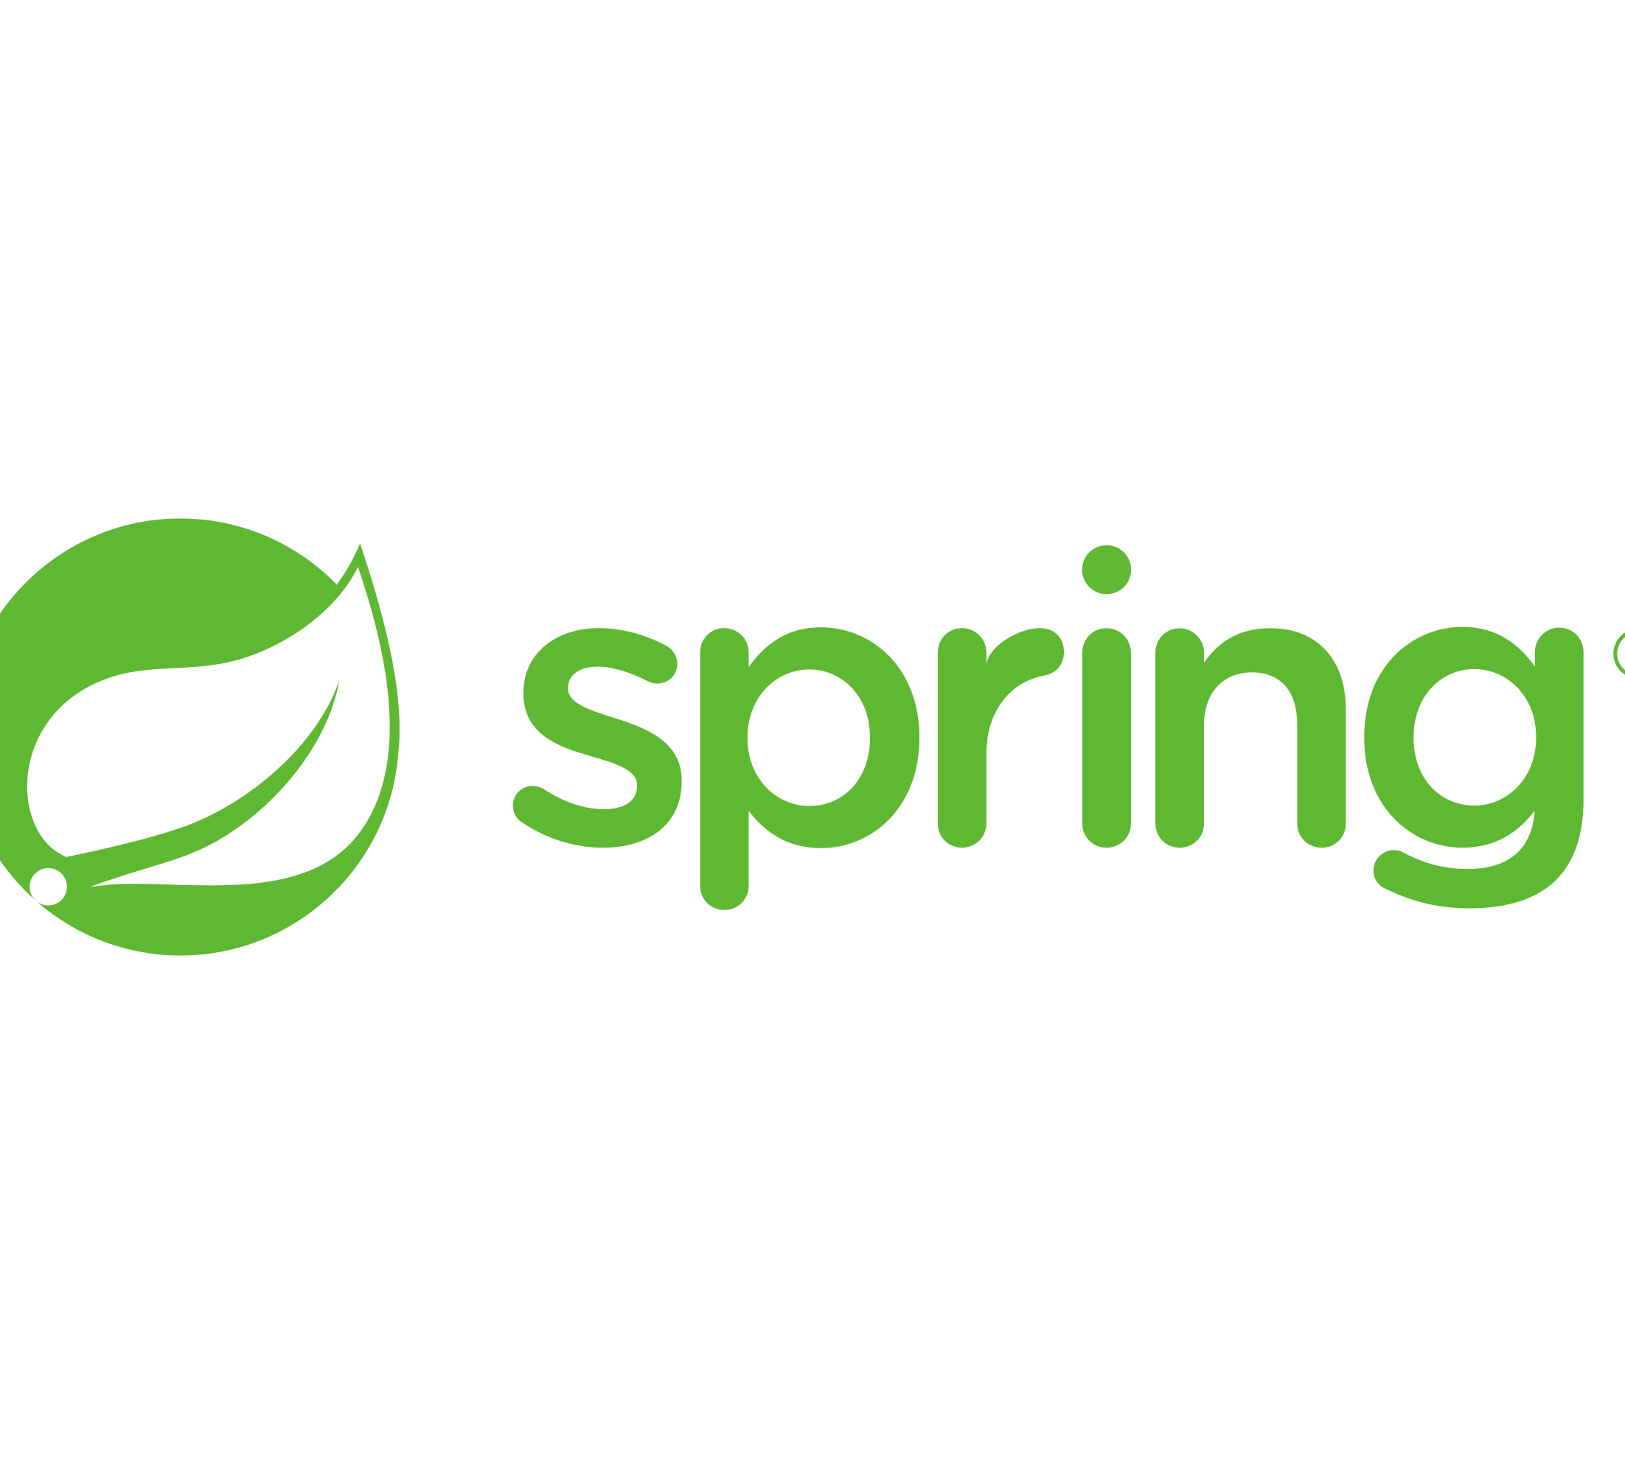
Spring ?
The Spring Framework is an open-source software development framework that offers infrastructure support for building primarily Java-based applications. Regarded for its security, cost-effectiveness, and flexibility, Spring enhances coding efficiency and reduces overall application development time by making efficient use of system resources.
There are a few important terms associated with Spring:
Dependency Injection (DI), Inversion of Control (IoC)
Autowiring
Bean.
Hibernate, JPA, RESTful,…
Notes:
Đầu tiên thì hãy nói qua Spring

Slide 5

Spring boot ?
Spring Boot is an extension of the Spring Framework, focusing on reducing complexity in developing Java applications based on Spring.
Spring Boot is favored for several reasons:
Embedded Servers
Rapid Development
Community Support
Auto Config
Notes:
Đầu tiên thì hãy nói qua Spring

Slide 6
Overview
01
Reports
2023
ReactJs?

Slide 7

ReactJs ?
ReactJS is a popular JavaScript library used for building user interfaces, particularly for single-page applications (SPAs). Developed and maintained by Facebook, React enables developers to create interactive, dynamic, and efficient UIs.
Notes:
Đầu tiên thì hãy nói qua Spring

Slide 8
ReactJs ?
The significant features of ReactJS:
Component – Based: ReactJs employs a component-base structure where UIs are built using self-contained components .
Virtual DOM: Instead of updating the entire DOM upon changes, React uses a Virtual DOM to identify the necessary changes to apply to the actual DOM. This enhances display and interaction speed.
JSX: JSX is a JavaScript extension allowing HTML-like syntax within JavaScript, making UI creation more straightforward and clear.
Notes:
Đầu tiên thì hãy nói qua Spring

Slide 9
ReactJs ?
The significant features of ReactJS:
Single page Application (SPAs):React is often used to build single-page applications, where the entire content of the web page isn't reloaded when users interact.
Data Binding: It supports a unidirectional data flow model, allowing easy management and tracking of data changes.
Community và Ecosystem: Community and Ecosystem: React has a large community providing numerous libraries and tools to efficiently build and develop applications.
Notes:
Đầu tiên thì hãy nói qua Spring

Slide 10
Overview
01
Reports
2023
Website blog

Slide 11


Website blog
The ultimate goal of learning Spring Boot and React.js is to apply them in future projects. To become more proficient, the aim within this project is to build a blog website where users can share their posts and publish content to share with others within the site's limitations. With goals like these, utilizing Spring Boot to manage the backend through APIs and employing React.js for creating an interactive user interface becomes applicable.
Notes:
Đây là một cơ hội để học hỏi và sau khi hoàn thành website có thể tự tin sử dụng spring boot cũng như reactjs cho các dự án khác để xây dựng hệ thống trang web có tính ổn định và dễ dàng bảo trì hơn.

Slide 12
02
Demo website
Reports
2023
Dinh Quan Blog

Slide 13
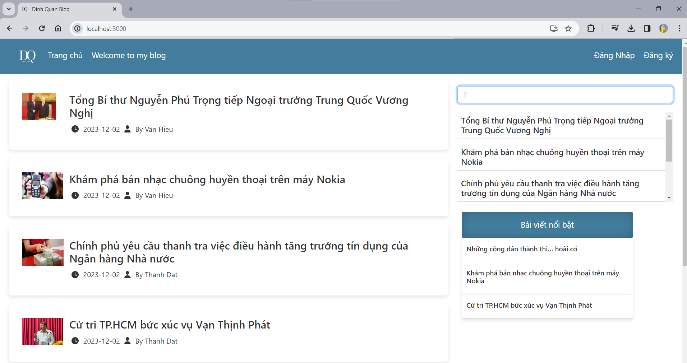
Home

Slide 14
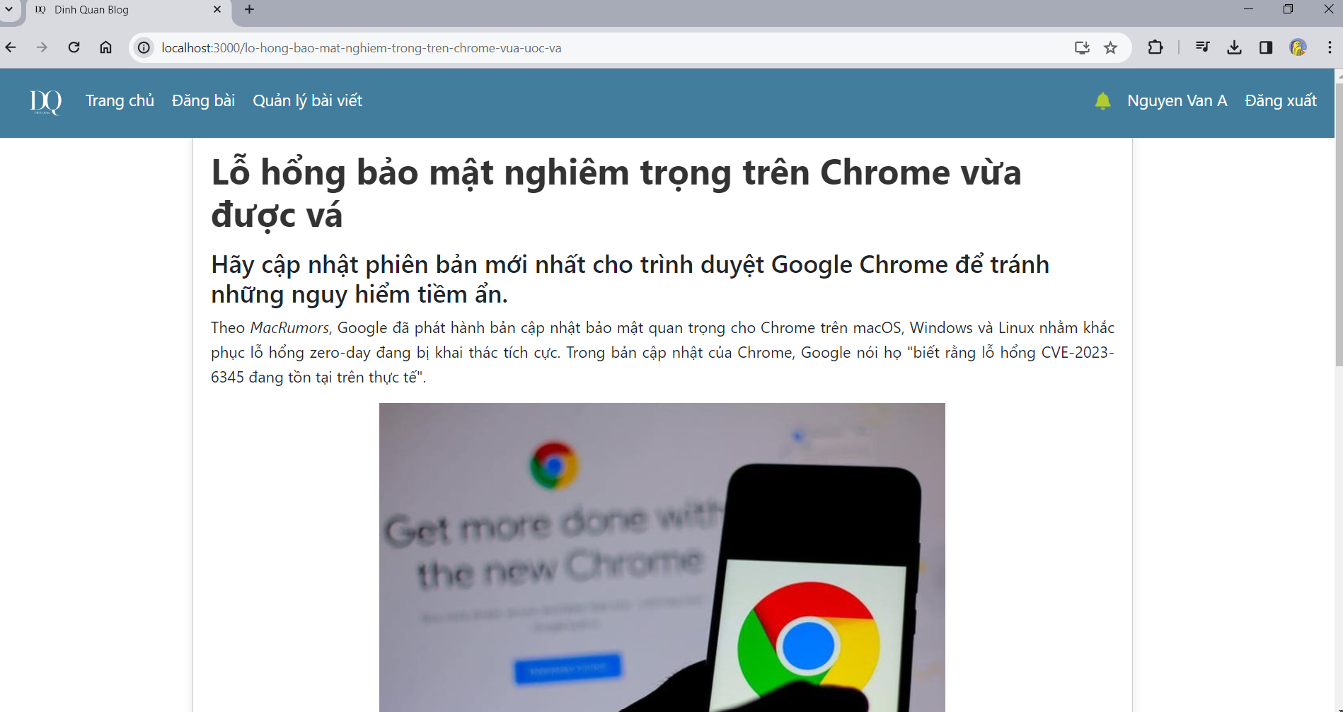
Read blog

Slide 15
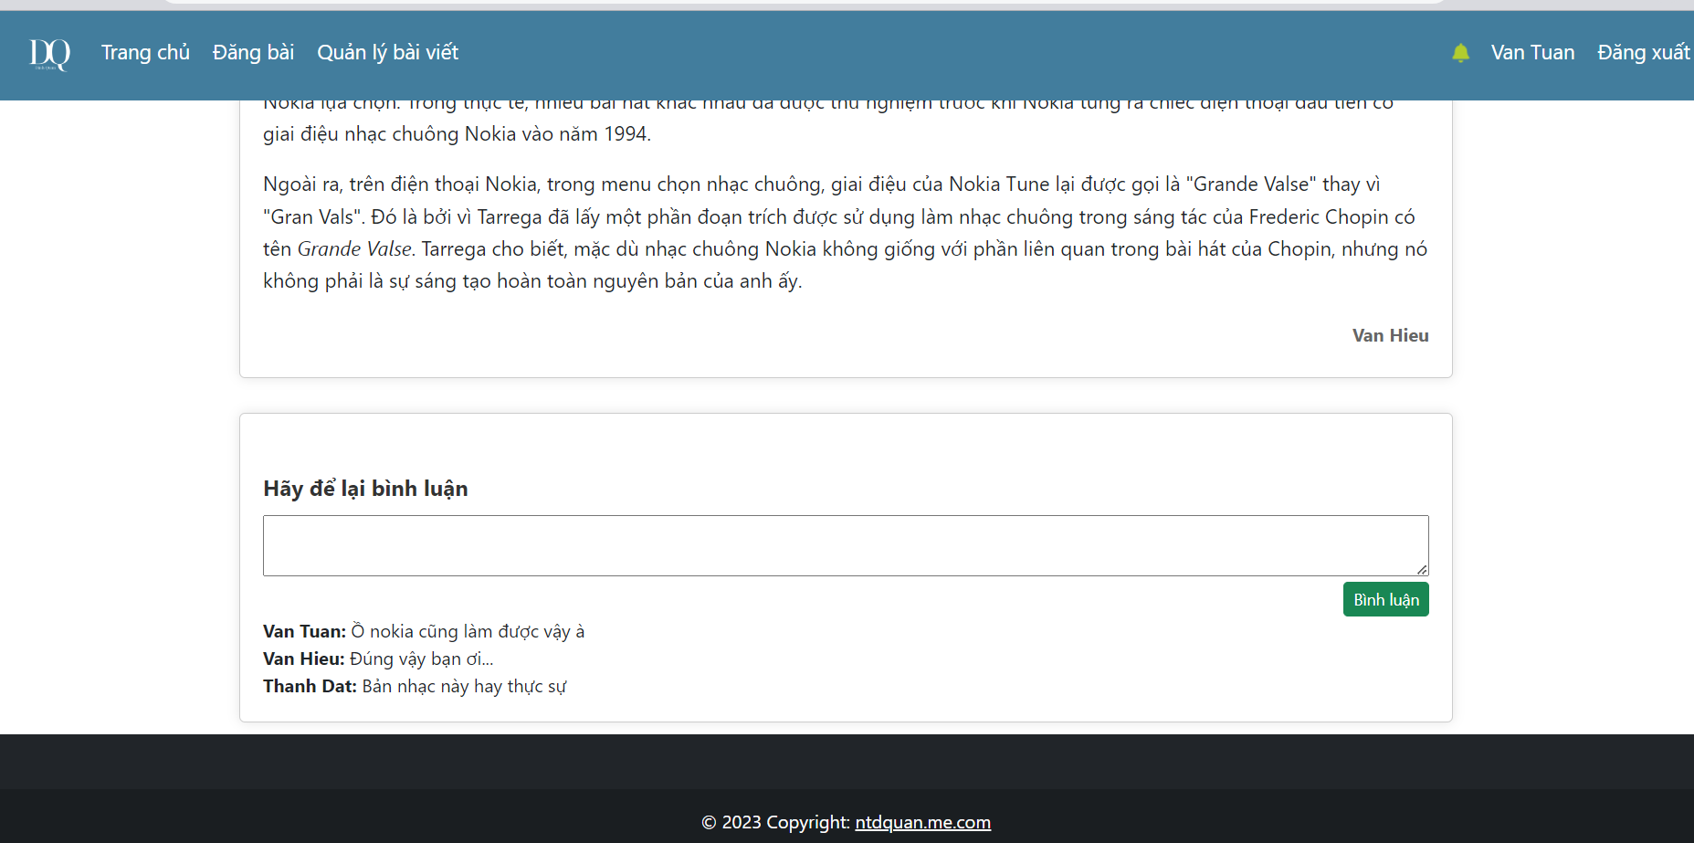
Read blog

Slide 16
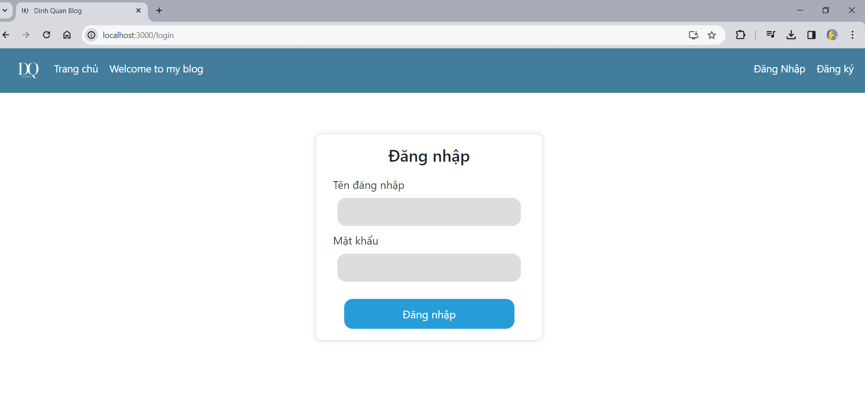
Login

Slide 17
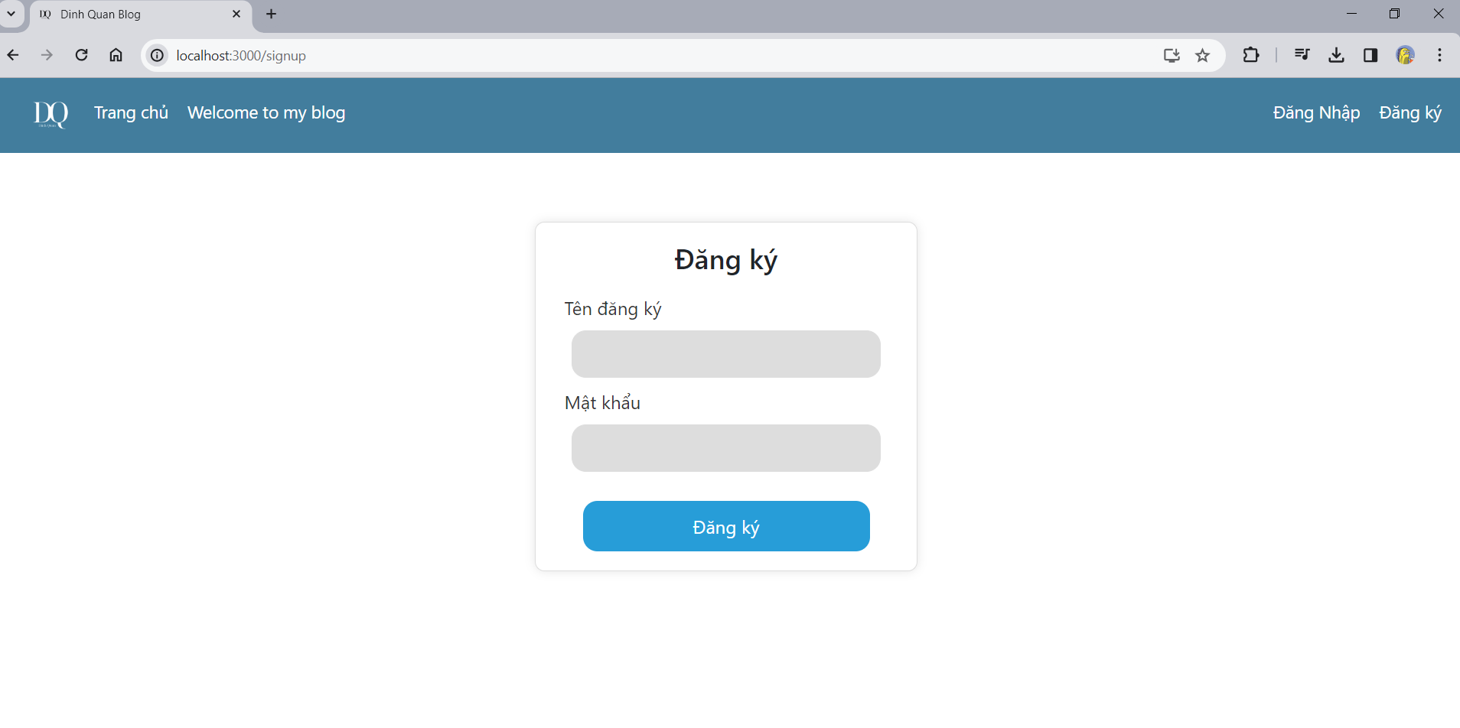
SignUp

Slide 18
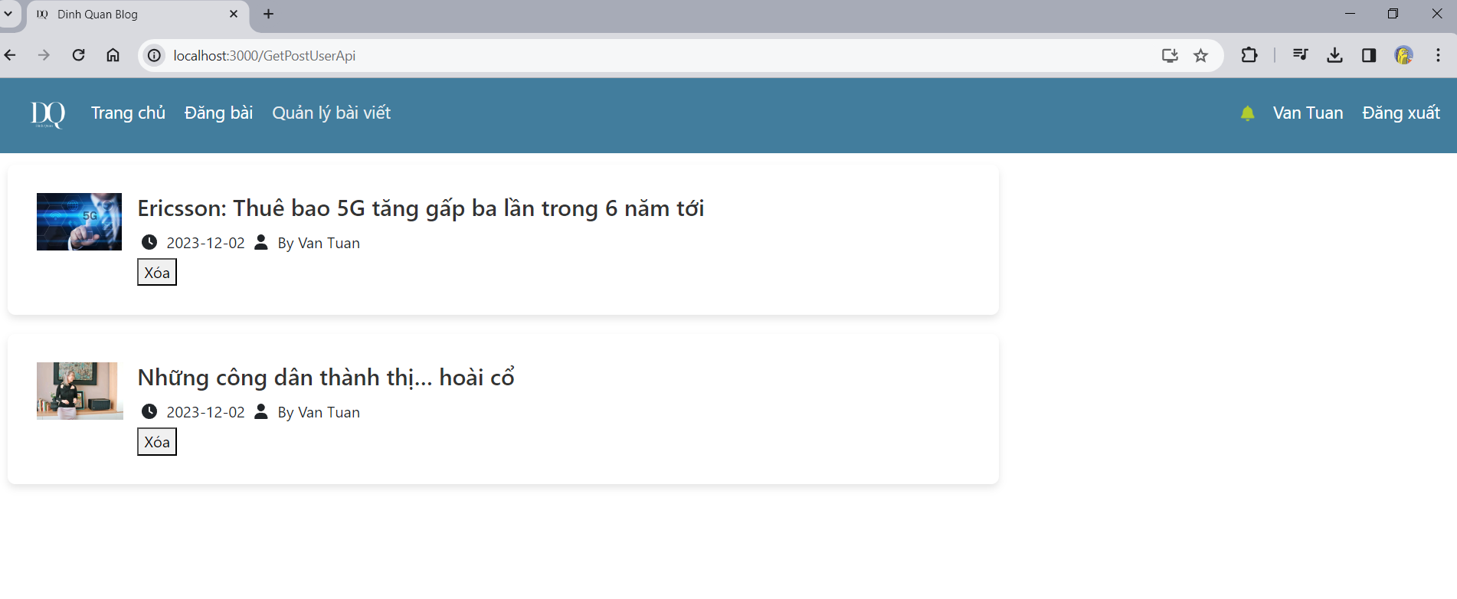
Manager blog

Slide 19
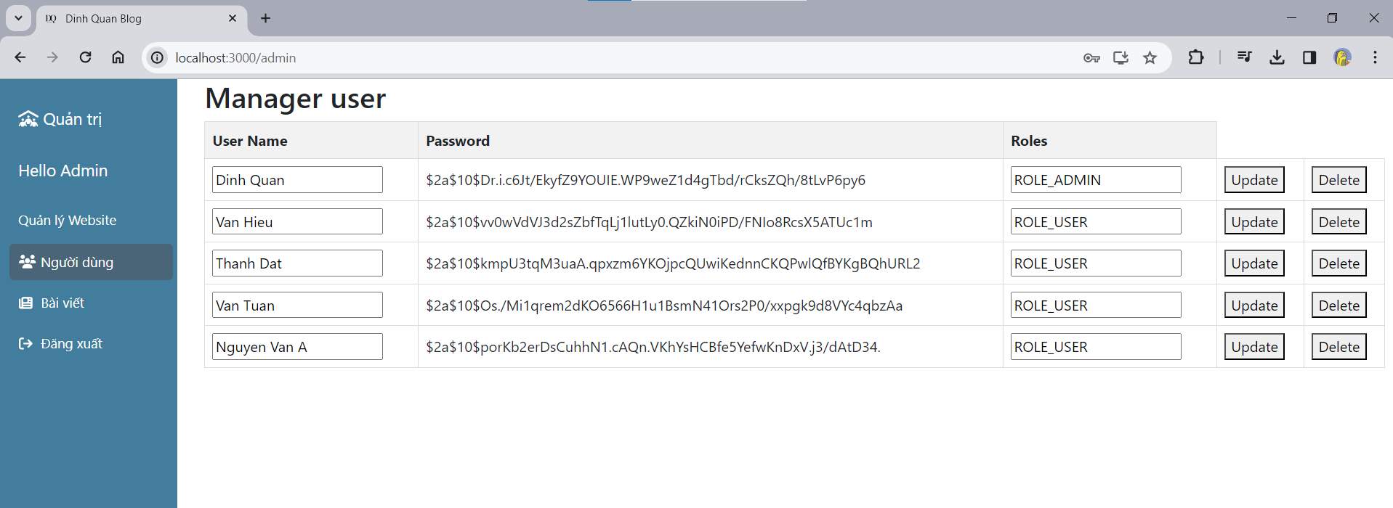
Admin page

Slide 20
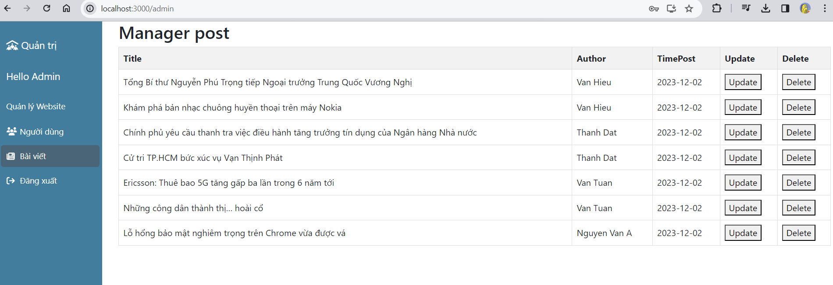
Admin page

Slide 21
Demo code
03
Reports
2023
Backend and frontend

Slide 22

Thanks!
UTH Reports
2023
Do you have any questions?
ntdquan2012@gmai.com
+84 905776151
dinhquan.blog.com

