Slide 1
State of the tech labor market
Natalya Doris

Slide 2
AGENDA
Project Objective
Data
The Big Picture
Modeling
Dashboard Preview
Conclusion and Next Steps

Slide 3
Project objective
Given the massive layoffs in tech, I wanted to take a deeper look at the state of the industry to get a sense of what is really going on behind the scenes. This project analyzes the market both from a layoffs and jobs posting perspective, as well as predicts what the near future might look like for the industry.

Slide 4
Data
Layoffs.fyi
Census API
Crunchbase
US Bureau of Labor Statistics
Simply WallStreet
Indeed / Lightcast
Kaggle
Yahoo Finance

Slide 5
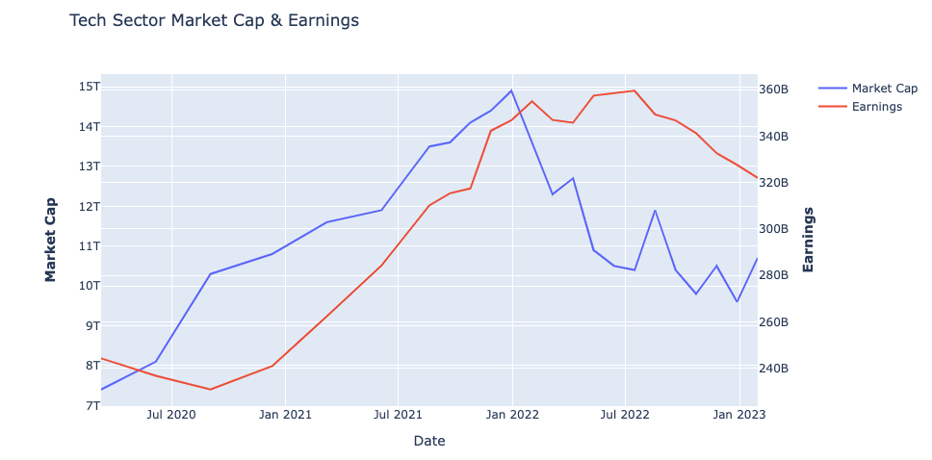
The BIG PICTURE

Slide 6
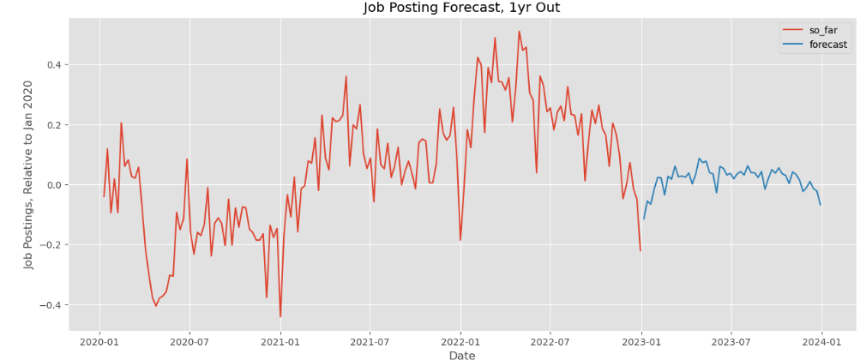
TIME SERIES MODEL – JOB POSTINGS

Slide 7
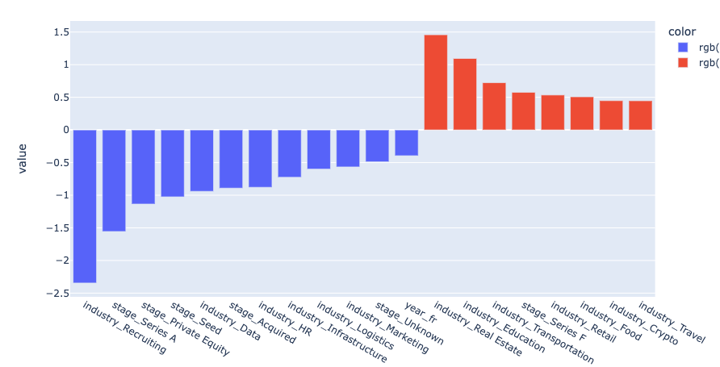
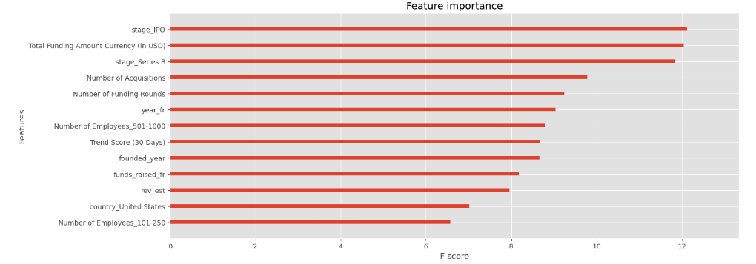
LAYOFF FREQUENCY PREDICTION – Feature Importance Logistic Regression coefficients

Slide 8
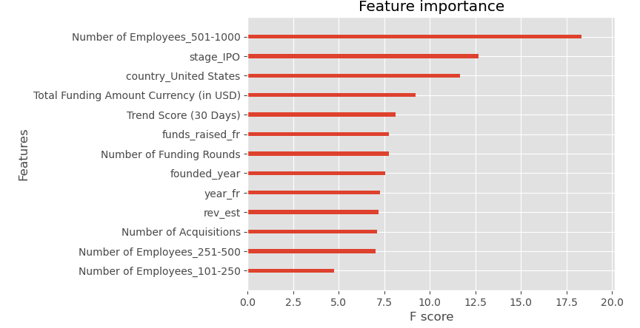
LAYOFF FREQUENCY PREDICTION – Feature Importance FINAL MODEL

Slide 9
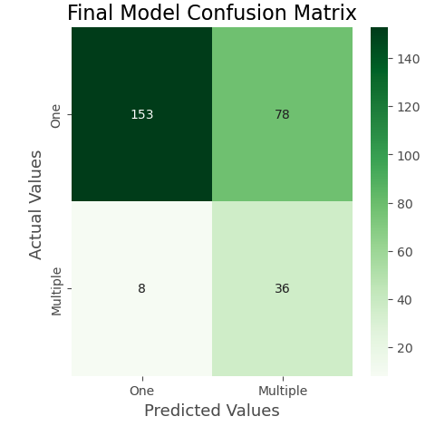
Layoff Model Evaluation

Slide 10
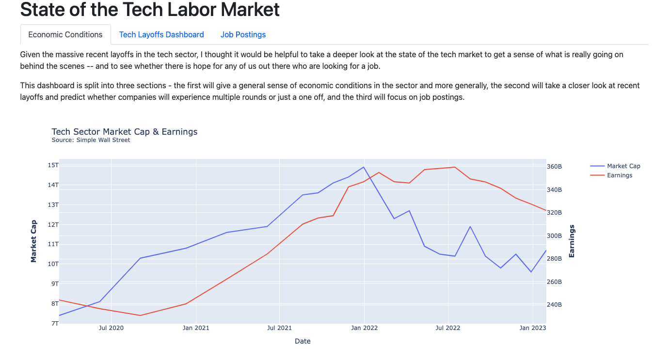
DASHBOARD PREVIEW
Q2
Coordinate e-business applications
Q3
Deploy strategic networks with compelling e-business needs

Slide 11
CONCLUSION AND NEXT STEPS
THERE IS HOPE
If you’re at a large company, be proactive
Next steps:
Gather more company data
Gather data on specific roles laid off & posted
Map postings to layoff in dashboard

Slide 12
THANK YOU
Natalya Doris
ntdoris2@gmail.com
https://github.com/ntdoris/

