Slide 1
V8-Garbage-collection
By Naor Tedgi (Abu Emma)
@ntedgi

Slide 2
Memory Management
Every application needs memory to work properly. Memory management provides ways to dynamically allocate memory chunks for programs when they request it, and free them when they are no longer needed

Slide 3
Reminder : The Stack
The stack contains local variables and pointers to objects on the heap or pointers defining the control flow of the application.
function addFunction (a, b){
return a + b
}
add(10, 12)

Slide 4
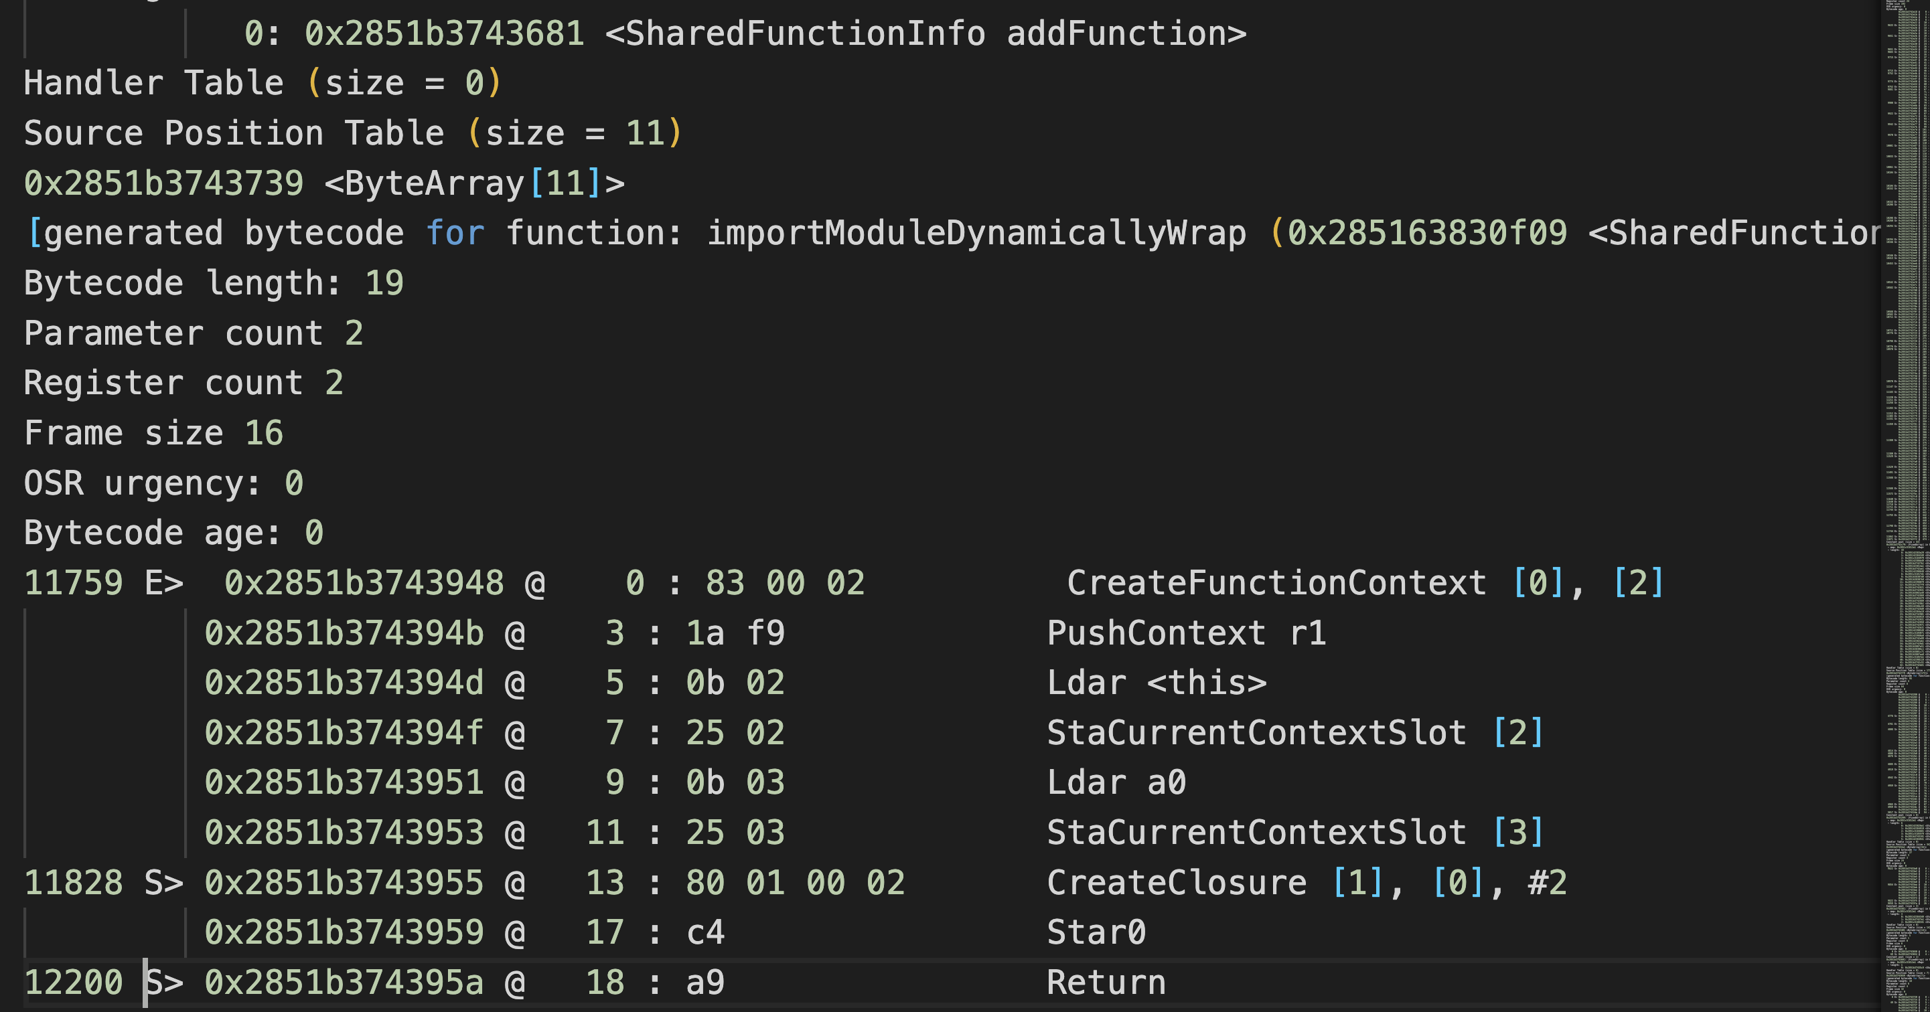
Reminder : The Stack
node --print-bytecode <JsFile>

Slide 5
Reminder :The Heap
The heap is dedicated to store reference type objects, like objects.
function Car (opts) {
this.type = opts.type;
}
const car = new Car({type :’BMW’})

Slide 6
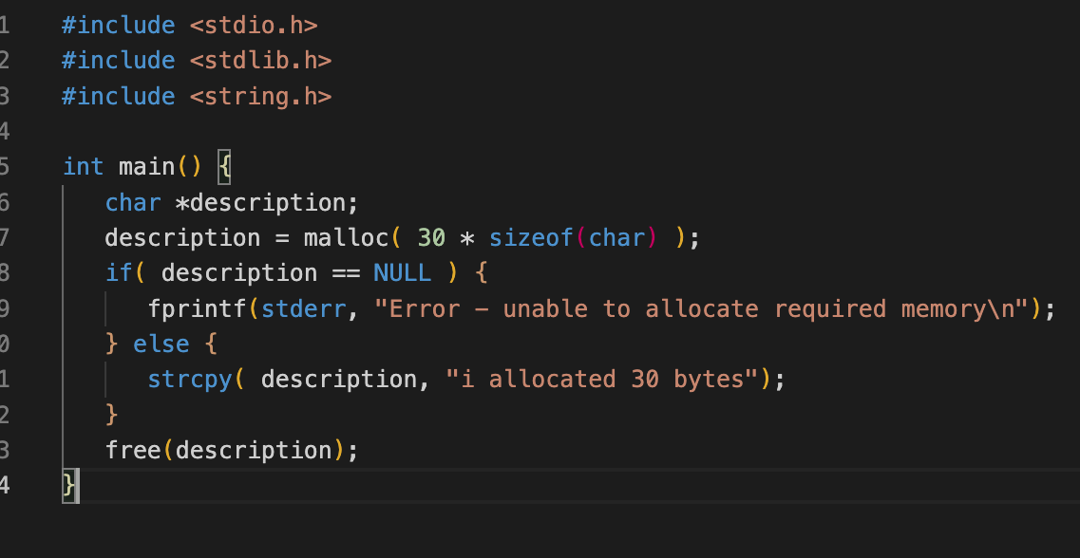
Early days

Slide 7
Early days

Slide 8
Garbeage Collection
Garbage collection is the process of reclaiming the memory occupied by objects that are no longer in use by the application.

Slide 9
Garbeage Collection Algorithems
Algorethem to find answer the problem determining whether or not an object is still needed

Slide 10
Garbeage Collection Algorithems
1) Refernce counting
This is the most naive garbage collection algorithm. This algorithm reduces the problem from determining whether or not an object is still needed to determining if an object still has any other objects referencing it. An object is said to be "garbage", or collectible if there are zero references pointing to it

Slide 11
Garbeage Collection Algorithems
1) Refernce counting
@4533433 | 3
@4235225 | 1
@324114 | 0

Slide 12
Who Is the root element?

Slide 13
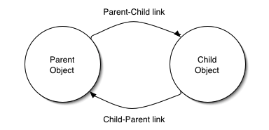
The problem with refernce counting
Circular reference

Slide 14
When an object is created, its mark bit is set to 0(false). In the Mark phase, we set the marked bit for all the reachable objects (or the objects which a user can refer to) to 1(true). Now to perform this operation we simply need to do a graph traversal, a depth-first search approach would work for us. Here we can consider every object as a node and then all the nodes (objects) that are reachable from this node (object) are visited and it goes on till we have visited all the reachable nodes.

Slide 15
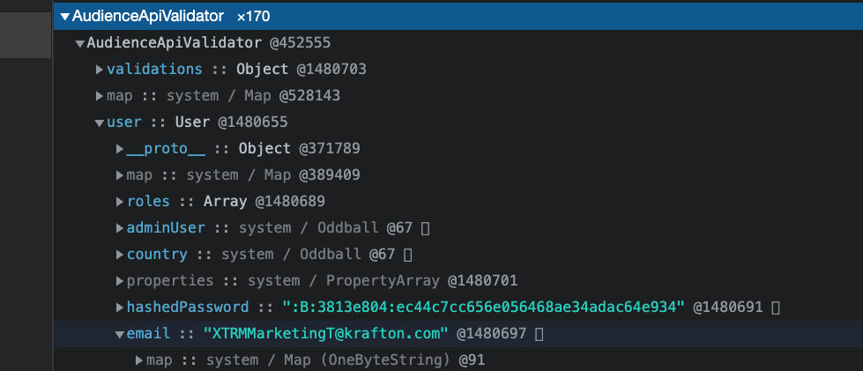
How it looks inside the heap

Slide 16
NodeJS world Term
--max_old_space_size
Sets the max memory size of V8's old memory section. As memory consumption approaches the limit, V8 will spend more time on garbage collection in an effort to free unused memory.
Note:We use 5G on prud servers
--max-semi-space-size
ets the maximum semi-space size for V8's scavenge garbage collector in MiB (megabytes)

Slide 17
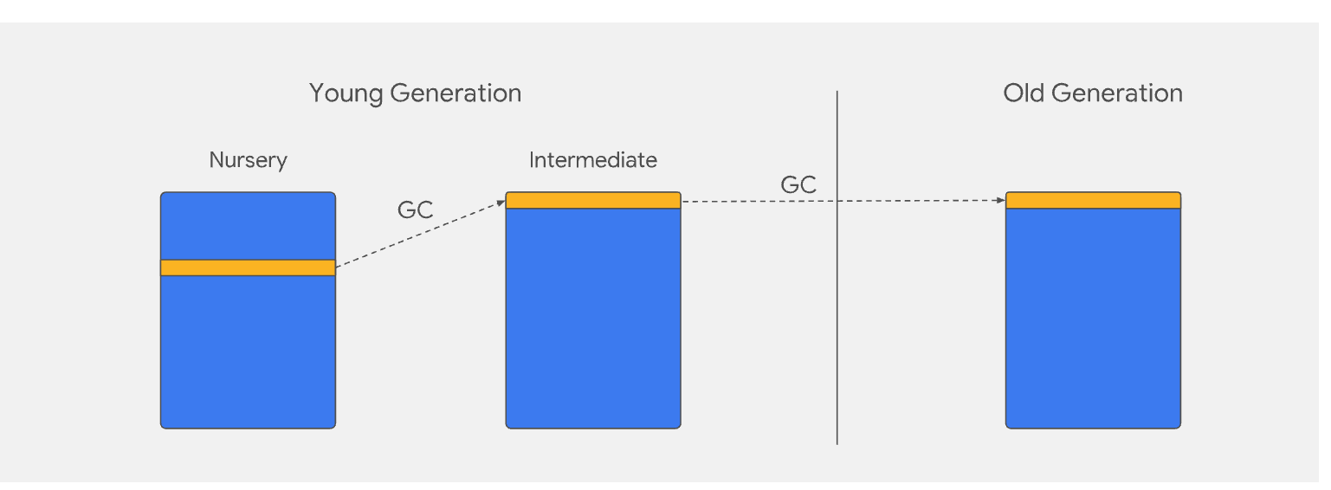
Node memory management
The heap has two main segments: the new space and the old space. The new space is where allocations are actively happening;
this is the fastest place where we could collect garbage, the new space is about 1 to 8 MBs. (--max-semi-space-size) All objects in the new space are called the young generation.

Slide 18
The Generational Hypothesis
in garbage collection there is an important term: “The Generational Hypothesis”. This basically states that most objects die young. In other words, most objects are allocated and then almost immediately become unreachable, from the perspective of the GC. This holds not only for V8 or JavaScript, but for most dynamic languages.

Slide 19
The Generational Hypothesis
in garbage collection there is an important term: “The Generational Hypothesis”. This basically states that most objects die young. In other words, most objects are allocated and then almost immediately become unreachable, from the perspective of the GC. This holds not only for V8 or JavaScript, but for most dynamic languages.

Slide 20
The Generational Hypothesis
hardly 20% of the young generation survives and it's promoted to the old generation, so this old space sweep does not actually need to be done very often.
It's only performed when this space is getting exhausted, which means around 512mb, you can set this limit with the --max-old-space-size flag in Node.js.

Slide 21
Heapdump demo

Slide 22
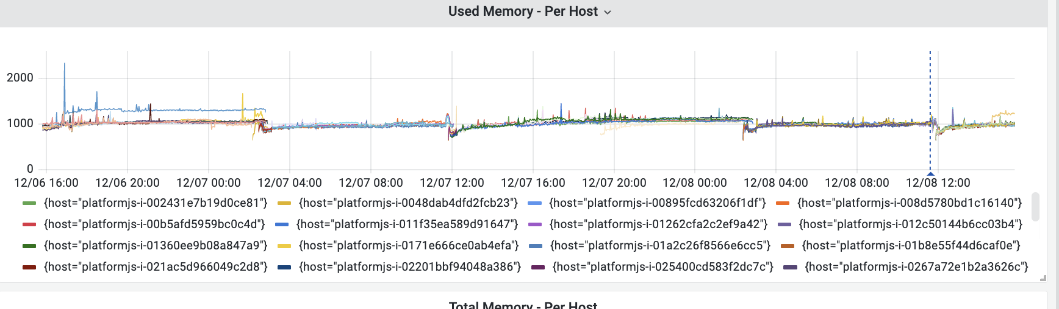
How it Shoold Look
https://monitoring-grafana.sonic-us.supersonicads.com/d/XEyQ5VJGk/demand-platformjs?orgId=1&from=now-2d&to=now

Slide 23
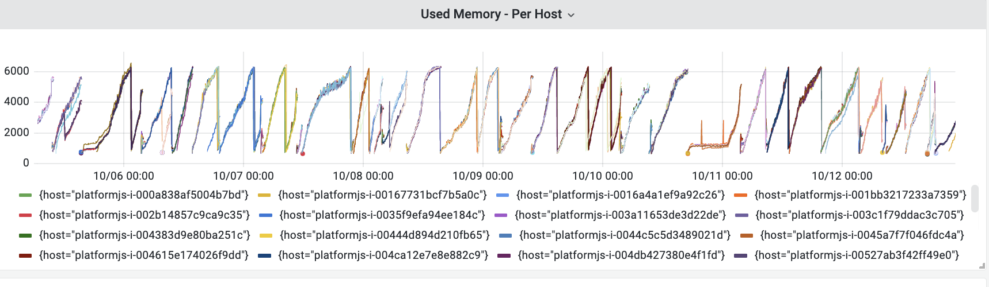
How it Look With memory leak
https://monitoring-grafana.sonic-us.supersonicads.com/d/XEyQ5VJGk/demand-platformjs?orgId=1&from=1664941185105&to=1665603606491

Slide 24
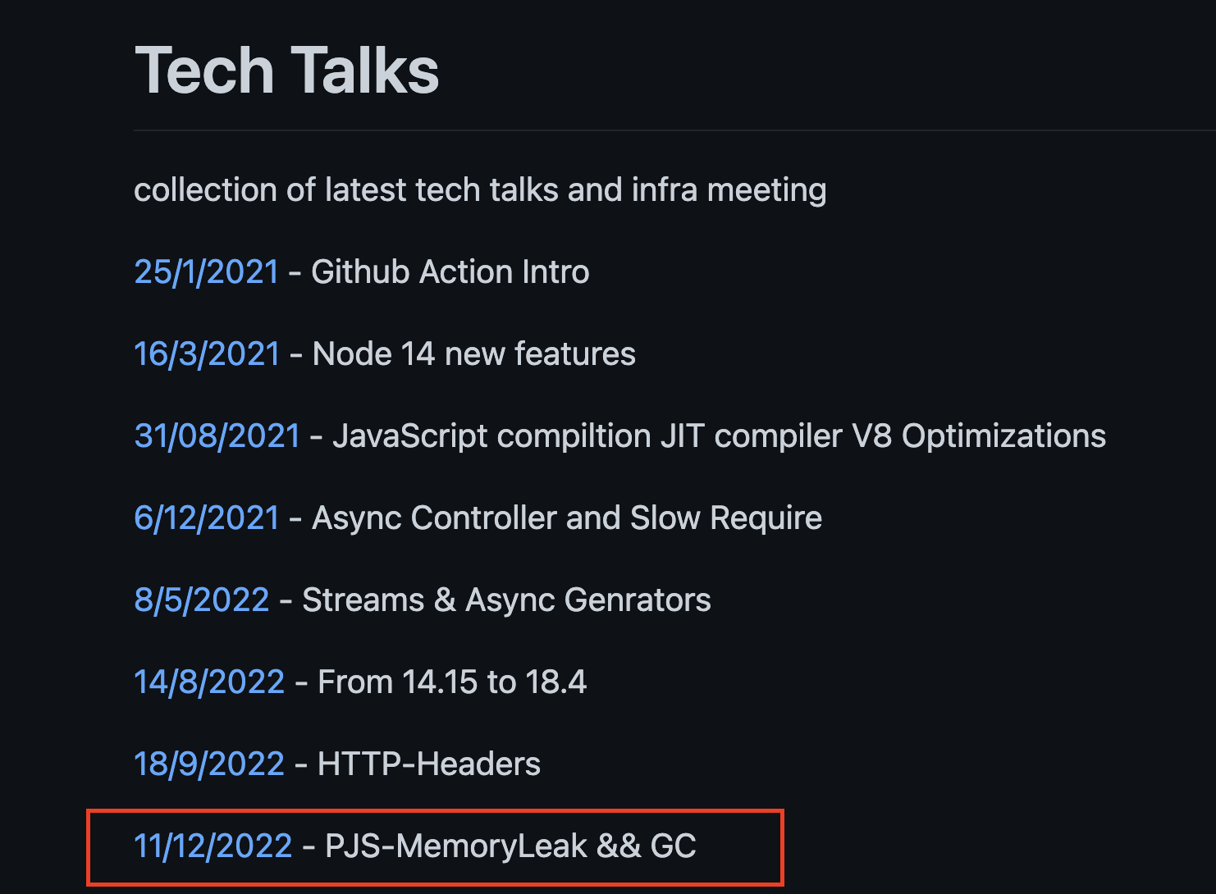
Happy Coding ..
https://github.com/ntedgi/Demand-TechTalks

