Slide 1
V8-Garbage-collection
By Naor Tedgi (Abu Emma)
@ntedgi

Slide 2
Memory Management
Every application needs memory to work properly. Memory management provides ways to dynamically allocate memory chunks for programs when they request it, and free them when they are no longer needed

Slide 3
Reminder : The Stack
The stack contains local variables and pointers to objects on the heap or pointers defining the control flow of the application.
function add (a, b){
return a + b
}
add(4, 5)

Slide 4
Reminder :The Heap
The heap is dedicated to store reference type objects, like objects.
function Car (opts) {
this.name = opts.name
}
const LM = new Car({name: ‘LM'})

Slide 5
Garbeage Collection
Garbage collection is the process of reclaiming the memory occupied by objects that are no longer in use by the application. Usually, memory allocation is cheap while it’s expensive to collect when the memory pool is exhausted.

Slide 6
NodeJS world Term
--max_old_space_size
Sets the max memory size of V8's old memory section. As memory consumption approaches the limit, V8 will spend more time on garbage collection in an effort to free unused memory.
Note:We use 5G on prud servers
--max-semi-space-size
ets the maximum semi-space size for V8's scavenge garbage collector in MiB (megabytes)

Slide 7
Garbeage Collection Algorithems
Algorethem to find answer the problem determining whether or not an object is still needed

Slide 8
Garbeage Collection Algorithems
1) Refernce counting
This is the most naive garbage collection algorithm. This algorithm reduces the problem from determining whether or not an object is still needed to determining if an object still has any other objects referencing it. An object is said to be "garbage", or collectible if there are zero references pointing to it

Slide 9
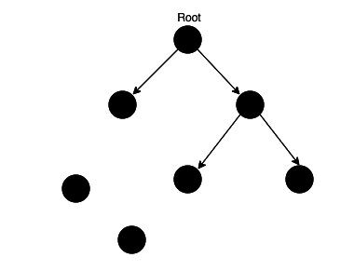
Garbeage Collection Algorithems
1) Refernce counting

Slide 10
Who Is the root element?

Slide 11
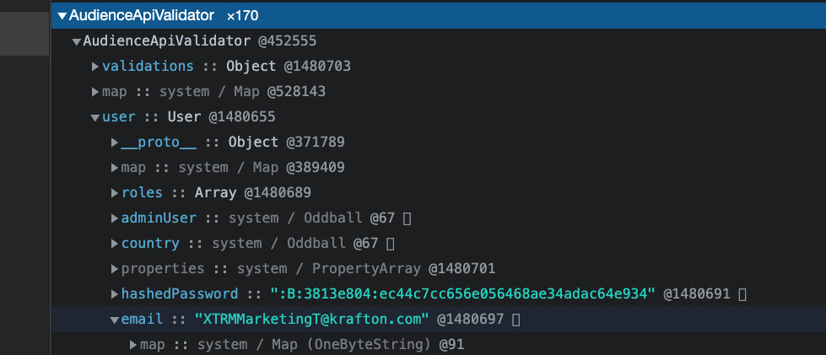
How it looks inside the heap

Slide 12
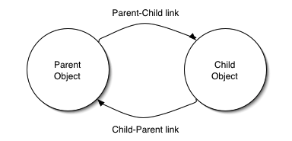
The problem with refernce counting
Circular reference

Slide 13
Scavenge and Mark-Sweep collection
TBD

Slide 14
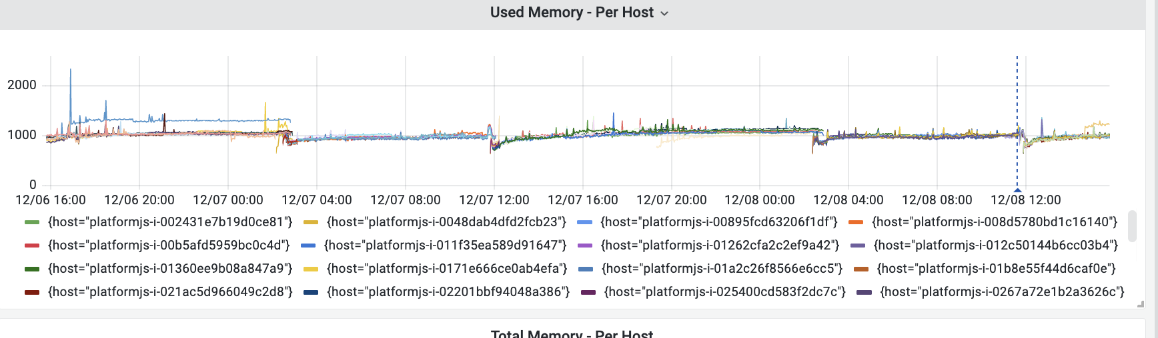
How it Shoold Look
https://monitoring-grafana.sonic-us.supersonicads.com/d/XEyQ5VJGk/demand-platformjs?orgId=1&from=now-2d&to=now

Slide 15
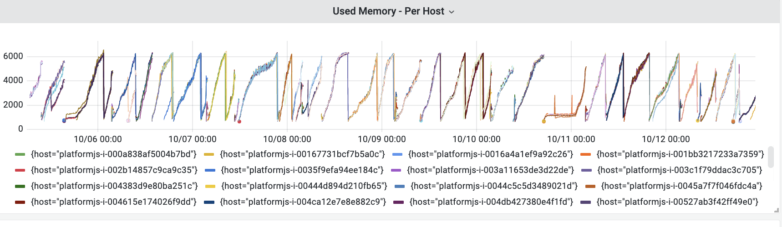
How it Look With memory leak
https://monitoring-grafana.sonic-us.supersonicads.com/d/XEyQ5VJGk/demand-platformjs?orgId=1&from=1664941185105&to=1665603606491

Slide 16
Heapdump demo

