Slide 1
Demand Headers
By Naor Tedgi (Abu Emma)
@ntedgi

Slide 2
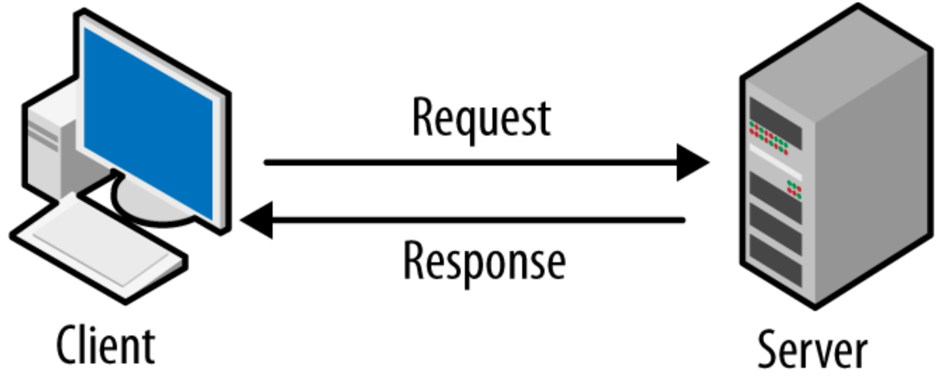
Headers are part of HTTP protocols
Exist on any client request
Exist on any server response
The response alters how the site is responding and how the browser render the site

Slide 3
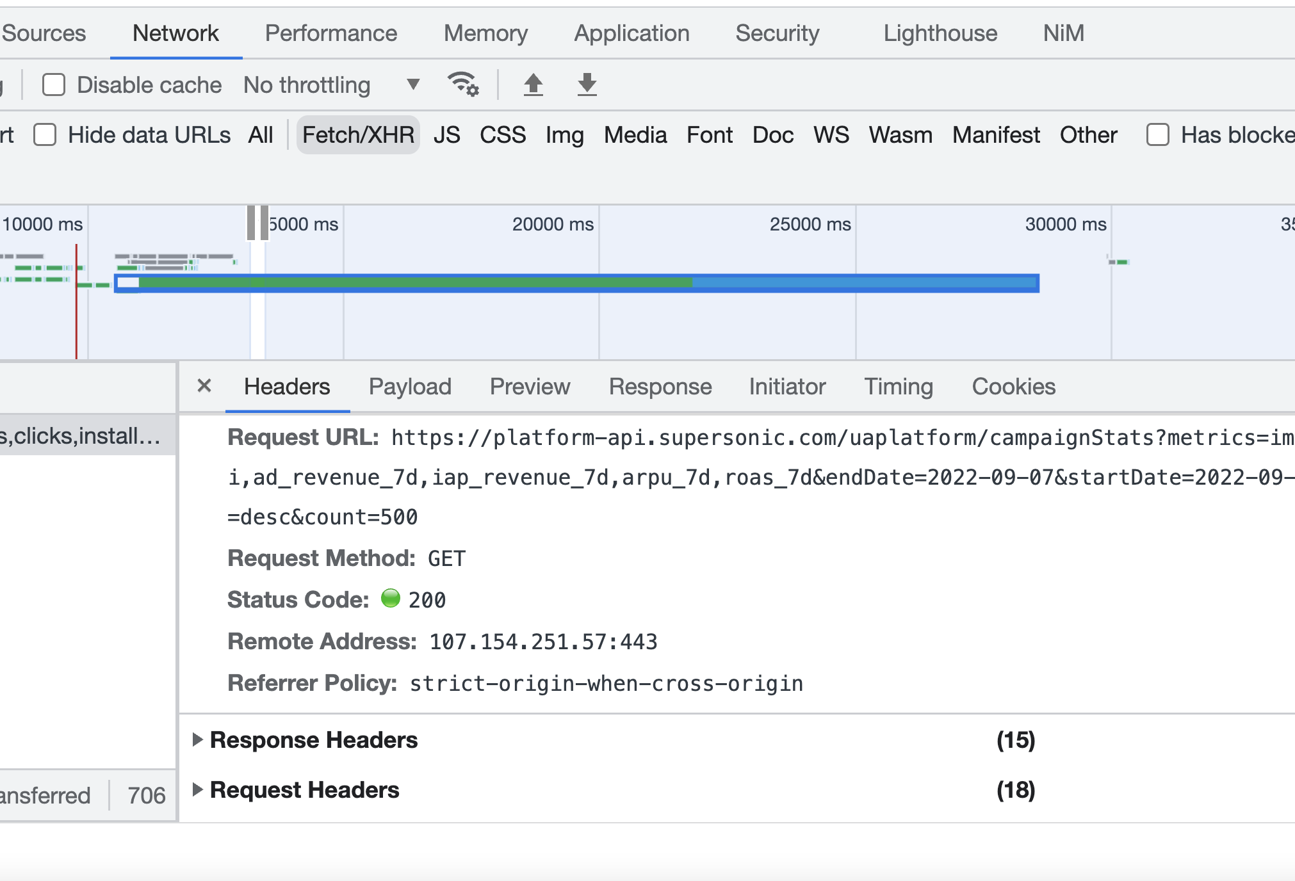

Slide 4





Where did they come from?

Slide 5
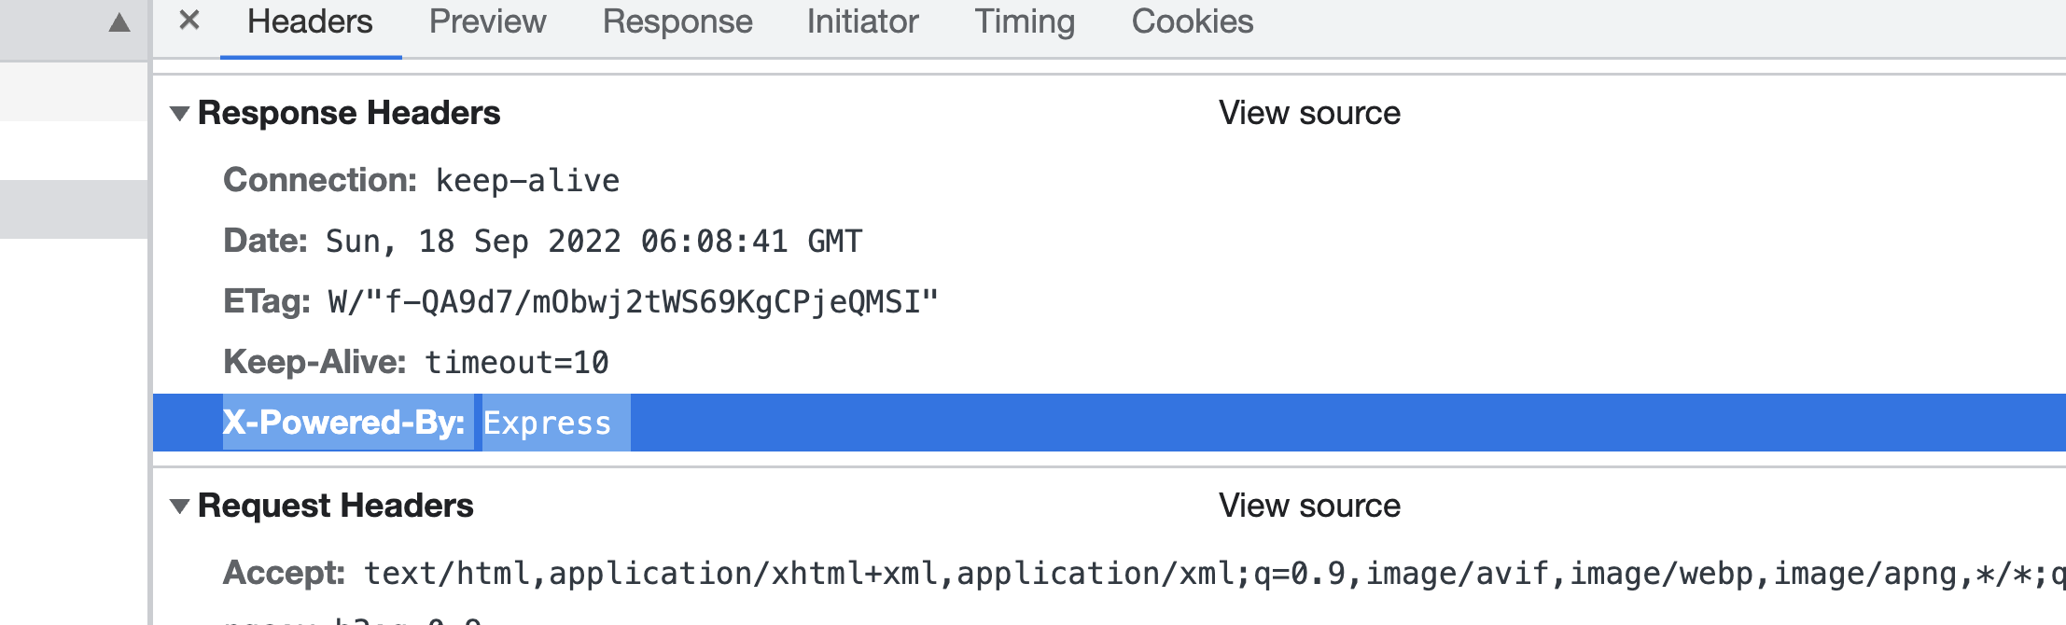
1) (Response) X-Powered-By :Express
http://netinfo.link/http/header/x-powered-by.html
PHP/5.4.45-4+deprecated+dontuse+deb.sury.org~precise+1

Slide 6
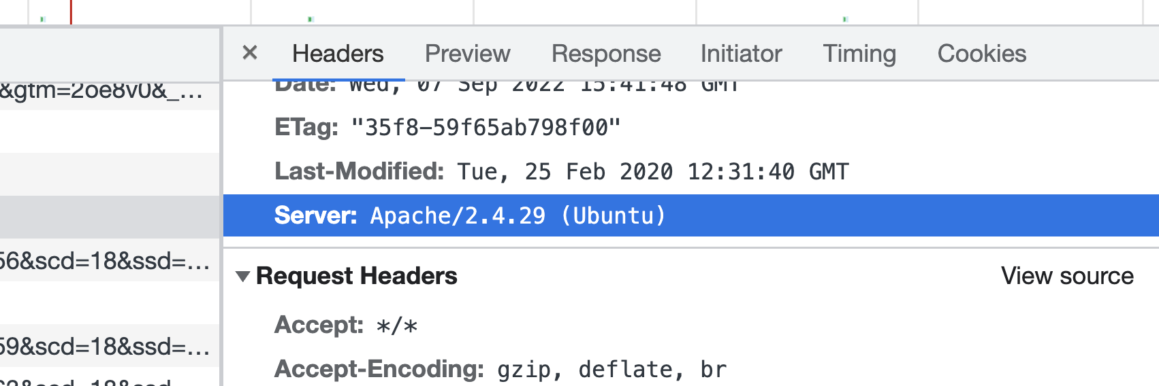
2) (Response) Server
https://httpd.apache.org/security/vulnerabilities_24.html
Something you want to remove!

Slide 7
Add Or Remove Headers in Express:
Remove Hedear:
app.disable( ‘X-powered-by’ );
app.use(function (req, res, next) {
res.removeHeader("X-Powered-By");
next();
});
Set Header:
res.setHeader( 'X-Powered-By', 'Awesome App v0.0.1' );

Slide 8
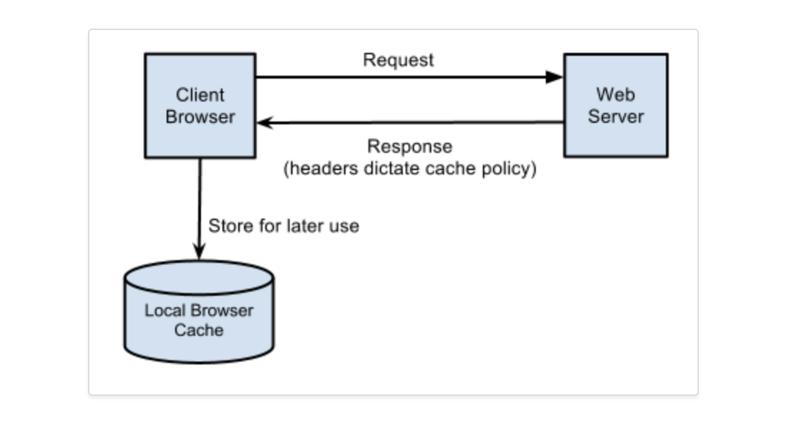
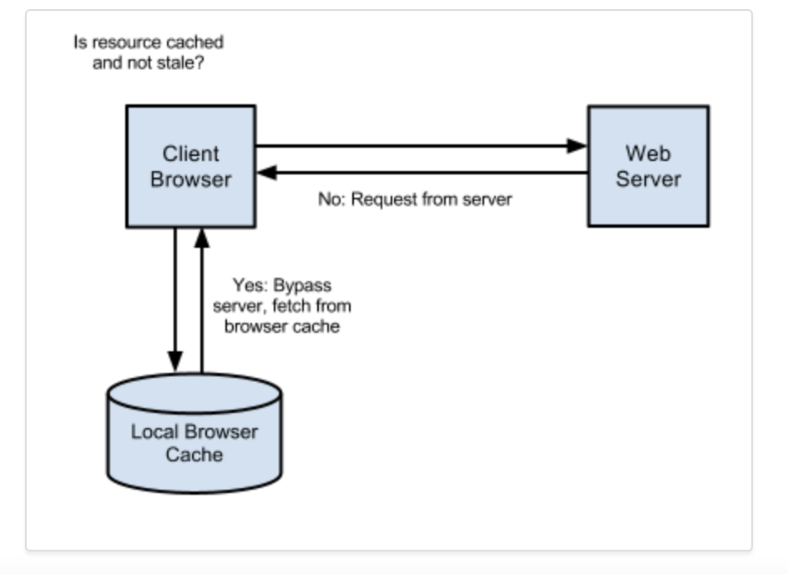
1) Etag: HTTP response header is an identifier for a specific version of a resource. It lets caches be more efficient and save bandwidth, as a web server does not need to resend a full response if the content was not changed
2) Cache-Policy: public, max age=31536000
Notes:
'if-none-match': 'W/"f-QA9d7/mObwj2tWS69KgCPjeQMSI"' Note : First req 200 second 304

Slide 9
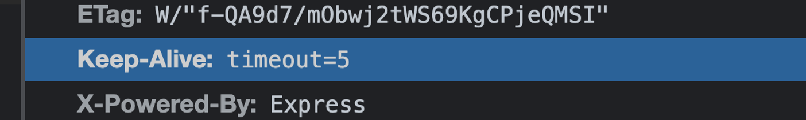
4) (Response) Keep Alive
The HTTP keep-alive header maintains a connection between a client and your server, reducing the time needed to serve files. A persistent connection also reduces the number of TCP and SSL/TLS connection requests, leading to a drop in round trip time (RTT).

Slide 10
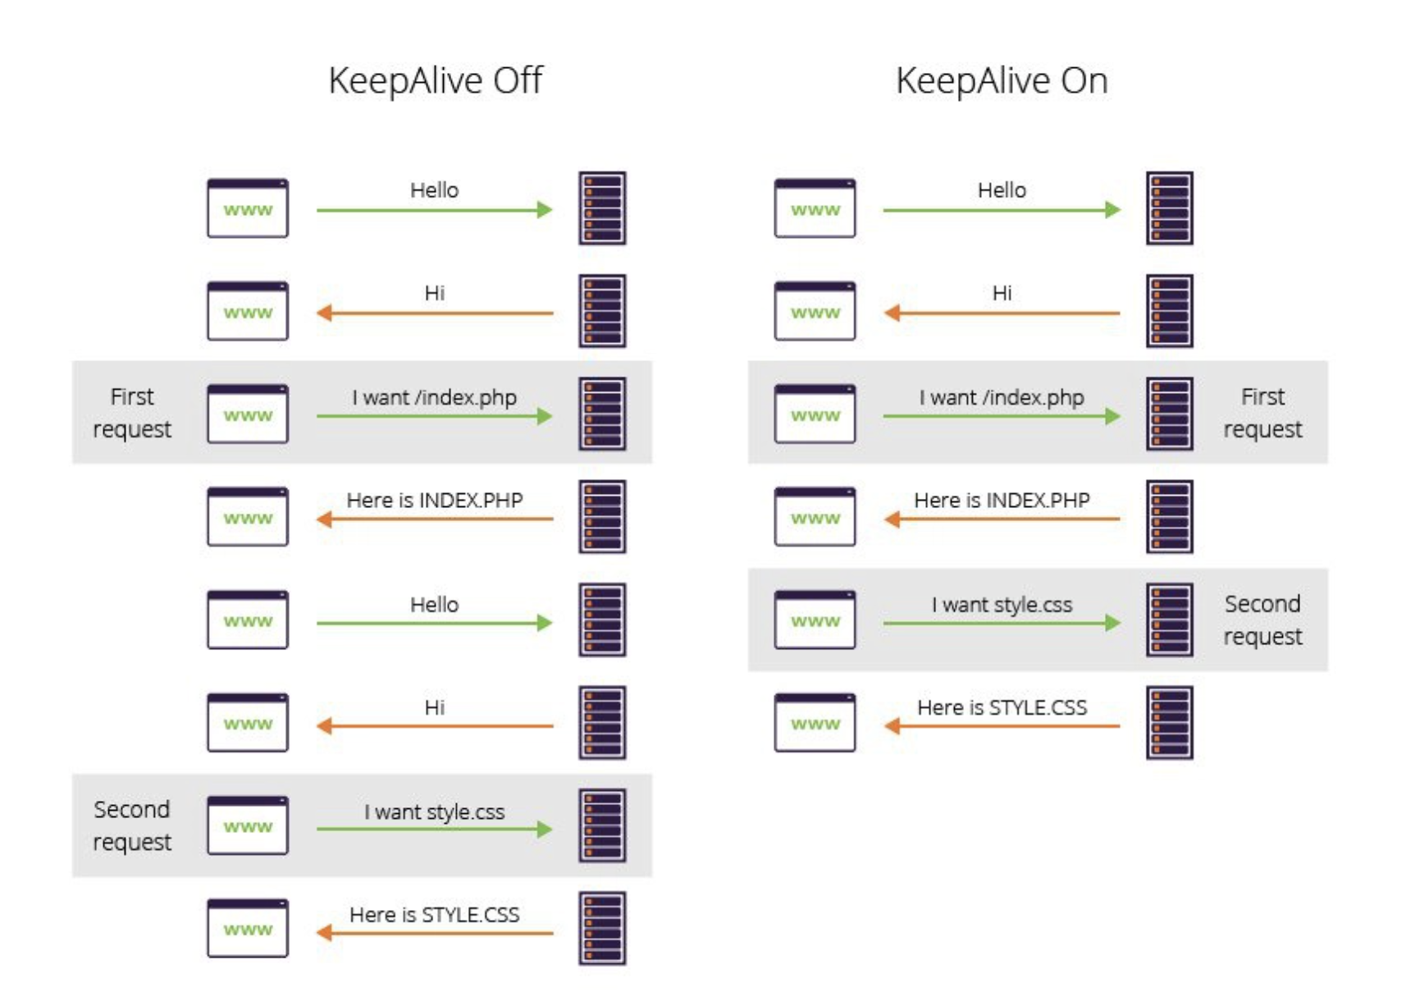
4) (Response) Keep Alive
Notes:
Notest: AB demo
Long pulling from UI ELB also Keep Connection Open RISK! Reminder AsyncWrapper and to many connection!!

Slide 11
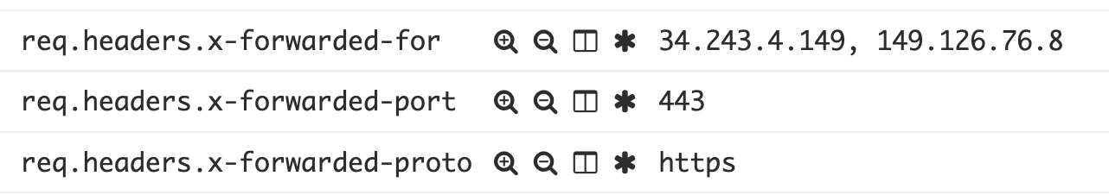
5) (Response) ELB Headers
https://docs.aws.amazon.com/elasticloadbalancing/latest/classic/x-forwarded-headers.html
Notes:
AB demo
Long pulling from UI

Slide 12
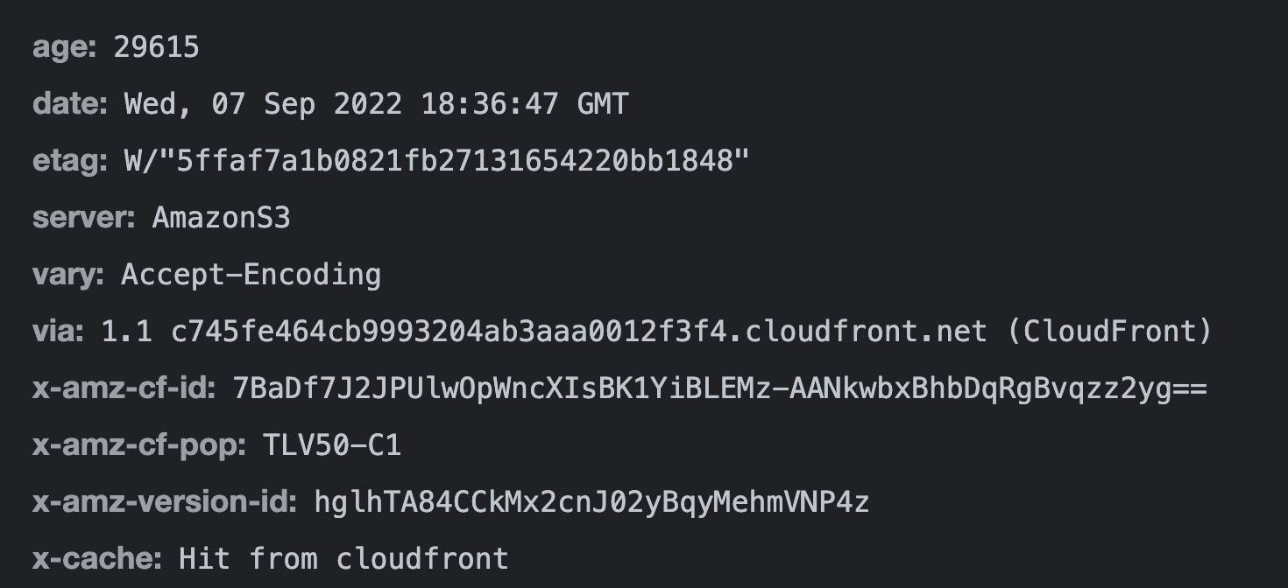
6) (Response) CDN
Notes:
AB demo
Long pulling from UI

Slide 13
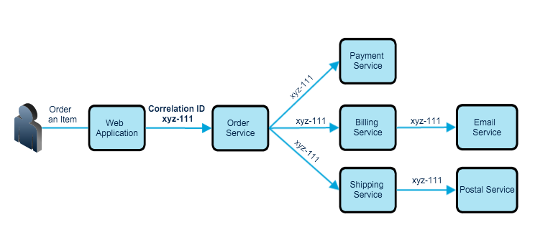
7) x-correlation-id
Notes:
AB demo
Long pulling from UI

Slide 14
Simple Header huge impact
Notes:
AB demo
Long pulling from UI

Slide 15
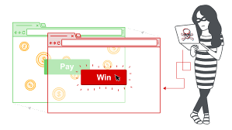
Clickjacking
Notes:
AB demo
Long pulling from UI

Slide 16
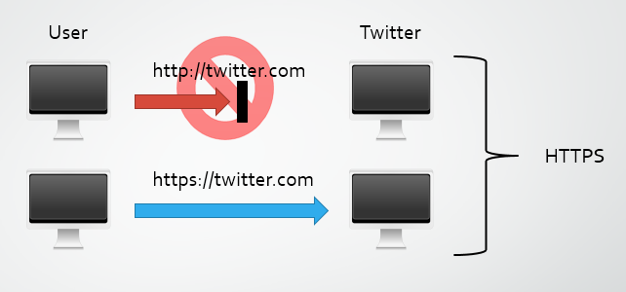
Block SSL Strip attack
Notes:
AB demo
Long pulling from UI

Slide 17
More Example:
XSS X-XSS-Protection
CSRF
HSTS
Notes:
AB demo
Long pulling from UI

Slide 18
Further reading:
https://www.imperva.com/learn/performance/http-keep-alive/
http://netinfo.link/http/header/x-powered-by.html
https://httpd.apache.org/security/vulnerabilities_24.html
https://cheatsheetseries.owasp.org/cheatsheets/Cross-Site_Request_Forgery_Prevention_Cheat_Sheet.html
Notes:
AB demo
Long pulling from UI

Slide 19
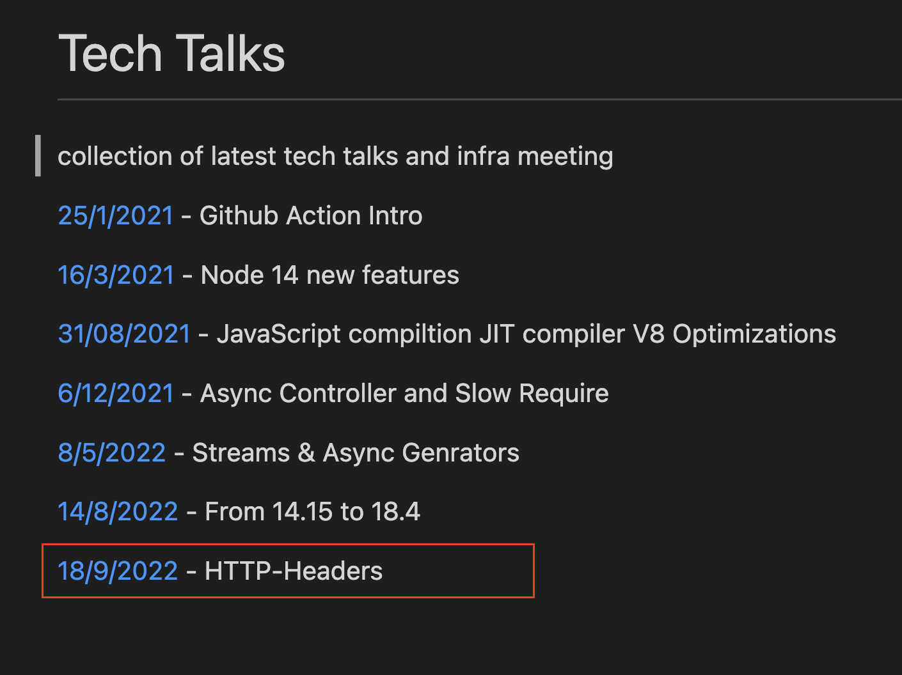
Happy Coding ..
https://github.com/ntedgi/Demand-TechTalks

