Slide 1

CLINICAL INFORMATICS · SYSTEM ARCHITECTURE
Healthcare Patient Management System Dashboard
A clinical data platform for secure patient management and cohort analytics.
PROJECT REVIEW
Name : Tejas N
Emp ID : 82617
Notes:
Introduce the architecture walkthrough: 101,766 diabetes encounters converted from legacy flat files into an integrated, role-governed clinical analytics suite. Emphasize that the focus is on production engineering rigor, data integrity, and strict access controls.

Slide 2

CLINICAL CONTEXT · PROBLEM STATEMENT
DATASET: UCI 130-US HOSPITALS
TEMPORAL RANGE: 1999–2008
ENCOUNTER DEPTH: 50+ ATTRIBUTES
Why the system exists: from records to action
01 / THE RAW RECORD PROBLEM
02 / SYSTEM OBJECTIVE
03 / DATA INGESTION VECTOR
High volume, missing normalization
The UCI Diabetes 130-US Hospitals dataset captures 101,766 clinical encounters across 71,518 unique diabetic patients over a ten-year observational period. In raw CSV form, this represents an intractable operational artifact: hospital-specific identifier encodings, multi-visit patient fragmentation, inconsistent medication status, and ambiguous sentinels.
DESIGN GOAL
Unified clinical intelligence
The system turns raw rows into a structured database and two core capabilities:
Patient Longitudinal Tracking: Link visits to patient histories.
Quality Analytics: Track readmissions, stay length, and medication trends.
RAW ENCOUNTERS | 101,766 records
UNIQUE COHORT | 71,518 patients
READMIT WINDOW | <30 days / >30 days / No
TRANSFORMS STATIC CSVS INTO INTERACTIVE DECISION SUPPORT
50+ FEATURES MAPPED TO THIRD-NORMAL-FORM RELATIONAL TABLES.
Notes:
Walk professors through the clinical scale: 101,766 hospitalizations across 71,518 patients over a 10-year period. Emphasize why flat CSVs fail in clinical workflows: lack of relational integrity, inability to protect patient identifiers, and absence of standardized aggregation pipelines.

Slide 3
SYSTEM ARCHITECTURE · HIGH-LEVEL TOPOLOGY
FLOW: LINEAR ETL TO CLIENT
SYNC: REST / JSON APIS
PERSISTENCE: ACID COMPLIANT
Three layers, one data flow
TIER 01 / INGESTION & WAREHOUSE
TIER 02 / SERVICES & AUTH
TIER 03 / PRESENTATION
CONTROL PLANE
USER PLANE
DATA PLANE
FastAPI Async Backend
React 18 Client Application
Python ETL & MySQL 8.0
RESTful CRUD: Secures access to patient and encounter records.
Analytical Engine: Aggregates readmissions, diagnoses, and medication trends.
Authentication & RBAC: JWT-based row and field permissions.
Role-Adaptive Views: Tailors UI modules dynamically based on JWT token scopes.
Interactive Visuals: Dynamic Recharts plotting categorical breakdowns and glycemic cohorts.
Operational Grids: Paginated, searchable patient tables for everyday clinical administration.
Batch Extraction: Loads diabetes CSVs with Pandas.
Normalization: Cleans nulls and resolves mappings.
Storage Engine: Stores indexed entities in transactional tables.
OUTPUT: NORMALIZED RELATIONAL SCHEMA
OUTPUT: FILTERED JSON PAYLOADS & CLAIMS
OUTPUT: RESPONSIVE END-USER DASHBOARDS
Notes:
Detail the architectural separation of concerns. Emphasize why FastAPI acts as the vital governance boundary: it ensures that no direct frontend query reaches the database, enforcing RBAC before executing parameterized aggregation queries.

Slide 4
ENGINEERING STACK · SPECIFICATIONS & TRADEOFFS
PYTHON 3.10+ · FASTAPI
REACT 18 · VITE 6
MYSQL 8.0+ INNODB
The stack: fast, typed, and auditable
A / API & BACKEND
B / PERSISTENCE & ETL
C / IDENTITY & AUTH
D / FRONTEND CLIENT
FastAPI Core
Data Layer
React Application
PYTHON 3.10+
MYSQL 8.0+
START HERE
REACT 18 + VITE 6
Security Layer
FastAPI: Async APIs with OpenAPI docs.
Pydantic v2: Strict payload validation.
SQLAlchemy 2.0: Typed queries with connection pooling.
MySQL 8.0: InnoDB, foreign keys, and B-tree indexes.
Pandas & NumPy: In-memory vectorized transformations for 100k+ record sets.
PyMySQL: Reliable database driver supporting high-throughput bulk inserts.
python-jose: Stateless cryptographic HS256 JWT generation and signature verification.
Passlib & Bcrypt: Salted password hashing protecting user access tables.
Bearer Middleware: Dependency injection intercepting all secure routes.
Vite 6: Lightning-fast compilation and optimized asset bundling.
Recharts: Composable SVG data visualizations reacting to state changes.
Axios & Lucide: HTTP request interceptors for token attachment and clinical icons.
TRADEOFF: FASTAPI ASYNC HANDLES CONCURRENT ANALYTIC QUERIES WITH MINIMAL LATENCY.
TRADEOFF: RELATIONAL RIGOR PREFERRED OVER NOSQL TO ENSURE STRICT FOREIGN-KEY LINKAGE.
TRADEOFF: STATELESS JWT ELIMINATES SESSION STORE LOCKS WHILE GUARANTEEING RBAC CLAIMS.
TRADEOFF: CLIENT-SIDE ROUTING DECOUPLES ANALYTICS VIEW RENDERING FROM API LATENCY.
Notes:
Present the engineering choices: why Pydantic v2 was chosen for runtime payload verification, why MySQL 8.0 was preferred over Document stores (guaranteeing cross-table foreign key constraints across encounters and mappings), and how bcrypt ensures secure credential storage.

Slide 5
DATA ENGINEERING · EXTRACTION & NORMALIZATION PIPELINE
STAGE 1: INGESTION
STAGE 5: BULK LOAD
INTEGRITY: STRICT FKS
From CSV to database: five ETL stages
STAGE 01
STAGE 02
STAGE 03
STAGE 04
STAGE 05
Ingest Source CSVs
Normalize Nulls
Deduplicate Entities
Bulk Load Execution
Load source CSVs with Pandas.
Convert "?" markers to SQL NULLs.
KEY STEP
Separate patients, visits, and ID mappings.
Load patients first, then linked encounters.
Resolve Collisions
Rename reserved fields for safe SQL use.
101,766 ROWS LOADED INTO MEMORY
ELIMINATES STRING ARTIFACT SKEW
HARDENS ORM COMPATIBILITY
71,518 MASTER PATIENT RECORDS
MAINTAINS REFERENTIAL INTEGRITY
DATA HYGIENE RULE
RELATIONAL CARDINALITY
TRANSACTIONAL GUARANTEE
Sentinel conversion prevented erroneous aggregations where missing laboratory values might have evaluated as valid categories.
Separating patients from encounters transformed flat multi-encounter records into an explicit 1-to-N normalized relational model.
Staged bulk inserts utilized transactional checkpoints to ensure no orphan encounter record could persist if a batch faulted.
Notes:
Explain the critical pipeline subtleties: the UCI dataset notoriously used '?' for missing measurements (e.g., weight, payer_code, medical_specialty). We converted these to NULLs and resolved schema keyword collisions like MySQL's reserved word 'change' before loading.

Slide 6
DATA WAREHOUSING · RELATIONAL SCHEMA DESIGN
SCHEMA: DIABETES_DB
PRIMARY ENTITIES: 4 TABLES
ENGINE: INNODB
What the schema holds
01 / RELATIONAL DATABASE MODEL
TABLE NAME | PRIMARY KEY / INDICES | CORE ATTRIBUTES & PAYLOAD | RELATIONAL PURPOSE & SCOPE
patients | patient_nbr (PK) | Demographics: race, gender, and age | One row per unique patient; ensures demographic normalization across 71,518 cohorts.
encounters | encounter_id (PK) patient_nbr (FK) | Length of stay, admission/discharge IDs, diagnoses (ICD-9), medications, readmission (<30, >30, NO) | One row per hospital admission; stores 101,766 longitudinal events linked back to patient master.
id_mappings | mapping_id (PK) admission_type_id | Maps source IDs to clinical concepts | Resolves source coding abstractions; enables dynamic dimension translation in API queries.
users | user_id (PK) username (UQ) | Hashed password (bcrypt), full name, user role (admin, clinical_ops, analyst), active status | Separates identity from clinical data.
STRICT FOREIGN KEY CONSTRAINT: ENCOUNTERS.PATIENT_NBR REFERENCES PATIENTS.PATIENT_NBR WITH ON DELETE CASCADE RESTRICTED.
B-TREE INDEXING ON PATIENT_NBR, ADMISSION_TYPE_ID, AND READMITTED.
Notes:
Review the relational design: highlighting how separating 'patients' from 'encounters' eliminated redundancy for readmitted individuals, while 'id_mappings' enables performant joins on admission codes without cluttering encounter rows with repetitive strings.

Slide 7
GOVERNANCE & SECURITY · ROLE-BASED ACCESS CONTROL
SECURITY: JWT / HS256
PRINCIPLE: LEAST PRIVILEGE
AUDIT: ENDPOINT MIDDLEWARE
Three roles, three access levels
ROLE 01 / SYSTEM GOVERNANCE
ROLE 02 / DAILY WORKFLOW
ROLE 03 / DE-IDENTIFIED RESEARCH
ADMINISTRATOR
CLINICAL OPERATIONS
CLINICAL ANALYST
Full System Governance
Direct Patient Operations
De-Identified Analytics
Full control of data, users, and settings.
For daily patient and encounter workflows.
For de-identified population analytics.
Patient Records: Full CRUD access.
Clinical Encounters: Full CRUD permissions on all historical encounters.
Analytics: Complete access to cohort engines and raw metric feeds.
User Management: Provision, role modification, and account revocation.
Patient Records: View, create new admissions, update demographic info.
Clinical Encounters: Log new encounter results and update diagnoses.
Data Protection: Zero delete permissions across any patient or visit tables.
User Management: No visibility or access to system accounts.
Aggregate Analytics: Read-only access to KPIs, readmission rates, and graphs.
Cohort Visualizations: Filter by diagnostic groups, medication regimens.
Privacy Barrier: Completely blocked from individual names, IDs, or encounter rows.
Zero Write Access: Inability to mutate any clinical or system entity.
EXCLUSIVE PERMISSION: PERMANENT RECORD DELETION & USER PROVISIONING
SAFETY CONSTRAINT: APPEND AND EDIT ONLY; RECORDS CANNOT BE PURGED
HIPAA PRINCIPLE: MATHEMATICAL ACCESS WITHOUT INDIVIDUAL RECORD DISCLOSURE
Notes:
Give special emphasis to this slide: the access model strictly follows the principle of least privilege. Highlight how the Analyst role is cryptographically barred from accessing individual record endpoints, satisfying clinical privacy standards while enabling population-level research.

Slide 8
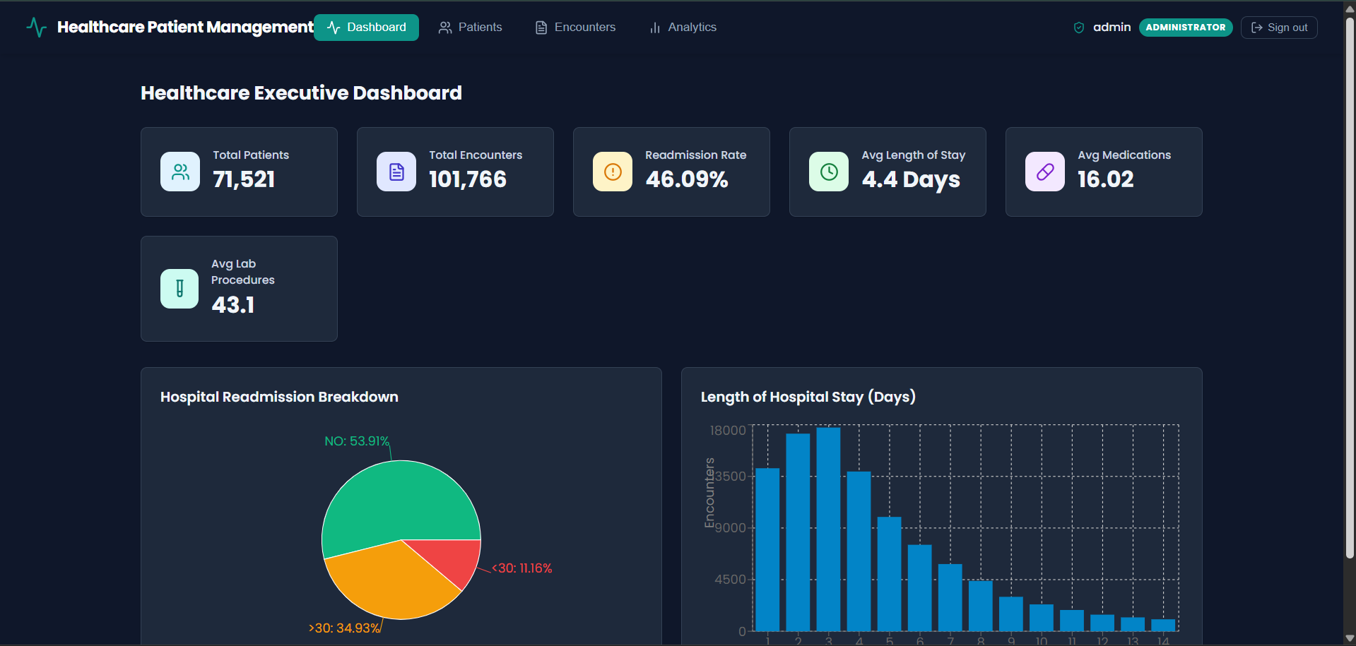
Notes:
Demonstrate how the analytics solve real healthcare challenges: tracking readmissions under 30 days is a primary CMS reimbursement metric. The dashboard turns 100k raw records into instantaneous risk-distribution insights.

Slide 9
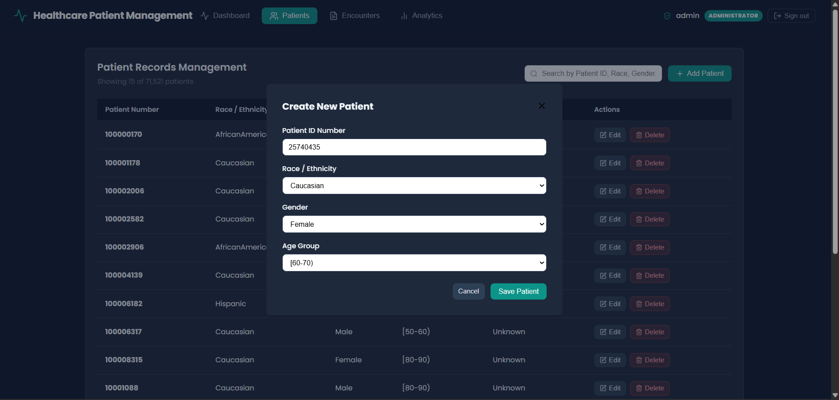

Slide 10
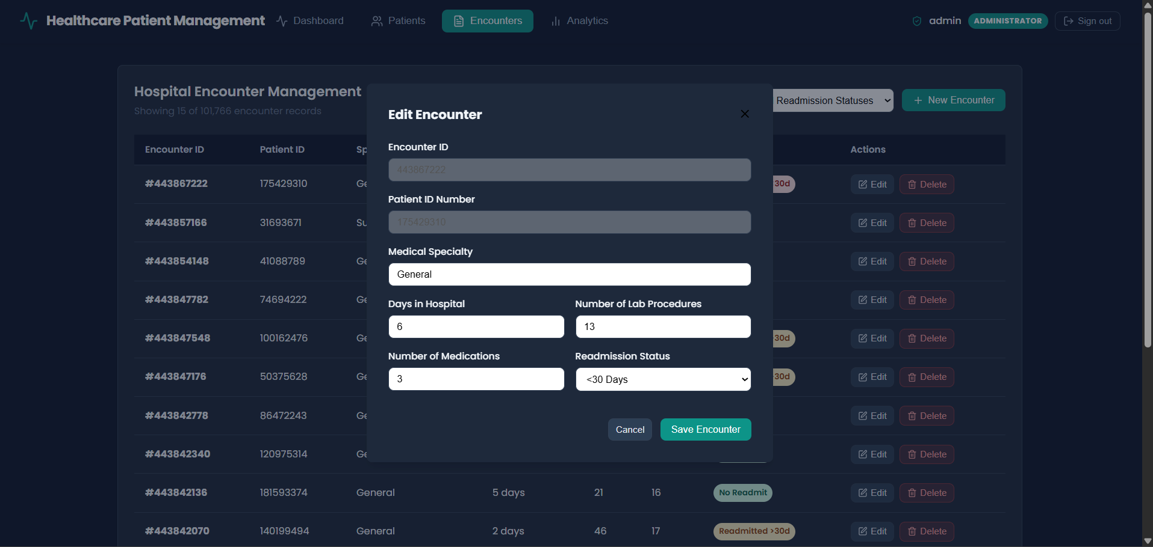

Slide 11
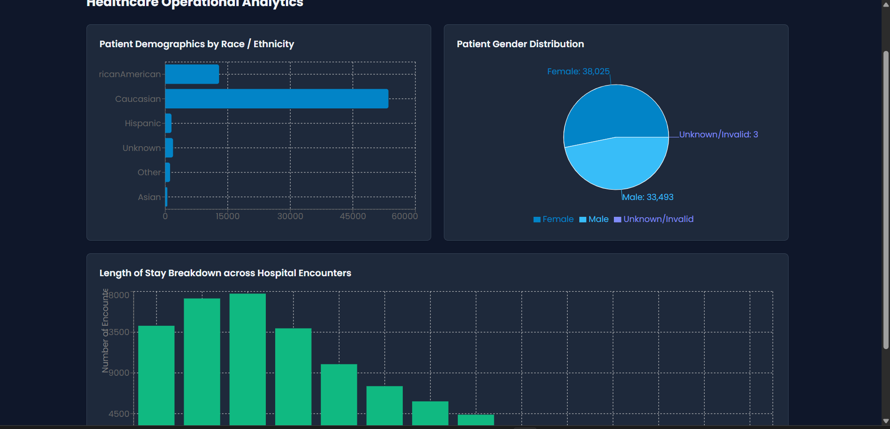

Slide 12
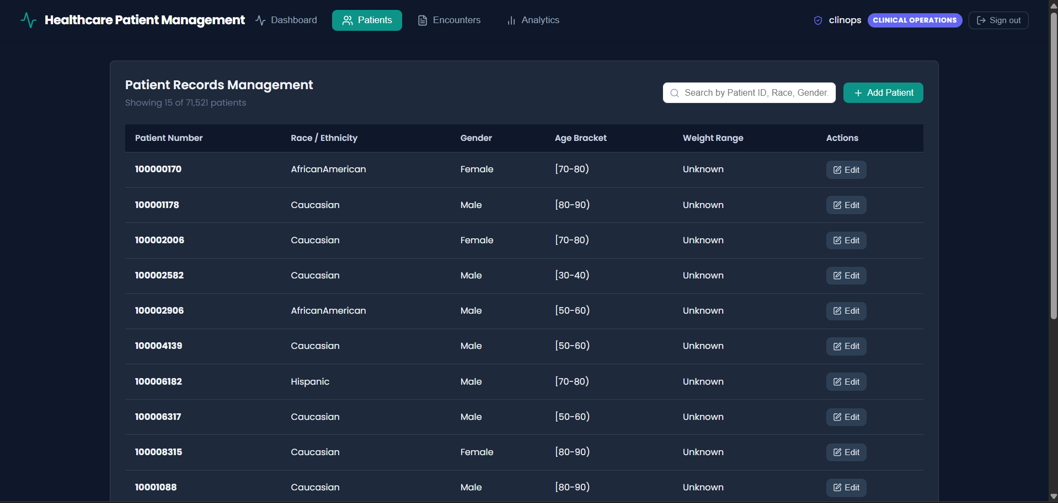

Slide 13
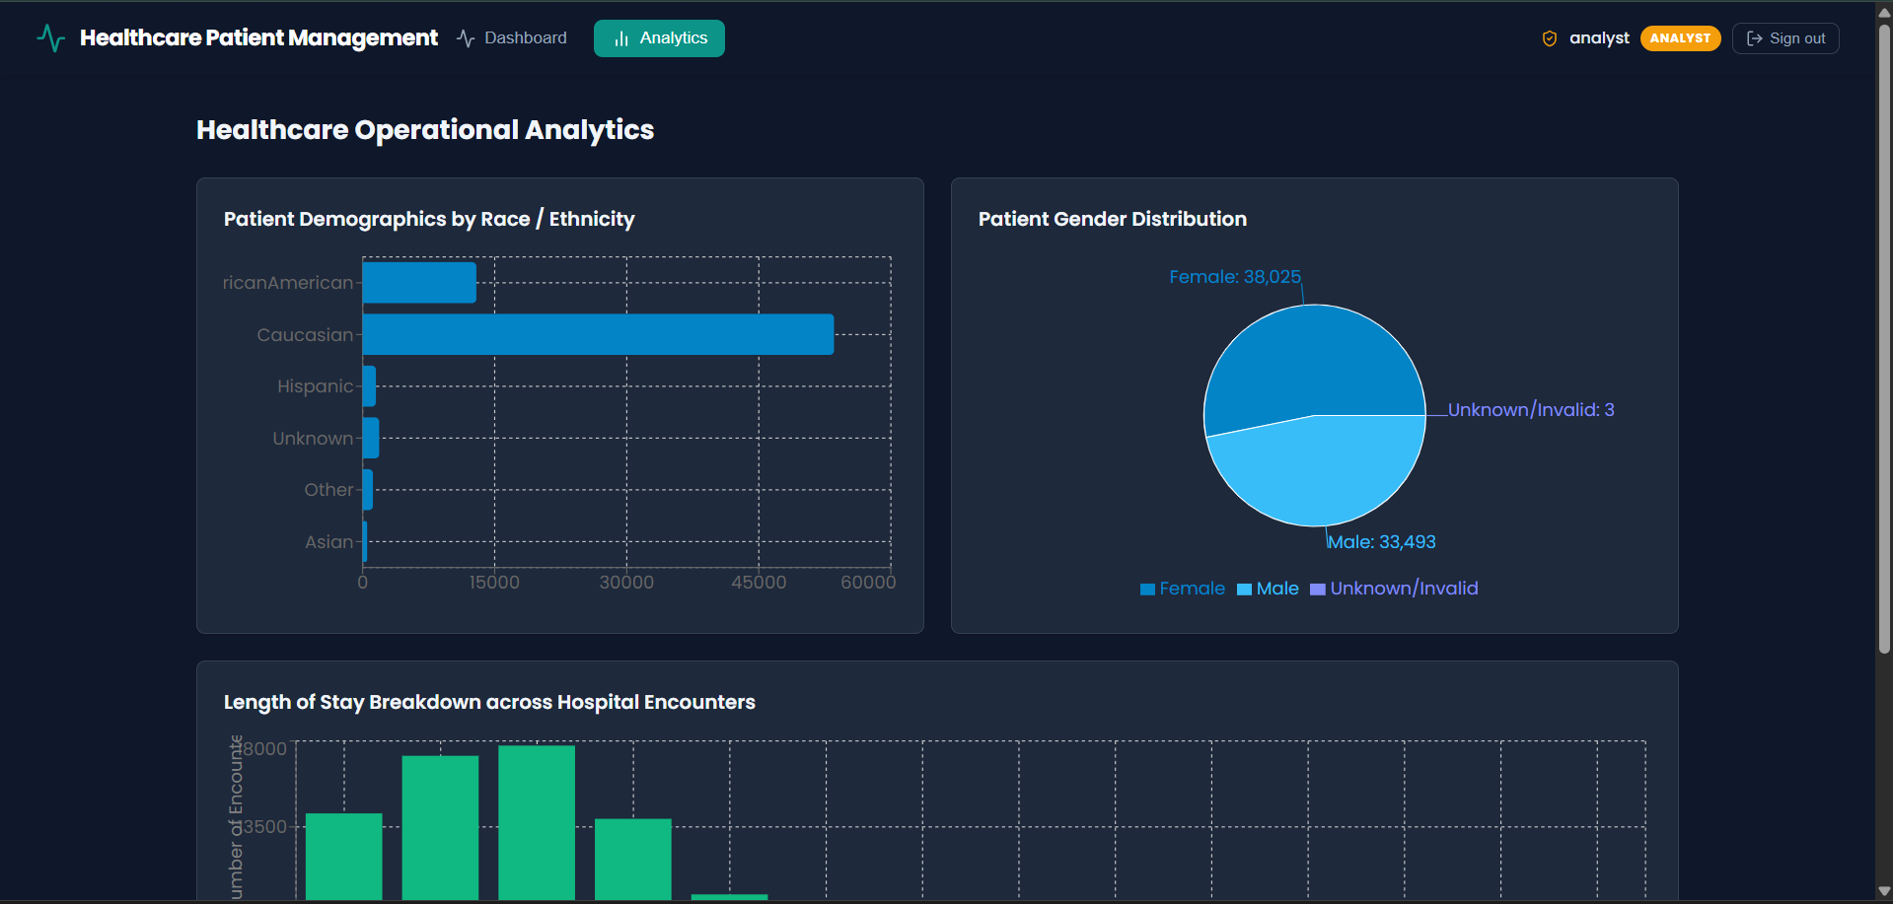

Slide 14
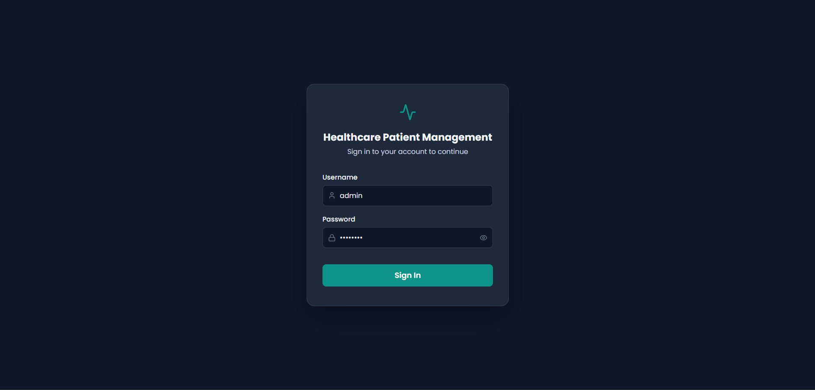

Slide 15
ROADMAP & EXTENSIBILITY · TECHNICAL EVOLUTION
PHASE 2: PREDICTIVE ML
PHASE 3: FHIR & HL7
PHASE 4: KAFKA STREAMS
Future enhancements
01 / MACHINE LEARNING INTEGRATION
PRIMARY TARGET
Predictive readmission scoring
Score readmission risk at intake using labs and patient history.
CLINICAL IMPACT
ENABLES AUTOMATED CLINICAL ALERT FLAGS FOR HIGH-RISK DIABETIC DISCHARGES
Preventing 30-Day Relapse
Current analysis identifies medication switches and glycemic extremes as primary drivers of relapse. Incorporating prospective scoring allows case managers to intervene before discharge.
02 / INTEROPERABILITY STANDARDS
HL7 FHIR interoperability
Refactor ETL connectors to ingest and export standardized FHIR Patient and Encounter JSON resources, enabling interoperability with modern EHRs.
TARGET: 15% REDUCTION IN PREVENTABLE 30-DAY DIABETES READMISSIONS
FACILITATES SEAMLESS INTEGRATION WITH EPIC AND CERNER HOSPITAL SYSTEMS
ARCHITECTURE HORIZON
Containerized Kubernetes Cluster
Dockerized microservice deployment with horizontal pod autoscaling for intensive aggregation queries across millions of patient encounters.
03 / STREAMING ARCHITECTURE
Apache Kafka / RabbitMQ Event-Driven Streaming
Stream telemetry and encounter updates in real time.
SUB-SECOND DASHBOARD LATENCY FOR MULTI-FACILITY HEALTHCARE OPERATIONS
Notes:
Outline the future evolution: moving from retrospective descriptive analytics to prospective predictive models (XGBoost for 30-day readmissions), adopting HL7 FHIR standards for hospital EHR interoperability, and deploying Kafka for real-time telemetry streaming.

Slide 16
Thank you

