Slide 1
AIOps Build and Assembly Project
Lead: Sana Hafez
Interns: Nahom Tesfu
Dhyey Vank
Ketan More
Mentors: Njock II, Jean-Pierre
Modjeski, Andrew T
Notes:
Title. The system does two things: temporal step segmentation and per-step compliance verification on egocentric assembly video. v2 is the current best offline configuration.

Slide 2
Build and Assembly Introduction
Scope: Research and develop an AI based system capable of detecting errors & deviations in various stages of assembly processes from first person view videos resulting in improved efficiency, higher throughput, and faster production times.
Value: Benefits the company wide effort by significantly reducing the time required of quality checks, allowing for faster production cycle and shorter lead times
Business Area: Aero
Viewpoint: Egocentric

Slide 3
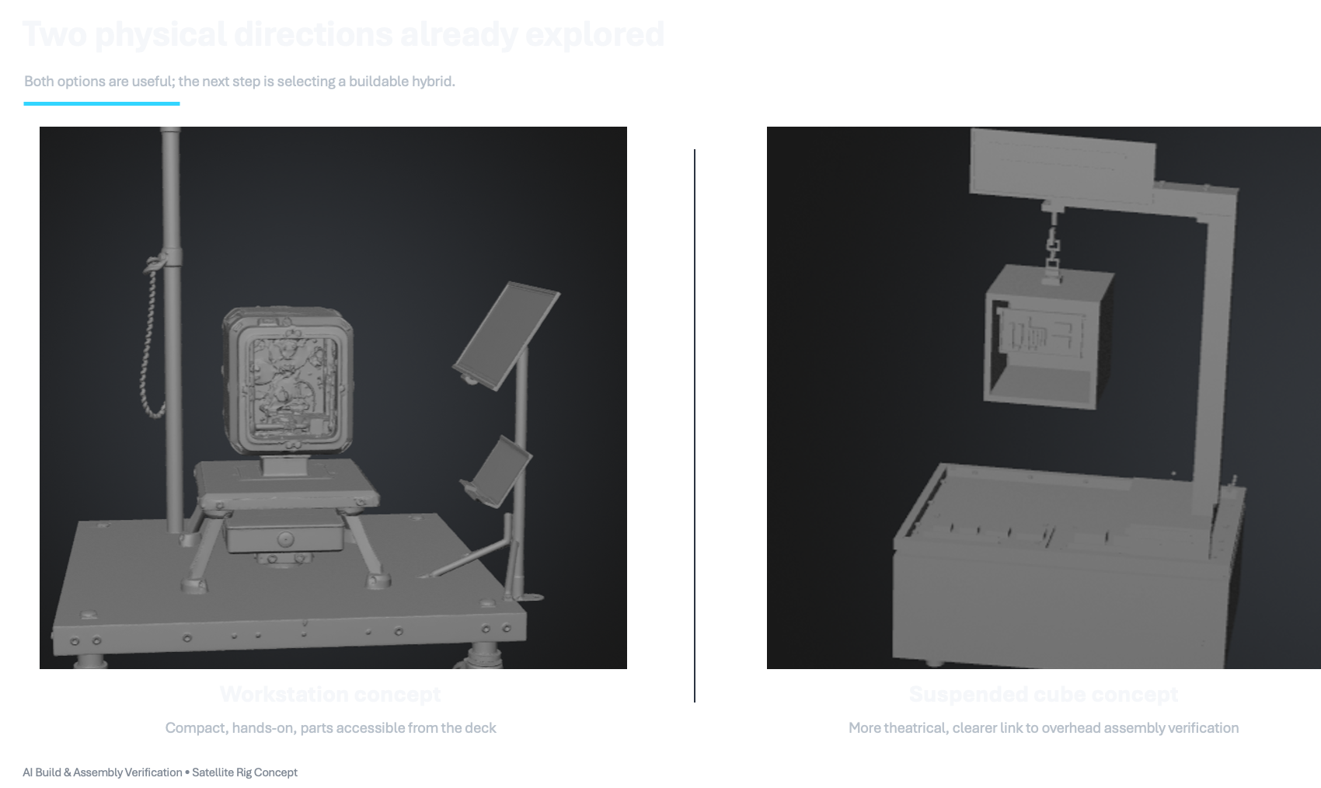
Data collection Setup prototypes

Slide 5
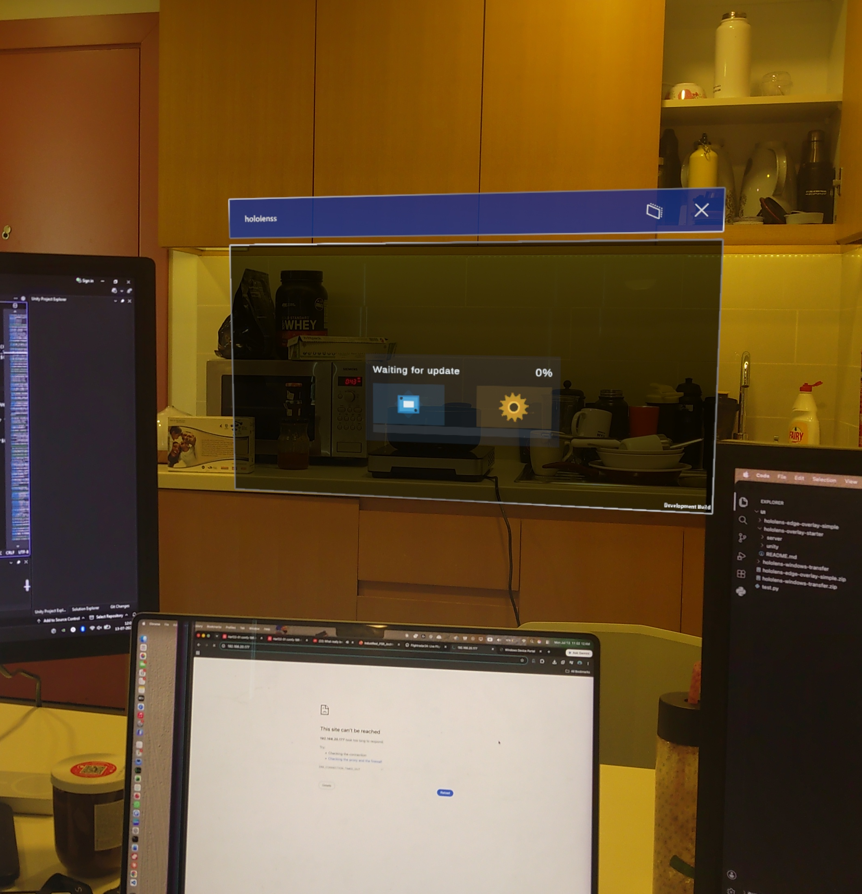
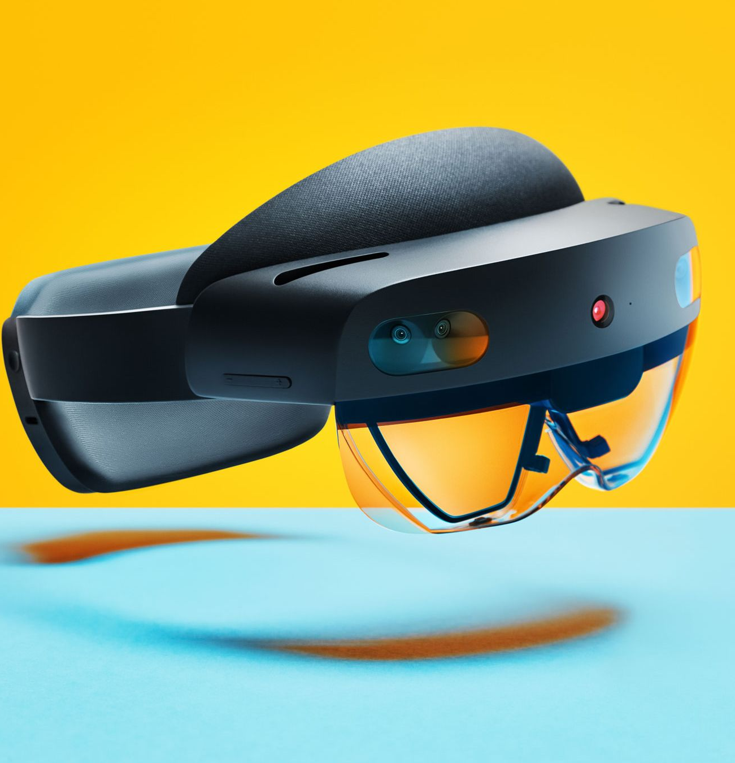

Slide 6
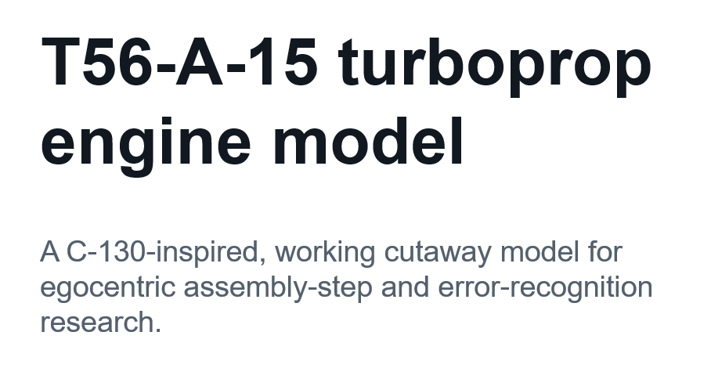
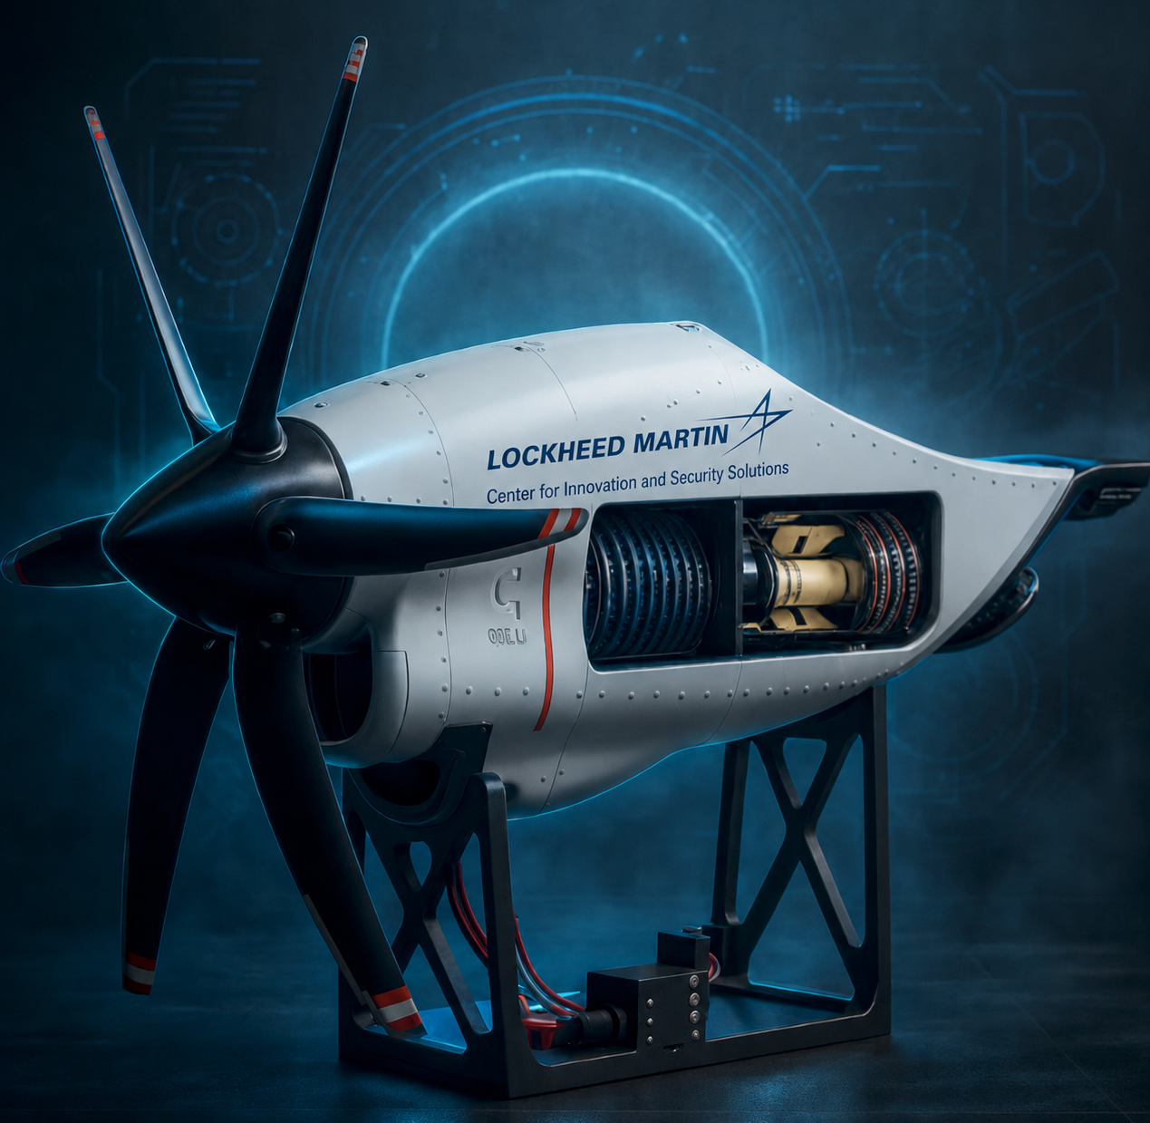
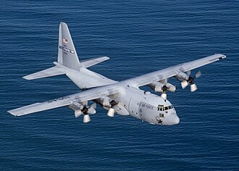
Final Selected Assembly Platform
Notes:
Frame the problem. Emphasize the small-data reality (36 recordings) up front — it explains the accuracy ceiling later.

Slide 7
Why this platform
Recognizable aerospace form
Visible internal mechanics
Powered motion
Modular interfaces
Repeatable assembly

Slide 8
The model creates strong visual evidence for a VLM
The chosen actions combine mechanical alignment, tool use, connectivity and functional motion.
01
02
03
Observable mechanics
Egocentric compatibility
Rich error vocabulary
Propeller, gears, compressor, turbine and casing create large, distinct visual state changes.
Most actions happen directly in front of the operator and remain visible to a HoloLens camera.
Wrong orientation, partial seating, missing fasteners, bad routing and skipped order are easy to stage.

Slide 9
Twenty observable actions fit a 4-5 minute run
Prepared subassemblies remove repetitive micro-fastening while preserving the interfaces that matter to the model.
PROPULSION INPUT
DRIVE + CONTROL
ENGINE CORE
INTEGRATION + TEST
1 Stage parts 2 Assemble blades 3 Close propeller hub 4 Assemble planetary gears 5 Close gearbox
6 Mount motor and frame 7 Install drive shaft 8 Mount controller board 9 Terminate wiring 10 Prepare compressor rotors
11 Stack compressor pack 12 Install compressor 13 Install aft support 14 Fit aft housing 15 Secure turbine module
16 Install turbine rotor 17 Connect main harness 18 Complete internal frame 19 Fit nacelle panels 20 Perform powered test
Target: <=15 seconds per action | One visible completion cue per step | Correct, error and recovery runs

Slide 10
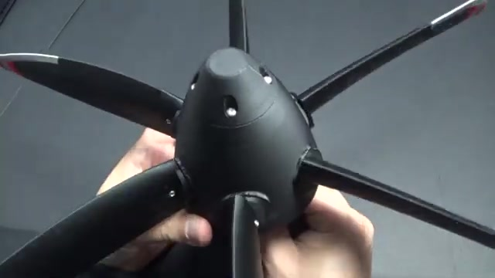
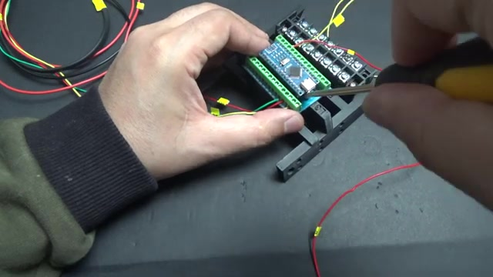
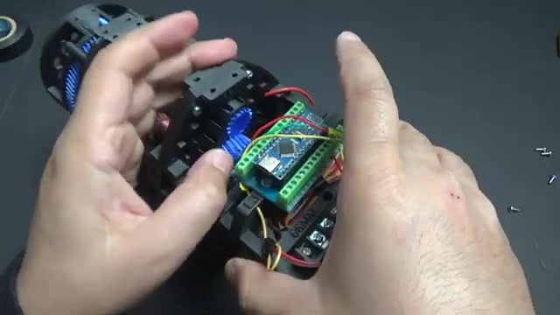
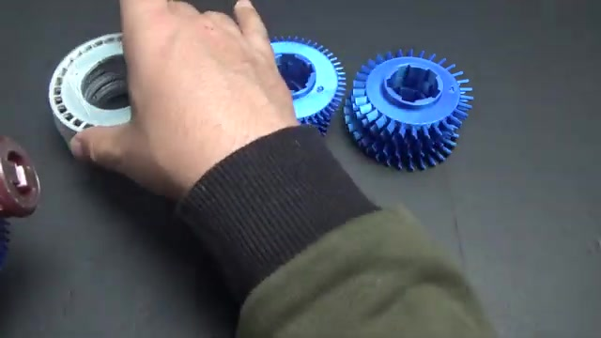
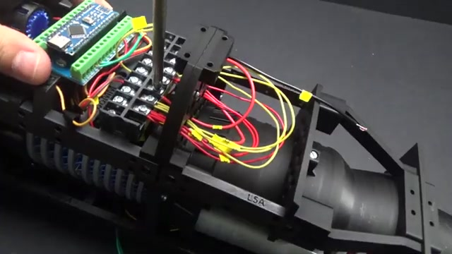
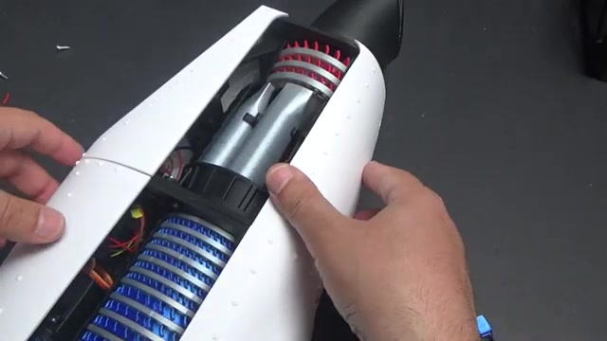
Each label is grounded by a visible before-and-after state
Store the action interval, contact frame and completion frame; use the completion cue for online feedback.
STEP 04 Planetary gears
STEP 09 Controller wiring
BEGIN
END
BEGIN
END
STEP 11 Compressor pack
STEP 19 Nacelle panels
BEGIN
END
BEGIN
END

Slide 11
IndustReal
Video
Procedure Step Recognition
Segment
Egocentric assembly video → step segmentation + compliance verification
Architecture v2 · VideoMAEv2-giant, SSv2-pretrained (frozen) → ASFormer / DiffAct++ → Viterbi
Verify
Sana Hafez (lead) . Nahom . Dhyey Vank . Ketan More
Notes:
Title. The system does two things: temporal step segmentation and per-step compliance verification on egocentric assembly video. v2 is the current best offline configuration.

Slide 12
The task
Turn a long egocentric assembly video into an ordered, verified step sequence
1
2
3
Input
What we output
Why it is hard
One egocentric video of a person performing an assembly, several steps in sequence.
Per-frame step labels collapsed into an ordered timeline, plus a correct / incorrect / missing judgment per step.
Fine-grained steps, egocentric motion and hand occlusion, and only a small annotated training set.
mp4 · 30 fps · 1280×720
step timeline + outcome + verdict
36 train recordings
The compliance angle is what makes this more than plain action segmentation: the system must catch a wrong or skipped step, not just name the current one.
IndustReal — Procedure Step Recognition
2
Notes:
Frame the problem. Emphasize the small-data reality (36 recordings) up front — it explains the accuracy ceiling later.

Slide 13
The current architecture is solving the wrong abstraction
The largest gain will come from physical state and procedure belief—not a second giant encoder
Four architectural gaps
Root cause
A frozen 1B motion encoder + clip classifier + Viterbi can segment familiar motion, but it cannot represent what part, tool or connection changed—or which branches are valid next.
01
Motion is not state
The same hand motion can seat the correct part, the wrong part or nothing at all.
02
Linear order is too rigid
Aerospace procedures contain optional, parallel and recovery branches.
03
Closed-set outcomes miss unseen faults
A safe system must preserve an UNKNOWN / escalate decision.
Why this matters: the current v2 result is strong offline, yet the causal model drops sharply and incorrect-install recall is approximately zero.
04
No future or recovery model
Detection alone cannot return the assembly to a verified state.
IndustReal — Procedure Intelligence Architecture
13
Notes:
This is the honest 'why accuracy is limited' slide. The single most important line is incorrect-install recall ~0% — it is an assembly-state problem, not a segmentation problem, and it motivates both the data-collection effort and the next-step encoder.

Slide 15
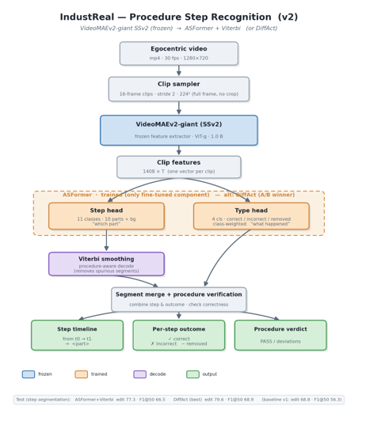
Candidate A fits one 24 GB GPU
Freeze/cache perception first; train compact state, temporal and graph modules
Adaptable video backbone
VideoMAEv2-B/L or V-JEPA 2.1; freeze, then tune late blocks with adapters/LoRA. 16 frames at 224p, ~0.5 s stride.
State branch
Detect hands, tools, parts and targets; form a dynamic relation graph; bootstrap with CAD synthetic views and real ROIs.
Streaming core
Causal FACT-lite + branching task-graph belief + state-delta tokens. Cached features keep the trainable path compact.
Live outputs
Step, completion, state delta, mistake type / UNKNOWN, PNR, evidence region, uncertainty and approved recovery.
IndustReal — Procedure Intelligence Architecture
15
Notes:
Walk the uploaded v2 diagram left to right. Key point: only the head (orange) is trained — the 1B backbone stays frozen, which is why the whole thing fine-tunes on a single 24 GB card. Viterbi is procedure-aware decoding; verification fuses the step and type heads.

Slide 17
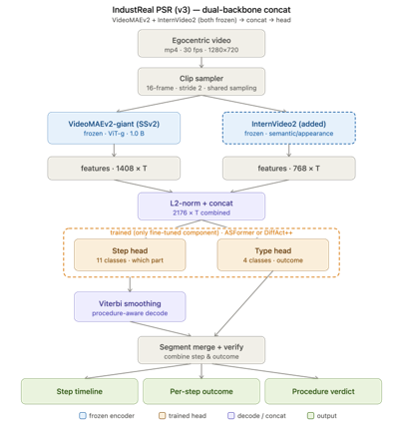
Candidate B learns procedure context from unlabeled runs
P-JEPA is a stronger next step than concatenating two frozen giant encoders
Why it helps
Long-horizon context.
Mask and predict latent segments across complete procedures.
Label efficiency.
Pretrain on normal, partial and multi-view recordings before task supervision.
State remains explicit.
Keep the relation graph and task graph; P-JEPA supplies progress-aware context.
24 GB: cache backbone features and train the contextualizer + heads. Multi-GPU: jointly adapt late video blocks and pretrain across views. Keep the dual-backbone concatenation only as an ablation—it adds semantics but does not solve physical state or procedure structure.
IndustReal — Procedure Intelligence Architecture
17
Notes:
Position the second encoder as the concrete next accuracy lever. Be precise that it is InternVideo2 (video encoder for features), not InternVL (chat VLM). Honest framing: complementary features, a modest gain, and it does not replace fixing the dataset.

Slide 18
Three candidates create a deliberate accuracy–risk ladder
Build a deterministic specialist core first, add procedural pretraining second, and collaborate with a VLM only on sparse evidence packets.
01
02
03
StateGraph-PSR
P-JEPA context
Triggered VLM
RECOMMENDED FIRST BUILD
Strong live state tracking, branching procedure belief, explicit errors and auditable recovery.
BEST RESEARCH PATH
Use unlabeled full procedures to learn progress and long-horizon context; cached-feature route fits 24 GB.
SEMANTIC ADD-ON
Adjudicate uncertain or high-impact events and explain evidence; never be the sole continuous alert detector.

Slide 19
Four label layers turn video into procedure intelligence
Every sample links what moved, what changed, what was allowed and what violated the plan.
1 ACTION
2 PHASE + EVIDENCE
3 PHYSICAL STATE
4 PROCEDURE + ERROR
Verb + object + target
Temporal interval
Hand / tool / part ROIs
Operator and viewpoint
Before / approach
Contact / manipulation
PNR / completion
Effect verification
Part present / selected
Pose / alignment
Connection graph
Torque / count / damage
Valid predecessors / next
Optional + parallel branches
Mistake type / role
Recovery edge + approval
Store evidence around before, first contact, point of no return and observed effect—not just a single step label.

Slide 20
A hierarchical taxonomy turns ‘incorrect’ into an actionable diagnosis
Predict parent type, subtype, violated semantic role, PNR, evidence region and calibrated uncertainty.
PROCEDURE
SELECTION
SPATIAL
EXECUTION + EFFECT
Omitted / skipped
Wrong order
Repeated / extra
Premature / late
Forbidden branch
Wrong part
Wrong tool
Wrong fastener
Wrong quantity
Wrong variant
Wrong target
Wrong orientation
Misalignment
Wrong connection
Wrong routing
Partial insertion
Under / over torque
Dropped / damaged
No expected state change
UNKNOWN anomaly
Fuse a known-type classifier with normal-only prototype distance. UNKNOWN is a valid safe output, not a failure.

Slide 21
A live alert is grounded in before, contact and effect evidence
Example: connector A is inserted where connector B is required
INPUT
OUTPUT
▶
▶
▶
▶
BEFORE
select B
REACH
socket C
CONTACT
insert A
EFFECT
A seated
LIVE EVENT TIMELINE
00:78–79
step
select_connector_B ✓ expected
Egocentric RGB-D + optional wrist/tool telemetry
00:79–80
contact
connector_A → socket_C ✕ wrong part
00:80–81
effect
A inserted_into C ✕ wrong connection
Object relation tokens: hand, connector A/B, socket C
00:81.4
PNR
mismatch becomes irreversible ⚠ alert
00:82–84
recovery
disconnect A ✓ approved operation
Task graph expects: insert connector B into socket C
00:84–86
verify
B connected_to C ✓ back on track
IMMEDIATE ALERT: wrong connection at 81.4 s — disconnect A, inspect C, then insert B
IndustReal — Procedure Intelligence Architecture
21
Notes:
Concrete I/O. The timeline is the step head; the ✓/✗ column is the type head; the verdict fuses them. Note the example deliberately shows a caught 'incorrect' — that's the compliance value proposition, and also the exact thing that is weakest today (next slides).

Slide 23
Mistakes are detected by three independent residuals
Procedure mismatch + normal-prototype distance + action-effect contradiction
Why it works
Procedure residual.
Compare the observed action with every valid next action in the current task-graph belief.
Execution residual.
Compare the live segment with multiple history-conditioned normal prototypes.
Effect residual.
Contrast predicted state delta with the observed relation graph after contact.
Fuse the three residuals into known type / UNKNOWN, violated semantic role, PNR, evidence ROI and confidence. Package four key moments—before, contact, PNR, effect—for human review or event-triggered VLM adjudication. This follows the structure exposed by AMNAR, EgoPED, AXG-Reasoner, MATT and action-effect modeling.
IndustReal — Procedure Intelligence Architecture
23
Notes:
Position the second encoder as the concrete next accuracy lever. Be precise that it is InternVideo2 (video encoder for features), not InternVL (chat VLM). Honest framing: complementary features, a modest gain, and it does not replace fixing the dataset.

Slide 25
Recovery is constrained graph search, not free-form generation
Predict future state in latent predicates; select only approved repair operations
Guardrails
Anticipate.
Predict valid next actions at horizons 1 / 3 / 5 and the resulting part-relation graph.
Score risk.
Estimate failure probability, uncertainty and irreversible state transitions.
Repair safely.
Search a versioned recovery graph for the shortest verified route to a valid state; escalation is always allowed.
A VLM may phrase the approved plan, explain evidence and retrieve an expert clip. It cannot invent a repair operation. Re-run state verification after every correction and stop when evidence is uncertain, the operation is unapproved or damage is possible.
IndustReal — Procedure Intelligence Architecture
25
Notes:
Position the second encoder as the concrete next accuracy lever. Be precise that it is InternVideo2 (video encoder for features), not InternVL (chat VLM). Honest framing: complementary features, a modest gain, and it does not replace fixing the dataset.

Slide 26
Candidate A is the only complete first build
Model choice is based on live operation, physical state, open-set errors and 24 GB feasibility
Candidate | 24 GB | Live | State | Unseen | Future | Decision
Current v2 | Yes* | Weak | No | No | No | Control
Dual giant concat | Yes* | Weak | No | No | No | Ablation
A StateGraph-PSR | Yes | Strong | Strong | Strong | Good | BUILD
B P-JEPA context | Yes* | Strong | Medium | Medium | Strong | Phase 2
C Triggered VLM | Yes | Event | Semantic | Medium | Good | Add-on
Recommendation
Build Candidate A first. It is the only design that closes the loop from action → state → mistake → future → approved recovery while remaining trainable on one 24 GB GPU.
VLM role
Use Qwen3-VL-4B/8B in 4-bit or ProVideLLM only for event-triggered adjudication, explanation and evidence retrieval—not as the sole safety detector.
IndustReal — Procedure Intelligence Architecture
26
Notes:
Numbers are the measured test-split results. Lead with DiffAct++ as best offline. Note the real-time row honestly — the streaming gap is real and is a separate work item.

Slide 27
The experiment sequence isolates one architectural question at a time
Advance only when step accuracy, false-alert rate and calibration improve together
Gate | Change | Step | State | Mistake | Latency | Advance if
E0 | Reproduce v2 | F1/Edit | — | Recall | Offline | Within ±1 pt
E1 | Causal FACT-lite | Online F1 | — | — | p95 | +F1, ≤1 s
E2 | Adapters + state ROIs | F1 | mAP/F1 | Type F1 | p95 | +state, stable step
E3 | Task graph + residuals | Edit | Graph F1 | AUROC/FAR | delay | +unseen, fewer alerts
E4 | P-JEPA / VLM add-ons | F1 | Graph F1 | macro-F1 | GPU/RTF | Pareto improvement
Release metrics
Online F1@50 + edit; state-delta macro-F1; per-type recall; unseen-error AUROC; false alerts/hour; PNR delay; ECE / risk-coverage.
Pilot blockers
High-impact false negatives, nuisance false alerts, uncalibrated UNKNOWN decisions, unsafe repair suggestions or p95 alert delay above the operational limit.
IndustReal — Procedure Intelligence Architecture
27
Notes:
Numbers are the measured test-split results. Lead with DiffAct++ as best offline. Note the real-time row honestly — the streaming gap is real and is a separate work item.

Slide 29
A twelve-week plan reaches a pilot-ready architecture decision
Weeks 1–2
Reproduce v2; define task graph, state predicates, error ontology and leakage-safe splits. Exit: baseline within ±1 point.
Weeks 3–6
Build causal FACT-lite + hand/tool/part relation graph + state-delta heads. Exit: step and state metrics improve together.
Weeks 7–9
Add procedure / execution / effect residuals, PNR localization, known + open-set error heads. Exit: unseen-error and false-alert gates pass.
Weeks 10–12
Add future state, approved recovery search, triggered VLM and edge profiling. Exit: safe plan + calibrated pilot candidate.
Notes:
Close with the roadmap. Two parallel tracks: the cheap model lever (InternVideo2 concat) and the real fix (data + assembly-state perception). Reinforce the 24 GB feasibility.

Slide 30
Research foundation for the proposed architecture
Primary sources span temporal segmentation, procedure graphs, mistake semantics, state change, anticipation and streaming VLMs.
FOUNDATIONS
PSR + STRUCTURE
MISTAKE + EFFECT
DATA + VLM
VideoMAE V2 — CVPR 2023
FACT — CVPR 2024
DiffAct — ICCV 2023
V-JEPA 2.1 — 2026
P-JEPA — 2026
IndustReal — WACV 2024
STORM-PSR — 2025
PREGO — CVPR 2024
Differentiable Task Graph — 2024
AMNAR — CVPR 2025
EgoPED — CVPR 2024
GTG2Vid — ICCV 2025
Action Effect Modeling — 2025
AXG-Reasoner — CVPR 2026
MATT / MisFormer — CVPR 2026
Assembly101 — CVPR 2022
CaptainCook4D — NeurIPS 2024
HoloAssist — ICCV 2023
ProVideLLM — ICCV 2025
Qwen3-VL — 2025
Full bibliography, links, implementation details and experiment matrix: docs/architecture_research_plan.md

