Slide 1

AI for Operations
Build & Assembly Verification

Slide 2
AIOps | Team
Andrew Modjeski
Jean-Pierre Njock II
Mentor
Mentor
Sana Hafez
Team Lead
Nahom Tesfu
Team Member
Ketan More
Team Member
Dhyey Vank
Team Member

Slide 3
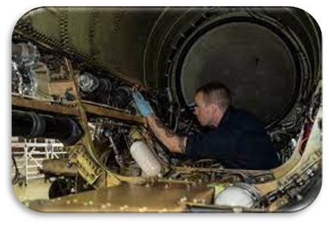
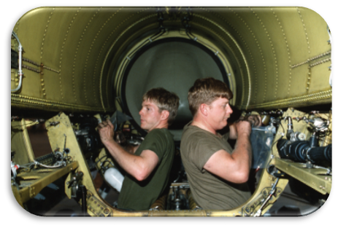
AI for Operations | Build & Assembly Verification
Problems faced on manual assembly line:
Assembly Errors
1
Wrong parts, incorrect placement, or skipped steps.
Increasing System Complexity
2
More components and steps become harder to track.
Late Error Detection
3
Errors found later cause costly rework and delays.
Verification Downtime
Extra Costs
Wasted Resources
“Humans will always make mistakes.”

Slide 4
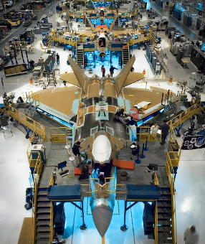
AIOps | Value
Faster delivery • fewer delays • fewer downstream defects​
Faster Deliveries
Lower Rework
Reduce verification delays and keep assembly moving.
Cut worker rework time by up to 10%. Projected $9B savings.
Better Detection
Zero-Defect Culture
Flag defects missed by manual inspection in real time.
Stop inconsistencies before they reach later production stages.
Quality
Improvements
Economical Value
Value to UAE
Value to
Stakeholders

Slide 5
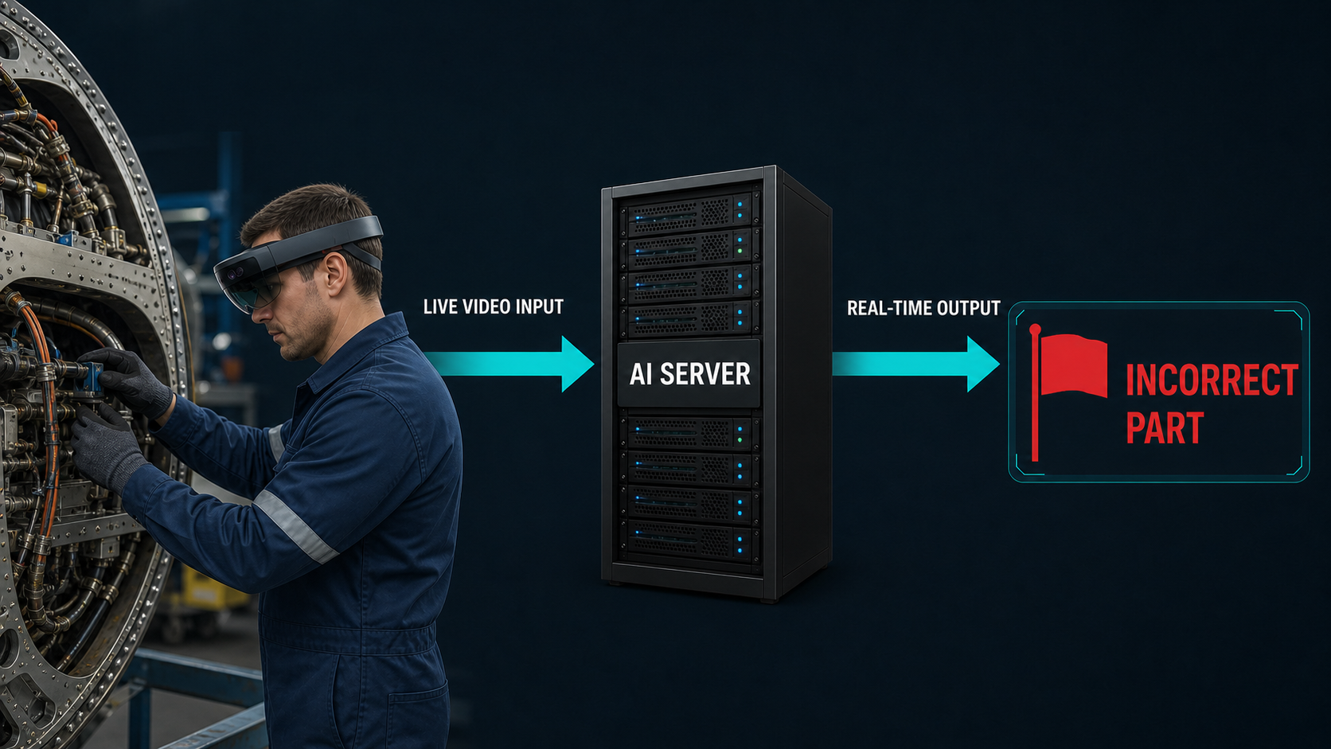
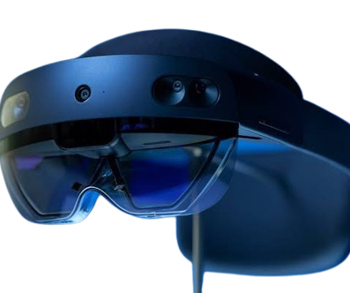
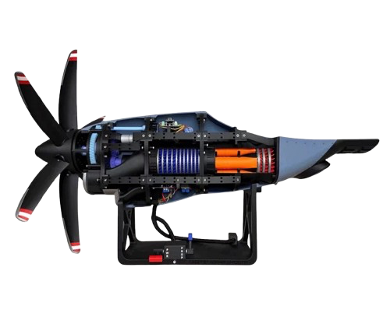
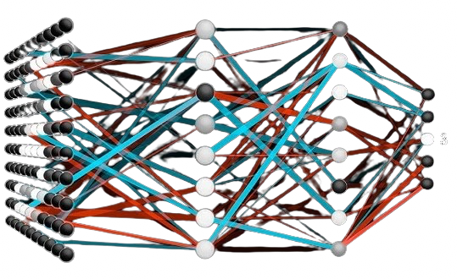
AIOps | Solution
An always-on vision system for real-time assembly guidance
Components of our system:
HoloLens 2
Video capture worn by the technician.
Develop AI architectures
Configure recording device (HoloLens 2)
Record egocentric videos
Finetune our AI model
Benchmark and select the best architecture
Select the data collection platform
3D-printed engine
Training model for assembly verification and testing our solution on
Local AI model
Locally trained and running for detection.
Accuracy:
81.9%
Watches every step and hand movement • overlays the correct torque, part, and order • flags deviations in real time

Slide 6
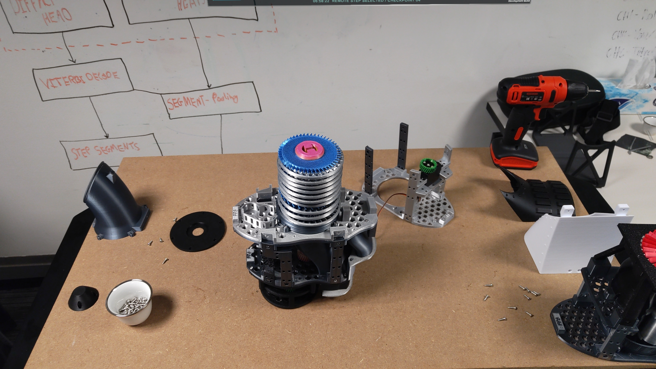
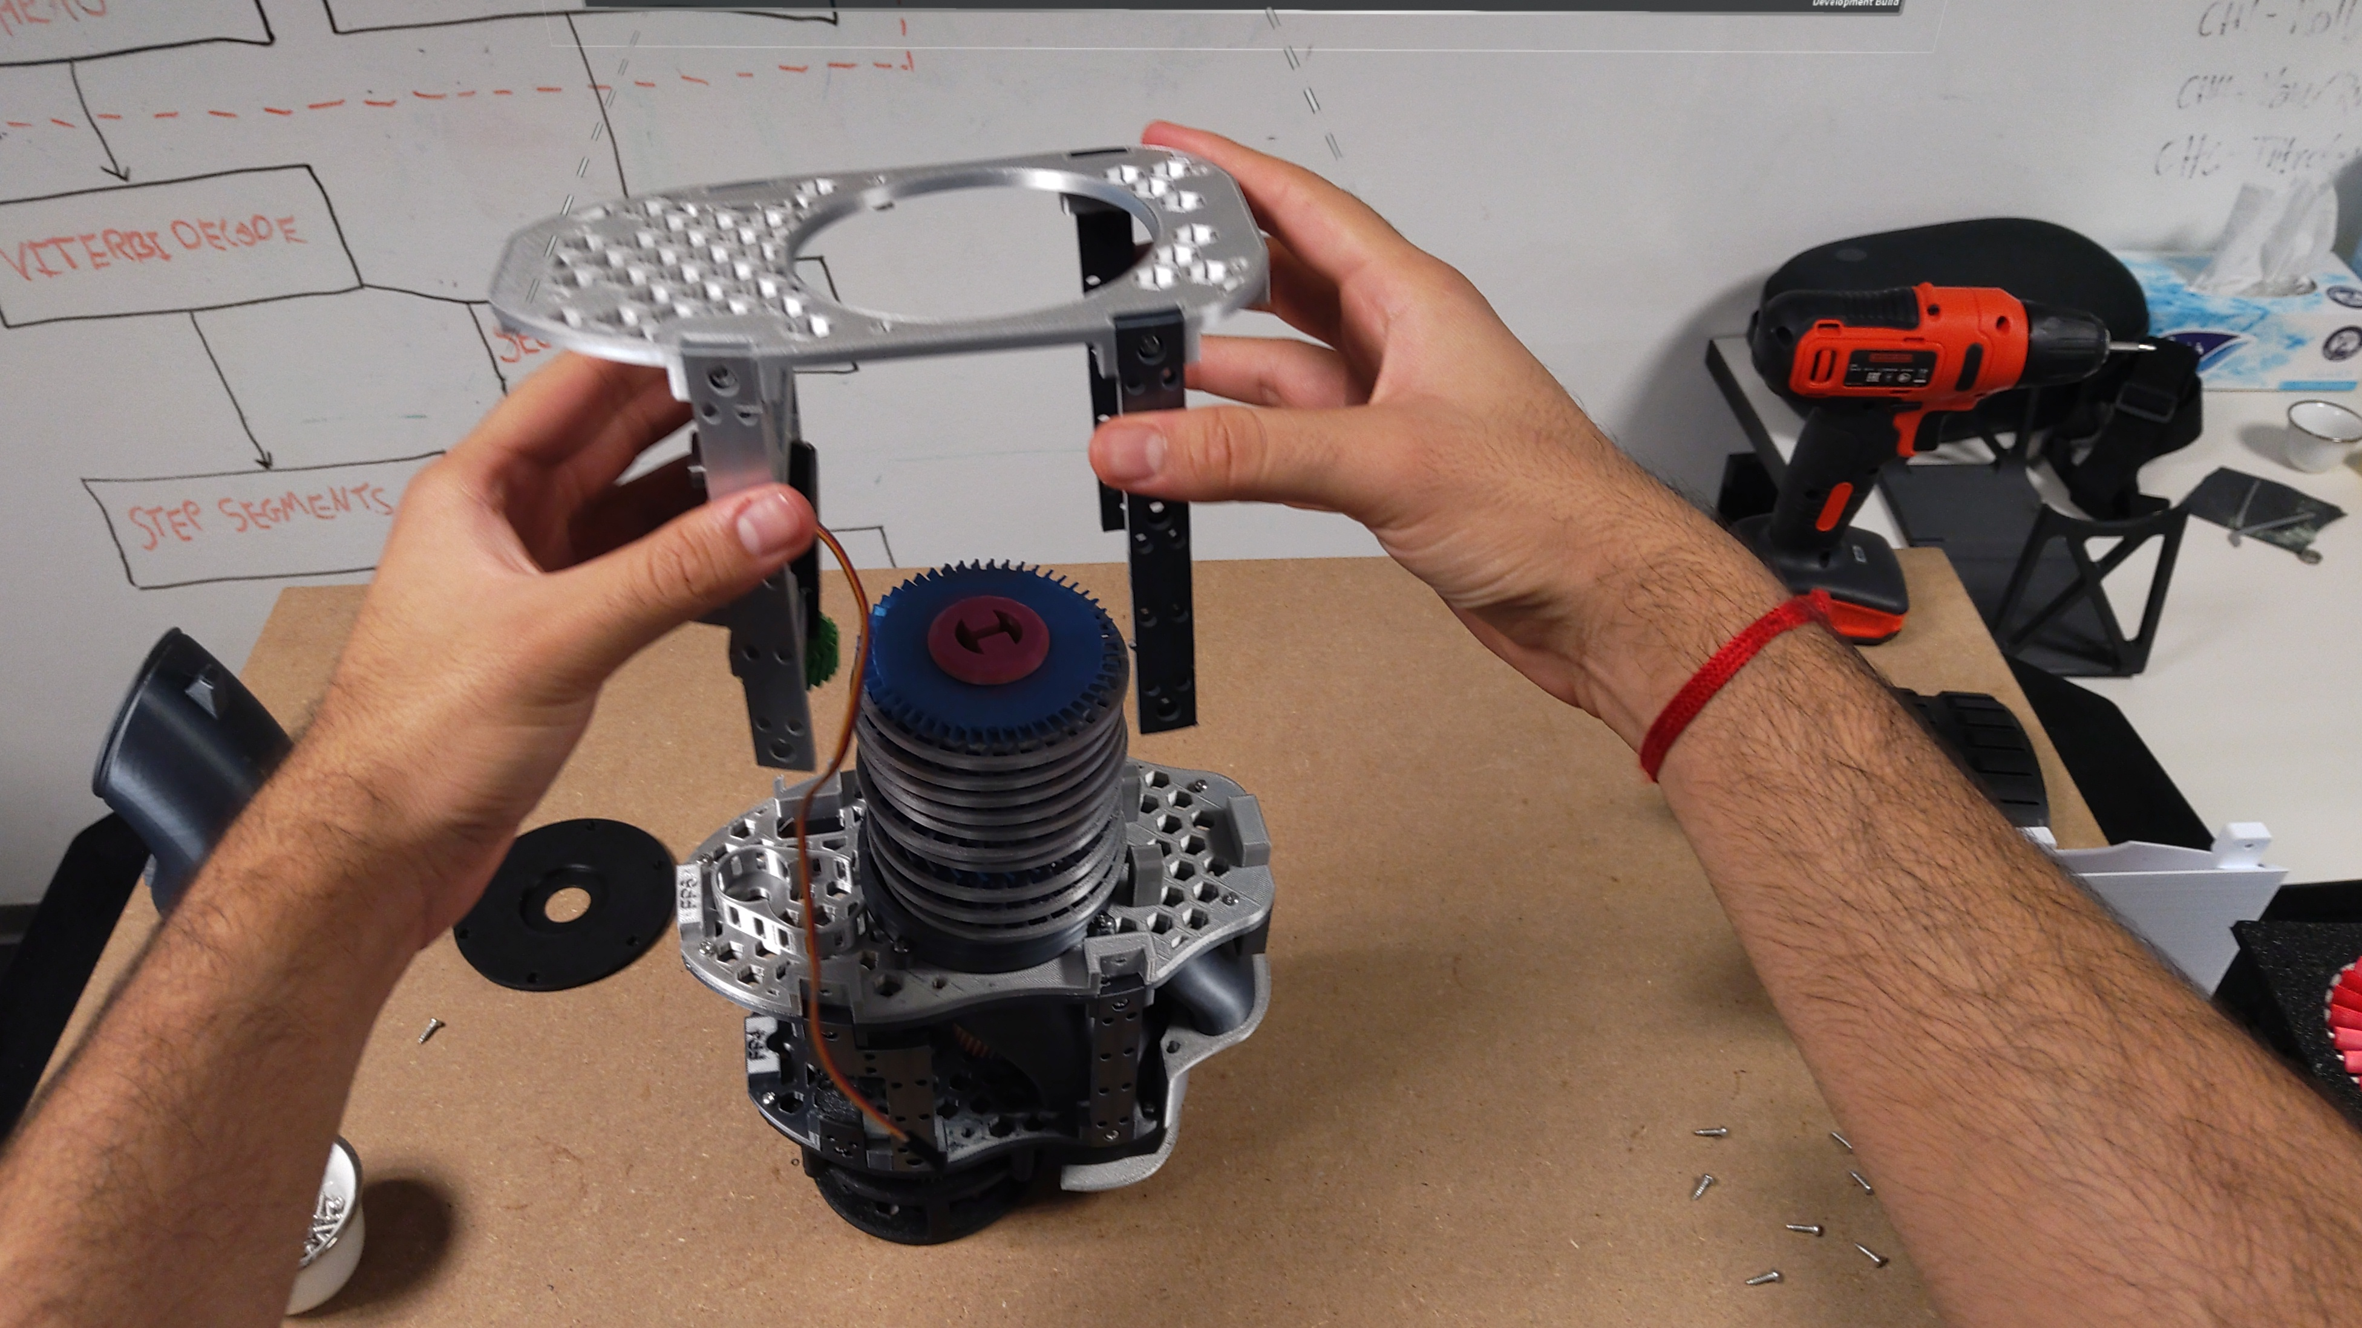
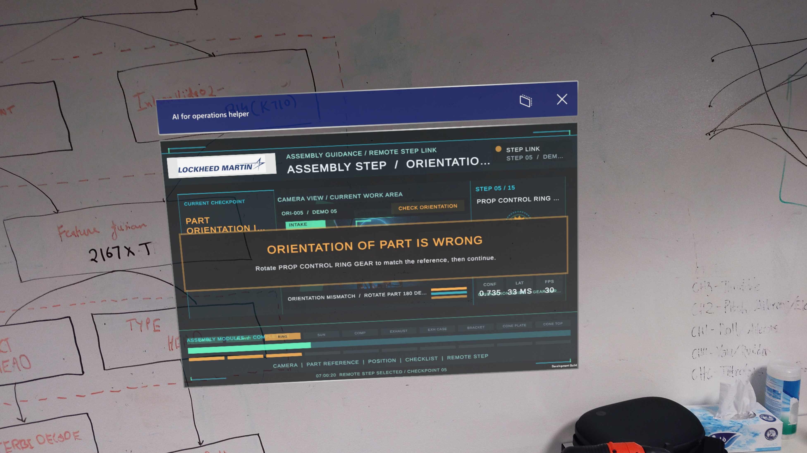
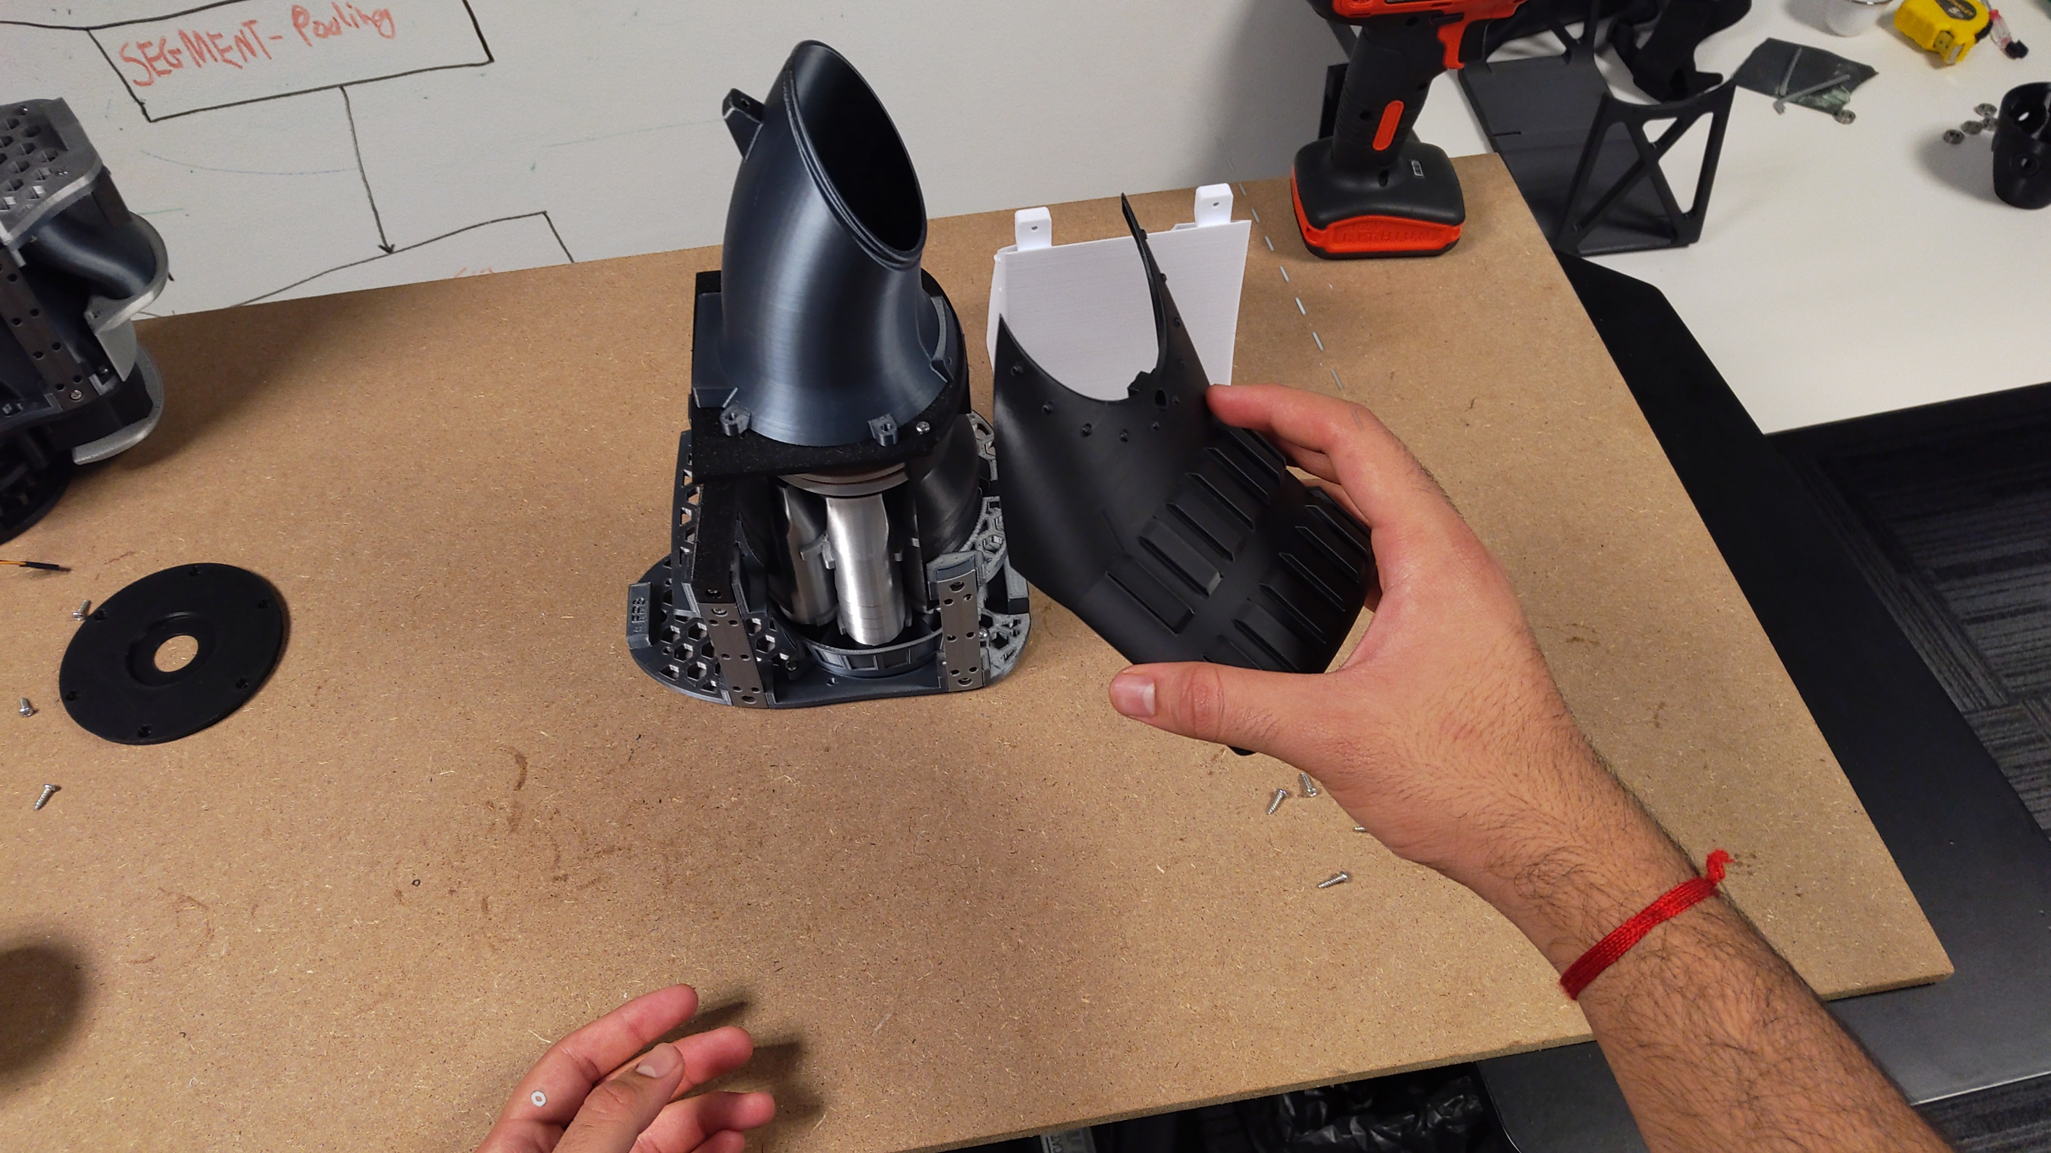
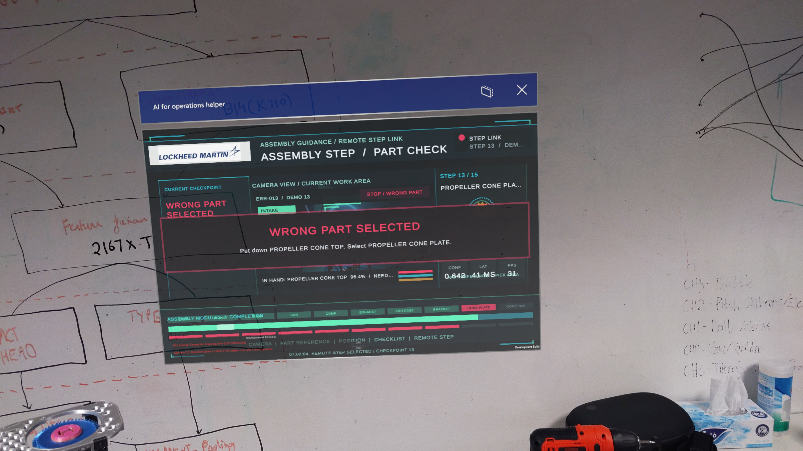
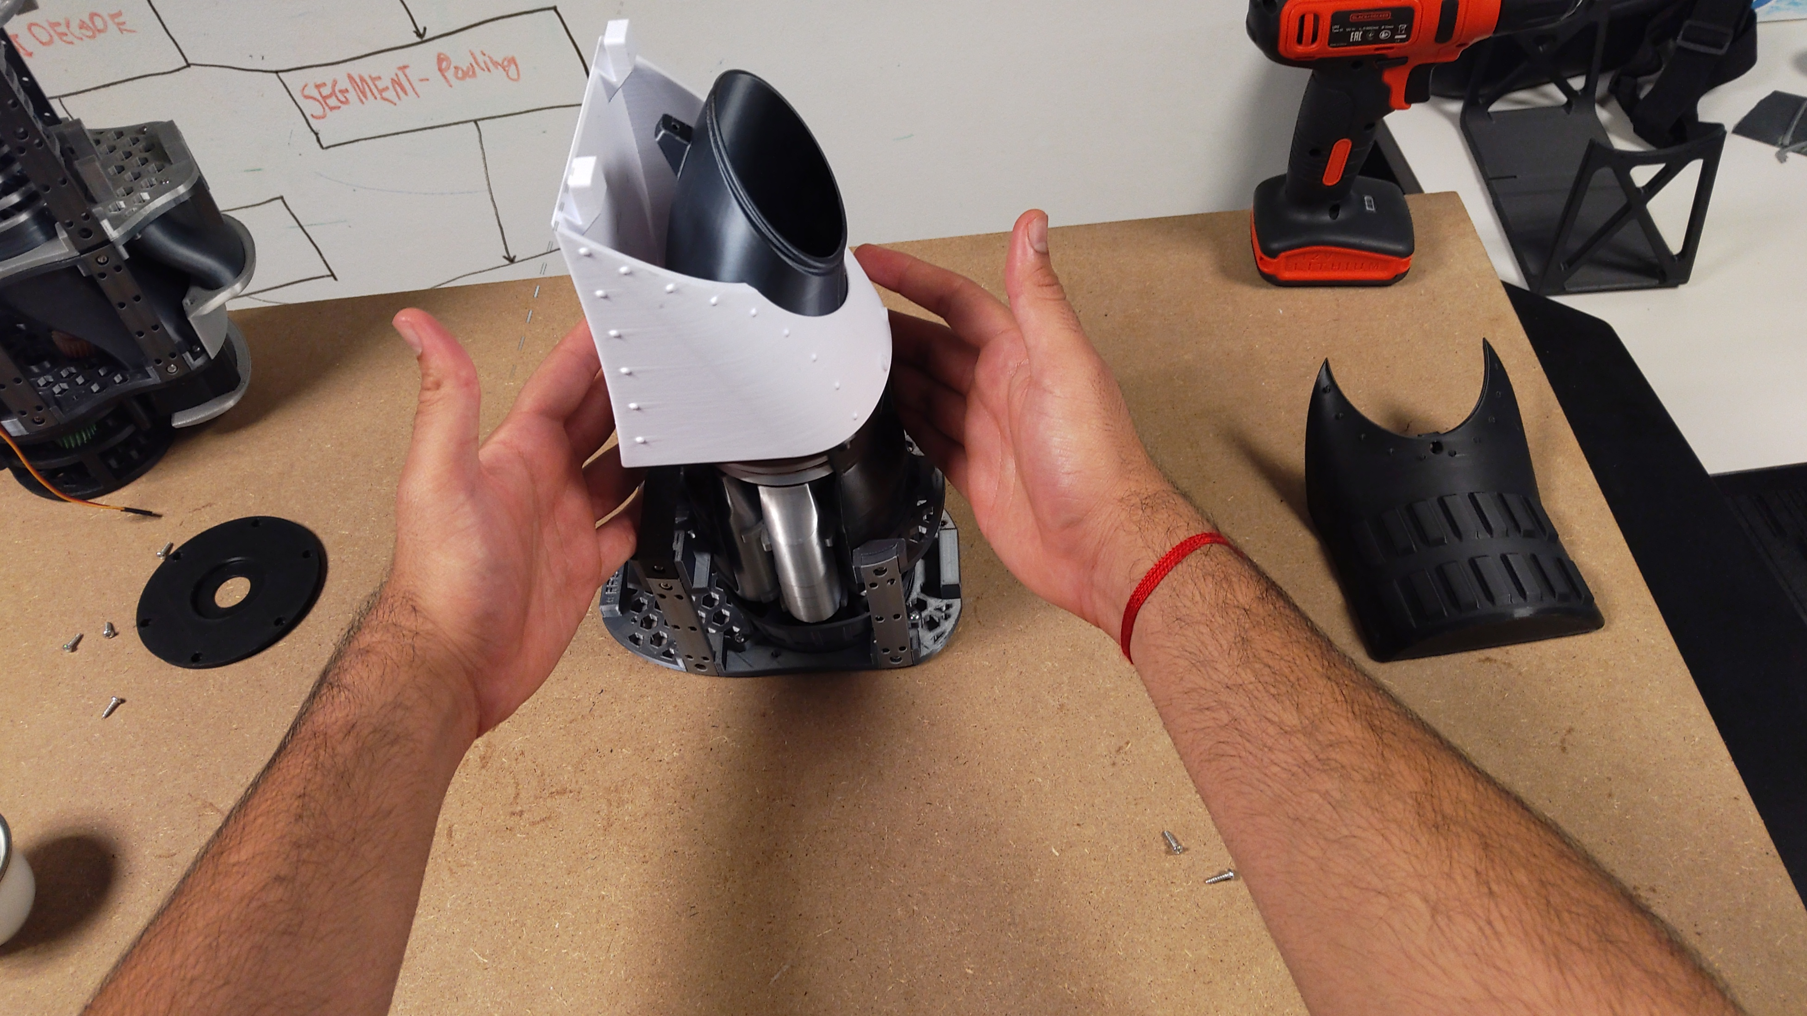
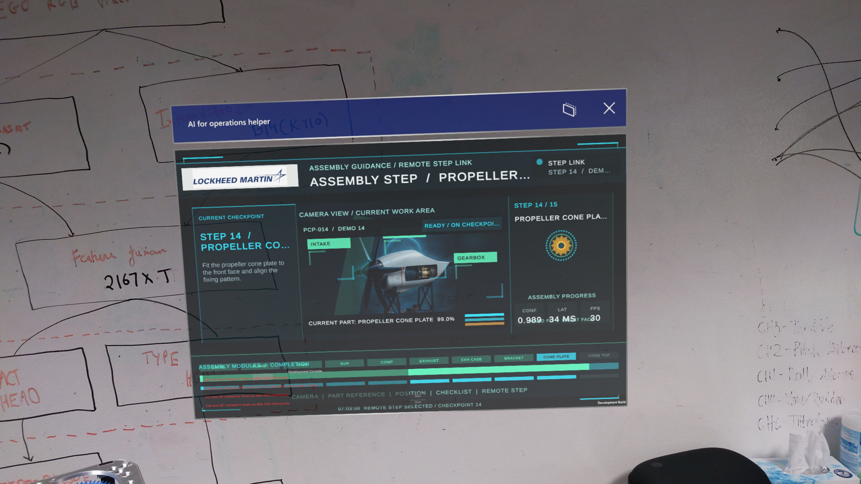
AIOps | Results/Demo
Incorrect Orientation:
Base ready for next step
Worker Orients Part Incorrectly
AI detects and Hololens flags it !
Wrong Part:
Worker Chooses the wrong part
AI detects and Hololens flags it
Worker corrects the part
AI detects correctness and continues

Slide 7
Thank you

