Slide 1

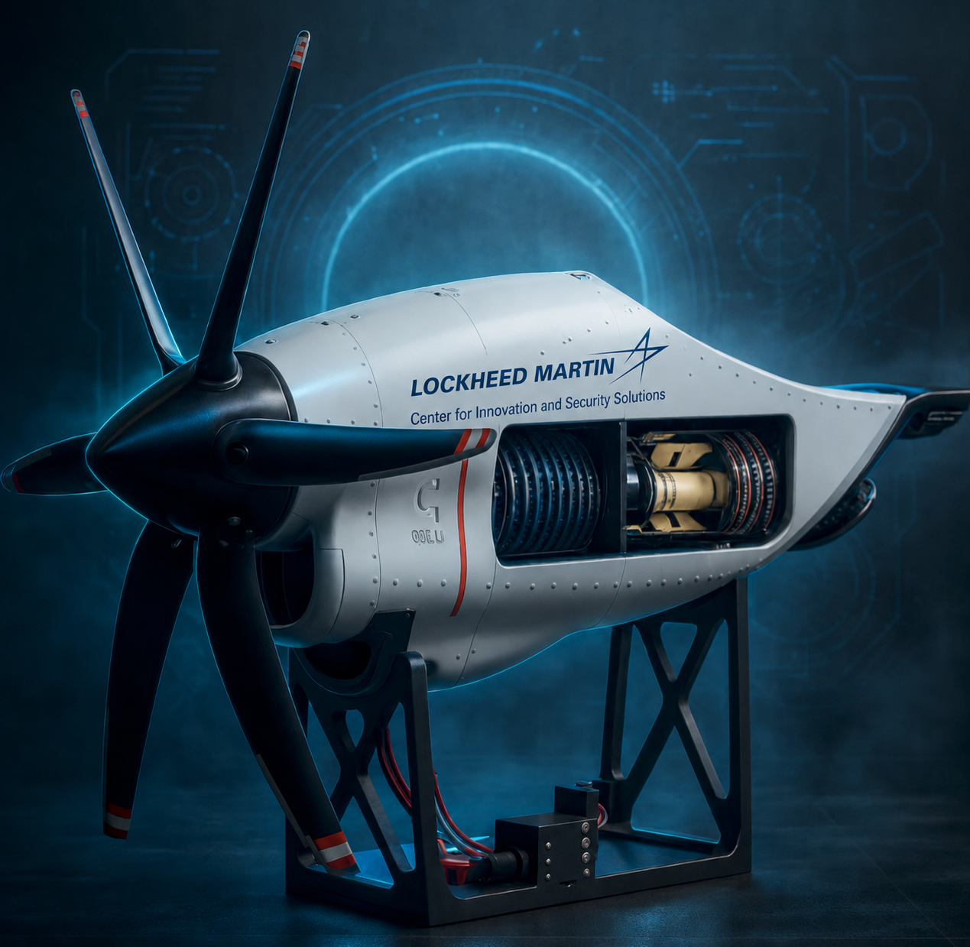
CENTER FOR INNOVATION & SECURITY SOLUTIONS · AI FOR OPERATIONS
Assembly Copilot
AI that watches assembly, flags mistakes,
and creates auditable proof — before rework.
Egocentric Procedure Step Recognition · Error Detection · Assembly Assurance
Executive Progress Review · August 2026
Lead: Sana Hafez · Interns: Nahom Tesfu · Dhyey Vank · Ketan More · Mentors: Jean-Pierre Njock II · Andrew T. Modjeski

Slide 2
WHY IT MATTERS
A fighter jet is thousands of go / no-go moments
The value at stake isn't only the aircraft — it's the chain of decisions that makes it trustworthy.
300,000+
$82.5M
20–30%
parts in an F-35 assembly
average F-35A flyaway cost
defects missed in manual visual inspection
Lockheed Martin production line
Production Lots 15–17
Peer-reviewed human-factors research
The hidden cost isn't the error — it's discovering it late.
Assembly Copilot shifts detection left — to the station.
1
STATION
›
2
SUB-ASSEMBLY
›
3
FINAL TEST
›
4
DELIVERY
catch here
rework
delay
escape
Cost of a missed step grows the further downstream it travels.
AIOps · Assembly Copilot
02

Slide 3
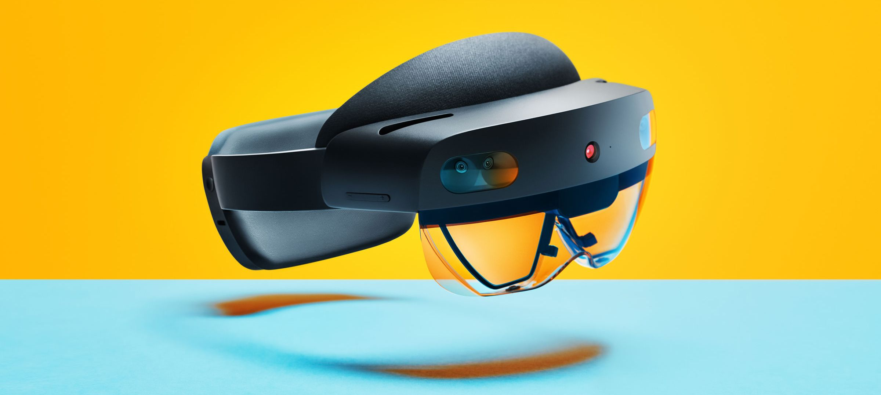
THE SOLUTION
Meet the AIOps Assembly Copilot
One first-person camera. Five actions. One auditable record.
1
Watch — first-person assembly video
2
Recognize — the part and procedure step
3
Flag — a missing or incorrect action
First-person capture · Microsoft HoloLens 2
4
Guide — the operator immediately
LIVE OUTPUT
5
Record — time-stamped visual evidence
Step timeline t0 → t1 per action
Part inventory bracket ×1 · fastener ×4
Evidence time · frame · verdict
ON-SITE
WORKER IN CONTROL
AUDITABLE
AIOps · Assembly Copilot
03

Slide 4
TEAM & ORGANIZATION
The people building AIOps
A focused build-and-assembly team inside CISS — mission: AI for Operations.
WHERE AIOps SITS IN CISS
LEAD
GAIT
Sana Hafez
INTERNS
ModSim
Nahom Tesfu
AI for Operations ◂ our team
Dhyey Vank
Ketan More
RSA
MENTORS
Systems Engineering
Jean-Pierre Njock II
Andrew T. Modjeski
Aero
Egocentric
7
business area
viewpoint
nationalities on the cohort
AIOps · Assembly Copilot
04

Slide 5
HOW IT WORKS
From egocentric video to a verified step timeline
Video → Segment → Verify. Frozen backbones, trained heads, procedure-aware decode.
Egocentric
video
Frozen
backbones
Trained
heads
Viterbi
decode
Verify
mp4 · 30 fps · 1280×720
VideoMAEv2-giant + InternVideo2
Step (which part) + Type (outcome)
procedure-aware smoothing
timeline + per-step verdict
OUTPUTS
Step timeline
Per-step outcome
Procedure verdict
which part, when
correct / incorrect / removed
pass or deviation
The only trained component is the head — the frozen backbones and Viterbi decode need no fine-tuning.
AIOps · Assembly Copilot
05

Slide 6
THE ASSEMBLY PLATFORM
A turbine engine, engineered to be watched
Chosen to generate strong, stageable visual evidence for the model.
WHY THIS PLATFORM
Recognizable aerospace form — a propeller-turbine the whole floor knows
Visible internal mechanics — gears, compressor, turbine, casing
Powered motion & modular interfaces — large, distinct visual state changes
Repeatable, stageable errors — wrong orientation, partial seating, missed fasteners
20 OBSERVABLE ACTIONS · 4 PHASES · ~4–5 MIN RUN
Propulsion
input
Drive +
control
Engine
core
Integration
+ test
steps 1–5
steps 6–10
steps 11–15
steps 16–20
AIOps · Assembly Copilot
06

Slide 7
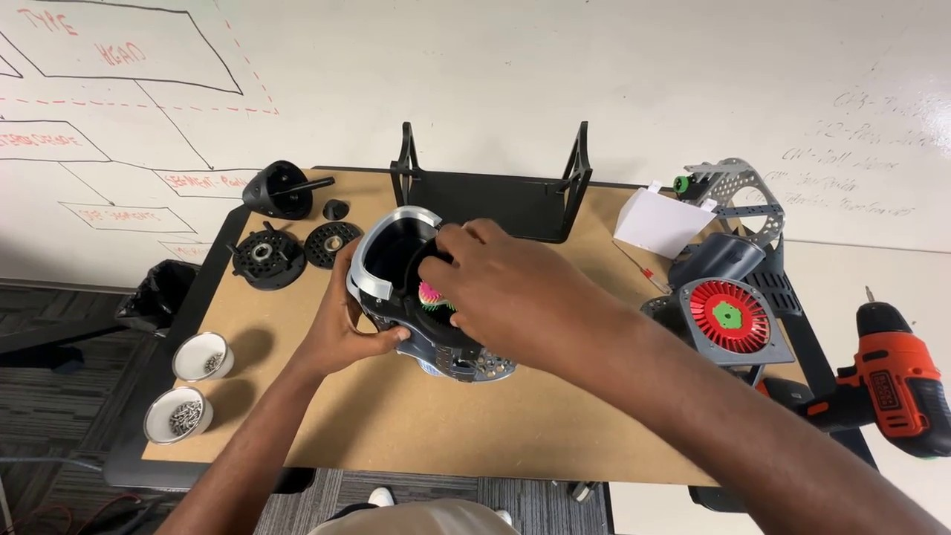
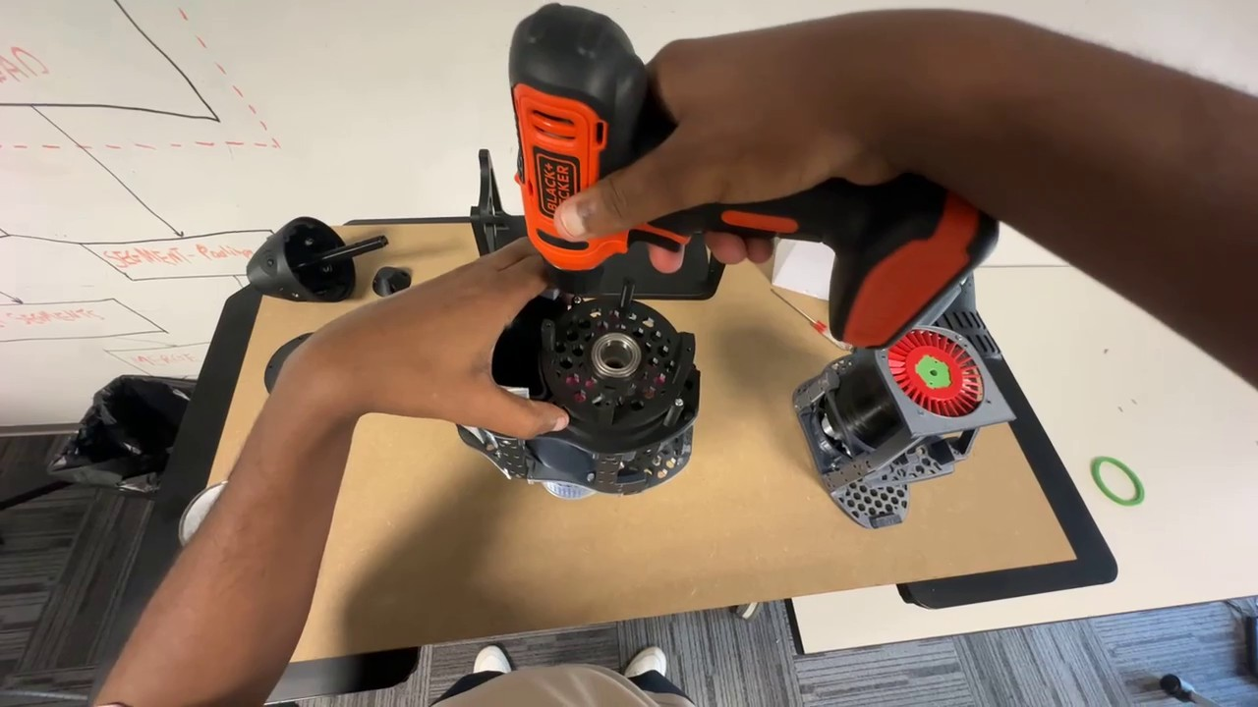
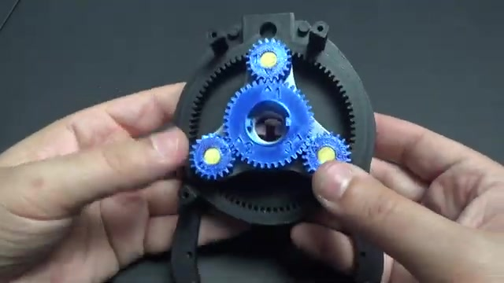
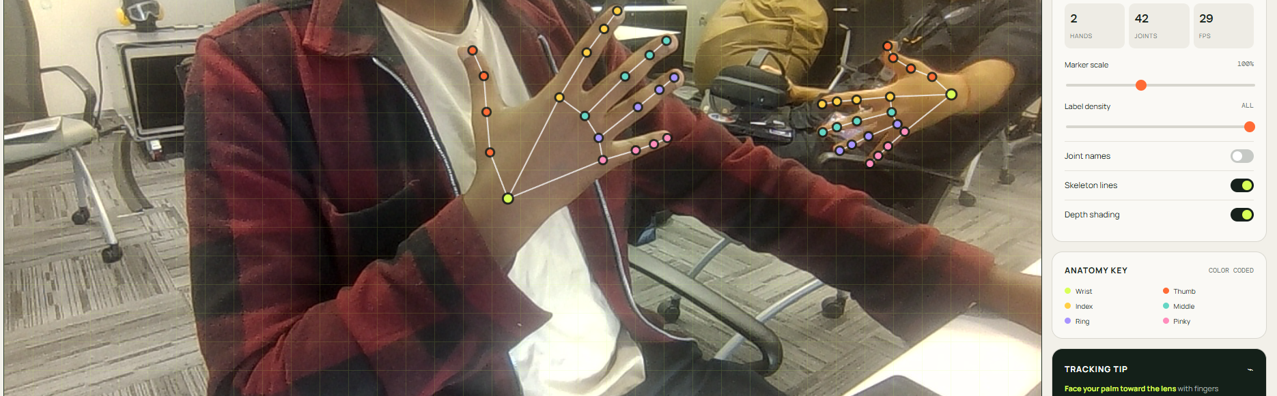
DATASET COLLECTION
Building our own egocentric assembly dataset
HoloLens-captured first-person runs — correct, error, and recovery — labeled with model assistance.
Correct run · gearbox assembly
Powered fastening · compressor
Planetary gears · sub-assembly
MODEL-ASSISTED LABELING
Hand joints
MediaPipe Hand Landmarker
Step / action
MS-TCN++ baseline + Viterbi
Tool labels
detector / segmenter
Orientation
FoundationPose
AIOps · Assembly Copilot
MediaPipe hand-landmark labeling · 21 joints × 2 hands
07

Slide 8
MODEL ARCHITECTURE
Two architectures, one recipe
Same frozen-backbone → trained-head design. A second appearance encoder unlocks fault detection.
A · Segmentation champion
B · Fault detector
SSv2-giant + DiffAct
Fusion + ASFormer
Frozen backbone
Fusion backbone
VideoMAEv2-giant (SSv2) · 1408-d
giant SSv2 + InternVideo2-B14 · 2176-d
↓
↓
DiffAct head
ASFormer head
diffusion action segmentation
Step head + Type head
↓
↓
Viterbi decode
Viterbi decode
procedure-aware
procedure-aware
Sharpest boundaries — best Edit & F1
Only architecture that catches faults
+ SAM3
enrichment lane
Runs on top at inference — no retraining, same accuracy. Adds per-step part masks (where) + a component inventory (what is present).
AIOps · Assembly Copilot
08

Slide 9
RESULTS · INDUSTREAL BENCHMARK
State-of-the-art step recognition — first result above 70
Segmentation quality (F1@50) climbing across five architecture generations.
BEST MODEL · v4 FUSION + DiffAct
74.9
79.5
70.1
Acc
Edit
F1@50
+13.8 F1@50 over the v1 baseline
THE HARD PART: CATCHING FAULTS
Incorrect-install recall 0% → 10.1%
Fusion produced the first non-zero fault recall. It is data-limited — the very gap our own engine dataset is built to close.
IndustReal test split · 32 recordings · higher is better. Custom engine dataset is being labeled to lift fault detection.
AIOps · Assembly Copilot
09

Slide 10
ROADMAP & THE ASK
Where we are — and the next 90 days
DONE
NEXT — MODEL
NEXT — DATA
› v2 pipeline validated on IndustReal
› Fusion fault head → higher incorrect recall
› Finish labeling the engine dataset
› v4 Fusion + DiffAct — F1@50 70.1
› Near-online causal decode for live use
› Stage correct / error / recovery runs
› SAM3 enrichment lane (masks + inventory)
› Assembly-state perception for correctness
› Model-assisted labels at scale
THE ASK
Measured on: first-pass yield · rework hours · defect escapes · cycle time · evidence completeness
Approve a one-station, 90-day pilot.
Every jet. Every shift. Every critical step.

