Slide 1
v4 + SAM3
The best model, plus a SAM3 enrichment lane
v4 (Fusion + DiffAct) is our best architecture — F1@50 70.1.
SAM3 is added on top: same accuracy, richer output (masks + component inventory).

Slide 2
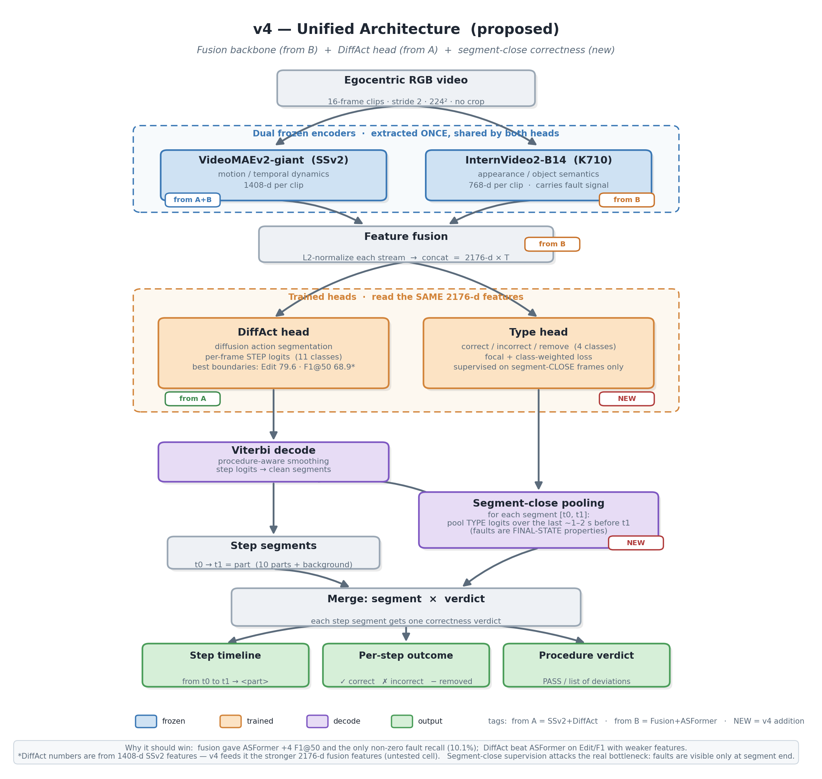
THE BEST MODEL
v4 — our best architecture
The winner among all configs
• Fusion backbone (frozen): VideoMAEv2-giant + InternVideo2-B14 → 2176-d
• DiffAct head (trained): diffusion action segmentation
• Wins every segmentation metric
• F1@50 = 70.1 — first result above 70
• This is the model SAM3 enriches (next slide)
Best segmentation: Acc 74.9 · Edit 79.5 · F1@50 70.1
Procedure Step Recognition — v4 + SAM3 enrichment
2

Slide 3
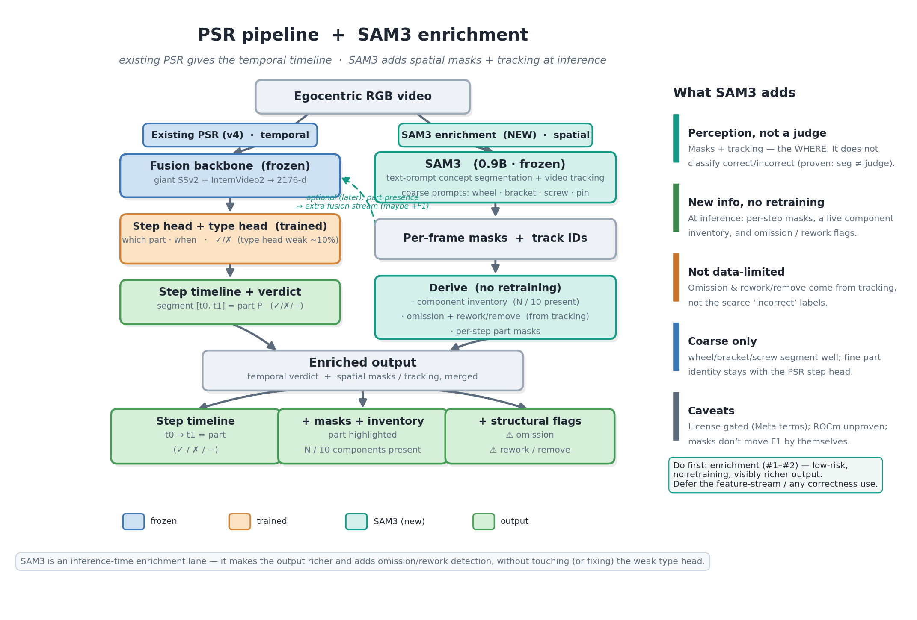
WITH SAM3
v4 + SAM3 — the enriched architecture
Procedure Step Recognition — v4 + SAM3 enrichment
3

Slide 4
THE CHOICE
Why SAM3 — and not LocateAnything?
we tried both; here is the plain-English difference
LocateAnything (3B)
SAM3 (0.9B)
What it outputs
rough boxes
exact pixel masks
Finds the parts?
yes (coarse)
yes (coarse) — more precise
Tracks parts across the video?
no
yes
Can it say correct / incorrect?
no
no
Model size
3B
0.9B
Best use
—
enrich the output (masks + inventory)
Both find the parts. Neither can judge correct vs incorrect (both only locate).
SAM3 wins for enrichment: precise masks + video tracking, and it is smaller.
Procedure Step Recognition — v4 + SAM3 enrichment
4

Slide 5
SCORECARD
All architectures so far
IndustReal test · step segmentation · 🏆 = best
Configuration
Acc
Edit
F1@50
v1 Huge-K710 + ASFormer (baseline)
73.3
68.8
56.3
v1 + Viterbi
73.4
74.2
62.2
v2 SSv2-giant + ASFormer + Viterbi
74.0
77.3
66.5
v2 SSv2-giant + DiffAct
74.4
79.6
68.9
Fusion (giant+IV2-B14) + ASFormer + Viterbi
75.7
77.6
68.2
🏆 v4 Fusion + DiffAct — BEST
74.9
79.5
70.1
v4 + SAM3 enrichment (same metrics · richer output)
74.9
79.5
70.1
v4 is the best model. SAM3 is not a new model — it is added on top of v4, so the numbers are identical; it only makes the output richer.
Procedure Step Recognition — v4 + SAM3 enrichment
5

Slide 6
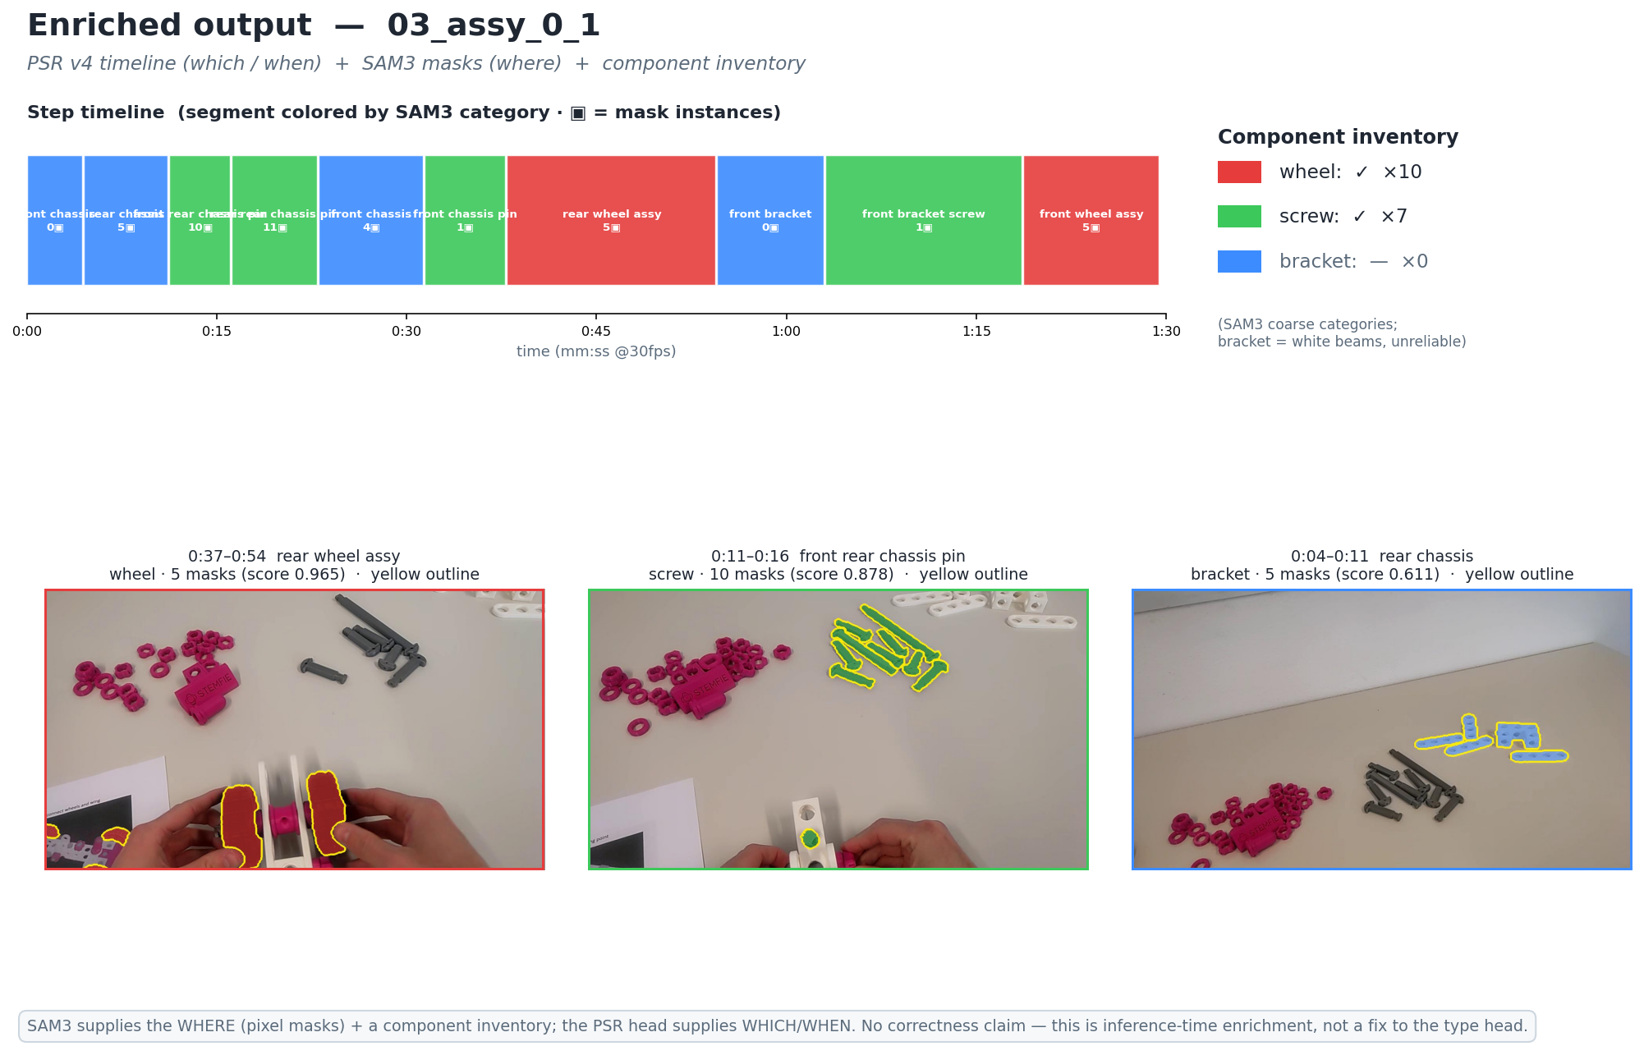
RESULT
What the enriched output looks like
Same timeline as v4 · each step now shows part masks (where) + a component inventory (what is present).
Procedure Step Recognition — v4 + SAM3 enrichment
6

Slide 7
SUMMARY
Bottom line
1
v4 stays the best model. Fusion + DiffAct, F1@50 70.1. SAM3 does not change it.
2
SAM3 is an add-on, not a replacement. It runs on top of v4 at inference — no retraining, same accuracy.
3
It makes the output richer. Per-step part masks (where) + a component inventory (what is present).
4
It does not judge correctness. Like LocateAnything, SAM3 only locates. Correct-vs-incorrect stays the open problem.
Procedure Step Recognition — v4 + SAM3 enrichment
7

