Slide 1

AI for Operations

Slide 2

Our Team
Andrew Modjeski
Jean-Pierre Njock II
Mentor
Mentor
Sana Hafez
Team Lead
Nahom Tesfu
Team Member
Ketan More
Team Member
Dhyey Vank
Team Member

Slide 3
Problem
Human Error
Time Consuming
Capital Heavy
Time consuming to verify thepresence and correct placement ofmultiple components.​
Time consuming to verify thepresence and correct placement ofmultiple components.​

Slide 4
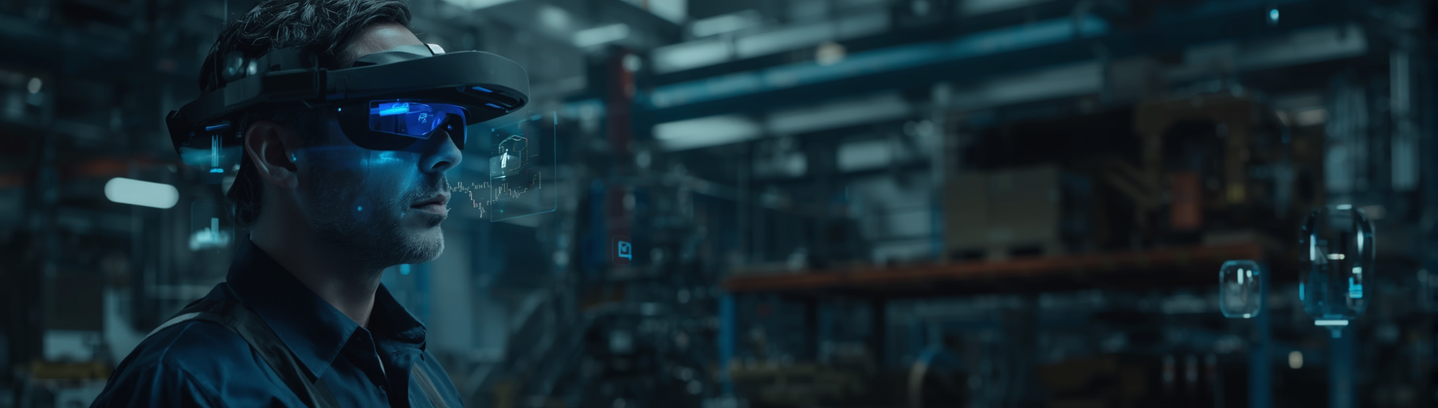
Problem
Human Error
Human Error

Slide 5
AIOps Team
Andrew Modjeski
Jean-Pierre Njock II
Mentor
Mentor
Sana Hafez
Team Lead
Nahom Tesfu
Team Member
Ketan More
Team Member
Dhyey Vank
Team Member

Slide 6
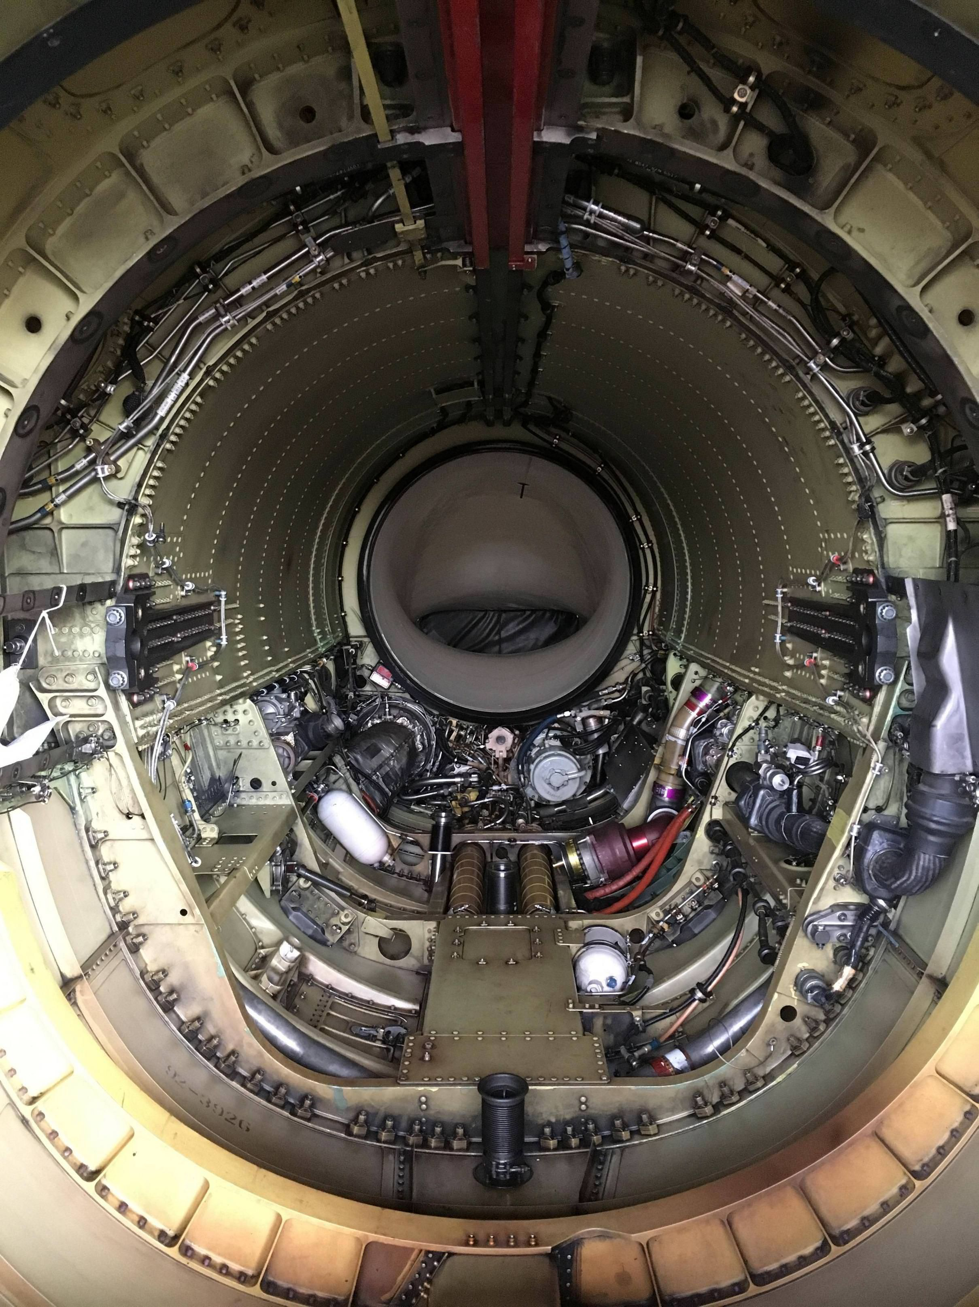

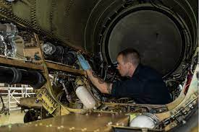
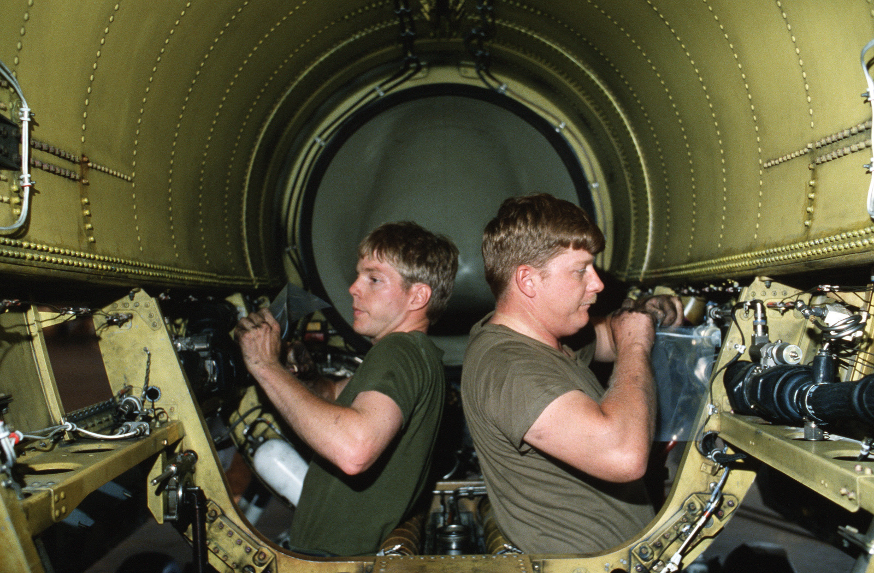
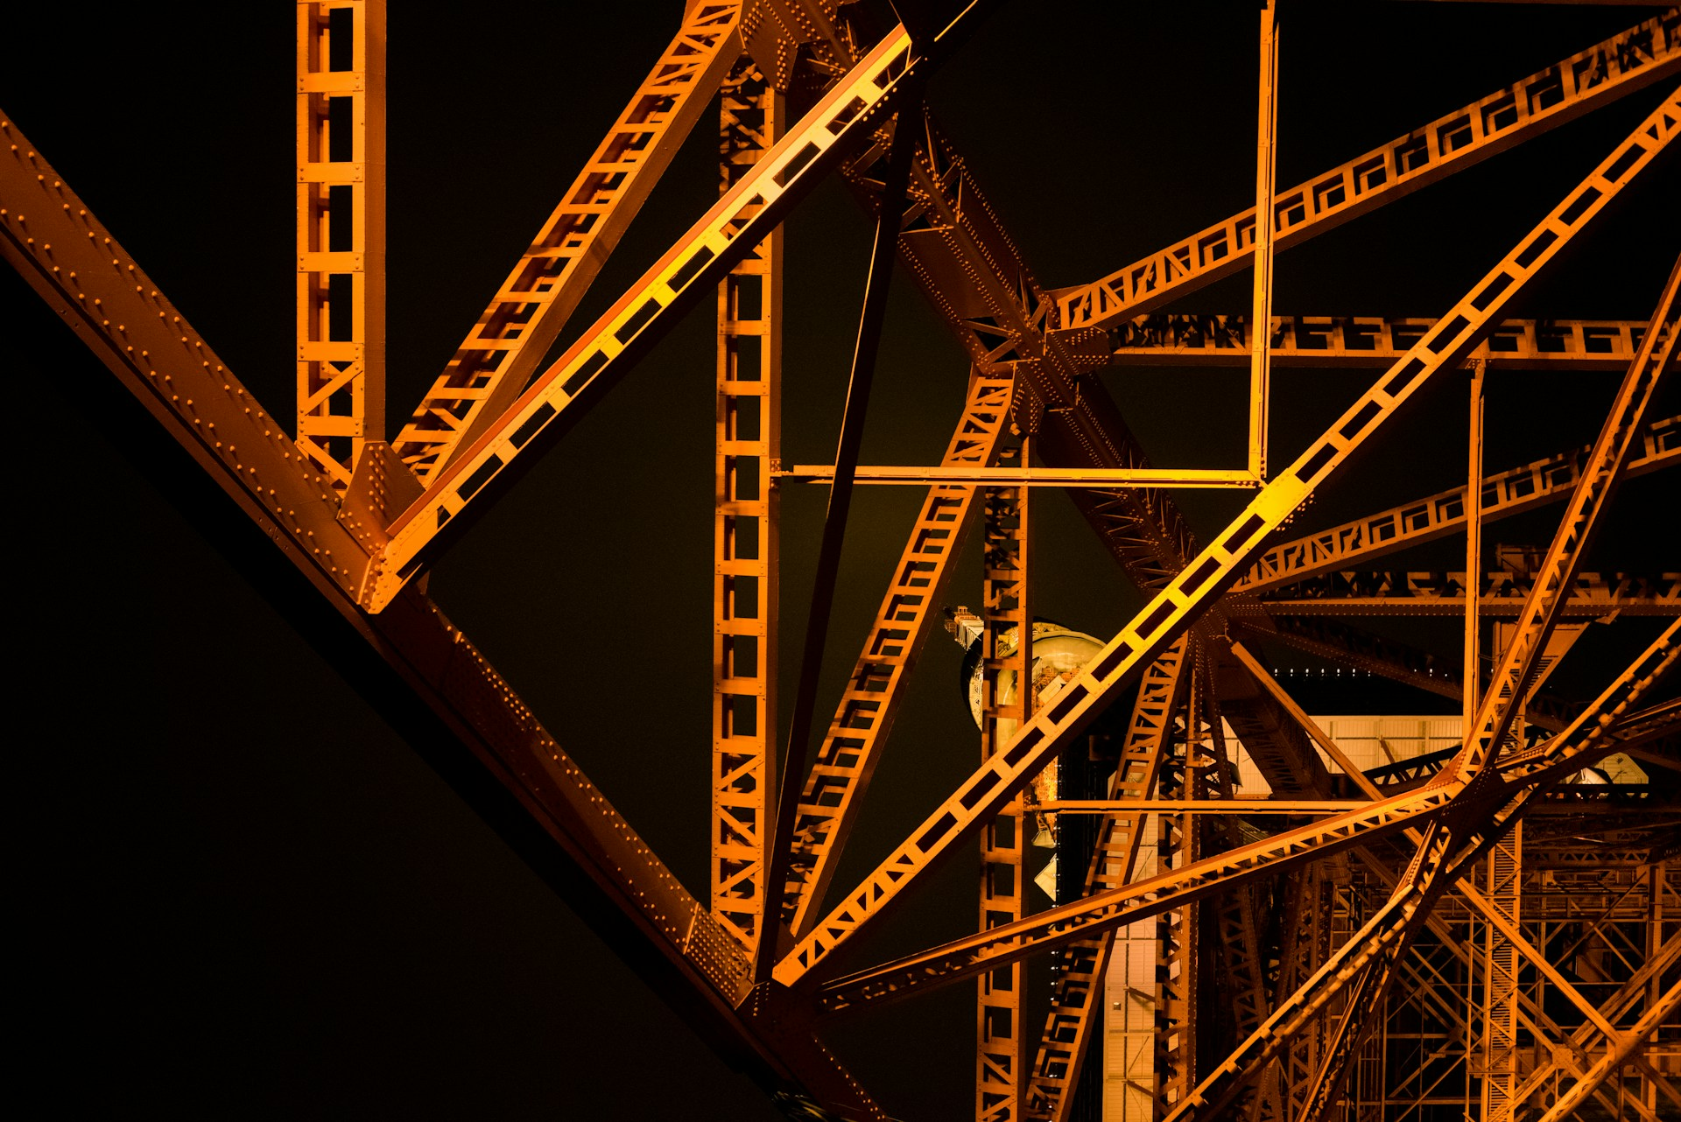
AI For Operations | Goals
Goal
Leveraging AI to support build and assembly processes
Explore Technical Approaches
Vision, guidance, latency, real-time feedback
Deliver
Working model architecture with feedback on assembly processes

Slide 7
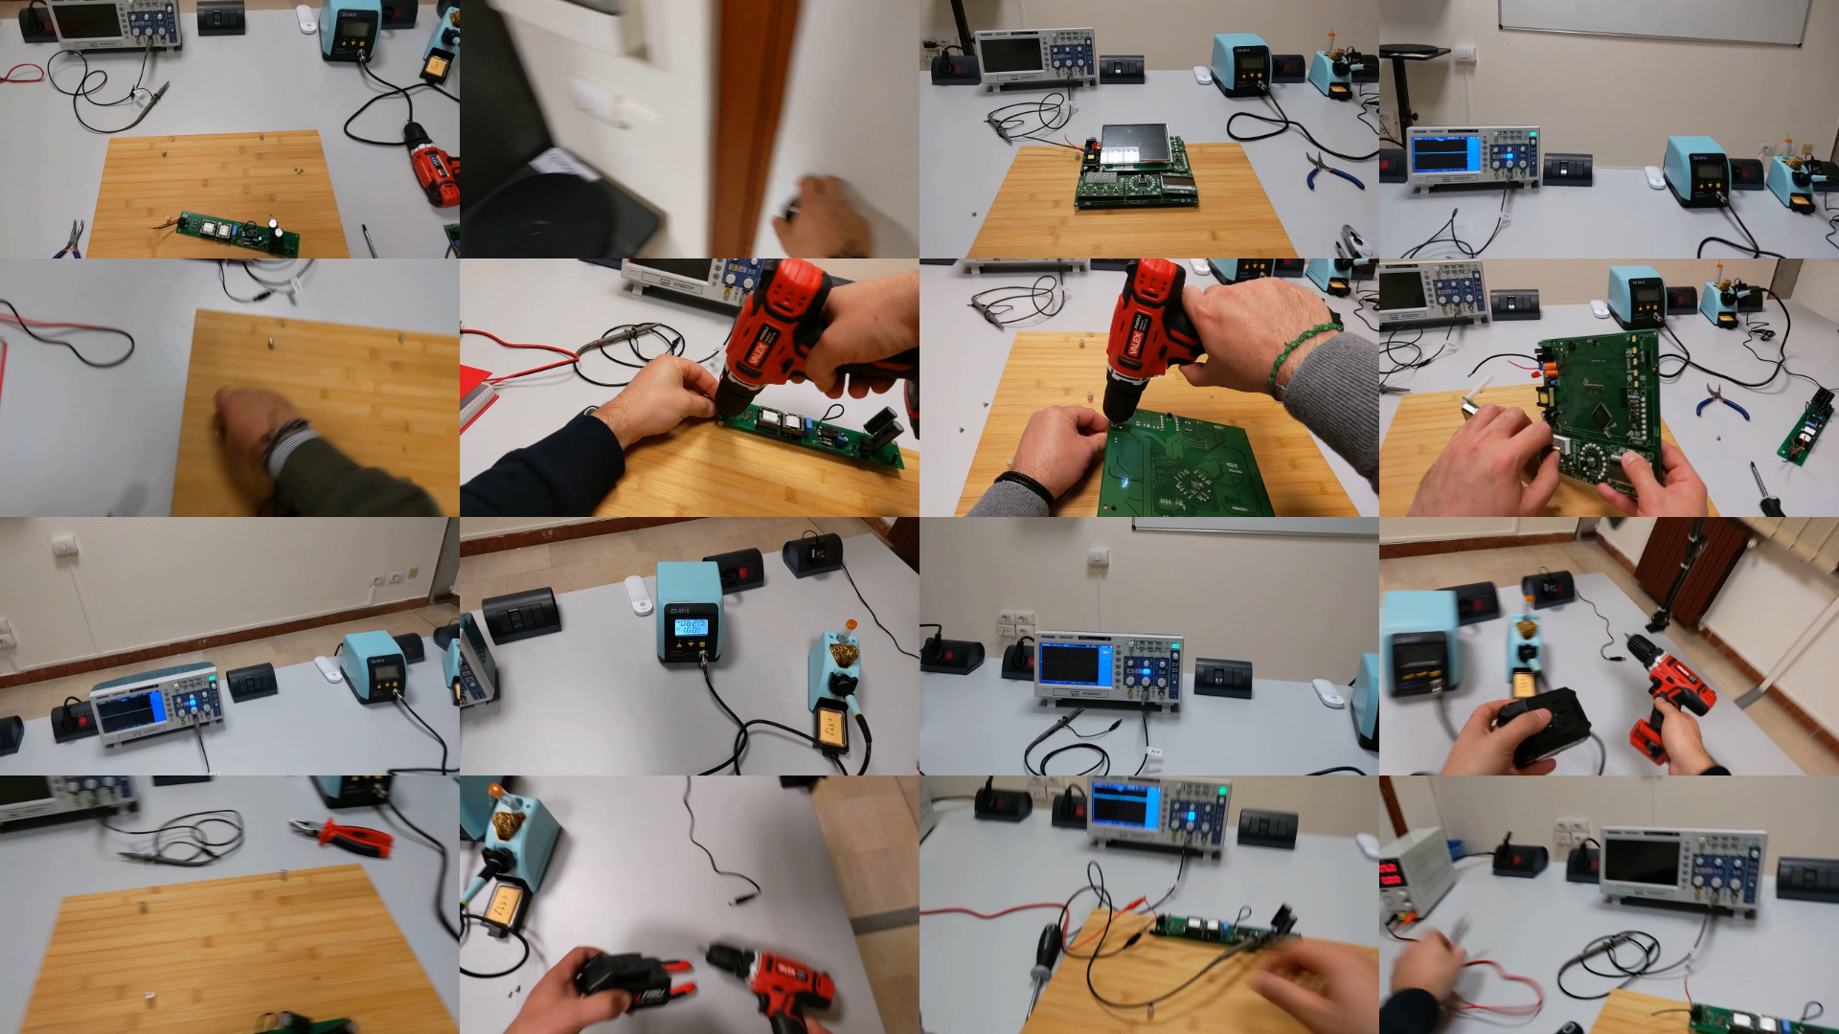
AIOps – Build & Assembly | Project Review
Problem
Manual assembly errors → 5–10% of build cost, schedule slips
Rework
Drilling, scrapping composite parts, endless inspections
Video not found
Solution
Always-on vision system watches every step, whispers correct torque/part/order, flags deviations in real time
First Person Technician Assembly View

Slide 8
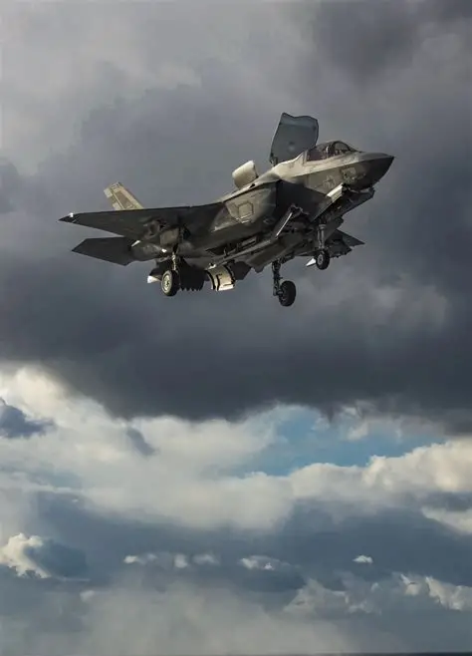
AI For Operations | why
300,000+
$82.5M
20–30%
Parts in an F-35 assembly
Avg F-35A production cost
Defects missed in manual visual inspection
The hidden cost isn't the error : it's discovering it late.
Assembly Copilot shifts detection left: to the station
1
STATION
›
2
SUB-ASSEMBLY
›
3
FINAL TEST
›
4
DELIVERY
catch here
rework
delay
escape
AIOps · Assembly Copilot

Slide 9
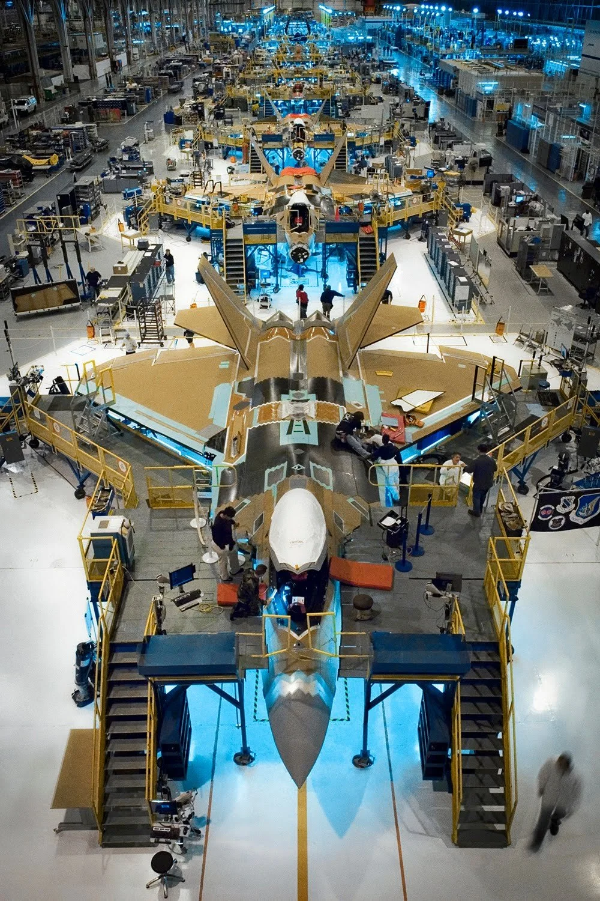
AI For Operations | Value
Total Addressable Market (TAM)
$7 - $35 billion USD
Value unlocked
Cut rework time 10% → $9 billion USD
Backlog
Faster deliveries, fewer delays
Safety & Workforce
Zero-Defect culture
Quality
Improvements
Economical Value
Value to UAE
Value to
Stakeholders

Slide 10
AI For Operations | Value
Quality Improvements
Economical Value
Value to UAE
Value to Stakeholders
Automatic detection of non-conformities
Production assistance
Less required personnel
Reduce maintenance costs
Seamlessly scale production
Original project
State of the art concepts
Becoming an R&D center
Inspection & assembly verification can be used in different business areas

Slide 11
Deliverables
Collect Proprietary Dataset for Build & Assembly
Working Model Architecture for Action Detection
Integrate to a real time feedback using Hololens
Propose a Solution to correct
Mistakes
= Finished
= Work in Progress
= Future Work

Slide 12
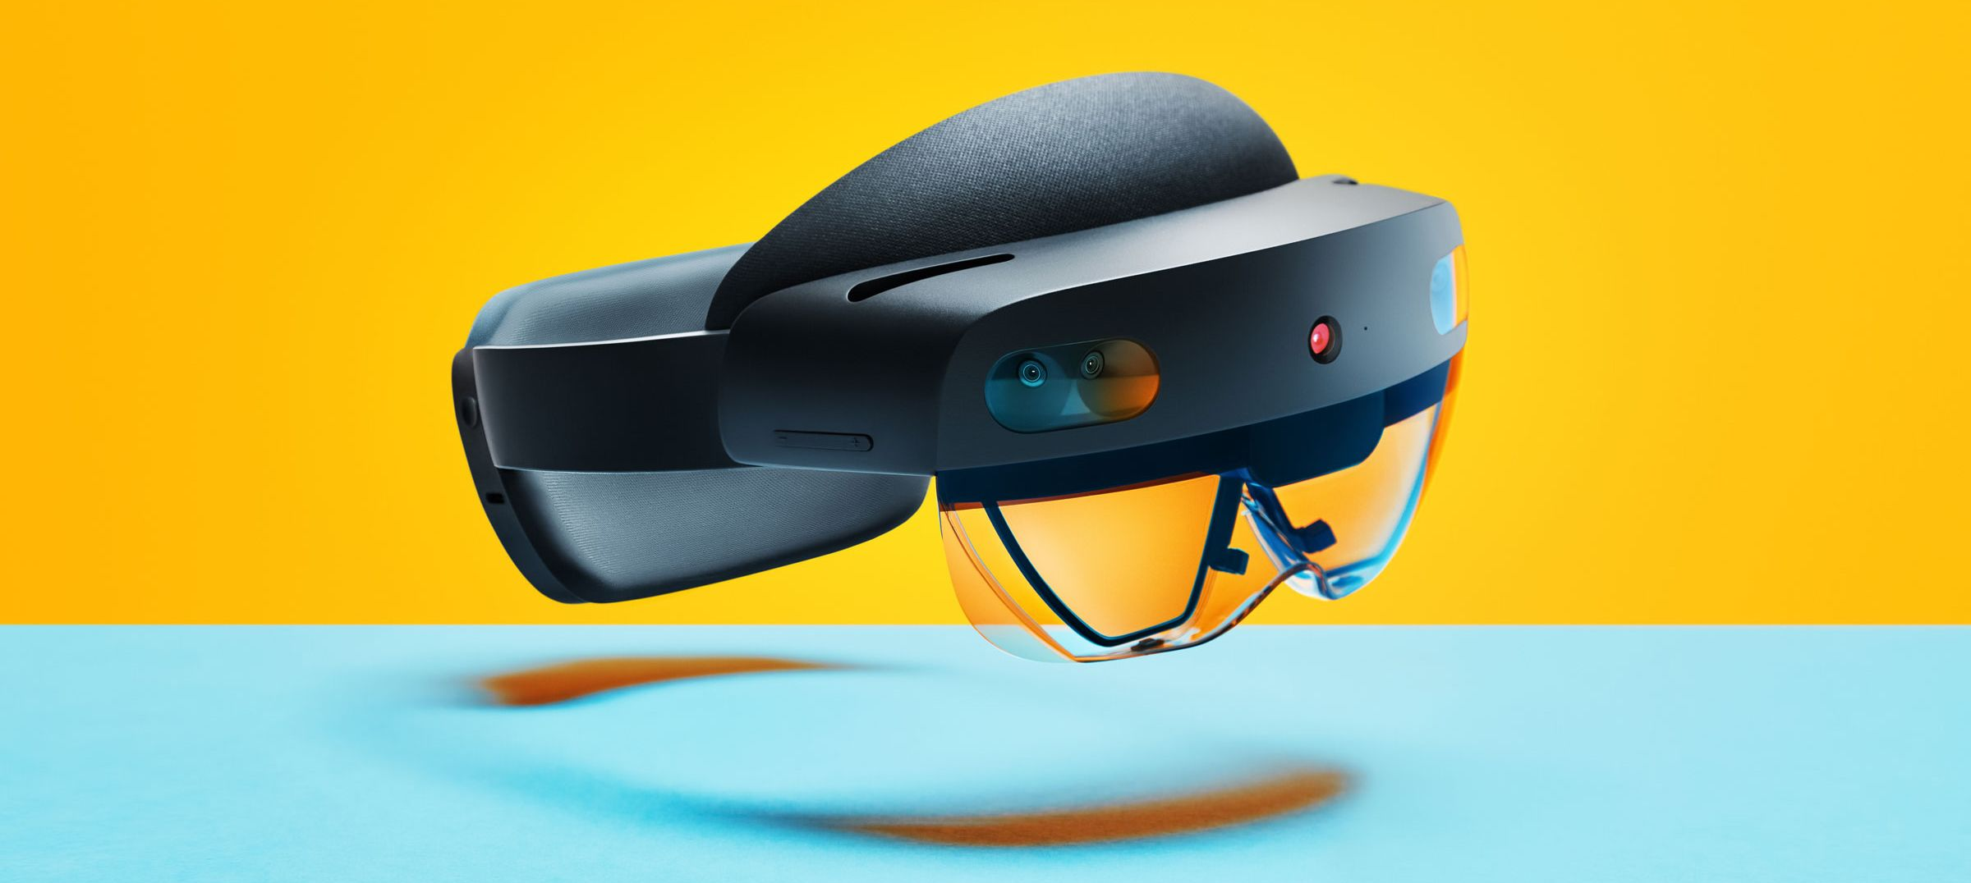
AIOps Assembly Copilot | THE SOLUTION
1
Watch — first-person assembly video
2
Recognize — part and procedure step
3
Flag — missing or incorrect action
First-person capture · Microsoft HoloLens 2
4
Guide — the operator immediately
ADVANTAGE
5
Record — time-stamped visual evidence
ON-SITE
WORKER IN CONTROL
AUDITABLE
AIOps · Assembly Copilot

Slide 13
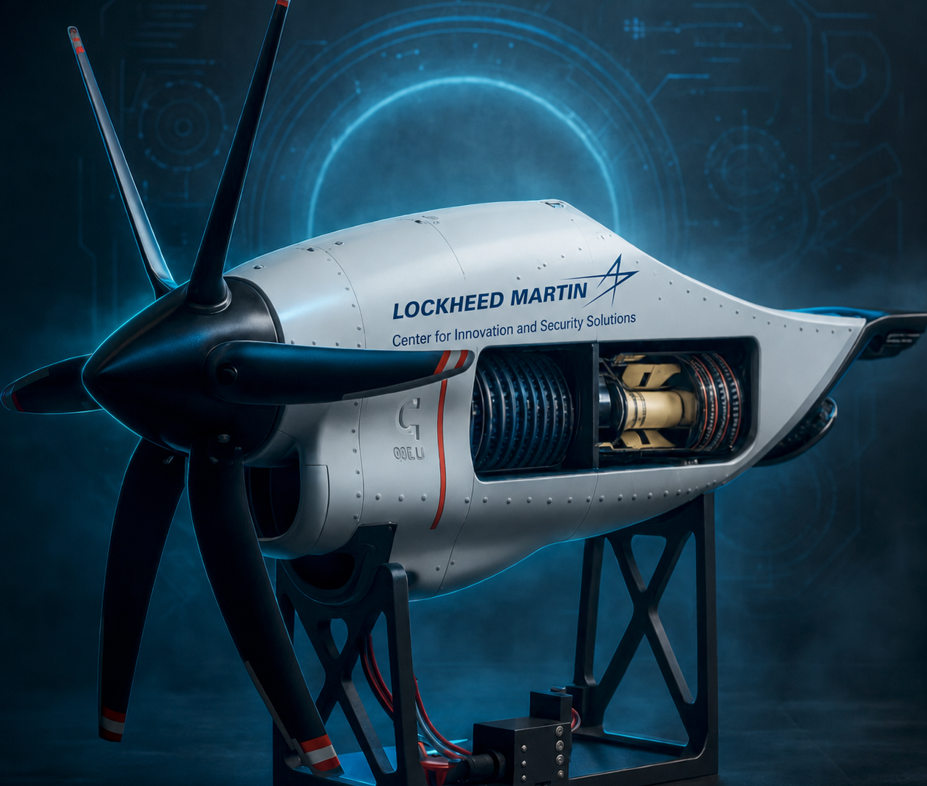
C-130 Engine Model | Assembly Platform
Recognizable aerospace form
Visible internal mechanics
Powered motion & modular interfaces
Repeatable, stageable errors
9 OBSERVABLE ACTIONS · 4 PHASES · ~5–6 MIN RUN
Propulsion
input
Drive +
control
Engine
core
Integration
+ test
AIOps · Assembly Copilot

Slide 14
Building our own egocentric dataset | Collection
AIOps · Assembly Copilot

Slide 15
Two architectures, one recipe | Model Architecture
Same frozen-backbone → trained-head design. A second appearance encoder unlocks fault detection.
A · Segmentation champion
B · Fault detector
SSv2-giant + DiffAct
Fusion + ASFormer
Frozen backbone
Fusion backbone
VideoMAEv2-giant (SSv2) · 1408-d
giant SSv2 + InternVideo2-B14 · 2176-d
↓
↓
DiffAct head
ASFormer head
diffusion action segmentation
Step head + Type head
↓
↓
Viterbi decode
Viterbi decode
procedure-aware
procedure-aware
Sharpest boundaries — best Edit & F1
Only architecture that catches faults
BEST MODEL
81.9
Acc
AIOps · Assembly Copilot

Slide 16
Our Solution in Action| Hololens Demo

Slide 17
Learning Outcomes
Understanding PSR architectures.
Designing 3D models.
Dataset collection and labeling at scale and privacy.
Engineering novel model architectures under hardware constraints.

