Slide 1
Software-Werkzeuge für die Programmierung SS 2016
Part 11: GIT – Using a Version Control System

Slide 2
Overview
Introduction to UNIX
Basics
Regular expressions
VIM and Emacs
Shell scripting
AWK and SED
Compiler
MAKE
Debugging and profiling
Documentation and visualization
GIT

Slide 3
Agenda
Introduction
Basics
Branching
Git on the server
Distributed Git
Git Tools
(All pictures in this presentation are taken from:
Pro Git by Scott Chacon ISBN-13: 978-1-4302-1834-0)

Slide 4
Agenda
Introduction
Basics
Branching
Git on the server
Distributed Git
Git Tools

Slide 5
Git
What is Git:
Git is a distributed version control system
Developed
by Linus Torvalds in April 2005
for managing Linux kernel project (since kernel 2.6.12 release in June 2005)
Since July 2005 maintained by Junio Hamano
What is Version Control?
Version control is a system that records changes to a file or set of files over time so that you can recall specific versions later.

Slide 6
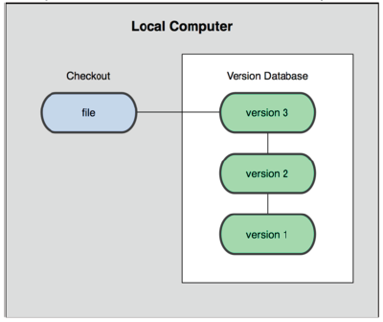
Git
Types of Version Control System:
Local Version Control Systems (e.g.: rcs)
A simple database that kept all the changes to files under revision control

Slide 7
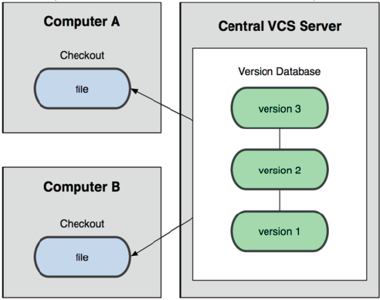
Git
Centralized Version Control Systems (CVS, SVN)
single server that contains all the versioned files
clients check out files from that server and save the changes theres (➔drawback)

Slide 8
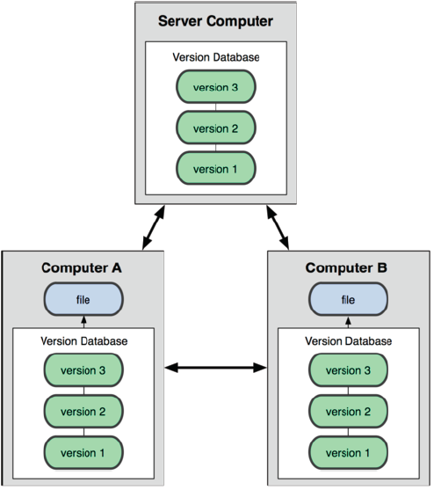
Git
Distributed Version Control Systems (Git, mercurial)
clients fully mirror the repository

Slide 9
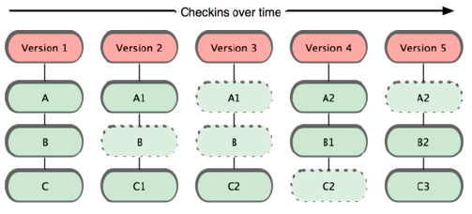
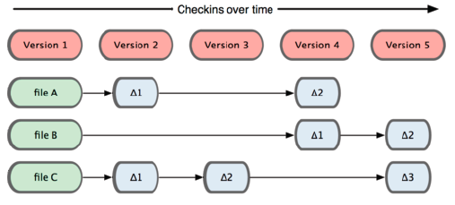
Git
Snapshots vs. Differences or Git vs. Others

Slide 10
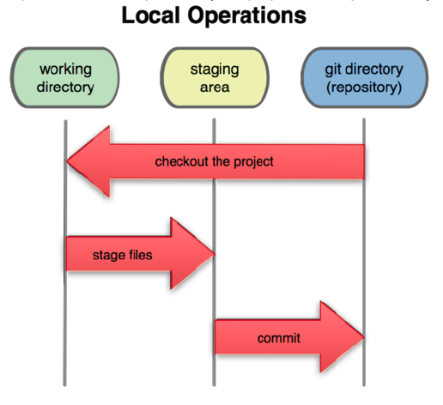
Git
The three states:

Slide 11
Git
Remarks:
Nearly every operation is local
Git has integrity because of SHA-1 hash e.g.: 24b9da6552252987aa493b52f8696cd6d3b00373
Git generally only adds data

Slide 12
Git
First-Time Git Setup via git config
$> git config --global user.name “Max Mustermann“
$> git config --global user.email mustermann@server.de
$> git config --global core.editor vim
$> git config --global merge.tool vimdiff
$> git config --list
user.name=Max Mustermann
user.email=mustermann@server.de
core.editor=vim
merge.tool=vimdiff
Global configurations for Git in:
/etc/gitconfig and
~/.gitconfig

Slide 13
Git
Getting help
syntax:
git help command
git command --help
man git-command
$> git help config
... (manpage of git config)

Slide 14
Agenda
Introduction
Basics
Branching
Git on the server
Distributed Git
Git Tools

Slide 15

Git
$> mkdir mygit
$> cd mygit/
$> git init .
Initialized empty Git repository in
/home/weise/mygit/.git/
$> git config user.name "Steffen"
$> git config user.email "steffen@iec.de"
$> git config core.editor "vim"
$> git config alias.st "status"
$> ls .git/
branches config description HEAD hooks info objects refs
$> cat .git/config
[core]
repositoryformatversion = 0
filemode = true
bare = false
logallrefupdates = true
editor = vim
[user]
name = Steffen
email = steffen@iec.de
[alias]
st = status

Slide 16
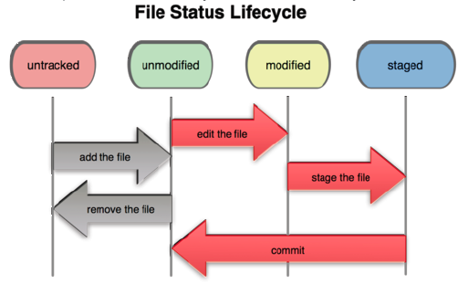
Git
File status

Slide 17
Git
$> echo "First line in my first file" >> firstfile.txt
$> git st
# On branch master
#
# Initial commit
#
# Untracked files:
# (use "git add <file>..." to include in what will be committed)
#
# firstfile.txt
nothing added to commit but untracked files present (use "git add" to track)
$> git add firstfile.txt
$> git st
# On branch master
#
# Initial commit
#
# Changes to be committed:
# (use "git rm --cached <file>..." to unstage)
#
# new file: firstfile.txt
#
$> git commit -m "first commit"
[master (root-commit) eb157f9] first commit
1 files changed, 1 insertions(+), 0 deletions(-)
create mode 100644 firstfile.txt
$> echo "Second line" >> firstfile.txt

Slide 18
Git
$> git st
# On branch master
# Changed but not updated:
# (use "git add <file>..." to update what will becommitted)
# (use "git checkout -- <file>..." to discard changes inworking directory)
#
# modified: firstfile.txt
#
no changes added to commit (use "git add" and/or "git commit -a")
$> echo "First line of my second file" >> secondfile.txt
$> git st
# On branch master
# Changed but not updated:
# (use "git add <file>..." to update what will be committed)
# (use "git checkout -- <file>..." to discard changes in workingdirectory)
#
# modified: firstfile.txt
#
# Untracked files:
# (use "git add <file>..." to include in what will be committed)
#
# secondfile.txt
no changes added to commit (use "git add" and/or "git commit -a")

Slide 19
Git
$> git add .
$> git st
# On branch master
# Changes to be committed:
# (use "git reset HEAD <file>..." to unstage)
#
# modified: firstfile.txt
# new file: secondfile.txt
#
$> git commit -m "second commit, added a few files"
[master b3a2f80] second commit, added a few files
2 files changed, 2 insertions(+), 0 deletions(-)
create mode 100644 secondfile.txt
$> echo "Second line of my second file" >> secondfile.txt
$> git add secondfile.txt
$> echo "Third line of my second file" >> secondfile.txt
$> git st
# On branch master
# Changes to be committed:
# (use "git reset HEAD <file>..." to unstage)
#
# modified: secondfile.txt
#
# Changed but not updated:
# (use "git add <file>..." to update what will be committed)
# (use "git checkout -- <file>..." to discard changes in working directory)
#
# modified: secondfile.txt
#

Slide 20
Git
$> git checkout -- secondfile.txt
$> git st
# On branch master
# Changes to be committed:
# (use "git reset HEAD <file>..." to unstage)
#
# modified: secondfile.txt
#
$> git commit -m "working my way through"
[master 36664b2] working my way through
1 files changed, 1 insertions(+), 0 deletions(-)
$> git log
commit 36664b2c9bb5ab7191cf831ccdc936cf06bef31b
Author: Steffen <steffen@iec.de>
Date: Wed Oct 12 10:29:44 2011 +0200
working my way through
commit b3a2f80a98b9e5a2270b76f05090d6430dd09dc0
Author: Steffen <steffen@iec.de>
Date: Wed Oct 12 10:22:25 2011 +0200
second commit, added a few files
commit eb157f90120dc232aefdd20ca6a7ef5b8fa2f38e
Author: Steffen <steffen@iec.de>
Date: Wed Oct 12 10:17:55 2011 +0200
first commit

Slide 21
Git
$> ls
firstfile.txt secondfile.txt
$> echo "*.[oa]" >> .gitignore
$> touch my.a
$> touch this.o
$> git st
# On branch master
# Untracked files:
# (use "git add <file>..." to include in what will be committed)
#
# .gitignore
nothing added to commit but untracked files present (use "git add" to track)
$> ls && git add .gitignore
firstfile.txt my.a secondfile.txt this.o
$> git commit -m "added some usefull ignore statements“
...
$> vi secondfile.txt (What happens???)
$> git st
# On branch master
# Changed but not updated:
# (use "git add <file>..." to update what will be committed)
# (use "git checkout -- <file>..." to discard changes in working directory)
#
# modified: secondfile.txt
#
no changes added to commit (use "git add" and/or "git commit -a")
$> git diff
diff --git a/secondfile.txt b/secondfile.txt
index c7dc2ec..a7ee1d5 100644
--- a/secondfile.txt
+++ b/secondfile.txt

Slide 22
Git
@@ -1,2 +1,3 @@
-First line of my second file
-Second line of my second file
+first line of my second file
+second line of my second file
+third line of my second file
$> git diff > my.patch
$> git add secondfile.txt
$> patch -p1 -R < my.patch
patching file secondfile.txt
$> git st
# On branch master
# Changes to be committed:
# (use "git reset HEAD <file>..." to unstage)
#
# modified: secondfile.txt
#
# Changed but not updated:
# (use "git add <file>..." to update what will be committed)
# (use "git checkout -- <file>..." to discard changes in working directory)
#
# modified: secondfile.txt
#
# Untracked files:
# (use "git add <file>..." to include in what will be committed)
#
# my.patch
$> git diff --cached secondfile.txt
diff --git a/secondfile.txt b/secondfile.txt
index c7dc2ec..a7ee1d5 100644
--- a/secondfile.txt
+++ b/secondfile.txt

Slide 23
Git
@@ -1,2 +1,3 @@
-First line of my second file
-Second line of my second file
+first line of my second file
+second line of my second file
+third line of my second file
$> git diff HEAD secondfile.txt
$> git checkout -- secondfile.txt
git checkout -- secondfile.txt
$> git st
# On branch master
# Changes to be committed:
# (use "git reset HEAD <file>..." to unstage)
#
# modified: secondfile.txt
#
# Untracked files:
# (use "git add <file>..." to include in what will be committed)
#
# my.patch
$> git commit -m "corrected case in secondfile"
...
$> rm my.patch
$> echo "first line of fourth file" >> thirdfile.txt
$> git add thirdfile.txt
$> git commit –m "added my fourthfile“
...
$> git mv thirdfile.txt fourthfile.txt
$> git st
# On branch master
# Changes to be committed:

Slide 24
Git
# (use "git reset HEAD <file>..." to unstage)
#
# renamed: thirdfile.txt -> fourthfile.txt
#
$> git rm secondfile.txt
rm 'secondfile.txt'
$> git st
# On branch master
# Changes to be committed:
# (use "git reset HEAD <file>..." to unstage)
#
# renamed: thirdfile.txt -> fourthfile.txt
# deleted: secondfile.txt
#
$> git commit -m "moving some files around"
...
$> git rev-list HEAD -- secondfile.txt
030b7c08d21e2f9380794aee66775c0e779de96c
f183967a9d2d6e9bc624d6195befff529b2e966f
36664b2c9bb5ab7191cf831ccdc936cf06bef31b
b3a2f80a98b9e5a2270b76f05090d6430dd09dc0
$> ls
firstfile.txt fourthfile.txt my.a this.o
$> git checkout 030b7c08d21e2f9380794aee66775c0e779de96c^ secondfile.txt
$> git st
# On branch master
# Changes to be committed:
# (use "git reset HEAD <file>..." to unstage)
#
# new file: secondfile.txt
#

Slide 25
Git
$> git add .
$> git commit -m "thank you git“
...
$> git config alias.lg "log --pretty=oneline --graph --abbrev-commit"
$> git lg
* 165dc66 thank you git
* 030b7c0 moving some files around
* c5e00df added my fourthfile
* f183967 corrected case in secondfile
* 6f119aa added some usefull ignore statements
* 36664b2 working my way through
* b3a2f80 second commit, added a few files
* eb157f9 first commit

Slide 26
Agenda
Introduction
Basics
Branching
Git on the server
Distributed Git
Git Tools

Slide 27
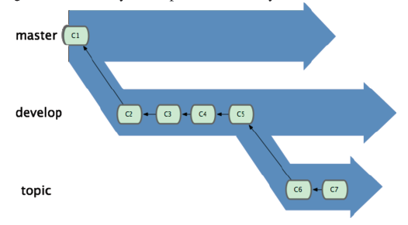
Git

Slide 28
Git
$> git branch
* Master
$> git branch longterm
$> git checkout longterm
Switched to branch 'longterm'
$> git branch
* longterm
master
$> vi longterm.txt
$> git add longterm.txt
$> git commit -m "added longterm branch“
...
$> git checkout master
Switched to branch 'master'
$> echo "Third line" >> firstfile.txt
$> git commit -am "more modifications on first file“
...
$> git checkout longterm
$> cat firstfile.txt
First line in my first file
Second line
$> echo "wow something in first file had to be modified" >> firstfile.txt
$> git commit -am "mod in firstfile"
...
$> git checkout master
$> git merge longterm
Auto-merging firstfile.txt
CONFLICT (content): Merge conflict in firstfile.txt
Automatic merge failed; fix conflicts and then commit the result
$> cat firstfile.txt
First line in my first file
Second line
<<<<<<< HEAD

Slide 29
Git
Third line
=======
wow something in first file had to be modified
>>>>>>> longterm
$> vi firstfile.txt
$> git commit
[master e00dd7c] Merge branch 'longterm'
$ git lg
* e00dd7c Merge branch 'longterm'
|\
| * a92c6d1 mod in firstfile
| * 15dc341 added longterm branch
* | f181430 more modifications on first file
|/
* 165dc66 thank you git
...
$> git branch -d longterm
Deleted branch longterm (was a92c6d1).

Slide 30
Agenda
Introduction
Basics
Branching
Git on the server
Distributed Git
Git Tools

Slide 31
Git
Setting up a git server
$> ssh user@server.com
...
$> mkdir myNewRepo.git
$> cd myNewRepo.git
$> git init --bare
$> logout
... (back in mygit)
Adding server to Git-Repository
$> git remote add name user@server.com:myNewRepo.git
Communication with server
$> git pull name master
$> git push name master

Slide 32
Agenda
Introduction
Basics
Branching
Git on the server
Distributed Git
Git Tools

Slide 33
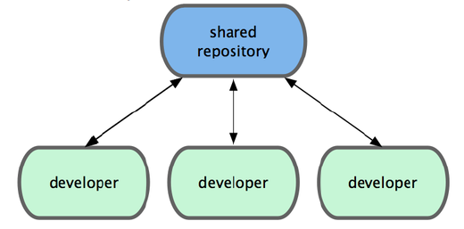
Git
Typical Git application:

Slide 34
Git
Example ...

Slide 35
Agenda
Introduction
Basics
Branching
Git on the server
Distributed Git
Git Tools

Slide 36
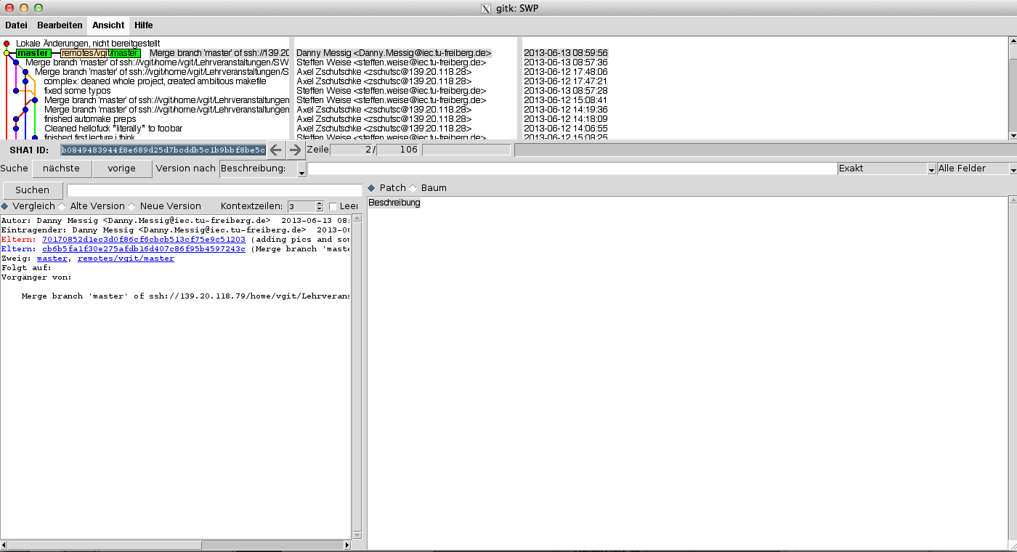
Git
$> gitk

Slide 37
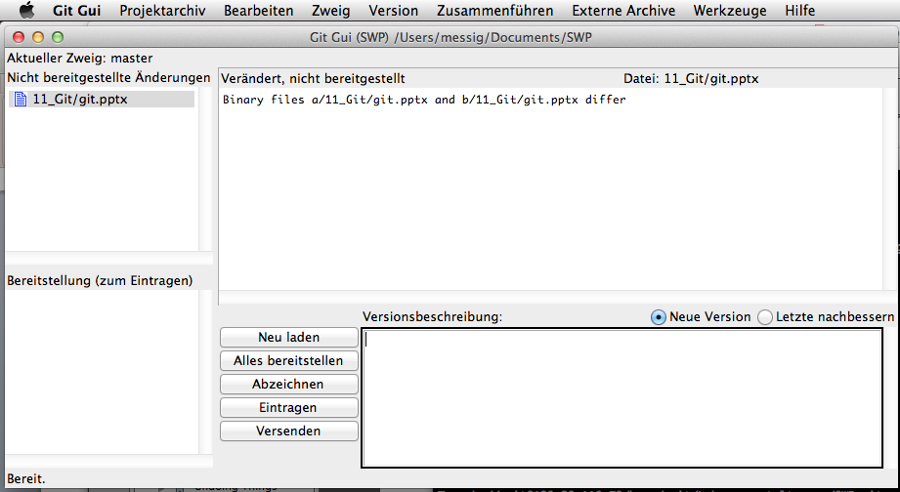
Git
$> git gui

