Slide 1
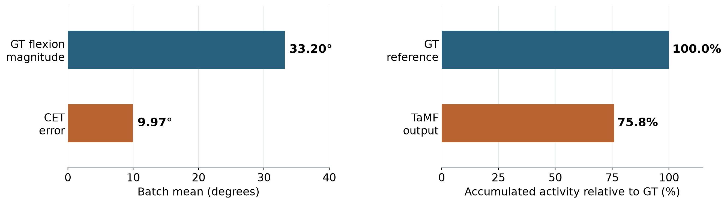
CET benchmark and the remaining articulation gap
Mean CET
Mean activity rate mismatch
9.97°
1.98°/s
About 30% of mean GT flexion magnitude
Median output activity is 24% below GT
Goal: reduce CET toward 0°
Goal: reduce the activity mismatch
Preserve the intended motion and interaction as both errors decrease.
91 motions, partial batch. CET/depth is a ratio of batch means, not a percentage of movement lost.
Notes:
This slide contextualizes residual errors without truncating axes or changing source values. CET primary benchmark mean9.965959984933022 degrees. GT mean absolute flexion33.196345976759865 degrees, ratio of means30.021255929523093 percent. These angular summaries use the same 15 joints, but CET averages DTW path pairs whereas GT depth averages original valid frames. This ratio is additional descriptive magnitude analysis, not fraction of motion lost, not a validated perceptual threshold, and not mean of motion-level ratios. Mean absolute activity rate mismatch1.9790365483315997 degrees/s, as introduced in prior summary slide. Right bar shows median per-motion output/GT accumulated angular variation75.80658322868619 percent, corresponding to24.19341677131381 percent lower accumulated variation. 74 of91 motions have lower prediction accumulated variation. Equal duration in each prediction/GT pair makes total variation ratio identical to paired variation rate ratio. The right bar is a median descriptor ratio, separate from the mean absolute rate gap1.98 degrees/s. Reduce discrepancy, not reference activity or finger movement itself. Matching a scalar descriptor does not ensure correct motion trajectories. Sources: common/partial_batch/test_one__0399/cet/20261006T015545971089Z/motions.json; Scripts/evaluate_cet.py and Scripts/CET.md. Calculation in build/context_figure.py, recorded in analysis/summary_context_metrics.json. Partial batch of91 unique motions from20 source sequences.

