Slide 1
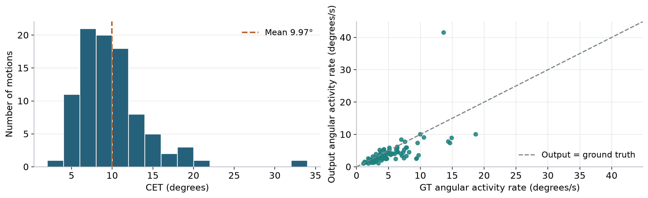
CET benchmark and thesis targets
Mean CET
Mean activity rate mismatch
9.97°
1.98°/s
Goal: reduce aligned curl error
Goal: match the reference activity
Reduce both errors while preserving the intended motion and interaction.
Activity mismatch = mean absolute output–GT rate difference (additional analysis). Partial batch: 91 motions.
Notes:
CET means Curl Error with Time Alignment, not CT. Primary benchmark: mean CET 9.965959984933022 degrees across the 91 final-output motions in common/partial_batch/test_one__0399/cet/20261006T015545971089Z. Additional analysis: for each motion, take the absolute difference between prediction and GT whole-hand variation_degrees_per_second, then average equally over motions. Mean activity rate mismatch = 1.9790365483316004 degrees/s. Whole-hand rate is the mean of the 15 joint total-variation/duration values. Both target errors have ideal value zero. Do not reduce the amount of activity itself: predictions often have less activity than GT already. Matching a scalar activity rate cannot establish trajectory correctness; CET and interaction checks remain necessary. Same valid frames and duration for each paired motion. Plot shows motion-level rate descriptors, not DTW aligned rates. Sources: saved motions.json, summary.json, evaluator Scripts/evaluate_cet.py. New analysis reproduced by build/summary_figure.py and recorded in analysis/summary_slide_metrics.json. Partial evaluation batch, not entire OakInk2 test set.

