Slide 1
Finger articulation in TaMF
Research findings from CET
Curl Error with Time Alignment
91 unique hand-motion segments
Mean CET 9.97° • Median 9.12°
Thesis objective
Reduce finger-flexion error while preserving the intended interaction.
Partial OakInk2 evaluation batch / Research meeting / 6 October 2026
Notes:
Sources: saved final-output run common/partial_batch/test_one__0399/cet/20261006T015545971089Z, motions.json and arrays/*.npz. Analysis and formulas: Scripts/evaluate_cet.py and Scripts/CET.md. All 91 saved CET values reproduced from the saved DTW paths. Partial batch of 20 source sequences, not the complete OakInk2 test set.

Slide 2
CET isolates finger-flexion disagreement
Reference and predicted hand poses
15 signed anatomical bend angles per frame
One shared DTW path, allowing up to 10% timing displacement
CET = mean absolute angle difference along that path
0° = perfect aligned agreement. Lower is better.
Wrist translation and root rotation are excluded.
Contact, action fidelity and full thumb opposition require other checks.
Equal weight for 15 joints and for each unique motion. Saved samples, no resampling.
Notes:
Sources: saved final-output run common/partial_batch/test_one__0399/cet/20261006T015545971089Z, motions.json and arrays/*.npz. Analysis and formulas: Scripts/evaluate_cet.py and Scripts/CET.md. All 91 saved CET values reproduced from the saved DTW paths. Partial batch of 20 source sequences, not the complete OakInk2 test set. Final output is the saved R-stage, decoded from refine_pose_repr. No stage comparison is made. Angle extraction is signed anatomical Z bend in the fixed manotorch XYZ template. The DTW cumulative cost is minimized, then divided by recovered path length.

Slide 3
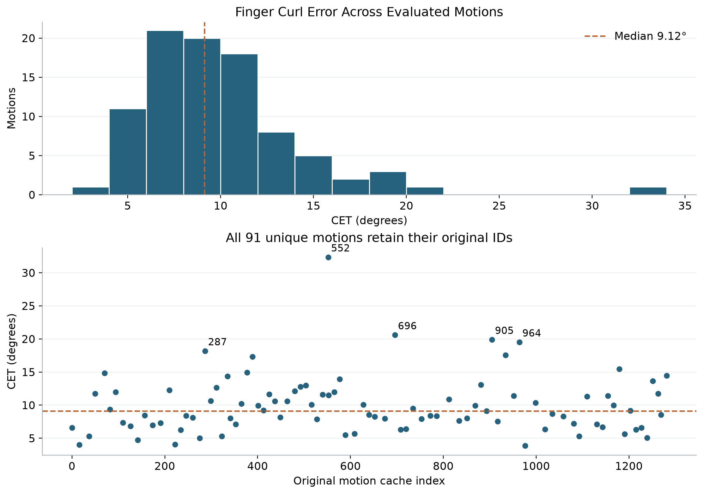
Typical error is near 9° with a substantial tail
9.97° mean
9.12° median
4.36° population SD
Middle half
7.11°–11.74°
Maximum
32.34°
Each point is one unique motion. IDs 287, 552, 696, 905 and 964 have the largest errors.
Notes:
Sources: saved final-output run common/partial_batch/test_one__0399/cet/20261006T015545971089Z, motions.json and arrays/*.npz. Analysis and formulas: Scripts/evaluate_cet.py and Scripts/CET.md. All 91 saved CET values reproduced from the saved DTW paths. Partial batch of 20 source sequences, not the complete OakInk2 test set. Mean 9.9659599849, median 9.1236063446, population SD 4.3553554557. P25 7.1055740615, P75 11.7408788114, P90 14.8466470749, P95 17.8500726124. 53/91 below 10 degrees.

Slide 4
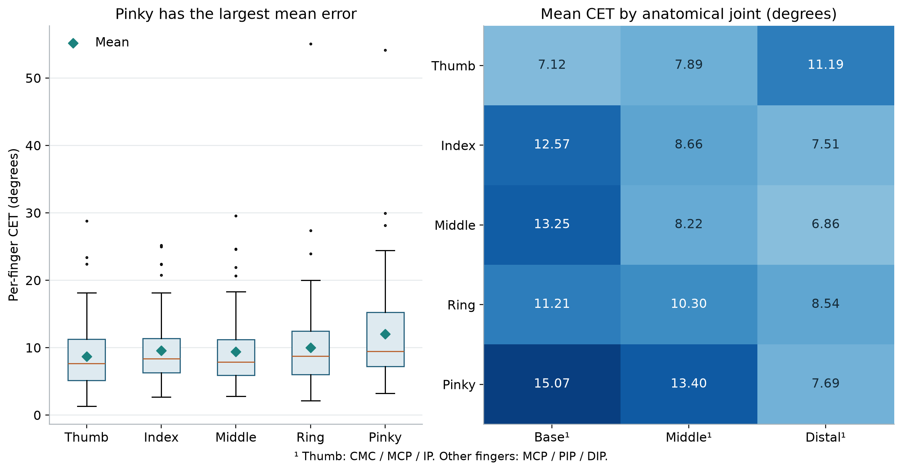
Pinky and proximal joints carry more error
Pinky mean CET 12.05°. It has the largest finger error in 32 of 91 motions.
Notes:
Sources: saved final-output run common/partial_batch/test_one__0399/cet/20261006T015545971089Z, motions.json and arrays/*.npz. Analysis and formulas: Scripts/evaluate_cet.py and Scripts/CET.md. All 91 saved CET values reproduced from the saved DTW paths. Partial batch of 20 source sequences, not the complete OakInk2 test set. Finger means thumb 8.7361,index 9.5797,middle 9.4419,ring 10.0191,little 12.0530. Pinky largest in 32/91. Joint means pinky MCP15.0669,PIP13.4014,middle MCP13.2461. Anatomy mapping: thumb CMC/MCP/IP, others MCP/PIP/DIP.

Slide 5
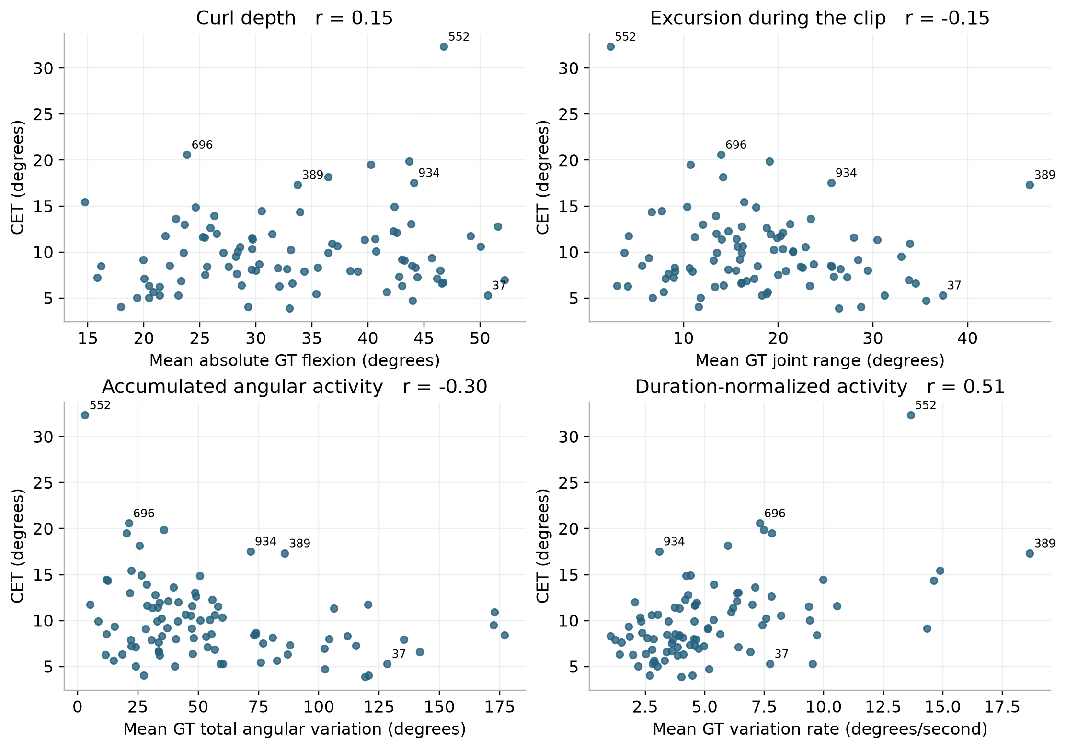
Reference curl amount and CET answer different questions
GT depth
How flexed is the hand?
GT activity
How much does it move?
CET
How much does prediction disagree?
Activity rate correlates with CET (r = 0.51). Depth is weakly associated (r = 0.15).
Notes:
Sources: saved final-output run common/partial_batch/test_one__0399/cet/20261006T015545971089Z, motions.json and arrays/*.npz. Analysis and formulas: Scripts/evaluate_cet.py and Scripts/CET.md. All 91 saved CET values reproduced from the saved DTW paths. Partial batch of 20 source sequences, not the complete OakInk2 test set. GT descriptors are mean of joint statistics. Depth r=.1475; range r=-.1485; accumulated activity r=-.2966; activity rate r=.5068. Correlations descriptive; shared sequences and duration confound them.

Slide 6
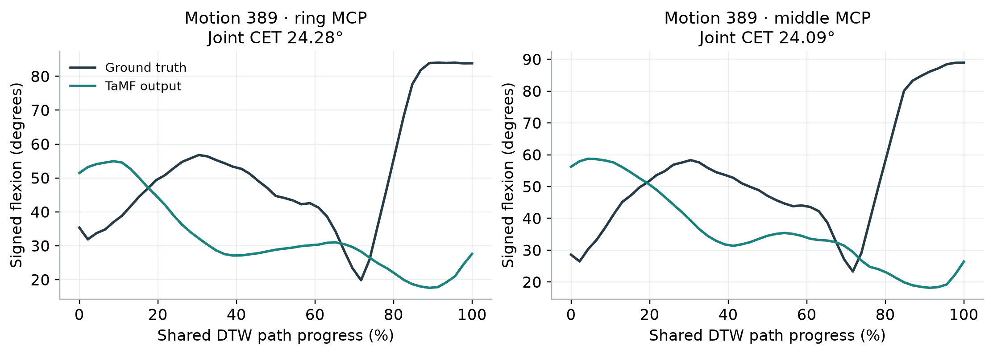
Motion 389 exposes a dynamic articulation mismatch
Close the microwave gate / Right hand
CET 17.33° GT range 46.56° GT activity rate 18.65°/s
Largest reference range and activity rate in this batch. Error remains after alignment.
Notes:
Sources: saved final-output run common/partial_batch/test_one__0399/cet/20261006T015545971089Z, motions.json and arrays/*.npz. Analysis and formulas: Scripts/evaluate_cet.py and Scripts/CET.md. All 91 saved CET values reproduced from the saved DTW paths. Partial batch of 20 source sequences, not the complete OakInk2 test set. Description: Close the gate of the microwave oven. Right hand. Duration4.6s,GT depth33.71765,range46.56041,totalvariation85.79155,rate18.65034,CET17.32647. Ring MCP24.277 and middle MCP24.086 are largest. Curves show the two largest-error joints on saved shared DTW path.

Slide 7
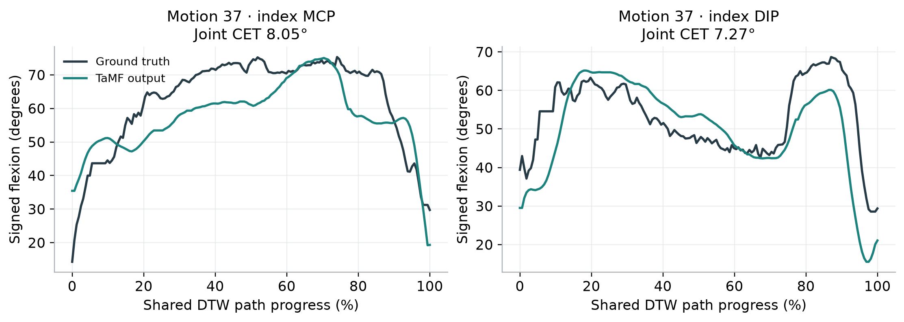
Motion 37 shows that demanding articulation can succeed
Pour juice from a tall blue mug into a bowl / Right hand
CET 5.31° GT depth 50.68° GT range 37.38°
A demanding positive control: future improvements should preserve this level of agreement.
Notes:
Sources: saved final-output run common/partial_batch/test_one__0399/cet/20261006T015545971089Z, motions.json and arrays/*.npz. Analysis and formulas: Scripts/evaluate_cet.py and Scripts/CET.md. All 91 saved CET values reproduced from the saved DTW paths. Partial batch of 20 source sequences, not the complete OakInk2 test set. Description: Pour the juice from the tall blue mug to the bowl. Right hand. GT depth50.681449,range37.378644,totalvariation128.392104,rate7.746130,CET5.312834. Index CET7.216429; top joints index MCP8.048,index DIP7.269.

Slide 8
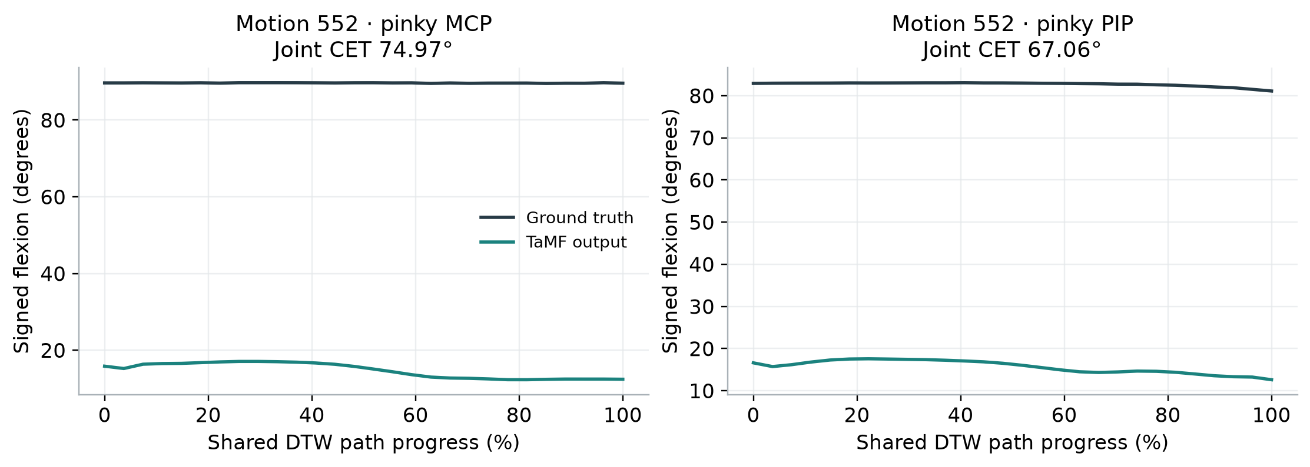
Motion 552 fails despite almost no curl excursion
Press the microwave button / Left hand
CET 32.34° GT range 2.27° Duration 0.225 s
Incorrect held posture can dominate CET. High variation rate alone would misclassify this case.
Notes:
Sources: saved final-output run common/partial_batch/test_one__0399/cet/20261006T015545971089Z, motions.json and arrays/*.npz. Analysis and formulas: Scripts/evaluate_cet.py and Scripts/CET.md. All 91 saved CET values reproduced from the saved DTW paths. Partial batch of 20 source sequences, not the complete OakInk2 test set. Description: Press the button on the microwave oven. Left hand. CET32.341098,GT depth46.771988,range2.270984,totalvariation3.070586,duration.225s,rate13.64705. Ring CET55.082,pinky54.142. Pinky MCP74.968,PIP67.063. High rate is affected by very short duration.

Slide 9
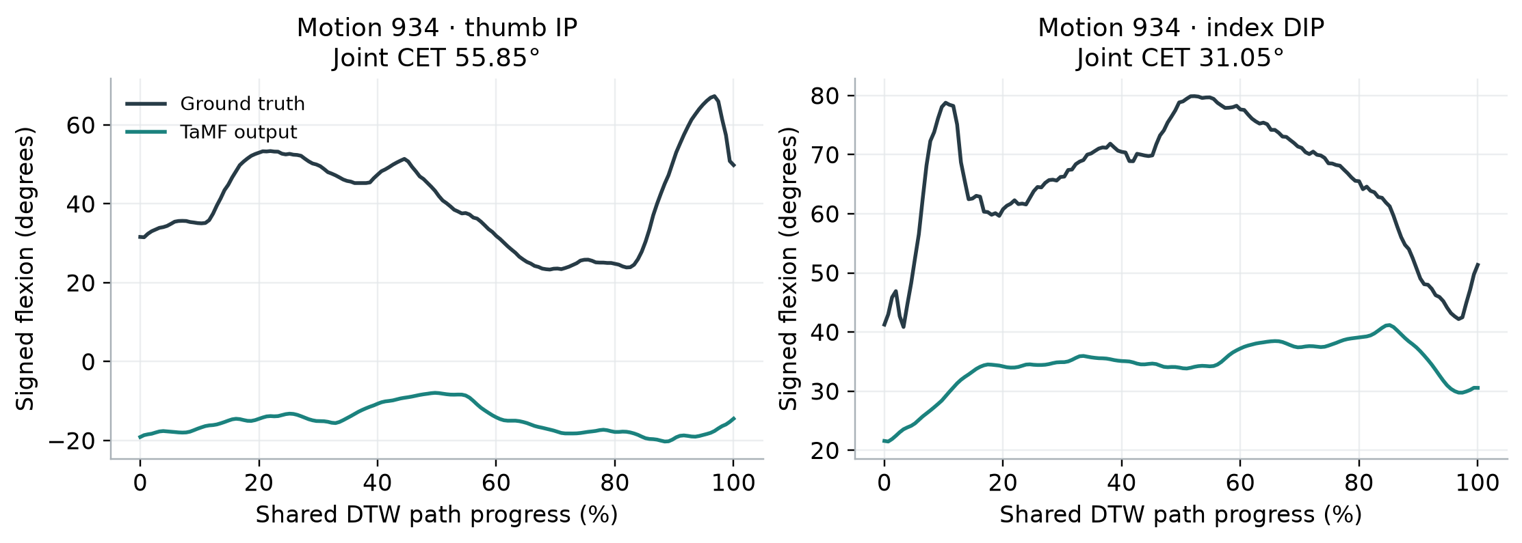
Motion 934 combines local errors with a meaningful ratio
Pour seasonings into a frying pan / Right hand
Pinky: 9.26° CET / 46.07° GT depth = 20.10%
Additional error-to-flexion magnitude ratio, not “20% of movement lost.” Thumb error is larger here.
Notes:
Sources: saved final-output run common/partial_batch/test_one__0399/cet/20261006T015545971089Z, motions.json and arrays/*.npz. Analysis and formulas: Scripts/evaluate_cet.py and Scripts/CET.md. All 91 saved CET values reproduced from the saved DTW paths. Partial batch of 20 source sequences, not the complete OakInk2 test set. Description: Pour the seasonings from the green striped bottle to the fryingpan. Right hand. CET17.535558. Thumb CET28.829760; index24.983991;pinky9.259491. Thumb IP55.853. Additional ratio pinky CET9.2594913465 / GT mean absolute flexion46.0690289077 =20.099168%. Both degrees, same three joints but DTW vs original frame time weighting. This is not percent motion lost.

Slide 10
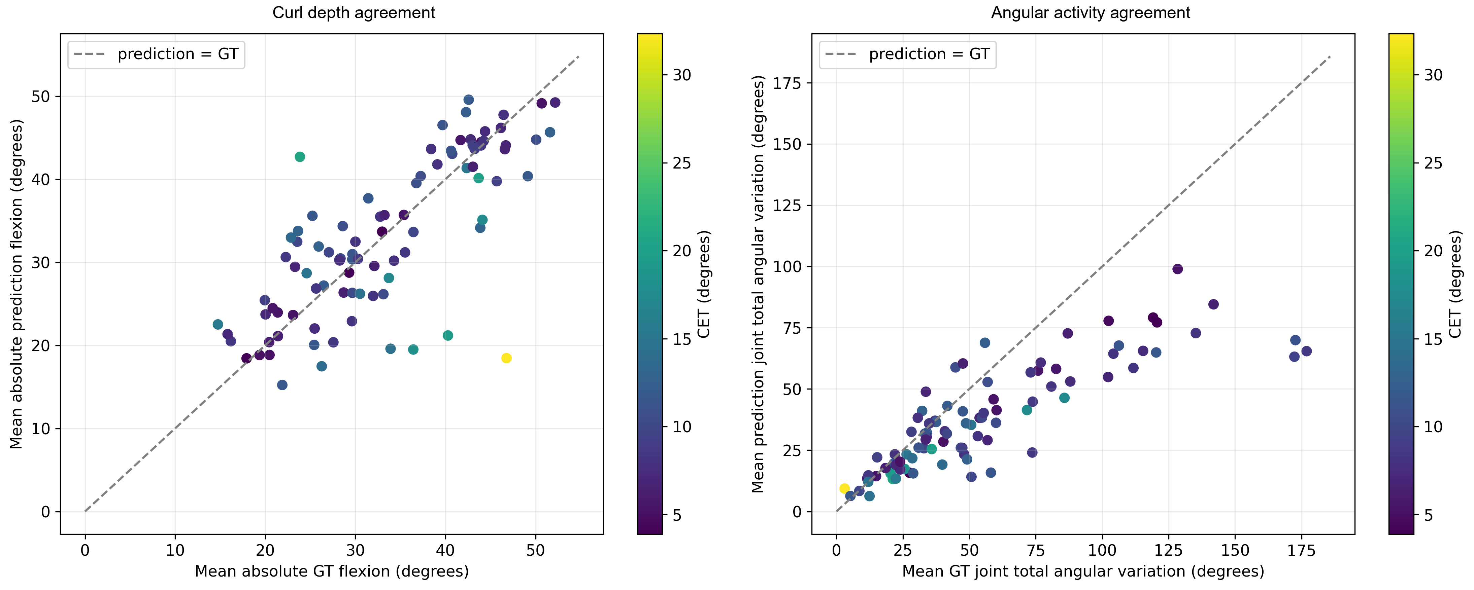
Outputs often contain less accumulated angular movement
74 of 91 outputs have lower total angular variation than GT
Median output / GT activity ratio 0.758. Accumulated angular movement is not energy.
Notes:
Sources: saved final-output run common/partial_batch/test_one__0399/cet/20261006T015545971089Z, motions.json and arrays/*.npz. Analysis and formulas: Scripts/evaluate_cet.py and Scripts/CET.md. All 91 saved CET values reproduced from the saved DTW paths. Partial batch of 20 source sequences, not the complete OakInk2 test set. Reused notebook export019 with simplified titles. 74 of91 predictions have lower whole-hand mean joint total angular variation than reference. Median per-motion pred/GT ratio .7580658323. Sampling, duration, smoothing and noise affect these descriptors.

Slide 11
A focused target for the next thesis stage
Reduce CET while preserving the intended interaction
Prioritize pinky and proximal-joint errors, while checking motion-specific failures.
Cover depth, excursion and activity separately. Retain demanding successes as controls.
Extend beyond 91 motions and evaluate contact and action fidelity alongside articulation.
Evidence scope: 20 source sequences. Partial batch, descriptive associations, no causal claims.
Notes:
Sources: saved final-output run common/partial_batch/test_one__0399/cet/20261006T015545971089Z, motions.json and arrays/*.npz. Analysis and formulas: Scripts/evaluate_cet.py and Scripts/CET.md. All 91 saved CET values reproduced from the saved DTW paths. Partial batch of 20 source sequences, not the complete OakInk2 test set. No conventional metric values were compared here; the claim that broader evaluation may leave articulation unresolved is a motivation, not an empirical head-to-head result. No causal attribution of anatomy or correlation is possible in this partial batch.

