Slide 1
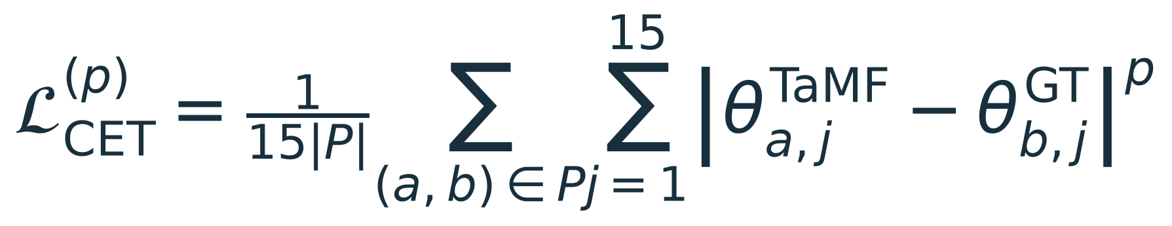
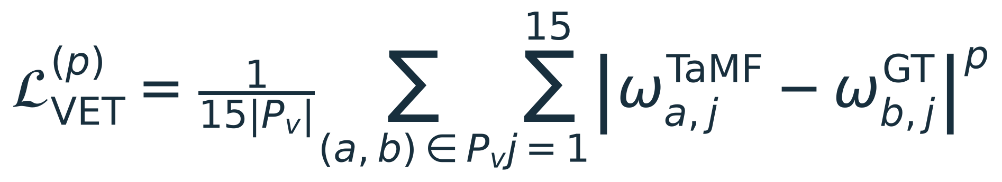
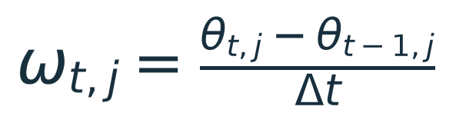
Proposed finger articulation objectives
p = 1: L1 loss p = 2: squared L2 loss (optional)
CET: Curl Error with Time Alignment
Match finger angles Current L1 mean: 9.97°
VET: Velocity Error with Time Alignment
Match angular velocity
Goal: both losses = 0
P / Pᵥ: aligned pairs j: joint θ: flexion angle ω: angular velocity VET and L2 values not yet computed
Notes:
Both CET and VET are introduced as proposed objectives for the first supervisor presentation. CET L1 has already been computed as an evaluation metric; its use as a training loss remains proposed. VET is a new proposed velocity error, not yet computed. p=1 gives mean absolute error (L1). p=2 gives mean squared error (squared L2), without square root. Units become degrees squared for CET and (degrees/second) squared for VET. Existing9.97degrees is the L1 CET batch mean only; it is neither the L2 value nor a value that can be squared to obtain mean squared error. L2 emphasizes larger residuals. P is the existing L1-angle-optimal shared constrained DTW path; the optional exponent2 version on this slide keeps that path fixed. Reoptimizing the path with squared local costs would define a different variant and requires an explicit implementation decision. VET uses signed velocities computed in original time before alignment and excludes pairs lacking valid velocity intervals. Both losses have an ideal minimum zero. Neither objective has been implemented in training. No claim of physical energy. This slide proposes a training objective and does not claim it is implemented. CET is currently an evaluation metric. With 15 equal joint weights the saved evaluator reports mean absolute angle error over its shared constrained DTW path P. Mean across 91 final-output motions is 9.965959984933022 degrees. GT depth D_GT=mean_j,t abs(theta_tj) and GT total variation V_GT=mean_j sum_t abs(theta_tj-theta_(t-1)j) are reference descriptors, not losses: minimizing either alone would encourage less curl or less movement. Proposed VCET here compares signed physical-time angular velocities, not scalar accumulated activity. Compute finite differences using actual frame timestamps before alignment; align the resulting velocity samples with the angle path, excluding pairs without a valid preceding interval, denoted P_v. Repeated DTW samples must not be differentiated as if path progress were real time. Freeze the interval/index convention before implementation. This VCET is a proposal and has not been computed from saved results. Existing NAE37.50 percent measures per-motion scalar activity-rate disagreement, not this trajectory velocity loss. Zero VCET alone cannot detect constant posture offsets, so CET remains primary. A possible training objective is L_base + lambda_C L_CET + lambda_V L_VCET with unit-aware weights. Hard DTW path selection needs a deliberate training implementation (e.g. a frozen path per forward pass or validated differentiable alignment surrogate); the exact evaluator is not automatically a differentiable loss. Keep original CET for validation. GT/prediction differences in physical-time velocity remain sensitive to execution speed and finite differences amplify noise. No energy in joules is computed. Source: Scripts/evaluate_cet.py and common/partial_batch/test_one__0399/cet/20261006T015545971089Z/motions.json. Partial batch91 unique motions.

