Slide 1
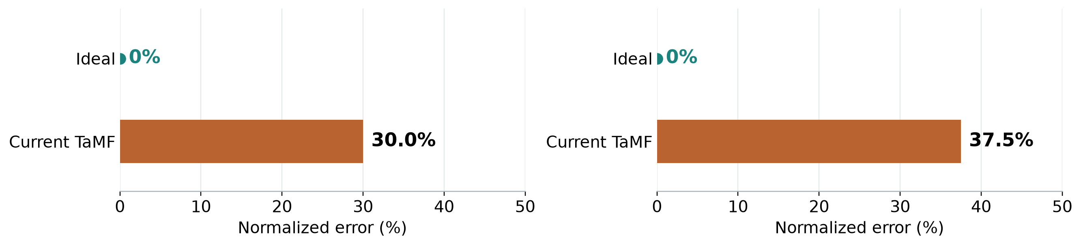
Thesis objective Reduce finger articulation errors
Relative curl error (PCET)
Normalized activity rate error (NAE)
30.02% → 0%
37.50% → 0%
Reproduce reference finger bend more accurately
Match the amount of reference activity per second
Reduce aligned finger-flexion error
Reduce overactivity and underactivity
Reduce both errors while preserving the intended motion and interaction.
Proposed normalizations, 91 motions. PCET describes relative angular error, not a fraction of movement lost.
Notes:
New descriptive normalization, not an established metric called PCET. For motion i, CET_i is original signed anatomical bend MAE on one shared constrained DTW path. D_i is GT mean absolute flexion over15 joints and original valid frames. Proposed batch PCET=100*sum CET_i/sum D_i=30.021255929523093%. This is ratio of batch means; averaging individual ratios would instead give32.26139997591723%. It compares angular magnitudes with different temporal weighting and is not fraction of movement lost. Mean original CET9.965959984933022 degrees, not9.97percent. Define rate A_i=mean of15 joint summed absolute angular changes divided by duration. NAE_rate=100*sum abs(A_pred_i-A_GT_i)/sum A_GT_i=37.50328144714692%. Numerator mean1.9790365483315997degrees/s, reference mean5.276969033018193degrees/s. Absolute values prevent cancellation of overactivity and underactivity. Zero NAE means each motion scalar activity rate exactly matches GT, so all scatter points lie on the diagonal; it does not imply correct curl trajectories. Both scores need positive batch denominators; per-motion zero reference would require explicit policy rather than silently adding epsilon. With motion552 omitted, activity NAE32.61907732012305%, PCET29.40595758763186%. Motion552 lasts.225s and influences rate-based aggregation. Duration normalization supports variable clip lengths but remains sensitive to sampling and short clips. Definitions should be frozen before model comparison. Sources: common/partial_batch/test_one__0399/cet/20261006T015545971089Z/motions.json; Scripts/evaluate_cet.py. Recorded analysis/normalized_benchmarks.json and build/normalized_figure.py. Partial batch91 unique motions from20 source sequences; no model evaluation rerun.

