Slide 1


Ab Initio Calculations of β-Decay Half-Lives for N = 50 Neutron-Rich Nuclei
Authors: Zhen Li, Takayuki Miyagi, Achim Schwenk
Reporter: Xingcan Cao

Slide 2

Contents
Outline
1. Introduction
2. Theoretical framework
3. Results
4. Summary

Slide 3
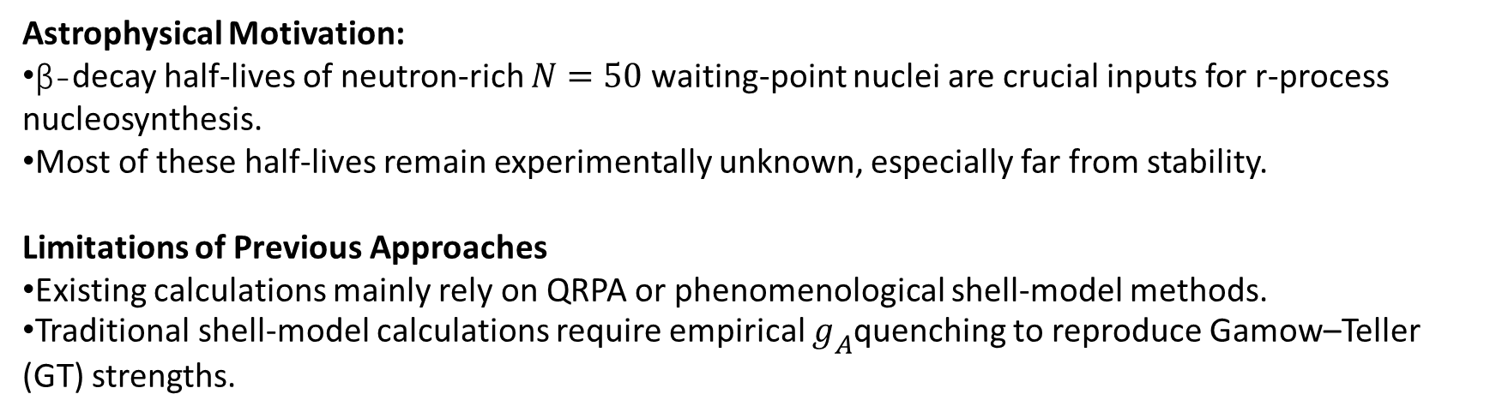
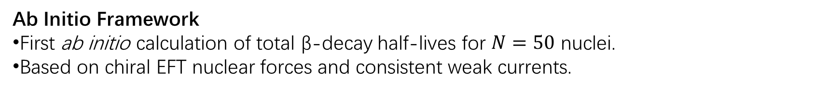
Introduction
Astrophysical Motivation:
β-decay half-lives of neutron-rich $N=50$waiting-point nuclei are crucial inputs for r-process nucleosynthesis.
Most of these half-lives remain experimentally unknown, especially far from stability.
Limitations of Previous Approaches
Existing calculations mainly rely on QRPA or phenomenological shell-model methods.
Traditional shell-model calculations require empirical $g_{A}$quenching to reproduce Gamow–Teller (GT) strengths.
Ab Initio Framework
First ab initio calculation of total β-decay half-lives for $N=50$ nuclei.
Based on chiral EFT nuclear forces and consistent weak currents.

Slide 4
Contents
Outline
1. Introduction
2. Theoretical framework
3. Results
4. Summary

Slide 5

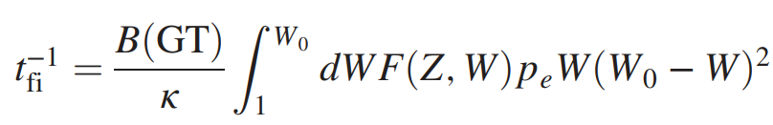
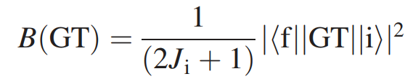


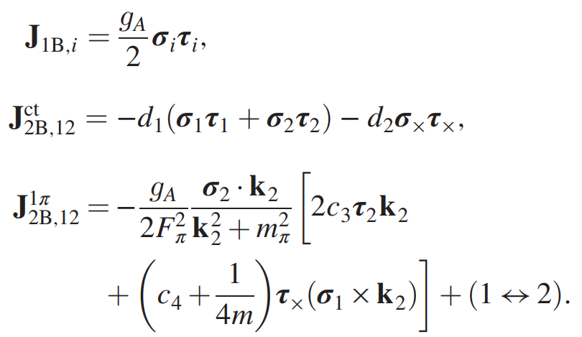
β-decay half-life
Half-life:
W : electron energy,
W₀ : maximum electron energy,
P_{e} : electron momentum
F : Fermi function
For allowed GT transitions
Up to next-to-next-to-leading order (N2LO) and at |q|=0,

Slide 6
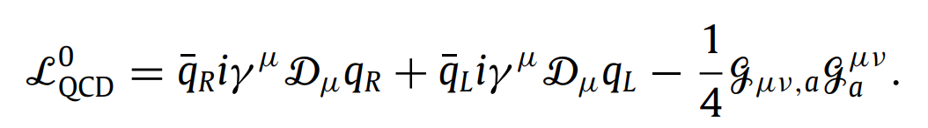
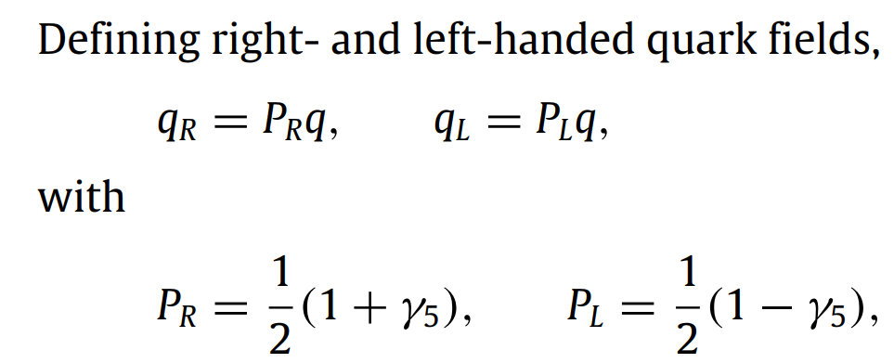
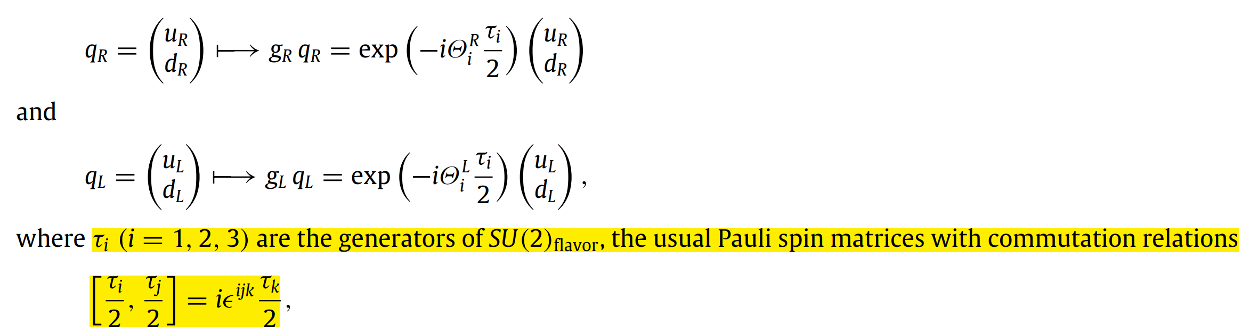
Chiral symmetry
Chiral symmetry
The right- and left-handed components of massless quarks do not mix.
QCD Lagrangian is invariant under the global unitary transformations:

Slide 7
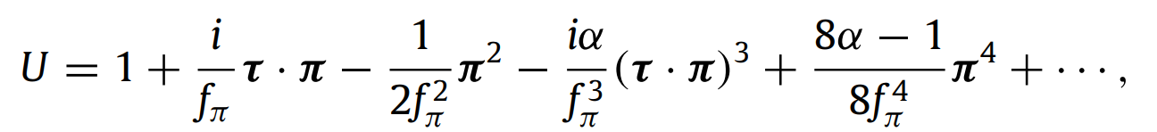
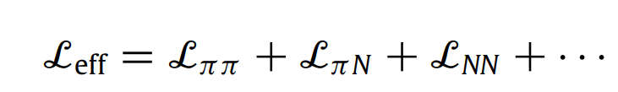
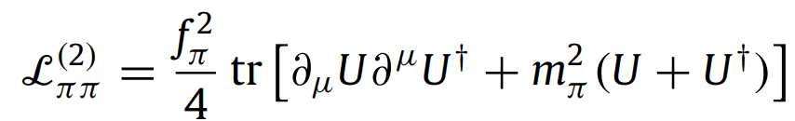
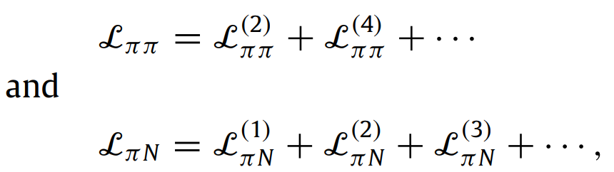
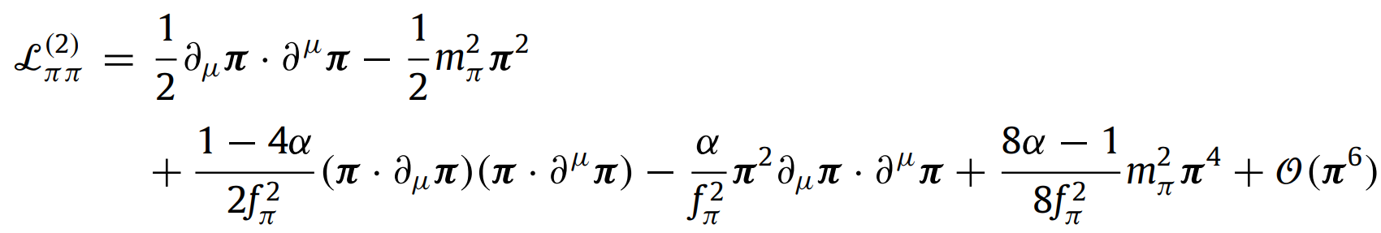
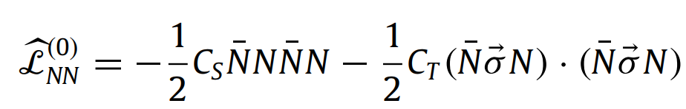
Chiral Lagrangians
To construct chiral Lagrangians, we introduce the following SU(2) matrix U in flavor space which collects the Goldstone pion fields π
leading order (LO) ππ Lagrangian
expanding in numbers of pion fields：
R. Machleidt et al., Phys. Rep. 503, 1-75 (2011)

Slide 8
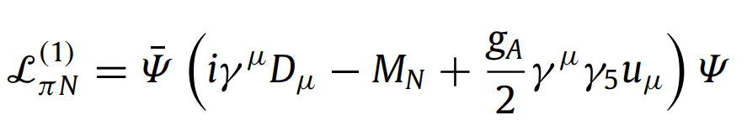
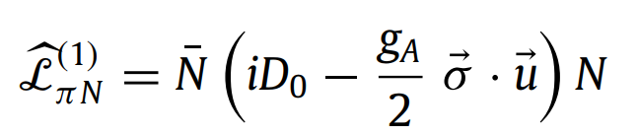
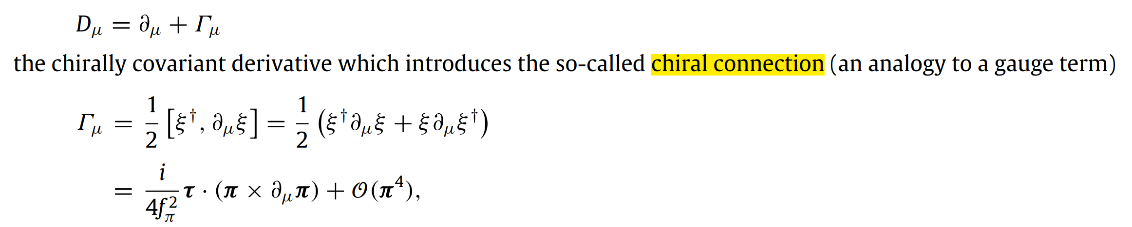
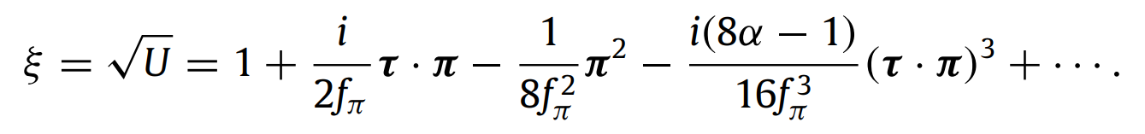
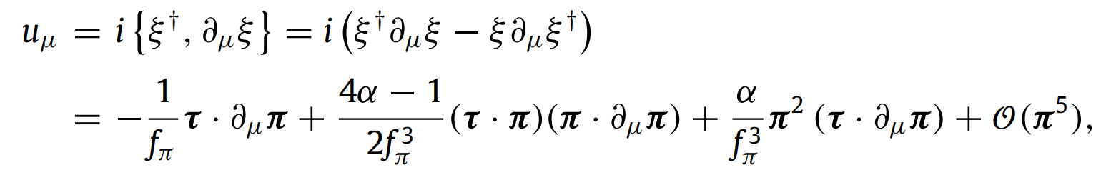
Chiral Lagrangians
the LO relativistic πN Lagrangian
The time-derivative of a relativistic baryon field generates a factor E ≈ M , leading to Q/Λχ ≈ 1
heavy baryon (HB) chiral perturbation theory (HBChPT)

Slide 9
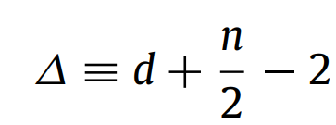
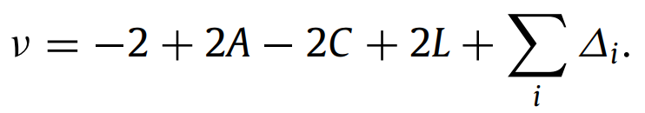
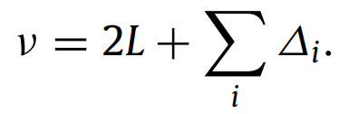
Power counting
For interactions among nucleons, it is sometimes useful to also consider the so-called index of the interaction:
d is the number of derivatives or pion-mass insertions
n is the number of nucleon field operators (nucleon legs)
In ChPT, graphs are analyzed in terms of powers of small external momenta over the large scale: (Q /Λχ)^{ν} , determining the power ν has become known as power counting.
C denotes the number of separately connected pieces and L the number of loops in the diagram.
For an irreducible NN diagram , A = 2, C = 1.

Slide 10
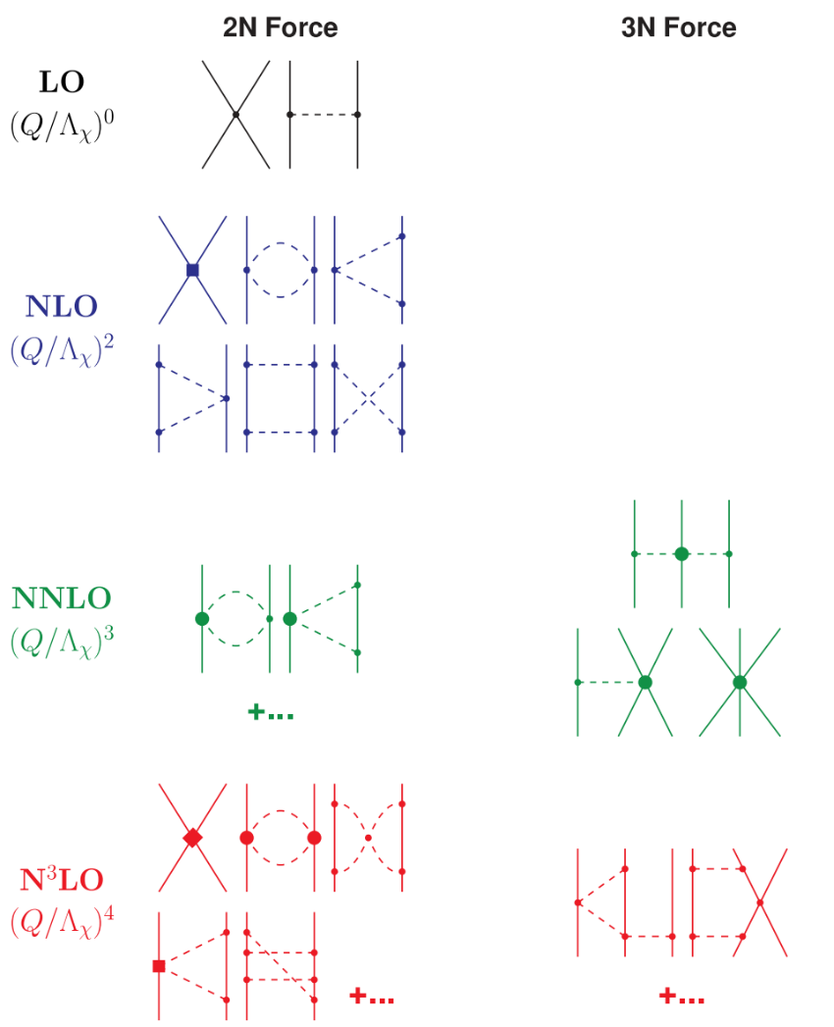
Power counting
Small dots, large solid dots, solid squares, and solid diamonds denote vertices of index ∆ = 0, 1, 2, and 4, respectively.
C=1
irreducible NN diagram

Slide 11
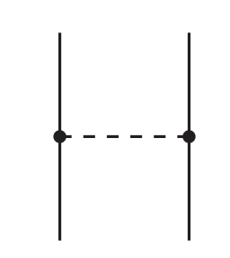
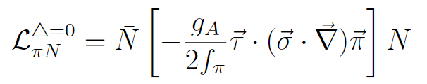

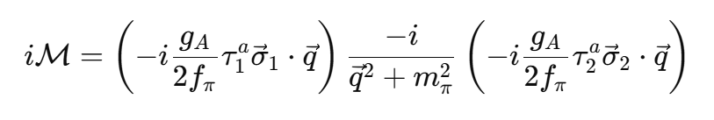

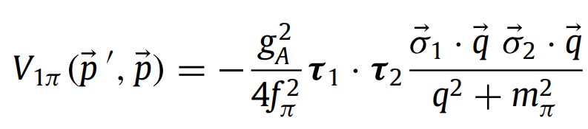
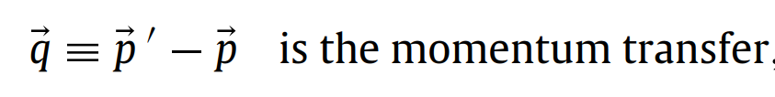
NN scattering in peripheral partial waves
Then deriving the pion-exchange contributions to the NN interaction.
Considering a very simple example, one-pion exchange in leading order.
Vertex:
Propagator:

Slide 12
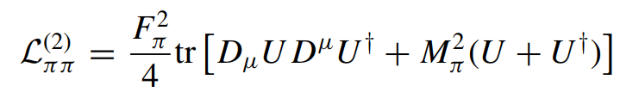
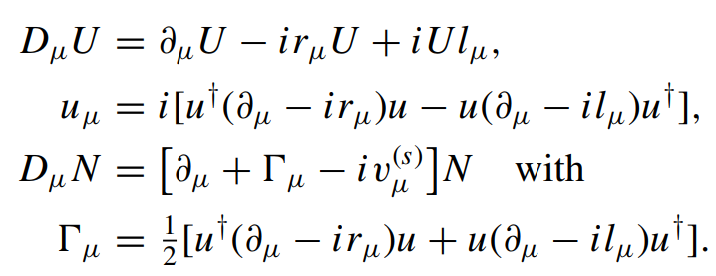

Electromagnetic current
We only consider the leading pion and pion-nucleon terms in the effective Lagrangian
S. Kolling et al., PRC 80, 045502 (2009)
To couple external electroweak fields, the global chiral symmetry is promoted to a local $SU{\left(2\right)}_{R}×SU{\left(2\right)}_{L}$symmetry.
To describe the coupling to an external electromagnetic field, the left- and right-handed currents r_{µ} and l_{µ} and the isoscalar current v(s)_{µ} have to be chosen as

Slide 13
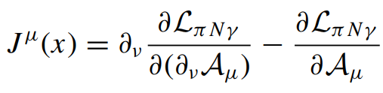
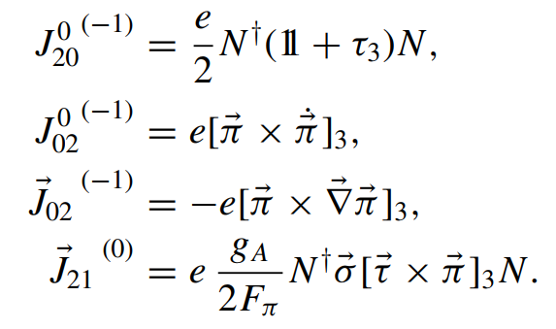
Electromagnetic current
According to E-L equation
the electromagnetic current density is of the form
the subscripts a and b refer to the
number of the nucleon and pion fields, respectively, while the superscript κ gives the dimension of the operator

Slide 14
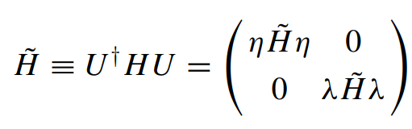
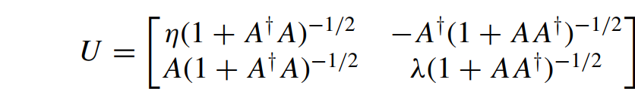

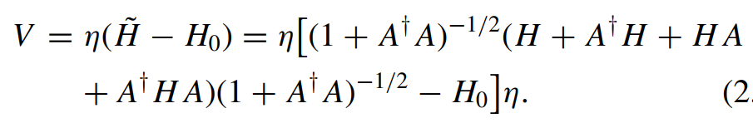

Effective electromagnetic current
One has to integrate out the pion fields, i.e. to decouple the purely nucleonic subspace of the Fock space from the rest.
η is a projection operator projecting onto the purely nucleonic (the remaining) part of the Fock space.
in terms of the operator A = λAη that has to satisfy the decoupling equation
The effective η-space potential V can be expressed in terms of the operator A

Slide 15
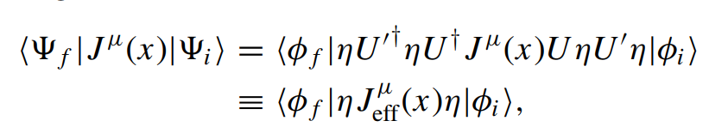
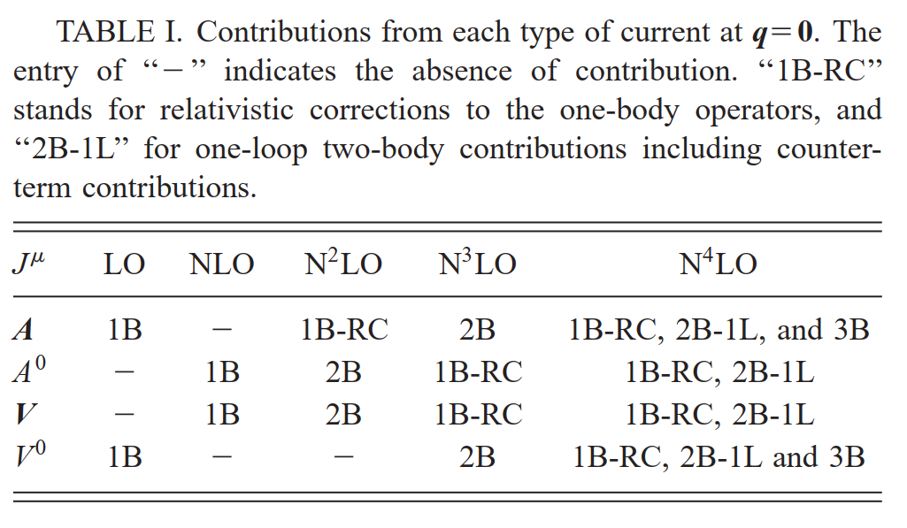
Effective electromagnetic current
effective nuclear current operator
Using additional unitary transformation U’ to restore renormalizability.
T. –S. Park et al., PRC 67, 055206 (2003)

Slide 16
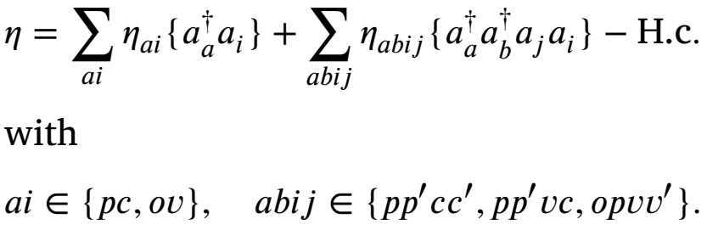
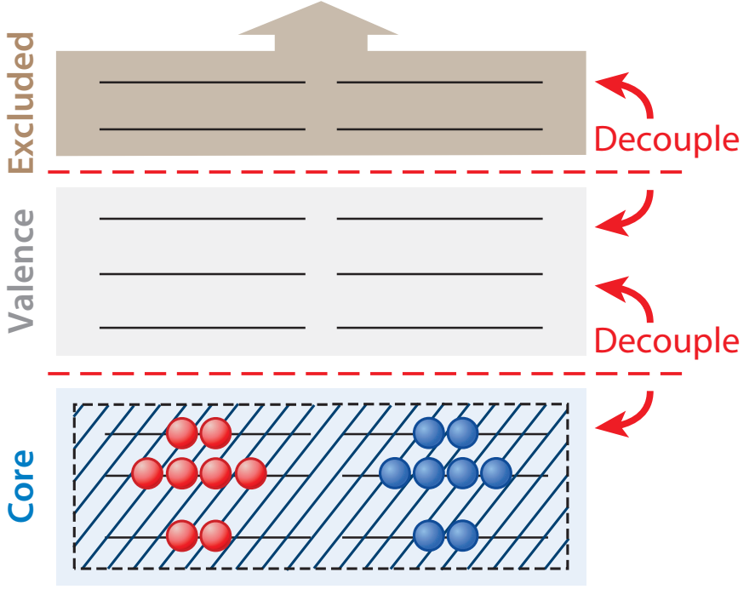
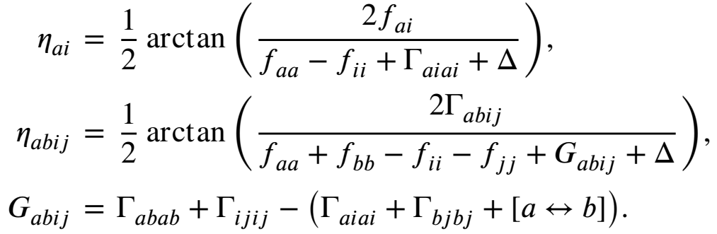
Methodology: ab initio multi-shell VS-IMSRG Hamiltonian
Valence-space In-Medium Similarity Renormalization Group (VS-IMSRG)
The anti-Hermitian generator for VS-IMSRG is
The indices c, v, and o indicate core, valence, and outside space orbitals, respectively, and p denotes either v or o.

Slide 17
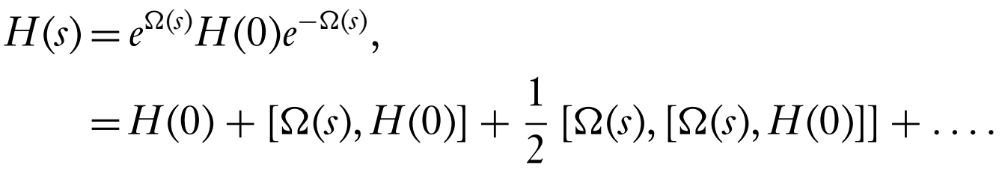
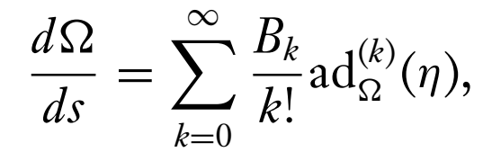
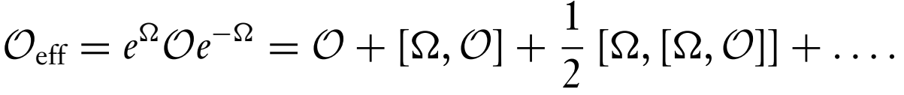
Methodology: ab initio multi-shell VS-IMSRG Hamiltonian
Magnus formulation for VS-IMSRG
Express the IMSRG transformation as the true exponential of the Magnus operator
we use the BCH formula to obtain
or
By solving for $Ω(s)$, we can compute arbitrary effective operators in a consistent VS-IMSRG transformation.
Cheers! We don’t rely on effective charges anymore!

Slide 18
Contents
Outline
1. Introduction
2. Theoretical framework
3. Results
4. Summary

Slide 19
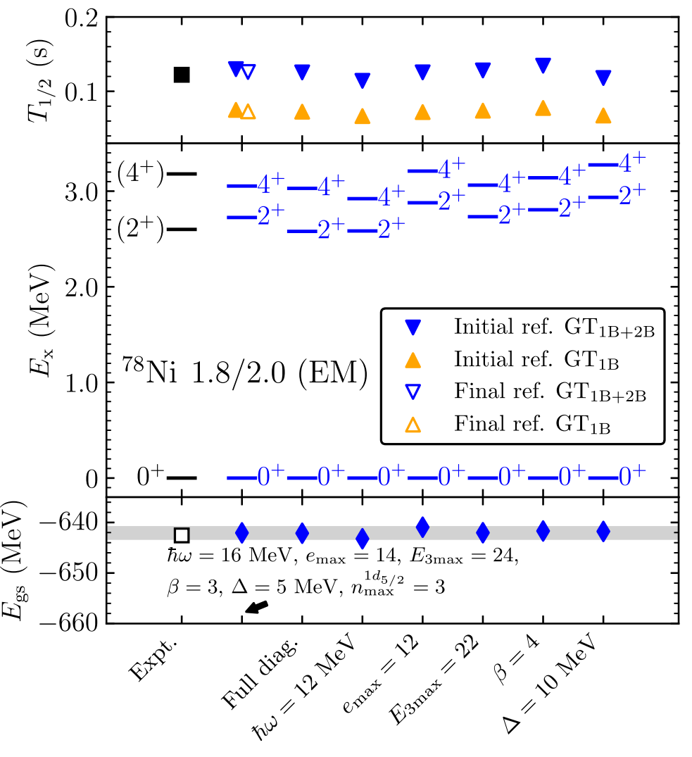
Results
valence space (⁴⁸Ca core) :
proton orbitals: {0f7/2; 0f5/2; 1p3/2; 1p1/2}
neutron orbitals :{0f5/2; 1p3/2; 1p1/2; 0g9/2; 1d5/2}
The dependence of on constrain of 1d_{5/2} , ℏω, emax, e3max, β and Δ is vary small.
It clearly shows the important impact of 2B currents, which is to decrease the GT strength and thus increase the half-life in all cases.

Slide 20
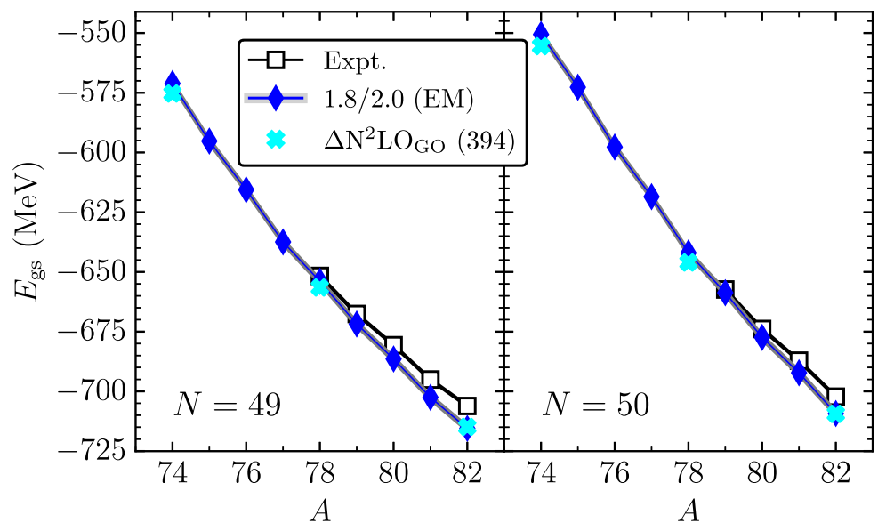
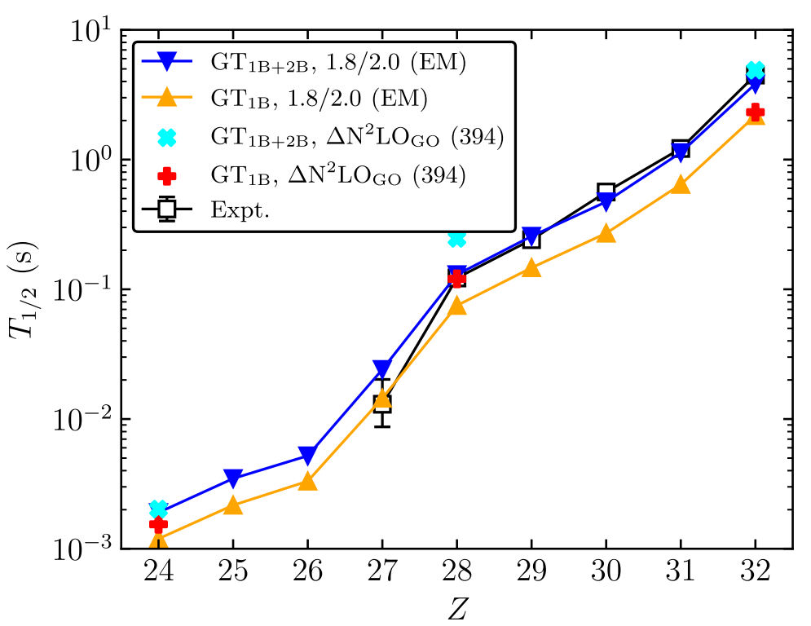
Results
The calculations mildly overestimate the ground-state energies where experimental data exists.
The inclusion of 2B currents leads to longer total half-lives for all N=50 nuclei studied, leading to a very good agreement with experiment for Z=28–32 and reproducing the trend down to Z=27.
⁷⁸Ni the ΔN²LO_{GO}(394) interaction leads to a longer half-life.

Slide 21
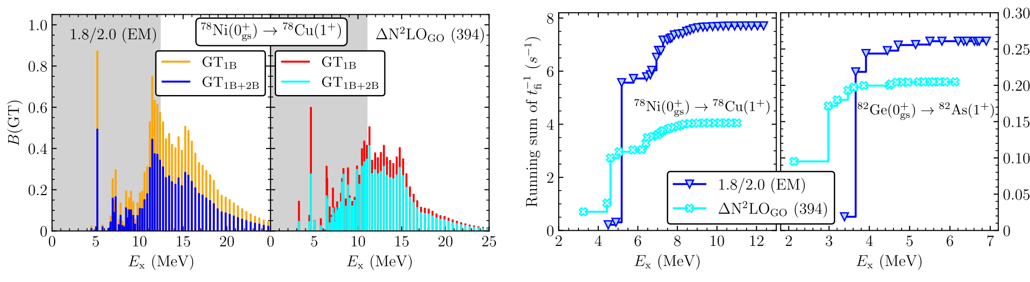
Results
distribution of GT transition strength B(GT) as a function of excitation energy in the final nucleus
The phase space factors are also different, and the spectrum is more compressed for the ΔN²LO_{GO}(394) interaction. This shows the intricate interplay of the B(GT) and the phase space factors for the total half-life.

Slide 22
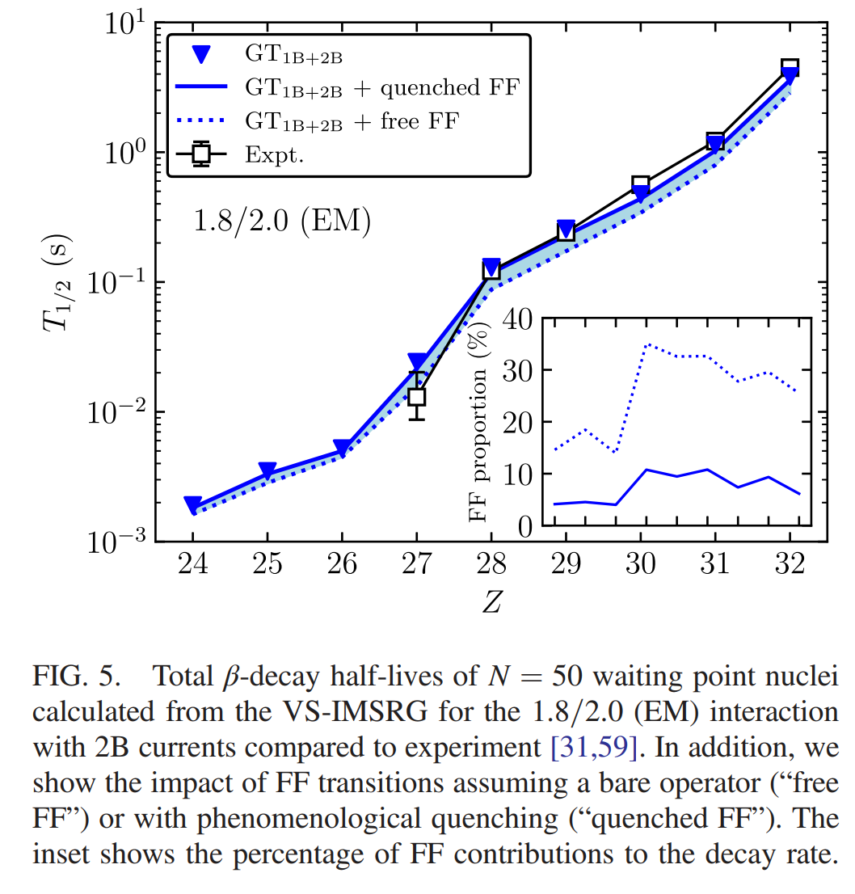
Results
The total FF transition rate is obtained by summing over the 20 lowest final states for each J_{f}, which is sufficient for converged results.
We find a reduction due to FF transitions, which is most pronounced for the free FF case.

Slide 23
Contents
Outline
1. Introduction
2. Theoretical framework
3. Results
4. Summary

Slide 24
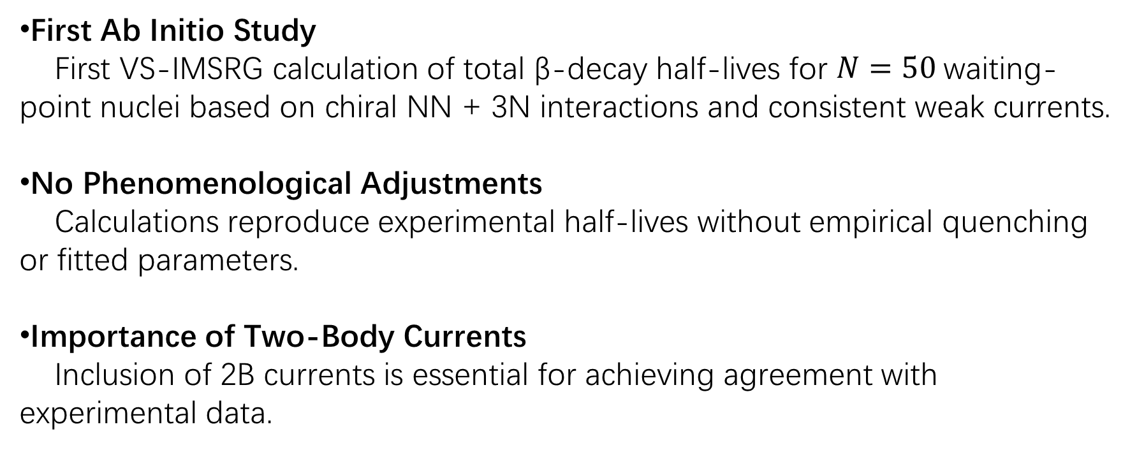
Summary
First Ab Initio Study
First VS-IMSRG calculation of total β-decay half-lives for $N=50$waiting- point nuclei based on chiral NN + 3N interactions and consistent weak currents.
No Phenomenological Adjustments
Calculations reproduce experimental half-lives without empirical quenching or fitted parameters.
Importance of Two-Body Currents
Inclusion of 2B currents is essential for achieving agreement with experimental data.
Thanks for your attention!

