Slide 1
Renormalization of CP-violating nuclear forces
罗青杨
School of Physics and Astronomy, Sun Yat-Sen University
Journal Club (20250430)
Reference: Jordy de Vries , Alex Gnech , and Sachin Shain, Renormalization of CP-violating nuclear forces PRC.103.L012501

Slide 2
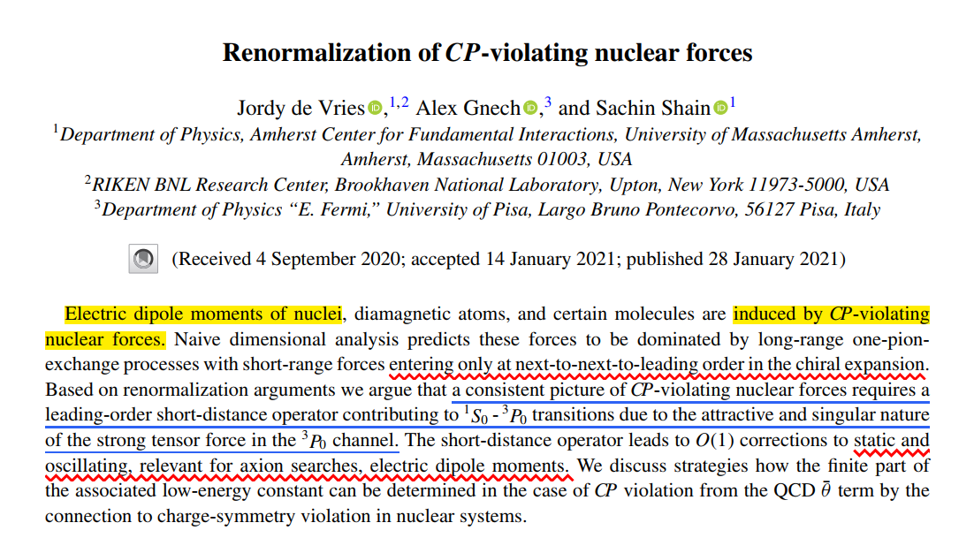
Notes:
原子核、抗磁性原子和某些分子的电偶极矩是由违反 CP 的核力引起的。通过对手征核力阶次展开，可以得到，这些核力是由长程单pai介子交换占主导，以及只有在次次领头阶才有的短程关联力。基于重整化论点，我们认为，由于 3P0 通道中强张量力的吸引力和奇异性，违反 CP 的核力的一致图景需要一个次领头阶的短距离算子来促进 1S0 - 3P0 转换。短距离算子导致对静态和振荡的 O（1） 校正，与轴子搜索、电偶极矩相关。我们讨论了在核系统中电荷对称性违规的情况下，如何从 QCD θ ̄ 项的 CP 违规情况下确定相关低能量常数的有限部分的策略。

Slide 3


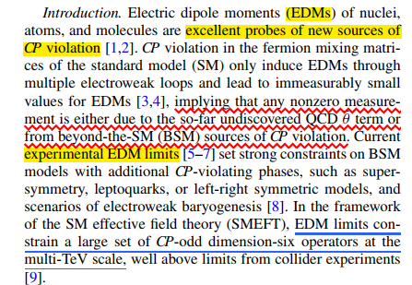
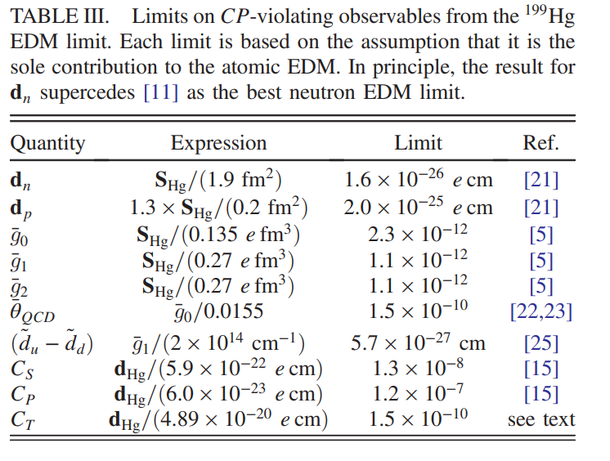
Introduction
Not sufficient enough to explain the problem of matters and anti-matters asymmetry
Violation of discrete Symmetries Violation of discrete Symmetries Violation of discrete Symmetries
B.Graner et al., PRL 119, 119901 (2017)

Slide 4
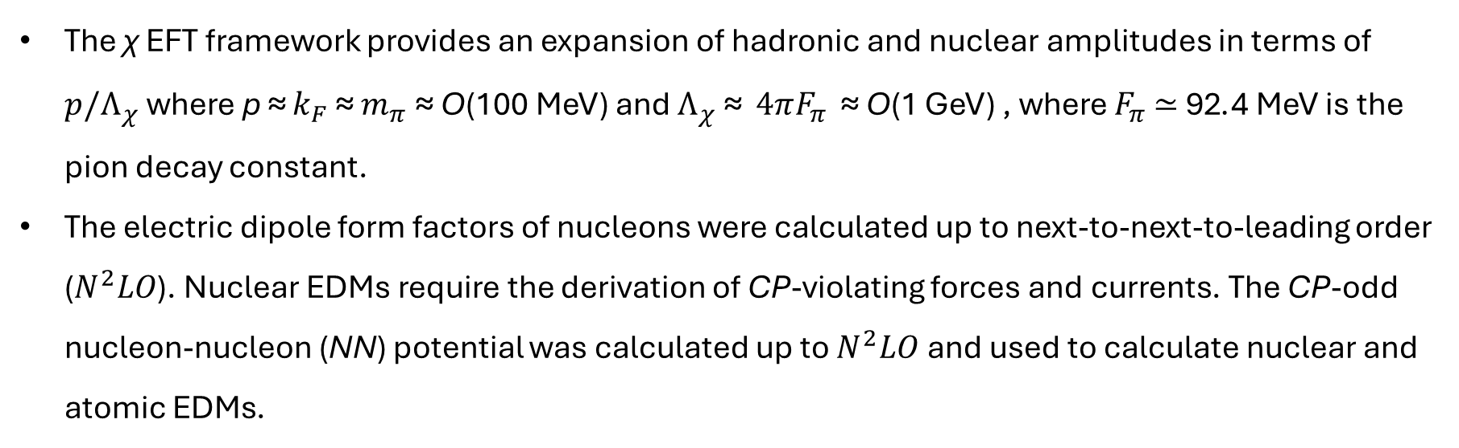

Introduction
The SMEFT framework allows for the derivation of a general set of dimension-four (the $\overline{θ}$ term) and dimension-six CP-violating operators involving light quarks, gluons, and photons.
χ EFT, the low-energy EFT
of QCD, is used to construct the corresponding CP-violating
interactions among the relevant low-energy degree of freedoms: pions, nucleons, and photons.
The χ EFT framework provides an expansion of hadronic and nuclear amplitudes in terms of $p/Λ_{χ}$where p ≈ $k_{F}$ ≈ $m_{π}$ ≈ O(100 MeV) and $Λ_{χ}$ ≈ $4πF_{π}$ ≈ O(1 GeV) , where $F_{π}$ ≃ 92.4 MeV is the pion decay constant.
The electric dipole form factors of nucleons were calculated up to next-to-next-to-leading order ($N^{2}LO$). Nuclear EDMs require the derivation of CP-violating forces and currents. The CP-odd nucleon-nucleon (NN) potential was calculated up to $N^{2}LO$and used to calculate nuclear and atomic EDMs.

Slide 5
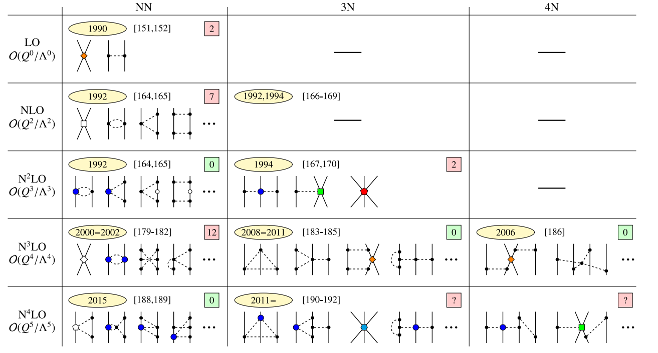
Introduction
Violation of discrete Symmetries Violation of discrete Symmetries Violation of discrete Symmetries
3

Slide 6
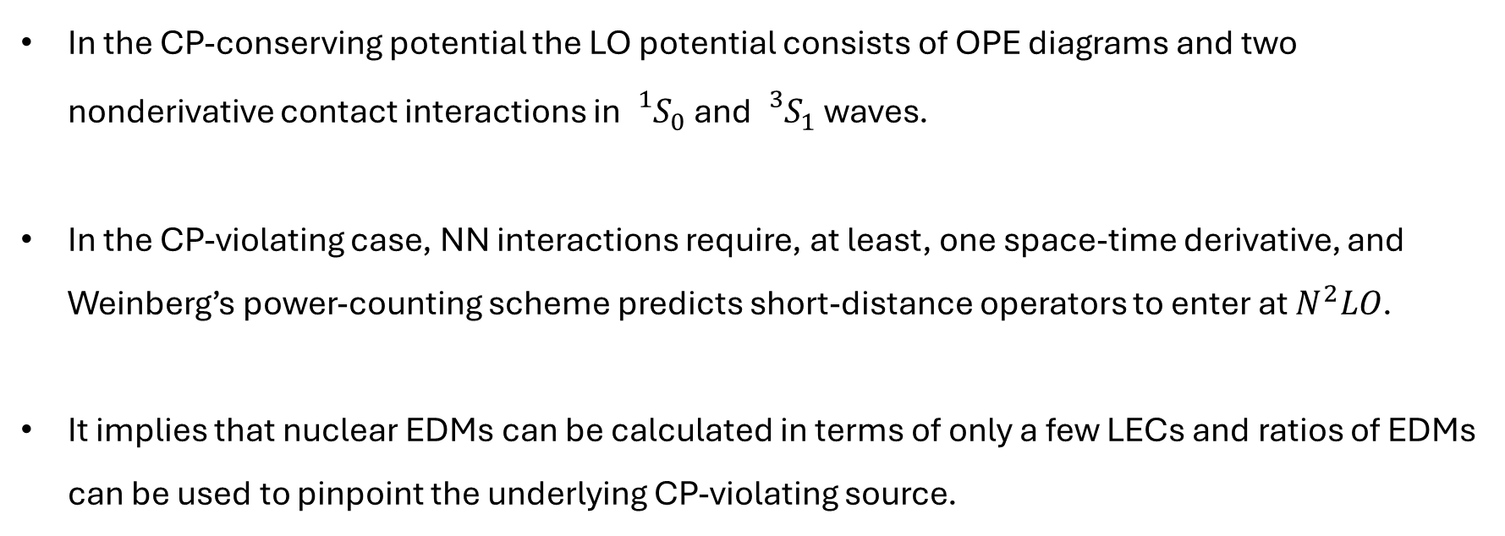
Introduction
In the CP-conserving potential the LO potential consists of OPE diagrams and two nonderivative contact interactions in ${{}_{}^{1}S}_{0}$and ${{}_{}^{3}S}_{1}$ waves.
In the CP-violating case, NN interactions require, at least, one space-time derivative, and Weinberg’s power-counting scheme predicts short-distance operators to enter at $N^{2}LO$.
It implies that nuclear EDMs can be calculated in terms of only a few LECs and ratios of EDMs can be used to pinpoint the underlying CP-violating source.

Slide 7
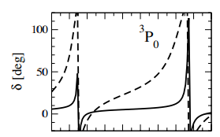


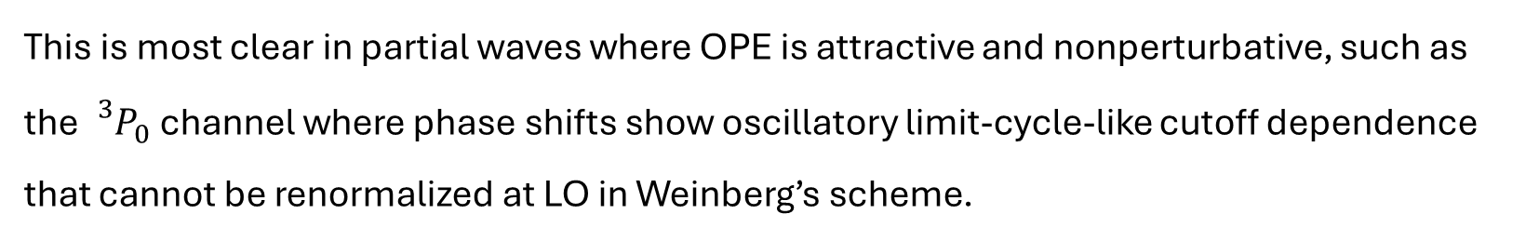
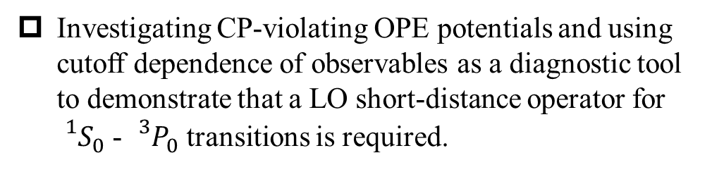
Problems on Leading-order
This is most clear in partial waves where OPE is attractive and nonperturbative, such as the ${{}_{}^{3}P}_{0}$ channel where phase shifts show oscillatory limit-cycle-like cutoff dependence that cannot be renormalized at LO in Weinberg’s scheme.
Investigating CP-violating OPE potentials and using cutoff dependence of observables as a diagnostic tool to demonstrate that a LO short-distance operator for ${{}_{}^{1}S}_{0}$ - ${{}_{}^{3}P}_{0}$ transitions is required.
Notes:
作者通过研究CP破坏的单π交换（OPE）势，利用观测量的截断依赖性作为诊断工具，证明在1S01S0​-3P03P0​跃迁中需要在领头阶引入短程算子。这一结论直接影响对EDM实验以及其他时间反演奇观测量的解释。

Slide 8
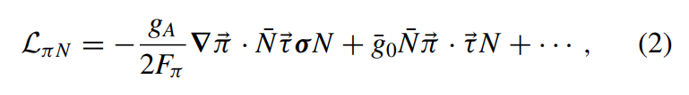
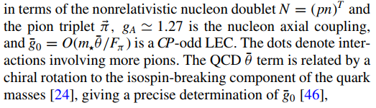

The leading CP-even and CP-odd pion-nucleon interactions for chiral Lagrangian

Slide 9
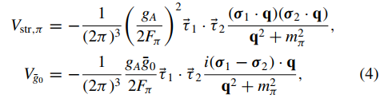
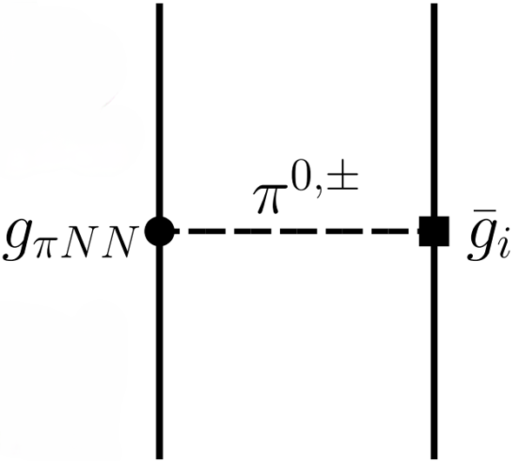

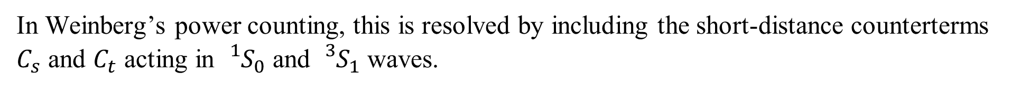
Counterterms in their own partial waves
$P_{s,t,p}$ means the projected partial wave, respectively, on the ${{}_{}^{1}S}_{0}$, ${{}_{}^{3}S}_{1}$, ${{}_{}^{3}P}_{0}$ waves.
In Weinberg’s power counting, this is resolved by including the short-distance counterterms $C_{s}$ and $C_{t}$ acting in ${{}_{}^{1}S}_{0}$ and ${{}_{}^{3}S}_{1}$ waves.

Slide 10
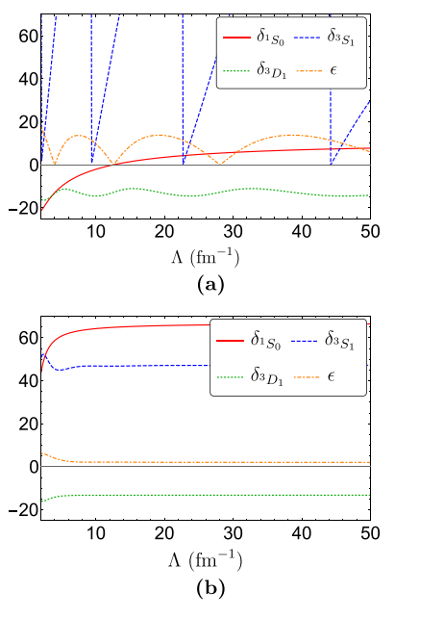

Results(OPE-even)

Slide 11
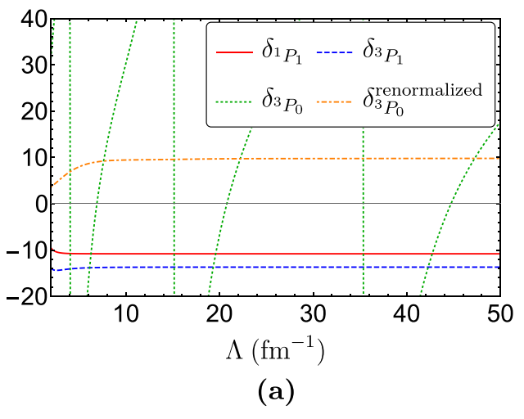
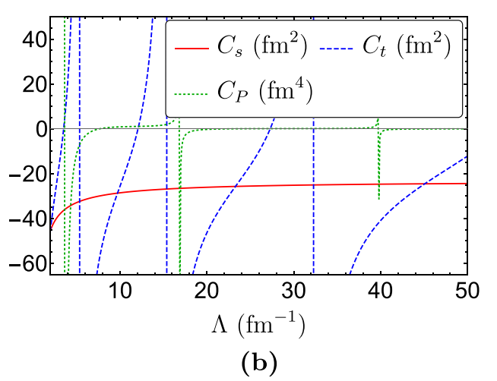
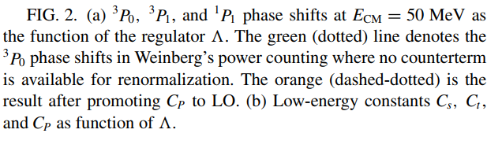
Results(OPE-even)

Slide 12
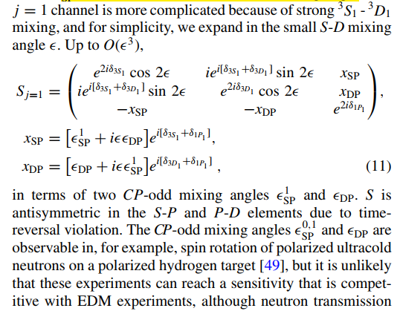
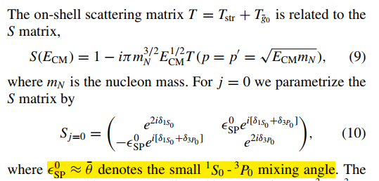
Results

Slide 13
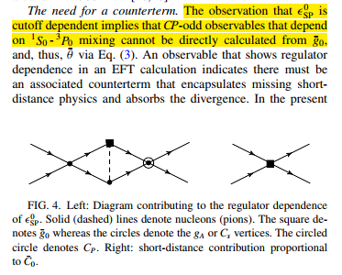
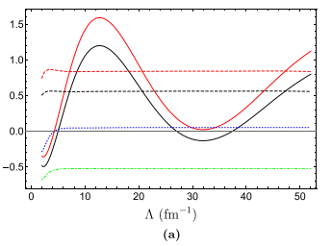


Results

Slide 14
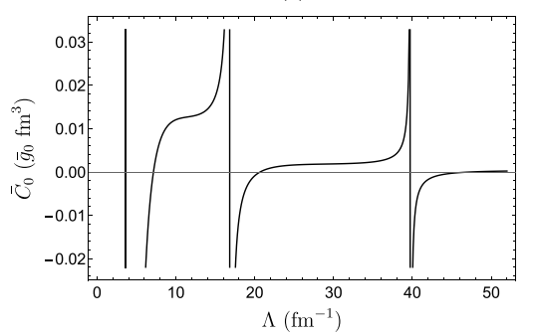
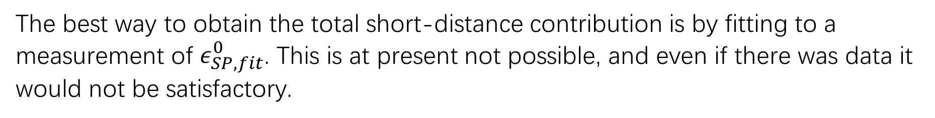
Naive dimensional analysis(NDA) suggests $\overline{C_{0}}=O[m_{⋆}\overline{θ}/(F_{π}^{2}Λ_{χ}^{2})]$ and a $N^{2}LO$ contribution, but renormalization enhances $\overline{C_{0}}$ to $LO$.
The best way to obtain the total short-distance contribution is by fitting to a measurement of $ε_{SP,fit}^{0}$. This is at present not possible, and even if there was data it would not be satisfactory.

Slide 15
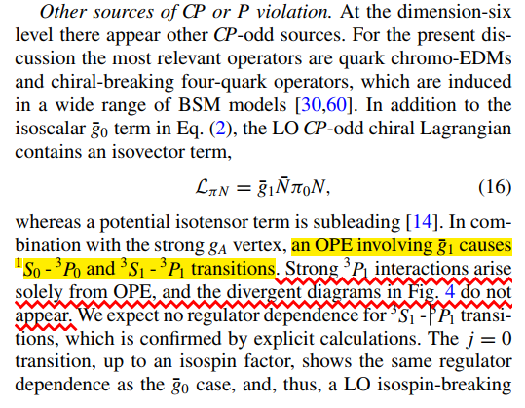
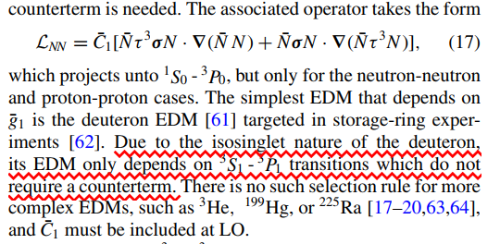


Slide 16
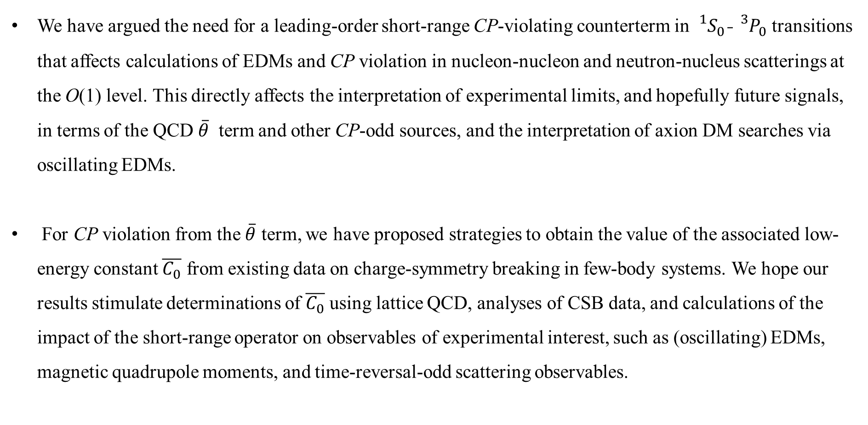
Conclusion
We have argued the need for a leading-order short-range CP-violating counterterm in ${{}_{}^{1}S}_{0}$-${{}_{}^{3}P}_{0}$ transitions that affects calculations of EDMs and CP violation in nucleon-nucleon and neutron-nucleus scatterings at the O(1) level. This directly affects the interpretation of experimental limits, and hopefully future signals, in terms of the QCD $\overline{θ}$ term and other CP-odd sources, and the interpretation of axion DM searches via oscillating EDMs.
For CP violation from the $\overline{θ}$ term, we have proposed strategies to obtain the value of the associated low-energy constant $\overline{C_{0}}$ from existing data on charge-symmetry breaking in few-body systems. We hope our results stimulate determinations of $\overline{C_{0}}$ using lattice QCD, analyses of CSB data, and calculations of the impact of the short-range operator on observables of experimental interest, such as (oscillating) EDMs, magnetic quadrupole moments, and time-reversal-odd scattering observables.
Notes:
我们论证了在1S01S0​-3P03P0​跃迁中需要引入一个领头阶（LO）的短程CPCP破坏反项，这一项对电偶极矩（EDM）的计算以及核子-核子、中子-核散射中CPCP破坏效应的O(1)O(1)量级修正具有重要影响。这将直接关系到如何从实验限制（以及未来可能的信号）中解读QCD的θ~θ~项与其他CPCP破坏源的意义，同时也影响通过振荡EDM寻找轴子暗物质的实验解释。
对于由θ~θ~项引发的CPCP破坏，我们提出了从少体系统中的电荷对称性破缺（CSB）现有数据提取相关低能常数C~0C~0​的策略。希望我们的研究能推动以下工作：
通过格点QCD确定C~0C~0​的数值；
对CSB数据的进一步分析；
计算短程算子对实验关注观测量（如振荡EDM、磁四极矩、时间反演奇散射观测量）的影响。

