Slide 1
手征核力的NN potential构建及程序使用
文献阅读汇报 丁晨蓉
May 13, 2024, SYSU
推导公式参考文献：Machleidt, Phys.Rep.503(2011), Erkelenz, Nucl.Phys.A.176(1971)413-432.
了解核力参考文献：Entem, Machleidt, “Nonlocal Chiral Nuclear Forces up to N5LO”, 2023.

Slide 2

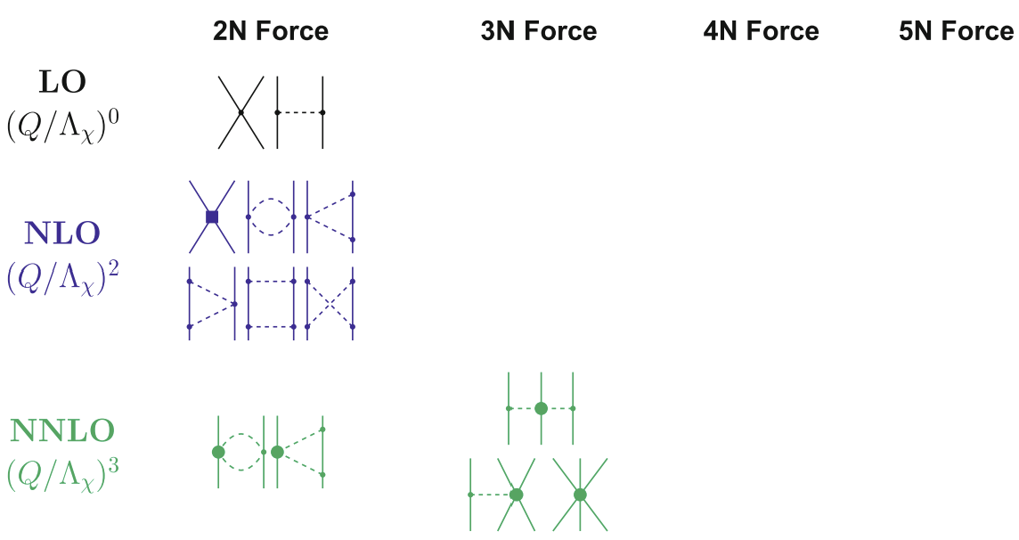
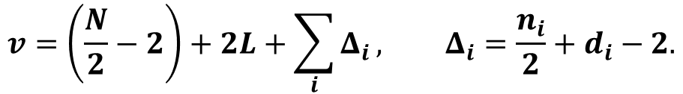
Section 1: 手征有效场论拉氏量
手征有效场论Lagrangian的building block (Goldstone boson)： $U=\exp\left(i\frac{\vec{π}⋅\vec{τ}}{F_{π}}\right)$
手征有效场论Lagrangian的building block (Nuclear field)： $N, D_{μ}N$
External lines
Vertex powering counting
The power counting rules for Feynman diagrams
Loops
$$v=\left(\frac{N}{2}−2\right)+2L+\sum_{i}{Δ_{i}}, Δ_{i}=\frac{n_{i}}{2}+d_{i}−2.$$
总结Feynman diagrams order by order
Entem, Machleidt, “Nonlocal Chiral Nuclear Forces up to N5LO”, 2023

Slide 3
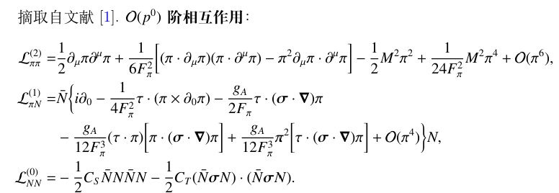
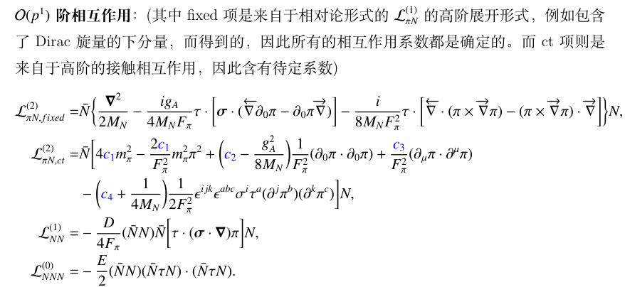
Section 1:手征有效场论拉氏量
手征有效场论Lagrangian的具体形式
Machleidt, Phys.Rep.503(2011)

Slide 4
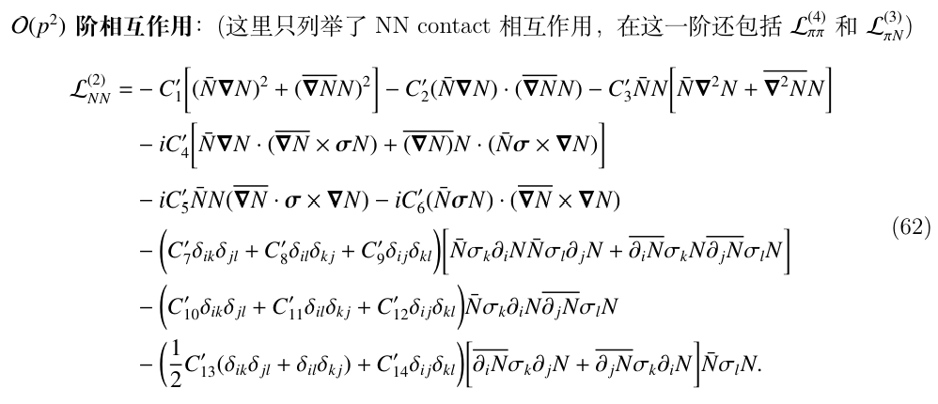
Section 1:手征有效场论拉氏量
手征有效场论Lagrangian的具体形式
Machleidt, Phys.Rep.503(2011)

Slide 5
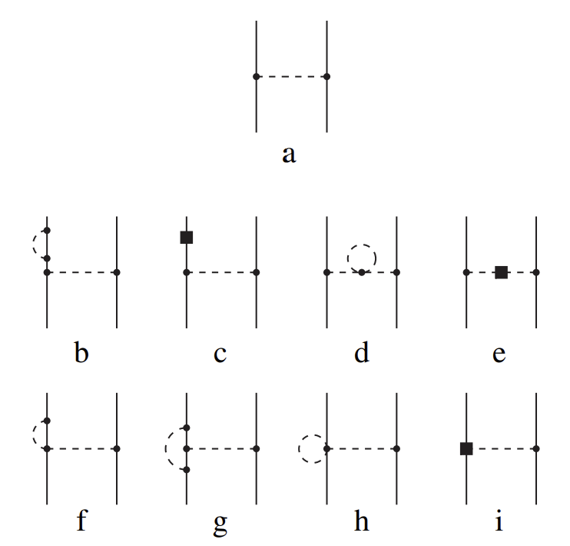
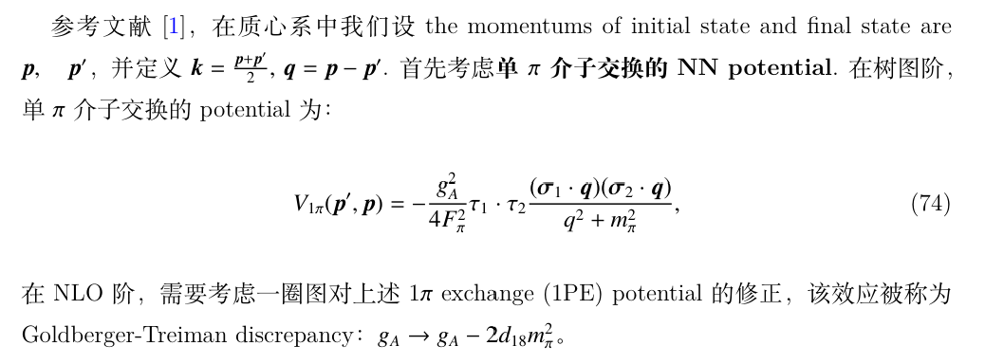
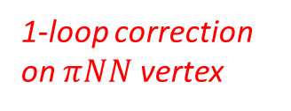

Section 2: NN potential (up to NNLO)
单$π$介子交换的potential
Leading order 1PE
1-loop correction on nuclear field
1-loop correction on pion field
Machleidt, Phys.Rep.503(2011)
1-loop correction on $πNN$ vertex

Slide 6
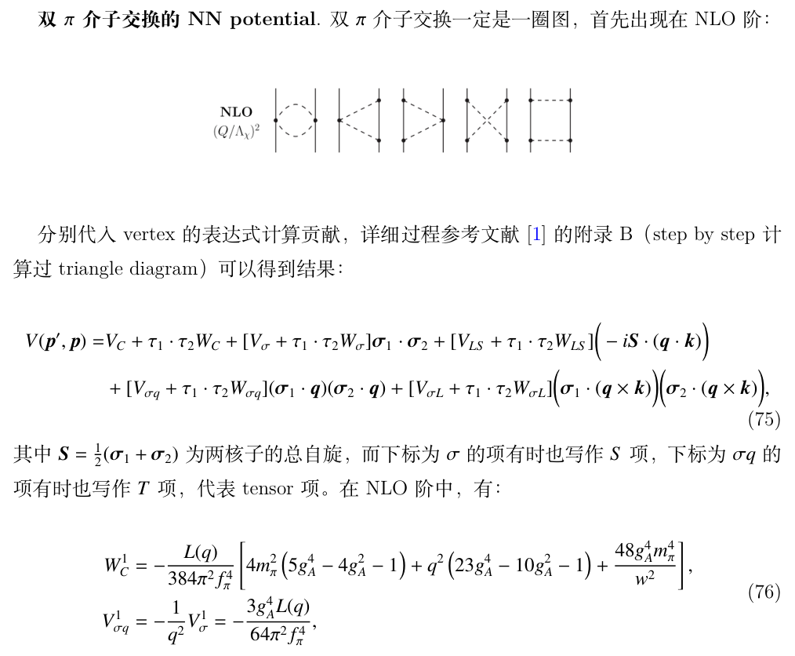


Section 2: NN potential (up to NNLO)
双$π$介子交换的potential
Machleidt, Phys.Rep.503(2011)

Slide 7
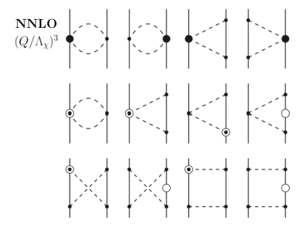
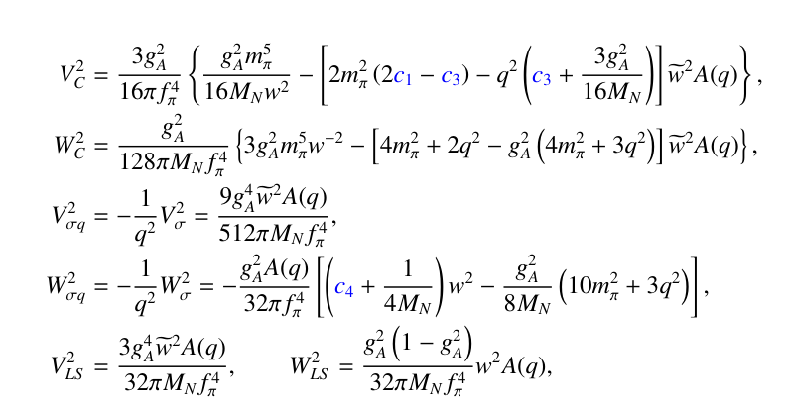


Section 2: NN potential (up to NNLO)
双$π$介子交换的potential
Machleidt, Phys.Rep.503(2011)
其次，双𝝅介子交换也出现在N2LO阶，只需要将NLO阶图中的某一顶点换成一阶的$L_{πN}^{\left(2\right)}$顶点即可，同样可以得到：

Slide 8
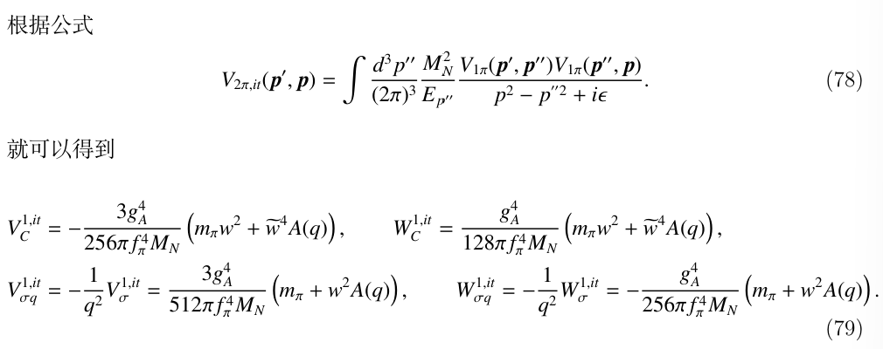
Section 2: NN potential (up to NNLO)
双$π$介子交换的potential
Machleidt, Phys.Rep.503(2011)
以上列举的2PE都是不可约的2PE图的贡献，除此之外，由两个1PE图拼接而成的可约2PE图也对NLO阶有贡献：

Slide 9

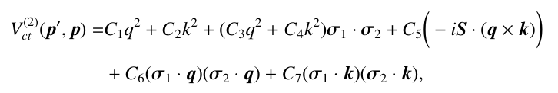
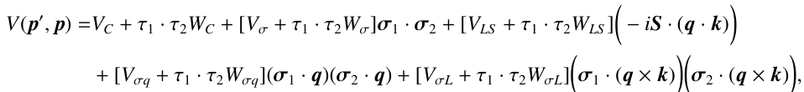
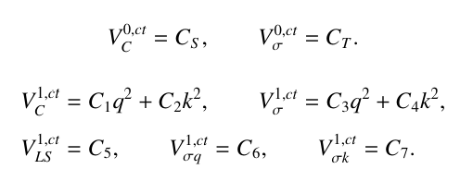
Section 2: NN potential (up to NNLO)
NN contact term的potential
Machleidt, Phys.Rep.503(2011)
LO阶：
NLO阶：
根据spin-isospin structure分类

Slide 10
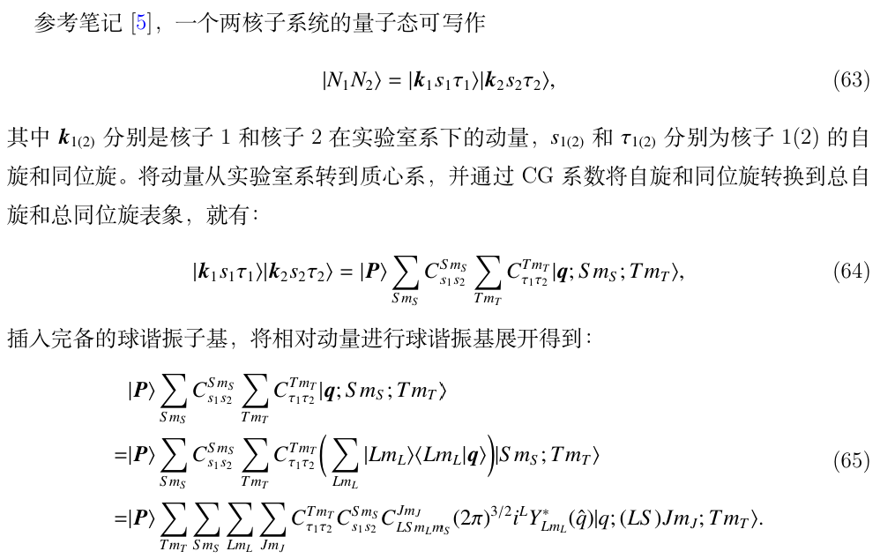
Section 3: NN potential in LSJ representation
C. C. Wang, “Note: Two-body Matrix Elements”, (2024) pp. 79-88

Slide 11
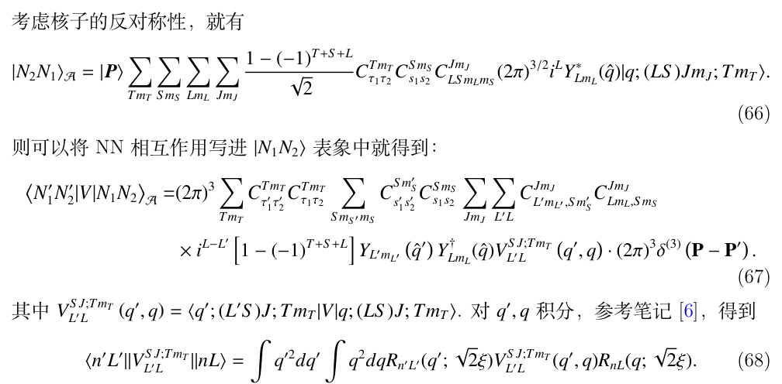
Section 3: NN potential in LSJ representation
C. C. Wang, “Note: Dynamics of nucleon-nucleon system”, (2024) pp. 89-98

Slide 12
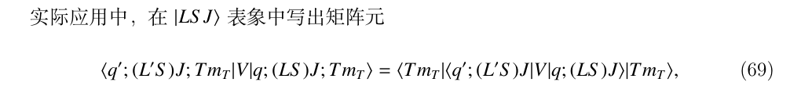
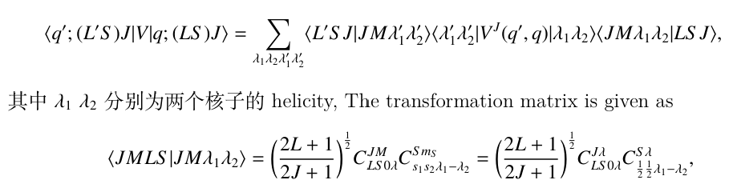
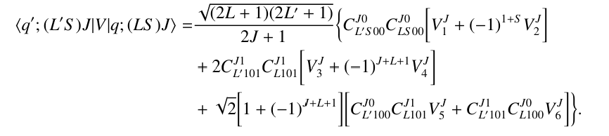
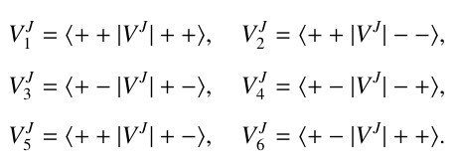
Section 3: NN potential in LSJ representation
Erkelenz, Nucl.Phys.A.176(1971)413-432
The matrix element in LSJ representation
Def:

Slide 13
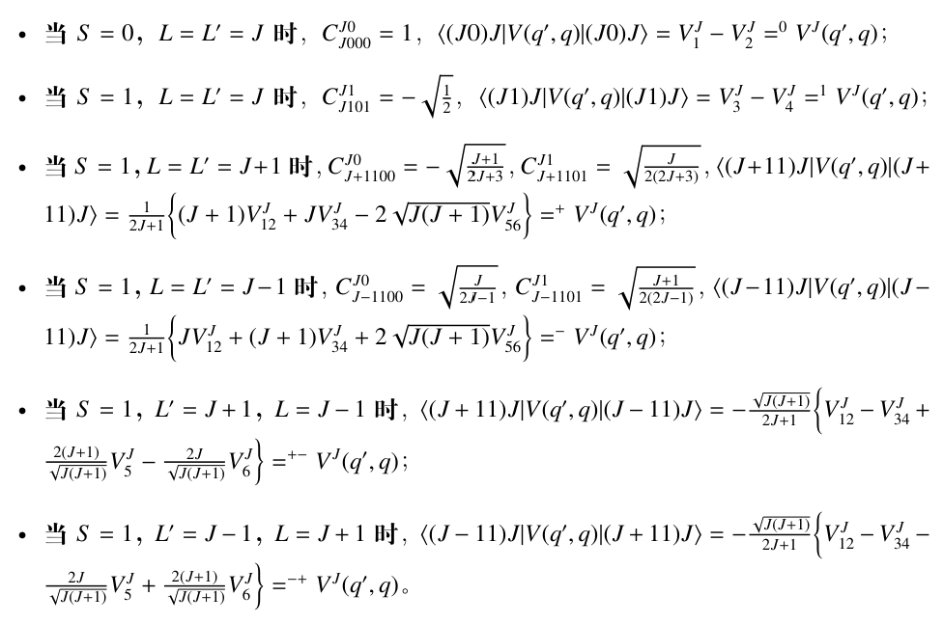
Section 3: NN potential in LSJ representation

Slide 14
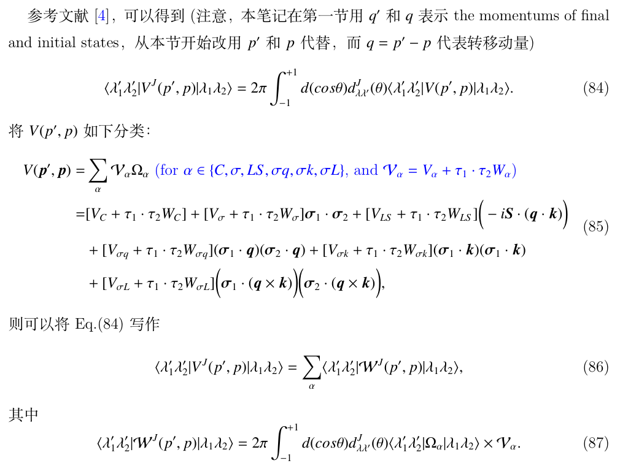
Section 3: NN potential in LSJ representation
NN contact potential的分波展开
Erkelenz, Nucl.Phys.A.176(1971)413-432

Slide 15
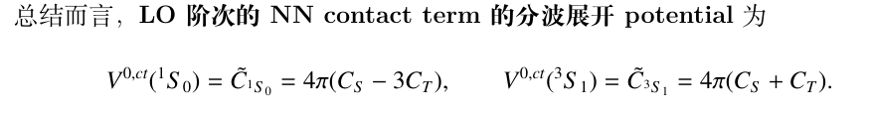
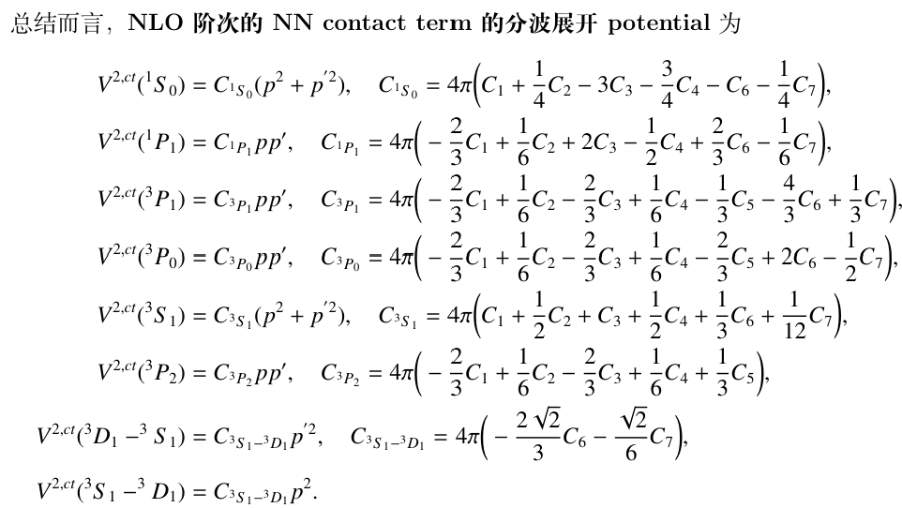
Section 3: NN potential in LSJ representation
NN contact potential的分波展开
Erkelenz, Nucl.Phys.A.176(1971)413-432
Proof: See CRD, “A Note of Nuclear Force in ChiPT”, (2024) pp. 19-24 for details.

Slide 16
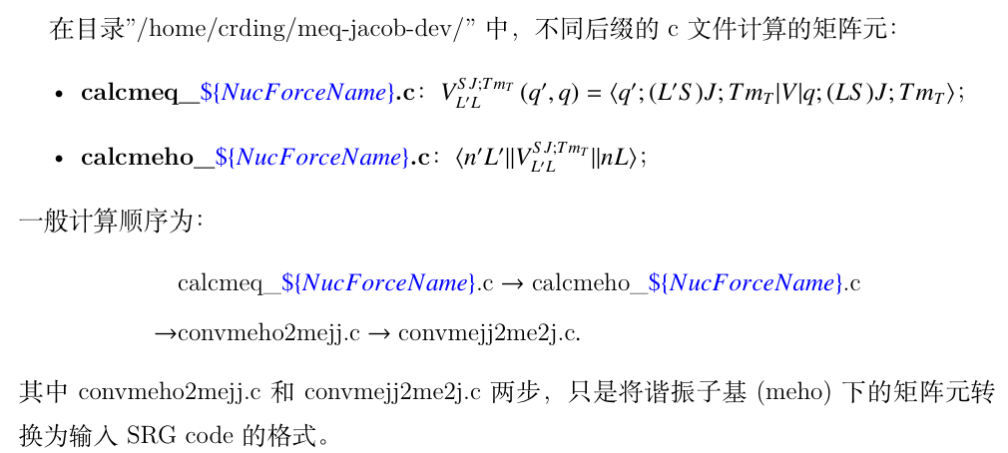
Section 4: The Note for Reading code
生成完整的 nnlosat / n2logo394 核力

Slide 17
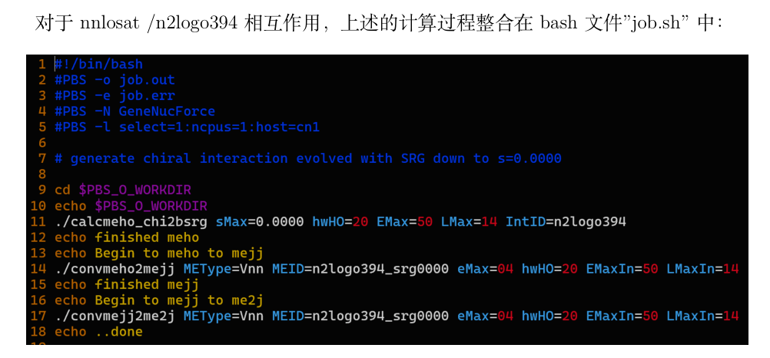
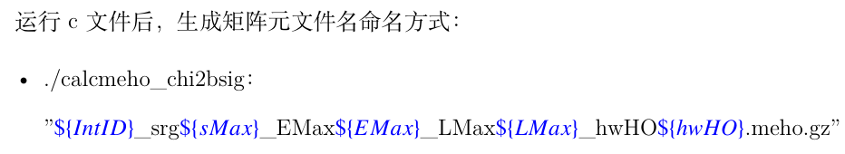
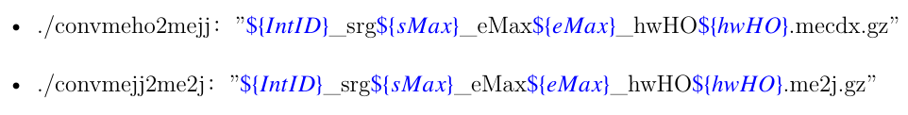
Section 4: The Note for Reading code
生成完整的 nnlosat / n2logo394 核力

Slide 18
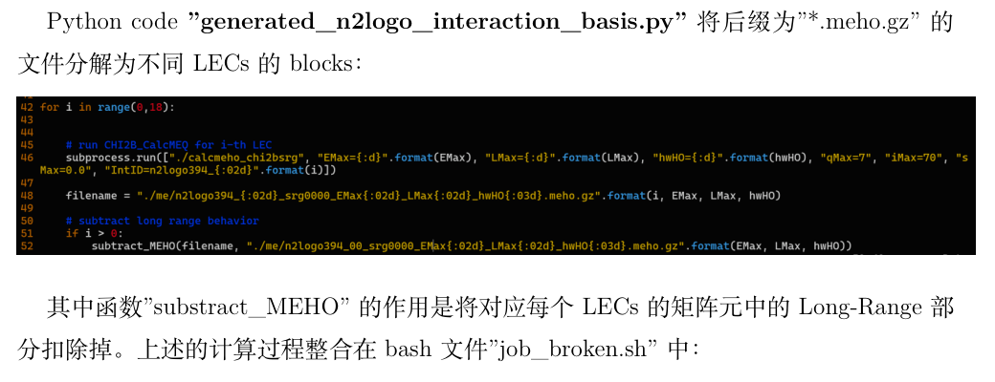
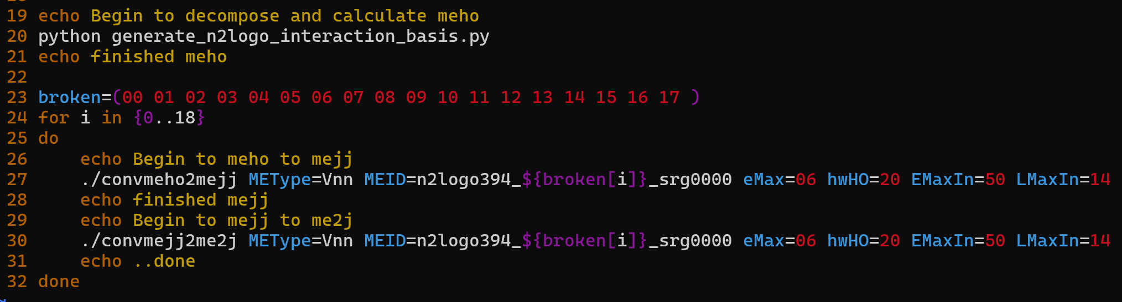
Section 4: The Note for Reading code
生成逐项分解的 n2logo394 核力

Slide 19
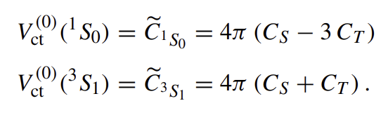
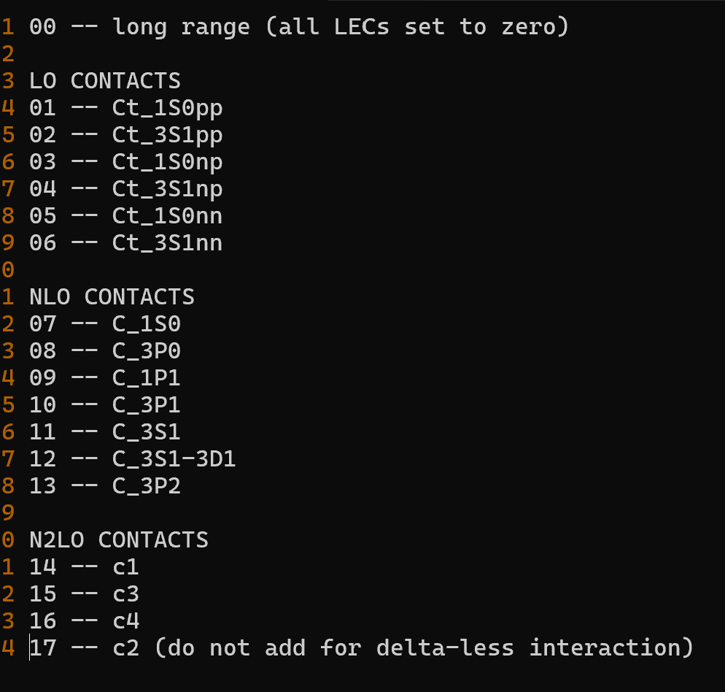
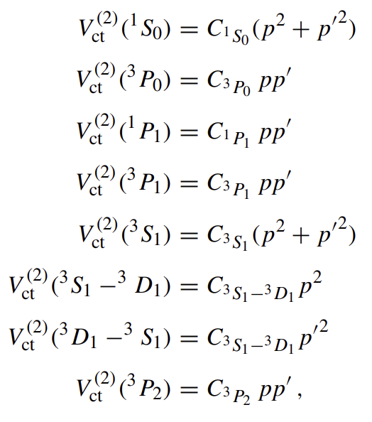
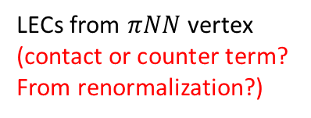
Section 4: The Note for Reading code
生成逐项分解的 n2logo394 核力
Code 中的核力blocks与公式中的LECs的对应关系：
Only LO NN terms are isospin dependent?
LECs from $πNN$ vertex (contact or counter term? From renormalization?)
* About the part of reading code, I thank Y. Li for fruitful discussions.

Slide 20
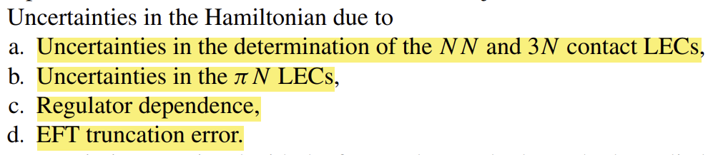
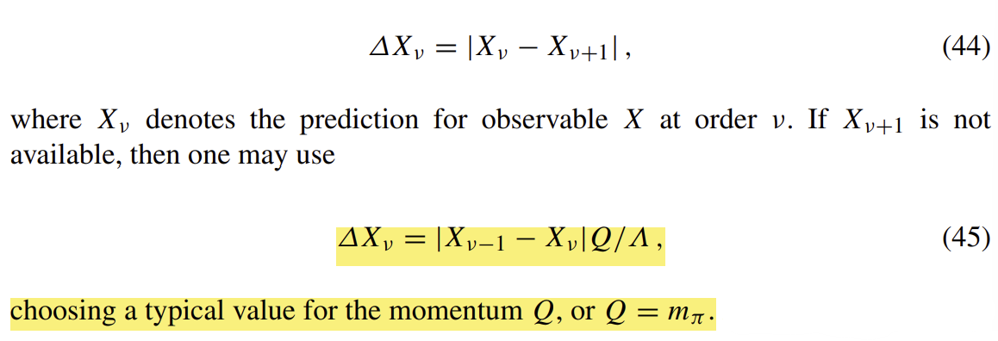

Section 5: Uncertainty quantifications
利用手征核力计算观测量的不确定度
Entem, Machleidt, “Nonlocal Chiral Nuclear Forces up to N5LO”, 2023.
* EFT truncation error at order $v$:
Thank you for your attention!

