Slide 1
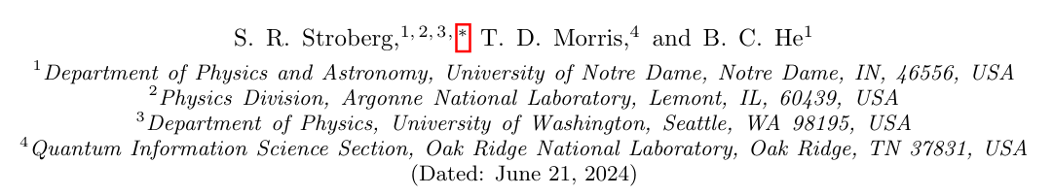
Journal Club
IMSRG with flowing 3 body operators, and approximations thereof
Date:2024.11.21 Linhai Chen Sun-Yat-San University

Slide 2
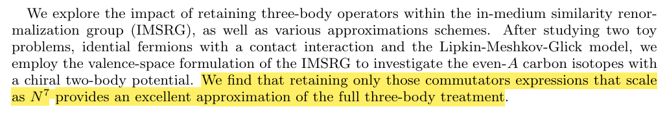
Abstract
Abstract:
将IMSRG方法的计算复杂度截断到$N^{7} 维（$IMSRG(3N7)），可以得到与IMSRG(3)方法相近的结果。

Slide 3
Introduction
Introduction:
There has been considerable progress in the past few years in ab initio many-body methods for atomic nuclei, with an explosion in the number of available methods, as well as in the systems amenable to ab initio treatment. At present, nuclei from A = 2 up to A ∼ 208 can be accessed, including many open-shell nuclei. There has simultaneously been great progress in quantifying uncertainties due to the truncation of effective field theory (EFT) to a finite order, especially the use of emulators for the solution of the many-body problem . One of the most important remaining open issues in ab initio nuclear theory is a robust and reliable assessment of the error due to approximations made in solving the many-body problem.
在从头计算理论中，一个关键的问题是如何对由于近似所产生的误差进行稳定和可靠的评估
In this paper, we focus on the in-medium similarity renormalization group (IMSRG) approach , and work towards understanding how the adopted truncation scheme manifests as errors in the predicted observables.
这篇论文主要关注介质相似重整化群（IMSRG）方法，并致力于理解所采用的截断方案的误差表现

Slide 4








In-Medium Similarity Renormalization Group
Basic ingredients：
Magnus formulation：

Slide 5
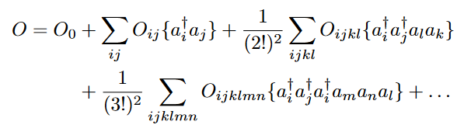
Truncation and NOnB approximation
Operator:
normal-ordered n-body (NOnB) approximation：to make the calculation feasible, all operators, including intermediate commutator expressions, are truncated at the n-body level.
For an A-body system with a single-determinant reference with A particles, at most A-particle-A-hole configurations can be present in the wave function, and so the NOnB approximation is exact for n ≥ 2A. With a vacuum reference, at most A quasiparticles are present, and so the NOnB approximation is exact for n ≥ A.
The NOnB approximation will also be exact if there are no m-body operators with m > n; for example, working at low order in chiral effective field theory ,there are no operators with m > 3, so the NO3B approximation is exact. However, SRG evolution will induce operators with m > 3, so IMSRG(3) is no longer exact.
在大多数情况下，我们研究的多体问题中，截断带来的误差是不可避免的

Slide 6
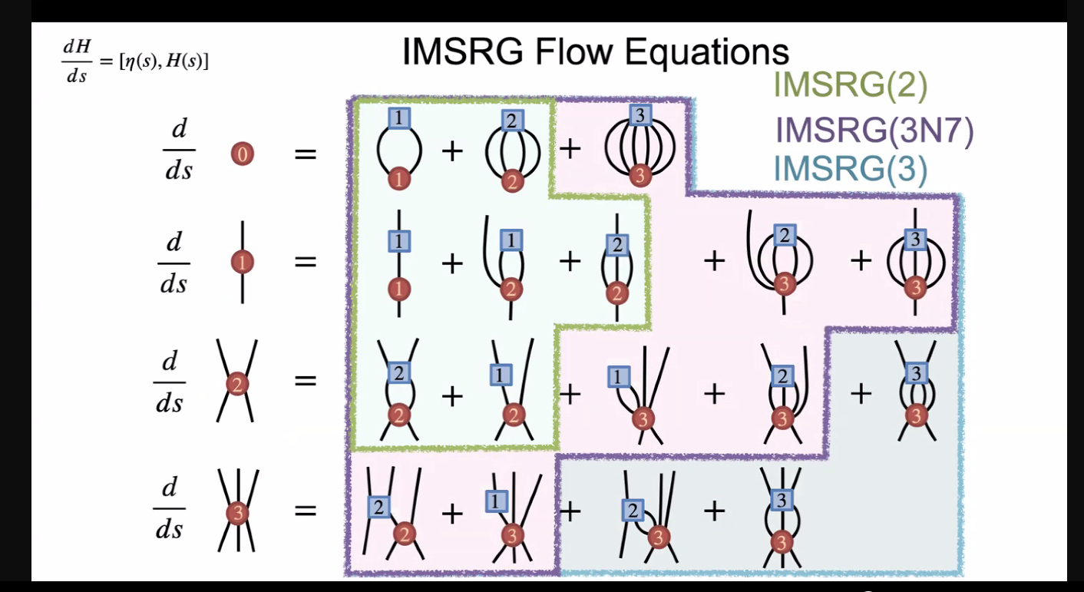
Approximations to full IMSRG(3)
The full IMSRG(3) is too expensive for realistic applications, and so we shall explore some approximation schemes which can render the calculation more tractable.

Slide 7
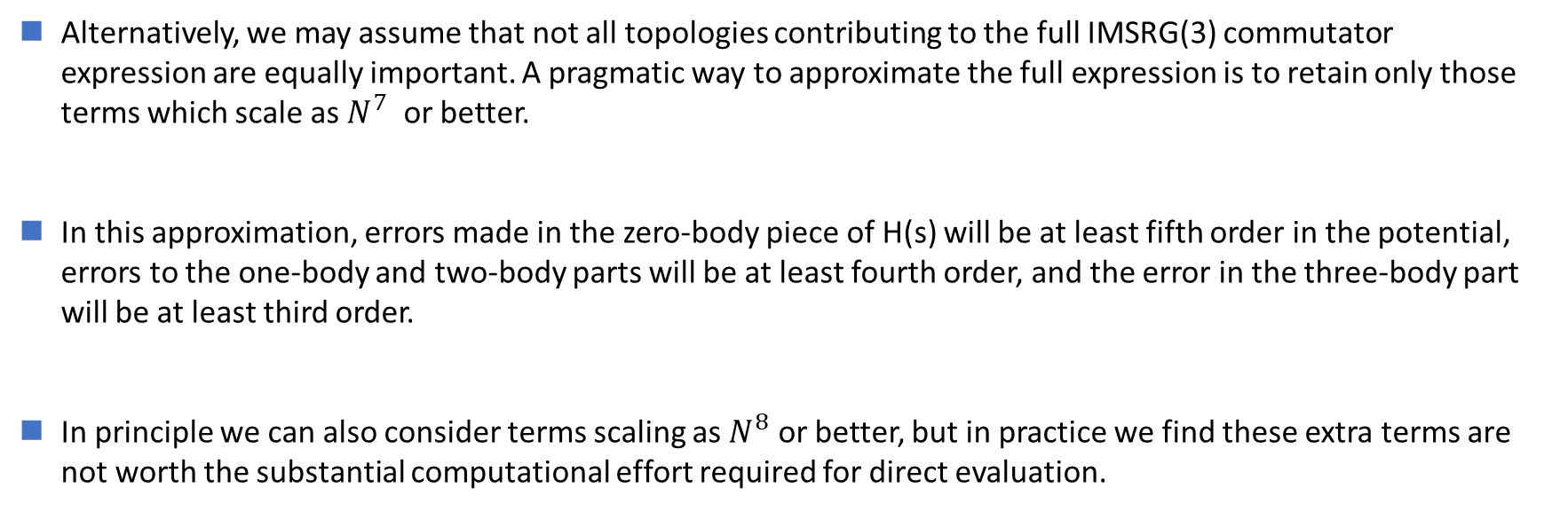
IMSRG(3N7)
Alternatively, we may assume that not all topologies contributing to the full IMSRG(3) commutator expression are equally important. A pragmatic way to approximate the full expression is to retain only those terms which scale as $N^{7}$ or better.
In this approximation, errors made in the zero-body piece of H(s) will be at least fifth order in the potential, errors to the one-body and two-body parts will be at least fourth order, and the error in the three-body part will be at least third order.
In principle we can also consider terms scaling as $N^{8}$ or better, but in practice we find these extra terms are not worth the substantial computational effort required for direct evaluation.
将IMSRG(3)的对易子只保留到$N^{7}$的计算复杂度，在保证计算效率的同时还可以得到不错的结果。

Slide 8
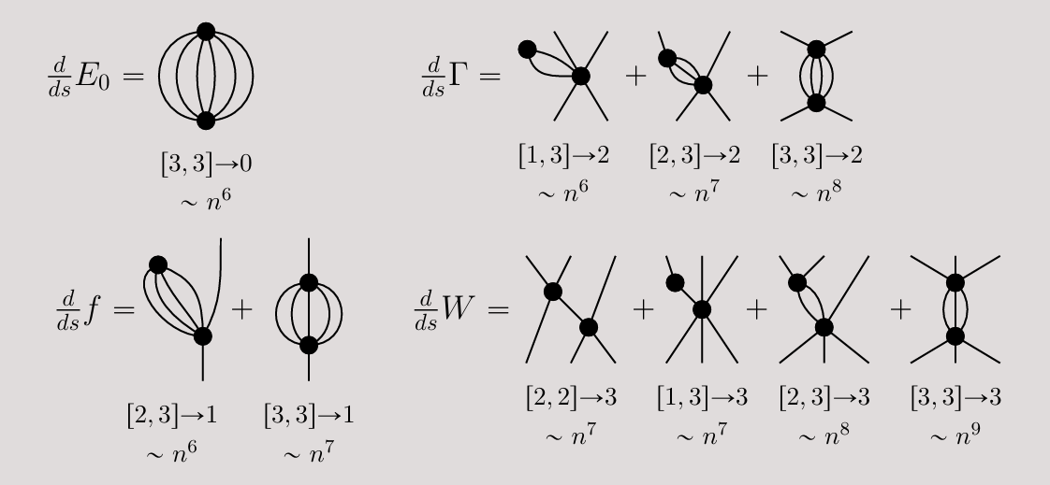
IMSRG(3N7)
n: the number of single-particle states in the basis

Slide 9
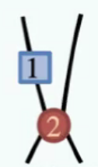
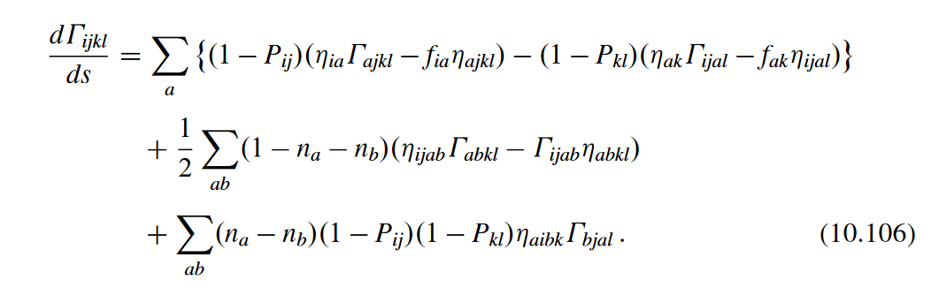
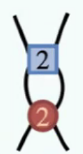
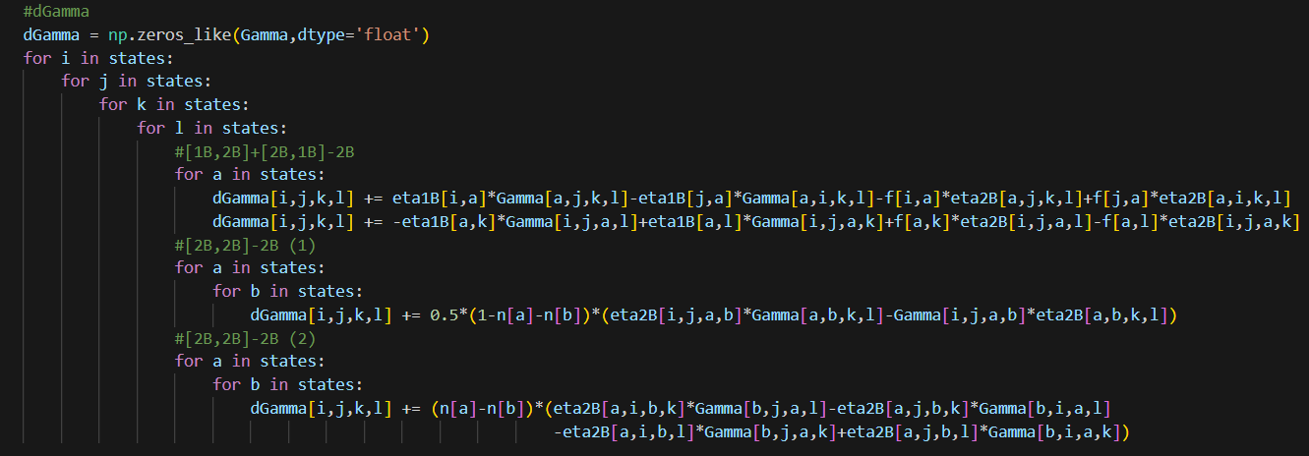





IMSRG(3N7)
$$\sim n^{5}$$
Equation:
$$\sim n^{6}$$
$$\sim n^{4}$$
Code:
$$\sim n^{6}$$
$$\sim n^{2}$$

Slide 10
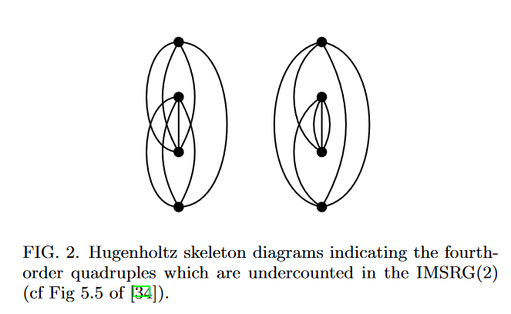
IMSRG(2*)
A perturbative analysis of the IMSRG demonstrated that the IMSRG(2) ground state energy is exact through third order in MBPT, while some fourth-order and higher-order terms are missed. Coupled cluster with singles and doubles (CCSD) also misses the fourth-order triples, but correctly includes the quadruples.
IMSRG(2)方法忽略了部分四阶以及更高阶的项，因此需要考虑如何通过某种方法恢复这些高阶项。

Slide 11
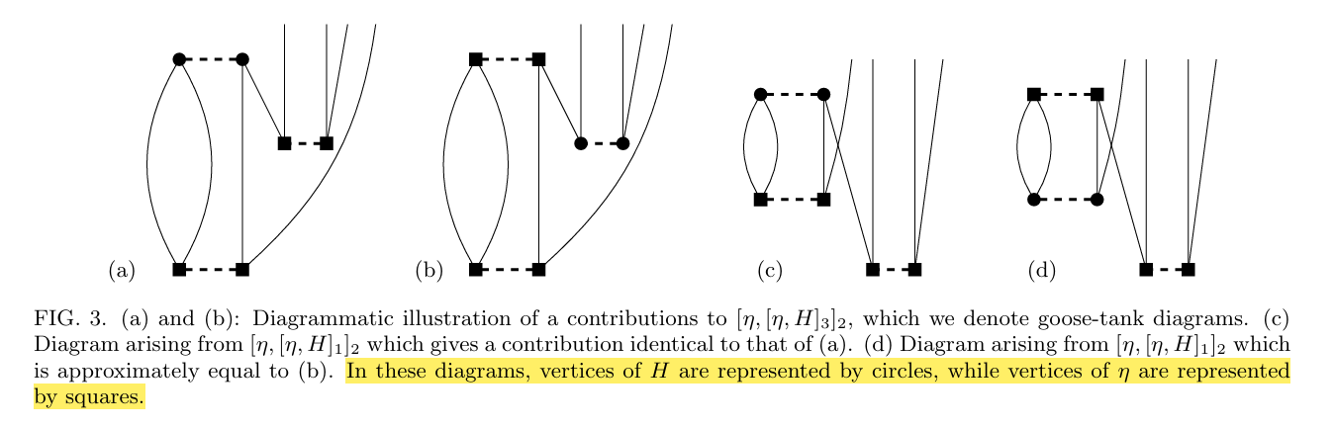




IMSRG(2*)
$${\left[η,H\right]}_{3}$$
$${\left[η,H\right]}_{1}$$
$$η_{2}$$
$$η_{2}$$
这表明图 (d) 在某种程度上可以代表图 (b) 的贡献，尽管它们可能在数学上不完全相同。

Slide 12
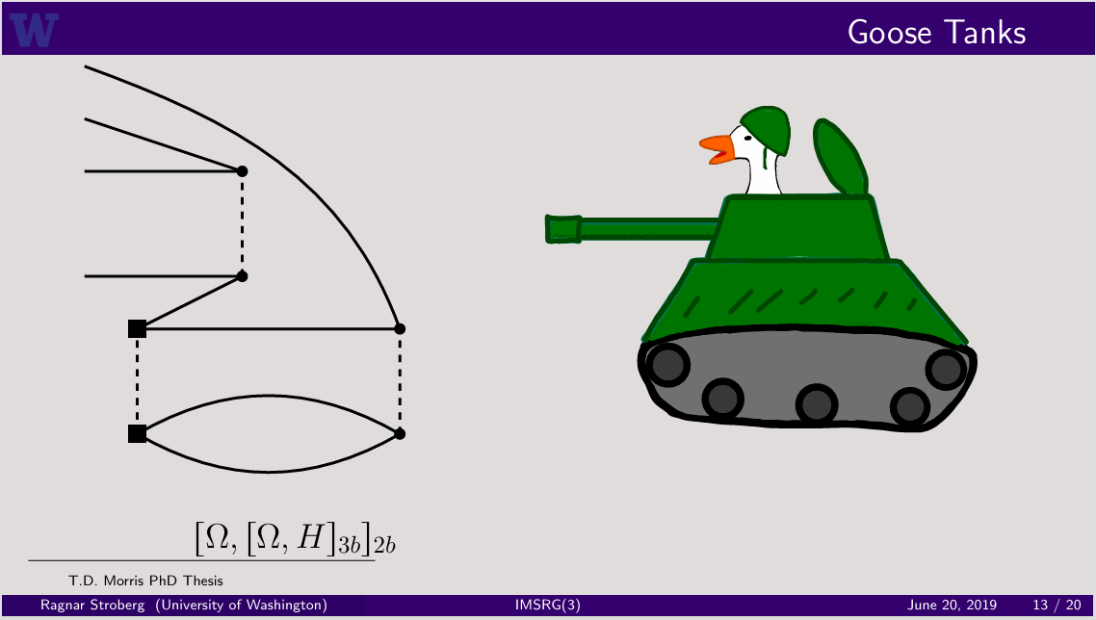
IMSRG(2*)

Slide 13
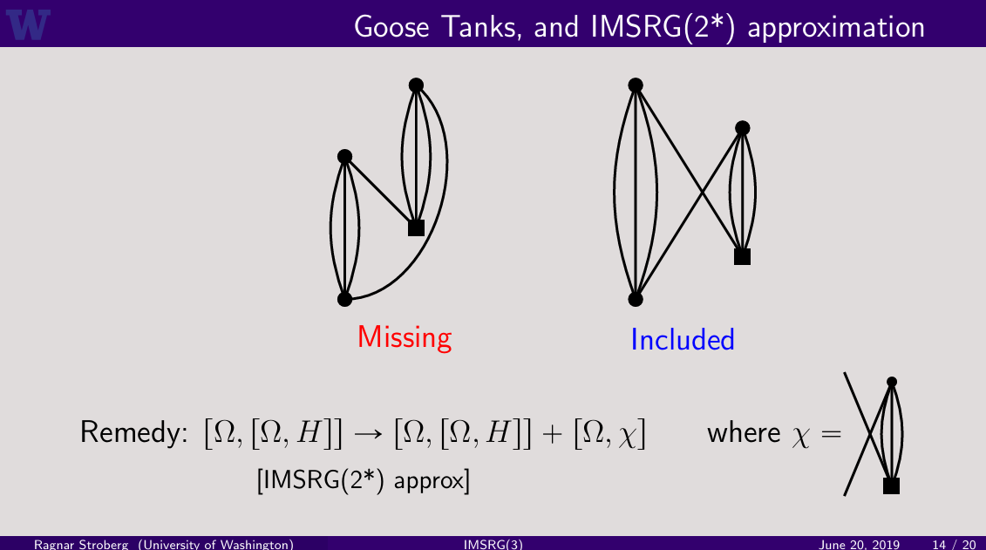
IMSRG(2*)

Slide 14


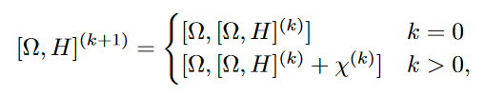

IMSRG(2*)
The full fourth-order quadruples can therefore be restored by modifying the IMSRG(2) to the so-called IMSRG(2∗) scheme. In the standard formulation, we modify the flow equation to be
where $χ(s)$ is an auxiliary one-body operator which obeys the flow equation
In the Magnus formulation, the nested commutators are modified to
and the one-body operator $χ^{(k)}$ is defined as

Slide 15
Benchmarking
Two fermions with a contact interaction
Lipkin-Meshkov-Glick model
Realistic nuclear interaction with the valence-space IMSRG

Slide 16


Two fermions with a contact interaction
By considering a toy problem of two neutrons in a harmonic trap with a contact interaction ,we work in a basis spanned by three major harmonic oscillator shells (i.e. 0s, 0p, 1s0d). The Hamiltonian is
where the single-particle energy is $ε_{i}=2n_{i}+ℓ$(we measure energy in terms of the oscillator energy $ℏω$) and the potential is
The relative coordinate $\vec{r}$ is expressed in units of the oscillator length $b=\sqrt{ℏ/mω}$. With this definition, $g$ < 0 corresponds to an attractive interaction, and the normalization is chosen so that $⟨0s0s|V |0s0s⟩ = g$.

Slide 17
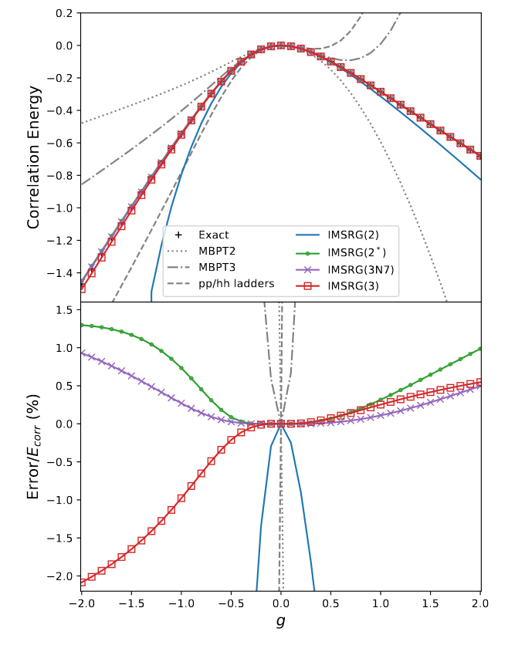
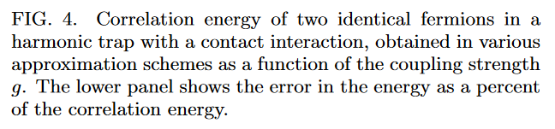
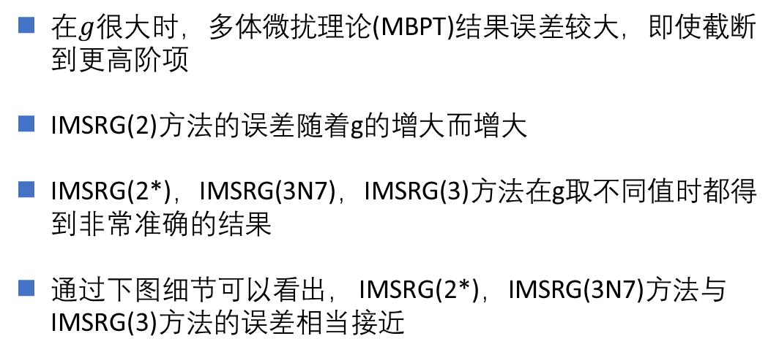
Two fermions with a contact interaction
在$g$很大时，多体微扰理论(MBPT)结果误差较大，即使截断到更高阶项
IMSRG(2)方法的误差随着g的增大而增大
IMSRG(2*)，IMSRG(3N7)，IMSRG(3)方法在g取不同值时都得到非常准确的结果
通过下图细节可以看出， IMSRG(2*)，IMSRG(3N7)方法与IMSRG(3)方法的误差相当接近

Slide 18
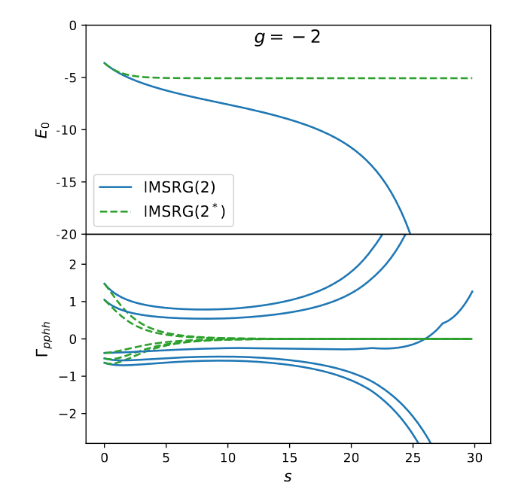
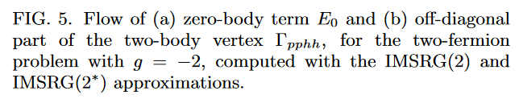
Two fermions with a contact interaction
在g较大时，IMSRG(2)方法由于忽略了高阶项导致演化流方程结果发散，而IMSRG(2*)方法却可以正常收敛，解决了发散问题。

Slide 19
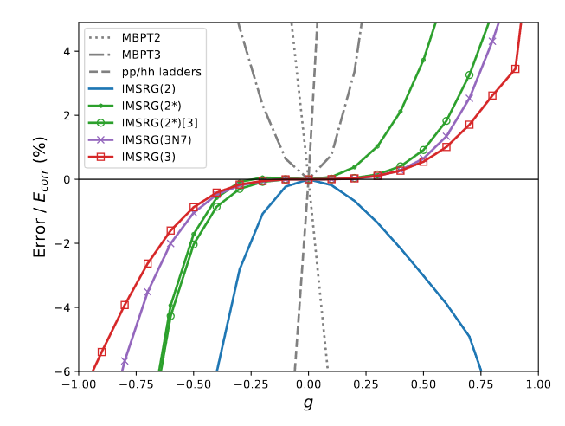

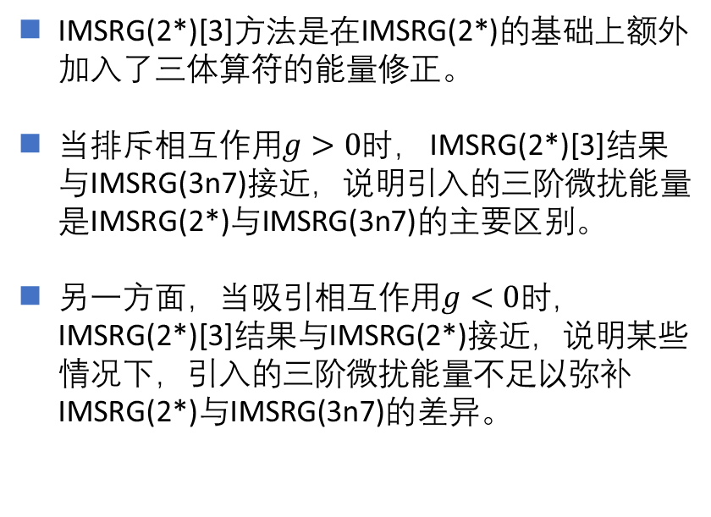
Two fermions with a contact interaction
IMSRG(2*)[3]方法是在IMSRG(2*)的基础上额外加入了三体算符的能量修正。
当排斥相互作用$g>0$时， IMSRG(2*)[3]结果与IMSRG(3n7)接近，说明引入的三阶微扰能量是IMSRG(2*)与IMSRG(3n7)的主要区别。
另一方面，当吸引相互作用$g<0$时， IMSRG(2*)[3]结果与IMSRG(2*)接近，说明某些情况下，引入的三阶微扰能量不足以弥补IMSRG(2*)与IMSRG(3n7)的差异。

Slide 20
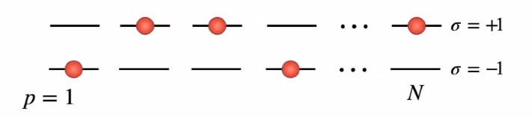

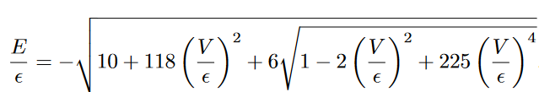





Lipkin-Meshkov-Glick model
Lipkin-Meshkov-Glick model：
Hamiltonian：
N=8 analytical solution:
Quasi-spin formulation：
Correlation energy:
CCD:$α≡N^{2}−7N+9$
IMSRG(2):$α≡N^{2}−5N+7$

Slide 21
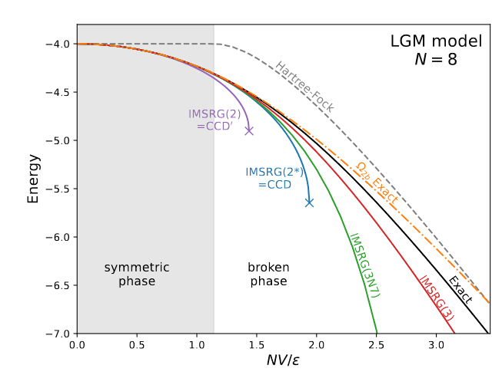

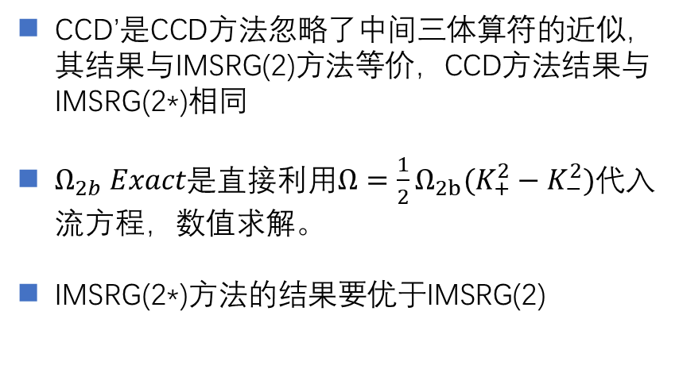
Lipkin-Meshkov-Glick model
CCD’是CCD方法忽略了中间三体算符的近似，其结果与IMSRG(2)方法等价，CCD方法结果与IMSRG(2*)相同
$Ω_{2b} Exact$是直接利用$Ω={\frac{1}{2}Ω}_{2b}(K_{+}^{2}−K_{−}^{2})$代入流方程，数值求解。
IMSRG(2*)方法的结果要优于IMSRG(2)

Slide 22
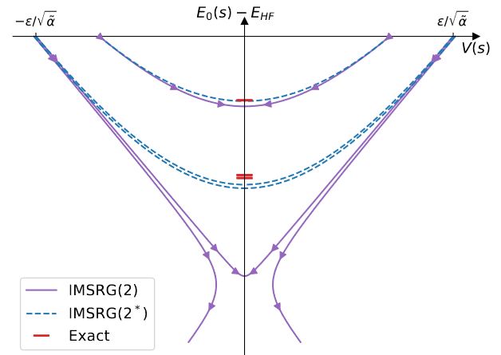
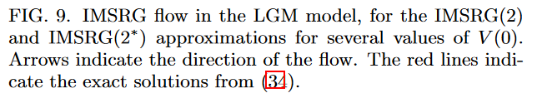
Lipkin-Meshkov-Glick model
在V比较小时，IMSRG(2)和IMSRG(2*)方法都可以取得与严格解接近的结果
在V接近临界点时，IMSRG(2)在V小于临界点时可以正常收敛，在大于临界点时会发散。而IMSRG(2*)都可以正常收敛，而且结果较为接近。

Slide 23
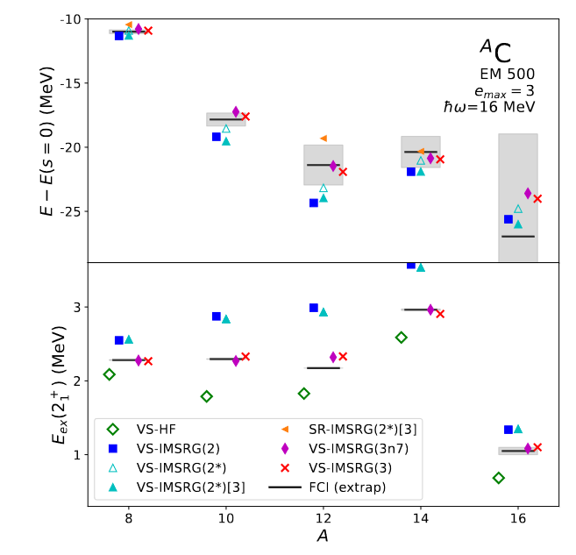

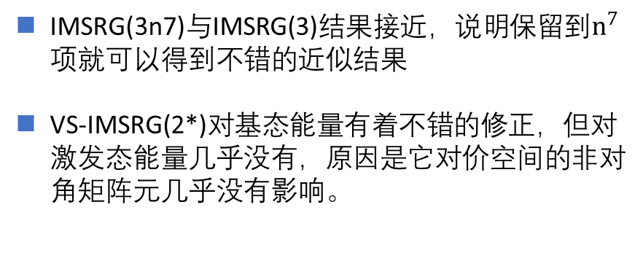
Realistic nuclear interaction with the valence-space IMSRG
IMSRG(3n7)与IMSRG(3)结果接近，说明保留到$n^{7}$项就可以得到不错的近似结果
VS-IMSRG(2*)对基态能量有着不错的修正，但对激发态能量几乎没有，原因是它对价空间的非对角矩阵元几乎没有影响。

Slide 24
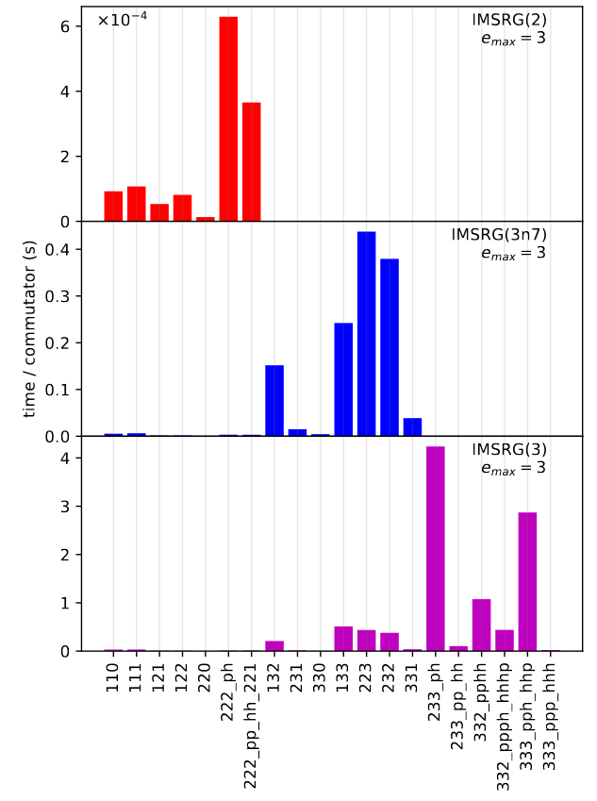
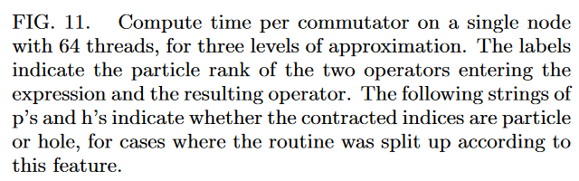
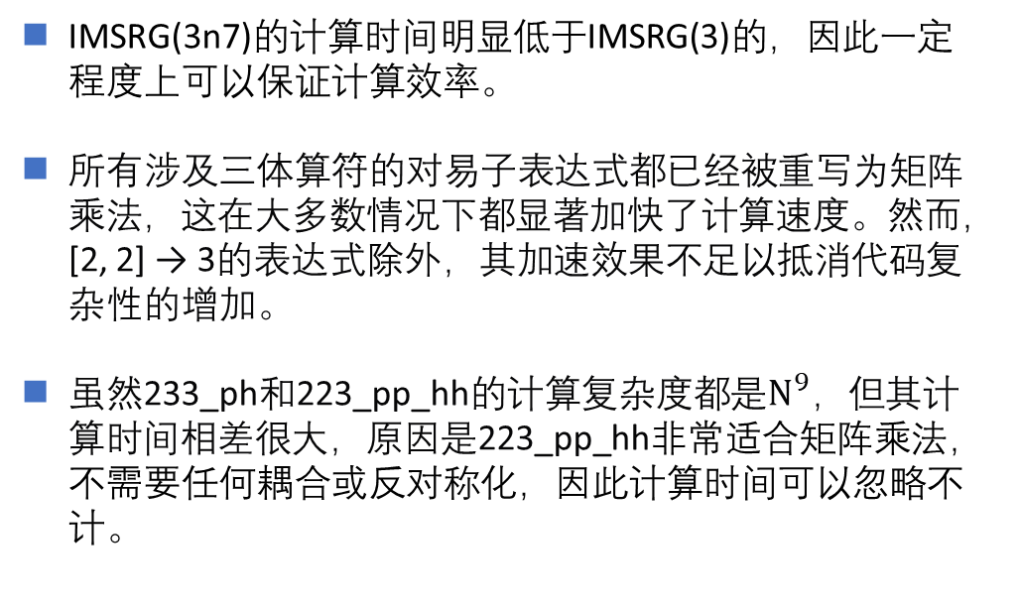
Computational cost
IMSRG(3n7)的计算时间明显低于IMSRG(3)的，因此一定程度上可以保证计算效率。
所有涉及三体算符的对易子表达式都已经被重写为矩阵乘法，这在大多数情况下都显著加快了计算速度。然而，[2, 2] → 3的表达式除外，其加速效果不足以抵消代码复杂性的增加。
虽然233_ph和223_pp_hh的计算复杂度都是$N^{9}，$但其计算时间相差很大，原因是223_pp_hh非常适合矩阵乘法，不需要任何耦合或反对称化，因此计算时间可以忽略不计。

Slide 25
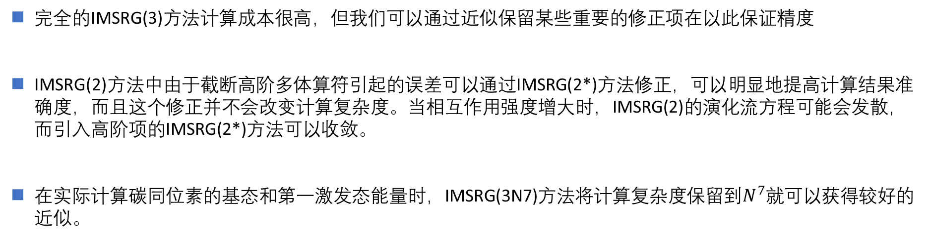
Conclusion
Conclusion:
完全的IMSRG(3)方法计算成本很高，但我们可以通过近似保留某些重要的修正项在以此保证精度
IMSRG(2)方法中由于截断高阶多体算符引起的误差可以通过IMSRG(2*)方法修正，可以明显地提高计算结果准确度，而且这个修正并不会改变计算复杂度。当相互作用强度增大时，IMSRG(2)的演化流方程可能会发散，而引入高阶项的IMSRG(2*)方法可以收敛。
在实际计算碳同位素的基态和第一激发态能量时，IMSRG(3N7)方法将计算复杂度保留到$N^{7}$就可以获得较好的近似。

Slide 26
Thanks!

