Slide 1
Optimization of the number of intrinsic states included in the discrete Generator Coordinate Method
Lingyu Huang
School of Physics and Astronomy, Sun Yat-Sen University
Journal Club (20250528)
Reference: Jaime Martínez-Larraz, Tomás R.Rodríguez
Optimization of the number of intrinsic states included in the discrete Generator Coordinate Method
https://doi.org/10.1103/PhysRevC.106.054301

Slide 2
CONTENTS
01
Introduction
02
Theoretical Framework
03
Results
04
Summary and Conclusions

Slide 3
Introduction
Core concept of GCM
The GCM provides a variational framework to solve the many-body problem by superposing non-orthogonal intrinsic states (e.g., symmetry-restored quasiparticle states) along generating coordinates (e.g., quadrupole deformation).
Realizations of the GCM formalism
GCM-based methods (MR-EDF, SCCM, PGCM, etc.) differ by the definition of the intrinsic states, the generating coordinates used, the nuclear interaction, the selection of the states.
Critical Challenges of GCM
Adding more configurations improves variational accuracy but requires evaluating expensive non-diagonal Hamiltonian kernels.
Natural basis construction suffers from exact/approximate linear dependencies (LD), requiring heuristic cutoffs.
Proposed solution
A protocol to pre-select intrinsic states based on the orthonormality of the natural basis (avoiding Hamiltonian kernel evaluations), validated with Gogny EDF in selected nuclei.

Slide 4
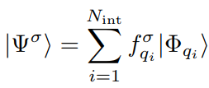


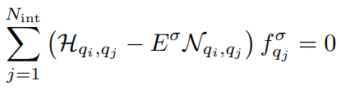
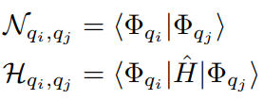
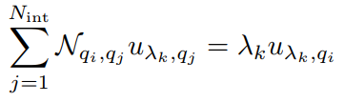
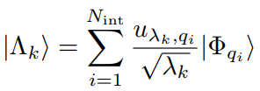
Theoretical Framework
^{1. The concept in GCM}
The nuclear many-body states are obtained as:
the axial quadrupole deformation parameter β2 is used to be the generating coordinate
HWG equation:
2. Solution of the HWG equation
Diagonalize the norm kernel to obtain a set of orthogonal basis called “natural states”

Slide 5
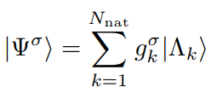
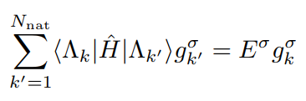

Theoretical Framework
2. Solution of the HWG equation
Eliminate the intrinsic states with exact or approximately linear dependencies based on the eigenvalues
Suppose there are L_{exa} intrinsic states with λ = 0，L_{app} intrinsic states with λ＜ε，then the N_{nat} = N_{int} - L_{exa} - L_{app}
Construct the GCM many-body states and the HWG equation:
3. Different way to determine the number of elements of the natural basis
Use the deviation of the natural basis from its orthonormality as a more restricted and numerically stable method to determine the number of elements of the natural basis:

Slide 6
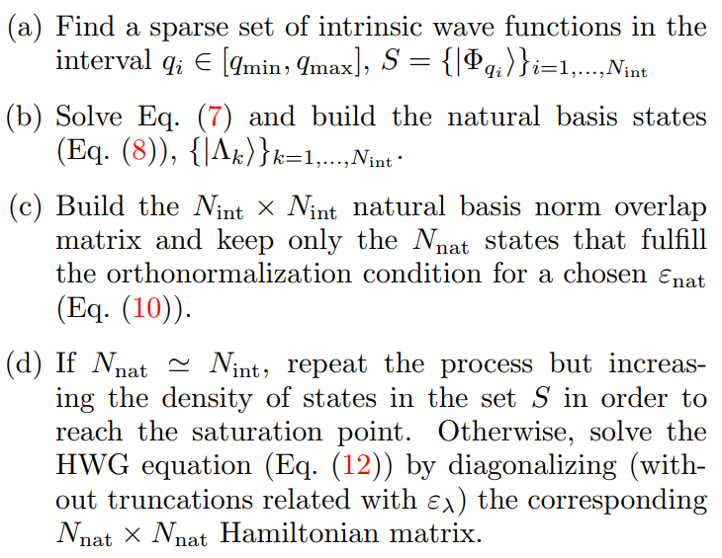
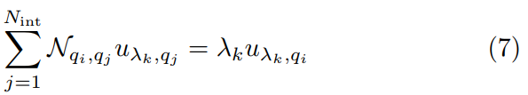
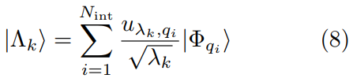

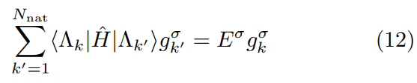
Theoretical Framework
^{4. Preselection}
Perform a preselection to limit a priori the number of intrinsic states before computing costly Hamiltonian overlaps and solving the HWG equation:

Slide 7
Results
^{1. Information}
PGCM calculations performed with the Gogny D1S energy density functional.
Choose three nuclei as examples of double-magic (⁴⁰Ca), open-shell (⁸⁰Sr), and semi-magic (¹⁸⁶Pb) nuclei
The intrinsic wave functions that are mixed within the GCM ansatz are particle number and angular momentum projected (PNAMP) HFB quasiparticle vacua.
Five different sets of intrinsic wave functions within the interval β2 ∈ [-0.65; 0.95] have been defined :S _{j=1,…,5} with N _{int,j} = 20, 40, 80, 160, 320 elements in each set such that S1 ⊂ S2 ⊂ … ⊂ S5.

Slide 8
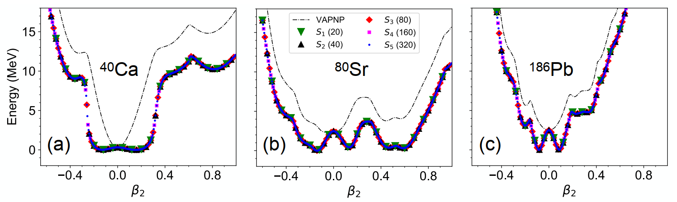
Results
2. Convergence of the GCM with the plateau condition
The three nuclei show spherical minima with narrower wells for the magic ones (40Ca and 186Pb) and some other local valleys at deformed configurations.
The simultaneous particle number and angular momentum restoration of the intrinsic HFB states (J = 0) produces an energy gain in all the points of the VAPNP-TECs except the spherical one that becomes a maximum that separates two almost symmetric minima around this point.

Slide 9

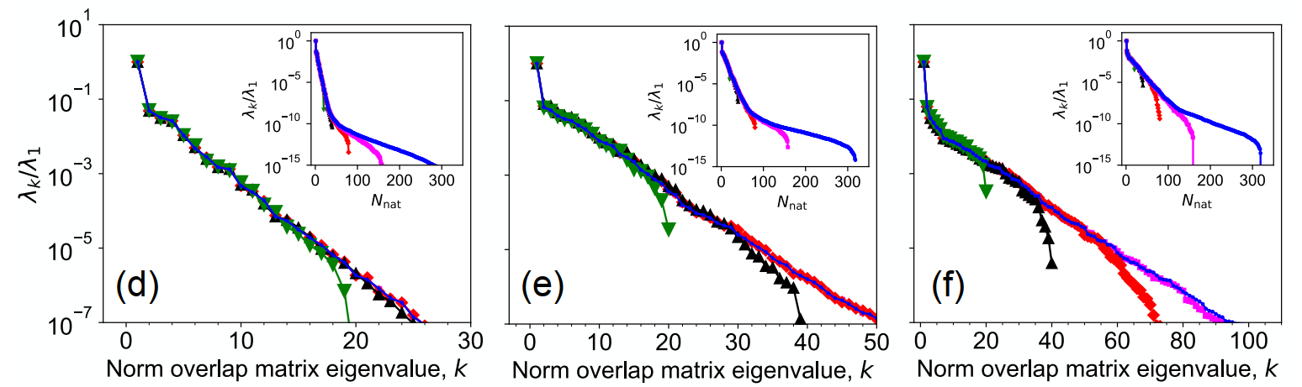
Results
2. Convergence of the GCM with the plateau condition
The largest eigenvalue is separated from the rest of the eigenvalues.
The larger the dimension of the norm overlap matrix is, the larger is the largest eigenvalue and smaller the smallest eigenvalue obtained
the rest of eigenvalues decrease smoothly to very small values with nearly the same slope for all the sets in a rather wide range of eigenvalues.
potential problems associated to approximate linear dependencies will be more evident in the sets with more intrinsic HFB states.

Slide 10
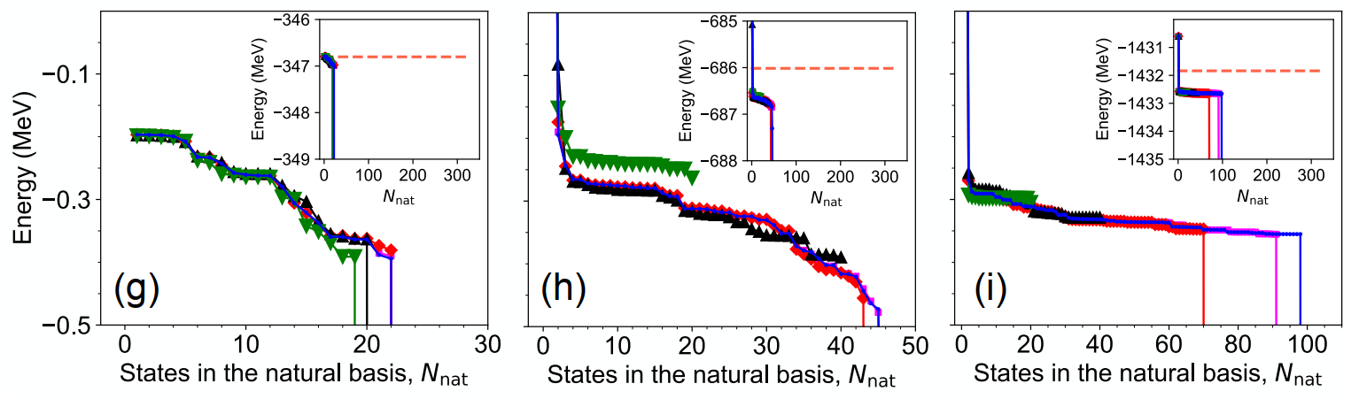
Results
2. Convergence of the GCM with the plateau condition
We observe in ⁸⁰Sr and ¹⁸⁶Pb a strong reduction of the GCM energy from considering only one state in the natural basis (the one built with the largest eigenvalue of the norm) to adding more states.
after this reduction, the GCM energy is slowly decreasing with the number of states in the natural basis and sudden drops are obtained with the sets S_{3,4,5} after considering a certain number of states
For ⁴⁰Ca we also see a similar result, but the initial jump is not found and the final abrupt drop is reached by all the sets.

Slide 11
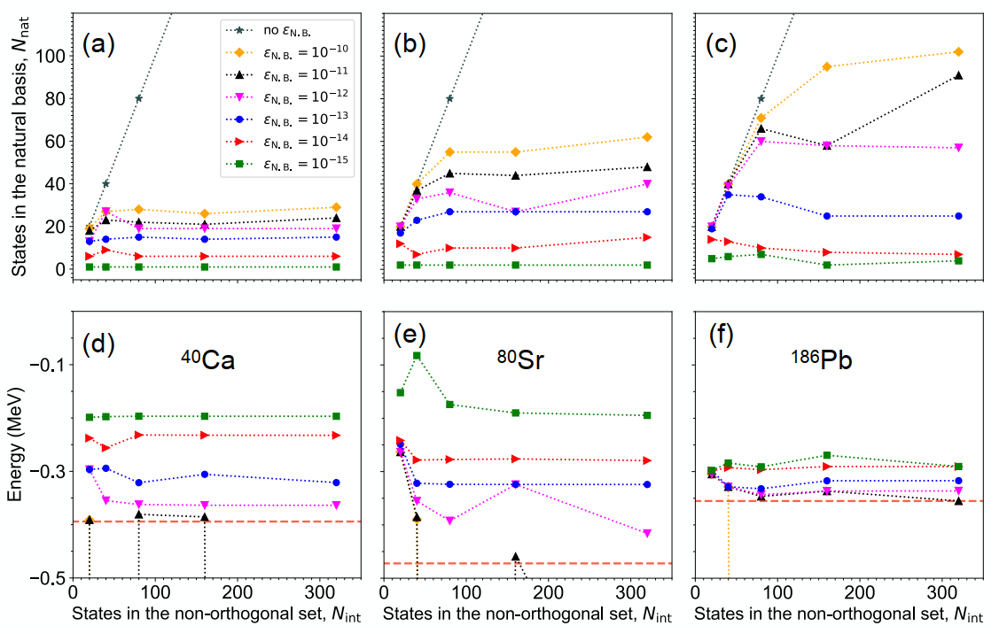
Results
3. Convergence of the GCM with the orthonormality of the natural basis

Slide 12
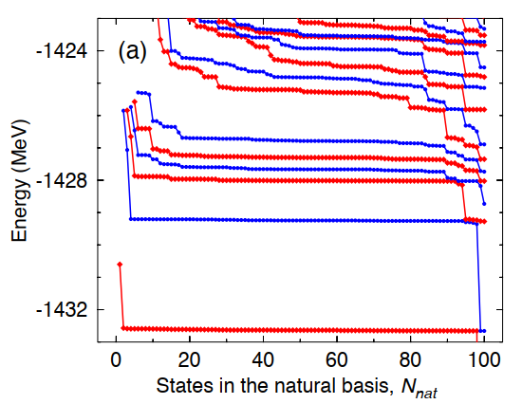
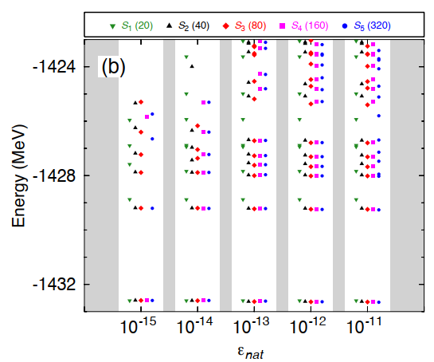
Results
4. Convergence of the GCM excited states

Slide 13
Summary and Conclusions
^{1. Summary}
Introduces a mechanism to pre-select intrinsic states in the discrete Generator Coordinate Method (GCM) by defining a natural orthonormal basis, reducing numerical instabilities caused by linear dependencies.
Validated using the Gogny energy density functional (D1S parameterization) for three nuclei: ⁴⁰Ca (double-magic), ⁸⁰Sr (open-shell), and ¹⁸⁶Pb (semi-magic).
^{2. Conclusions}
The natural basis size saturates when exploring a collective coordinate interval, enabling reliable results with fewer intrinsic states.
Strict orthonormality criteria ensure all eigenstates (ground and excited) are numerically stable, unlike traditional plateau-based methods.
Provides a systematic framework to study collective excitations and high-spin states with reduced computational overhead.

