Slide 1
Ab initio calculations of electric dipole moments of light nuclei
罗青杨
School of Physics and Astronomy, Sun Yat-Sen University
Journal Club (2026/01/07)
Reference: Kia Boon Ng et al., arXiv:2103.06365v2

Slide 2
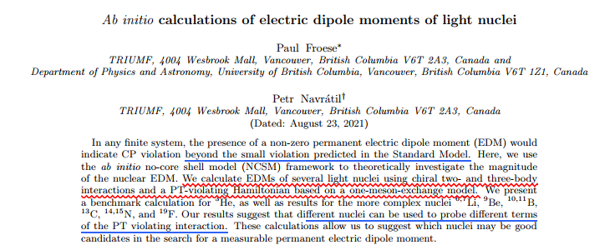
Notes:
我们的结果表明，不同的原子核可以用来探测PT破坏相互作用的不同项。这些计算使我们能够建议哪些原子核可能是在寻找可测量的永久电偶极矩时的良好候选对象。

Slide 3


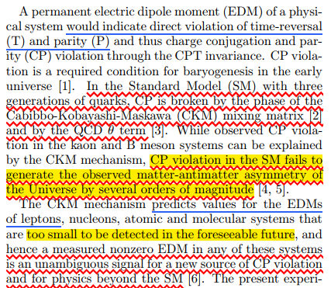
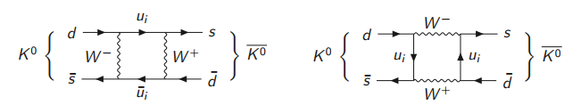
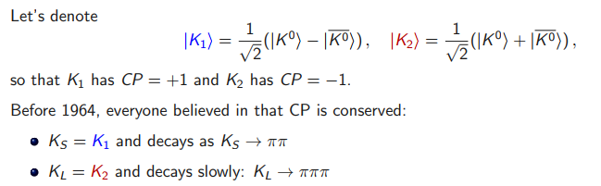
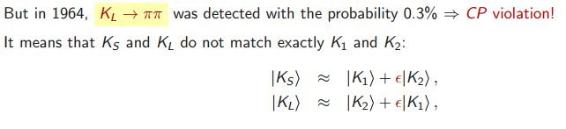
Introduction
Violation of discrete Symmetries Violation of discrete Symmetries Violation of discrete Symmetries
Igor Ivanov EPP2 lecture notes
Notes:
原子与分子中单个量子态的精确控制和操纵技术的快速发展，极大地推动了量子信息、量子模拟以及量子水平化学反应探测等领域的进步.

Slide 4
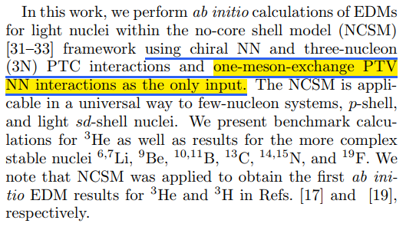
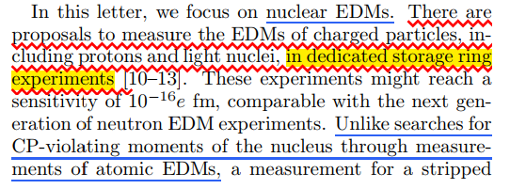
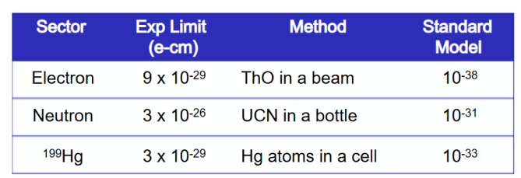
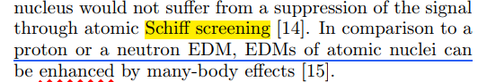
Introduction
C. Abel et.al, Phys. Rev. Lett. 124, 081803 (2020).
B. Graner et.al, Phys. Rev. Lett. 116, 161601 (2016). ← Hg199 atom
J. Baron, et.al, Science 343, 269 (2014). ← ThO molecule.
Notes:
原子与分子中单个量子态的精确控制和操纵技术的快速发展，极大地推动了量子信息、量子模拟以及量子水平化学反应探测等领域的进步.

Slide 5
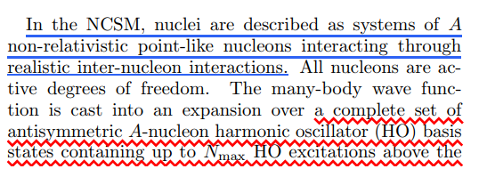


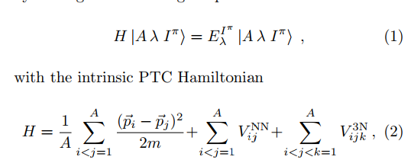
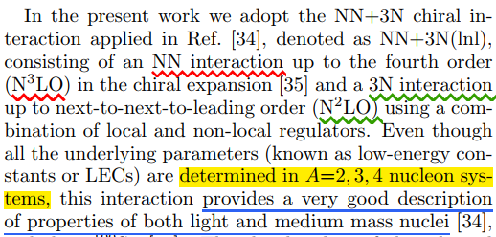
NCSM
Identify neutron and proton?
nn, pp, np interaction?
Only the eigenstates (1) obtained by diagonalization using the Lanczos algorithm have good I and approximately good T .
Notes:
原子与分子中单个量子态的精确控制和操纵技术的快速发展，极大地推动了量子信息、量子模拟以及量子水平化学反应探测等领域的进步.

Slide 6
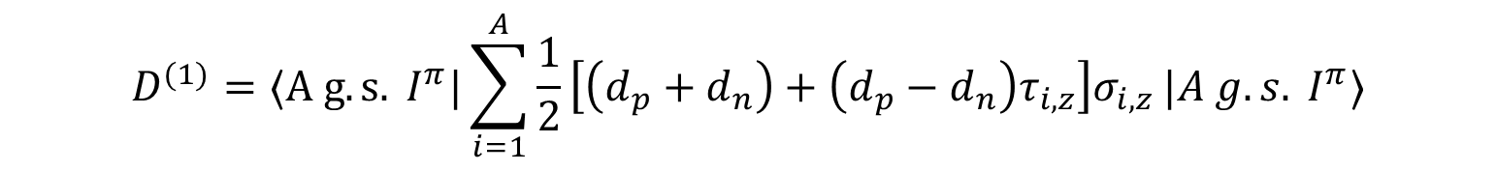
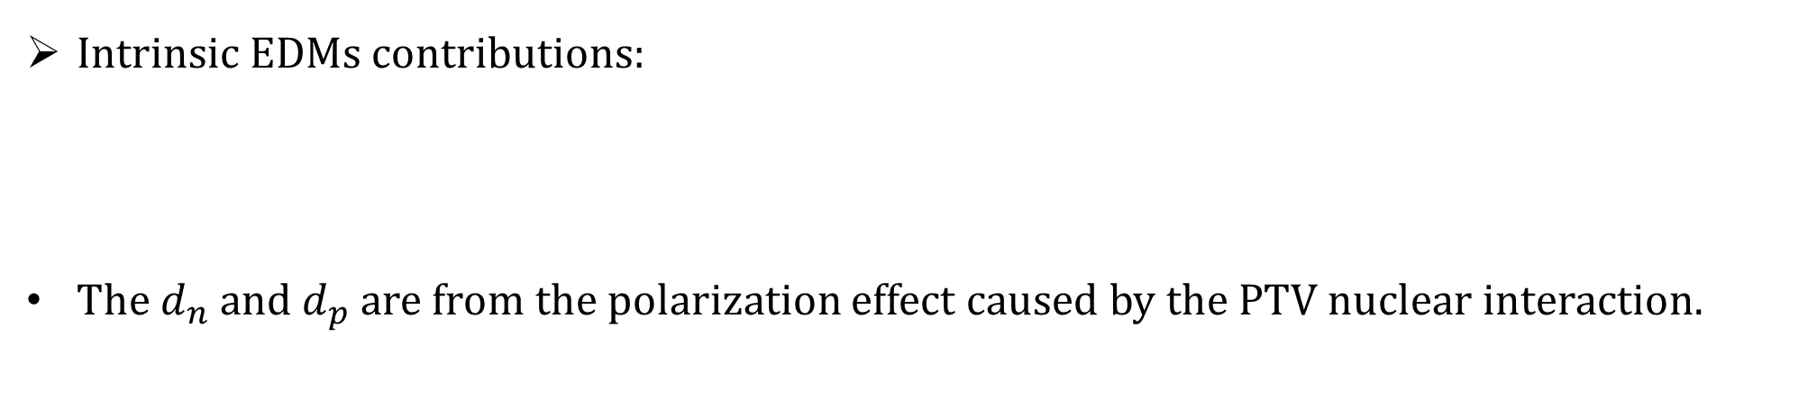
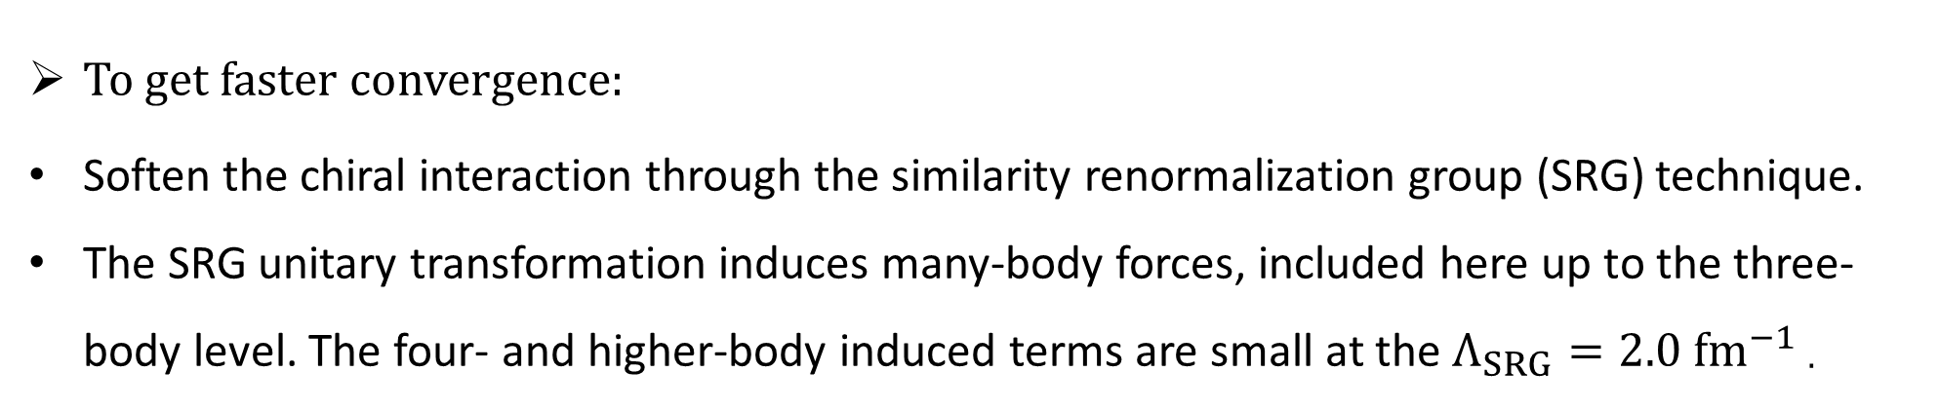
NCSM
To get faster convergence:
Soften the chiral interaction through the similarity renormalization group (SRG) technique.
The SRG unitary transformation induces many-body forces, included here up to the three-body level. The four- and higher-body induced terms are small at the $Λ_{SRG}=2.0 fm^{−1}$.
Intrinsic EDMs contributions:
The $d_{n}$ and $d_{p}$ are from the polarization effect caused by the PTV nuclear interaction.
$$D^{(1)}=⟨A g.s. I^{π}|\sum_{i=1}^{A}{\frac{1}{2}\left[\left(d_{p}+d_{n}\right)+\left(d_{p}−d_{n}\right)τ_{i,z}\right]σ_{i,z}}|A g.s. I^{π}⟩$$
Notes:
原子与分子中单个量子态的精确控制和操纵技术的快速发展，极大地推动了量子信息、量子模拟以及量子水平化学反应探测等领域的进步.

Slide 7
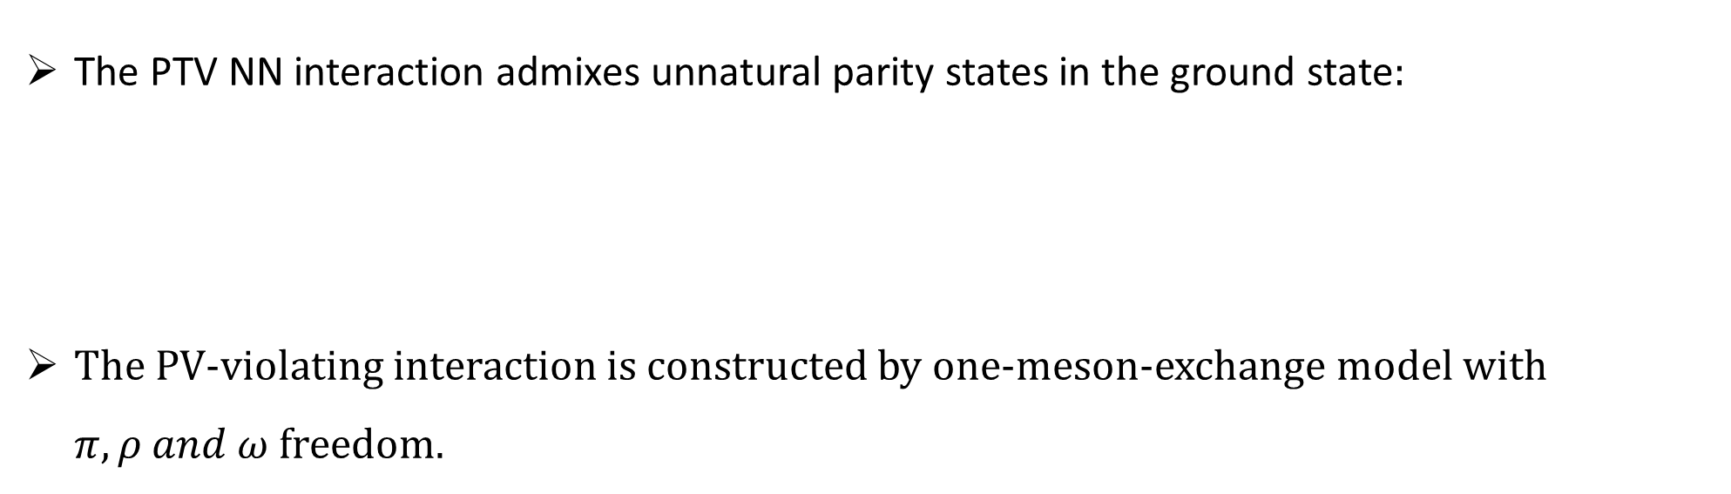
PT-violating interaction
The PTV NN interaction admixes unnatural parity states in the ground state:
The PV-violating interaction is constructed by one-meson-exchange model with $π, ρ and ω$ freedom.
$$\left|A g.s. I\right\rangle =\left|A g.s. I^{π}\right\rangle +\sum_{λ}{\left|A λ I^{−π }\right\rangle ×}\frac{1}{E_{g.s.}^{I^{π}} −E_{λ}^{I^{−π}}}\left\langle A λ I^{−π}\left|V_{NN}^{PTV}\right|A g.s. I^{π}\right\rangle$$
$$V_{NN}^{PTV}=\frac{1}{2m} \{σ_{−}⋅∇\left(− {\overline{G}}_{ω}^{0}y_{ω}\left(r\right)\right)+τ_{1}⋅τ_{2}σ_{−}⋅∇\left({\overline{G}}_{π}^{0}y_{π}\left(r\right)−{\overline{G}}_{ρ}^{0}y_{ρ}\left(r\right)\right)$$
$$+ \frac{1}{2}τ_{+}^{z}σ_{−}⋅∇ \left({\overline{G}}_{π}^{1}y_{π}\left(r\right)−{\overline{G}}_{ρ}^{1}y_{ρ}\left(r\right)− {\overline{G}}_{ω}^{1}y_{ω}\left(r\right)\right)+\frac{1}{2}τ_{−}^{z}σ_{+}⋅∇ \left({\overline{G}}_{π}^{1}y_{π}\left(r\right)+{\overline{G}}_{ρ}^{1}y_{ρ}\left(r\right)− {\overline{G}}_{ω}^{1}y_{ω}\left(r\right)\right)$$
$$+ \left(3τ_{1}^{z}τ_{2}^{z}−τ_{1}⋅τ_{2}\right)σ_{−}⋅∇ \left({\overline{G}}_{π}^{2}y_{π}\left(r\right)−{\overline{G}}_{ρ}^{2}y_{ρ}\left(r\right)\right)\}$$
Notes:
原子与分子中单个量子态的精确控制和操纵技术的快速发展，极大地推动了量子信息、量子模拟以及量子水平化学反应探测等领域的进步.

Slide 8
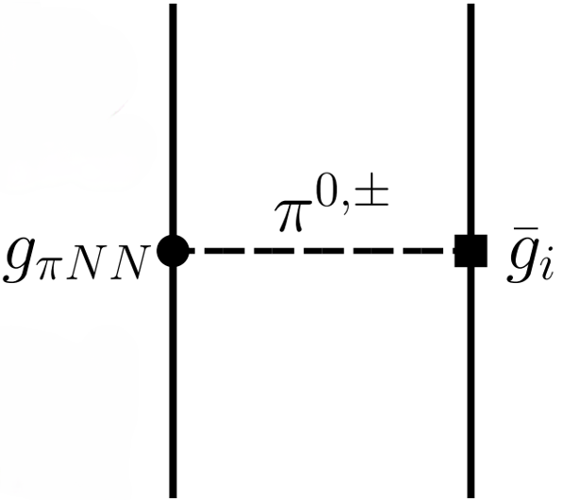
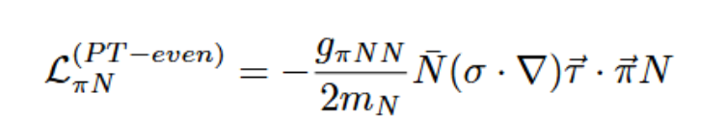

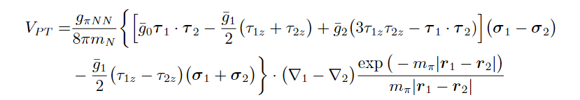
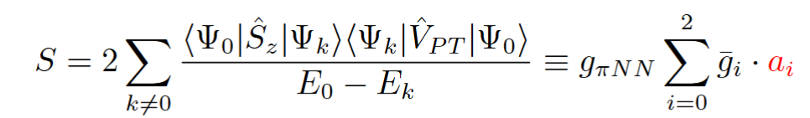

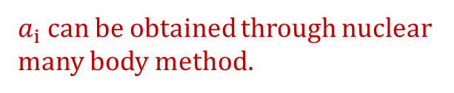
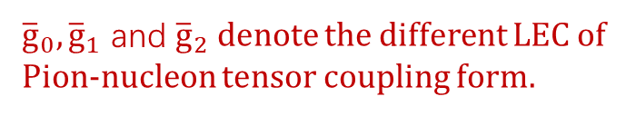
Schiff moment and P, T violating nuclear force
The Schiff moment induced by the P,T-odd two-body nucleon-nucleon interaction ${\hat{V}}_{PT}$, associated with the P, T-odd Lagrangian density.
Axial-scalar $π$-pion vertex
${\overline{g}}_{0},{\overline{g}}_{1}$ and ${\overline{g}}_{2}$ denote the different LEC of Pion-nucleon tensor coupling form.
$a_{i}$can be obtained through nuclear many body method.

Slide 9
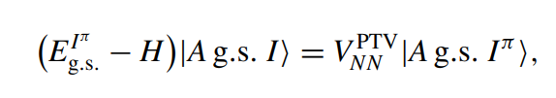

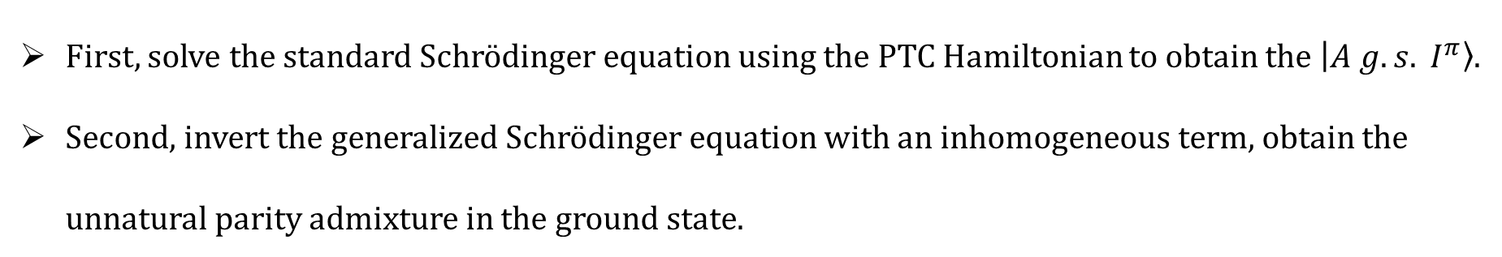
Reduce computation complexity
First, solve the standard Schrödinger equation using the PTC Hamiltonian to obtain the $\left|A g.s. I^{π}\right\rangle$.
Second, invert the generalized Schrödinger equation with an inhomogeneous term, obtain the unnatural parity admixture in the ground state.
The polarization contribution to the nuclear EDM is then calculated as,
$$D^{(pol)}=⟨A g.s. I^{π}|\frac{e}{2}\sum_{i=1}^{A}{\left(1+τ_{i}^{z}\right)z_{i}}|A g.s. I⟩+h.c.$$
Notes:
我们对带有非齐次项的广义薛定谔方程进行求逆，

Slide 10
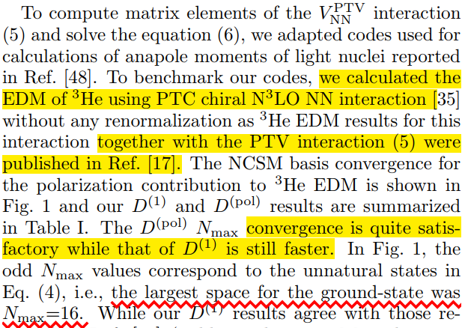
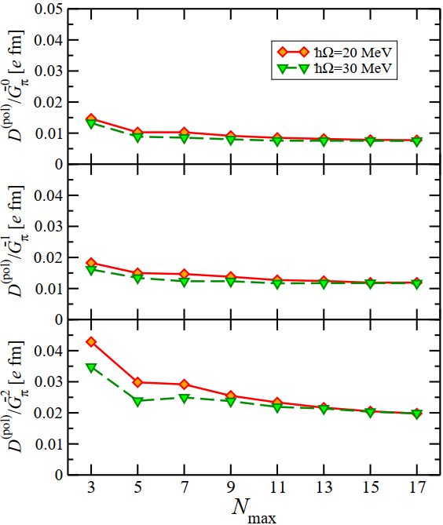
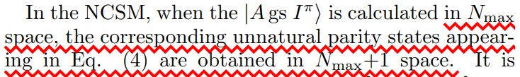
Results and Discussion
Notes:
原子与分子中单个量子态的精确控制和操纵技术的快速发展，极大地推动了量子信息、量子模拟以及量子水平化学反应探测等领域的进步.

Slide 11
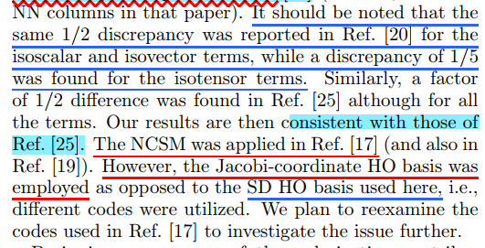
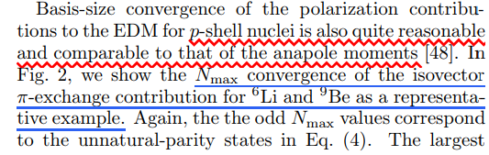
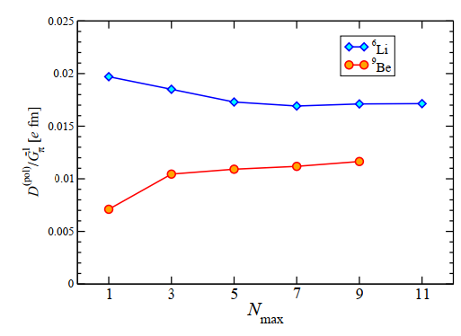
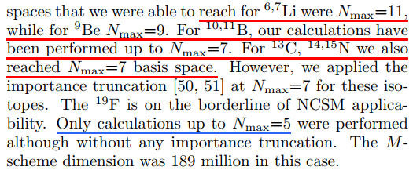
Results and Discussion
I. Stetcu, C.-P. Liu, J. Friar, A. Hayes, and P. Navratil, PLB 665, 168 (2008).
Notes:
原子与分子中单个量子态的精确控制和操纵技术的快速发展，极大地推动了量子信息、量子模拟以及量子水平化学反应探测等领域的进步.

Slide 12
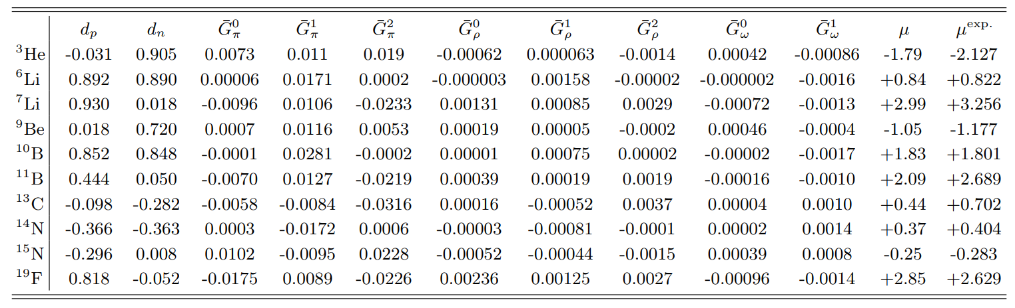

Results and Discussion
The comparison between the NCSM and cluster model results reveals three levels of agreement: purple indicates close agreement, blue denotes minor discrepancies, and red corresponds to differences within a factor of 2–4.
Notes:
原子与分子中单个量子态的精确控制和操纵技术的快速发展，极大地推动了量子信息、量子模拟以及量子水平化学反应探测等领域的进步.

Slide 13
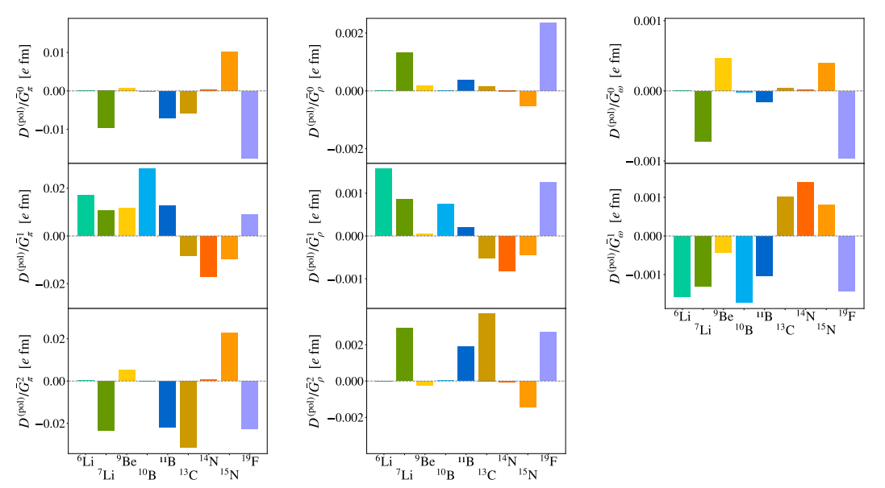

Results and Discussion

Slide 14
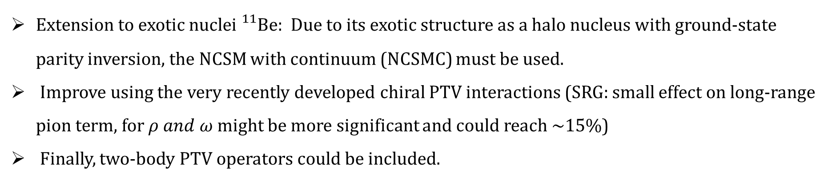
Conclusion and Outlook
Extension to exotic nuclei ${}_{}^{11}{Be}$: Due to its exotic structure as a halo nucleus with ground-state parity inversion, the NCSM with continuum (NCSMC) must be used.
Improve using the very recently developed chiral PTV interactions (SRG: small effect on long-range pion term, for $ρ and ω$ might be more significant and could reach ~15%)
Finally, two-body PTV operators could be included.
Using ab initio NCSM framework to calculates a series of light-nuclei, and systematically conducted various analyses on their EDMs.
These calculations allow us to better understand which nuclei may have enhanced EDMs, and thus allow us to suggest which ones may be good candidates in the search for a measurable permanent electric dipole moment.
Notes:
原子与分子中单个量子态的精确控制和操纵技术的快速发展，极大地推动了量子信息、量子模拟以及量子水平化学反应探测等领域的进步.

