Slide 1
Docker & Kubernetes

Slide 2
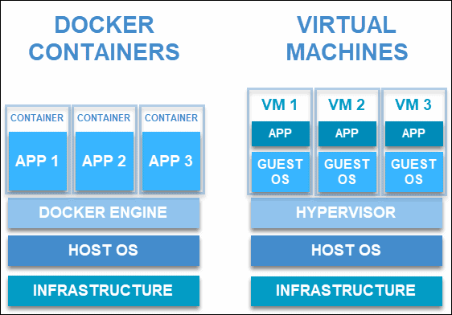
What is Docker
Docker is a containerization platform that packages your application and all its dependencies together in the form of a docker container to ensure that your application works seamlessly in any environment.
Why Docker:
VMs have its own OS, storage & I/O and uses hardware resources and hence they are heavy, not easily portable, lot of boot up time etc.
Dockers share host OS and resources and are light weight & provide better portability and speed.

Slide 3
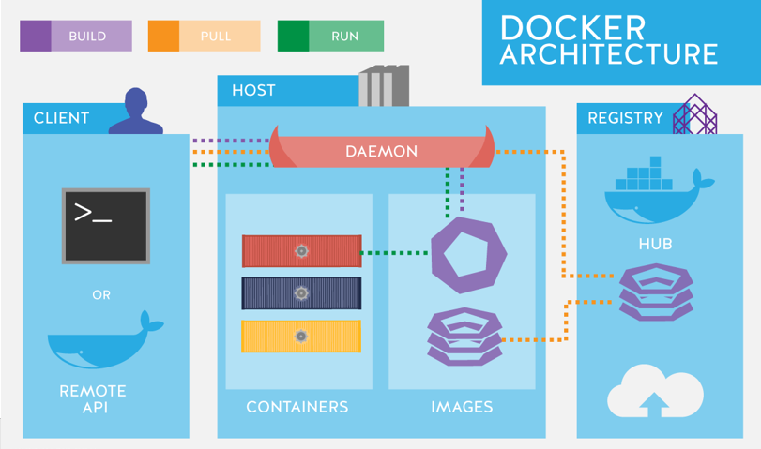
Docker Architecture :

Slide 4
Docker File : It is a text document that contains necessary commands which on execution helps assemble a Docker Image. Docker image is created using a Docker file.
Docker Image : It is a file used to execute code in a Docker container. They are a set of instructions used to create docker containers.
Docker Container : It is runtime instance of docker image, It virtualized environment that has system resources, It consists of application code, libraries, tools, dependencies and other files needed to make an application run.
Components of Docker

Slide 5
Docker Engine : The software that hosts the containers, Docker Engine is a client-server-based application
Docker Client : A command line interface client for interacting with the Docker daemon. It greatly simplifies how you manage container instances and is one of the key reasons why developers love using Docker.
Docker Server : A persistent background process that manages Docker images, containers, networks, and storage volumes. The Docker daemon constantly listens for Docker API requests and processes them.
Docker Engine REST API : An API used by applications to interact with the Docker daemon; it can be accessed by an HTTP client.
Docker Registries : Docker registries are services that provide locations from where you can store and download images. In other words, a Docker registry contains Docker repositories that host one or more Docker Images. Public Registries include Docker Hub and Docker Cloud
Components of Docker :

Slide 6
Docker installation on Linux
Step 1 - Before installing Docker, you first have to ensure that you have the right Linux kernel version running. Docker is only designed to run on Linux kernel version 3.8 and higher.
uname –a
Step 2 - You need to update the OS with the latest packages, which can be done via the following command
apt-get update
Step 3 - The next step is to install the necessary certificates that will be required to work with the Docker site on to download the necessary Docker packages.
sudo apt-get install apt-transport-https ca-certificates
Step 4 - The next step is to add the new GPG key. This key is required to ensure that all data is encrypted when downloading the necessary packages for Docker.
curl -fsSL https://download.docker.com/linux/ubuntu/gpg | sudo apt-key add -
Step 5 - Add the Docker repository to APT sources
sudo add-apt-repository "deb [arch=amd64] https://download.docker.com/linux/ubuntu bionic stable“
Step 6 - update the package database with the Docker packages from the newly added repo:
sudo apt update
Step 7 - sudo apt-get install –y docker-engine

Slide 7
Dockerizing application
Create a docker file
Build the image
Run as container

Slide 8
# syntax=docker/dockerfile:1
FROM golang:1.10
# Set the Current Working Directory inside the container
RUN mkdir /app
WORKDIR /app
COPY go.mod ./
COPY go.sum ./
RUN go mod download
COPY *.go ./
# Build the Go app
RUN go build -o go-sample-app .
# This container exposes port 8080 to the outside world
EXPOSE 8080
# Run the executable
CMD ["/go-sample-app"]
Docker file

Slide 9
Build the image: Docker build command is used to create docker image form docker file
docker build --tag go-sample-app .
docker image tag go-sample-app :latest go-sample-app :v1.0
Run the image to start the container
docker run -p 8081:8081 golang-docker-example

Slide 10
Basic Docker commands
docker images
docker pull hello-world
docker run -it ubuntu
docker logs ‘cont_id’
docker history ubuntu
docker ps
docker stop ‘cont_id’
docker rm ‘cont_id’
docker stat ‘cont_id’
docker pause ‘cont_id’
docker kill ‘cont_id’

Slide 11
KUBERNETES
CONCEPTS

Slide 12
OVERVIEW
Kubernetes is a container management technology developed in Google lab
It manage containerized applications in different kind of environments such as physical, virtual, and cloud infrastructure.
It is an opensource system which helps in creating and managing containerization of application.

Slide 13
What Problems Does Kubernetes solve
Trend from monolith to microservices
Increased usage of containers
Demand for managing proper way for hundreds of containers

Slide 14
Features of Kubernetes
High Availability
Scalability
Disaster Recovery

Slide 15
Kubernetes Components
Pod –Abstraction of Containers
Services –Communication
Ingress – Route Traffic into Cluster
Config Maps –External Configuration
Secrets
Volumes –Data Persistence
Deployment
Stateful Sets –Specifically useful for stateful applications like database

Slide 16
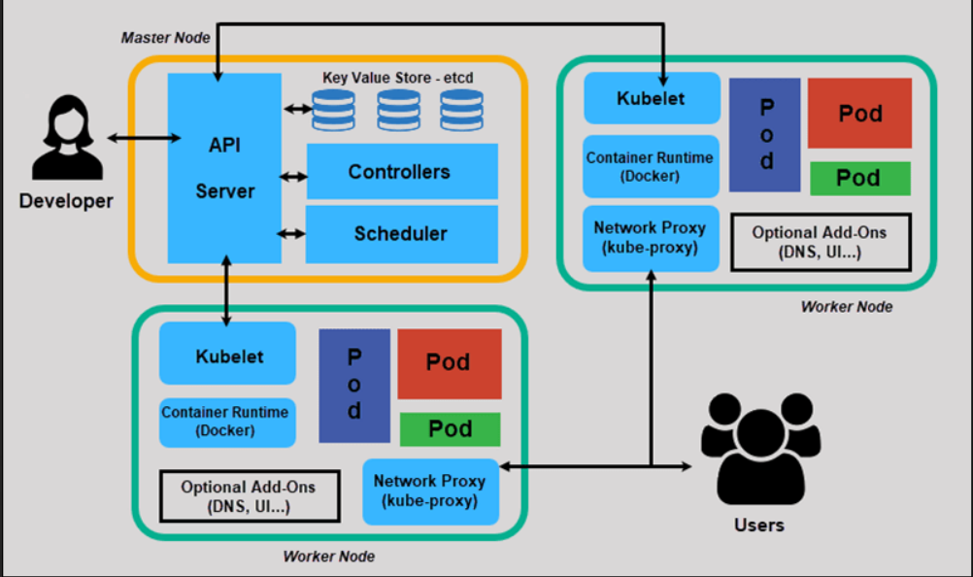
KUBERNETES ARCHITECTURE

Slide 17
Components of Master Node
ETCD
This component stores the configuration details and essential values
It communicates with all other components to receive the commands to perform an action.
Controller Manager
A daemon (server) that runs in a continuous loop and is responsible for gathering information and sending it to the API Server
The controller manager runs controllers to administer nodes and endpoints
The key controllers are the replication controllers, endpoint controller, namespace controllers, and service account controllers

Slide 18
Components of Master Node
Scheduler :
The scheduler assigns the tasks to the slave nodes
It is responsible for distributing the workload and stores resource usage information on every node
API Server :
Kubernetes uses the API server to perform all operations on the cluster
It is a central management entity that receives all REST requests for modifications, serving as a frontend to the cluster

Slide 19
Components of Worker Node
POD
A pod is one or more containers controlled as a single application
Pods are the smallest deployable units.
Docker Runtime
It helps run the applications in an isolated, but lightweight operating environment. It runs the configured pods
It is responsible for pulling down and running containers from Docker images

Slide 20
Components of Worker Node
Kubelet
Service responsible for conveying information to and from to the control plane service
It gets the configuration of a pod from the API server and ensures that the containers are working efficiently
Kubernetes proxy
Acts as a load balancer and network proxy to perform service on a single worker node
A proxy service that runs on every node that makes services available to the external host

Slide 21

Kubernetes Objects And Workloads

Slide 22
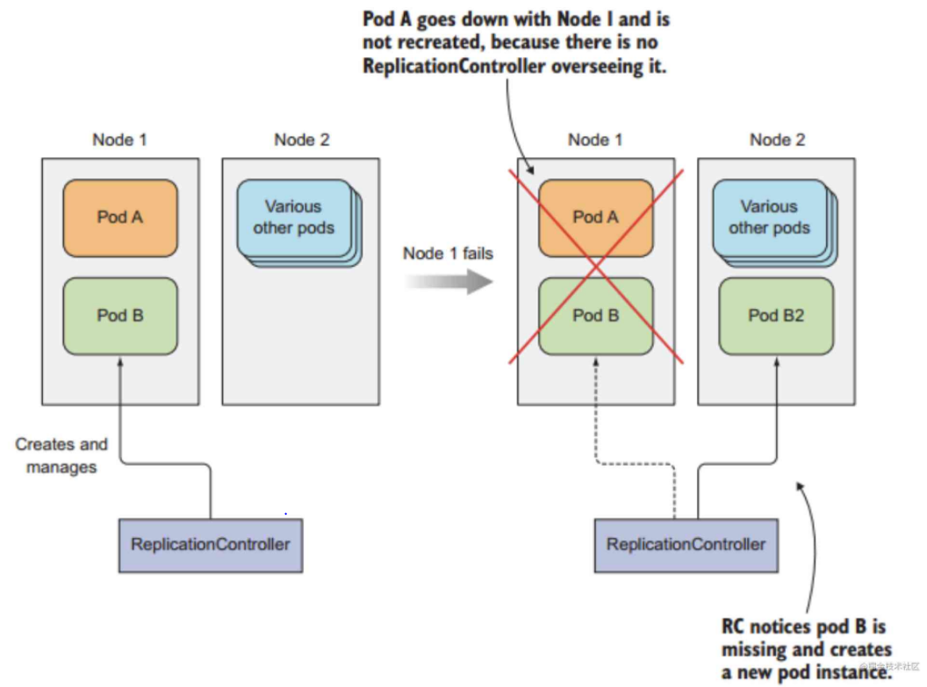
Replication Controller
Replication Controller is one of the key features of Kubernetes, which is responsible for managing the pod lifecycle.
It can also perform rolling updates to roll over a set of pods to a new version one by one, minimizing the impact on application availability.
It is responsible for ensuring that the number of pods deployed in the cluster matches the number of pods in its configuration.
It has the capability to bring up or down the specified no of pod.

Slide 23
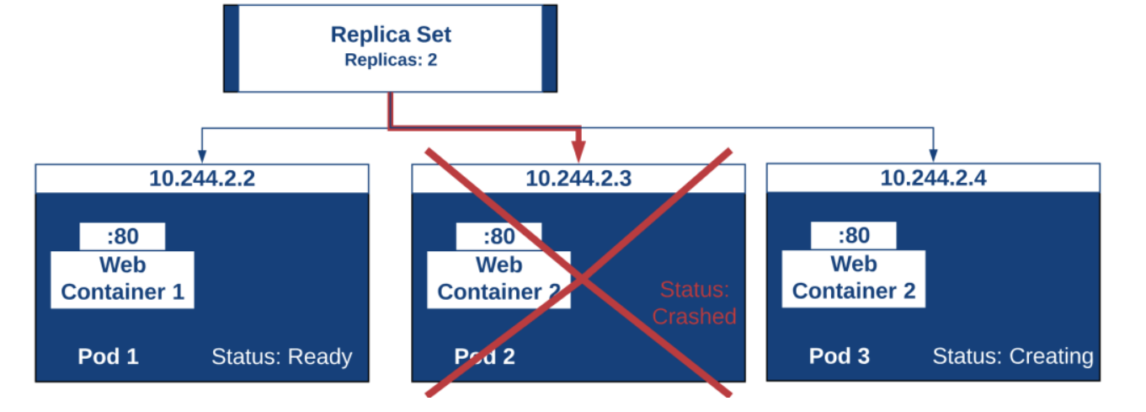
Replica Set
To maintain a stable set of replica pods running at any given time
To Guarantee the availability of identical pods

Slide 24
Deployment
Blueprint for application pods
Create deployment yaml’s
Abstraction of pods

Slide 25
Deployment
Deployments are one of the most common workloads to directly create and manage. Deployments use replication sets as a building block, adding flexible life cycle management functionality to the mix.
Deployments can be modified easily by changing the configuration and Kubernetes will adjust the replica sets, manage transitions between different application versions, and optionally maintain event history and undo capabilities automatically

Slide 26
Services
Permanent IP
Load Balancer

Slide 27
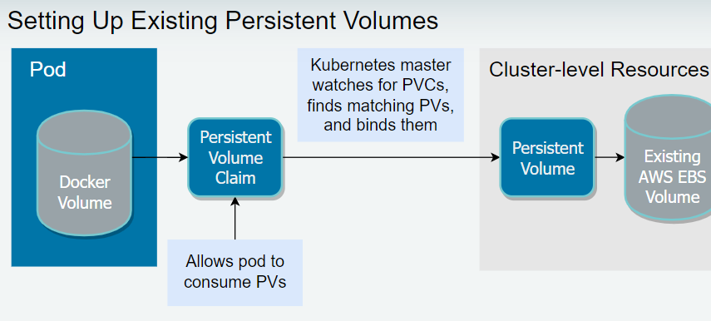
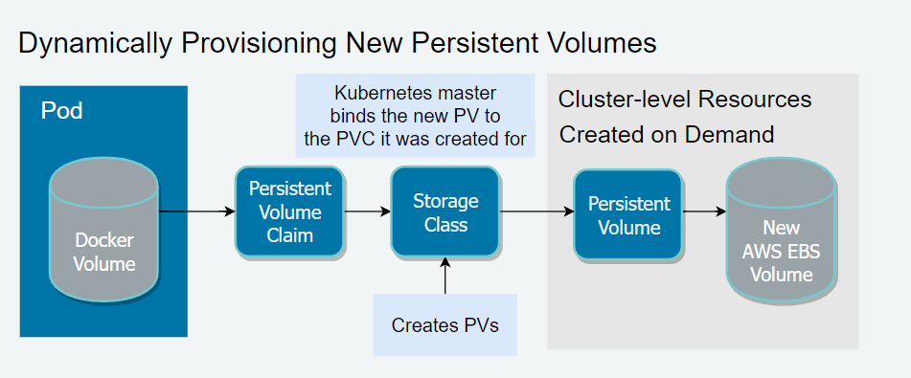
Kubernetes Volumes
Persistent Volume
PV is a piece of storage in a cluster that has been provisioned by an administrator or dynamically provisioned using storage class
Persistent volume is a solution to store data of a containers permanently even after the pods get deleted.
Persistent Volume Claim
Persistent Volume Claim is a request for storage by user.
PVC’s consumes PV Resources.
Claims can request specific size and access modes.

Slide 28
Docker Swarm vs Kubernetes
Category | Docker Swarm | Kubernetes
Scaling | No Auto Scaling | Auto Scaling
Load Balancing | Autoload Balancing | Manually configures load balancing
Installation | Easy and fast | Long and time-consuming
Scalability | Cluster strength is weak when compared to Kubernetes | Cluster strength is strong
Storage Volume Sharing | Shares storage volumes with any other container | Shares storage volumes between multiple containers inside the same pod
GUI | Not available | Available

Slide 29
THANK YOU

