Slide 1
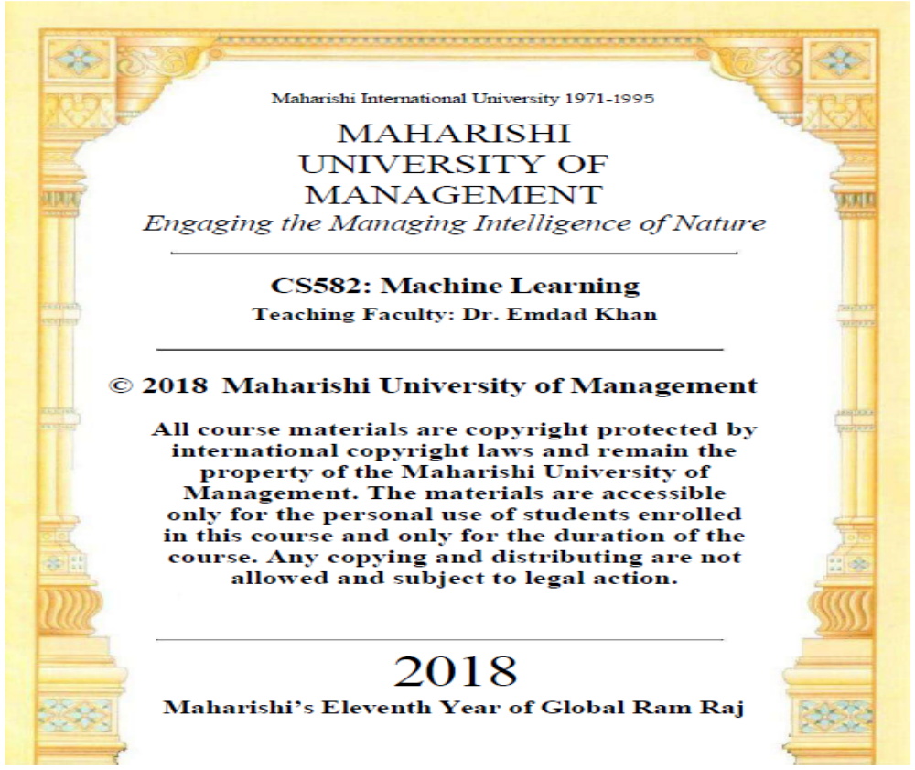

Slide 2
CS 582
Machine Learning: Getting Computers
to Program Themselves
“Discovering the Learning Dynamics of the Laws of Nature”
Lesson # 1 Introduction: ML Creates Programs using Data
Dr. Emdad Khan
ekhan@mum.edu
Dept. of Computer Science
Maharishi University of Management
Nov, 2018
Notes:
Quick-Sort

Slide 3
Overview: Machine Learning (CS 582)
A Core Course for Data Science, Big Data and AI
Connects Parts to the Wholeness of the Data Science / Big Data Program: Big Data, Data Analytics, Natural Language Processing, AI; ALSO connected to Algorithms, FPP, MPP, SWE, WAP, WAA,…..
  Direct use of Learning from SCI
Strong Connection to the Industry: Design, Implement, Test, Manage S/W,…
Essential for Growth: Solving Future Problems
Helping the Society and Leading to Prosperity
Knowledge, Action, Achievement and Fulfillment
Notes:
Quick-Sort

Slide 4
What is Machine Learning
Gives computers the ability to learn from data
Learn getting computers to program themselves
Traditional Programming
Program
Output
Data
Computer
Machine Learning
Data
Program
Output
(desired)
Computer
Notes:
Quick-Sort

Slide 5
Why Machine Learning - 1?
Rapidly Growing Need for Automation
  Computers & Internet have significantly changed our lives & society.
  Programming is the KEY for this.
  Hence Improving & automating “How to program” is VERY important.
  ML addresses this VERY important part.
We do NOT have good algorithms to solve Data Driven problems, for example, Regression, Classification and Clustering:
  Spam filtering.
  Detecting fraud transactions.
  Reliable Speech Recognition.
  Auto-driving of vehicles, …..
Notes:
Quick-Sort

Slide 6
Why Machine Learning - 2?
Algorithms may exist for some complex applications but they will take longer time to run and will be inefficient.
ML is also the key for Big Data as the data size is very large and complexity is very high; hence algorithms which may exist may run very inefficiently.
[NOTE – See “Machine Learning: Brief Overview” during today’s lab]
Notes:
Quick-Sort

Slide 7
Applications - 1
Many application areas - Software Engineering, Internet, Healthcare, Financing, Engineering, Automotive Industry, Physics, Biology, Bioinformatics, Meteorology, Economics, Education,……
-
Macy's Inc. and real-time pricing. The retailer adjusts pricing in near-real time for 73 million (!) items, based on demand and inventory, using technology from SAS Institute.
Notes:
Quick-Sort

Slide 8
Applications - 2
  Wal-Mart Stores Inc. and search. The mega-retailer's latest search engine for Walmart.com includes semantic data. Polaris, a platform that was designed in-house, relies on text analysis, machine learning and even synonym mining to produce relevant search results. Wal-Mart says adding semantic search has improved online shoppers completing a purchase by 10% to 15%. "In Wal-Mart terms, that is billions of dollars," Laney said.
Google Self Driving Car
Google Self Driving Car -
Notes:
Quick-Sort

Slide 9
What is Data Science - 1
Data science, is an interdisciplinary field of scientific methods, processes, algorithms and systems to extract knowledge or insights from data – structured, unstructured or mixed data.
Data is growing very fast – about 2 exa bytes (10^18) per day (so called Big Data).
There are multiple issues with big data including storage, search, transfer, sharing, analysis, processing, viewing, deriving meaning / semantics & extracting knowledge & intelligence.
Notes:
Quick-Sort

Slide 10
What is Data Science - 2
Addressing these key issues brings Challenges & Opportunities!
Data Scientists are the key to address all Data Science needs!
Hence, the need for Data Scientists is growing very Fast!
ML is a Key Component of Data Science as ML Learns from data, Extract knowledge and Solves Complex Problems.
Notes:
Quick-Sort

Slide 11
Roles & Responsibilities of a Data Scientist - 1
Data scientists are responsible for discovering insights from massive amounts of structured and unstructured data to help shape or meet specific business needs and goals.
The data scientist role is becoming increasingly important as businesses rely more heavily on data analytics to drive decision-making and lean on automation and machine learning as core components of their IT strategies.
Data scientist must have enough business domain expertise to translate company or departmental goals into data-based deliverables such as prediction engines, pattern detection analysis, optimization algorithms, and the like.
Notes:
Quick-Sort

Slide 12
Roles & Responsibilities of a Data Scientist - 2
Big Data have 2 Broad Types – Structured & Unstructured.
Structured data is organized, typically by categories. So, it is easier for a computer to sort, read and organize such data automatically. This includes data collected by services, products and electronic devices, but rarely data collected from human input.
Unstructured data, the fastest growing form of big data, is more likely to come from human input — customer reviews, emails, videos, social media posts, etc. This data is typically more difficult to sort through and less efficient to manage with technology.
Typically, businesses employ data scientists to handle mainly this unstructured data, although some companies still focus more on structured data.
Data Scientists spend 80% of the time on Data Preparation!
Notes:
Quick-Sort

Slide 13
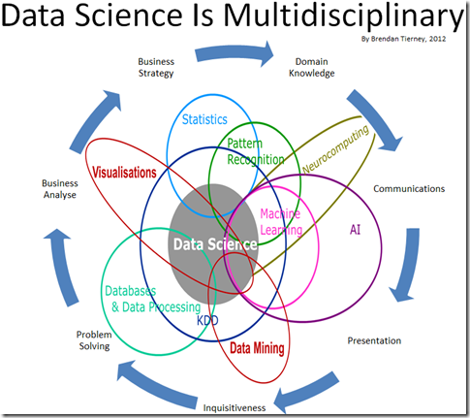
DS is Multi Disciplinary
Notes:
Quick-Sort

Slide 14
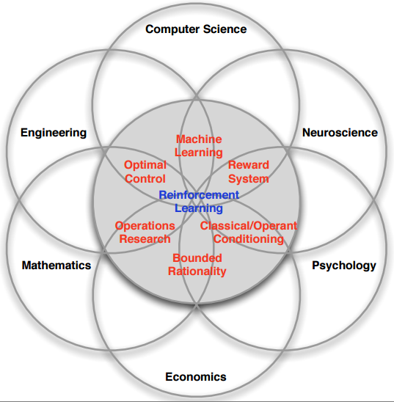
CS, DS & Other Sciences
Notes:
Quick-Sort

Slide 15
Why ML, AI, DS & CS Started Growing Fast - 1
Data growing very fast (two exa [10^18] bytes a day as already mentioned).
More computing capabilities.
More storage.
More networking capabilities.
Computing moving to mobile devices!
More users are getting to the Internet and increasingly using more time.
This trend will continue for a long time!
Notes:
Quick-Sort

Slide 16
Why ML, AI, DS & CS Started Growing Fast - 2
More automation helping many businesses from multiple perspectives – better product, better tracking, better customer support,…
New Computing Methods / Infrastructure – Cloud Computing.
Internet of Things (IoTs).
People can interact with computing machines in a more natural way via speech and Natural Language Processing.
This trend will continue for a long time!
Notes:
Quick-Sort

Slide 17
How ML Relates to Your Future - 1?
You will be working on Software and Programming.
Many complex problems & data driven applications need ML today.
With the rapid growth of Big Data / Data Science, applications needing ML is growing very rapidly!
Thus, ML will help you in the following ways:
  Higher chance to get jobs more quickly
  Higher salary
  Broader range of industries and companies
  Rapid Future growth, especially when you also take S/W Engg., WAP, WAA, EA,..
  Enable yourself to become an entrepreneur & innovator
Notes:
Quick-Sort

Slide 18
How ML Relates to Your Future - 2?
ML, Big Data, AI & Natural Language Processing are hot areas.
“A breakthrough in machine learning would be worth ten Microsofts” (Bill Gates, Microsoft)
Notes:
Quick-Sort

Slide 19
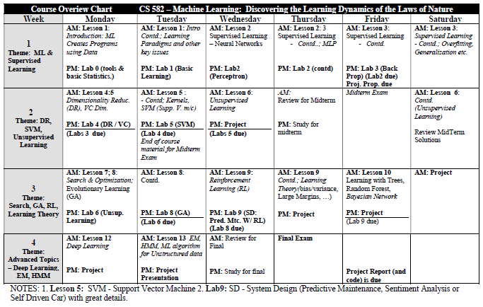
Course Overview Chart
Notes:
Quick-Sort

Slide 20
Course Objectives - 1
Develop skill in designing systems that can learn from data.
Develop the ability to understand the core Machine Learning algorithms and learn how to use such algorithms in practical applications.
Learn how to evaluate learning & generalization capabilities, and efficiency of Machine Learning algorithms.
Notes:
Quick-Sort

Slide 21
Course Objectives - 2
Develop the ability to determine the type of ML algorithms to be used for various applications.
Be able to read current ML related research papers and understand the issues.
Become acquainted with the self-referral transcendental foundation of all computation both on a theoretical and experiential level
Notes:
Quick-Sort

Slide 22
Course Description - 1
ML gives computers the ability to learn from data & is at the heart of almost every scientific discipline, and the study of generalization (that is, prediction) from data is the central topic of machine learning.
This course gives a graduate-level introduction to machine learning and in-depth coverage of new and advanced methods in machine learning, as well as their underlying theory.
Notes:
Quick-Sort

Slide 23
Course Description - 2
Recent applications such as Data Mining (in Big Data / Data Science, Data Analytics), Natural Language Processing, Computer Vision, Robotics, Bioinformatics and Text and Web data processing.
Various industries including Financial Services, Oil & Gas, Health Care, Marketing & Advertising, Government, Internet and Internet of Things.
Notes:
Quick-Sort

Slide 24
Course Description - 3
Variety of learning paradigms, algorithms, theoretical results and applications.
Topic include: Supervised learning (generative/discriminative learning, parametric/non-parametric learning, neural networks, support vector machines, decision tree, Bayesian learning & optimization)
Notes:
Quick-Sort

Slide 25
Course Description - 4
Unsupervised learning (clustering, dimensionality reduction, kernel methods);
Reinforcement learning and adaptive control.
HMM (Hidden Markov Model), Evolutionary Computing, Deep Learning
An important part of the course is a group project.
Notes:
Quick-Sort

Slide 26
Group Project -1
30% of your grade
A good project would be
  one that applies one or more machine learning algorithms covered in class, in novel ways to a dataset.
  one that applies one or more machine learning algorithms NOT covered in class.
An excellent project is a research project that will result in a paper at a major conference
The project will provide you with a unique opportunity for exploring one or more areas of machine learning.
Notes:
Quick-Sort

Slide 27
Group Project - 2
Some examples of ML algorithms partially covered / Not covered in the class are:
  Recurrent Neural Networks
  LSTM
  Swarm Intelligence
  Random Forest
  Graphical models,
  Hidden Markov Model
  Deep Learning
Notes:
Quick-Sort

Slide 28
Group Project - 3
Can tie the project to your research project or a fun application, you are strongly encouraged to do so.
If so, can use algorithms that we have covered in the class or any other algorithms. However, you should be able to demonstrate novelty.
Notes:
Quick-Sort

Slide 29
Group Project – Deliverables - 1
Proposal (Friday, first week of the class). 10% of your project grade – see the format below.
A video and / or slides of your talk (Tuesday of 4th week). 30% of your project grade.
A paper describing your work (Due Friday of 4th week). 30% of your project grade.
Notes:
Quick-Sort

Slide 30
Group Project – Deliverables - 2
Code and scripts (Due Friday of 4th week). 30% of your project grade.
Refer to the Syllabus doc for sample projects, project reports and other issues related to your projects.
Notes:
Quick-Sort

Slide 31
Teaching, Learning and Interaction
Very Interactive - to ensure effective teaching and learning
[Related to Moharishi’s Principles of Ideal Learning - Reception, Intelligence, Knowledge, Experience (examples, labs), Expressions – how you express what you learned]
2. Highly encourage to ask questions. Unless it is a burning question, wait until a critical part of a topic is explained
3. Think of new (similar) problems for algorithm / topic covered
(a good way to learn)
4. Group discussion, especially in the lab
5. 3 types of questions, problems etc:
- easy - medium - reasonably difficult
(to challenge your thinking, to help learn more….)
6. Will Use Industry Examples Frequently to ensure better Learning
Notes:
Quick-Sort

Slide 32
Class Schedule and Grading
Text Book
1. The strongly recommended text for the course is Machine Learning: An Algorithmic Perspective, by Stephen Marsland (2nd Edition, 2015), available through Amazon and Barnes and Noble.
Grading
1. Mid Term - 30%
Final - 30%
Project – 30%
Lab (Group work), attendance, class participation – 10%
Consciousness-Based Education
- Develop Full Potential, Integrate Subjective & Objective
- Proper Use of TM
Academic Honesty is Very Important
Notes:
Quick-Sort

Slide 33
WHOLENESS OF THE LESSON
Machine learning (ML) provides computers the ability to learn without being explicitly programmed. Machine learning focuses on the development of computer programs that can teach themselves to grow, reconfigure and change when exposed to new data. Algorithms that are used for computation / programming address only a tiny set of all problems in nature. Thus, for many problems algorithms do not exist. ML tries to develop models / programs to solve problems that algorithms cannot address. However, ML based approach also addresses only a tiny set of all problems in nature. The full range of Nature’s computational power is too vast to be grasped by the intellect alone.
Science of Consciousness: Transcendental Meditation (TM) allows one to easily reach the state of pure creative intelligence from where the un-manifest abstract ideas and thoughts may be efficiently converted into the fully expressed useful values and objects.

Slide 34
What is Learning - 1?
What is Learning?
  The acquisition of knowledge or skills through experience, study, or by being taught.
How humans learn?
  We mainly learn from experience.
  Remembering, adapting and generalizing are key parts of human learning.
How machines can learn?

Slide 35
What is Learning - 2?
What is Machine Learning (ML)?
  Making computers modify or adapt their actions i.e. (as defined before)
  Gives computers the ability to learn from data
  Learn getting computers to program themselves
Thus, ML today does only a small part of what humans / animals can do.
Our goal is to borrow as much as we can from human learning process.

Slide 36
Machine Learning is Prediction - 1
Consider an example – a website selling some software
You want to make the website more personalized to the user
So you start to collect data about visitors, such as their computer type/operating system, web browser, the country that they live in, and the time of day they visited the website
So you have some data like computer type, web browser, time, software bought etc

Slide 37
Machine Learning is Prediction - 2
So, you like to populate a ‘Things You Might Be Interested In’ box within the webpage
Such data will provide some key information about the type of products some types of users would buy
Once a large set of such data is collected, you can use some ML algorithm to learn and then test it, and once comfortable, you can start making predictions about how new users would buy your products
Thus, learning about user’s buying pattern can help make predictions about future sale!

Slide 38
ML in Nutshell
Thus, ML is basically making computers modify or adapt their actions:
prediction, controlling a robot, making a decision and the like
using data as the key source of learning

Slide 39
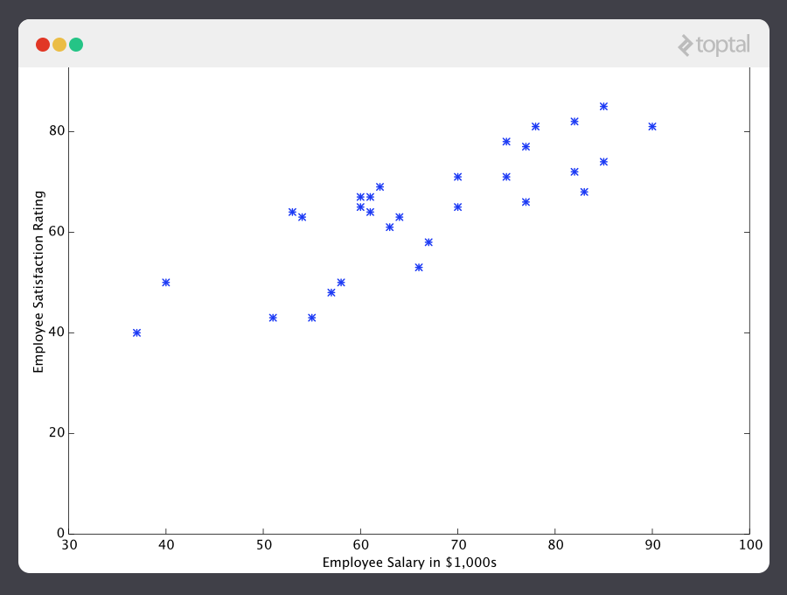
Regression - 1

Slide 40
Regression - 2
How do we find a value for say x = 45? The data for x = 45 is not provided in the given dataset.
Well, somehow we need to come up with a function that can represent or model these data well – this means for any input value of x, the equation will predict a very good output.
This is known as Regression in statistics.
Question is “How do we come up with such a model i.e. how do we find the equation that can fit the data well?”

Slide 41
Regression - 3
One common approach is to use some known mathematical function that will fit the data.
For the given data, we can use a straight line approximation as a good start.
A general equation for such a straight line is
y(x) = mx + c where m is the slope and c is the intercept.
Let’s start with y(x) = 0.2x + 12 (graph next page)

Slide 42
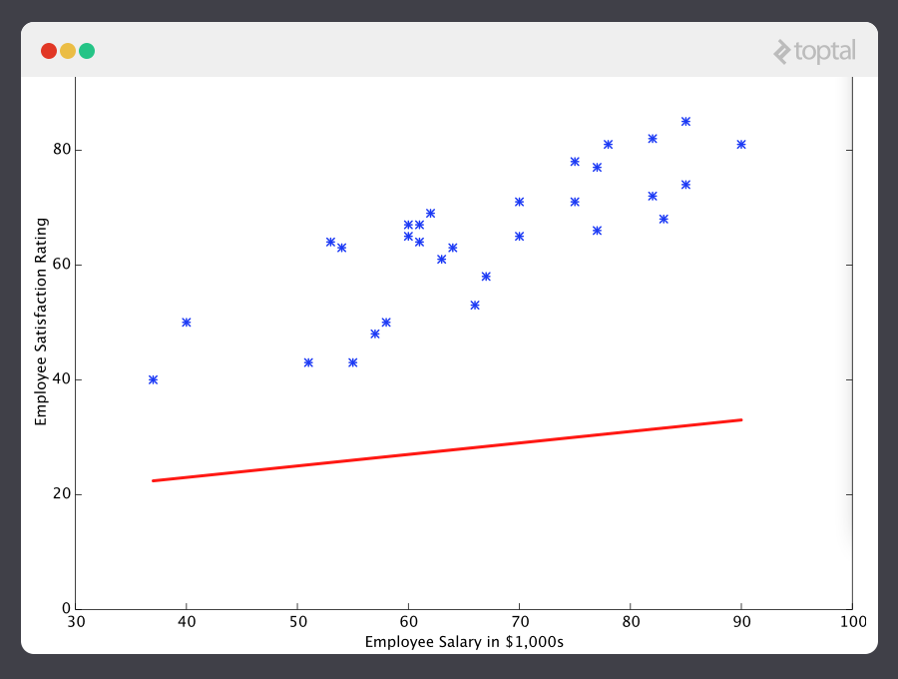
Regression - 4
Large error (Initial values for m and c are not good).
Take the error i.e. differences between the predicted and the actual value (-ve in this case). So, increase m and c a bit and try again.

Slide 43
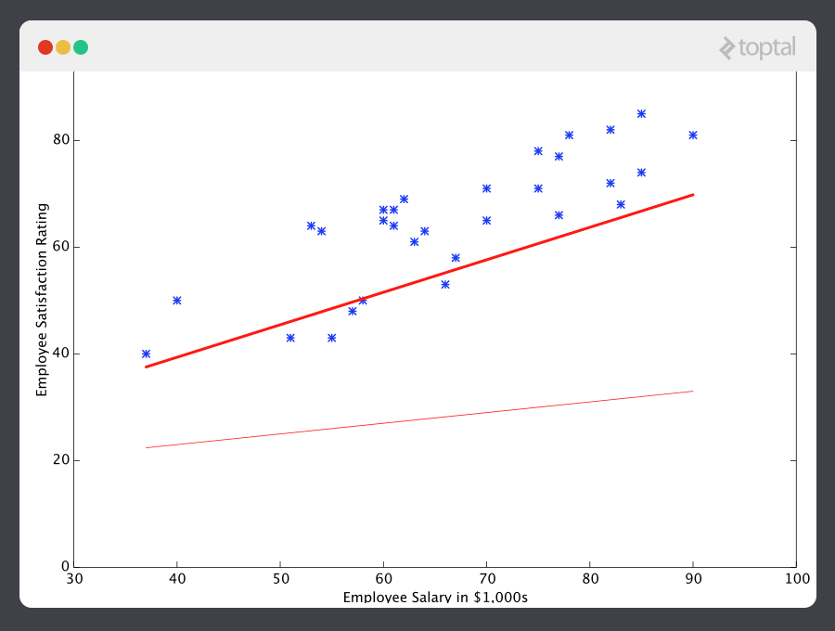
Regression - 5
Less error after one iteration (i.e. improving m and c)

Slide 44
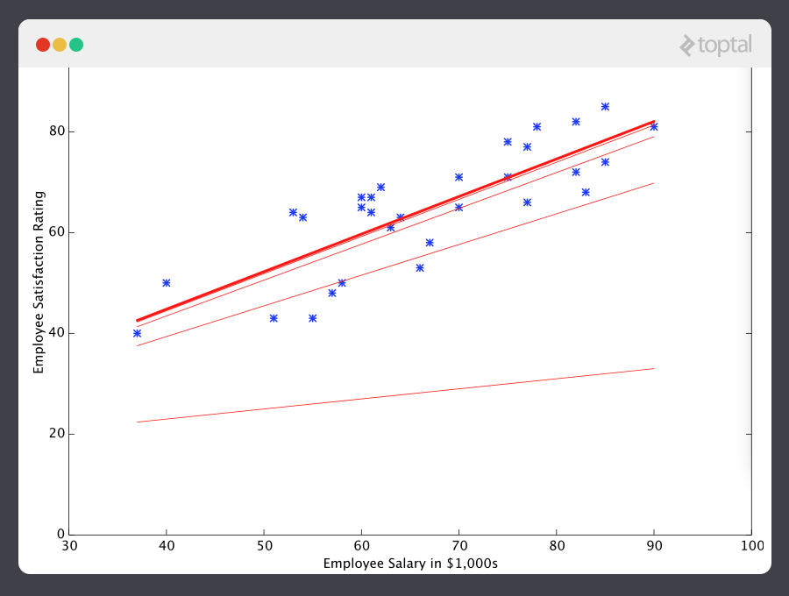
Regression - 6
Final line (solid) after several iterations (i.e. improving m and c) y(x) = 0.75x + 15.54

Slide 45
How Learning is Done?
Clearly, Learning in this case is determining m and c that will produce minimum total error.
How do we select such m and c in a general way? In above, we have incrementally changed them for each iteration with some simple logic.
There are various approaches and algorithms for ML. It is a multi-disciplinary area – Neuroscience, biology, statistics, mathematics and physics.

Slide 46
Simple Learning Algorithm
Consider our Linear Regression example.
How do we select such m and c?
Intuitively what can we do to compute m & c?
Let’s use basic math to do so. Then we will relate it to other techniques.

Slide 47
Basic Math for Linear Regression - 1
One approach is to guess various values for m and c, calculate corresponding errors for each m and c combination, and then find out the m and c combination that produce the minimum error. This is Brute force and hence not smart.
A better approach is to use some reasoning and mathematics:
  When error is at minimum level (after some iterations), there will be no change in error if we continue computation.
  So, we can use derivative of the error with respect to m and c to find their optimal values

Slide 48
Basic Math for Linear Regression - 2
This is the approach that was taken originally in 1700s.
Let ε² = error² = Σ (y_{i} - y_{p})² …………………….(1)
where y_{p} = predicted value when x = x_{i}, and y_{i} = experimental value when x = xi (using square of the errors help us to avoid +Ve and –Ve sign of errors)
Let y_{p} = m x_{i} + c ………………………..(2)

Slide 49
Basic Math for Linear Regression - 3
Combine (1) and (2), and expand:
ε² = Σ (y_{i} - m x_{i} - c)²
ε² = Σ (m²x_{i}² + 2mcx_{i} - 2mx_{i}y_{i} + c² – 2cy_{i} + y_{i}²)
Now use differentiation to find the optimal values of m and c –
dε² / dm = 0 and dε² / dc = 0
(Show the details in class)

Slide 50
Basic Math for Linear Regression - 4
Using simpler notations like Sx = Σ x_{i}
Sy = Σ y_{i ,} Sxy = Σ (x_{i}y_{i}) , Sxx = Σ (x_{i}²) and
nc = Σ c, we have,
m = (n Sxy - Sx Sy) / (n Sxx - Sx Sx )
And c = (Sy - m Sx) / n
(details to be shown in class)

Slide 51
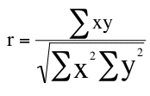
Relating Math Derivation to Statistics
m = r s_{Y}/s_{X} and c = M_{Y} - mM_{X}.
where Sx, the standard deviation of x, Sy is standard deviation of y, Mx is the mean of x, My is mean of y and r is the correlation between X and Y.
Mean is defined as Sum(x) / n i.e. Sx /n for x; Sum(y) / n i.e. Sy/n for y.
Standard Deviation for x is defined as sqrt[Sum (x – Mx)^2 / (N-1)] where the term under the sqrt is the mostly used equation for the variance (i.e. when sample is used in to estimate the variance in a population).
r is defined as
^{[More on this in the Lab]}

Slide 52
On Complexity - 1:
The linear regression example shown is very simple.
In general, there are several variables – for both inputs and for outputs.
Consider a single output but several inputs with nonlinearity
Here h is same as y. There are 4 variables – x1, x2, x3 and x4.

Slide 53
On Complexity - 2:
Deriving a solution for this function is a significant challenge.
Many modern machine learning problems take thousands or even millions of dimensions of data to build predictions using hundreds of coefficients.
Predicting how an organism’s genome will be expressed, or what the climate will be like in fifty years, are examples of such complex problems.

Slide 54
Which Approach to Use?
Clearly, we cannot use equations as solutions are not available for complex cases.
Moreover, we may not even have equations for many complex systems – e.g. (Auto Driving cars)
So, we sure need ML and iterative approach to learn! (very successful in solving data driven problems)
This is the reason use of ML is growing so fast!
And use human / biological approach when possible to make it more capable & effective!

Slide 55
Classification
Instead of predicting a particular value as used in Regression, Classification allows to classify an input into a class of say N classes.
The most important point in classification is that it is “discrete” – each example belongs to a one class. The set of classes covers the whole set of output space.
Examples: Coin Classification needed in a vending machine or handwriting recognition where each handwritten character is classified to one letter or character.
Some sample features in doing classification: diameter, weight, shape for coin classification; eyes, nose, mouth, eyebrows for face recognition.

Slide 56
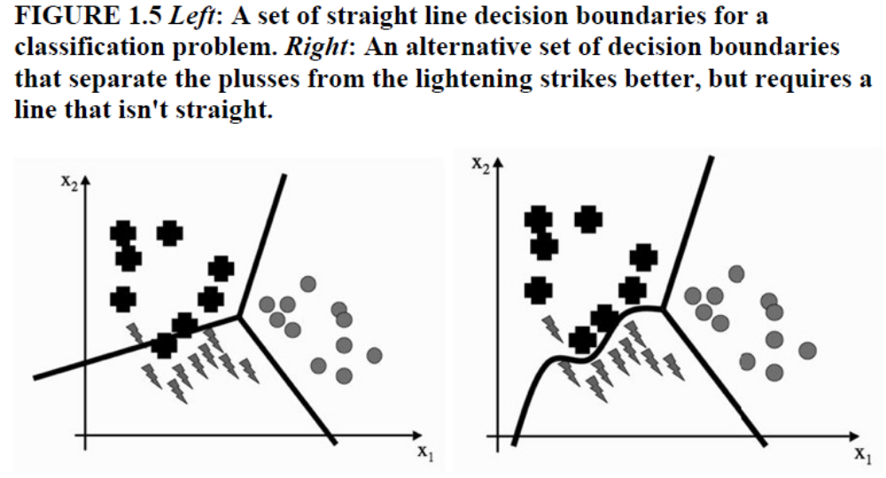
Classification

Slide 57
Supervised Learning
Use initial dataset that has both input and corresponding outputs (or targets) – this is called Supervised Learning as it is guided or supervised by the target data.
Regression (Prediction) and Classification are good examples of Supervised Learning.
Many applications fall under Regression and Classification (so we will use these a lot).
There are other types of learning (to be covered in the next slides).

Slide 58
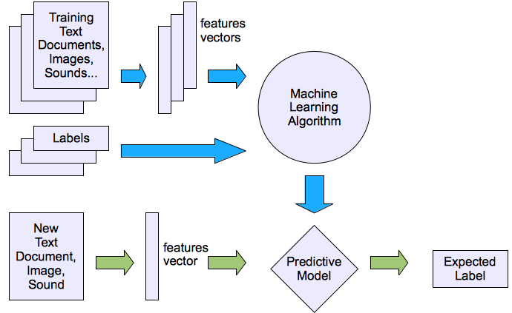
Machine learning structure
Supervised learning

Slide 59
Types of Machine Learning
Supervised Learning (already covered).
Unsupervised Learning: Input data but with no target / output data. The algorithms tries to find similarities between input data and group them into different classes or categories.
Reinforcement Learning: This is somewhere between Supervised and Unsupervised Learning. The algorithm gets told when the answer is wrong but does not get told how to correct it.
Evolutionary Learning: Biological evolution can be seen as a learning process. Biological organisms adapt to improve their survival rates and chance of having offspring.
We will discuss all these in details throughout the course.

Slide 60
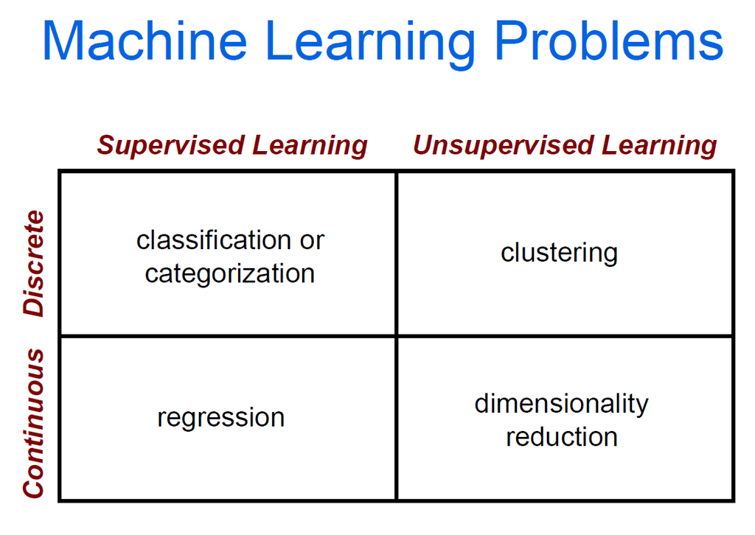


Slide 61
ML Algorithm Strategy
When possible we will try to use biological approaches / algorithms to ensure more capable & efficient learning. It is dominated by 2 approaches:
  Neural Networks
  Evolutionary Learning
There are various mathematical techniques we will use along with Biological Approaches.
In non-biological approach, we will use various techniques. It is dominated by Statistical approach / algorithms.

Slide 62
Machine Learning Process
Data collection and preparation
Feature Selection
Algorithm Choice
Parameter and Model selection
Training
Evaluation

Slide 63
Some Issues to Think About
What type of input data will ensure better learning?
How can we better mange / optimize minimizing the errors?
Can the error be zero?
What is a good learning?
What is generalization?
How can we ensure “good” generalization?
What happens when derivatives do not exist?
More…(e.g. can Deep Learning do all the magic?)

Slide 64
Some Very Hard Problems for ML
Can Machine learn everything?
Learning Natural Language (and associated Semantics) is not possible yet. So, the following problems are difficult for ML:
  Long Conversation
  Summarization
  Drawing Inference
  Question Answering
Can Machine Think?

Slide 65
Whole, Parts & Integrative Learning
World
Peace.
Global
Dev.
Econ.
AI
DS
More
Biolo.
ML
More
S/W
Web App
Astro.
Internet
Higher Level of Consciousness, Unified Field

Slide 66
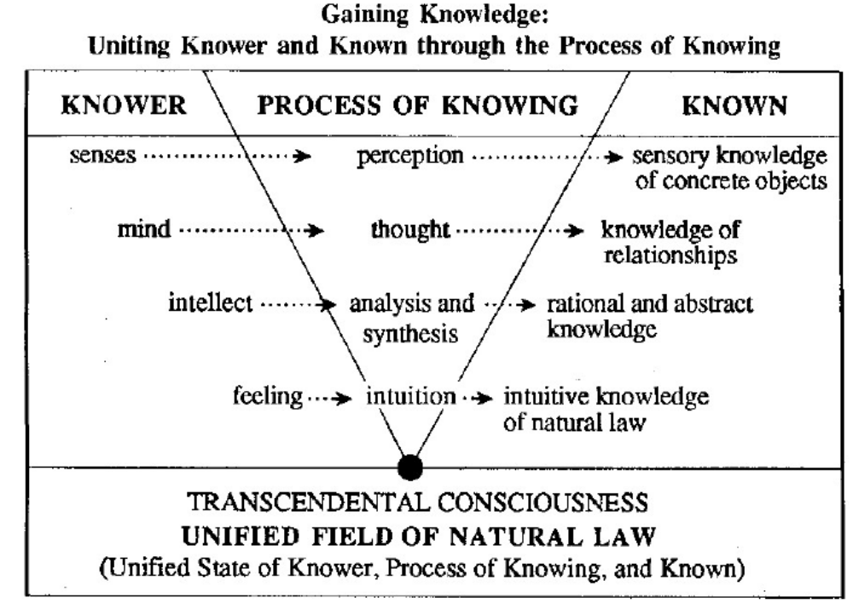
Higher Level Consciousness & Gaining Knowledge

Slide 67
MAIN POINTS
1. Machine learning (ML) provides computers the ability to learn without being explicitly programmed. Machine learning focuses on the development of computer programs that can teach themselves to grow, reconfigure and change when exposed to new data.
Science of Consciousness: Transcendental Meditation (TM) allows one to reach the pure consciousness state easily and thus enables to become very intelligent. Unbounded awareness enables to use Total Natural Law to easily and efficiently solving problems and helping the society.

Slide 68
MAIN POINTS
2. Machine Learning addresses simple, complex and very complex problems. Simple problems include Regression, Classification (Predictive Maintenance, Classifying pictures); Complex problems include doing Search (Auto driving car, Speech Recognition); and very complex problems include complex Decision Making, Understanding human language (Semantics, Question Answering, Summarization, Drawing Inference), Thinking capability.
Science of Consciousness:
Scientific research on students practicing TM shows holistic improvement in intellectual performance, personality and individual differences [1] and improved graduate academic performance [2].

Slide 69
MAIN POINTS
3. Major machine learning types are Supervised, Unsupervised, Reinforcement and Evolutionary. - Supervised Learning: It is done with input data and some target / output data (like using a teacher). The ML algorithm tries to learn to match the input to the output.
- Unsupervised Learning: Input data but with no target / output data. The algorithms tries to find similarities between input data and group them into different classes or categories.
- Reinforcement Learning: This is somewhere between Supervised and Unsupervised Learning. The algorithm gets told when the answer is wrong but does not get told how to correct it.
- Evolutionary Learning: Biological evolution can be seen as a learning process. Biological organisms adapt to improve their survival rates and chance of having offspring.
Science of Consciousness: Regular practice of TM is the key to reach higher level consciousness, namely, Cosmic, Refined Cosmic and Unity Consciousness. Reaching such higher states of consciousness is the key to gain complete knowledge and intelligence to clearly understand and solve all problems.

Slide 70

UNITY CHART
THE SELF-REFERRAL BASIS OF COMPUTATION
1. Computation in computer science is represented by sequential procedures.
2. Machine Learning (ML) develops models / programs by learning from data to solve some problems for which appropriate sequential procedures cannot be expressed / computed by algorithms.
__________________________________________________
3. Transcendental Consciousness is the field of pure unbounded silence, beyond the active field of Nature’s computation.
4. Impulses Within the Transcendental Field. The hidden self-referral dynamics within the field of pure intelligence, on the ground of pure silence, give rise to the perfectly orderly unfoldment of creation.
5. Wholeness Moving Within Itself. In Unity Consciousness, one appreciates the flawless unfoldment of life and existence as the lively impulse of one’s own pure consciousness.

