Slide 1
Clustering “Grouping similar objects”
Dr Yves Matanga

Slide 2
Outline
Clustering
Theory and Practice

Slide 3
Learning Systems
A learning system is one that discovers hidden structures that exists in the data through an intelligent search or mining of the data.
The are three main types of learning systems:
Supervised learning
Unsupervised learning
Reinforcement learning

Slide 4
Supervised learning
Supervised learning is the process of learning the existing relationship f that exists in labelled data (existing input output pair).
Y = f(X)
x1 | x2 | Y (label)
123.5 | 45.6 | 0.1
145.6 | 34.5 | 0.23
345.3 | 32.1 | 0.4
… | … | ..
12.3 | 12.4 | 0.45
123.5 | 34.6 | 0.63
In labelled data, the target output or attribute is known

Slide 5
Supervised learning (1)
House price estimator
Career recommendation system
House size (m2) | Number of bedrooms | .. | Price (R)
125 | 2 | .. | 350000
400 | 3 | .. | 450000
350 | 2 | .. | 400000
… | … | .. | ..
901 | 4 | .. | 2100000
1230 | 5 | .. | 3200000
Maths score | APS | .. | Career
7.5 | 21 | .. | Engineering
7 | 25 | .. | IT
9 | 22 | .. | Maths
… | … | .. | ..
9 | 28 | .. | Physics
6.5 | 24 | .. | Psychology

Slide 6
Unsupervised learning
Unsupervised learning is the process of learning hidden structures that exists in unlabelled data (no existing input output pair).
Y = f(X)
x1 | x2 | x3
123.5 | 45.6 | 0.1
145.6 | 34.5 | 0.23
345.3 | 32.1 | 0.4
… | … | ..
12.3 | 12.4 | 0.45
123.5 | 34.6 | 0.63
In unlabelled data, the target output is unknown. Relationships in the data must be modelled.

Slide 7
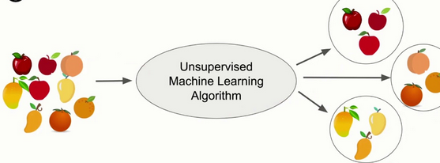
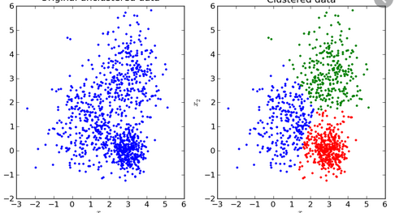
Unsupervised learning (2)
The algorithm has to discover some hidden structure from the unlabelled data

Slide 8
Reinforcement learning
Reinforcement learning is the dynamic process of learning the best course of action based upon feedback or reward.
x1 | x2 | r
123.5 | 45.6 | +0.1
145.6 | 34.5 | -0.1
345.3 | 32.1 | +0.2
… | … | ..
12.3 | 12.4 | +0.14
123.5 | 34.6 | -0.63
For every action taken there is feedback that helps improve the strategy

Slide 9
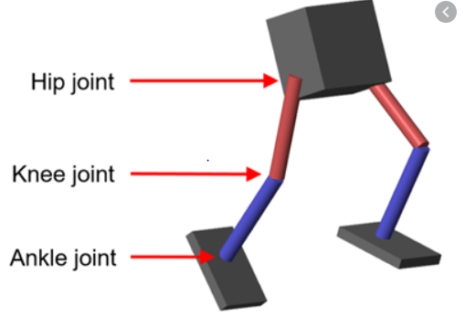
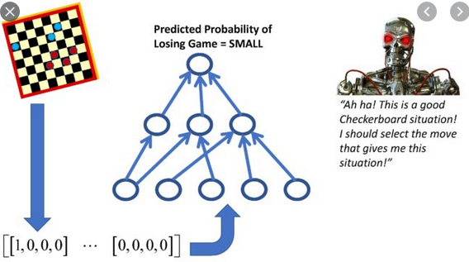
Reinforcement learning
Learning how to walk
Self improving computer players

Slide 10
Clustering
Clustering is an unsupervised learning approach that aims to group unlabelled data records in classes based upon a discovered hidden pattern. In other terms, it is unsupervised technique to group similar objects.

Slide 11
Clustering: Characteristics
Unsupervised: The data scientist does not determine in advance the labels that exists to apply to the cluster
Clustering is informed from the data: The structure of the data describes the objects of interest and determines how best to group the objects. The key idea in clustering is the search for similarities in the data

Slide 12
Clustering: Common use
Clustering is a method often used for explanatory data analysis. As a data mining function, cluster analysis serves as a tool to gain insight into the distribution of data to observe characteristics of each cluster.
In clustering, there are no predictions made. Rather, clustering methods find the similarities between objects according to the object attributes and group the similar objects into clusters
Applications in market research (slicing customer groups), banking (credit card outlier detection), patter recognition, image processing etc.

Slide 13
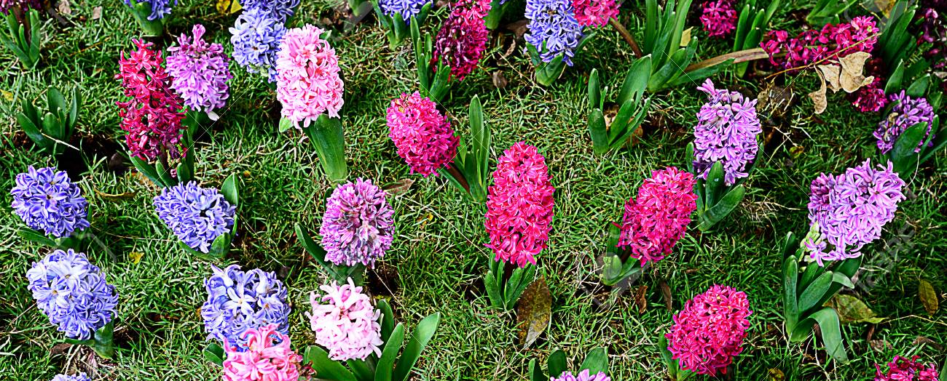
Clustering: Grouping similar objects

Slide 14
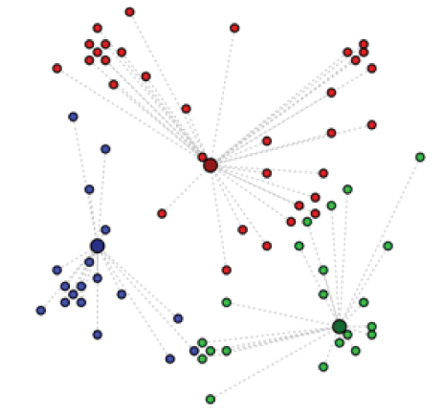
K-means: a popular clustering method
Given a collection of objects each with n measurable attributes, k-means is an analytical technique that, for a chosen value of k, identifies k clusters of objects based on the objects' proximity to the center of the k groups (centroid)

Slide 15




K-means: steps of the algorithm (2D case)
Choose the value of k and the k initial guesses for the centroids
Compute the distance from each data point to each centroid. Assign each point to the closest centroid to defines the first k clusters.
Compute the centroid, the center of mass, of each newly defined cluster from Step 2.
(general)
(general)

Slide 16
K-means: steps of the algorithm (2D case) (2)
4. Assign each point to the closest centroid computed in Step 3.
5. Compute the centroid of newly defined clusters.
Repeat until the algorithm reaches the final answer
Convergence is reached when the computed centroids do not change or the centroids and the assigned points oscillate back and forth from one iteration to the next

Slide 17
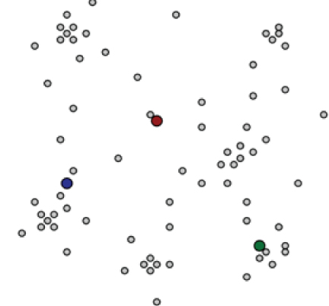
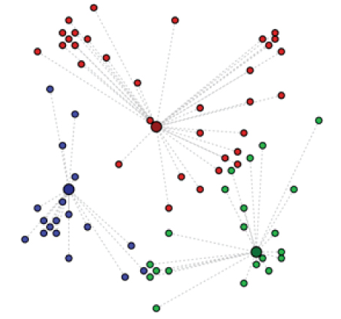
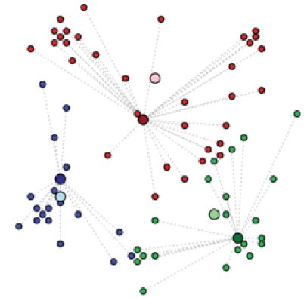
K-means: steps of the algorithm (2D case): Illustration
Step 1
Step 2
Step 3
Step …

Slide 18

K-means: Determining the number of clusters k
How many clusters should a dataset be divided? Make use of Heuristics or predefined requirements
Criteria to decide k-1 or k+1 clusters: Within Sum of Square (metric)

Slide 19
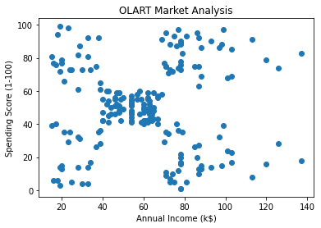
Example: Client Cluster Analysis
Discover the existing cluster groups in a datasets of account customers in a clothing shop.

Slide 20
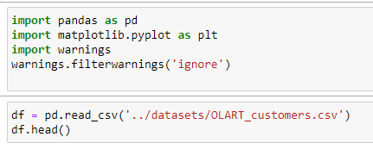
Loading the datasets

Slide 21
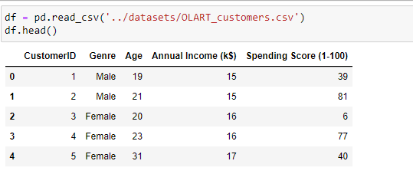
Visualise the datasets

Slide 22
Visualise the datasets

Slide 23
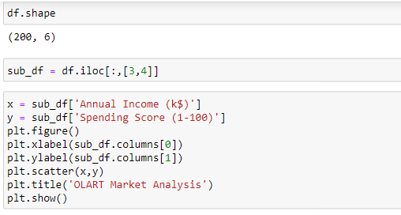
Visualise the datasets

Slide 24
Visualise the datasets

Slide 25
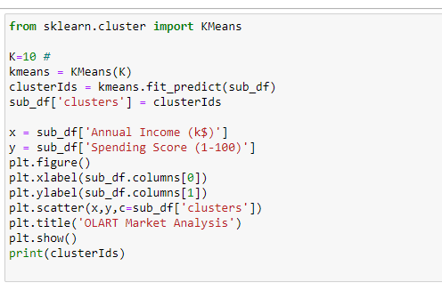
Cluster the data using k-Means clustering

Slide 26
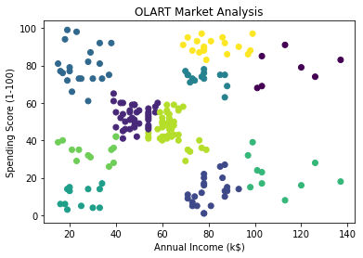
Cluster the data using k-Means clustering

