Slide 1
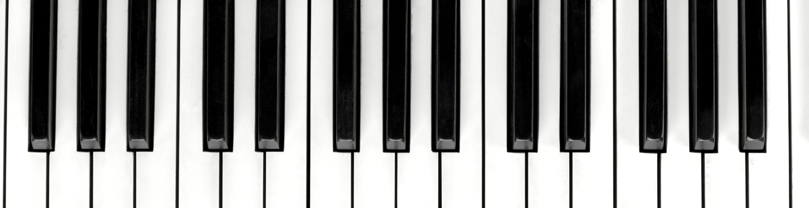

Nick Theile
https://github.com/ntheile/soundblock

Slide 2
Soundblock App
Open source music player and discovery tool.
For Independent artists and fans powered by the Blockchain.
It supports peer (fan) to peer (artist) payments and licensing model with no fees
No record labels, no middlemen
The artist gets 100% of the profits for his music

Slide 3
Problem Statement
What
Why
Artists are making less and less money for their art the more and more it becomes digitized
Independent artists do not fully own there music
Why can't I just go to Spotify and upload my music?
Why can't I get paid when I upload songs to Soundcloud?
There are more middle men to pay, like Spotify and iTunes to handle licensing and distribution
Must conform to 3rd party pricing schemas.
Spotify outsources licensing to third parties and record labels
It’s too expensive to handle the infrastructure for licensing and payment model at scale for indie artists (lots of lawyer and middlemen to pay)

Slide 4

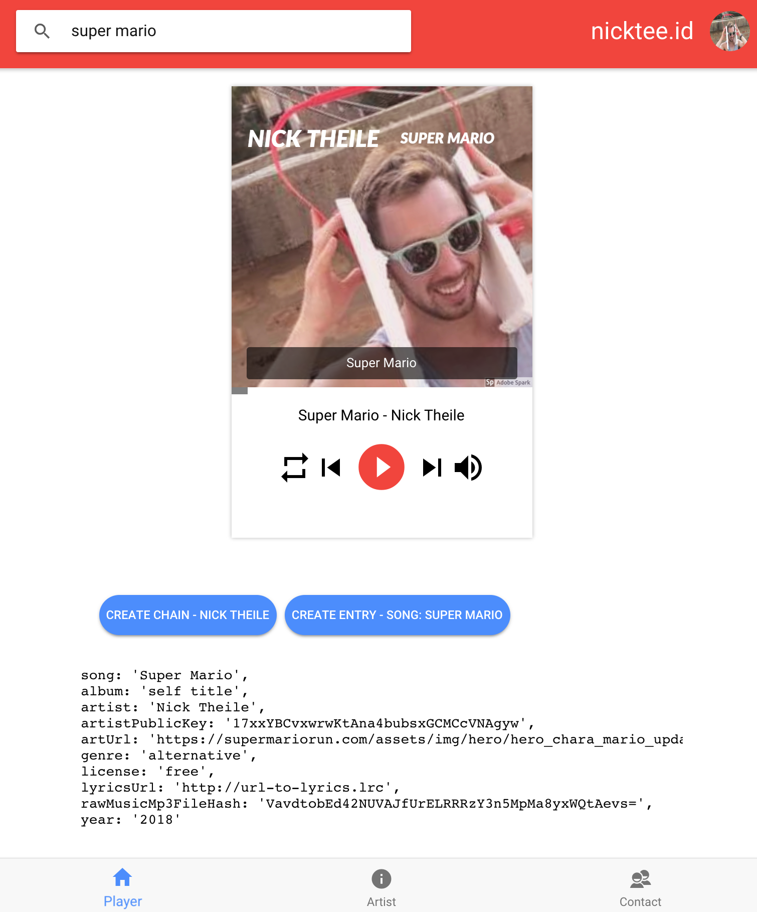
(2)
Music Discovery
(1)
Identity
{ Self Sovereign
Pub/Pri Key; Digital Sig }
(3)
Music
Player
(4)
Artist Blockchain
Song Entries
(5)
Artist Owned
Data
{ DID3 Tag }

Slide 5
Demo
(1) Self Sovereign Identity
Digital Signatures - Blockstack Login
Create an Artist chain
(2) Self Sovereign Music Ownership
Upload the song to your storage bucket (Blockstack Gaia Storage)
Free = no license and no encryption
License = choose your own model (free, free for X plays, pay to own), public private key cryptography
Each artist needs to digitally sign a copy of the song to the public key of the fan (so they can decrypt it in the player)
(3) Decentralized Music Discovery
DID3 Tag Open Protocol
Hash of the raw music file
Pointer to the storage location
Meta data about the song , artist, genre, lyrics, album art

Slide 6
DID3 Decentralized ID3 Tag for Music
did3Tag = {
song: 'Super Mario',
album: 'self title',
artist: 'Nick Theile',
artistDigitalSignature: ’32u4948290njkfwhf8948948i390fjn4f4390fm3942k494f0j3n',
artistPublicKey: ' 17xxYBCvxwrwKtAna4bubsxGCMCcVNAgyw ',
musicPointer: 'https://raw.githubusercontent.com/Super%20Mario.mp3',
artUrl: 'https://supermariorun.com/hero_chara_mario_update_pc.png',
genre: 'alternative',
license: 'free',
lyricsUrl: 'http://url-to-lyrics.html',
rawMusicFileHash: '',
year: '2018'
};

Slide 7
Thanks

