Slide 2
Introduction
What is parallel computing?
Why go parallel?
When do you go parallel?
What are some limits of parallel computing?
Types of parallel computers
Some terminology

Slide 3
Slides and examples at:
http://peloton.sdsc.edu/~tkaiser/mpi_stuff

Slide 4
What is Parallelism?
Consider your favorite computational application
One processor can give me results in N hours
Why not use N processors -- and get the results in just one hour?
The concept is simple:
Parallelism = applying multiple processors to a single problem

Slide 5
Parallel computing is computing by committee
Parallel computing: the use of multiple computers or processors working together on a common task.
Each processor works on its section of the problem
Processors are allowed to exchange information with other processors
Grid of Problem to be solved
CPU #1 works on this area
of the problem
CPU #2 works on this area
of the problem
exchange
y
CPU #3 works on this area
of the problem
CPU #4 works on this area
of the problem
exchange
x

Slide 6
Why do parallel computing?
Limits of single CPU computing
Available memory
Performance
Parallel computing allows:
Solve problems that don’t fit on a single CPU
Solve problems that can’t be solved in a reasonable time
We can run…
Larger problems
Faster
More cases
Run simulations at finer resolutions
Model physical phenomena more realistically

Slide 7
Weather Forecasting
Atmosphere is modeled by dividing it into three-dimensional regions or cells, 1 mile x 1 mile x 1 mile (10 cells high) - about 500 x 10 ⁶ cells.
The calculations of each cell are repeated many times to model the passage of time.
About 200 floating point operations per cell per time step or 10 ¹¹ floating point operations necessary per time step
10 day forecast with 10 minute resolution => 1.5x10¹⁴ flop
100 Mflops would take about 17 days
1.7 Tflops would take 2 minutes

Slide 8
Modeling Motion of Astronomical bodies (brute force)
Each body is attracted to each other body by gravitational forces.
Movement of each body can be predicted by calculating the total force experienced by the body.
For N bodies, N - 1 forces / body yields N ² calculations each time step
A galaxy has, 10 ¹¹ stars => 10 ⁹ years for one iteration
Using a N log N efficient approximate algorithm => about a year
NOTE: This is closely related to another hot topic: Protein Folding

Slide 9
Types of parallelism two extremes
Data parallel
Each processor performs the same task on different data
Example - grid problems
Task parallel
Each processor performs a different task
Example - signal processing such as encoding multitrack data
Pipeline is a special case of this
Most applications fall somewhere on the continuum between these two extremes

Slide 10
Simple data parallel program
Example: integrate 2-D propagation problem:
Starting partial
differential equation:
Finite Difference
Approximation:
PE #0
PE #1
PE #2
PE #3
y
PE #4
PE #5
PE #6
PE #7
x

Slide 11
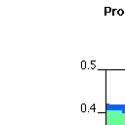
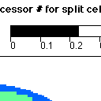
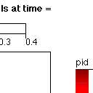
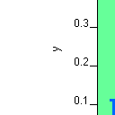

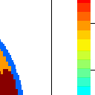



Typical data parallel program
•
Solving a Partial
Differential Equation
in 2d
•
Distribute the grid to N
processors
•
Each processor calculates
its section of the grid
•
Communicate the
Boundary conditions

Slide 12
Basics of Data Parallel Programming
One code will run on 2 CPUs
Program has array of data to be operated on by 2 CPU so array is split into two parts.
program.f:
…
if CPU=a then
low_limit=1
upper_limit=50
elseif CPU=b then
low_limit=51
upper_limit=100
end if
do I = low_limit, upper_limit
work on A(I)
end do
...
end program
CPU A
CPU B
program.f:
…
low_limit=1
upper_limit=50
do I= low_limit, upper_limit
work on A(I)
end do
…
end program
program.f:
…
low_limit=51
upper_limit=100
do I= low_limit, upper_limit
work on A(I)
end do
…
end program

Slide 13
Typical Task Parallel Application
DATA
Normalize
Task
FFT
Task
Multiply
Task
Inverse
FFT
Task
•
Signal processing
•
Use one processor for each task
Can use more processors if one is overloaded
•
v

Slide 14
Basics of Task Parallel Programming
One code will run on 2 CPUs
Program has 2 tasks (a and b) to be done by 2 CPUs
program.f:
…
initialize
...
if CPU=a then
do task a
elseif CPU=b then
do task b
end if
….
end program
CPU A
CPU B
program.f:
…
Initialize
…
do task a
…
end program
program.f:
…
Initialize
…
do task b
…
end program

Slide 15
How Your Problem Affects Parallelism
The nature of your problem constrains how successful parallelization can be
Consider your problem in terms of
When data is used, and how
How much computation is involved, and when
Geoffrey Fox identified the importance of problem architectures
Perfectly parallel
Fully synchronous
Loosely synchronous
A fourth problem style is also common in scientific problems
Pipeline parallelism

Slide 16
Perfect Parallelism
Scenario: seismic imaging problem
Same application is run on data from many distinct physical sites
Concurrency comes from having multiple data sets processed at once
Could be done on independent machines (if data can be available)
This is the simplest style of problem
Key characteristic: calculations for each data set are independent
Could divide/replicate data into files and run as independent serial jobs
(also called “job-level parallelism”)

Slide 17
Fully Synchronous Parallelism
Scenario: atmospheric dynamics problem
Data models atmospheric layer; highly interdependent in horizontal layers
Same operation is applied in parallel to multiple data
Concurrency comes from handling large amounts of data at once
Key characteristic: Each operation is performed on all (or most) data
Operations/decisions depend on results of previous operations
Potential problems
Serial bottlenecks force other processors to “wait”

Slide 18
Loosely Synchronous Parallelism
Scenario: diffusion of contaminants through groundwater
Computation is proportional to amount of contamination and geostructure
Amount of computation varies dramatically in time and space
Concurrency from letting different processors proceed at their own rates
Key characteristic: Processors each do small pieces of the problem, sharing information only intermittently
Potential problems
Sharing information requires “synchronization” of processors (where one processor will have to wait for another)

Slide 19
Pipeline Parallelism
Scenario: seismic imaging problem
Data from different time steps used to generate series of images
Job can be subdivided into phases which process the output of earlier phases
Concurrency comes from overlapping the processing for multiple phases
Key characteristic: only need to pass results one-way
Can delay start-up of later phases so input will be ready
Potential problems
Assumes phases are computationally balanced
(or that processors have unequal capabilities)

Slide 20
Limits of Parallel Computing
Theoretical upper limits
Amdahl’s Law
Practical limits

Slide 21
Theoretical upper limits
All parallel programs contain:
Parallel sections
Serial sections
Serial sections are when work is being duplicated or no useful work is being done, (waiting for others)
Serial sections limit the parallel effectiveness
If you have a lot of serial computation then you will not get good speedup
No serial work “allows” prefect speedup
Amdahl’s Law states this formally

Slide 22
Amdahl’s Law
Amdahl’s Law places a strict limit on the speedup that can be realized by using multiple processors.
Effect of multiple processors on run time
Effect of multiple processors on speed up
Where
Fs = serial fraction of code
Fp = parallel fraction of code
N = number of processors
Perfect speedup t=t₁/n or S(n)=n
t
=
(
f
/
N
+
f
)
t
p
p
s
s
=
1
S
f
+
f
/
N
s
p
22

Slide 23
Illustration of Amdahl's Law
It takes only a small fraction of serial content in a code to
degrade the parallel performance. It is essential to
determine the scaling behavior of your code before doing
production runs using large numbers of processors
250
200
fp = 1.000
fp = 0.999
fp = 0.990
150
fp = 0.900
100
50
0
0
50
100
150
200
250
Number of processors

Slide 24
Amdahl’s Law Vs. Reality
Amdahl’s Law provides a theoretical upper limit on parallel
speedup assuming that there are no costs for communications. In reality, communications will result in a further degradation of performance
80
fp = 0.99
70
60
50
40
Amdahl's Law
Reality
30
20
10
0
0
50
100
150
200
250
Number of processors

Slide 25
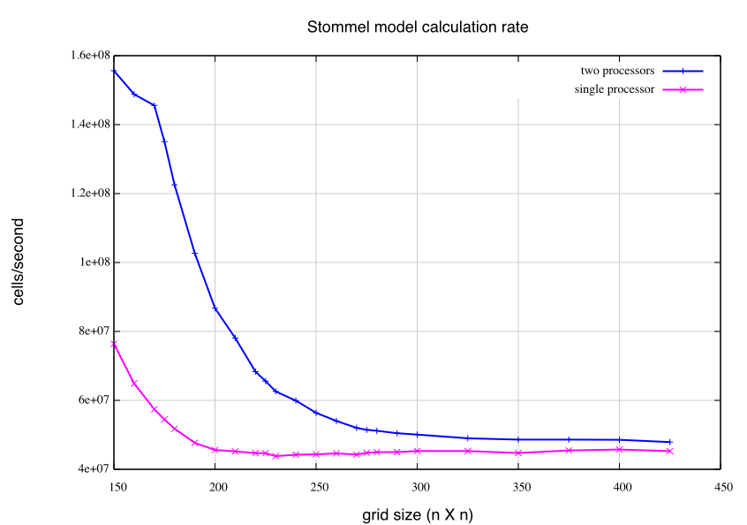
Sometimes you don’t get what you expect!

Slide 26
Some other considerations
Writing effective parallel application is difficult
Communication can limit parallel efficiency
Serial time can dominate
Load balance is important
Is it worth your time to rewrite your application
Do the CPU requirements justify parallelization?
Will the code be used just once?

Slide 27
Parallelism Carries a Price Tag
Parallel programming
Involves a steep learning curve
Is effort-intensive
Parallel computing environments are unstable and unpredictable
Don’t respond to many serial debugging and tuning techniques
May not yield the results you want, even if you invest a lot of time
Will the investment of your time be worth it?

Slide 28
Test the “Preconditions for Parallelism”
According to experienced parallel programmers:
no green − Don’t even consider it
one or more red − Parallelism may cost you more than you gain
all green − You need the power of parallelism (but there are no guarantees)

Slide 29
One way of looking at parallel machines
Flynn's taxonomy has been commonly use to classify parallel computers into one of four basic types:
Single instruction, single data (SISD): single scalar processor
Single instruction, multiple data (SIMD): Thinking machines CM-2
Multiple instruction, single data (MISD): various special purpose machines
Multiple instruction, multiple data (MIMD): Nearly all parallel machines
Since the MIMD model “won”, a much more useful way to classify modern parallel computers is by their memory model
Shared memory
Distributed memory

Slide 30
Shared and Distributed memory
P
P
P
P
P
P
P
P
P
P
P
P
M
M
M
M
M
M
B
U
S
M
e
m
o
r
y
Network
Distributed memory - each processor
has it’s own local memory. Must do
message passing to exchange data
between processors.
(examples: CRAY T3E, IBM SP )
Shared memory - single address
space. All processors have access
to a pool of shared memory.
(examples: CRAY T90)
Methods of memory access :
- Bus
- Crossbar

Slide 31
Styles of Shared memory: UMA and NUMA
Uniform memory access (UMA)
Each processor has uniform access
to memory - Also known as
symmetric multiprocessors (SMPs)
Non-uniform memory access (NUMA)
Time for memory access depends on
location of data. Local access is faster
than non-local access. Easier to scale
than SMPs
(example: HP-Convex Exemplar)

Slide 32
Memory Access Problems
Conventional wisdom is that systems do not scale well
Bus based systems can become saturated
Fast large crossbars are expensive
Cache coherence problem
Copies of a variable can be present in multiple caches
A write by one processor my not become visible to others
They'll keep accessing stale value in their caches
Need to take actions to ensure visibility or cache coherence

Slide 33
Cache coherence problem
P
P
2
P
1
3
u
=
?
u
=
?
u
=
7
$
4
$
5
$
3
u
:
5
u
:
5
1
2
I
/
O
d
e
v
i
c
e
s
u
:
5
M
e
m
o
r
y
Processors see different values for u after event 3
With write back caches, value written back to memory depends on circumstance of which cache flushes or writes back value when
Processes accessing main memory may see very stale value
Unacceptable to programs, and frequent!

Slide 34
Snooping-based coherence
Basic idea:
Transactions on memory are visible to all processors
Processor or their representatives can snoop (monitor) bus and take action on relevant events
Implementation
When a processor writes a value a signal is sent over the bus
Signal is either
Write invalidate tell others cached value is
Write broadcast - tell others the new value

Slide 35
Machines
T90, C90, YMP, XMP, SV1,SV2
SGI Origin (sort of)
HP-Exemplar (sort of)
Various Suns
Various Wintel boxes
Most desktop Macintosh
Not new
BBN GP 1000 Butterfly
Vax 780

Slide 36
Programming methodologies
Standard Fortran or C and let the compiler do it for you
Directive can give hints to compiler (OpenMP)
Libraries
Threads like methods
Explicitly Start multiple tasks
Each given own section of memory
Use shared variables for communication
Message passing can also be used but is not common

Slide 37
Distributed shared memory (NUMA)
Consists of N processors and a global address space
All processors can see all memory
Each processor has some amount of local memory
Access to the memory of other processors is slower
NonUniform Memory Access

Slide 38
Memory
Easier to build because of slower access to remote memory
Similar cache problems
Code writers should be aware of data distribution
Load balance
Minimize access of "far" memory

Slide 39
Programming methodologies
Same as shared memory
Standard Fortran or C and let the compiler do it for you
Directive can give hints to compiler (OpenMP)
Libraries
Threads like methods
Explicitly Start multiple tasks
Each given own section of memory
Use shared variables for communication
Message passing can also be used

Slide 40
Machines
SGI Origin
HP-Exemplar

Slide 41
Distributed Memory
Each of N processors has its own memory
Memory is not shared
Communication occurs using messages

Slide 42
Programming methodology
Mostly message passing using MPI
Data distribution languages
Simulate global name space
Examples
High Performance Fortran
Split C
Co-array Fortran

Slide 43
Hybrid machines
SMP nodes (clumps) with interconnect between clumps
Machines
Origin 2000
Exemplar
SV1, SV2
SDSC IBM Blue Horizon
Programming
SMP methods on clumps or message passing
Message passing between all processors

Slide 44
Communication networks
Custom
Many manufacturers offer custom interconnects
Off the shelf
Ethernet
ATM
HIPI
FIBER Channel
FDDI

Slide 45
Types of interconnects
Fully connected
N dimensional array and ring or torus
Paragon
T3E
Crossbar
IBM SP (8 nodes)
Hypercube
Ncube
Trees
Meiko CS-2
Combination of some of the above
IBM SP (crossbar and fully connect for 80 nodes)
IBM SP (fat tree for > 80 nodes)

Slide 46
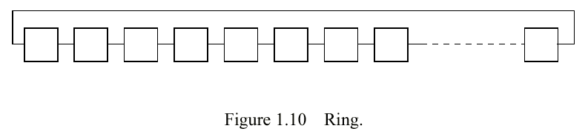

Slide 47
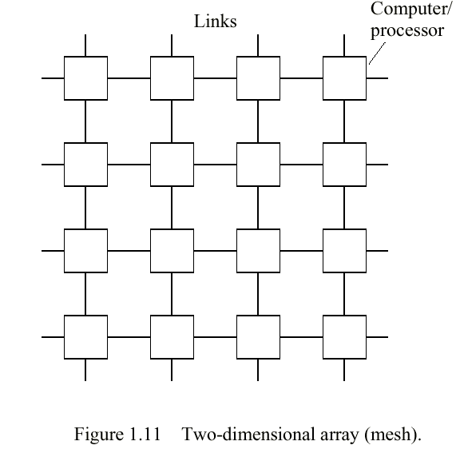
Wrapping
produces torus

Slide 48
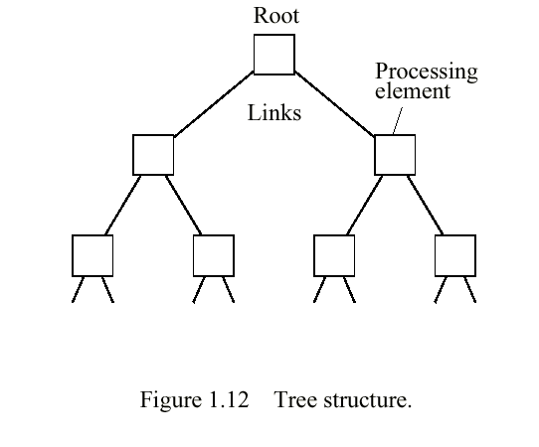

Slide 49
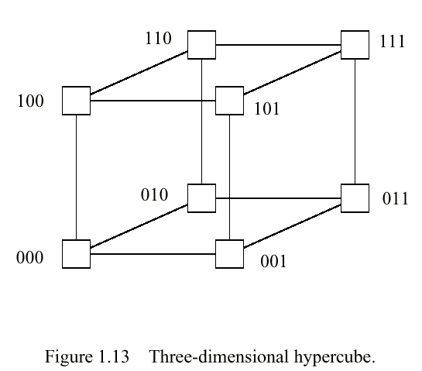

Slide 50
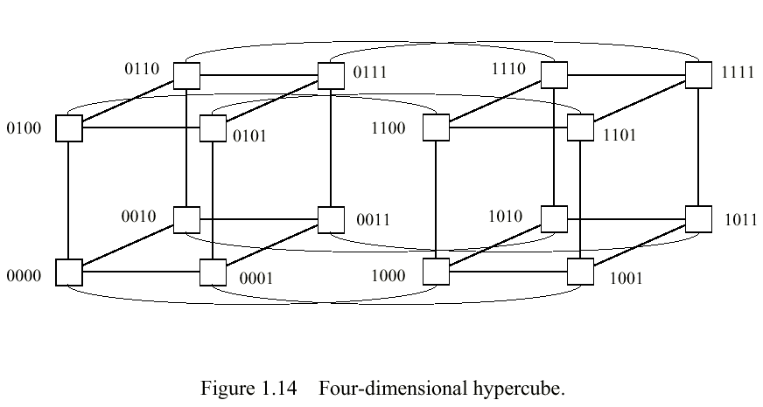

Slide 51
Some terminology
Bandwidth - number of bits that can be transmitted in unit time, given as bits/sec.
Network latency - time to make a message transfer through network.
Message latency or startup time - time to send a zero-length message. Essentially the software and hardware overhead in sending message and the actual transmission time.
Communication time - total time to send message, including software overhead and interface delays.
Diameter - minimum number of links between two farthest nodes in the network. Only shortest routes used. Used to determine worst case delays.
Bisection width of a network - number of links (or sometimes wires) that must be cut to divide network into two equal parts. Can provide a lower bound for messages in a parallel algorithm.

Slide 52
Terms related to algorithms
Amdahl’s Law (talked about this already)
Superlinear Speedup
Efficiency
Cost
Scalability
Problem Size
Gustafson’s Law

Slide 53
Superlinear Speedup
S(n) > n, may be seen on occasion, but usually this is due to using a suboptimal sequential algorithm or some unique feature of the architecture that favors the parallel formation.
One common reason for superlinear speedup is the extra memory in the multiprocessor system which can hold more of the problem data at any instant, it leads to less, relatively slow disk memory traffic. Superlinear speedup can occur in search algorithms.

Slide 54
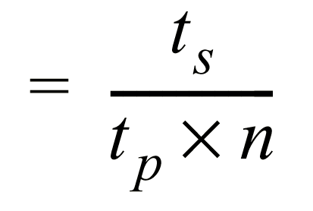
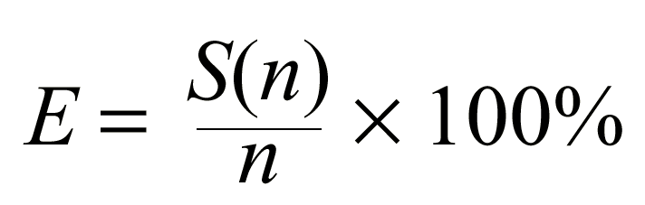
Efficiency
Efficiency = Execution time using one processor
Execution time using a number of processors
Its just the speedup divided by the number of processors

Slide 55
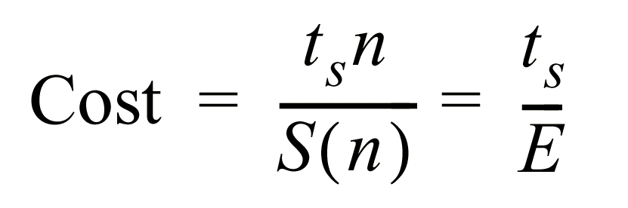
Cost
The processor-time product or cost (or work) of a computation defined as
Cost = (execution time) x (total number of processors used)
The cost of a sequential computation is simply its execution time, t _{s} . The cost of a
parallel computation is t _{p} x n. The parallel execution time, t _{p} , is given by t_{s}/S(n)
Hence, the cost of a parallel computation is given by
Cost-Optimal Parallel Algorithm
One in which the cost to solve a problem on a multiprocessor is proportional to the cost

Slide 56
Scalability
Used to indicate a hardware design that allows the system to be increased in size and in doing so to obtain increased performance - could be described as architecture or hardware scalability.
Scalability is also used to indicate that a parallel algorithm can accommodate increased data items with a low and bounded increase in computational steps - could be described as algorithmic scalability.

Slide 57
Problem size
Problem size: the number of basic steps in the best sequential algorithm for a given problem and data set size
Intuitively, we would think of the number of data elements being processed in the algorithm as a measure of size.
However, doubling the date set size would not necessarily double the number of computational steps. It will depend upon the problem.
For example, adding two matrices has this effect, but multiplying matrices quadruples operations.
Note: Bad sequential algorithms tend to scale well

Slide 58
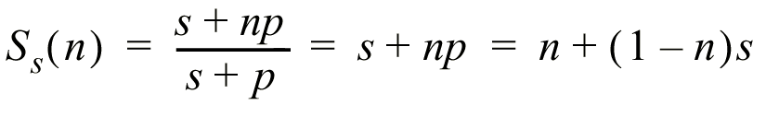
Gustafson’s law
Rather than assume that the problem size is fixed, assume that the parallel execution time is fixed. In increasing the problem size, Gustafson also makes the case that the serial section of the code does not increase as the problem size.
Scaled Speedup Factor
The scaled speedup factor becomes
called Gustafson’s law.
Example
Suppose a serial section of 5% and 20 processors; the speedup according to the formula is 0.05 + 0.95(20) = 19.05 instead of 10.26 according to Amdahl’s law. (Note, however, the different assumptions.)

Slide 59
Credits
Most slides were taken from SDSC/NPACI training materials developed by many people
www.npaci.edu/Training
Some were taken from
Parallel Programming: Techniques and Applications Using Networked Workstations and Parallel Computers
Barry Wilkinson and Michael Allen
Prentice Hall, 1999, ISBN 0-13-671710-1
http://www.cs.uncc.edu/~abw/parallel/par_prog/

