Slide 1
Non-Buffered Blocking
Message Passing Operations
A simple method for forcing send/receive semantics is for the send operation to return only when it is safe to do so.
In the non-buffered blocking send, the operation does not return until the matching receive has been encountered at the receiving process.
Idling and deadlocks are major issues with non-buffered blocking sends.
In buffered blocking sends, the sender simply copies the data into the designated buffer and returns after the copy operation has been completed. The data is copied at a buffer at the receiving end as well.
Buffering alleviates idling at the expense of copying overheads.

Slide 2
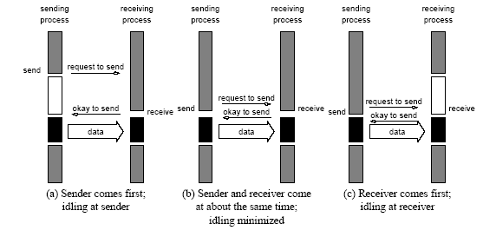
Non-Buffered Blocking
Message Passing Operations
Handshake for a blocking non-buffered send/receive operation.
It is easy to see that in cases where sender and receiver do not
reach communication point at similar times, there can be considerable idling overheads.

Slide 3
Buffered Blocking
Message Passing Operations
A simple solution to the idling and deadlocking problem outlined above is to rely on buffers at the sending and receiving ends.
The sender simply copies the data into the designated buffer and returns after the copy operation has been completed.
The data must be buffered at the receiving end as well.
Buffering trades off idling overhead for buffer copying overhead.

Slide 4
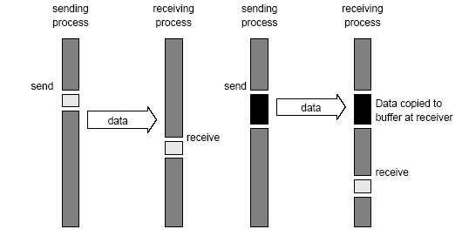
Buffered Blocking
Message Passing Operations
Blocking buffered transfer protocols: (a) in the presence of
communication hardware with buffers at send and receive ends; and (b) in the absence of communication hardware, sender interrupts receiver and deposits data in buffer at receiver end.

Slide 5
Buffered Blocking
Message Passing Operations
Deadlocks are still possible with buffering since receive
operations block.
P0 P1
receive(&a, 1, 1); receive(&a, 1, 0);
send(&b, 1, 1); send(&b, 1, 0);

Slide 6
Non-Blocking
Message Passing Operations
The programmer must ensure semantics of the send and receive.
This class of non-blocking protocols returns from the send or receive operation before it is semantically safe to do so.
Non-blocking operations are generally accompanied by a check-status operation.
When used correctly, these primitives are capable of overlapping communication overheads with useful computations.
Message passing libraries typically provide both blocking and non-blocking primitives.

Slide 7
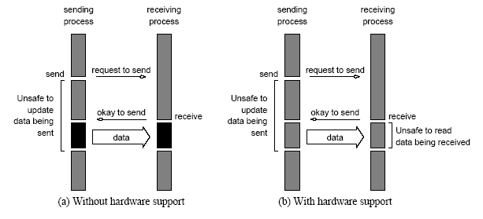
Non-Blocking
Message Passing Operations
Non-blocking non-buffered send and receive operations (a) in
absence of communication hardware; (b) in presence of
communication hardware.

Slide 8
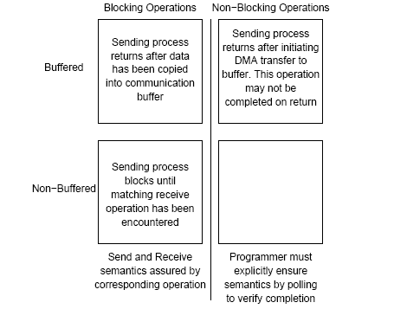
Send and Receive Protocols
Space of possible protocols for send and receive operations.

Slide 9
Avoiding Deadlocks: Example
int a[10], b[10], myrank;
MPI_Status status;
...
MPI_Comm_rank(MPI_COMM_WORLD, &myrank);
if (myrank == 0) {
MPI_Send(a, 10, MPI_INT, 1, 1, MPI_COMM_WORLD);
MPI_Send(b, 10, MPI_INT, 1, 2, MPI_COMM_WORLD);
}
else if (myrank == 1) {
MPI_Recv(b, 10, MPI_INT, 0, 2, MPI_COMM_WORLD);
MPI_Recv(a, 10, MPI_INT, 0, 1, MPI_COMM_WORLD);
}
...
If MPI_Send is blocking, there is a deadlock.

Slide 10
Avoiding Deadlocks
Consider the following piece of code, in which process i sends a message to process i + 1 (modulo the number of processes) and receives a message from process i - 1 (module the number of processes).
int a[10], b[10], npes, myrank;
MPI_Status status;
...
MPI_Comm_size(MPI_COMM_WORLD, &npes);
MPI_Comm_rank(MPI_COMM_WORLD, &myrank);
MPI_Send(a, 10, MPI_INT, (myrank+1)%npes, 1, MPI_COMM_WORLD);
MPI_Recv(b, 10, MPI_INT, (myrank-1+npes)%npes, 1, MPI_COMM_WORLD);
...
Once again, we have a deadlock if MPI_Send is blocking.

Slide 11
Avoiding Deadlocks
We can break the circular wait to avoid deadlocks as follows:
int a[10], b[10], npes, myrank;
MPI_Status status;
...
MPI_Comm_size(MPI_COMM_WORLD, &npes);
MPI_Comm_rank(MPI_COMM_WORLD, &myrank);
if (myrank%2 == 1) {
MPI_Send(a, 10, MPI_INT, (myrank+1)%npes, 1, MPI_COMM_WORLD);
MPI_Recv(b, 10, MPI_INT, (myrank-1+npes)%npes, 1, MPI_COMM_WORLD);
}
else {
MPI_Recv(b, 10, MPI_INT, (myrank-1+npes)%npes, 1, MPI_COMM_WORLD);
MPI_Send(a, 10, MPI_INT, (myrank+1)%npes, 1, MPI_COMM_WORLD);
}
...

Slide 12
Overlapping Communication with Computation
In order to overlap communication with computation, MPI provides a pair of functions for performing non-blocking send and receive operations.
  int MPI_Isend(void *buf, int count, MPI_Datatype datatype,
  int dest, int tag, MPI_Comm comm,
  MPI_Request *request)
  int MPI_Irecv(void *buf, int count, MPI_Datatype datatype,
  int source, int tag, MPI_Comm comm,
  MPI_Request *request)
These operations return before the operations have been completed. Function MPI_Test tests whether or not the non-blocking send or receive operation identified by its request has finished.
  int MPI_Test(MPI_Request *request, int *flag,
  MPI_Status *status)
MPI_Wait waits for the operation to complete.
  int MPI_Wait(MPI_Request *request, MPI_Status *status)

