Slide 1

TS. Vũ Văn Thiệu

Slide 2
Nội dung
Giới thiệu
OpenMP API
Biên dịch OpenMP
OpenMP directives

Slide 3
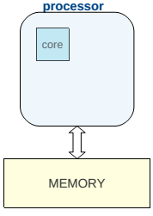
Cấu trúc CPU ban đầu
Mỗi Processor có một core

Slide 4
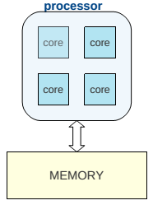
CPU ngày nay
Mỗi Processor có thể có 2, 4, 8 core
Nhiều core chia sẻ chung một bộ nhớ

Slide 5
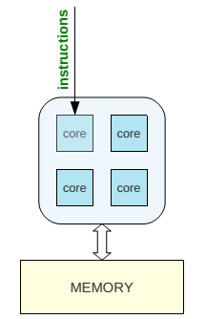
Chương trình tuần tự
Chương trình được thực hiện trên 1 core
Các core khác Idle
Lãng phí tài nguyên hệ thống

Slide 6
OpenMP
OpenMP là một API cho phép viết ứng dụng song song trên các hệ thống có bộ nhớ chia sẻ bằng C, C++, Fortran
OpenMP bao gồm:
  Compiler directives
  Runtime Library routines
  Environnent variables

Slide 7
HelloWorld OpenMP
#include <omp.h>
#include <stdio.h>
int main() {
#pragma omp parallel
int threadnumber = omp_get_num_threads();
int threadID = omp_get_thread_num();
printf("Hello from thread %d, nthreads %d\n", threadID, threadnumber);
}

Slide 8
HelloWorld OpenMP
Cài đặt: OpenMP có sẵn trong gcc/g++ trên Ubumtu
Biên dịch:
  gcc –fopenmp -o HelloWord HelloWorld.c
  g++ –fopenmp -o HelloWord HelloWorld.cpp
Chạy chương trình
    ~/HelloWord
Kết quả:
  Hello from thread 0, nthreads 4
  Hello from thread 1, nthreads 4
  Hello from thread 2, nthreads 4
  Hello from thread 3, nthreads 4

Slide 9
Khi thực hiện chương trình
Start OMP program
Thread #0
Thread #1
Thread #2
Thread #3
Trong OMP block, tất cả các thread thực hiện tất cả các instructions
Print “Hello…”
Print “Hello…”
Print “Hello…”
Print “Hello…”
End program

Slide 10

Mô hình Fork/Join
OpenMP programs start with a single thread; the master thread (Thread #0)
At start of parallel region master creates team of parallel ”worker” threads (FORK)
Statements in parallel block are executed in parallel by every thread
At end of parallel region, all threads synchronize, and join master thread (JOIN)

Slide 11
OpenMP Threads vs Cores
Thread is independent sequence of execution of program code
  Block of code with one entry and one exit
Unrelated to Cores/CPUs
OpenMP threads are mapped onto physical cores
Possible to map more than 1 thread on a core
In practice best to have one-to-one mapping.

Slide 12
OpenMP Threads
Number of openMP threads can be set using:
  Environmental variable OMP_NUM_THREADS
  Runtime function omp_set_num_threads(n)
Other useful function to get information about threads:
  Runtime function omp_get_num_threads()
    Returns number of threads in parallel region
    Returns 1 if called outside parallel region
  Runtime function omp_get_thread_num()
    Returns id of thread in team
    Value between [0,n-1] // where n = #threads
    Master thread always has id 0

Slide 13
Bài tập 1
Chuyển chương trình sau sang OpenMP sao cho dòng thông báo “Hello …” được in ra 10 lần
  #include <stdio.h>
  int main() {
  int threads, id;
  threads = 10;
  id = 10;
  printf("Hello from thread %d, nthreads %d\n",id,threads);
  return 0;
  }

Slide 14
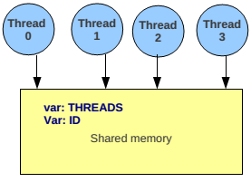
Mô hình Shared Memory
The memory is (logically) shared by all the cpu's
“All threads try to access the
same variable (possibly at the
same time). This can lead to a
race condition. Different runs
of same program might give
different results because of
race conditions”

Slide 15
Shared and Private Variables
OpenMP provides a way to declare variables private or shared within an OpenMP block. This is done using the following OpenMP clauses:
  SHARED ( list )
    All variables in list will be considered shared.
    Every openmp thread has access to all these variables
  PRIVATE ( list )
    Every openmp thread will have it's own “private” copy of variables in list
    No other openmp thread has access to this “private” copy
    E.g.: #pragma omp parallel private(a,b,c)
By default most variables are considered shared in OpenMP. Exceptions include index variables (Fortran, C/C++) and variables declared inside parallel region (C/C++)

Slide 16
Bài tập 2: Chạy thử chương trình sau, nhận xét KQ, khắc phục
    #include <stdio.h>
    #include <omp.h>
    int main() {
    int id,x;
    omp_set_num_threads(100);
    #pragma omp parallel
    {
    id = omp_get_thread_num();
    x = 10*id;
    printf("\n");
    printf("Hello from thread %d,x = %d", id, x);
    printf("\n");
    }
    return 0;
    }

Slide 17
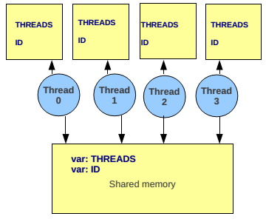
Mô hình Shared memory
The memory is (logically) shared by all the cpu's
  There is also private memory for every openmp thread
shared variables ”threads”
and ”id” still exist, but every
thread also has a private copy
of variables “threads” and
”id”. There will not be any
race condition for these
private variables

Slide 18
Note: Private variable
OpenMP creates separate data stack for every worker thread to store copies of private variables (master thread uses regular stack)
Size of these stacks is not defined by OpenMP standards
  Intel compiler: default stack is 4MB
  gcc/gfortran: default stack is 2MB
Behavior of program undefined when stack space exceeded
  Although most compilers/RT will throw segmentation fault
To increase stack size use environment var OMP_STACKSIZE, e.g.
  export OMP_STACKSIZE=512M
  export OMP_STACKSIZE=1GB
To make sure master thread has large enough stack space use
  ulimit -s command (unix/linux).

Slide 19
Assignment 1
Create a program that computes the sum of all the elements in an array A (in C). Then Use OpenMP directives to make it run in parallel.
Create a program that finds the largest number in an array A (in C). Then Use OpenMP directives to make it run in parallel.

Slide 20
Assignment 2
Create a program that computes a simple matrix multiplication C=AxB, in C. Then, use OpenMP directives to make it run in parallel. Determine the speedup of OpenMP over the C code

