Slide 1
Paper battle ship
MSSV | Name
1412168 | Vo Thanh Hieu
1412180 | Nguyen Thai Hoang
1412175 | Tran Hiep
1712414 | Nguyen Dinh Han

Slide 2
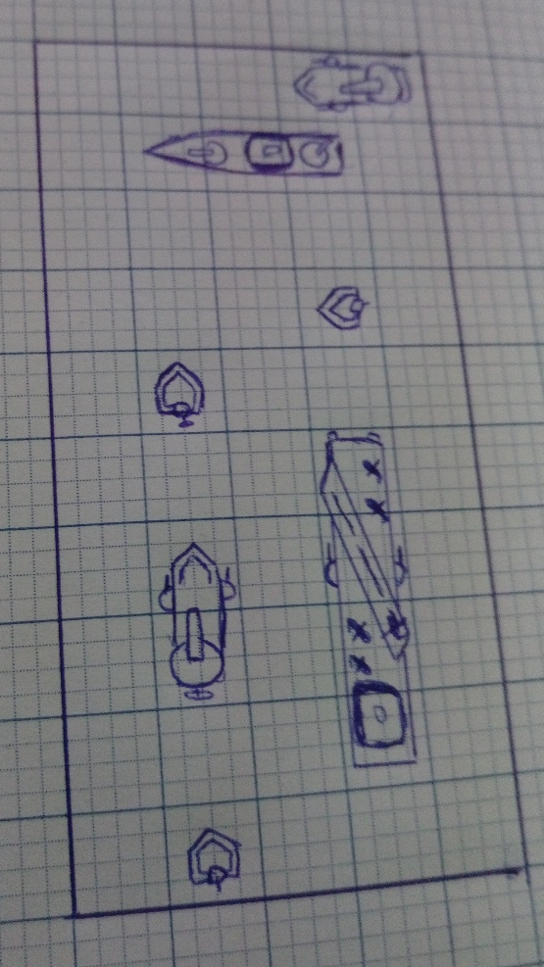

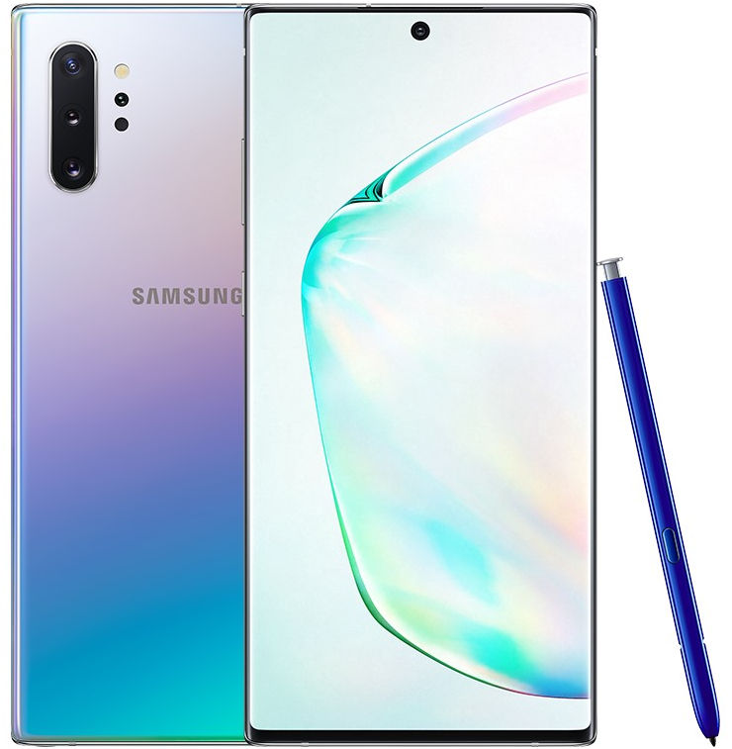
IDEA

Slide 3



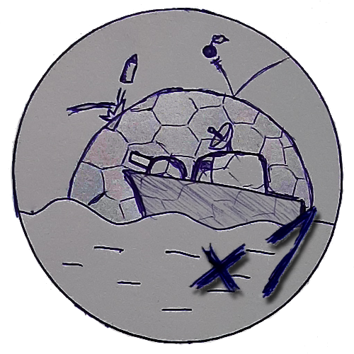


IDEA
Paper Battle ship

