Slide 1
ASL Citizen
Pilot results & test evidence
75.00%
frozen official-test
top-1
End-to-end preprocessing, engineering checks, model comparison, signer-grouped validation, and a frozen held-out test evaluation.
388 held-out clips
32 selected classes
291/388 top-1 correct
Results snapshot — 4 Oct 2026

Slide 2
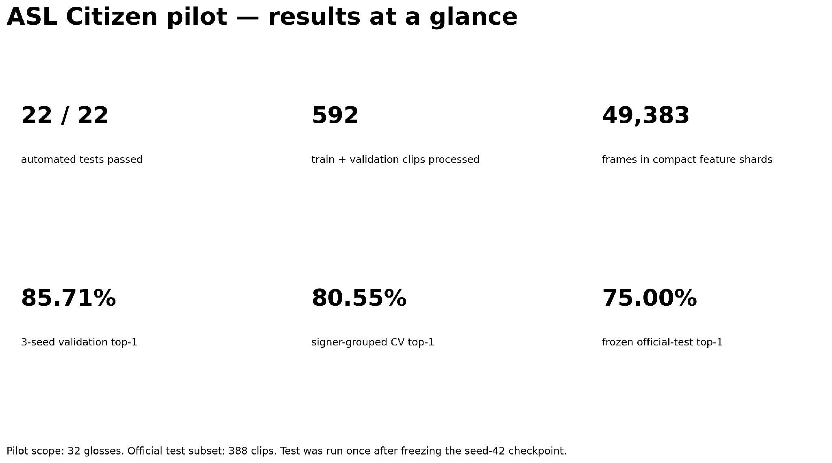
01 Results at a glance
The pilot passed the engineering gates and produced measurable model signal, with a meaningful generalization gap.

Slide 3
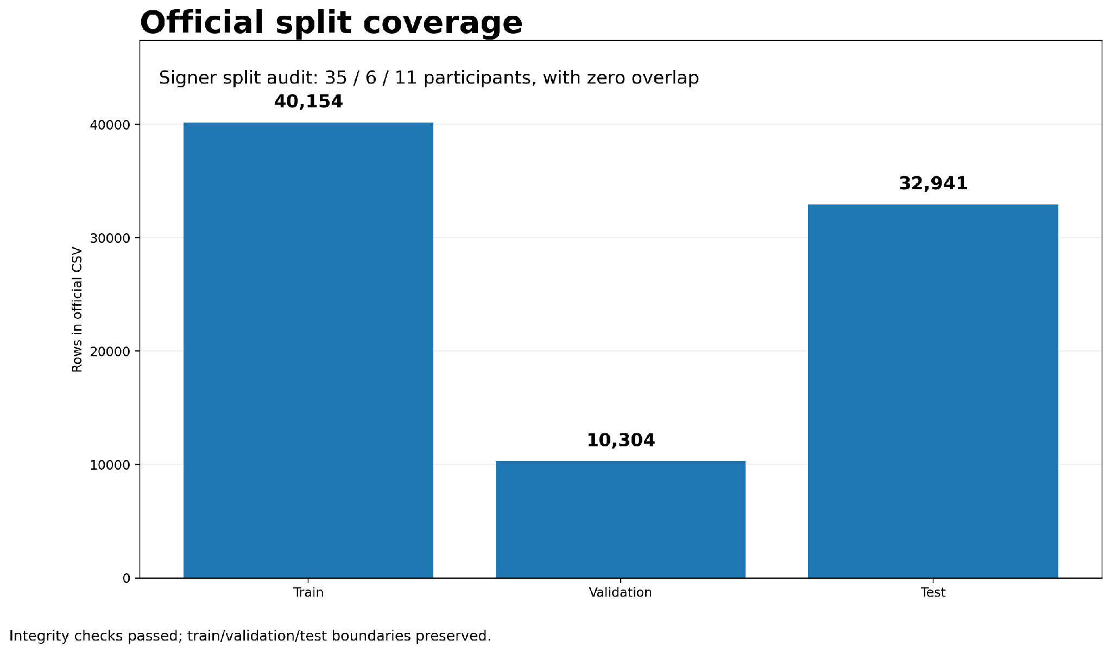
02 Data & split integrity
83,399 official rows
35 / 6 / 11 signers
0 overlap
The pipeline uses the official split files and preserves signer separation across train, validation, and test.

Slide 4
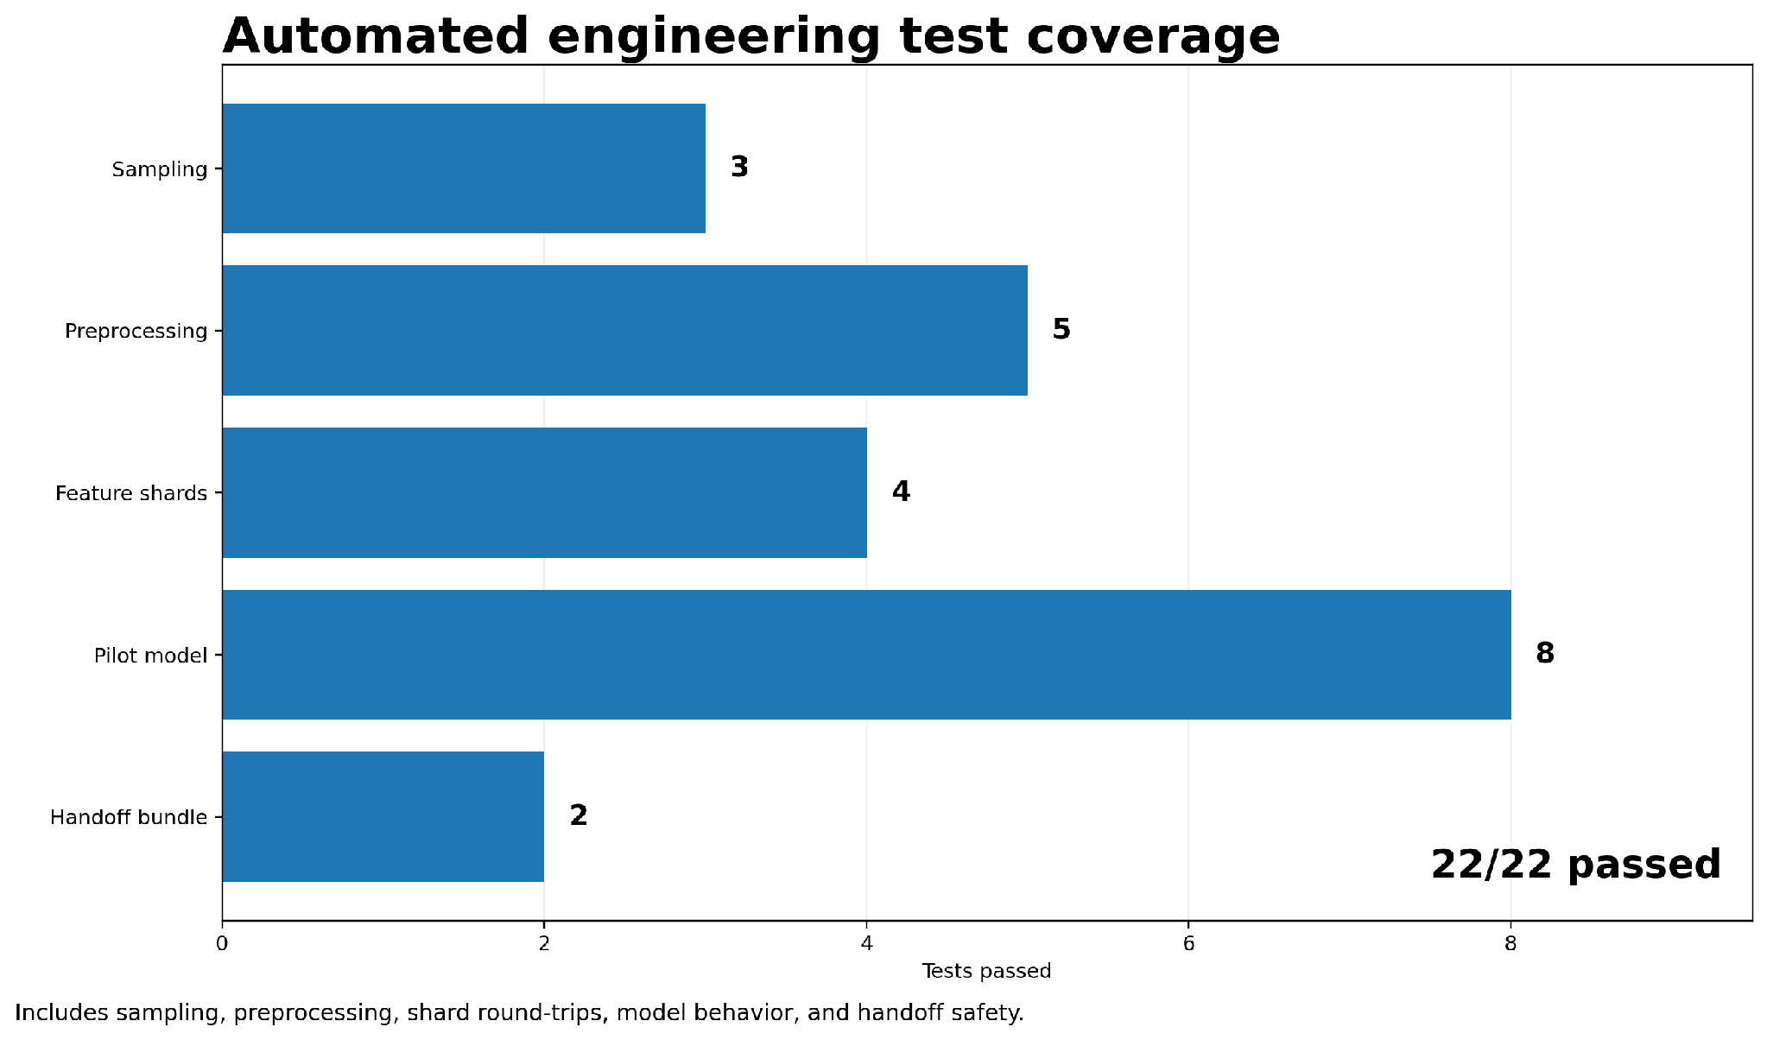
03 Engineering correctness
22 / 22 passed
22 focused automated tests passed across sampling, preprocessing, feature shards, model behavior, and handoff safety.

Slide 5
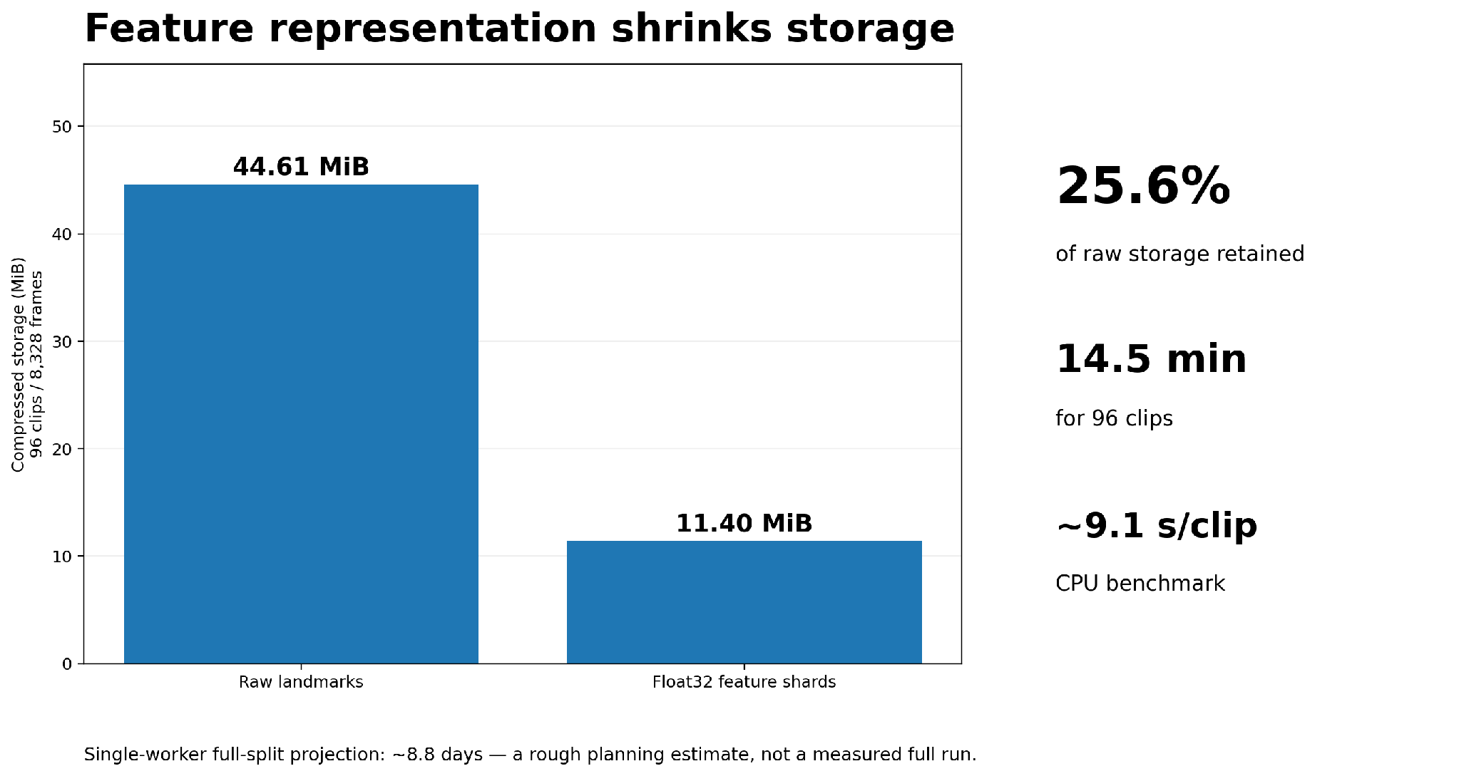
04 Preprocessing & storage efficiency
11.40 MiB
feature shards
A 96-clip CPU benchmark completed successfully, and model-ready features retained only about one-quarter of raw landmark storage.

Slide 6
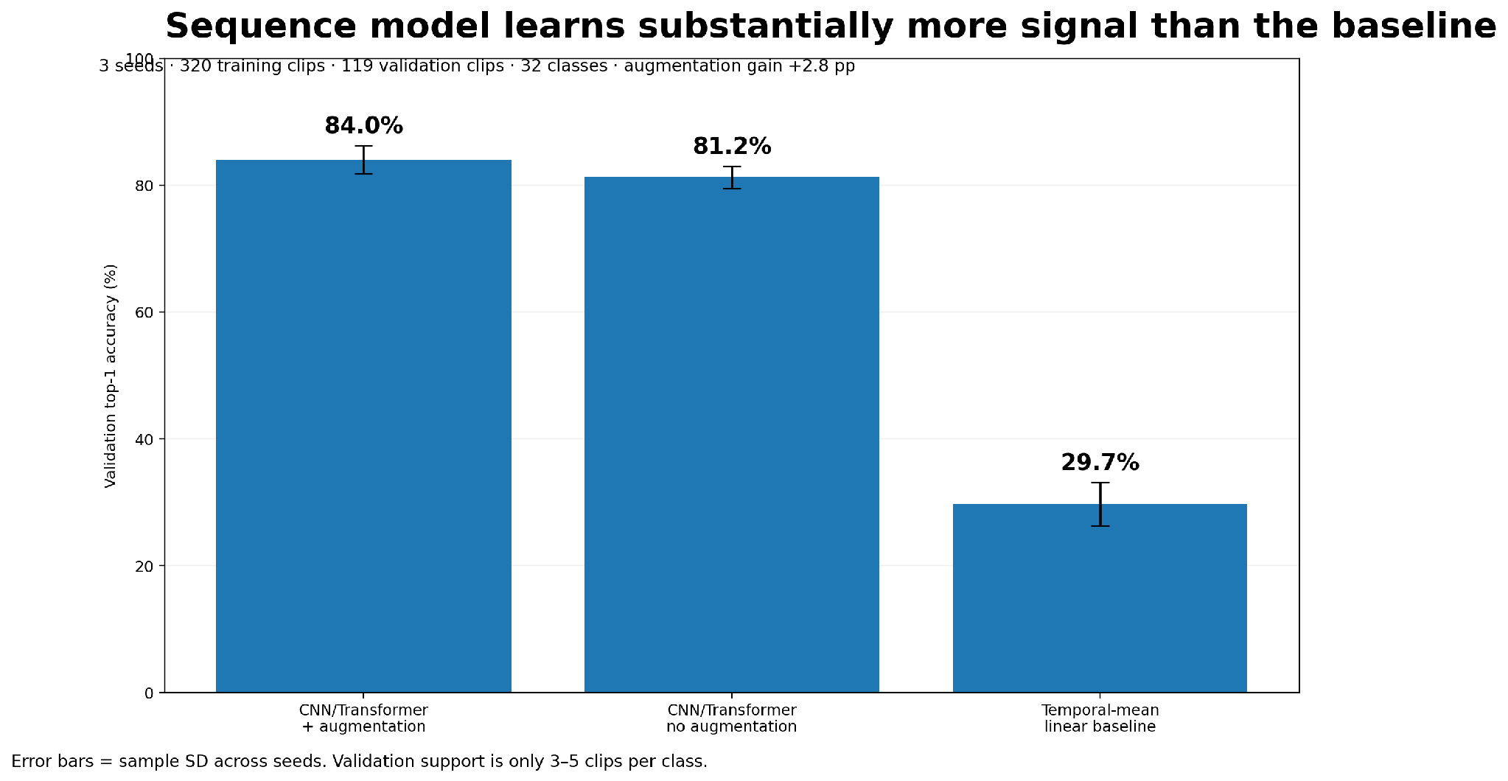
05 Model comparison
85.71%
expanded-train mean
The temporal CNN/Transformer learned substantially more than the linear temporal-mean baseline; mild augmentation added another 2.8 pp.

Slide 7
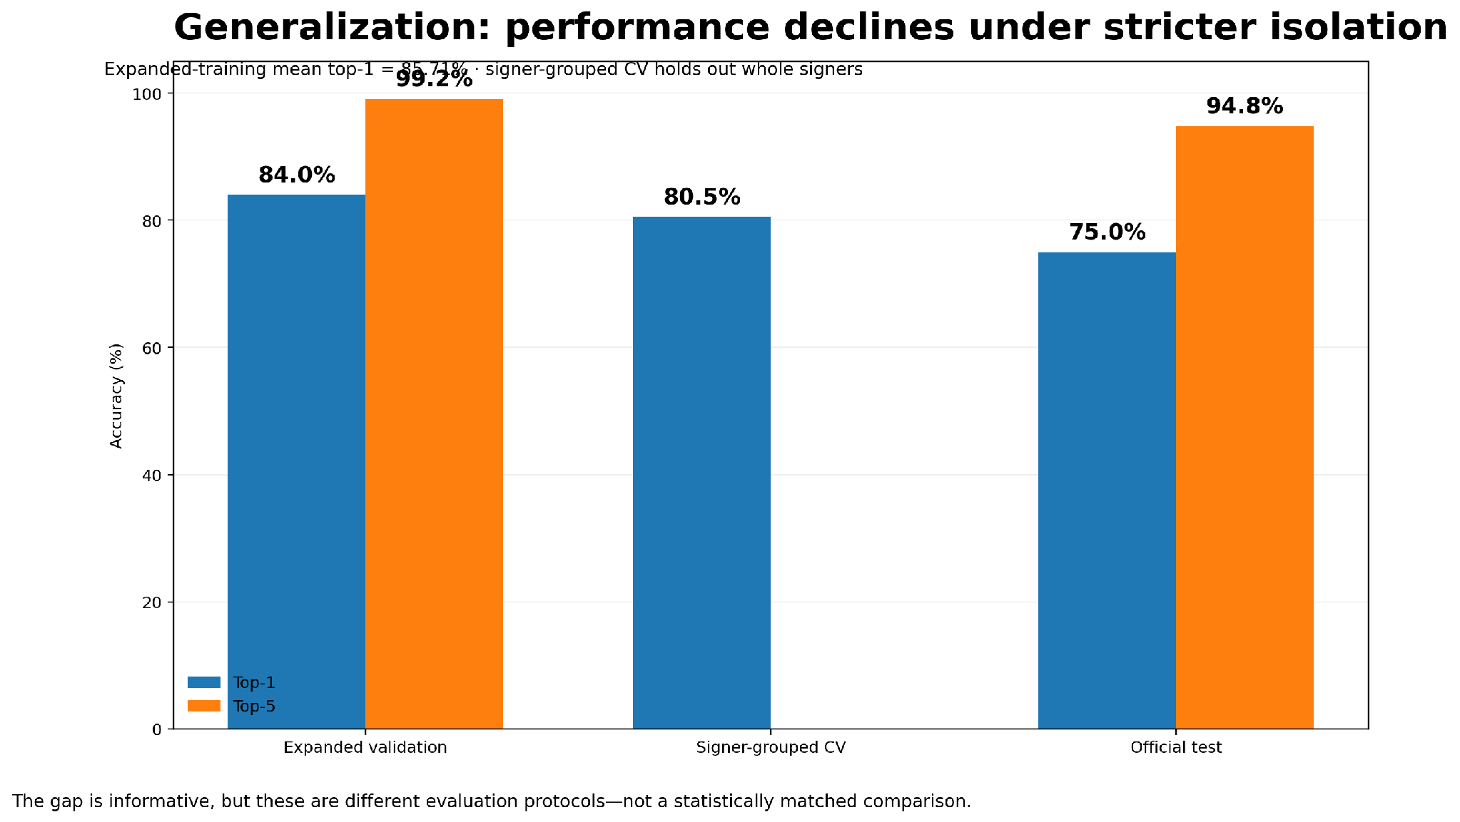
06 Generalization across evaluation settings
84.0% → 80.6% → 75.0%
Top-1
Performance falls as evaluation becomes more isolated from the training distribution; that gap is an important result, not a failure of the pipeline.

Slide 8
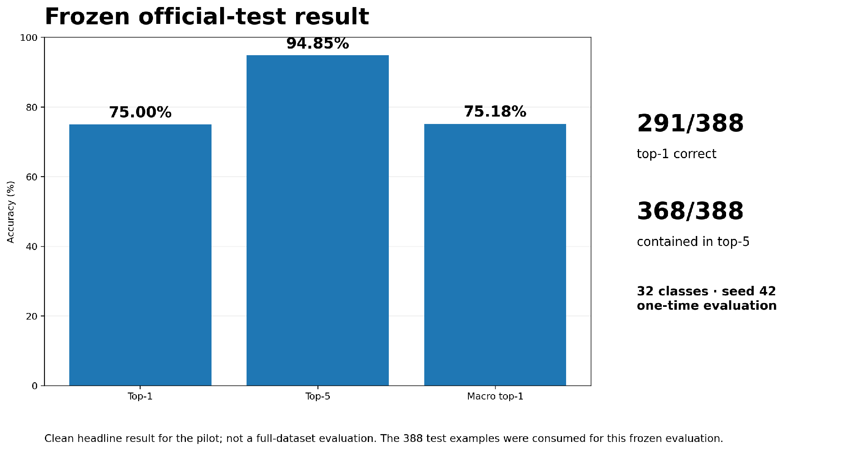
07 Frozen official-test evaluation
94.85%
Top-5
The seed-42 checkpoint was frozen before test inference and evaluated once on the selected 388 official-test clips.
Important: this is a 32-class pilot subset, not a full-dataset evaluation. The 388 test examples are considered consumed for model selection.

Slide 9
08 What the results support — and what they do not
What is supported
What remains uncertain
Best next experiment
• The preprocessing path is reproducible and passes the focused automated checks.
• The compact feature representation is materially smaller than raw landmarks.
• The sequence model learns useful temporal signal.
• Whole-signer validation and the frozen test both retain substantial top-1 performance.
• The pilot covers only 32 glosses.
• Official validation has just 3–5 clips per class.
• Full-dataset extraction has not been completed.
• Runtime projections are CPU estimates.
• The signer-CV and test protocols are complementary, not statistically matched.
• Move to a CUDA-enabled GPU lease for scale.
• Expand the vocabulary and training set.
• Use more robust signer-aware validation.
• Compare stronger temporal architectures and augmentation.
• Add the webcam / deployment path only after larger-scale evaluation.
Headline: a working 32-class pilot with credible engineering evidence, meaningful learned signal, and a clear generalization gap that the next phase should address.

